Slide 1
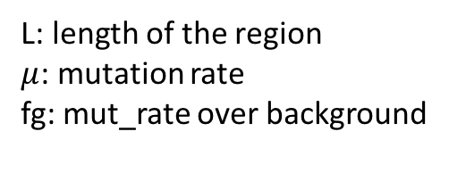
L: length of the region
$μ$: mutation rate
fg: mut_rate over background
Frequency in population
Miss rate in variant calling
Total number of elements
Min number of trials

Slide 2
Mutation rate = 6/MB
And mutation detection rate at 0.5
Population freq=5%
Assume 25000 regions to be tested, like promoter
Longer regions needs more samples

Slide 3
Mutation rate = 6/MB
And mutation detection rate at 0.5
Population freq=5%
Assume enhancer length = 2000
Calculate how many samples are needed as number of enhancers changes
More enhancers need more samples, but the effect is smaller than the length of element

Slide 4
Larger heterogeneity -> Larger overdispersion -> lower power

