Slide 1
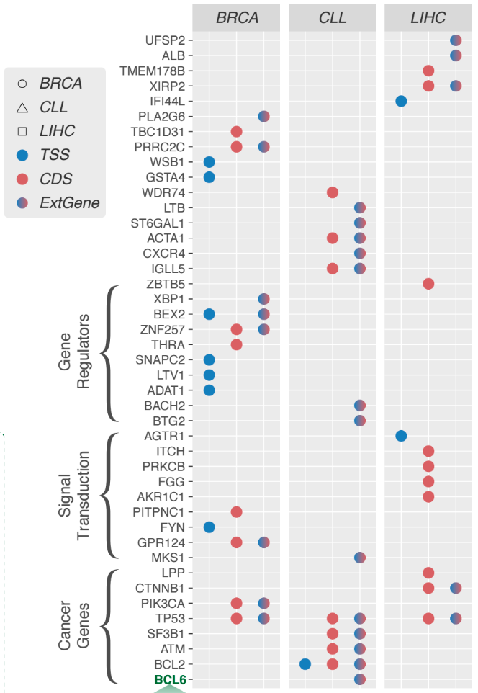
Overview
Starting with EBI liver germline variant calls
  ERP001196
  88 liver cancer samples
~4.1-4.2 million variants per sample
  Before blacklist and 1KG filtering
  After filtering, ~320,000 variants per sample
  Treat these as “rare germline variants”
See these genes over here?
  Let’s see how many samples have at least one rare mutation in these genes

Slide 2
Number of samples with >= 1 mutation/length

Slide 3
Number of variants/length

