Slide 1
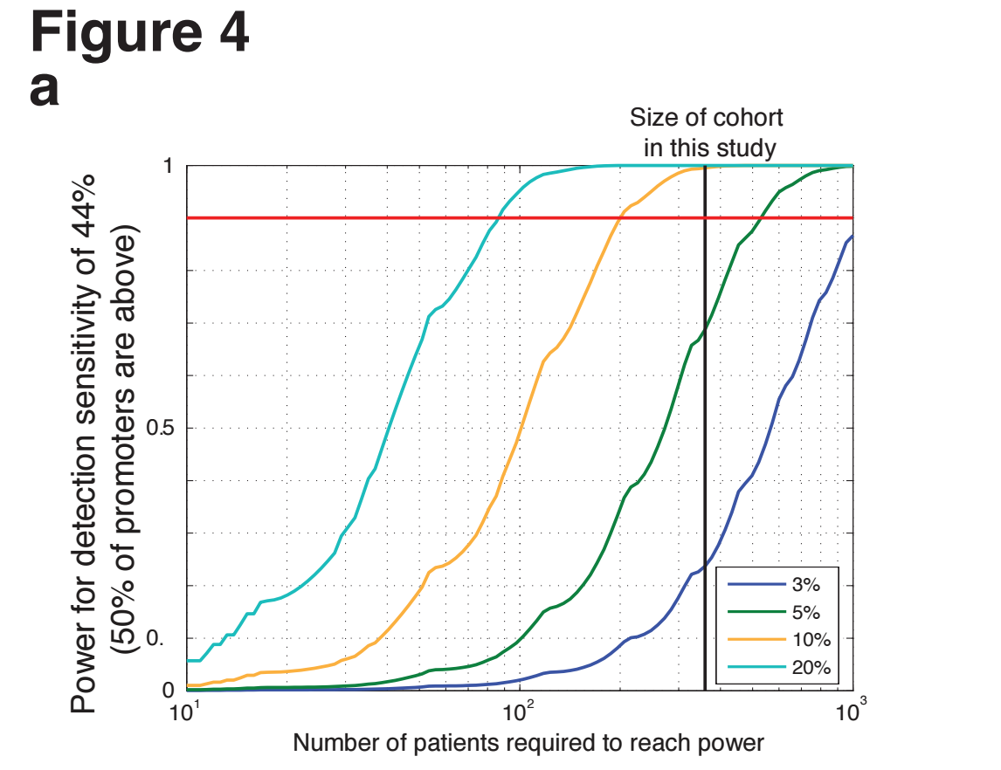
Power Analysis from Gaddy’s promoters (left) and reconstruction by WM (right)

Slide 2
Power analysis makes Space for Latent Drivers

