Slide 1
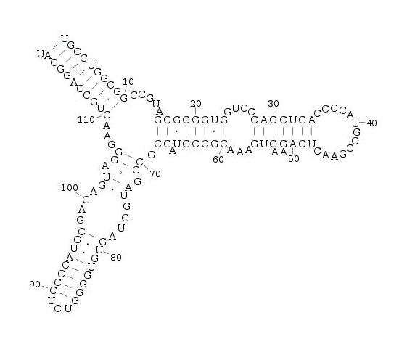
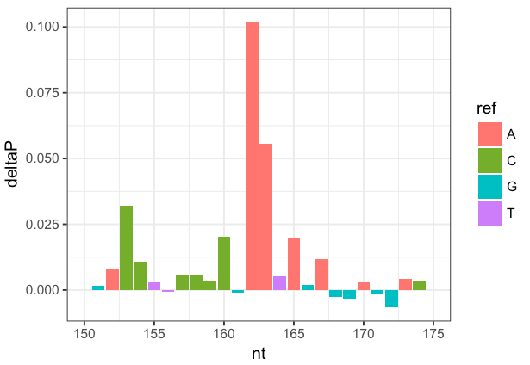
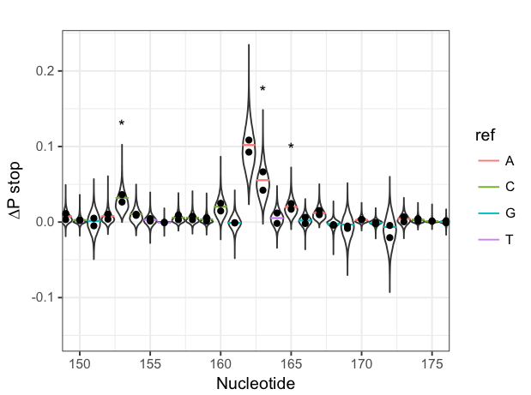
Modeling of overdispersion in chemical probing data and application to RNA secondary structure prediction
Michael Rutenberg-Schoenberg
gpmtg
Gerstein lab
19 April 2017

Slide 2
Outline
Chemical probing aids prediction of RNA secondary structure
What should be done with replicate chemical probing experiments?
Modeling “overdispersion” in chemical probing data
A statistical test for nucleotide modification in chemical probing data
Using statistical models of chemical probing data for RNA secondary structure prediction

Slide 3
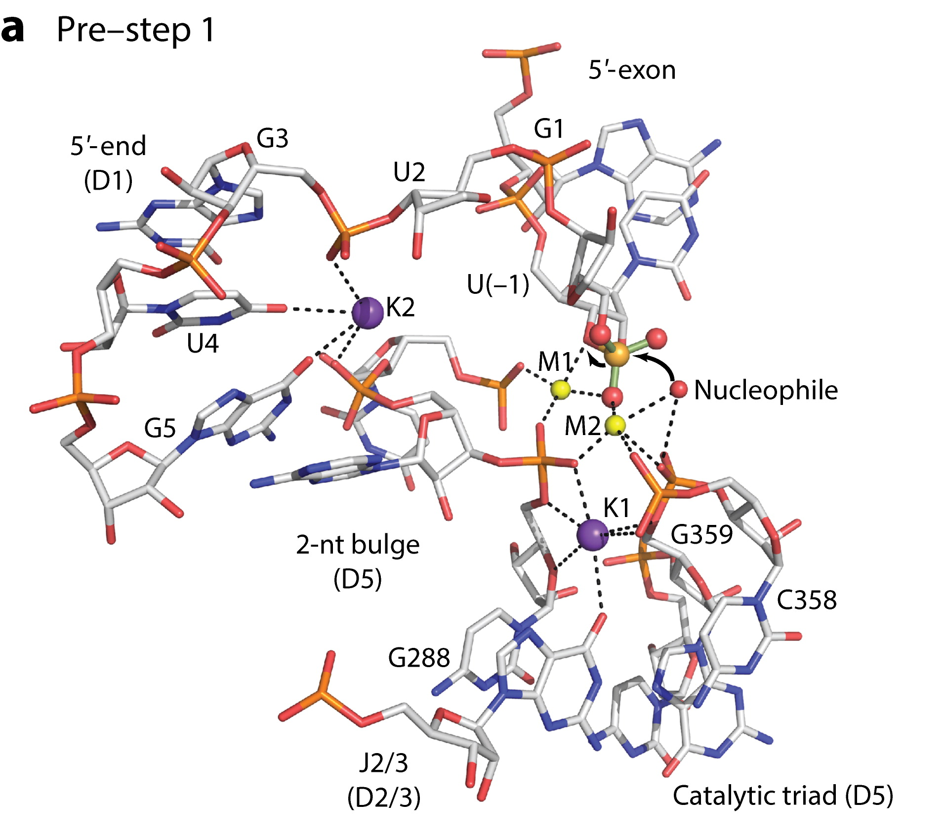
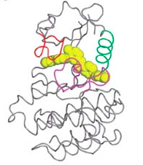
Molecular structure aids mechanistic understanding
Group II Intron
Active Site
BCR-Abl Kinase in complex with Imatinib
(leukemia drug)
Weisberg et al. Nat Rev Cancer 2007
Nagar et al. Cancer Research 2002
Toor et al. Science 2008, Anna Pyle Ann. Rev. Biophys. 2016

Slide 4
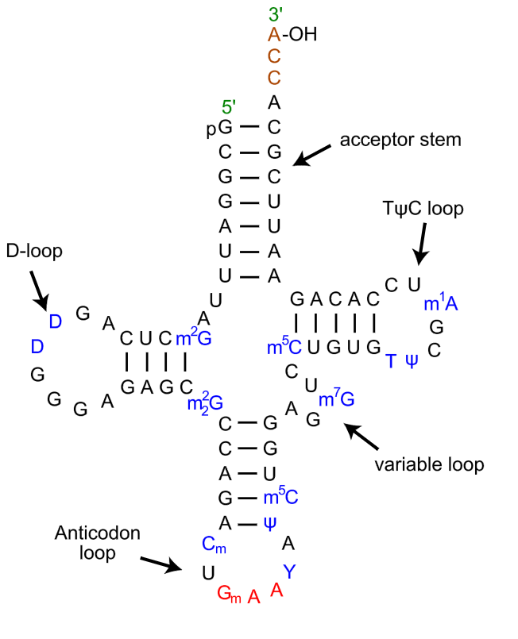
RNA secondary structure
S. cerevisiae tRNA^{Phe}
Maps of base pairing interaction of RNA
Essential to RNA regulation and function
  ribosomal RNAs
  riboswitches
  long noncoding RNAs, e.g. Xist
https://en.wikipedia.org/wiki/Transfer_RNA; reviewed in Kevin Weeks Curr Opin Struct Biol 2010

Slide 5
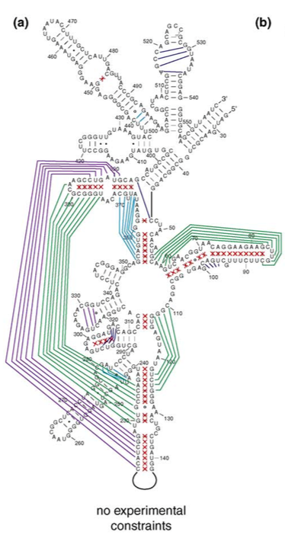
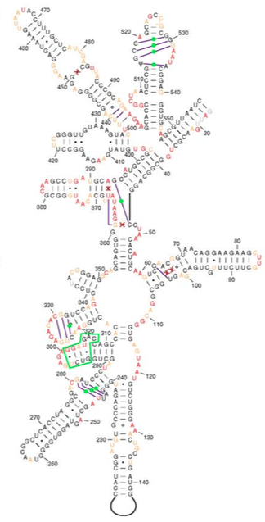
Constraints can improve RNA secondary structure prediction
E. coli 16S rRNA
naïve prediction
constrained prediction
Green and purple indicate mistakes in structure prediction
Prior knowledge of which nucleotides are single- or double-stranded aids prediction.
Deigan et al. PNAS 2009; Kevin Weeks Curr Opin Struct Biol 2010

Slide 6
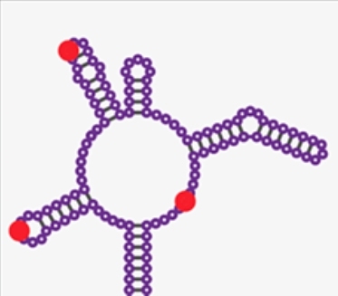
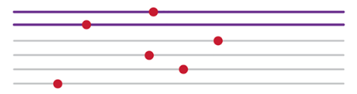
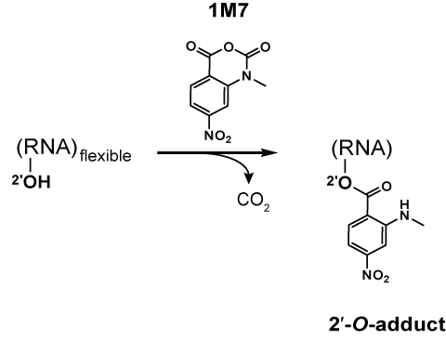
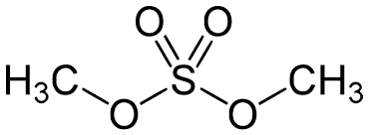
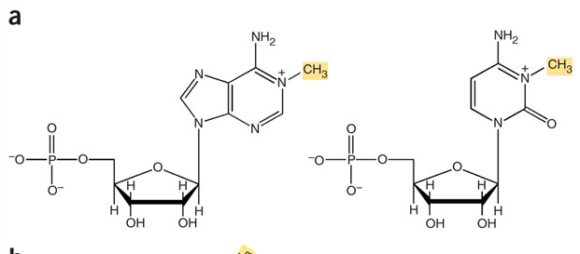
Chemical probing of RNA
Chemically modify RNA
  Usually unstructured nucleotides are modifiable
Read out with reverse transcriptase
Stops & Mutations
Chemically modify RNA
(mainly unstructured regions)
SHAPE
(Selective 2’-hydroxyl acylation & primer extension)
Dimethyl Sulfate (DMS)
A
C
Reviewed in Kubota et al Nat Chem Biol 2016; https://en.wikipedia.org/wiki/Nucleic_acid_structure_determination, Tijerna et al. Nat Protocols 2007
Notes:
DMS – methylates the Watson-Crick face of A,C
1M7 (SHAPE reagent) – acylate flexible 2’ OH in the ribose sugar

Slide 7

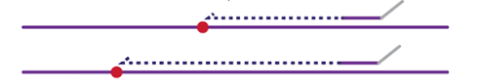
Chemical probing of RNA
Chemically modify RNA
  Usually unstructured nucleotides are modifiable
Read out with reverse transcriptase
Stops & Mutations
Chemically modify RNA
(mainly unstructured regions)
Read out with Reverse Transcriptase
Stops
Mutations
(SHAPE-MaP)
mutation
Reviewed in Kubota et al Nat Chem Biol 2016
Siegfried et al. Nat Methods 2014
Notes:
DMS – methylates the Watson-Crick face of A,C
1M7 (SHAPE reagent) – acylate flexible 2’ OH in the ribose sugar

Slide 8
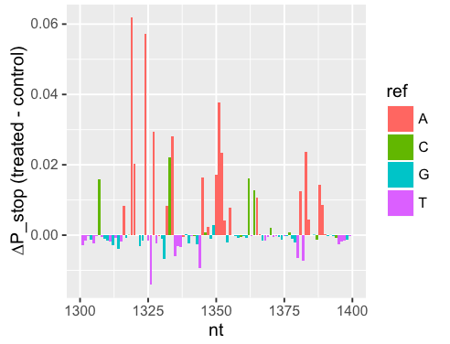
How do we statistically identify modified nucleotides
Typical work in the field: Poisson statistics
  Assumes uniform statistical process
Extensively used in the chemical probing field to describe variation of data
  Aviran et al. PNAS 2011
  Choudhary et al. Bioinformatics 2016
  Smola et al. Biochemistry 2015
  Smola et al. PNAS 2016
  Siegfried et al. Nat Methods 2014
Notes:
Modify -

Slide 9
Expansion of chemical probing techniques
Chemical probing has been traditionally done in vitro
Recently in vivo has analysis become widespread
  Rouskin et al. Nature 2014 – DMS-Seq genome-wide
  Spitale et al. Nature 2015 – icSHAPE genome-wide
  Fang, Moss et al. PLoS Genet 2015 – DMS-Seq Xist
  Smola et al. Biochemistry 2015 – ∆SHAPE
  Smola et al. PNAS 2016 – ∆SHAPE Xist
  (several others)

Slide 10
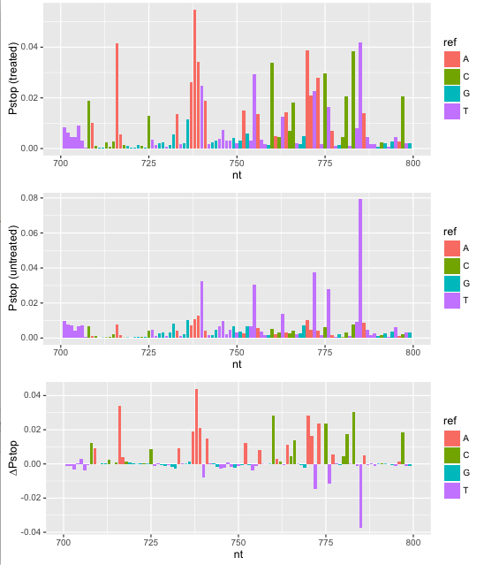
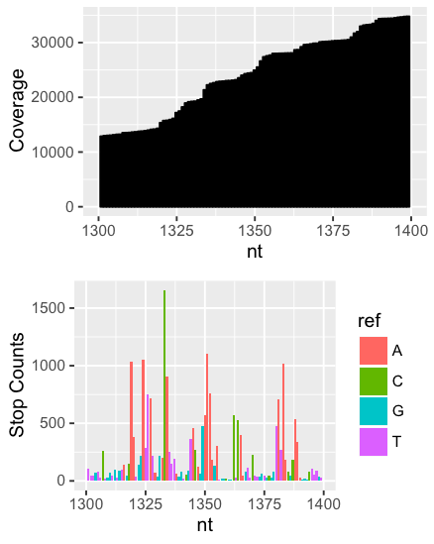
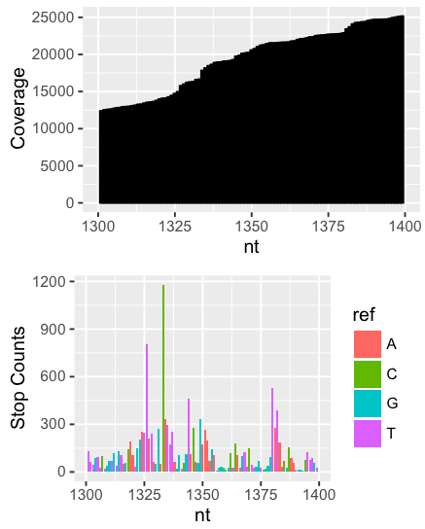
Basic analysis of chemical probing data
i ∈ nucleotides; N total
P_{stop}(i) = stops(i)/coverage(i)
∆P_{stop}(i) = P_{stop}(treated) - P_{stop}(control)
DMS-Seq data for Xist RNA
A and C should be modified
Treated
Control
Combined
Fang, Moss et al. PLoS Genet. 2015
Notes:
Fang, Moss et al. PLoS Genet. 2015. This slide is still not particularly clear.

Slide 11
Data setup
RT stop counts
Nucleotides
Rep 1
Treated
Rep 2
Nucleotides
Rep 1
Control
Rep 2
Counts are normalized to control for different levels of coverage before further analysis
Key question: Does RT stop more in treatment than control (potentially indicating that the nucleotide is single-stranded)?

Slide 12
Adapting a solution from RNA-Seq
Chemical probing
i∈nucleotides; N total
j∈samples; M total
Y_{ij} = stop (or mutation) counts for nucleotide i in sample j
Coverage for nucleotide i in sample j
  C_{ij} =
S_{ij} = relative coverage for nucleotide i in sample j
  S_{ij} =
Pseudocounts
  P_{ij} = Y_{ij}/S_{ij}
RNA-Seq
i∈genes; N total
j∈samples; M total
Y_{ij} = counts for gene i in sample j
C_{j} = total coverage for sample j
S_{j} = relative library size
Pseudocounts
  P_{ij} = Y_{ij}/S_{j}
Notes:
----- Meeting Notes (10/27/16 15:24) -----
RNA-Seq on left
Make things correspond as clearly as possible

Slide 13
Outline
Chemical probing aids prediction of RNA secondary structure
What should be done with replicate chemical probing experiments?
Modeling “overdispersion” in chemical probing data
A statistical test for nucleotide modification in chemical probing data
Using statistical models of chemical probing data for RNA secondary structure prediction

Slide 14
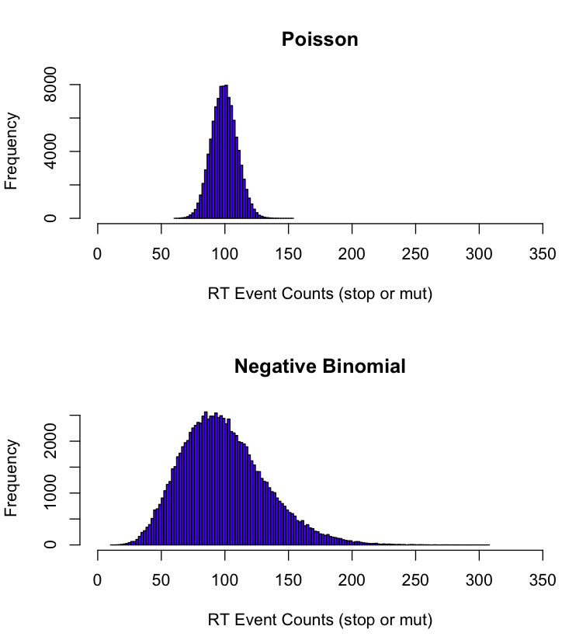
How should we deal with chemical probing replicates?
Nucleotide of interest
RNA molecule
Expected distribution of RT events at nucleotide of interest
Nucleotide of Interest
Replicate 1
Replicate 2
Uniform statistical process
Poisson (or binomial)
VS.
Intra-replicate heterogeneity
Overdispersed
AND/OR
Inter-replicate heterogeneity
Probability
Low
High

Slide 15
How should we deal with chemical probing replicates?
Nucleotide of Interest
Nucleotide of interest
RNA molecule
Analysis method for replicate experiments
Replicate 1
Replicate 2
Uniform statistical process
Add results together
VS.
Intra-replicate heterogeneity
Consider replicates as separate observations
Fit a statistical model with a flexible mean-variance relationship
AND/OR
Inter-replicate heterogeneity
Probability
Low
High

Slide 16
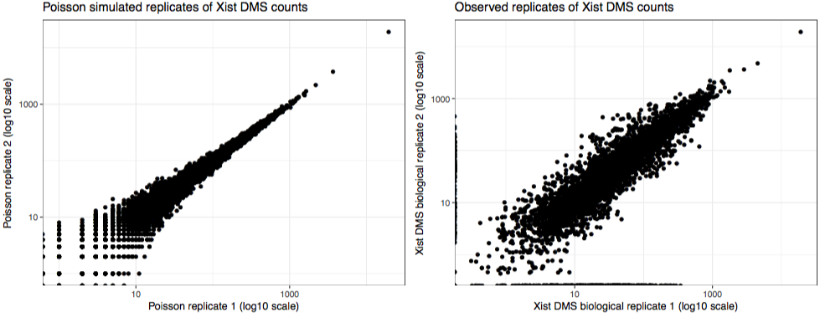
Do replicates follow the Poisson distribution?
Xist DMS stop counts from 2015 PLoS Genetics paper
Mean from 1 of 6 replicates used for Poisson simulation
2 (other) sample replicates plotted

Slide 17
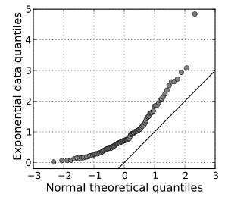
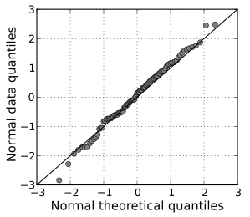
Showing overdispersion statistically
2 methods
  Kolmogorov-Smirnov test
  Quantile-quantile plot
Quantile = value at a given percentile in a distribution
Challenge: only a few data points per nucleotide → can’t analyze distribution fit on a nucleotide-by-nucleotide level

Slide 18
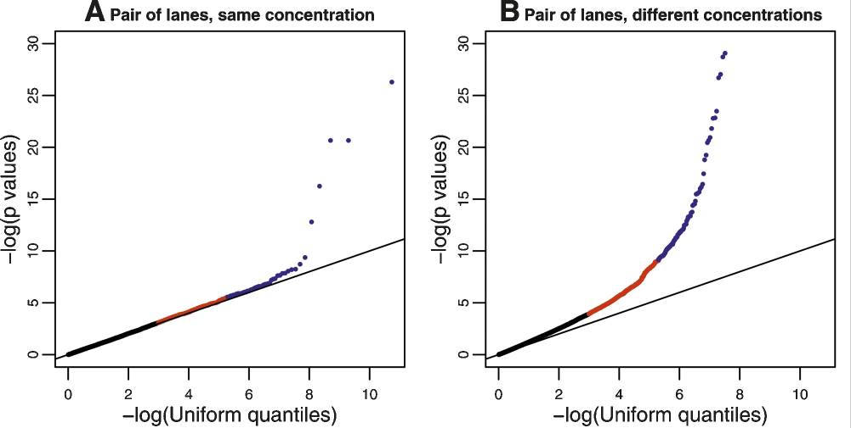
Quantile-quantile plots for sequencing reproducibility of RNA-Seq
Alternative: If data in general follow a statistical model, then p-values of observed values should follow the uniform distribution
Same cDNA library sequenced at same or different concentrations
Marioni et al Genome Research 2008

Slide 19
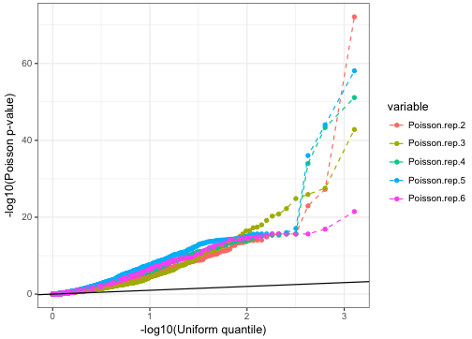
Chemical probing data are highly overdispersed relative to Poisson distribution
Fit Poisson using one replicate, test with other replicates
Poisson distribution is different from real replicates with
Kolmogorov-Smirnov p < 2.2*10⁻¹⁶

Slide 20
How should we deal with chemical probing replicates?
Nucleotide of interest
RNA molecule
Expected distribution of RT events at nucleotide of interest
Nucleotide of Interest
Replicate 1
Replicate 2
Uniform statistical process
Poisson (or binomial)
VS.
Intra-replicate heterogeneity
Overdispersed
AND/OR
Inter-replicate heterogeneity
Probability
Low
High

Slide 21
How should we deal with chemical probing replicates?
Nucleotide of Interest
Nucleotide of interest
RNA molecule
Analysis method for replicate experiments
Replicate 1
Replicate 2
Uniform statistical process
Add results together
VS.
Intra-replicate heterogeneity
Consider replicates as separate observations
Fit a statistical model with a flexible mean-variance relationship
AND/OR
Inter-replicate heterogeneity
Probability
Low
High

Slide 22
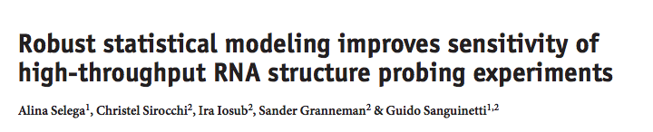
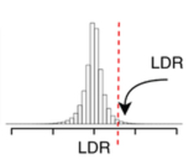
One existing replicate sensitive method
Uses comparisons of control experiments as background distribution to score differences between treatment and control
No method uses variability in both treatment and control

Slide 23
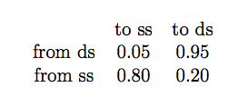
One existing replicate sensitive method
Introduces the idea of Hidden Markov Model smoothing of signal in chemical probing experiment
RNA loops and helices are generally long, so transitions between structural states are less likely than staying in the same structural state

Slide 24
Outline
Chemical probing aids prediction of RNA secondary structure
What should be done with replicate chemical probing experiments?
Modeling “overdispersion” in chemical probing data
A statistical test for nucleotide modification in chemical probing data
Using statistical models of chemical probing data for RNA secondary structure prediction

Slide 25
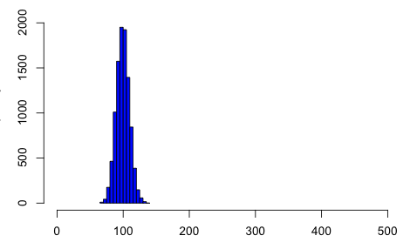
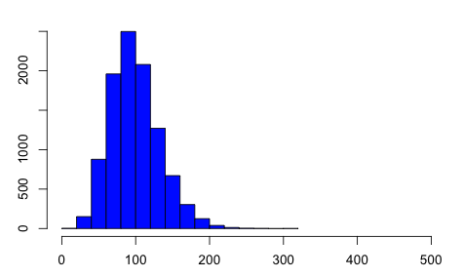
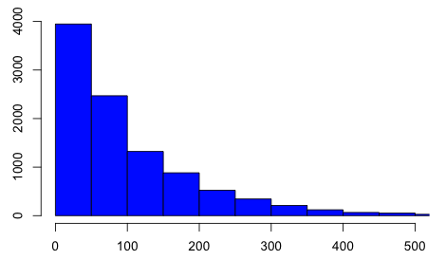
Challenge: How do we estimate degree of overdispersion with a small number of replicates?
RT stop counts
Nucleotides
Rep 1
Rep 2
Poisson
(α = 0)
Slightly overdispersed
(α = 0.01)
Highly overdispersed
(α = 1)
Key insight: assume that nucleotides have similar levels of overdispersion

Slide 26
A familiar problem from RNA-Seq
Gene expression (read counts)
Genes
Rep 1
Rep 2
Poisson
Slightly overdispersed
Highly overdispersed
Key insight: assume that nucleotides have similar levels of overdispersion

Slide 27
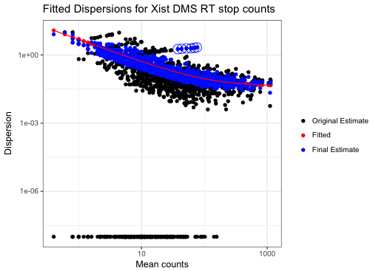
Negative binomial distribution: DESeq2
σ² = µ + αµ²
  α = 0 → Poisson
  Larger alpha → more overdispersed
Also called Poisson-Gamma
  Y ~ Poisson(λ)
  λ ~ Gamma(k, θ)
  Y ~ Poisson-Gamma(µ,α)
α = 0
α = 0.01
α = 1
Notes:
----- Meeting Notes (10/27/16 15:24) -----
Estimate variance
DESeq/edgeR

Slide 28
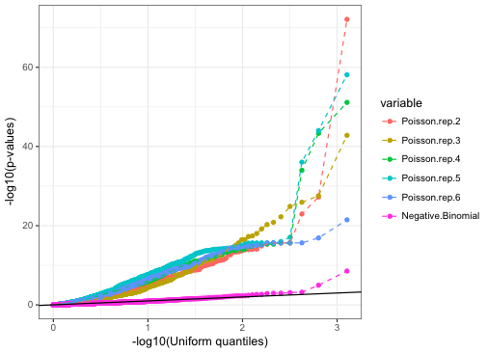
Negative binomial distribution fit with DESeq2 is a more accurate model for chemical probing data
Kolmogorov Smirnov test:
Poisson: p < 2.2*10⁻¹⁶
Negative binomial: p = 0.24
Negative binomial fit to 5 replicates, tested with the 6th

Slide 29
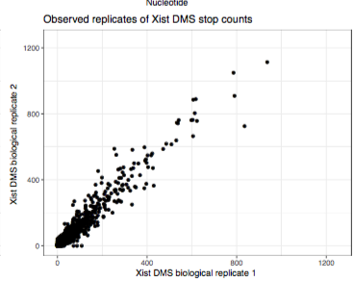
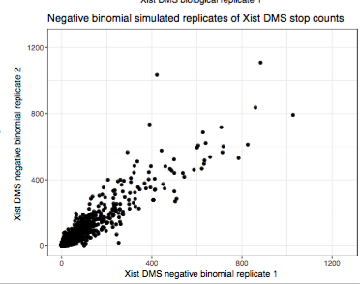
Negative binomial simulated replicates have similar variability to observed replicates
Biological replicates
Negative binomial replicates

Slide 30
Outline
Chemical probing aids prediction of RNA secondary structure
What should be done with replicate chemical probing experiments?
Modeling “overdispersion” in chemical probing data
A statistical test for nucleotide modification in chemical probing data
Using statistical models of chemical probing data for RNA secondary structure prediction

Slide 31
Data setup
RT stop counts
Nucleotides
Rep 1
Treated
Rep 2
Nucleotides
Rep 1
Control
Rep 2
Key question: Does RT stop more in treatment than control (potentially indicating that the nucleotide is single-stranded)?

Slide 32
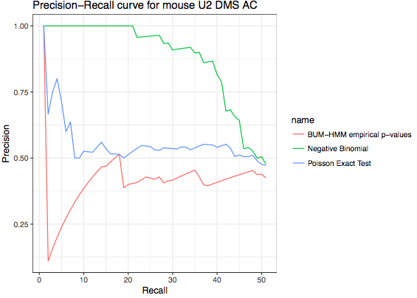
P-values from negative binomial model outperform other methods identifying nucleotides with reactivity toward chemical probes

Slide 33
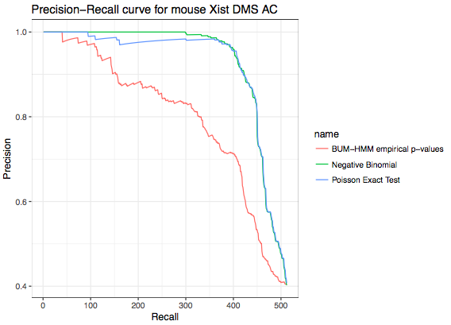
P-values from negative binomial model outperform other methods identifying nucleotides with reactivity toward chemical probes

Slide 34
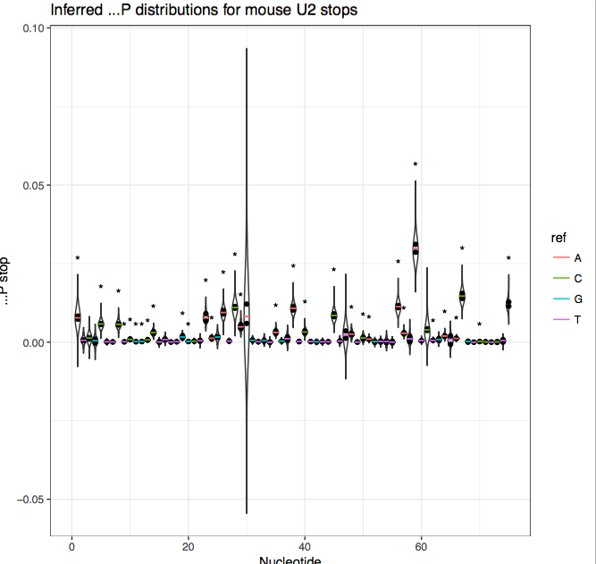
Significant amounts of reactivity do not necessarily correspond to biochemical state
Nucleotide reactivity (∆P)
distributions simulated from treated and control count distributions
Stars indicate significant nucleotides
Notes:
Better figure labels

Slide 35
Outline
Chemical probing aids prediction of RNA secondary structure
What should be done with replicate chemical probing experiments?
Modeling “overdispersion” in chemical probing data
A statistical test for nucleotide modification in chemical probing data
Using statistical models of chemical probing data for RNA secondary structure prediction

Slide 36
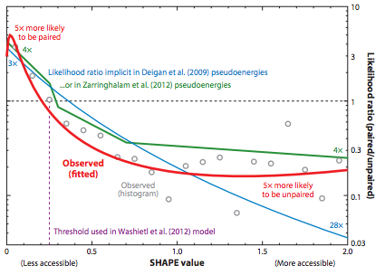

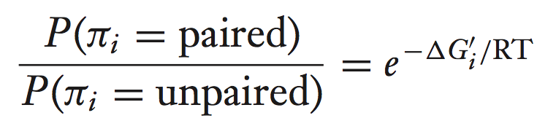
Relating SHAPE reactivity to pseudoenergies/pairing probabilities
Nonlinear relationship between reactivity and energy
Blue line is the standard method:
Red line is the empirical distribution of pairing probabilities at different SHAPE reactivity values
Eddy 2014 Ann Rev Biophys

Slide 37
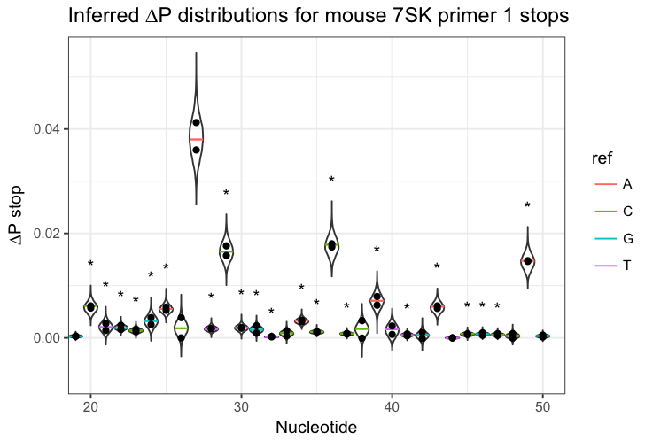
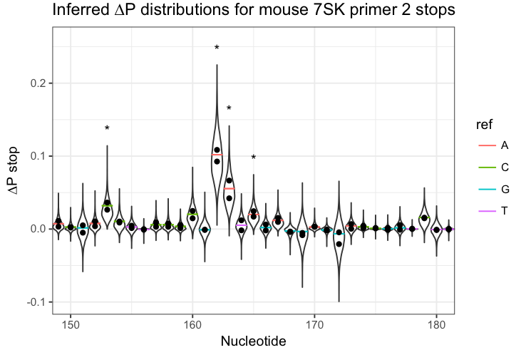
Normalizing reactivity
Different experiments may have different levels of reagent modification
Different RNAs have different overall levels of structure
No clear relationship between reactivity (∆P) and probability of being single-stranded.
Many ad-hoc proposals for how to normalize raw reactivities for each RNA relative to mean or other
High coverage
Low coverage

Slide 38
Normalizing reactivity
Different experiments may have different levels of reagent modification
Different RNAs have different overall levels of structure
No clear relationship between reactivity (∆P) and probability of being single-stranded.
Many ad-hoc proposals for how to normalize raw reactivities for each RNA
Most common method:
  Remove outliers that are
  Divide all values by mean of top 10% of non-outlier points

Slide 39
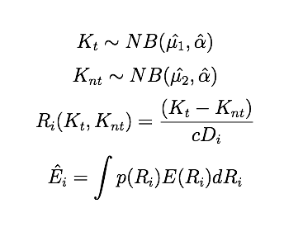
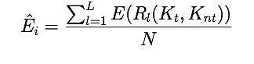
Incorporating variability in chemical probing data
Sample treated and untreated counts K from distributions fit with DESeq2
Compute reactivity (D_{i} is mean coverage)
Estimate pseudoenergy E as the mean pseudoenergy from all sampled reactivities

Slide 40
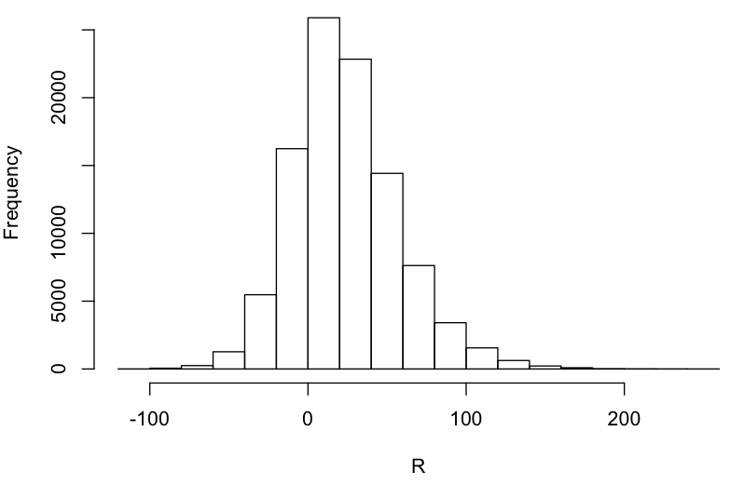
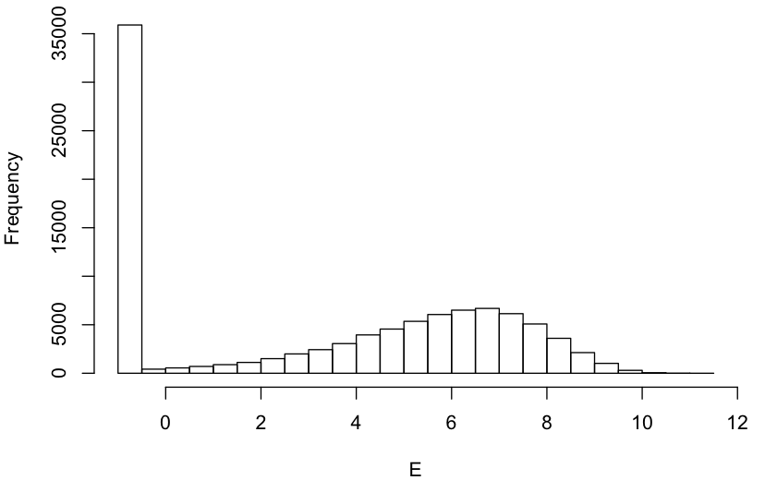
Example nucleotide
Reactivity
pseudoenergy
Naïve pseudoenergy: E = 5.2 kJ/mol
Mean pseudoenergy: E = 4.6 kJ/mol

Slide 41
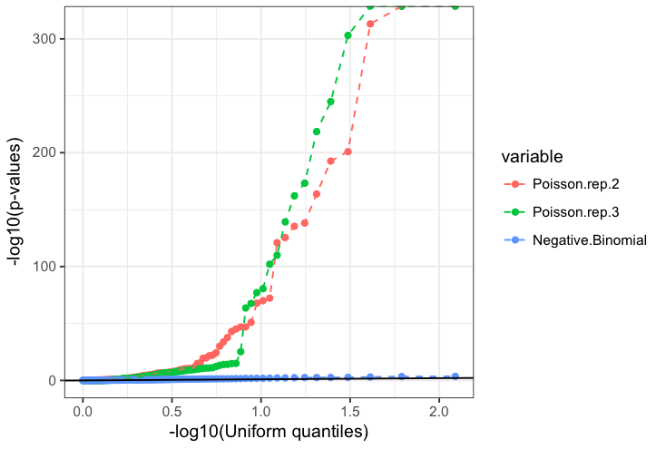
in vitro 5S rRNA SHAPE-Seq data
An in vitro dataset is also overdispersed (KS-test p < 2.2*10⁻¹⁶)
Negative binomial fit is not as good as for Xist data (p = 0.008)

Slide 42
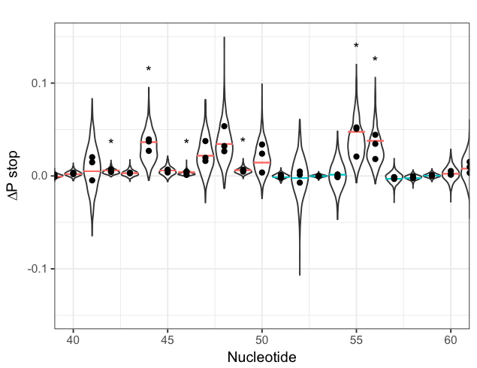
Inferred 5S rRNA reactivity distributions
Single-stranded
Double-stranded

Slide 43
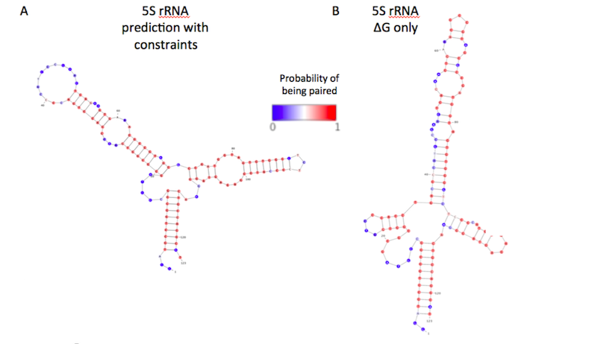
in vitro 5S rRNA SHAPE-Seq data
Constrained structure is correct
Unconstrained structure has only ~25% of base pairs correct
Notes:
To do:
Switch color scheme to reflect odds

Slide 44
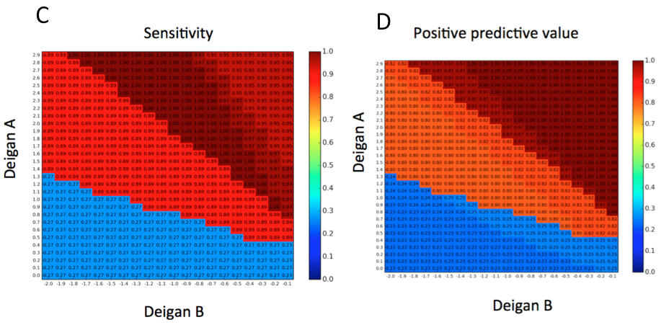
Performance is robust to parameters of pseudoenergy function

Slide 45
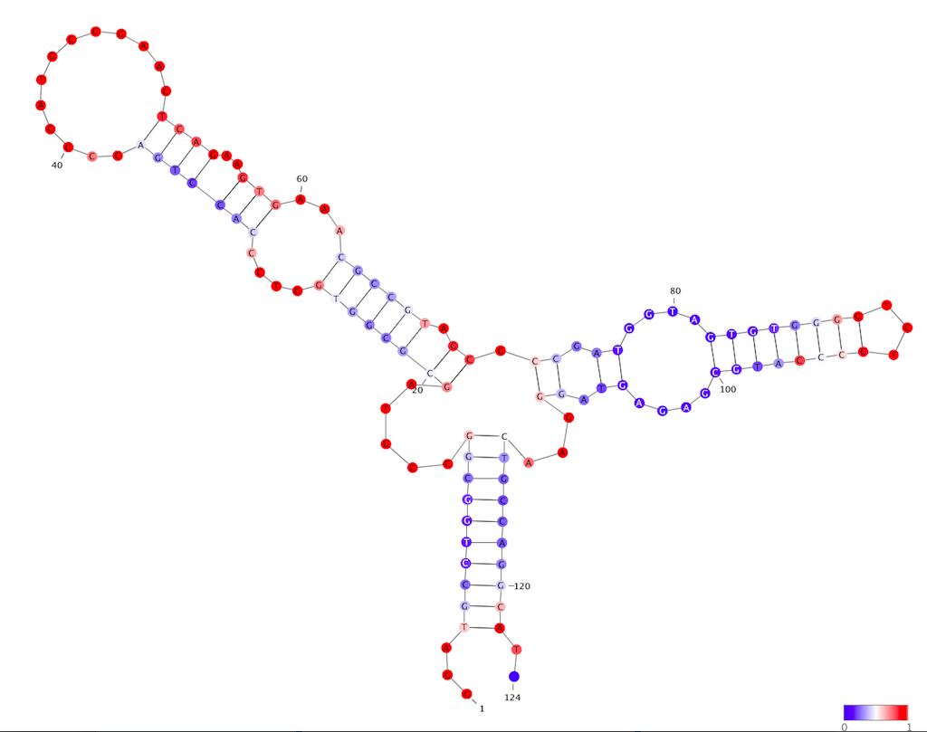
HMM: try 1
Inferred probabilities on reference structure
Initial probabilities of pairing come directly from probing data
Forward backward algorithm used to infer final probabilities using transition matrix
These parameters are not helpful, but optimization of HMM parameters for RNAs of known structure could be good

Slide 46
Conclusions
Chemical probing data are overdispersed, and require replicate experiments to model statistically
Modeling with the negative-binomial distribution using the DESeq2 tool more accurately captures the variability in RNA chemical probing
P-values from negative binomial model are useful for biochemical inferences that follow reagent selectivity
Computing constraints from based on inferred statistical model can lead to correct structure prediction
  Working on comparisons for more RNAs and with other folding methods
  Will try to optimize HMM transition probabilities as well

Slide 47


Acknowledgements
Gerstein Lab
Mark
Jing Zhang
Arif Harmanci
P2-TECH
Simon Lab
  Matt
  Erin Duffy
  Tyler Smith
  Alec Sexton
  Will Culligan
  Lea Kiefer
  Martin Machyna
  Jeremy Schofield
  Meaghan Sullivan
  Maddie Zoltek
  Peter Wang
Notes:
----- Meeting Notes (10/14/15 15:58) -----
Future status. Say that I hope to have a tag which anyone in the room could use to pull down and tag their RNA of interest. Use visual of end system washing away
----- Meeting Notes (10/7/16 15:18) -----
Redo the logic of the talk
Diagram of what I want to talk about - clean transitions about my two efforts
"Wanted to test instead" of "worried about"
7SK pull down hypothesis is correct, not that the whole method is working

