Slide 1
Aging and cell-to-cell transcriptional variability
Jinrui
04-18-2017

Slide 2
Aging: loss of physiological and cellular functions
What is the molecular basis of aging?

Slide 3
Exploring how aging affects transcriptional dynamics using single-cell RNA sequencing
Cell line: CD4+ T cell of mouse
Naïve stage => activated state
Maintained lifelong (important in young and old)
Adaptive immune against infections and cancers

Slide 4
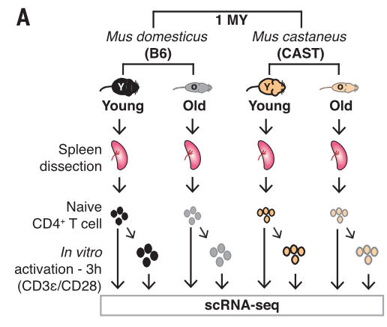
Experimental design

Slide 5
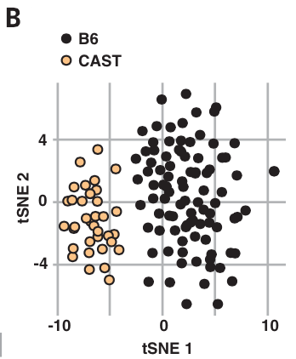
Divergence in transcriptome btw the two mouse species (B6 vs CAST)
The B6 and CAST cells are well separated based on transcriptome differences
Notes:
Maybe partially due to batch effect. No biological replicates?
Smaller number of cells in yellow

Slide 6
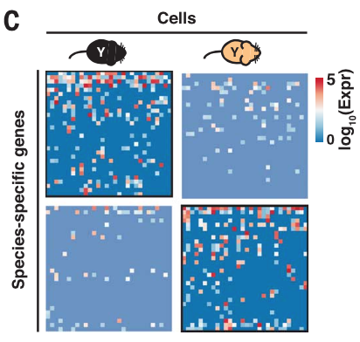
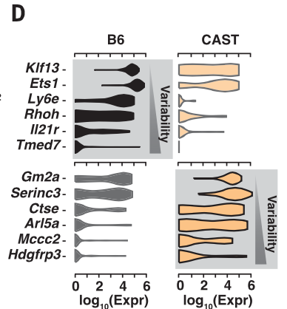
Differentially expressed genes (DEG) btw B6 and CAST
Examples of DEGs

Slide 7
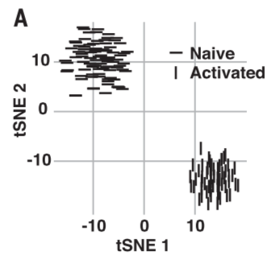
Activation of naïve CD4+ T cells induces a transcriptomic switch
Naïve and activated cells are well separated

Slide 8
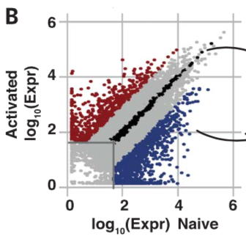
Identification of DEGs btw naïve and activated states

Slide 9
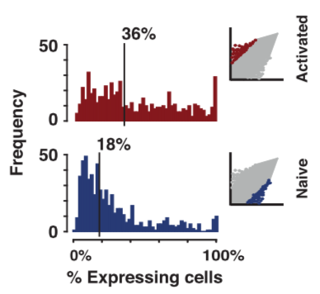
Up-regulated DEG expressed in higher fraction of the single cells

Slide 10
Identification of Activated Genes
225 up-regulated DEGs upon activation shared between B6 and CAST young mice

Slide 11
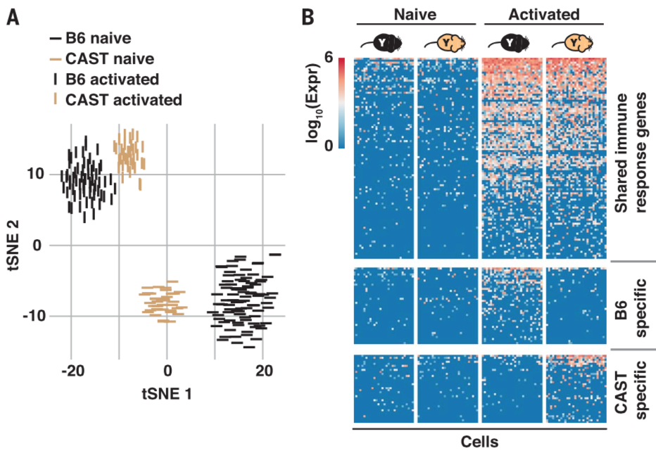
Naïve and active cells are well separated by the 225 activated genes

Slide 12
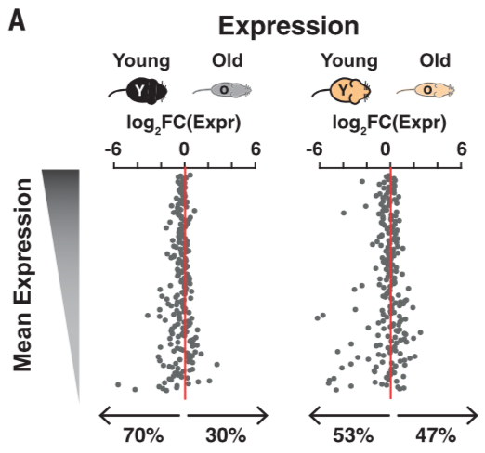
Old mice show lower expression than young mice in the 225 activated genes
225 genes
Notes:
This may be due to artifact because the up-regulated genes were identified in young mice only, not in old mice

Slide 13
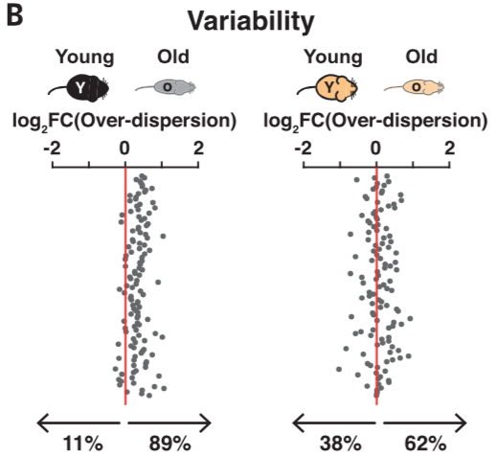
Old mice show higher variability than young mice in expression of the genes (with similar mean expression level between old and young)
~100 genes

Slide 14
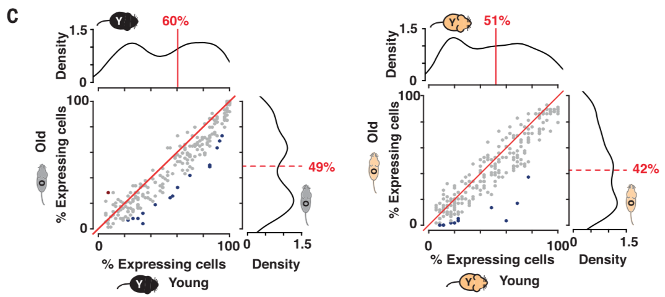
The old mice (w/ high variability) have genes expressed in small fraction of the single cells

Slide 15
Conclusions
Increased cell-to-cell transcriptional variability is another major hallmark of aging

