Slide 1
ENCODE 4 DAC

Slide 2
DAC Participants
MPI: Zhiping Weng, Mark Gerstein
Co-I: Manolis Kellis, Shirley Liu, Rafa Irizarry, Bill Noble, Anshul Kundaje, Roderic Guigo

Slide 3
* Assist the DCC in uniformly processing major ENCODE data types
Assess the quality of ENCODE data and provide feedback to the NHGRI and the Consortium
Update and further improve uniform processing pipelines for existing ENCODE data types.
Develop uniform processing pipelines for new ENCODE data types on assays used by the mapping centers.
Bru-seq pipeline & QC
ATAC-seq pipeline & QC
Hi-C pipeline & QC
ChIA-PET pipeline & QC
Single-cell RNA-seq (long-RNA-seq, small-RNA-seq and PacBio)
icSHAPE pipeline & QC
Assess the quality of ENCODE data and provide feedback to the NHGRI and the Consortium.
Participate in all ENCODE working groups and aid the development of data standards and quality control metrics.
Participate in the working groups of other consortia to increase the compatibility of data standards across consortia.
Develop QC metrics and data standards for the assays used by the characterization centers
Mouse transgenic
Enhancer-seq & MPRA
CRISPR KO, CRISPRa, CRISPRi

Slide 4
* Further develop a General Encyclopedia of DNA elements
Work with mapping centers and characterization centers to incorporate the most direct interpretation specific to their data types into the ground level of annotations in the Encyclopedia.
Work with all ENCODE groups and the GENCODE group, in the format of various ENCODE working groups (including the AWG and the sub-AWG groups), to incorporate the analysis results of their data into the appropriate level of the Encyclopedia.
Further build the Registry of candidate Regulatory Elements and its visualization capabilities to meet the needs of diverse user groups.
Assist the ENCODE consortium in prioritizing assay and cell types to complete Encyclopedia

Slide 5
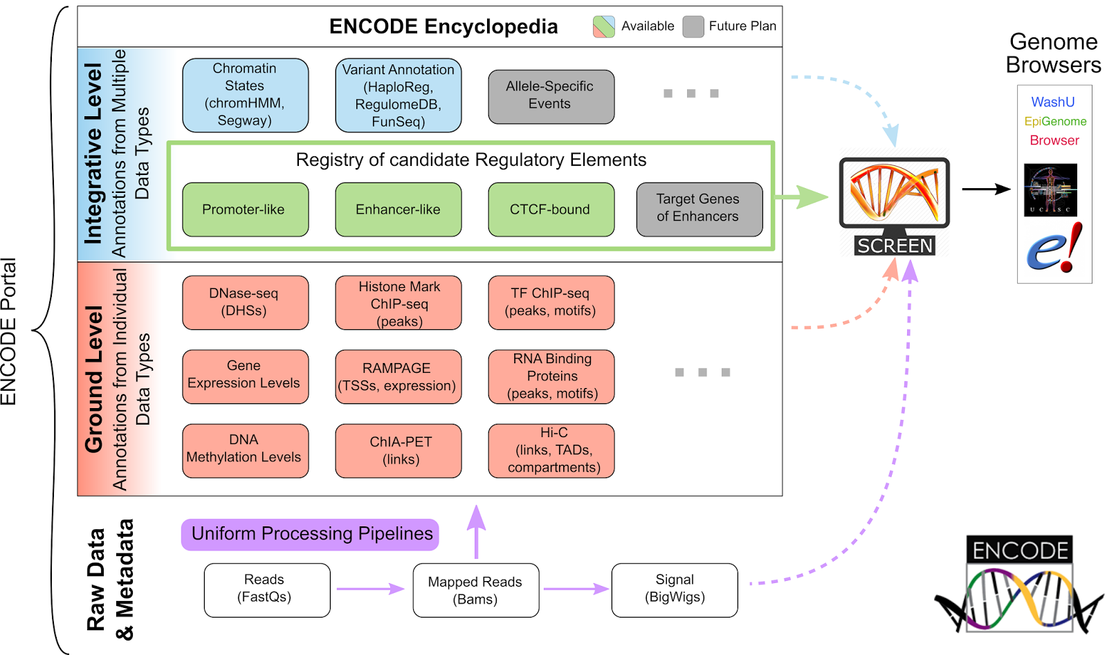
Encyclopedia/SCREEN

Slide 6
* Building an Encyclopedia for personal genomes
Interact with the data production groups on developing reference personal genomes for mapping of ENCODE data
Perform detailed integration of variants (SNVs and SVs) in personal genomes with ENCODE data and annotations
Develop personalized annotations and assess their utility

Slide 7
* Harmonize and connect the Encyclopedia and the ENCODE data with datasets from other consortia, with the goal of improving the utility of ENCODE data for the broader research and clinical communities.
GSP
TOPMED
IHEC
TCGA/PCAWG
GTEx
psychENCODE
modERN
exRNA
4DN

Slide 8
* Participate in AWG to perform integrative analysis of ENCODE data
Assist the Analysis Working Group (AWG) and its sub-groups in defining and prioritizing integrative analysis.
Build transcriptional regulatory networks and study their structure and dynamics.

