Slide 1
Graph-theoretical approach to 3D genome organization
KKY
Group meeting 2017

Slide 2
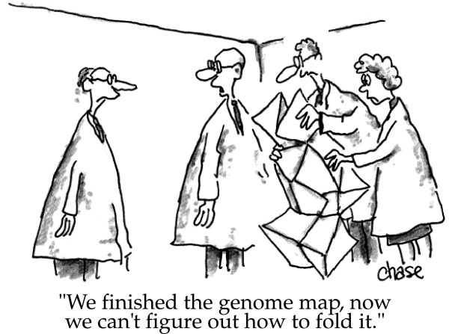
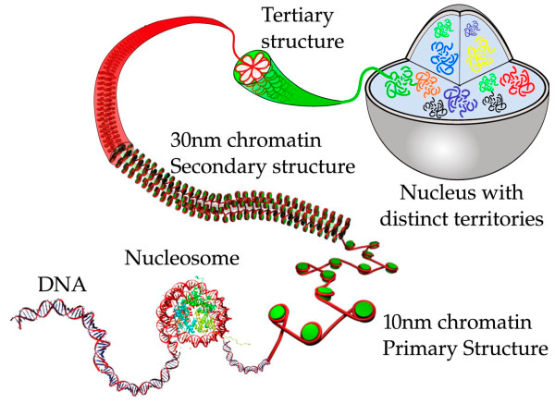
3D organization of genome
image credit: Iyer et al. BMC Biophysics 2011,
cartoonist John Chase
image credit: Iyer et al. BMC Biophysics 2011

Slide 3
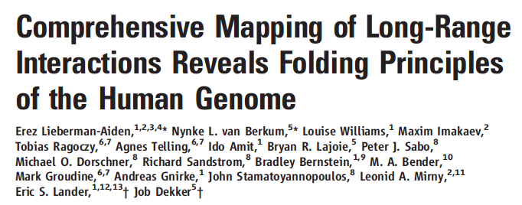
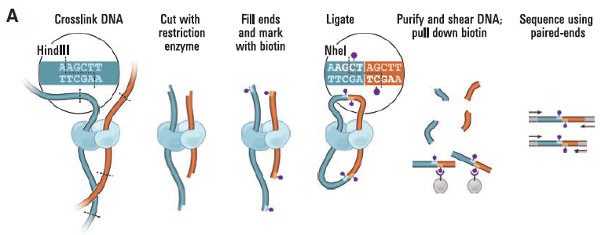
Chromosome conformation capture (3C) and Hi-C

Slide 4
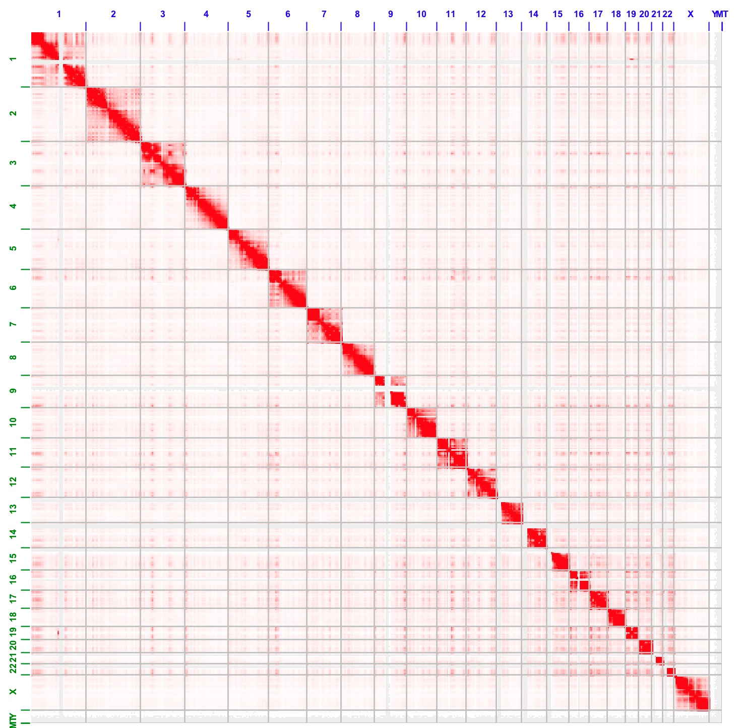
Data:
Rao et al. Aiden, Cell 2014
Notes:
.

Slide 5
Quantifying reproducibility / distance of Hi-C contact maps
Identifying topologically associating domains in multiple resolutions
Relating spatial organization and gene expression in a system-wide manner

Slide 6
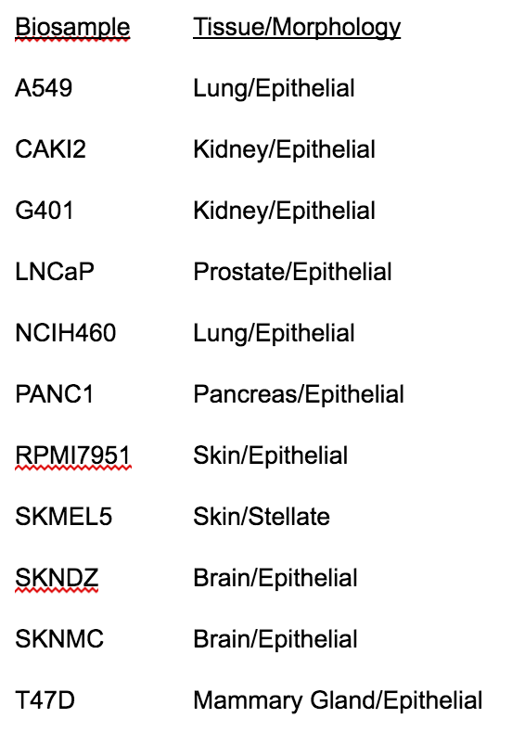
Quantifying reproducibility
of Hi-C data
ENCODE Hi-C data

Slide 7
Quantifying reproducibility
of Hi-C data
Is there a better way to decompose the contact map W (matrix)?
Spectral clustering commonly used in image processing
Transform W into the Laplacian matrix
Decomposed into eigenvectors, and consider only the leading ones (dimension reduction)
Distance between the corresponding vectors
Yan KK et al. Bioinformatics 2017

Slide 8
Quantifying reproducibility
of Hi-C data
How many eigenvectors should be used?
Yan KK et al. Bioinformatics 2017

Slide 9
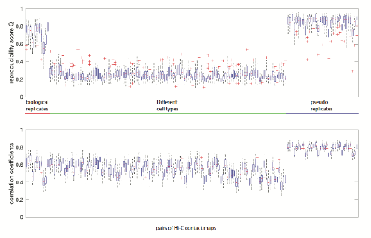
Quantifying reproducibility
of Hi-C data
Yan KK et al. Bioinformatics 2017

Slide 10
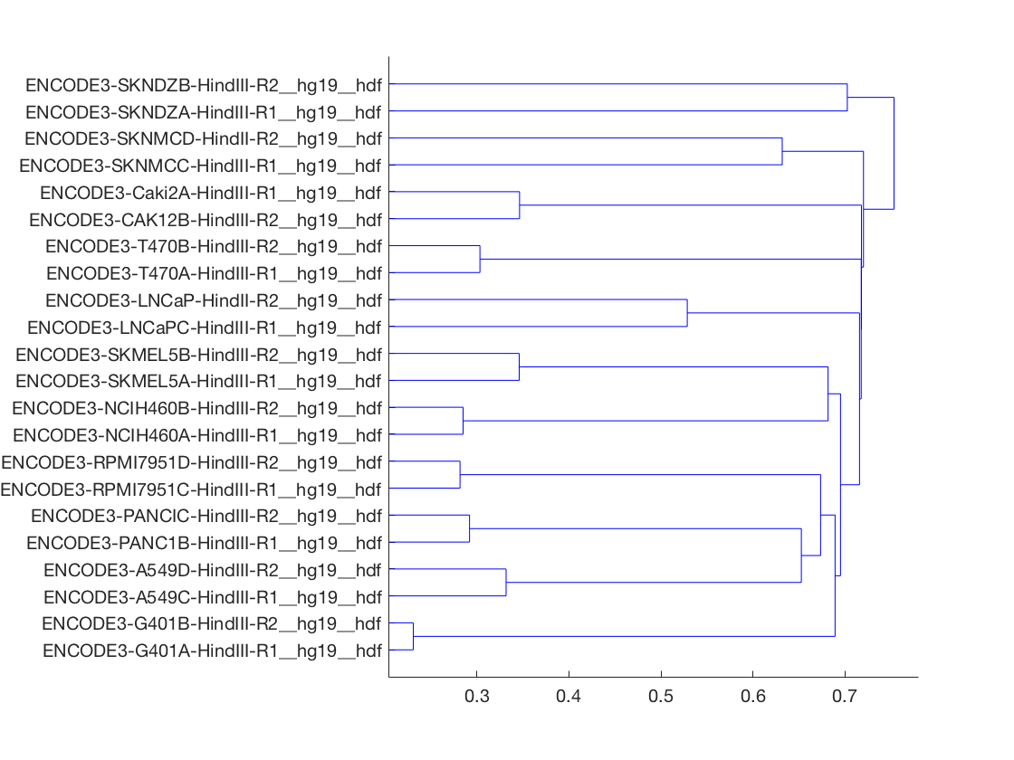
A distance measure between two contact maps

Slide 11
Comparison with other methods
Effects of noise
Credit: Gurkan Yardimci

Slide 12
Comparison with other methods
Separating replicates
Bio Reps
Bio Reps
Bio Reps
Bio Reps
Credit: Gurkan Yardimci

Slide 13
Comparison with other methods
biological replicate (blue); non replicates (red); pseudo replicates (purple)
Separating replicates
Gurkan Yardimci

Slide 14
Comparison with other methods
effect of
coverage
Credit: Gurkan Yardimci

Slide 15
Comparison with other methods
biological replicate (blue); non replicates (red); pseudo replicates (purple)
effect of coverage
Gurkan Yardimci

Slide 16
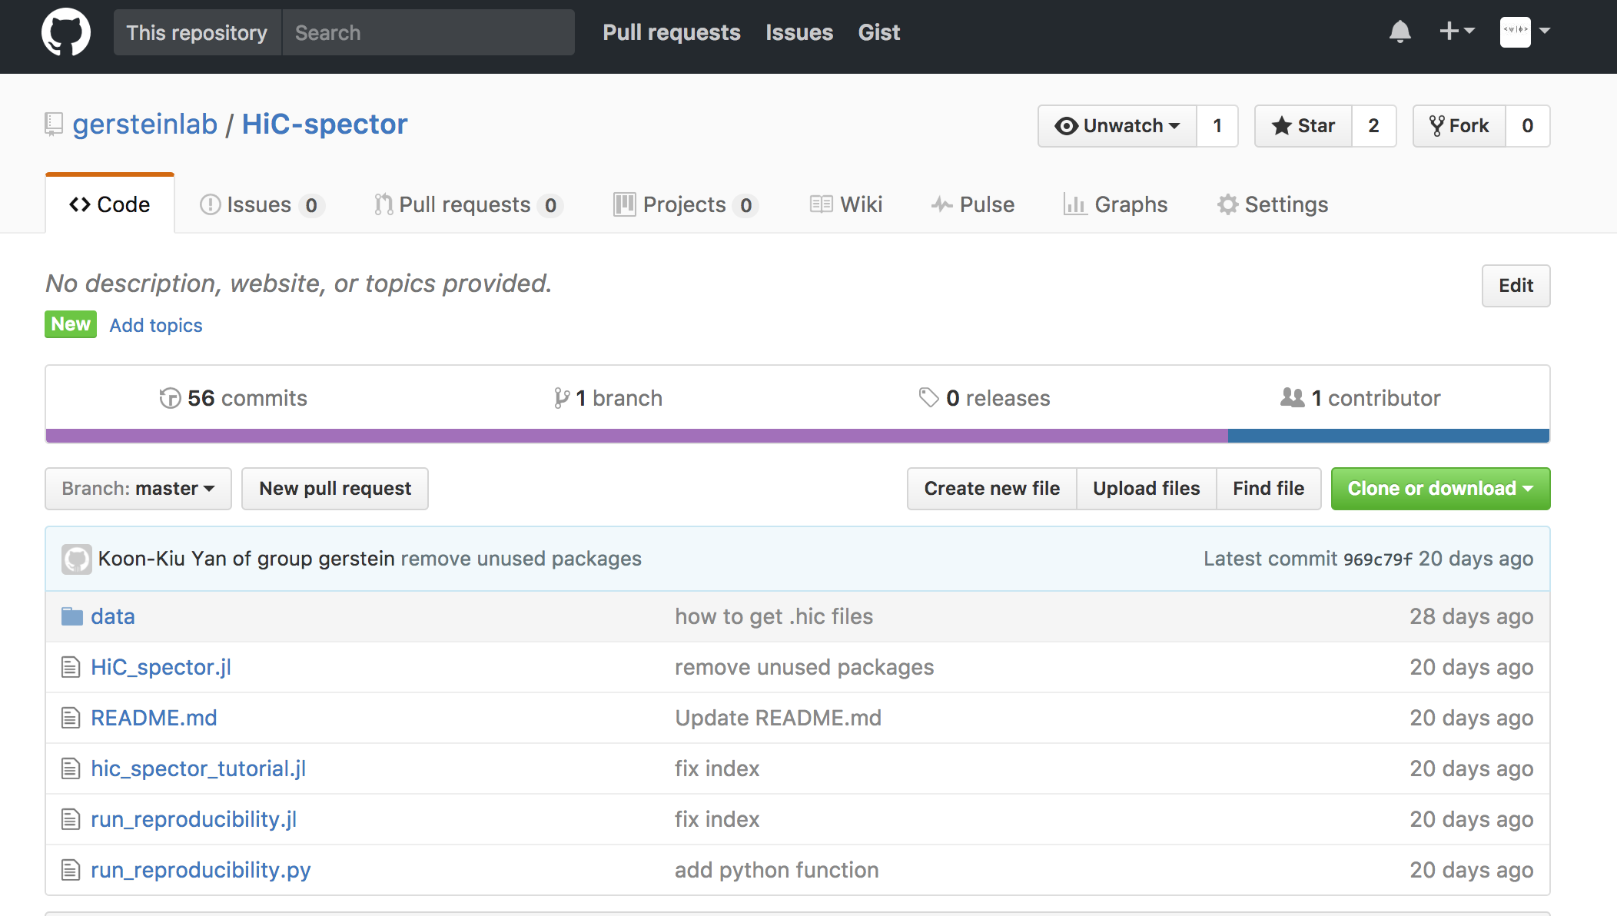

Slide 17
Summary and future work
We have a way to quantify the reproducibility of two entire intra-chromosomal contact maps
It may be more interesting to quantify the similarity of two sets of significant interactions. Algorithms for identifying significant interactions
Fit-Hi-C
HiCCUPs etc
Similarly, the same problem for ChIA-PET data
IDR kind of formalism for 2D peak calling. Of particular interest to the ENCODE community

Slide 18
Quantifying reproducibility / distance of Hi-C contact maps
Identifying topologically associating domains in multiple resolutions
Relating spatial organization and gene expression in a system-wide manner

Slide 19
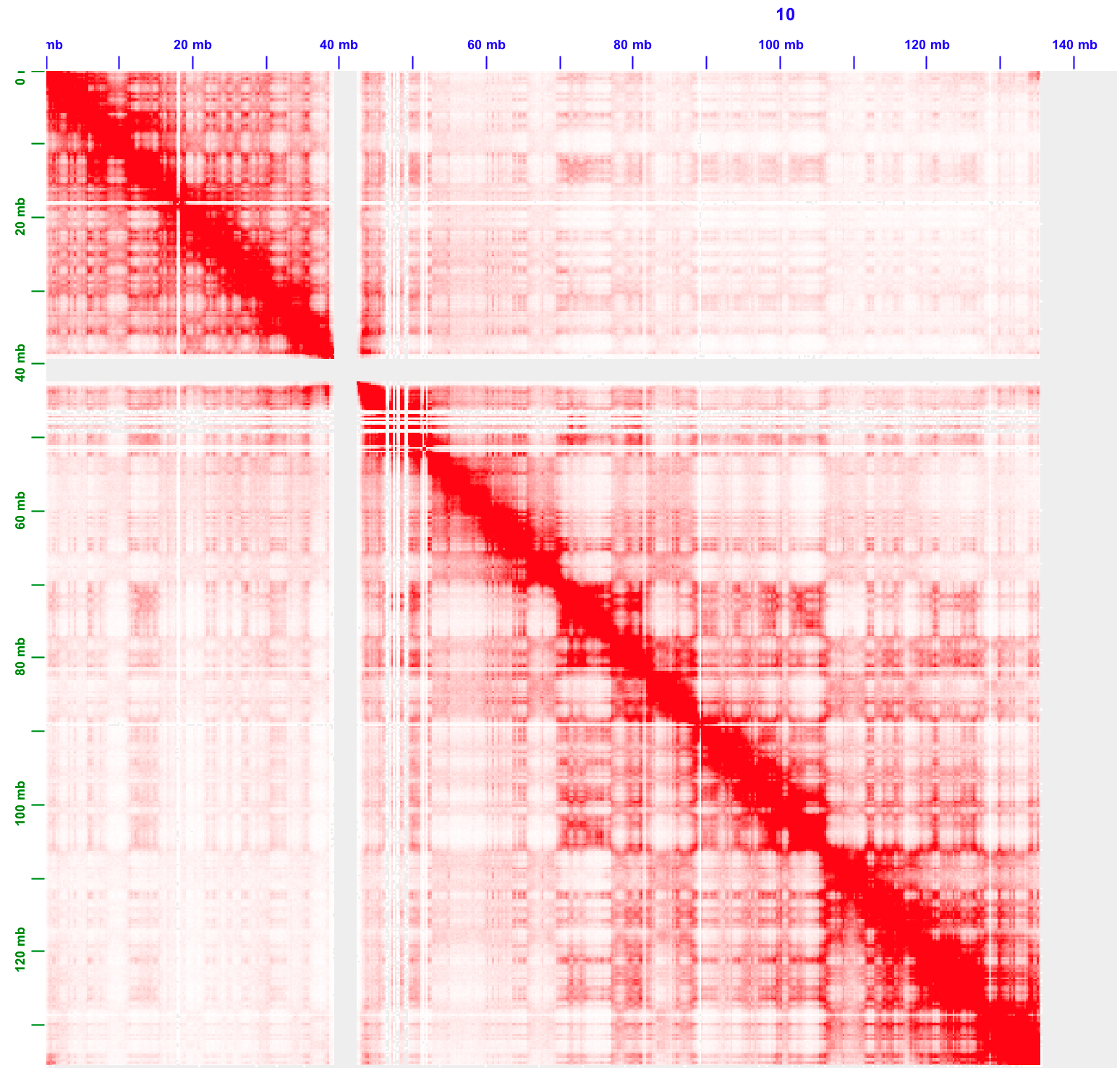
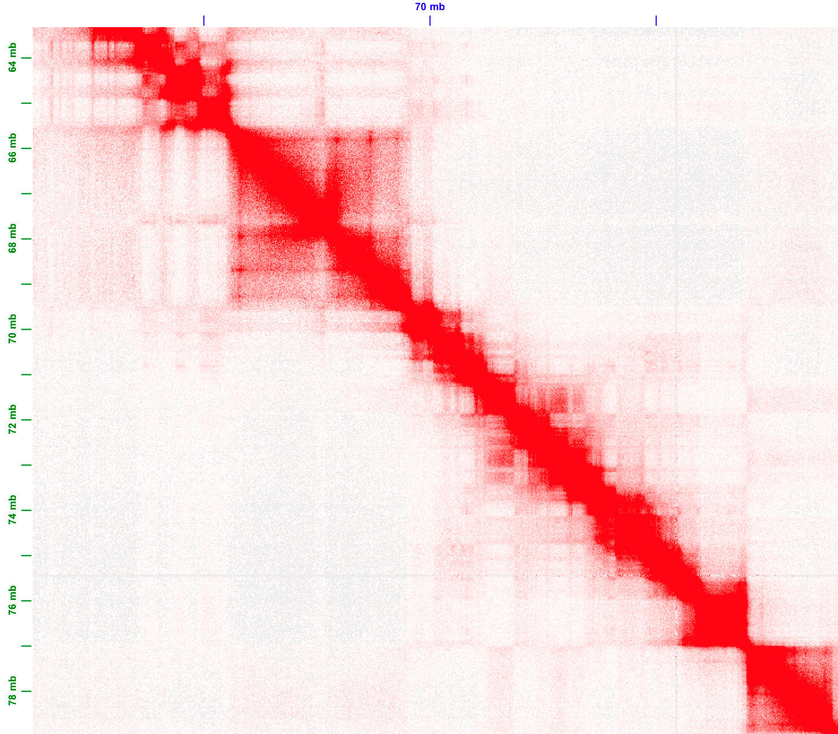
Topologically associating domains (TADs)
TADs have apparent
hierarchical organization

Slide 20
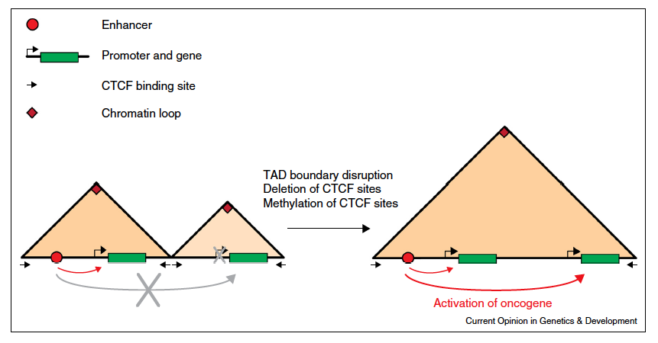
Local TAD boundary disruption activates oncogene
Example: IDH mutant gliomas
Flavahan et al. Bernstein Nature 2016
Example: T-ALL
Hnisz et al. Young Nature 2016
Valton and Dekker Curr. Opin. Genetics and Development 2016

Slide 21
Network modularity
degree of i
adjacency matrix
whether or not
i, j are in the
same module
number of edges
expected number of
edges between i and j

Slide 22
Network modularity
Optimization problem
degree of i
adjacency matrix
whether or not
i, j are in the
same module
number of edges
expected number of
edges between i and j

Slide 23
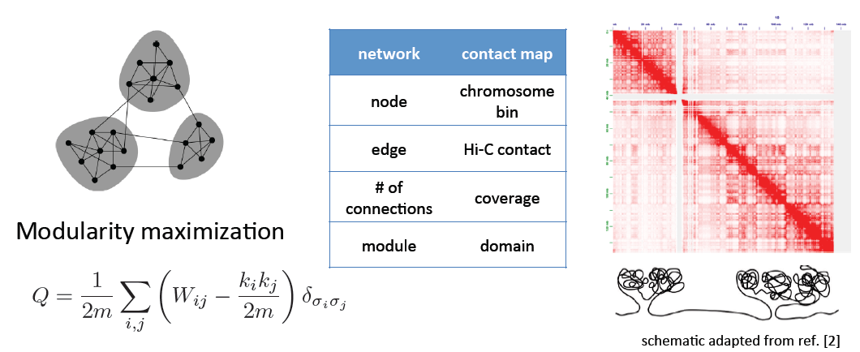
Identifying TADs in multiple resolutions

Slide 24
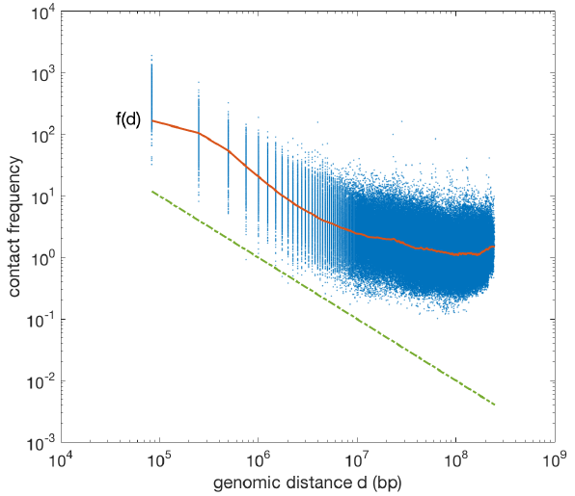
Identifying TADs in multiple resolutions

Slide 25
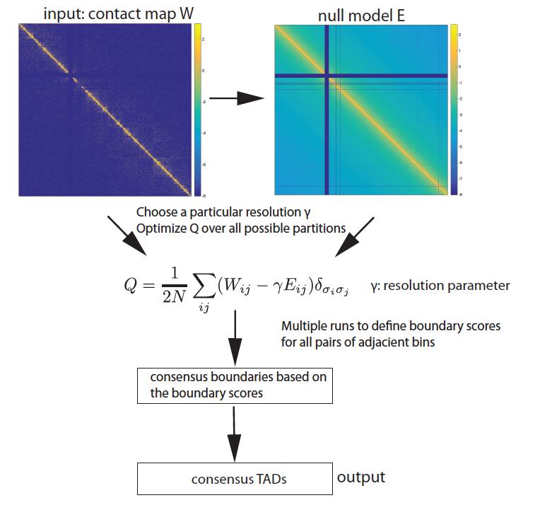
Identifying TADs in multiple resolutions
Numerically solve for
in equations
Yan KK and Gerstein M bioRxiv 097345
Notes:
It turns out that we can assume the expected number of contacts between i and j has the functional form ci*, cj* are unknowns for loci i and j. f is a function of the distance between bin i and bin j, which could be estimated empirically by aggregating the number of reads for each distance of separation. Given a contact map W, and by imposing the functional form, we can numerically solved for c* and all the elements in the null model. As you can see, the number of contact decreases gradually away from the diagonal. Now, we combine the raw map and the expectation to a new objective function. The algorithm is probabilistic and thus we need to perform multiple runs, arriving at a set of consensus boundaries, and consensus domains. More importantly, we introduced a parameter gamma called the resolution parameter. BY tuning the parameter, we are able to detect TADs in multiple resolutions.

Slide 26
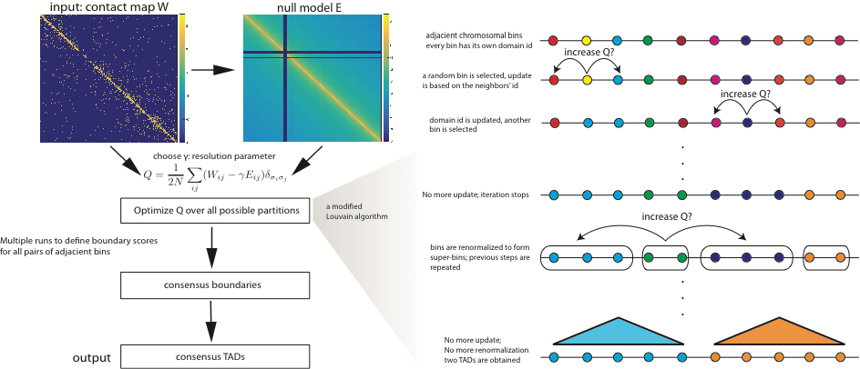
Identifying TADs in multiple resolutions

Slide 27
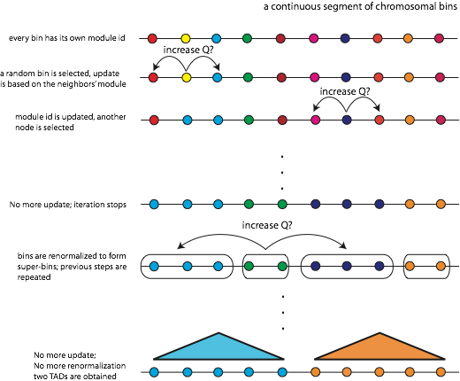
Identifying TADs in multiple resolutions
a modified Louvain algorithm

Slide 28
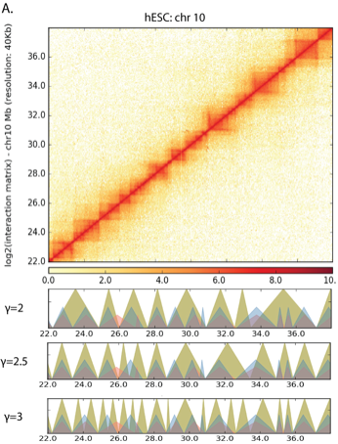
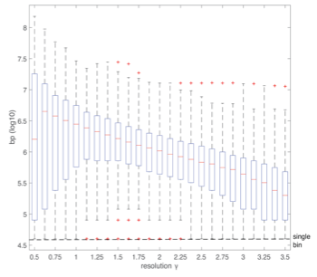
Identifying TADs in multiple resolutions

Slide 29
From one resolution to
multiple resolutions

Slide 30
Enrichment of histone features at different resolution

Slide 31
Enrichment of histone features at different resolution
characteristic length scale

Slide 32
House-keeping vs tissue-specific genes

Slide 33
Enrichment of TF binding sites near boundaries
Question: Causes or Consequences?

Slide 34
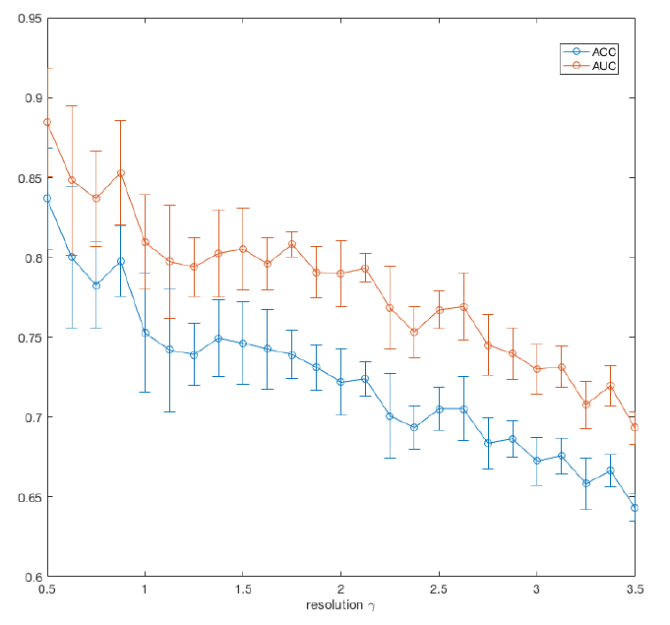
Predicting TAD boundaries using TFs binding pattern
Classification problem:
model performance
Notes:
To address the question, we have formulated a ML model. A classification problem. Positive set: TAD boundaries identified by our method. Negative set: a set of random boundaries. we use binding of transcription factors to predict boundary or not.
e.g. TF1 vs TF3..
We build a logistic regression model. Beta is a vector quantifying the contribution of each TFs.
AUC. OK. low resolution 0.85…
Decreasing trend. Consistent with the previous analysis, increases of resolution, many TADs, enrichment decreases.

Slide 35
Predicting TAD boundaries using chromatin features
Which transcription factors play a role in border formation?
contribution of individual factors

Slide 36
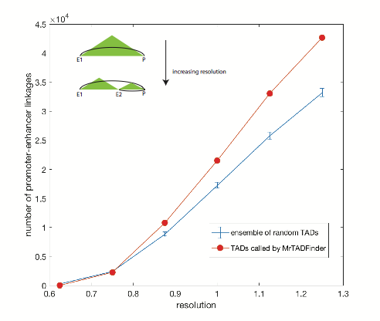
Loop domains and potential enhancer-promoter linkages
Peaks connecting
endpoints of a domain
Capture Hi-C data
Credit: SKL
Sanborn et al. Aiden PNAS 2016

Slide 37
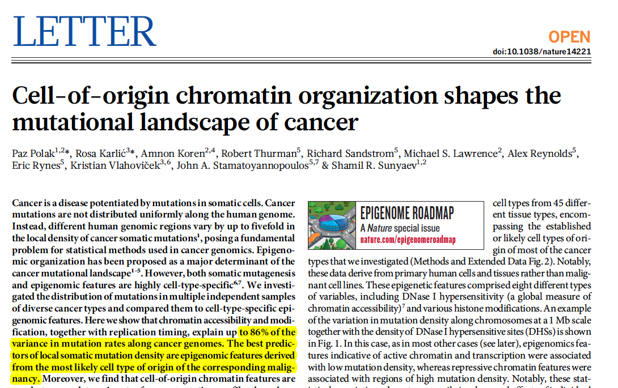
Domain organization shapes mutational landscape

Slide 38
Domain organization shapes mutational landscape
TADs identified in MCF7
mutations called from breast cancer
samples (~700 donors)
Cluster 1
Cluster 2
Yan KK and Gerstein M bioRxiv 097345

Slide 39
Domain organization shapes mutational landscape
TADs identified in MCF7
mutations called from breast cancer
samples
Cluster 1
late
early
Cluster 2
early
late
Yan KK and Gerstein M bioRxiv 097345

Slide 40
Optimize Q by Dynamic programming
The continuous nature of TADs is intrinsically different from modules in a network. Optimization of Q in TADs finding is much easier.
Divide a chromosome into TADs is analogous to partitioning a sequence into subsequences.
= max of
the optimal Q for
partitioning the loci

Slide 41
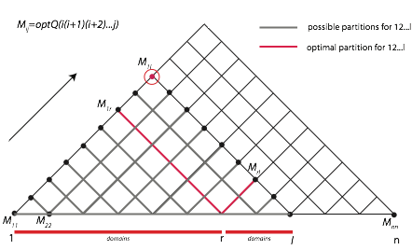
Optimize Q by Dynamic programming
Evaluate Q for all the possible partitions.
O(n^3)
loop over length x=1,2,…n
loop over all subsequences of length x
loop over each position of a subsequence

Slide 42
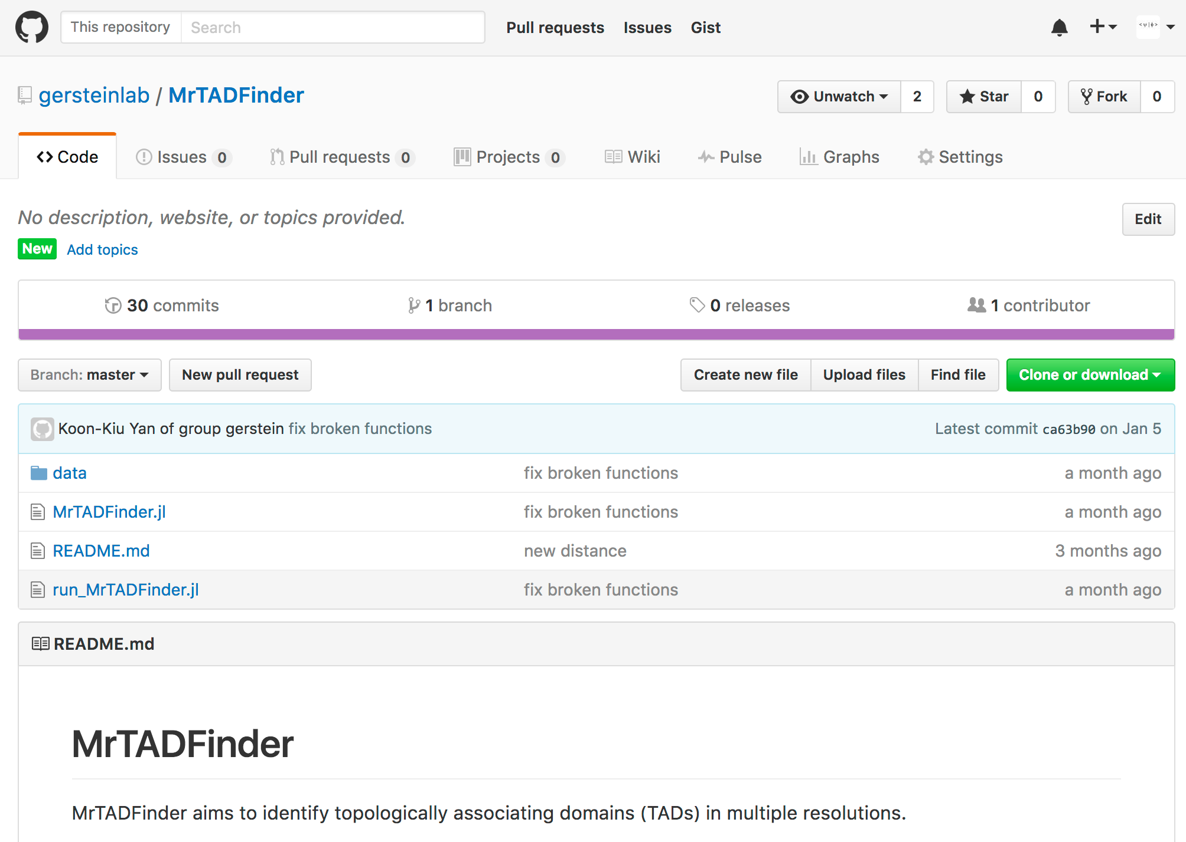
MrTADFinder
Notes:
There is a tool developed. MrTAD Finder, standing for TADs in multiple resolution.

Slide 43
Quantifying reproducibility / distance of Hi-C contact maps
Identifying topologically associating domains in multiple resolutions
Relating spatial organization and gene expression in a system-wide manner

Slide 44
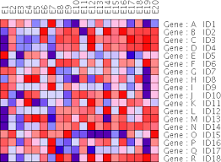
A mapping between two spaces
real physical space
abstract expression space
cell type 1
cell types: 1, 2, 3 …
?
Gene
cell type 2
cell type 3

Slide 45
Gene-Gene proximity network
Hi-C contact matrix
Gene-Gene proximity
matrix/network
N
N
2 genes
(interchromosomal/intrachromosomal)
large N means closer
all genes
Genomics coordinates
100kb resolution, ICED
How do various attributes (expression, pathways etc)
distribute on the network? A graph coloring problem
Notes:
network is a bit overkill
use math.

Slide 46
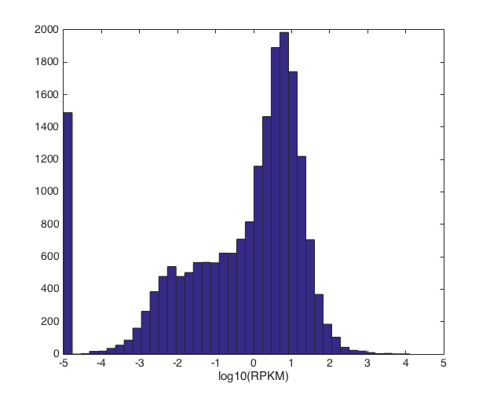
Gene-Gene proximity versus co-expression
e=-1
e=+1
Graph partition
problem
d is the weighted adjacency matrix and e=+1 or -1
minimizing the weights of the edges between separate components.

Slide 47
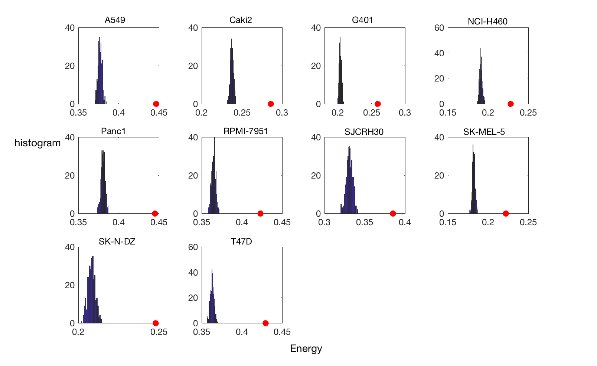
Gene-Gene proximity versus co-expression
Distribution of E by shuffling the expression profile
empirical profile

Slide 48
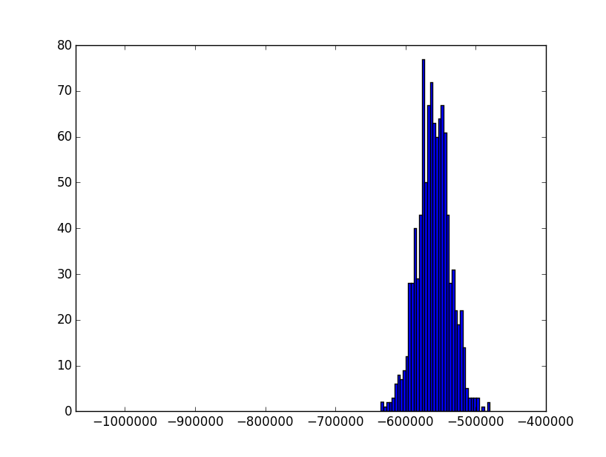
Gene-Gene proximity versus co-expression
empirical A549 profile
H
Notes:
features like open/close chromatin, TF targets etc

Slide 49
Gene-Gene proximity versus co-expression
N nodes:
m is expressed, n is not
empirical A549 profile
The spatial location of expressed genes are highly non-random.
May be it’s too naive to compare with random - perform shuffling while preserving other genomics features
H
Notes:
features like open/close chromatin, TF targets etc

Slide 50
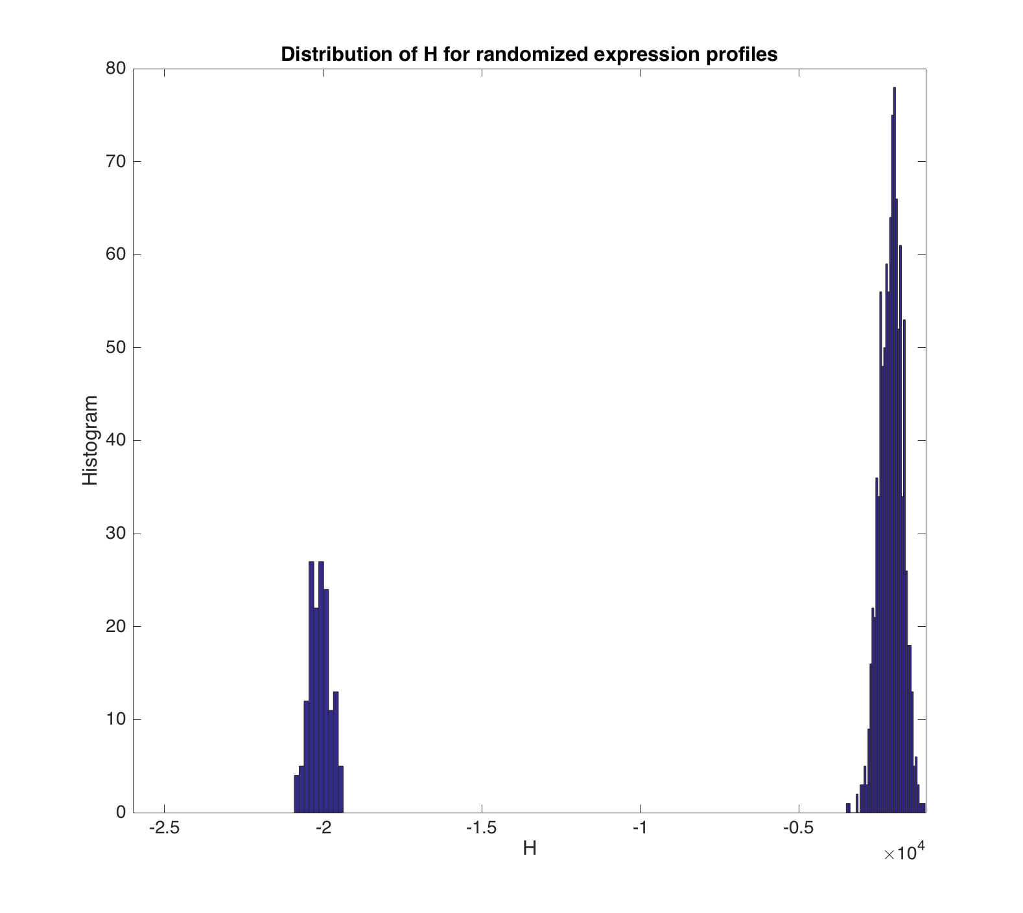
Gene-Gene proximity versus co-expression
randomized profile but with
preserved TADs structure
empirical A549 profile
50￼

Slide 51
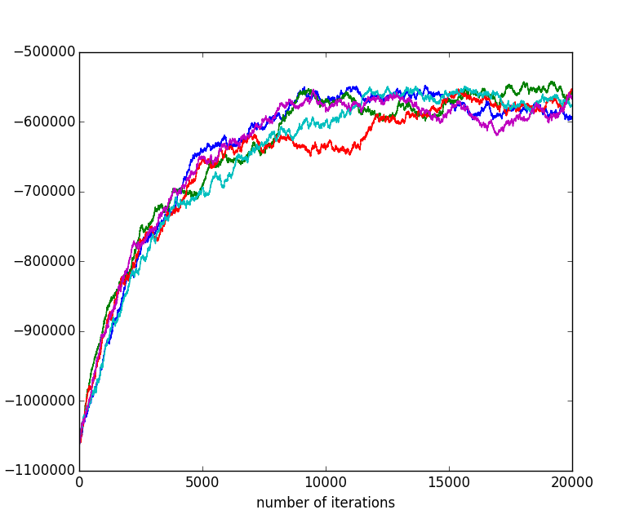
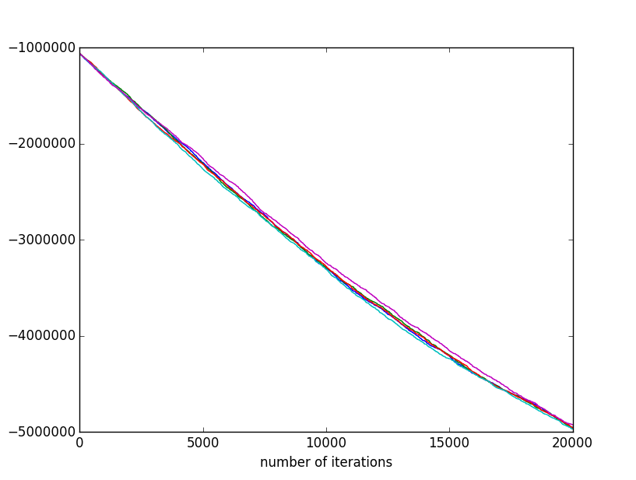
Is the spatial configuration optimal?
Plenty of room for optimization.
H

Slide 52
Gene-Gene proximity versus co-expression
e=-1
e=+1
Modularity
detection
d is the weighted adjacency matrix and e=+1 or -1

Slide 53
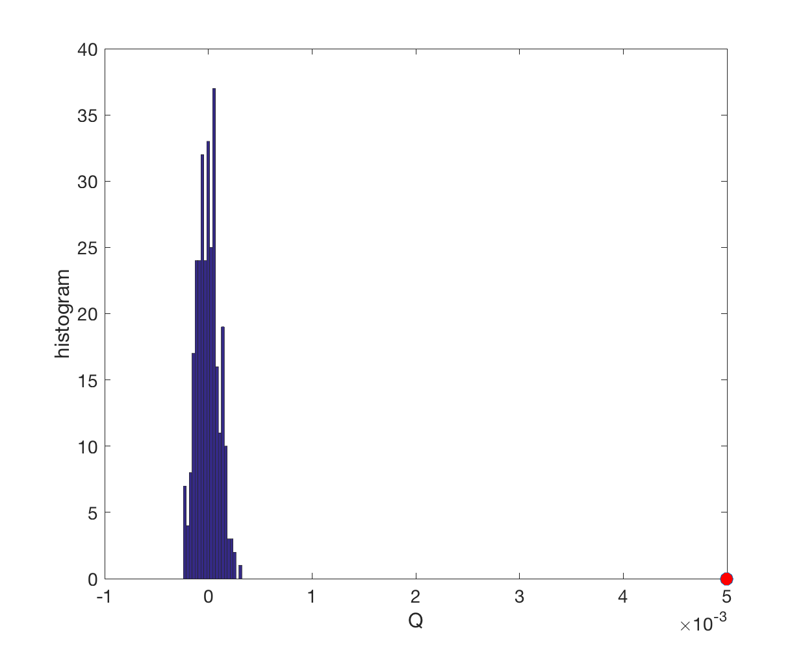
Gene-Gene proximity versus co-expression
e=-1
e=+1
Modularity
detection
d is the weighted adjacency matrix and e=+1 or -1

Slide 54
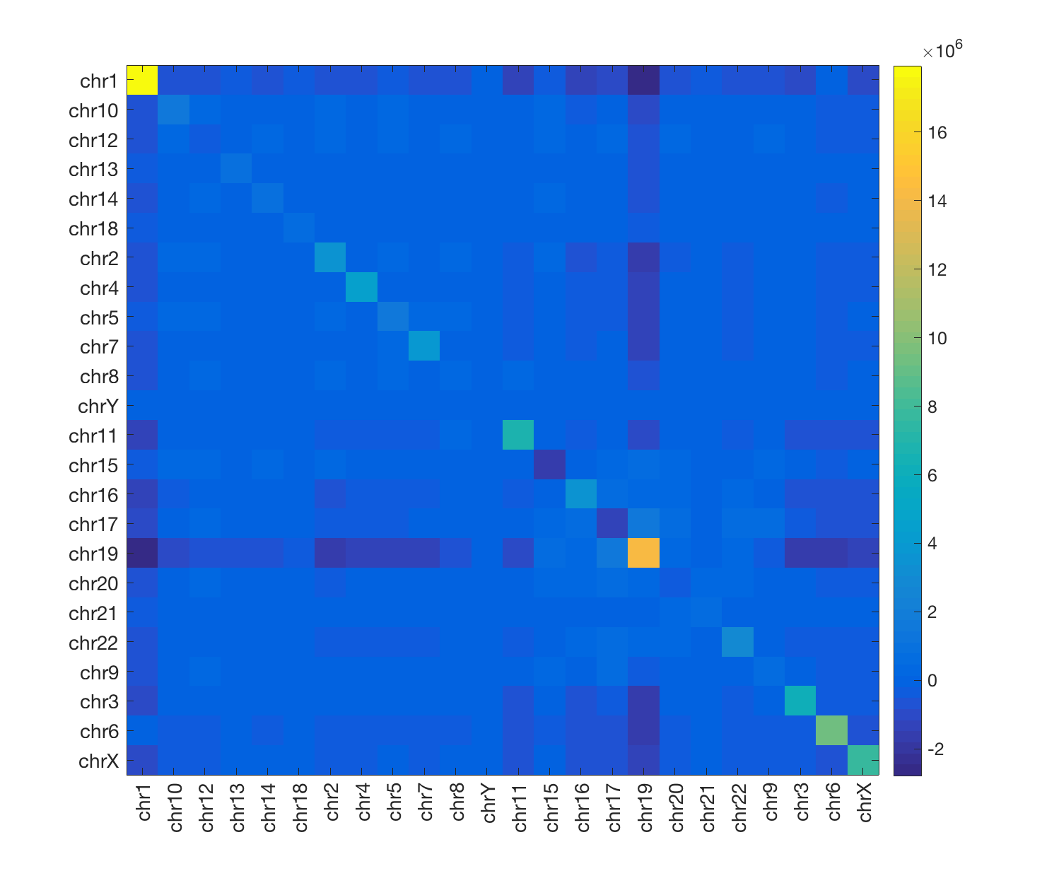
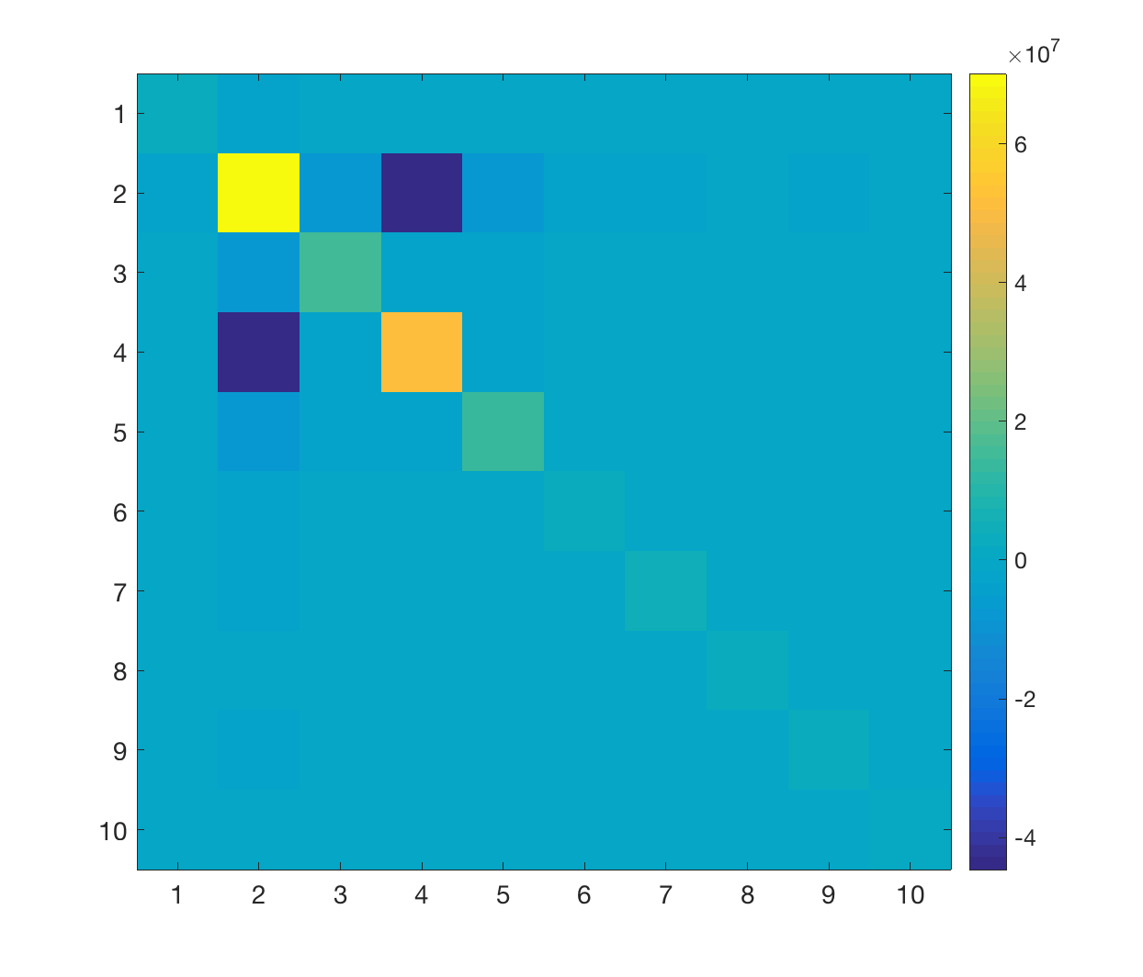
Divide gene-gene proximity network into modules
renormalized modularity matrix
Q
0
0.04
0.08

Slide 55
Modularity may potentially reveal chromosome territories
Modules resemble the
chromosome territories
Contents?
Conservation across cell types?
Where are the pathways etc?

Slide 56
Acknowledgement
MG
Quantifying reproducibility / distance of Hi-C contact maps
Gurkan Yardimci, Bill Noble, Chengfei
Identifying topologically associating domains in multiple resolutions
Shaokei, Joel, Anurag, Ari, Timur, Jonathan
Relating spatial organization and gene expression in a system-wide manner
Cheng Ye, Alberto, Hannah Lawrence

Slide 57
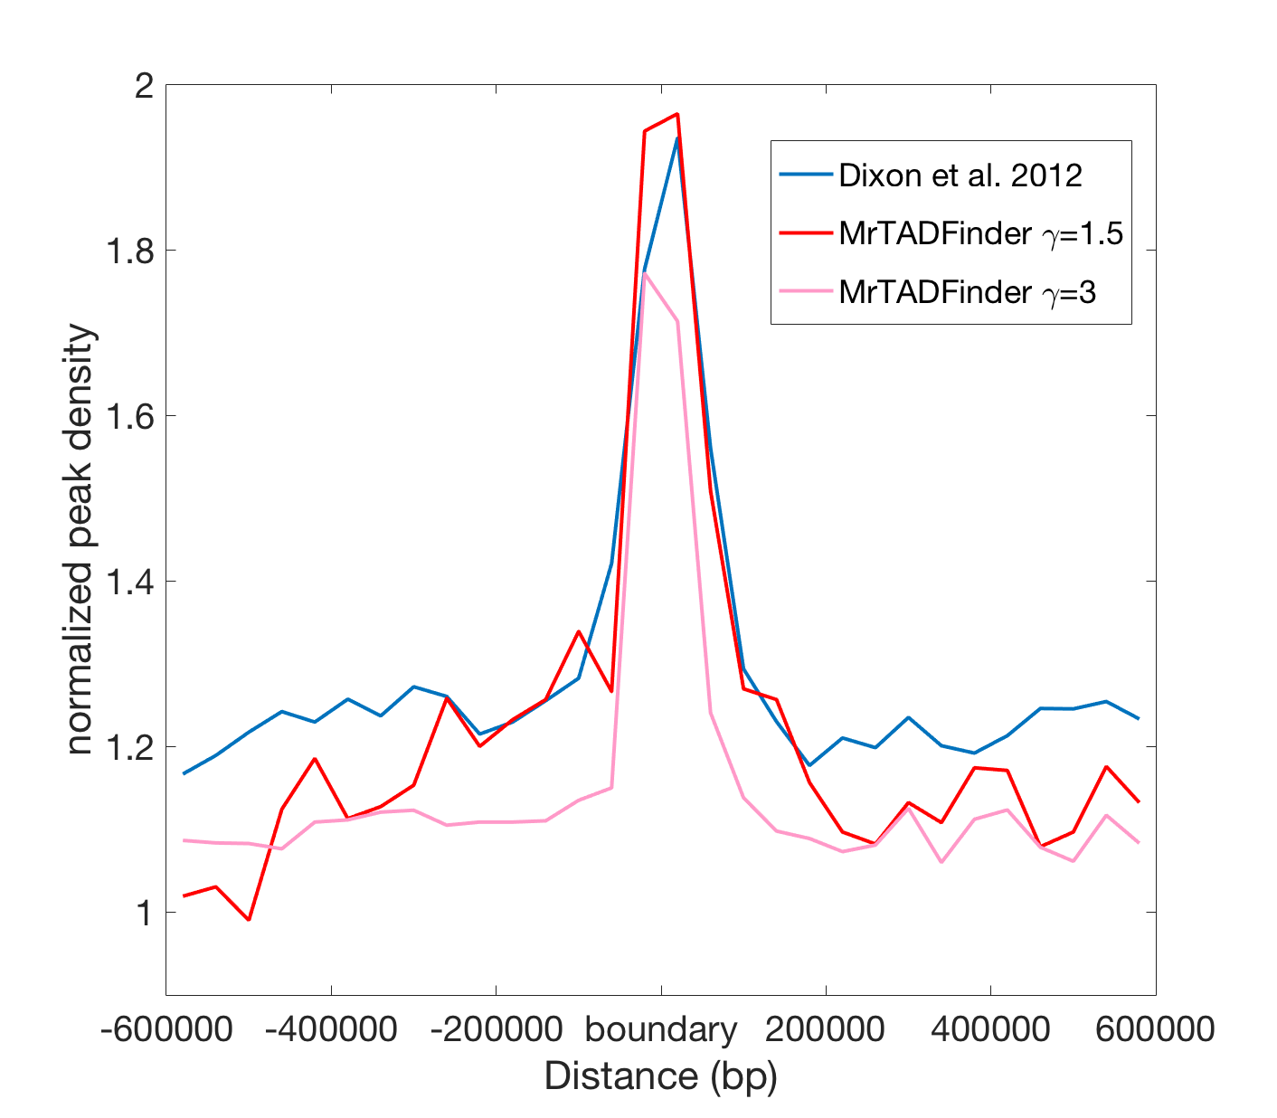
Benchmark with previous methods
Yan KK and Gerstein M bioRxiv 097345

Slide 58
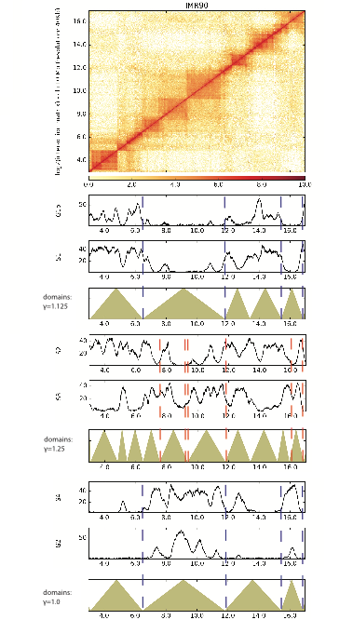
More Repli-seq data
Notes:
There is a tool developed. MrTAD Finder, standing for TADs in multiple resolution.

Slide 59
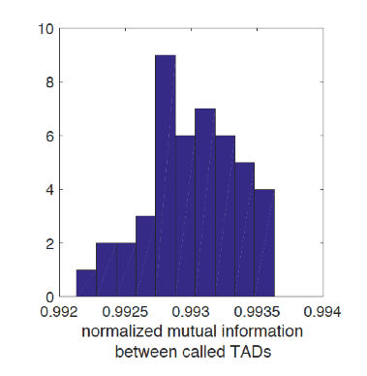
algorithm robustness
Louvain algorithm
Notes:
There is a tool developed. MrTAD Finder, standing for TADs in multiple resolution.

