Slide 1
Impacts of Neanderthal-Introgressed Sequences on the Landscape of Human Gene Expression
Paper by Rajiv C. McCoy, Jon Wakefield, Joshua M. Akey (University of Washington)
Journal Club: April 13, 2017
Presented by Aparna Nathan, YC ’17

Slide 2
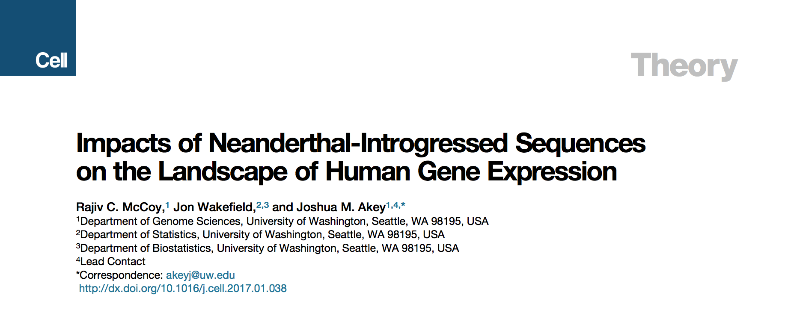
Rajiv McCoy
Postdoc in Genome Sciences, University of Washington
Jon Wakefield
Professor of Statistics,
University of Washington
Joshua Akey
Professor of Genome Sciences,
University of Washington
Notes:
Previous work: 2016 Science Akey: phenotype info from EHRs, match to alleles

Slide 3
Background
2% human genome is from Neanderthal sequences
Includes: protein coding genes, disease-associated SNPs
cis-regulatory variation
Allele-specific expression (ASE)
Notes:
How to sequence Neanderthal
(Mapped GWAS hits to neanderthal) Some of this section includes protein coding genes: human traits? (particularly depression, hypercoagulation, tobacco)
This study looks at introgressed sequences
No info on regulatory impact
ASE: Heterozygous individuals’ allelic differences in transcript abundance
Counts of reads supporting each allele
eQTL: more confounding batch effects
Unable to combine information across samples

Slide 4
Goal
Integrate ASE information across samples
Use a Bayesian Generalized Linear Mixed Model (GLMM)
Apply to GTEx data
Notes:
214 individuals, 52 tissues

Slide 5
Methods

Slide 6
Methods
Used RNA-seq data from GTEx
Filtered to white individuals
Counted heterozygous allele-specific reads with GATK’s ASEReadCounter
Previously identified introgressed Neanderthal haplotypes with S* approach
SNP data
Introgressed: 5055 SNPs, 2034 genes
Non-introgressed: 581,124 SNPs, 26,437 genes
Notes:
GTEx: 544 individuals, 53 tissues (non africans have neanderthal ancestry)
Aligned reads to hg19 with TopHat (GENCODE annotations), used GATK’s ASEReadCounter
S*: dynamic programming to pick SNPs maximizing high divergence from human, identity with neanderthal
Count number of chromosomes where they differ
Using neanderthal Altai genome (2014 german)

Slide 7
Methods
Notes:
Looked at the expression of those specific SNPs across different tissues of different people
Combine info from different tissues of different people → determine up or down regulation

Slide 8
Model
Bayesian mixed model, fit with gene read counts
logit(p_{it}) = β₀ + α_{t} + ϒ_{i}
ASE: posterior probability of β₀
ASE
Individual-specific
Tissue-specific
Notes:
P is proportion of reads with alt allele
Didn’t give a why, not a statistician, suspect because separate effects
Random factors, added noise too

Slide 9
ASE for Neanderthal Introgressed Variants
1,236 introgressed SNPs with
ASE at
10% FDR
Notes:
About 50% up/down

Slide 10
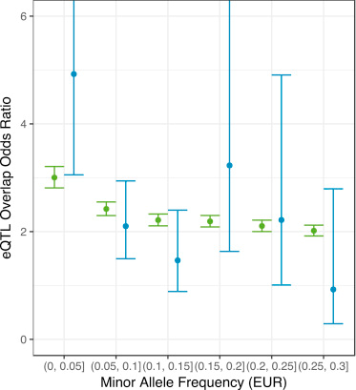
Correlation between ASE and eQTL
Notes:
Compared to known eQTLs from GTEx with fisher exact — found correllation, particularly at low minor allele freq
Green: non neanderthal, blue: neanderthal
Phenotypically relevant

Slide 11
Correlation with human traits
Notes:
Beta: degree of ASE
Matches known info re: SNPS: group of linked immunity SNPs in TLR1 → increased expression of neanderthal
GWAS hits for lupus, might have cis-regulatory mechanisms involved
Interesting for me: ADAMTSL3 (height and schizophrenia): downregulated neanderthal

Slide 12
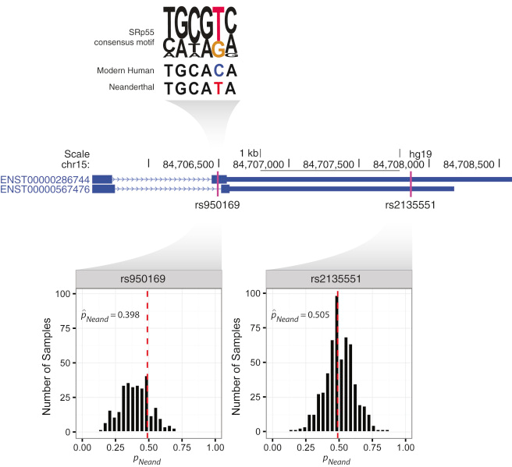
Example: ADAMTSL3
Notes:
SNPs on the same haplotype didn’t always have correlated expression (one has no ASE) → splicing
Neanderthal’s T increases splicing
Relevant to my interests and shows power of ASE precision

Slide 13
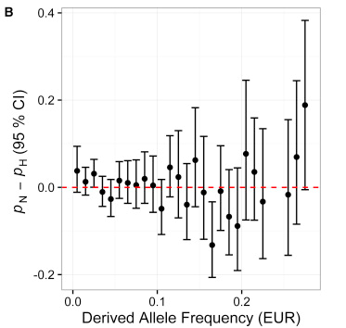
No significant difference in ASE due to introgression
Notes:
Neanderthal traits being weak → introgressed might have more regulatory variants?
Pn = % introgressed showing ASE
Ph = nonintrogressed
Simulation using Binomial distribution (total # SNPs, proportion with ASE)
No: Weak alleles have been eliminated (purifying selection)

Slide 14
Tissue specificity of ASE
Notes:
Genes expressed across tissues and differently even within same tissue

Slide 15
Tissue-specific model
Bayesian mixed model (pooled SNPs)
logit(p_{it}) = β₀ + β_{t} + ϒ_{i} + ζ_{g}
Fixed tissue-specific
Notes:
Compare to model without β_{t} to verify significance of variable
Then look tissue specific to find values for each tissue

Slide 16
ASE is tissue-dependent
Notes:
Looking just at introgressed, generally around or slightly below half
Supplemental figure shows this broken by rare and common – most of this trend comes from common, less trend in rare.
Brain resembles human more (less divergence), re-ran this with covariant and no change in trend
Downregulation in brain (blue) and testes (yellow)
Cerebellum, basal ganglia — interesting because neanderthals may have had smaller brains, these regions responsible for motor control, perception, also cognition, language, behavior
Prior GTEx showed that brain has lower ASE overall, but there is significance in neanderthal alleles
Very few genes did display tissue specificity, reflects general homogeneity of cis reg across tissues
Separate the effects of differential expression and ASE
High DE in brain → low neanderthal ASE

Slide 17
Ex: NTRK2
Notes:
Neurotrophic receptor, neuron survival, synapse formation: depression, impaired development, OCD, AD, anorexia
Neanderthal allele down reg
Also in testis DNALI1 — dynein for flagella movement, better fitness of sperm?

Slide 18
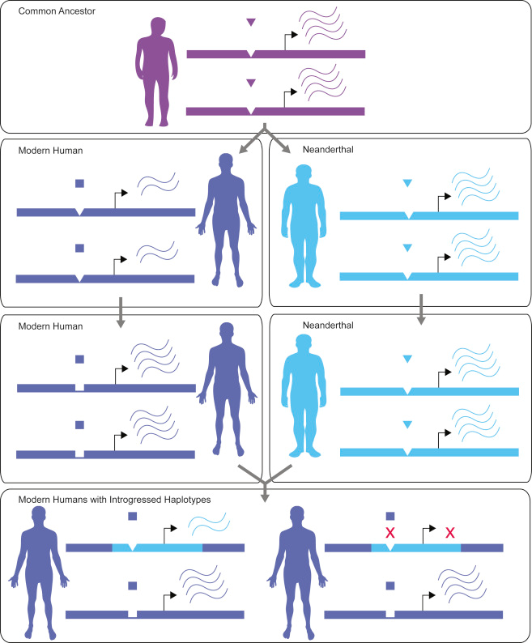
Notes:
Why?
Increased regulatory divergence in brain/testis
Probably not human-specific overexpression in brain
Compensate for bad neanderthal alleles

Slide 19
