Slide 1
Asthma single cell processing
12 Apr 2017
DS

Slide 2
Sample summary
11 samples total
  10 individuals, 1 replicate
  5 asthmatics (4 with bulkRNAseq data), 5 controls (2 w. bulk)
  96 cells/sample (1056 samples)
100bp PE files
2* 70MB files / cell, ~ 1.5 TB
No spike-in controls
No UMIs
+ 2 previous samples with potential cell stacking

Slide 3
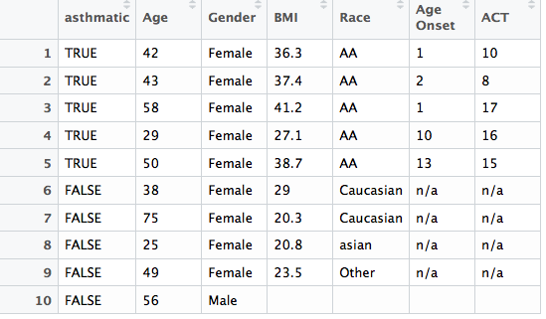
Demographic information for the single cell

Slide 4
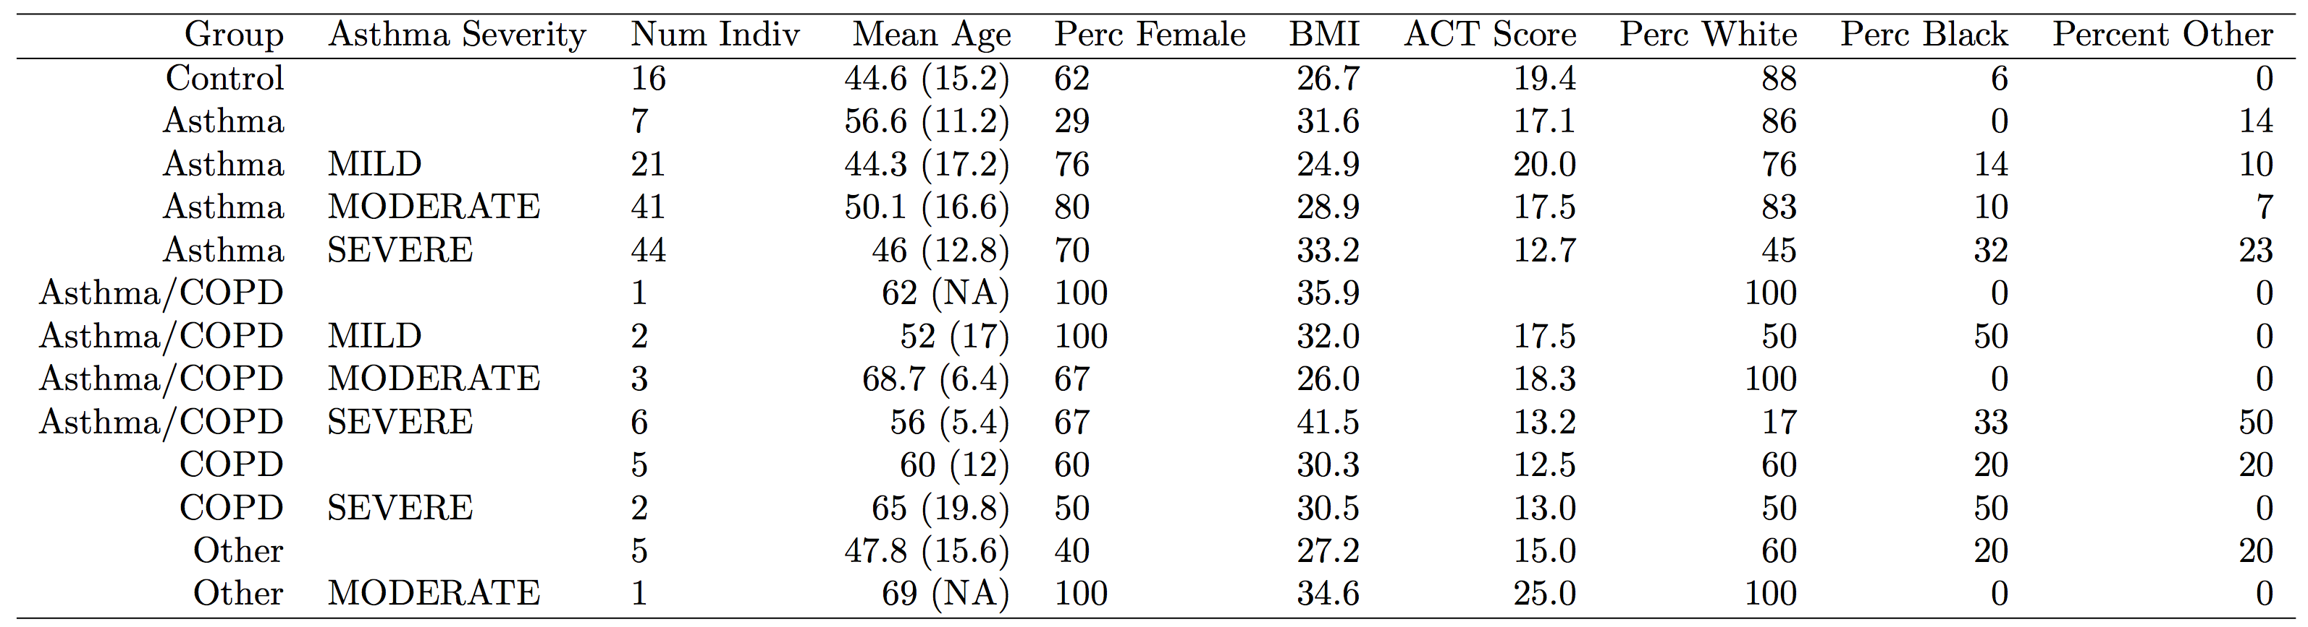
Demographic information for the bulk-RNAseq data

Slide 5
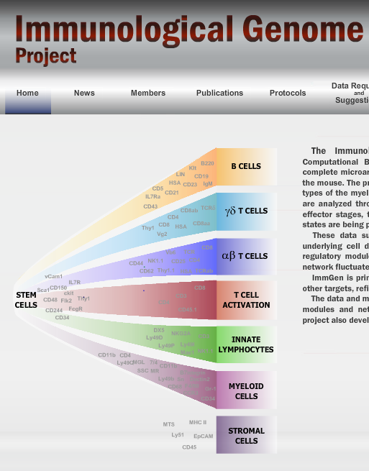
Current processing/plans
Fastqc
Trim_galore
STAR to hg38
RSEM
Cell clustering
  tSNE, PCA
  Identify cell types
  Differential expression between matched cell types in asthmatics vs control
  Correlation with exogenous signal

Slide 6
Quality filtering results

Slide 10
After removing those not expressed in any sample
(72% of the genes are expressed in at least one sample)

Slide 11
Initial clustering, PCA

Slide 13
Cleaning: single cells and
Reduced to wells with a single cell
637 cells
Well Contents | Freq
0 | 96
1 | 825
2 | 52
2+d | 1
d | 1
debris | 59
multi | 3
multi cells | 1
multi-cells | 6
Multi-cells | 1
Positive | 8
squamous | 3

Slide 15
Hierarchical clustering method (SINCERA)
Size of the largest cluster with different numbers of cuts

Slide 16
Clustering each sample individually

Slide 30
Next steps
Other cleaning procedures
  Normalize expression levels
  Use monocle to convert to read counts
Intra-individual clustering
  Compare clusters between samples
Assign to cell types
Notes:
show a clear distinction between the asthmatics and the controls

Slide 31
FDR p-values for select clinical vars

Slide 32
Corrected for Age at Visit, Gender, BMI
Notes:
bruce levy steriods affect the cell population and maybe make the disease worse

