Slide 1
To Mock or Not?
Jinrui
April 13th

Slide 2
Control is critical in Chip-seq
  DNA input
    Being widely used
      e.g. it is preferred by ENCODE
  Mock IP, in theory a better control
    To exclude spurious peaks due to antibody, if any

Slide 3
Mock IP is controversial, operationally
  Low library complexity
    Duplicate reads => non-informative and misleading
    Biased to certain genomic regions
Notes:
Results unpredictable, reduce real peak more than spurious peaks?
Or

Slide 4
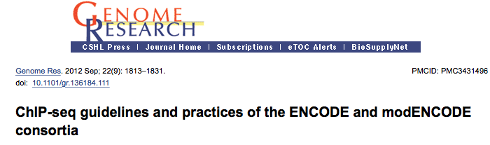
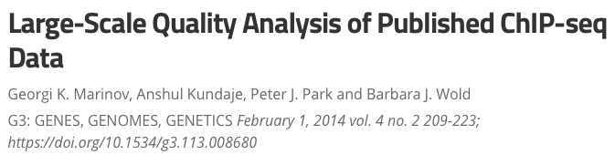
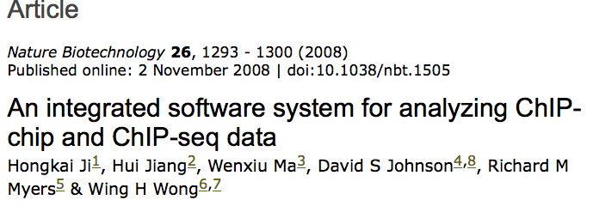
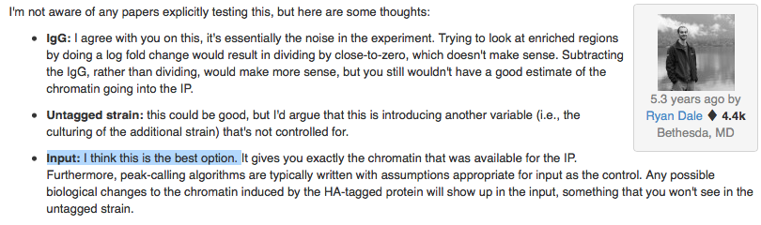
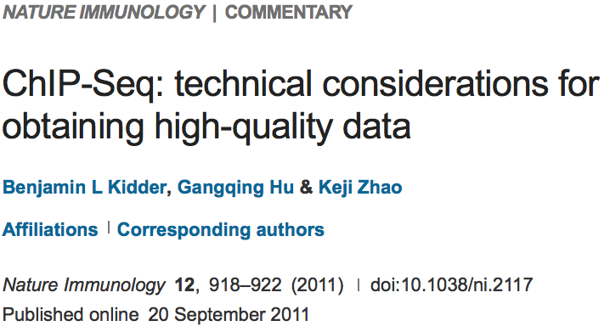
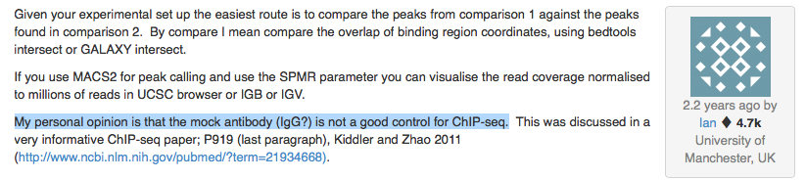
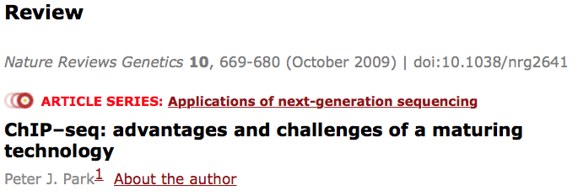
Against/ or raise caveats of mock IP
.
.
.

Slide 5
Support mock IP or against DNA input

Slide 6
Benefit of Mock IP is understudied due to
  Lack of large scale and comparable data
    i.e. same sample/condition, same protocol/lab
  Lack of golden standard
    Small number of TFs with binding motif known

Slide 7
Benefit of Mock IP is understudied due to
  Lack of large scale and comparable data
    i.e. same sample/condition, same protocol/lab
  modERN and ENCODE
  Lack of golden standard
    Small number of TFs with binding motif known
  TF motifs identified by high-throughput experiments

Slide 8
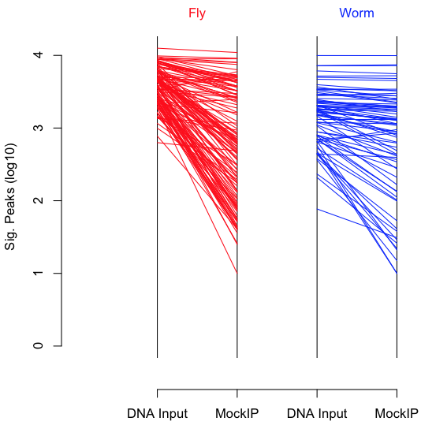
Comparison of significant peaks
Using mock IP control, less significant peaks from SPP-IDR
It is also true for human data from ENCODE

Slide 9
Peak reduction does not necessary mean less spurious peaks
Motif enrichment as a proxy of peak quality
  Motifs from bacteria one hybrid (B1H)

Slide 10
Significant peaks called with mock IP as control(a/b), motif enrichment > using DNA input (a/a’)
Motif enrichment among sig. peaks
Genome shuffled locally
Bin size = 50 nt
A
B
P < 1.1e-6
P = 0.12
a/b
a/a’
a/b
a/a’
Notes:
Suggest a/a’ with antibody peaks

Slide 11
a/b gives less significant peaks than a/a’
The total n, a/b significant peaks vs the top n, a/a’ significant peaks
A
B
Genome shuffled locally
Bin size = 50 nt
P < 8.6e-6
P = 0.14
a/b
a/a’
a/b
a/a’
Notes:
Suggest antibody peaks are also significantly enriched in top peaks of a/a’

Slide 12
Sensitivity of mock IP in detecting bona fide peaks
Twilight peaks
  e.g. For each TF, suppose a/b and a/a’ generate 100 ranked peaks respectively, the top 10 and 50 peaks are sig. peaks for a/b and a/a’, then the 11-50 peaks are twilight peaks, 51-100 peaks are negative peaks

Slide 13
a/b twilight peaks enrich more motifs than negative peaks, marginally more than the a/a’ twilight peaks
A
B
Genome shuffled locally
Bin size = 50 nt
P = 0.09
P = 0.23
P < 2.0e-4
P = 0.53
a/b
a/b
a/a’
a/b
a/b
a/a’

Slide 14
a/a’ twilight peaks is only marginally better than a/a’ negative peaks
P = 0.04
a/a’
a/a’
Taken together, twilight peaks in a/b have significant amount of bona fide peaks

Slide 15
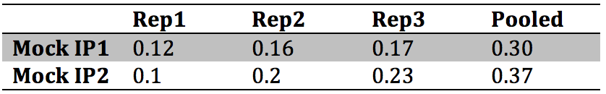
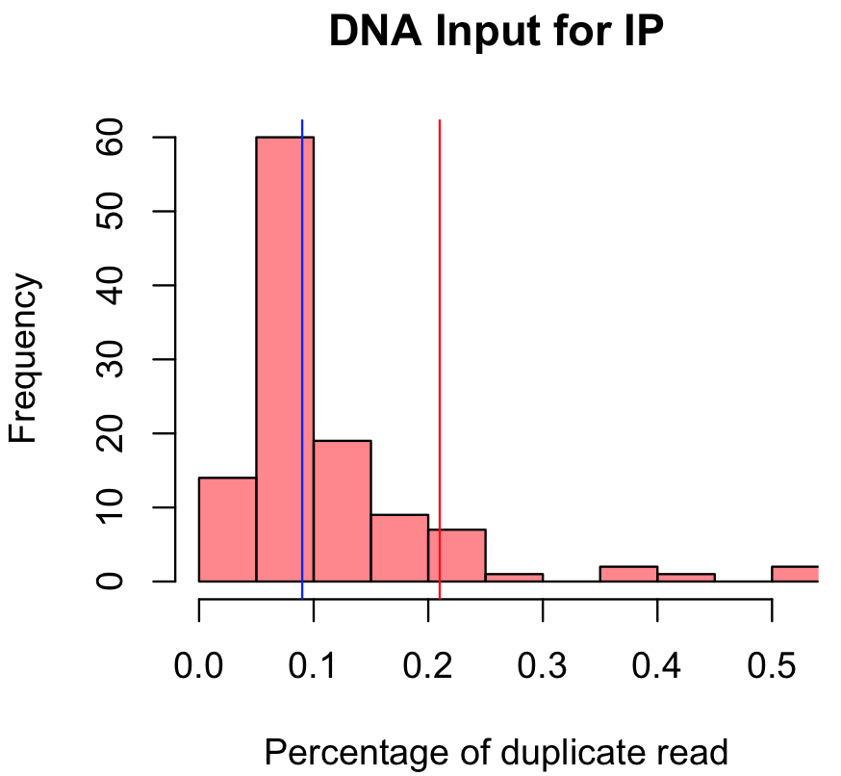
Caveats of using mock IP
Library complexity of mock IPs
Fraction of duplicate reads
Potential reason of low complexity in mock IP2
Vertical lines:
DNA input for mock IP 1
DNA input for mock IP 2

Slide 16
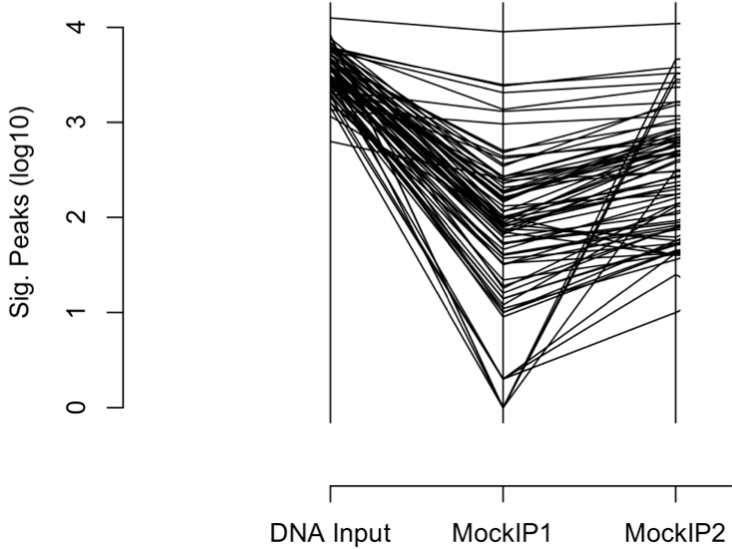
Impact of library complexity on peak calling
  Low library complexity reduce sig. peaks
Mock IP 2
Mock IP 1

Slide 17
Conclusion
Although with risk of low complexity, mock IP substantially increases discovery rate of bona fide binding peaks
Spurious peaks are prevalent even among the top peaks identified using DNA input control
Routine peak caller fails to identify significant amount of bona fide binding peaks
Other caveats: match btw IP and mock IP, e.g. development stages, fragment lengths
Worm and human ChIP-seq data will be analyzed an compared to fly

Slide 18
Developing peak caller for using mock IP
Down-weight mock IP to compensate for low library complexity
  Methods tried
    SPP with many tricks implemented => NO. of significant peaks: 331(median)/720(mean), for fly
    Poisson, Poisson-gamma, Fisher model, using p-value => all reduce significant peaks
  Methods ongoing
    Scale mock IP sequencing depth
    Remove noisy regions (based on p-value) before using IDR
    Use other peak callers, reportedly with high sensitivity, such as mosaics and music

