Slide 1
Suggested slides for the Baylor talk
Prashant Emani

Slide 2
Expression of genes is quantified by transcription: RNA-Seq measures mRNA transcript amounts
Genes (DNA)
Transcription
Regulation
RNA transcripts
Non-coding regulatory RNAs
Protein coding mRNA
Gene Expression measured by RNA-seq
Translation
Proteins
[ NATURE 459: 927; NAT. REV. GEN. 10: 57 ]

Slide 3
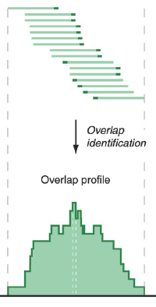
ATACAAGCAAGTATAAGTTCGTATGCCGTCTT
GGAGGCTGGAGTTGGGGACGTATGCGGCATAG
TACCGATCGAGTCGACTGTAAACGTAGGCATA
ATTCTGACTGGTGTCATGCTGATGTACTTAAA
Fastq sequence files
~5-10 GB
Index-building + Alignment to reference genome
BAM files
~1-2-fold reduction
Successive steps of Data Reduction
Conversion to signal track by overlapping reads
BigWig files
~25-fold reduction
Mapping to genes
Gene/Transcript expression matrix
~20-fold reduction
Quantitative information from RNA-seq signal: average signals at exon level (RPKMs)
Reads => Signal
[NAT. REV. 10: 57; PLOS CB 4:e1000158; PNAS 4:107: 5254 ]

Slide 4
Some Core Science Qs Addressed by RNA-seq
Gene activity as a function of:
Developmental stage: basic patterns and clusters of co-active genes across an organisms development
Evolutionary relationships: behavior preserved across a wide range of organisms; patterns and clusters in model organisms in relation to those in humans
Tissue- and cell-type: relationship of expression and specialized function
Disease phenotypes: disruption of patterns in disease
Individual variation: person-to-person discrepancies; personalized medicine
[ NATURE 512: 445 ]

Slide 5
The Data Exhaust
Key aspect of data science is creative analyses of the data
Not necessarily core purpose of the data
Mining the exhaust of the activity of many researchers generating large-scale data sets
An aspect of exhaust is the inadvertent compromising of study participants privacy

