Slide 1
ENCODE & Cancer Analysis of Rare Germline Variants
Lucas Lochovsky
E&C
2017-04-12

Slide 2
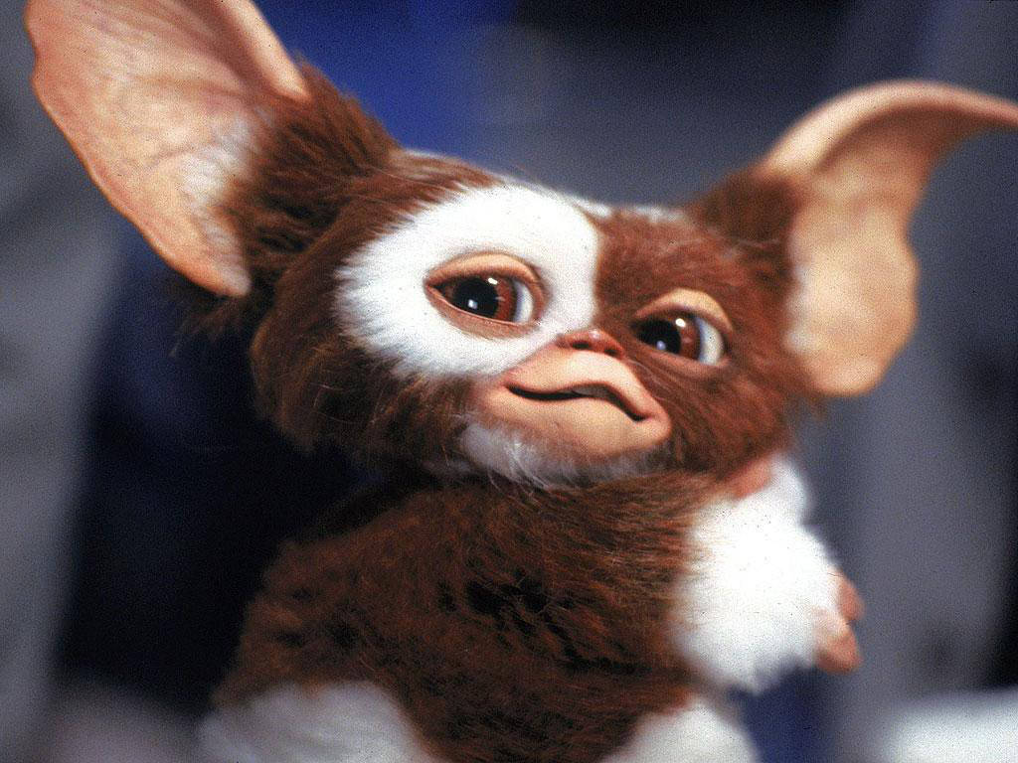
Note: Germline ≠ Gremlin

Slide 3
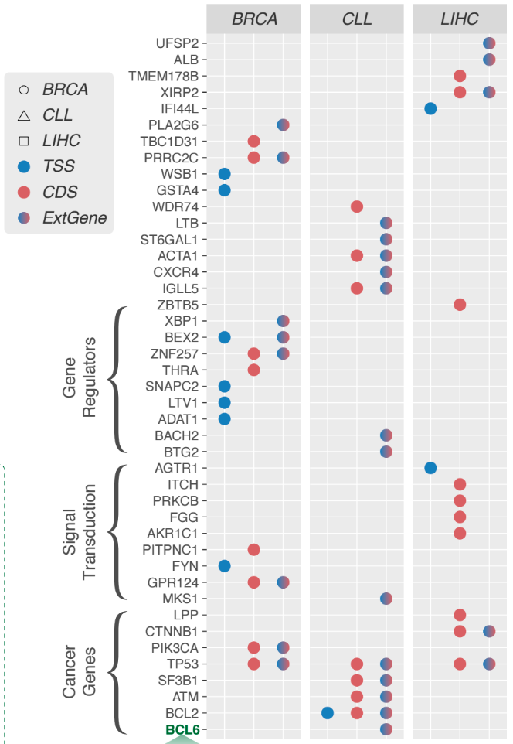
Overview
Starting with EBI liver germline variant calls
  ERP001196
  88 liver cancer samples
~4.1-4.2 million variants per sample
  Before blacklist and 1KG filtering
  After filtering, ~320,000 variants per sample
  Treat these as “rare germline variants”
See these genes over here?
  Let’s see how many samples have at least one rare mutation in these genes

Slide 4
And here’s what I found…

