Slide 1
Clonal Fitness

Slide 2
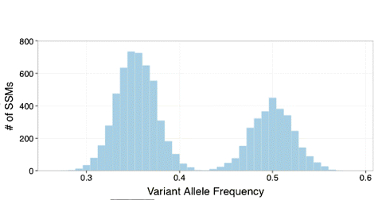
Calling Subclones

Slide 3
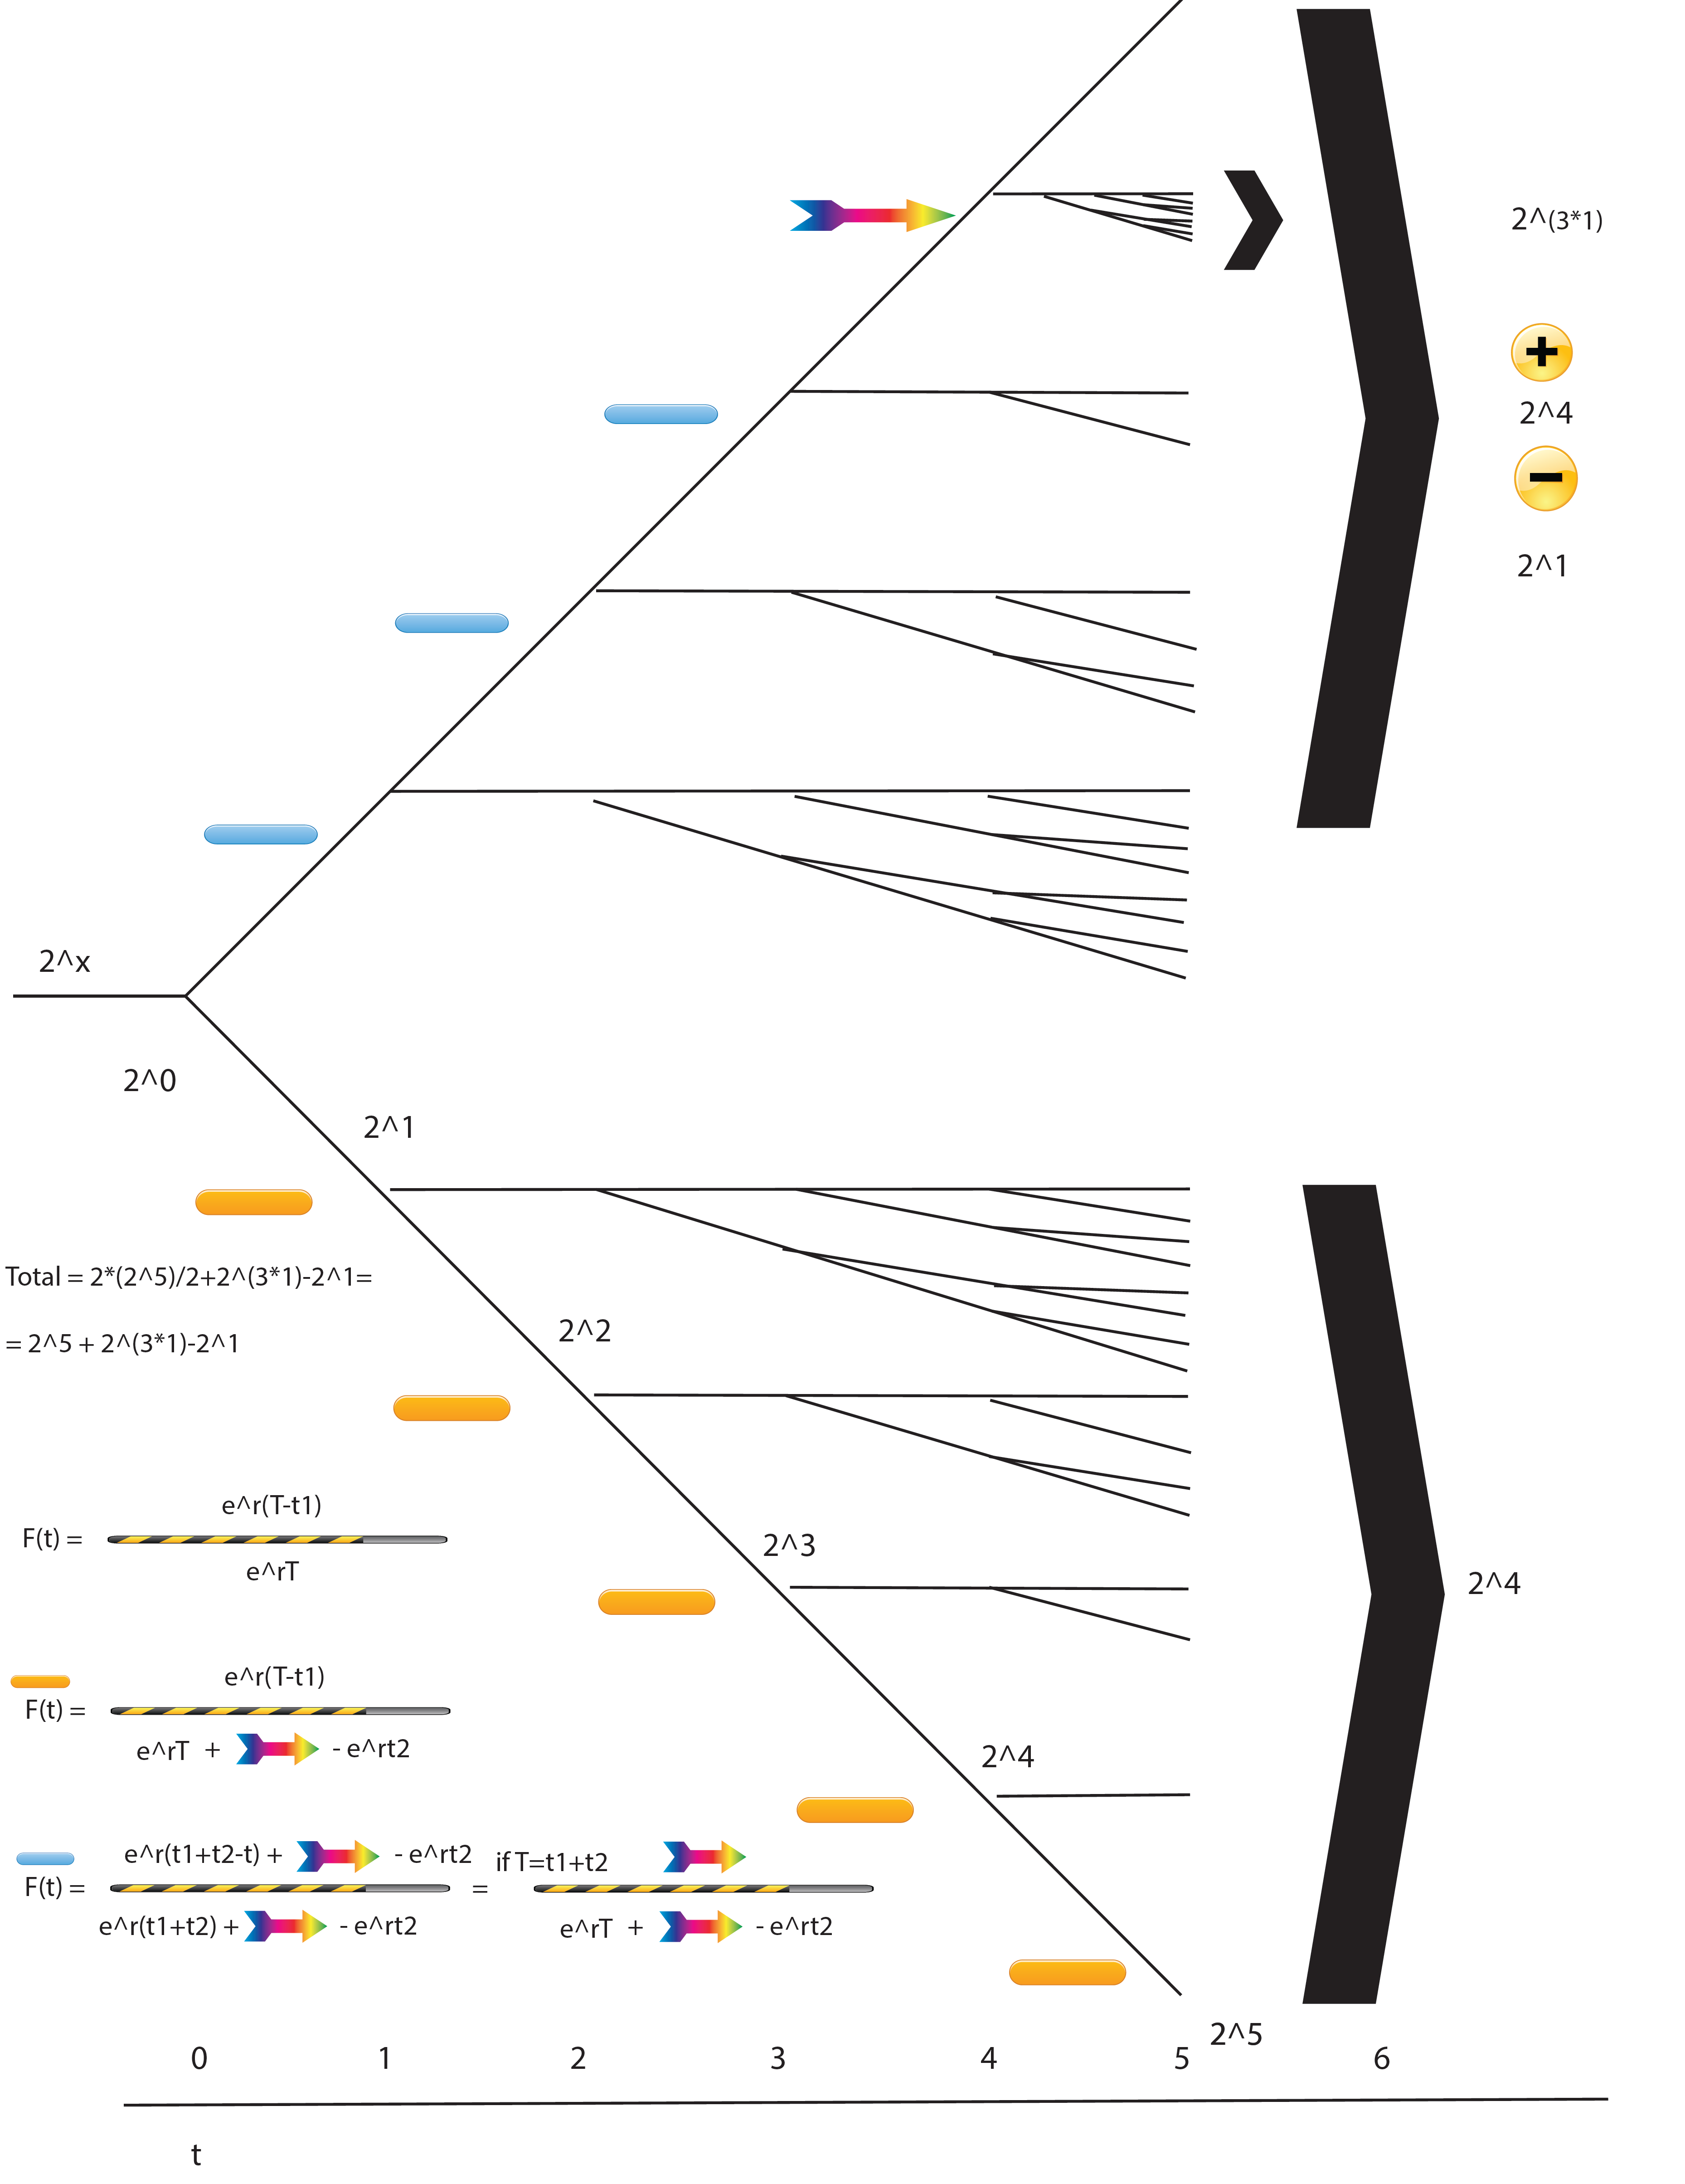

Slide 4
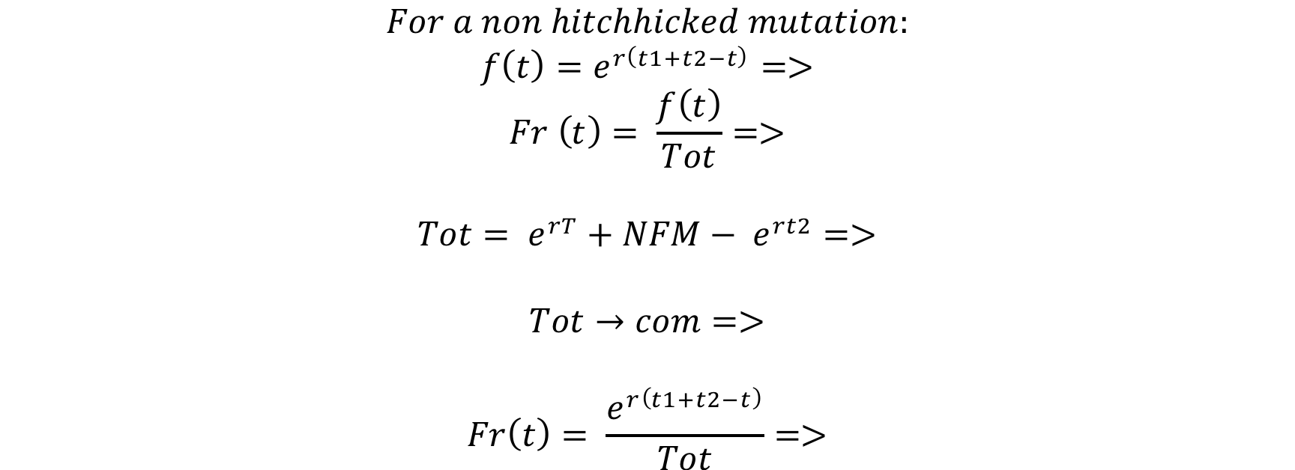
Green mutations with lower Freq

Slide 5
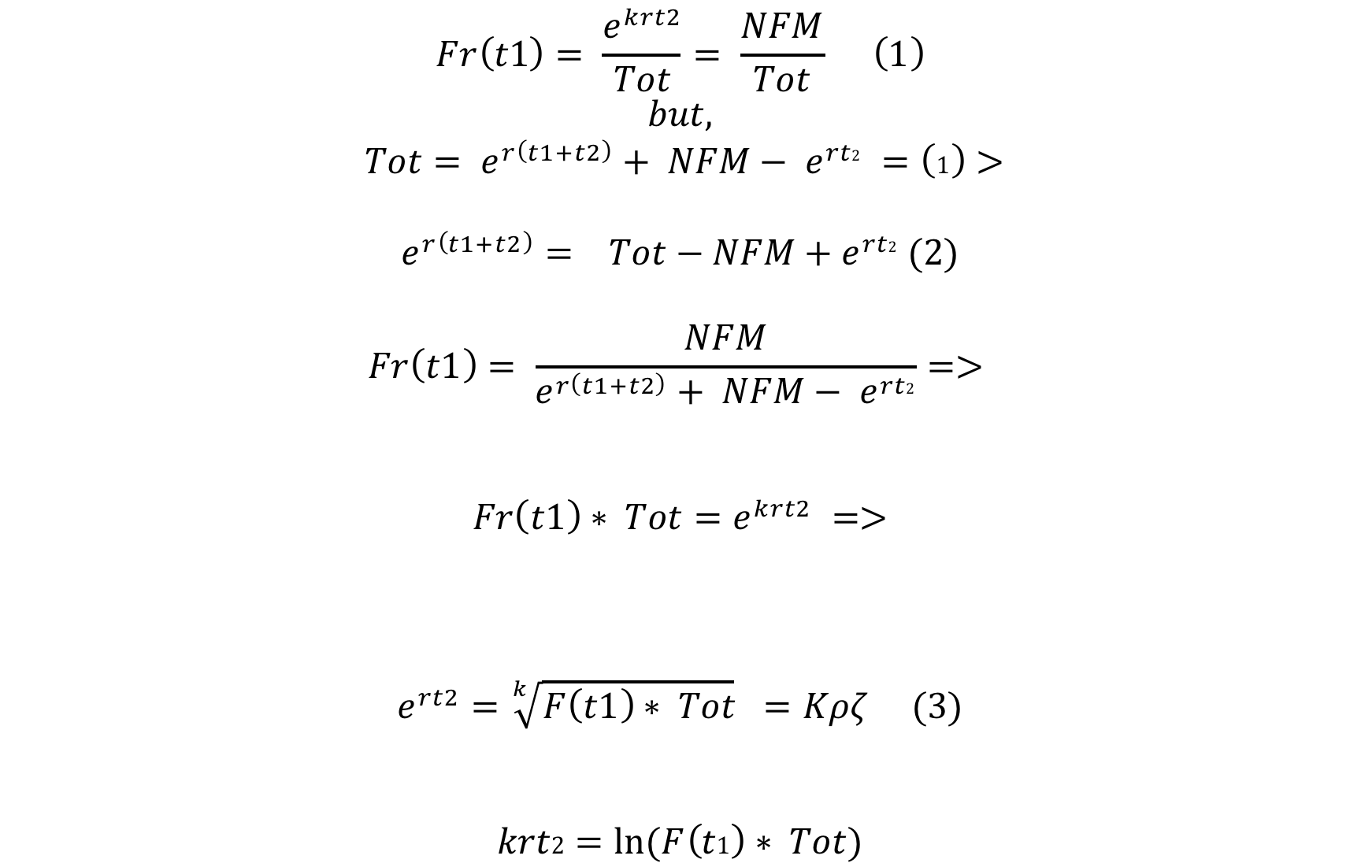
T=t1+t2, t1 the moment of driver mutation

Slide 6
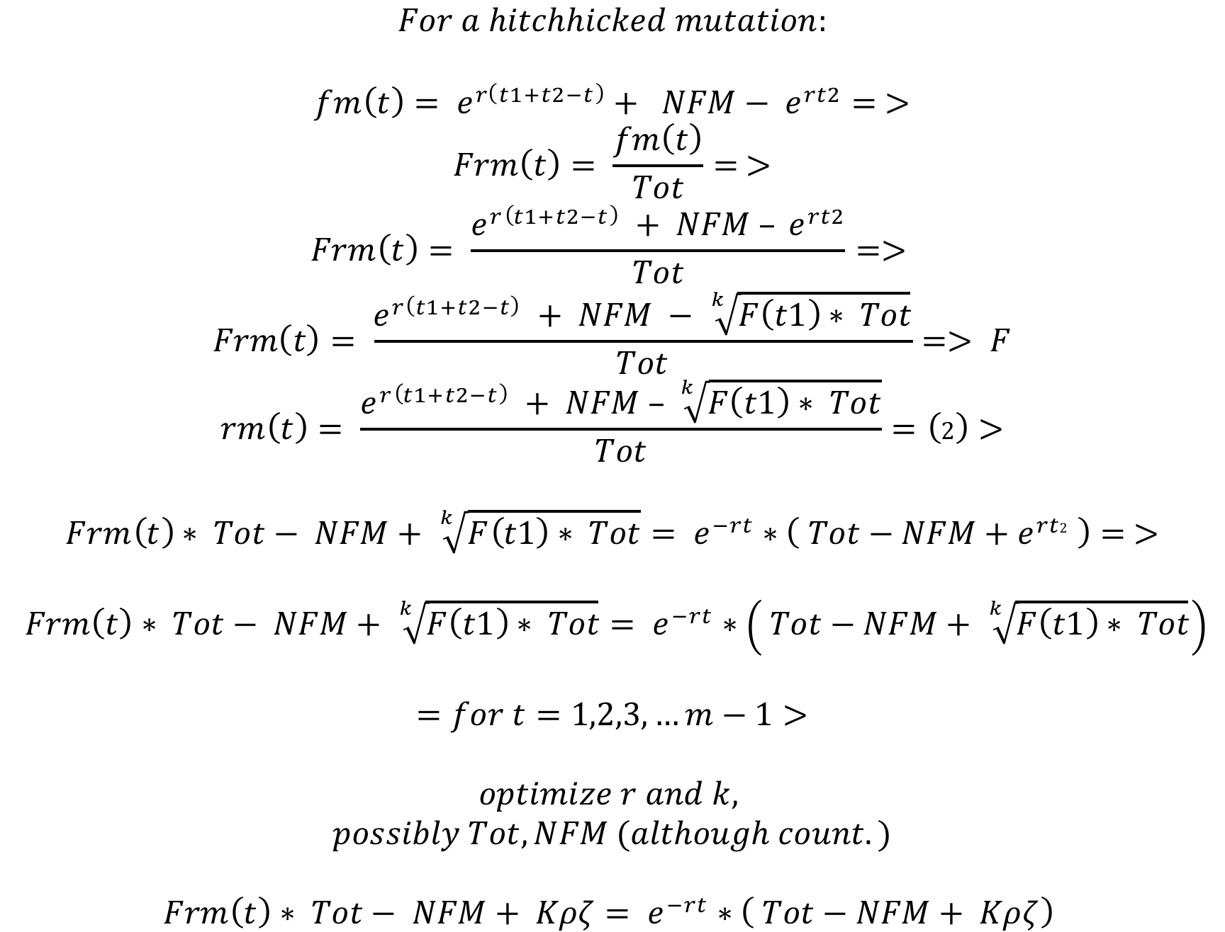
Hitchhiked mutations with higher Freq

Slide 7
Calling Subclones
Early Hitchhiked Mutations with Fitness r
New Fitness Mutations (NFM)
with fitness K*r
Mutations with fitness r
Subclone With Higher Fitness

Slide 8
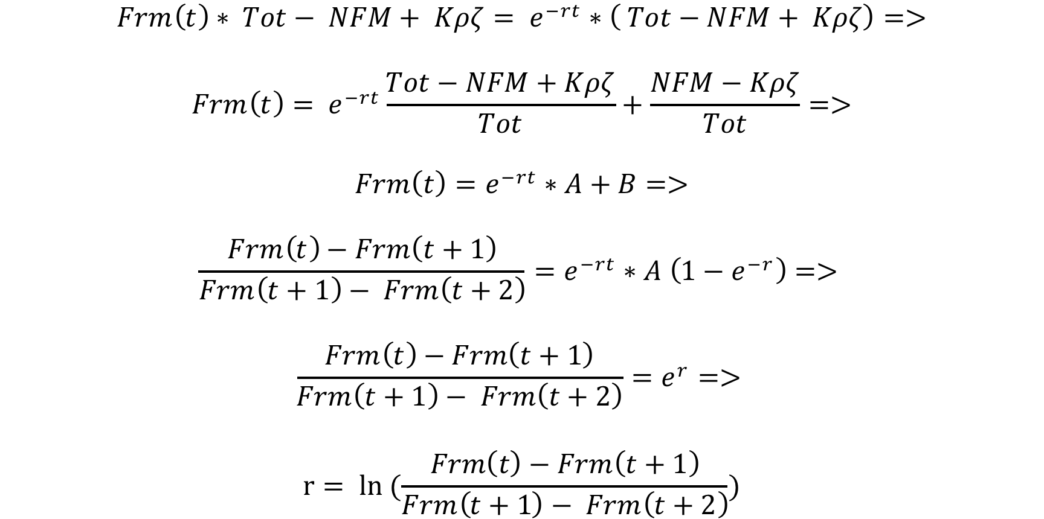
Sampling ‘r’ from hitchhiking freqs

Slide 9
Identifying the fitness mutation
Out of 1987 simulations
TPs:1983
FPs:850
TPrate(Sensitivity):0.998
FPrate(per sim):0.572

Slide 10
Estimating K from simulations
By calculating ‘r’ from hitchhike mutations
By optimizing the algorithm statistically to stop at best k
(So far the most stable to errors)
C) By sampling k that for well optimized ‘r’s
(Bayesian approach, obtain ‘k’ probability)

Slide 11
estimating fitness effect k and growth r
From hitchhike mutations
By optimizing the algorithm to stop at best k
  From 0 to n
  From n-x to n (local window frame)

Slide 12
Finding Fitness using TCGA data
Data liabilities:
Mutation identification (Tumor size)
Sequencing depth
Subclone assignment
Model fit optimization

Slide 13
Optimizing the model
A sliding frame of 100 ordered mutations for the dominant subclone
Determined the non-linear least squares estimates of the parameters of my model (using R::nls optimization)
Estimated
  K: the effect parameter
  r: the growth rate
  Re-estimation/optimization of subclone/Tumor size

Slide 14
Results look a bit like this:

Slide 15
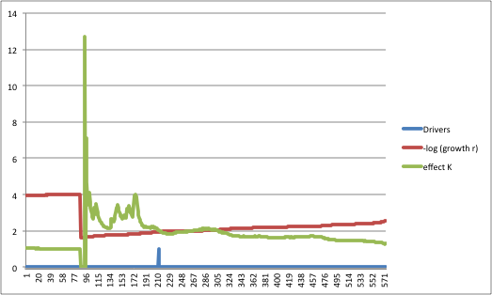
Or this:

Slide 16
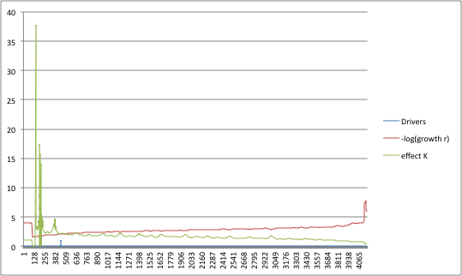
Or this:

Slide 17
Shifting?

Slide 18
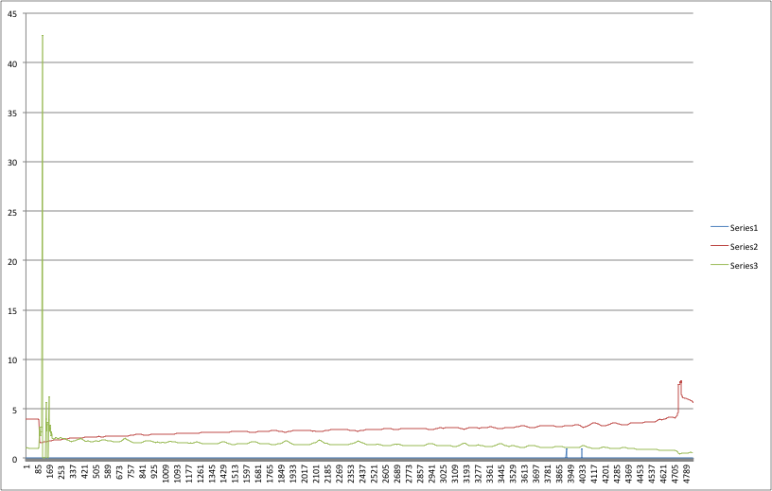
Wrong call?

Slide 19
Calling Subclones

Slide 21
Green mutations with lower Freq

Slide 22
T=t1+t2, t1 the moment of driver mutation

Slide 23
Hitchhiked mutations with higher Freq

Slide 24
Calling Subclones
Early Hitchhiked Mutations with Fitness r
New Fitness Mutations (NFM)
with fitness K*r
Mutations with fitness r
Subclone With Higher Fitness

Slide 25
Sampling ‘r’ from hitchhiking freqs

Slide 26
Identifying the fitness mutation
Out of 1987 simulations
TPs:1983
FPs:850
TPrate(Sensitivity):0.998
FPrate(per sim):0.572

Slide 27
Estimating K from simulations
By calculating ‘r’ from hitchhike mutations
By optimizing the algorithm statistically to stop at best k
(So far the most stable to errors)
C) By sampling k that for well optimized ‘r’s
(Bayesian approach, obtain ‘k’ probability)

Slide 28
estimating fitness effect k and growth r
From hitchhike mutations
By optimizing the algorithm to stop at best k
  From 0 to n
  From n-x to n (local window frame)

Slide 29
Finding Fitness using TCGA data
Data liabilities:
Mutation identification (Tumor size)
Sequencing depth
Subclone assignment
Model fit optimization

Slide 30
Optimizing the model
A sliding frame of 100 ordered mutations for the dominant subclone
Determined the non-linear least squares estimates of the parameters of my model (using R::nls optimization)
Estimated
  K: the effect parameter
  r: the growth rate
  Re-estimation/optimization of subclone/Tumor size

Slide 31
Or this:

Slide 32
Or this:

Slide 33
Shifting?

Slide 34
Wrong call?

Slide 35
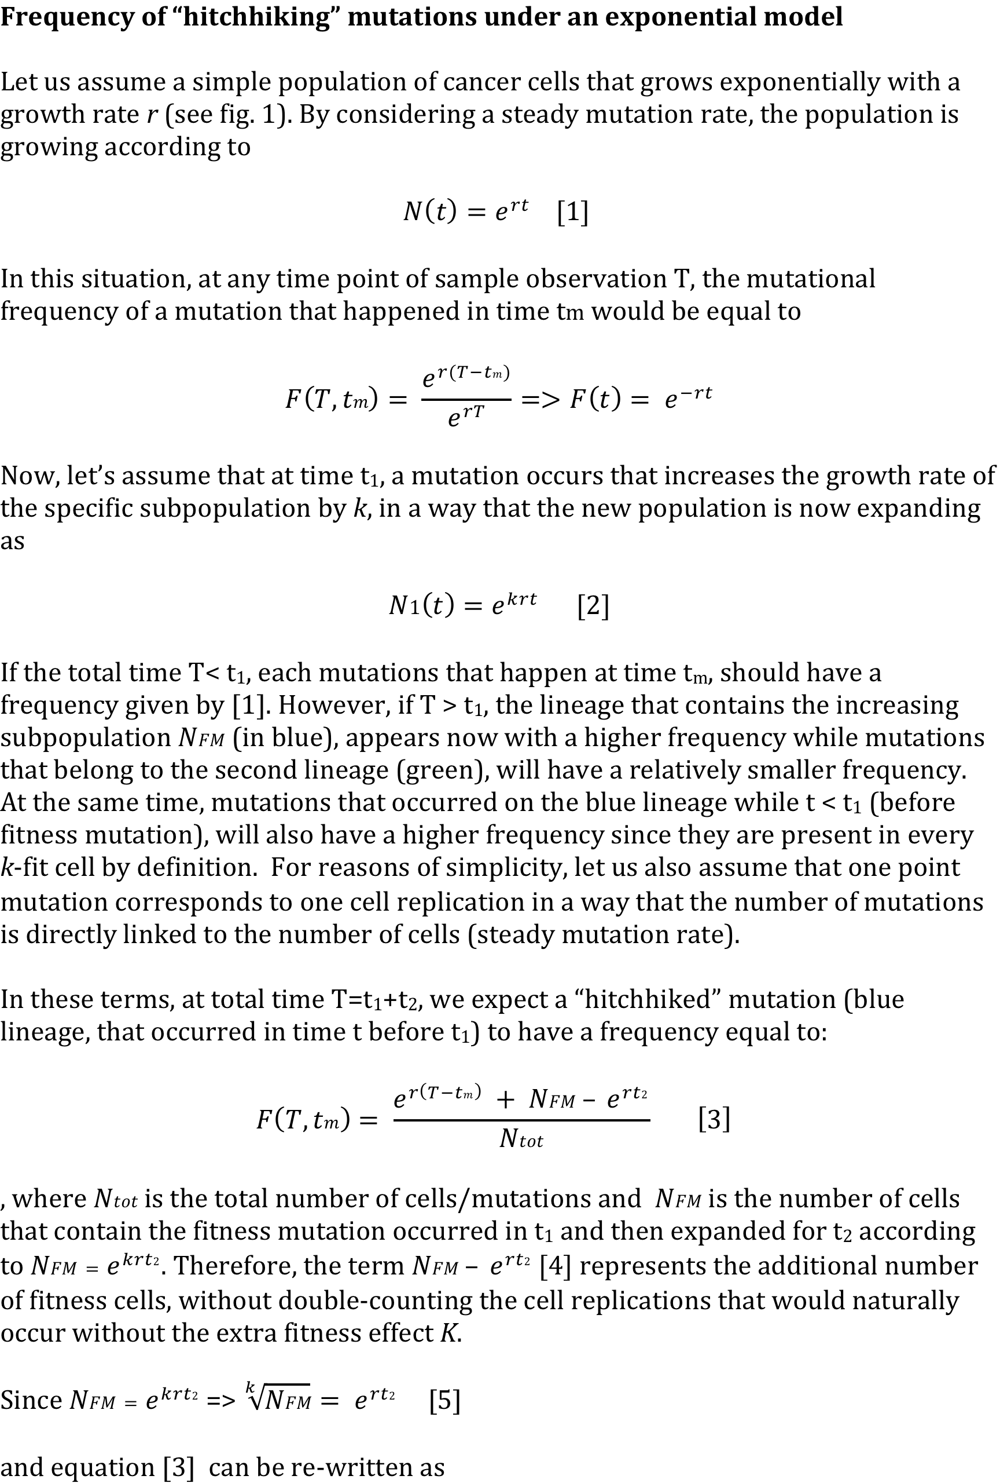
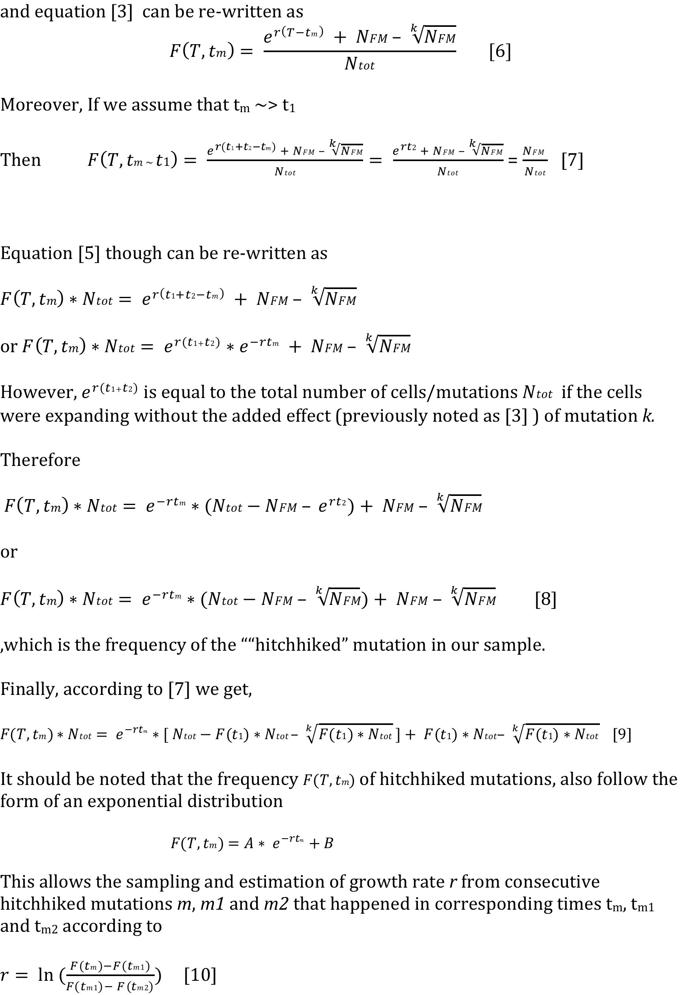
Τυμοr γroωtη μοδελ

Slide 36
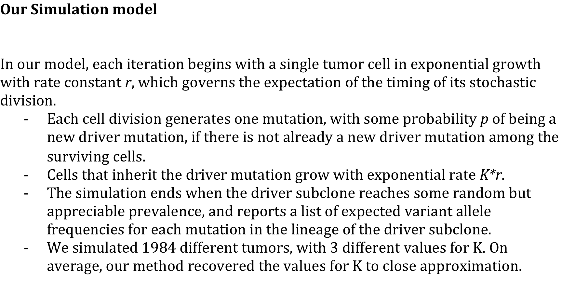
Simulation Model

Slide 37
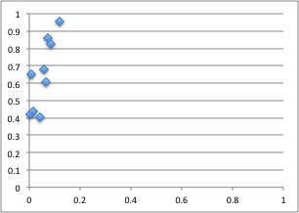
Accuracy and ROC
Roc curve
Sensitivity
1-Specificity
Run Type | Win | TP | TN | FP | FN | FDR | Accuracy | PPV | Sensitivity | Specificity | 1-Specificity
sig0.05win7wpo1 | 7 | 20 | 141 | 19 | 1 | 0.487 | 0.890 | 0.513 | 0.952 | 0.881 | 0.119
sig0.05win6wpo1 | 6 | 292 | 2646 | 242 | 62 | 0.453 | 0.906 | 0.547 | 0.825 | 0.916 | 0.084
sig0.05win5wpo1 | 5 | 1197 | 15458 | 1114 | 786 | 0.482 | 0.898 | 0.518 | 0.604 | 0.933 | 0.067
sig0.01win7wpo1 | 7 | 18 | 148 | 12 | 3 | 0.400 | 0.917 | 0.600 | 0.857 | 0.925 | 0.075
sig0.01win6wpo1 | 6 | 241 | 2724 | 164 | 113 | 0.405 | 0.915 | 0.595 | 0.681 | 0.943 | 0.057
sig0.01win5wpo1 | 5 | 799 | 15857 | 715 | 1184 | 0.472 | 0.898 | 0.528 | 0.403 | 0.957 | 0.043
sig0.01win6wpo0_wPC | 6 | 806 | 14371 | 65 | 1111 | 0.075 | 0.928 | 0.925 | 0.420 | 0.995 | 0.005
sig0.01win6wpo0_noPC | 6 | 872 | 14371 | 216 | 1111 | 0.199 | 0.920 | 0.801 | 0.440 | 0.985 | 0.015
sig0.05win6wpo0_wPC | 6 | 1240 | 14275 | 94 | 659 | 0.070 | 0.954 | 0.930 | 0.653 | 0.993 | 0.007

Slide 38
Predicting K effect
Real K
Median K
Predicted K
Window Size
REAL | 2 | 3 | 4
Win5 | 1.892415623 | 2.494610716 | 2.709028066
Win6 | 2.071445844 | 3.0969771 | 3.559152187
win7 | 2.41748917 | 3.924859052 | 4.266900055

Slide 39
Some Simulation results

Slide 40
Some Simulation results

Slide 41
Some Simulation results

Slide 42
Some Simulation results

Slide 43
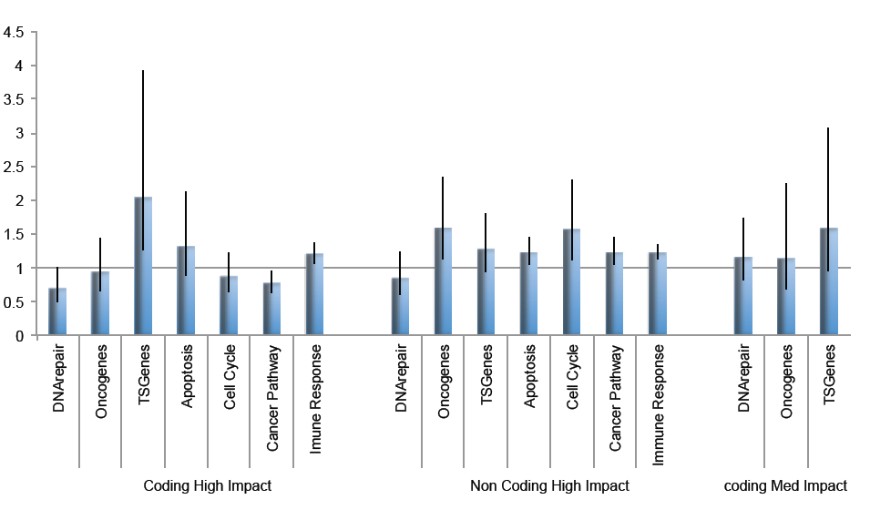
Using PCAWG data

Slide 44
Early TSG not predicted
Late prediction probably not real
Pcawg Driver
Pcawg Driver
Pcawg Driver
TSG region
Immune response
Immune response
Immune response

Slide 45
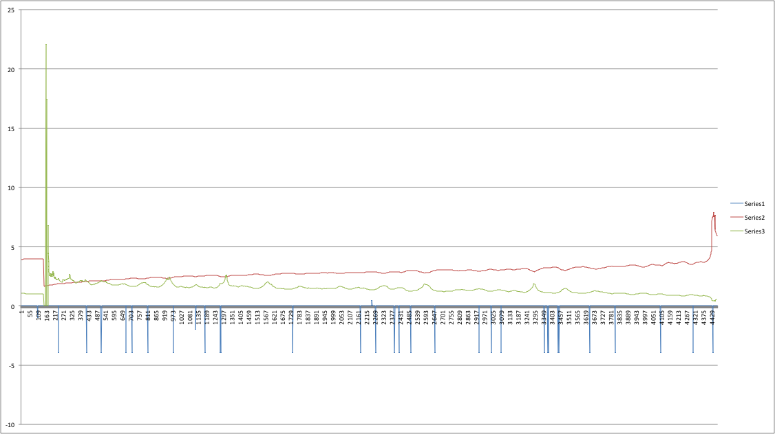
With impact mutations 01dc*
Early TSG not predicted

Slide 46
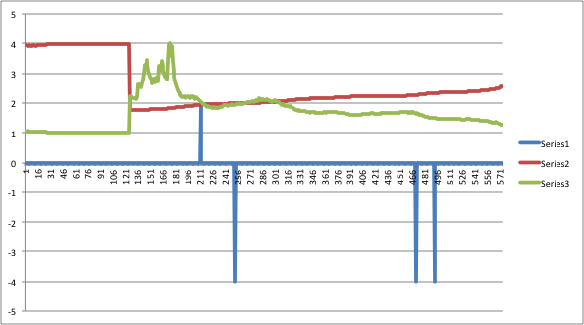
With impact mutations 0049*
-log(growth r)
PCAWG Driver
K effect
Immune response SNV
Immune response SNV
Immune response SNV

Slide 47
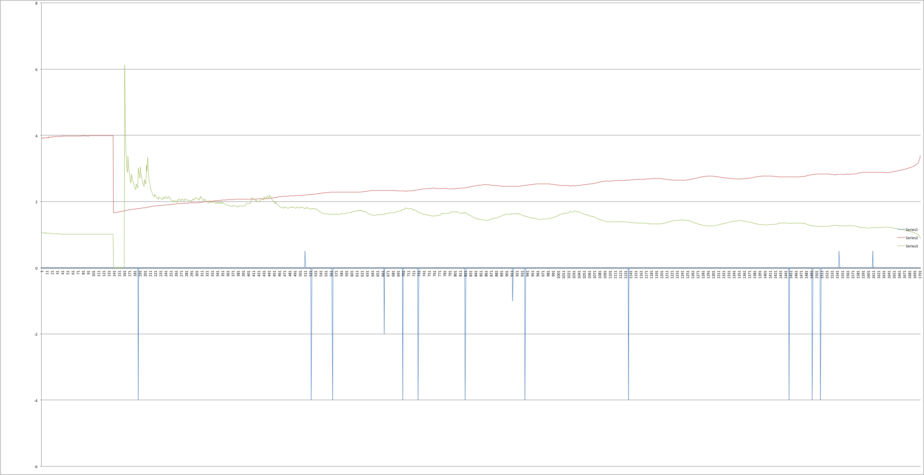
With impact mutations 00db*
-log(r)
driver
driver
driver
K effect
Tumor Suppressor Gene SNV
Oncogenic SNV
Oncogenic SNV
Immune response SNV
Immune response SNV

Slide 48
No data to validate peaks
-log(r)
driver
driver
driver
K effect
Tumor Suppressor Gene SNV
Oncogenic SNV
Oncogenic SNV
Immune response SNV
Immune response SNV

Slide 49
Or do we?
-log(r)
driver
driver
driver
K effect
Tumor Suppressor Gene SNV
Oncogenic SNV
Oncogenic SNV
Immune response SNV
Immune response SNV

Slide 50
To do with PCAWG data
Identify how many peaks we get per sample
  (ie ~how many “drivers” per sample)
Correlate number of peaks with number of high impact mutations in impact regions
Estimate the average k effect for different gene categories and compare to estimated effect from subclones

