Slide 1
Yale ChIP-seq updates
Gerstein Lab
04/14/2017

Slide 2
Study Name | Samples | Status
Yale-ASD | 36 | Finished processing and compared with UMASS results
UCLA-ASD | 285 | Received the hard drive from Singapore, data uploaded to our new cluster, fastq files organized according to metadata, start processing after Yale IPSC
Yale-IPSC | 124 | Got corrected sample ID, currently processing
Reference tissue (Sestan lab at Yale) | 23 | Finished processing
Notes:
18
288
10 reference tissue

Slide 3
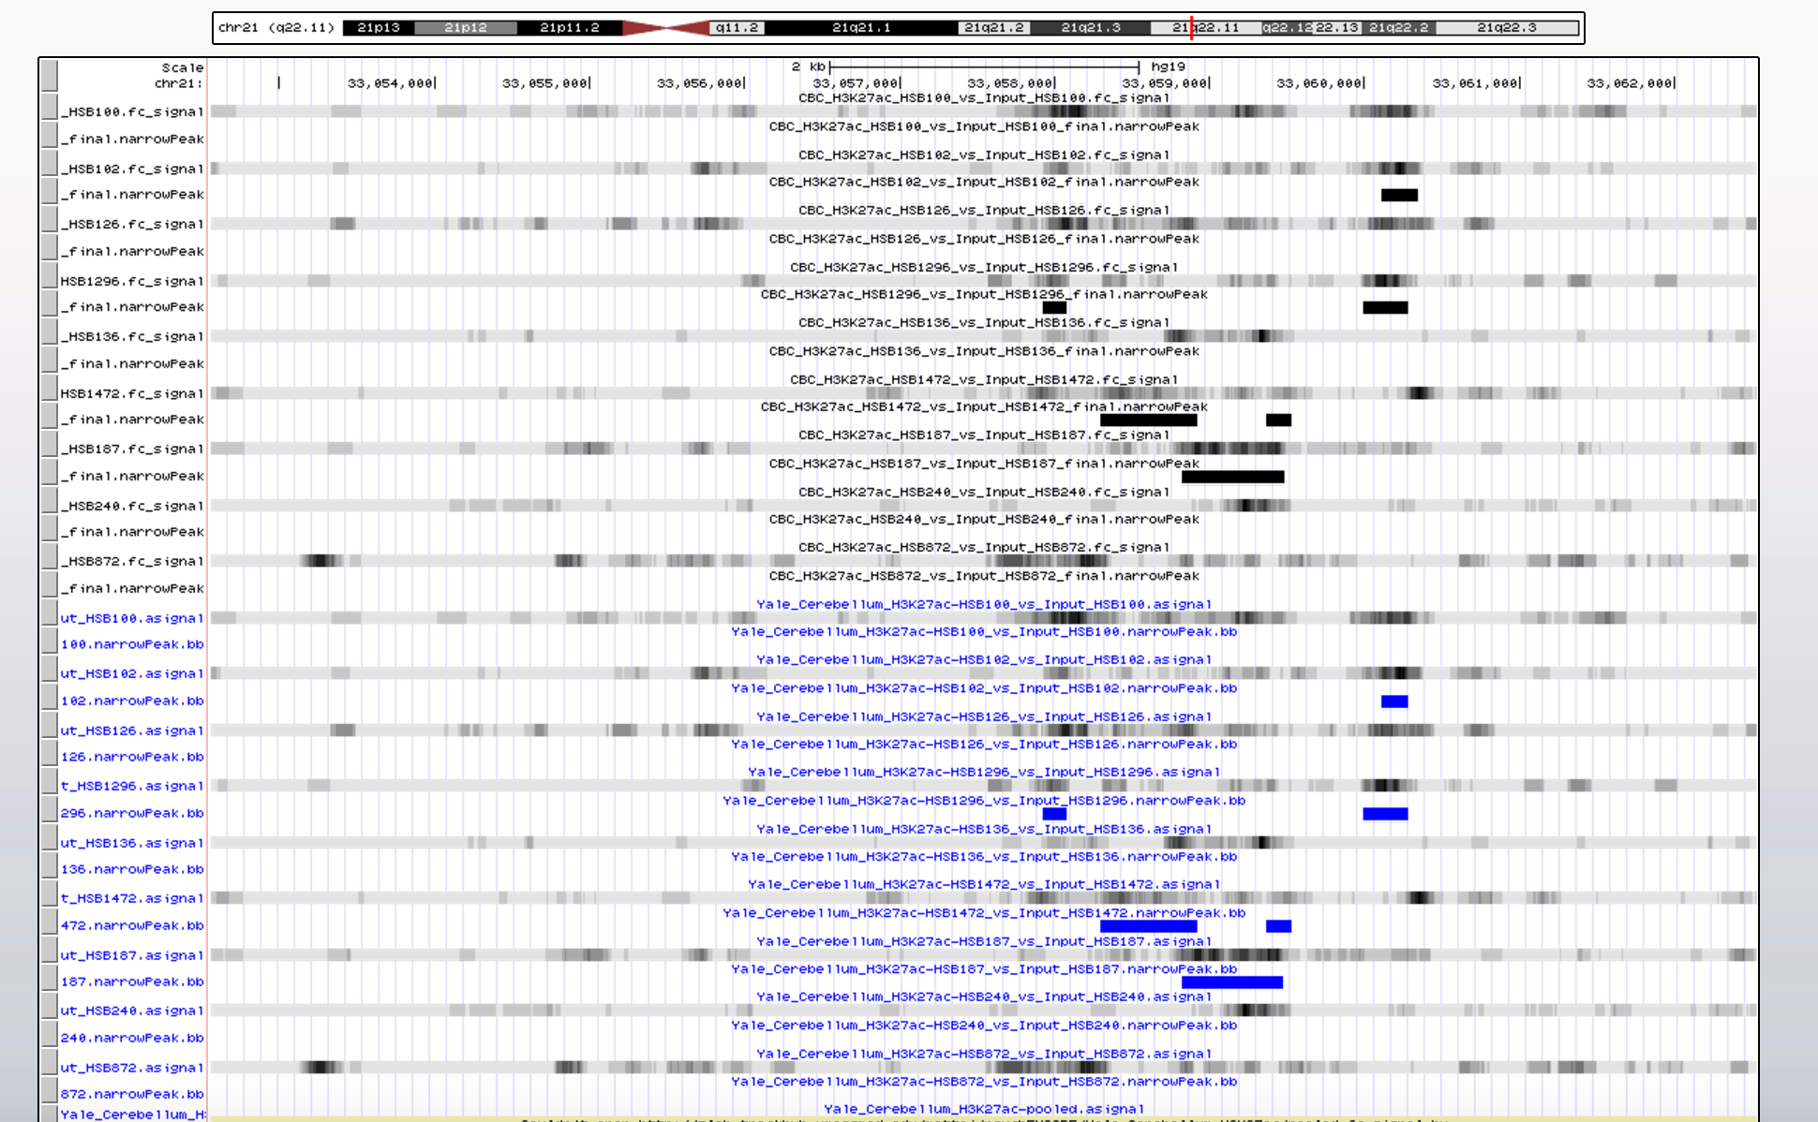
Yale site
UMass
site

Slide 4
Ongoing work and troubleshooting
Found differences in peak boundaries and a few called peaks (at least partially a result of down-sampling (?))
Eugenio (U Mass) has indicated that ChIP-seq pipeline results depend on choice of processor; constraining this in our current cluster job submissions
Processing Yale IPSC data for H3K27ac and H3K4me3 in batches

Slide 5
Brain “Connectome”: network of neuronal connections between brain regions
Central question: if there is a well-established set of connections between brain regions, maybe gene expression in a region is impacted by the nature and number of contacts (some sort of equilibrium?)
Contacts are not necessarily between spatially proximal regions
Researchers at the Allen Institute published a mesoscale connectome of the mouse (Oh et al., Nature (2014) 508: 207)
Used AAV vectors to label synaptic connections using EGFP; 469 injections into 295 non-overlapping structures
Images were used to quantify number of connections from injection site to all other regions

Slide 7
Connection strength map between regions (not injection sites) Could potentially use this matrix to see if there is any impact on gene expression

