Slide 1
Co-Expression Network Analysis of Asthma Samples
Heidi Sofia
By Brian Barron
Mentored by Koon-Kiu Yan
Notes:
Introduction: Name and YSM Student
Project: 6 months; KK pitched idea -> reanalyze the microarray data -> switch from gene-by-gene analysis to network analysis to see if anything came up

Slide 2
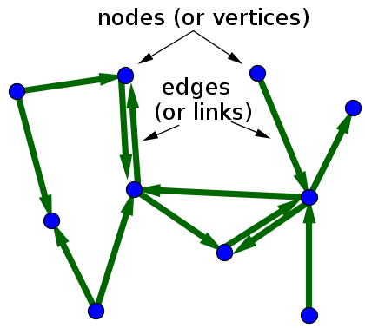
What is Network Analysis?
Network analysis focuses upon the interactions of genes between each other, instead of gene-by-gene comparisons.
A network is a collection of objects (nodes) that are connected together (via edges, which can have direction and/or weight).
In our study, nodes are genes, and edges are undirected with weights proportional to their Topological Overlap (TOM).
Genes that are highly co-expressed (i.e., close to each other) form modules (smaller clusters) that may reflect regulatory groups implicated in the pathophysiology of asthma.
Notes:
Read slide
Show schematic
Group on the left -> immune system genes
Image Citation:
Nykamp DQ, “Small directed network with labeled nodes and edges.” From Math Insight. http://mathinsight.org/image/small_directed_network_labeled

Slide 3
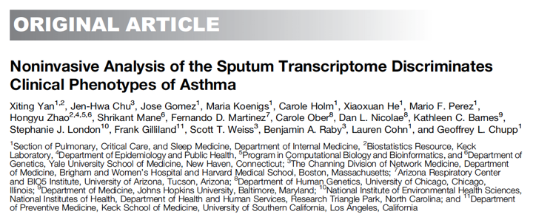
The Data Set
Heidi Sofia
112 microarray samples (100 asthma, 12 control)
18,309 genes total on Affymetrix 1.0 ST gene array
Clinical information for each sample
3 separate “TEA clusters” (transcriptional profiles) were present in the asthma samples.
Notes:
Read slide
Why not RNA-Seq?
Not many samples
Quality not good, a lot of QC
Multiple persons processing the data..

Slide 4
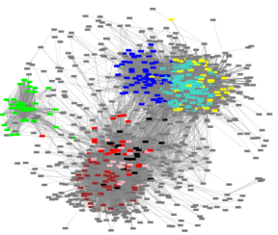
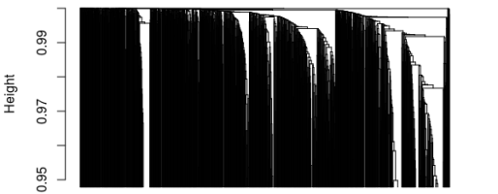
Identify Modules
Weighted Gene Co-expression
Network Analysis (WGCNA)
Langfelder BMC Bioinformatics 2008
Top 1,500 differentially expressed genes (DEGs) between asthma and control.
Heidi Sofia
Notes:
WGCNA: Give expression values, calculate different networks on different parameters, and determine relevant modules
Supervised WGCNA to see relationship between DEGs

Slide 5
Module Eigengenes and Representative Genes
A Module Eigengene (ME) may be thought of as the “average expression” of genes within a module (across samples).
A high eigengene value for a particular sample indicates that, on average, the genes belonging to that module are highly expressed.
Representative Genes are those genes with high module membership (i.e., highly correlated with the ME).
ME
Expression
1 2 3 4 5 6
Genes
Notes:
Once we know the modules, we want to know how well is each sample type (asthma vs control) represented by the module? -> ME
What gene best represents the module? -> Representative Gene

Slide 6
Module Constituents
Module | GO enrichment | Representative Gene
Blue | virus response, interferon | RNF213 (Ubiquitin Ligase)
Yellow |  | NBPF14
Turquoise | Immune system | LCP2 (T-cell receptor signaling)
Green | Exosome | ECM1 (extracellular matrix prot)
Red |  | YDJC (deacetylates)
Brown |  | OSBPL7 (Oxysterol binding)
Black |  | HNMT (histamine degradation)
Plink |  | NHLRC2
Notes:
9 modules
LCP2 <- Th2, T-cell mediated recruitment of leukocytes
OSBPL7 <- oxysterol (oxidized cholesterol, corticosteroids)
HNMT <- histamine degradation (implicated in asthma; mast cell degranulation)

Slide 7
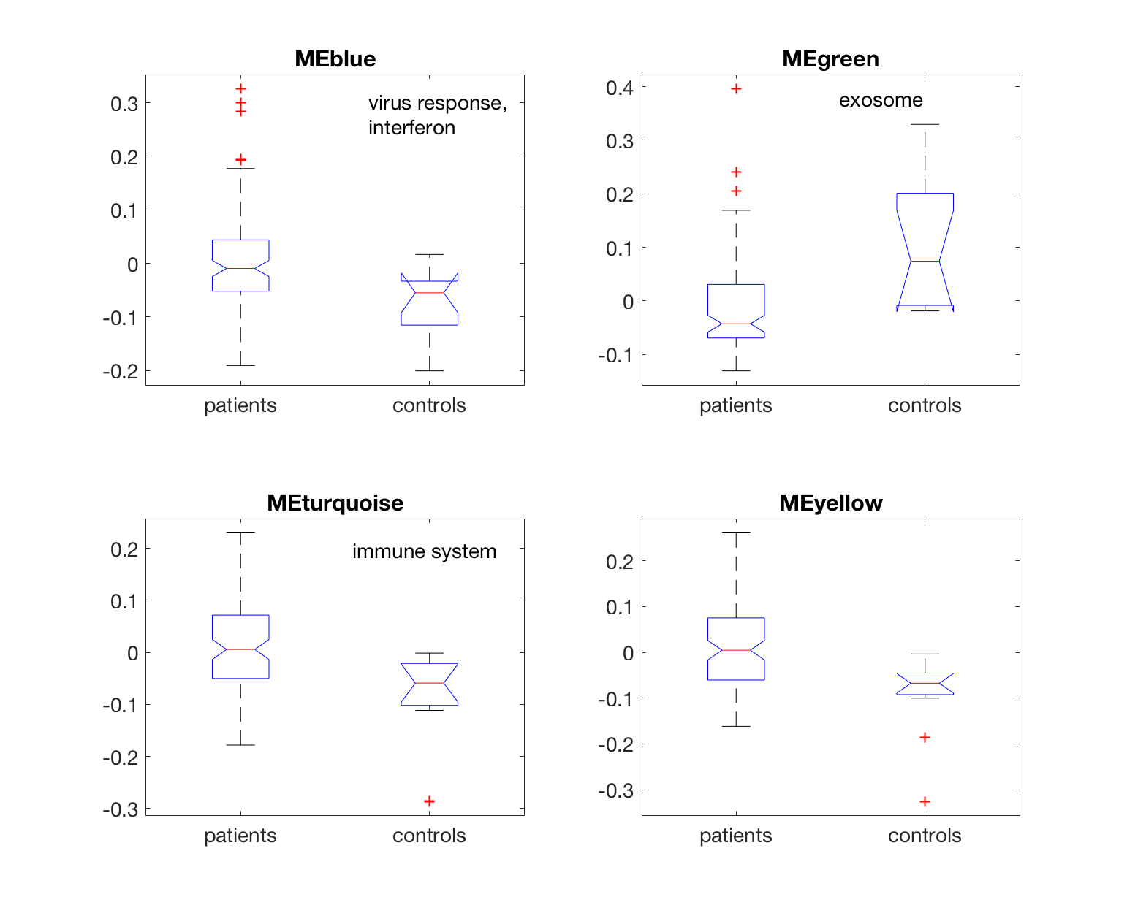
Module Eigengenes Separate Patients and Controls
Notes:
Modules can separate asthma patients from controls.
MEblue and MEturquoise higher in asthma vs control (immune activation is higher -> as predicted).
1. We compare the eigengene components at controls and patients. For modules related to immune system and virus response, the components in patients are higher than controls. For modules related to exosome, we see an opposite effect. If I understand correctly, exosome carries the bad things out of the cells, supposed to be more for normal function.

Slide 8
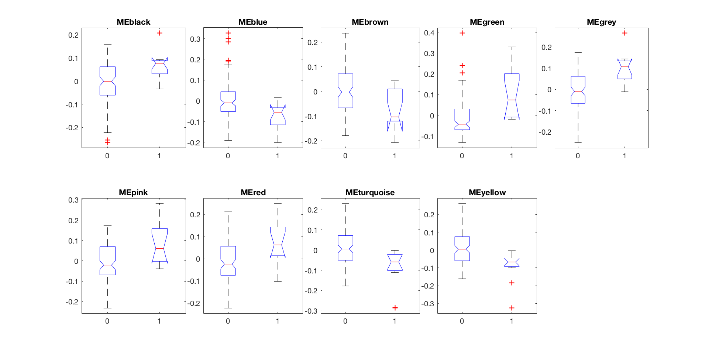
Module Eigengenes Separate Patients and Controls
0: asthma
1: control

Slide 9
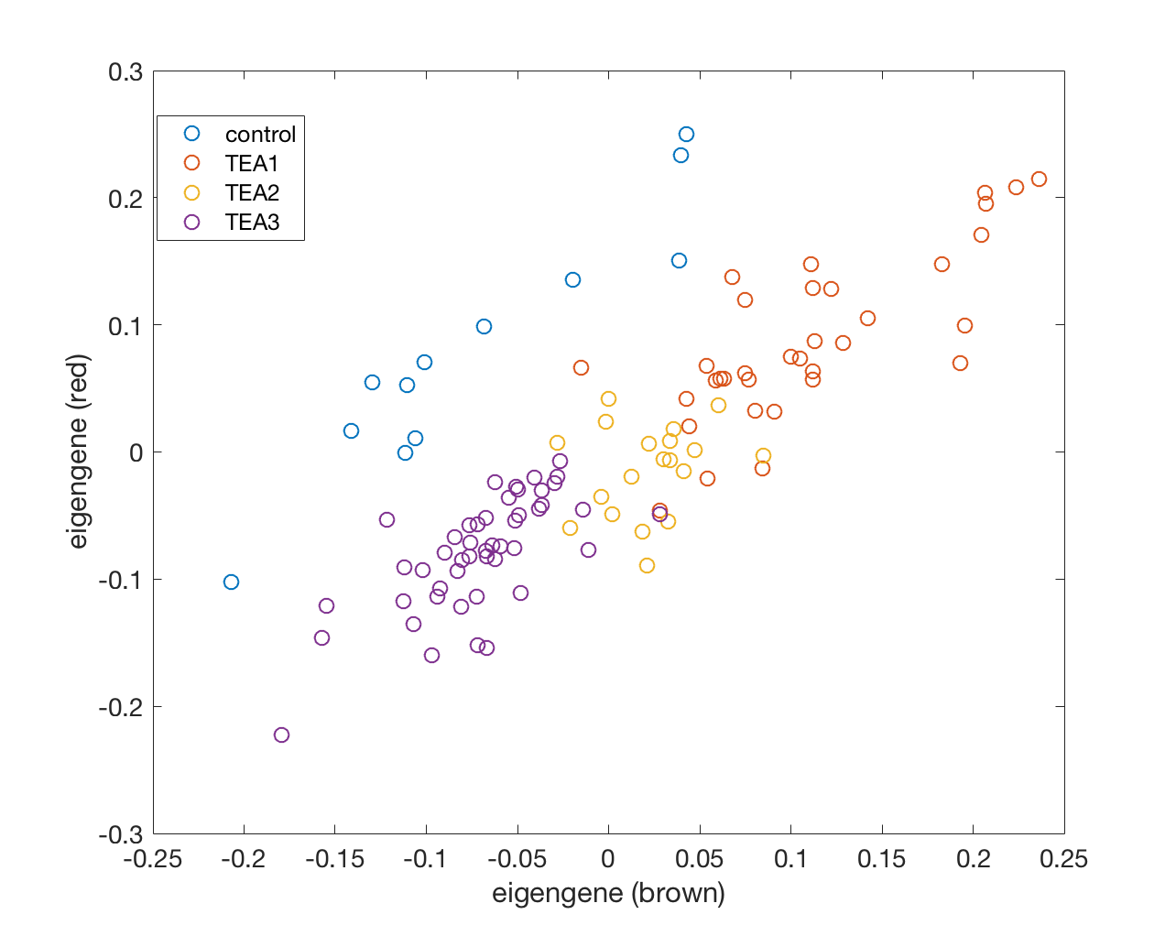
Module Eigengenes Can Predict / Refine TEA Clusters
Notes:
What happens if we combine the information from two modules? Can we further illustrate the differences?
Asthma samples separate from control
The asthma samples seem to form a continuum reflecting the TEA clusters mentioned before
How about the other eigengenes? Here we plot the eigengenes of two modules red and brown. The controls are actually quite well separated from the patients. Our collaborator before used a more curated approach to divide the patients into two clusters. Here, we see our eigengenes are closely related to their divisions, forming a continuum. Also, we see the eigengene is highly correlated with certain clinical measures, like the FEV1 (forced expiratory volume) (more is better). It is interesting that the different patients have different level of FEV1, but well captured by the eigengenes.

Slide 10
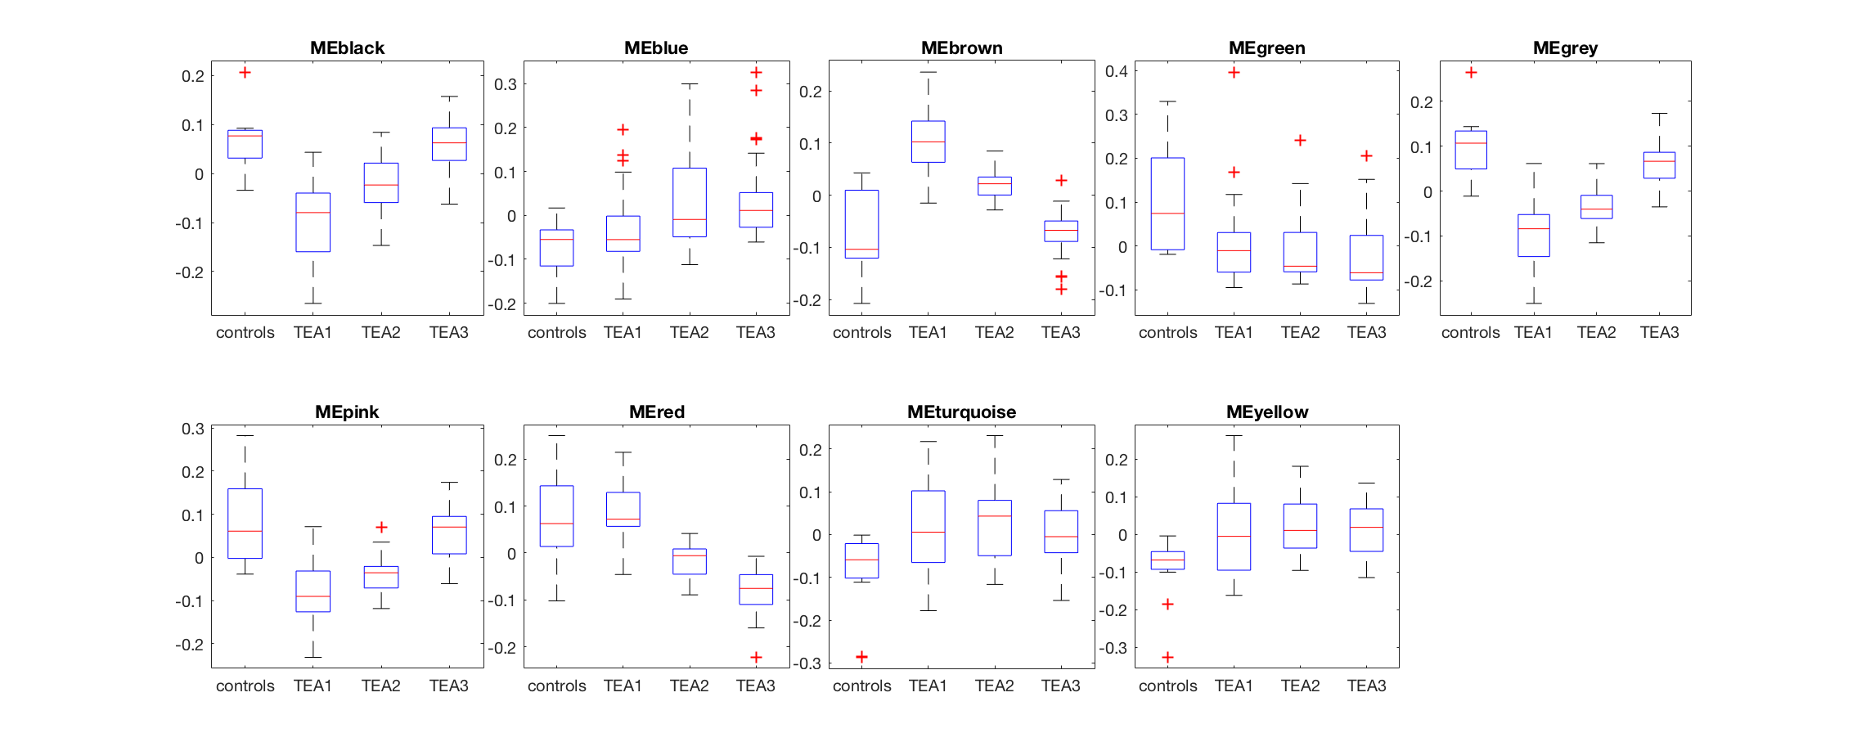
Module Eigengenes Can Predict / Redefine TEA clusters

Slide 11
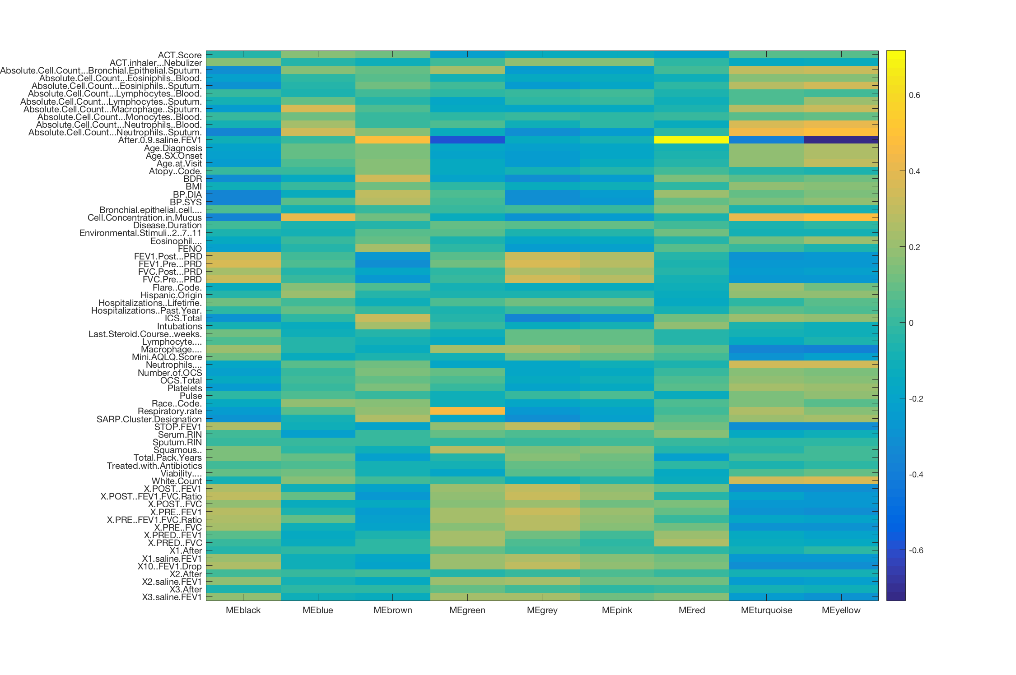
Eigengenes vs Clinical Features
air forcibly expirated 1s
Virus response
Exosome
immune system
Notes:
At the end of the day, we are interested in what can these modules tell us about the pathophysiology or severity of asthma that patients have?
Asthma is characterized by reversible airway obstruction, inflammation, and excess mucus production, commonly precipitated by environmental “triggers” (e.g. cold, allergens, etc.).
Look for problems with obstruction (reduction in FEV-1/FVC), inflammation (leukocyte count sputum), and BDR
The severity of asthma can be measured by the reduction in airway flow during an asthmatic episode.
The FEV-1/FVC Ratio should be < 0.80 with a normal TLC.
FEV-1 measures the amount of air forcibly expired in 1 second (inversely related to airway resistance).
Asthma may be treated with beta-agonists and corticosteroids.
BDR (BronchoDilator Response) measures the amount of obstruction corrected by the relevant treatment.

Slide 12
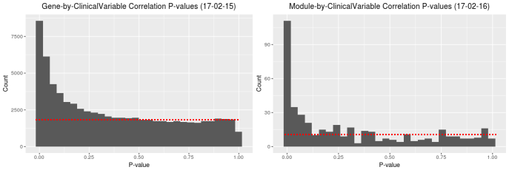
Modules are Better Biomarkers than Individual Genes
Lower FDR
Notes:
Before we go into specifics, we should compare the predictive capabilities of the module comparison.
LHS: Look at all individual genes, and their correlation with our clinical measures.
RHS: module genes and their correlation with clinical measures.

Slide 13
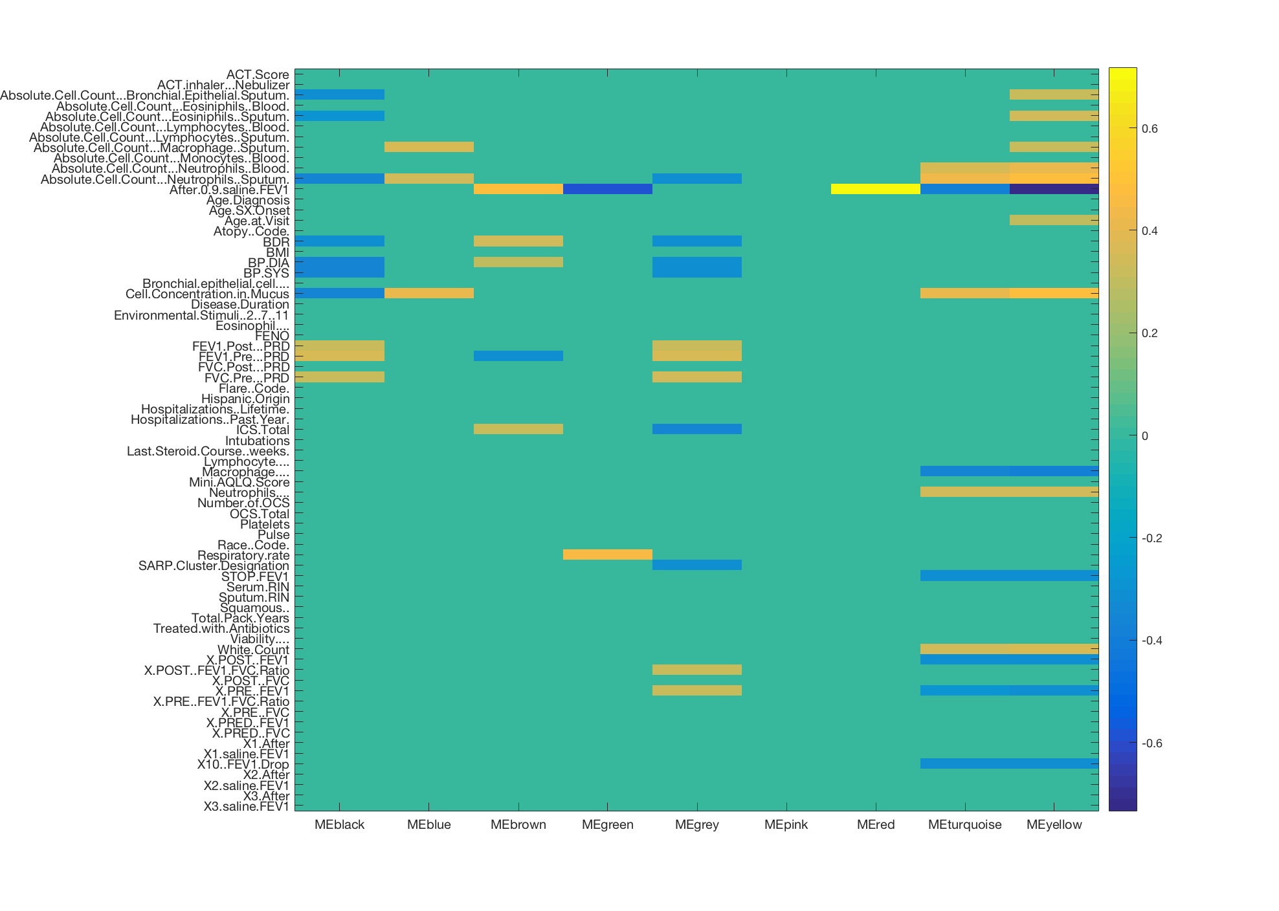
Eigengenes vs Clinical Features
bronchodilator response
Virus response
Exosome
immune system
Notes:
Notes:
Correlations with q<0.01 are represented
Important Correlations: (1 most severe -> 3 least severe)
BDR: MEbrown (+) correlated with BDR (Paper: TEA1 best response -> TEA3, then control) => brown module shows the same relationship; inverse relationship holds true for the black and grey modules
White Count: MEturquoise and MEyellow (+) correlated with sputum white cell count and neutrophil counts (turquoise showed enrichment for immune system processes, and was elevated in asthma patients [with TEA2/TEA3 highest]); MEyellow also has elevated levels eosinophils & macrophages & bronchial epithelium
Cell Concentration in Mucus: (+) with MEblue, MEturquoise, and MEyellow (inflammatory state), (-) with Meblack
FEV-1: MEbrown and MEred (+)
After 0.9 Saline FEV1
BDR
Cell Concentration in Mucus
Neurophils (acute inflammation)
White Count

Slide 14
Points Worth Highlighting
Analysis: Transition from individual genes to networks & modules
Module Eigengenes (MEs) can be used to look at the heterogeneity of asthma patients:
redefine the TEA clusters
correlate with clinical parameters
MEs have the potential to be biomarkers (lower FDR).
The same analysis could be repeated with the bulk RNA-Seq data.
This analysis is currently underway.

Slide 15
The End! Thank You
15

Slide 16
Module Clinical Correlations, Pt. 1
Module | Clinical Variable | Correlation | P-Value
Grey | BP.SYS, BP.DIA FEV1.Pre, FEV1.Post, FVC.Pre X.PRE..FEV1, X.POST..FEV1.FVC.Ratio BDR | -0.32, -0.32 0.37, 0.33, 0.34 0.32, 0.31 -0.32 | 6.73e-04, 4.96e-04 5.17e-05, 3.96e-04 5.94e-04, 8.79e-04 6.15e-04
The Grey Module (“background” DEGs) is correlated with lower blood pressure, lower airway resistance, and reduced response to bronchodilator agents.
NOTE: The grey module is best represented in control and TEA #3.
This result is consistent with the (Yan et al., 2015) paper, which showed that control and TEA #3 had the LOWEST BDR.

Slide 17
Module Clinical Correlations, Pt. 2
Module | Clinical Variable | Correlation | P-Value
Black | BP.SYS, BP.DIA FVC.Pre, FEV1.Pre, FEV1.Post BDR Cell.Concentration (Mucus) | -0.35, -0.36 0.33, 0.36, 0.31 -0.32 -0.36 | 1.45e-04, 1.01e-04 4.12e-04, 1.21e-04, 8.61e-04 5.23e-04 1.15e-04
Brown | BP.DIA After.0.9.saline.FEV1, FEV1.Pre BDR | 0.31 0.49, -0.32 0.35 | 9.86e-04 5.79e-08, 6.13e-04 1.82e-04
Green | After.0.9.saline.FEV1 Respiratory Rate | -0.59 0.46 | 1.26e-11 3.75e-07
Pink
Red | After.0.9.saline.FEV1 | 0.72 | 5.95E-19
The Brown Module (high in TEA#1, low in control) was positively correlated with BDR, which mirrors the (Yan et al., 2015) paper (BDR highest in TEA#1 and lowest in control).
The Green Module (GO enrichment for exosome) was positively correlated with the basal rate of breathing.
The Black Module was negatively correlated with mucus cell concentration.
Notes:
Q-value?

Slide 18
Module Clinical Correlations, Pt. 3
Module | Clinical Variable | Correlation | P-Value
Blue | Cell.Concentration (Mucus) | 0.41 | 5.88e-06
Turquoise | X.PRE..FEV1, X.POST..FEV1 After.0.9.saline.FEV1, STOP.FEV1, X10..FEV1.Drop Cell.Concentration.in.Mucus, White.Count Mucus: Macrophage, Neutrophils Blood: Neutrophils | -0.30, -0.30 -0.38, -0.30, -0.32 0.41, 0.34 -0.35, 0.35 0.36 | 0.0012, 0.0011 3.03e-05, 1.2e-02 7.13e-06, 2.89e-04 1.60e-04, 1.32e-04 9.34e-05
Yellow | X.PRE..FEV1, X.POST.FEV1 After.0.9.saline.FEV1, STOP.FEV1, X10..FEV1.Drop Cell.Concentration.in.Mucus, White.Count Mucus: Macrophage, Neutrophils Blood: Neutrophils | -0.31, -0.31 -0.73, -0.32, -0.32 0.486, 0.36 -0.39, 0.35 0.40 | 8.54e-04, 7.34e-04 3.82e-20, 8.00e-04 5.29e-08, 8.92e-05 2.09e-05, 1.58e-04 1.04e-05
Both the Turquoise and Yellow Modules were positively correlated with mucus cell concentration, mucus white count, and mucus / blood neutrophils.
This result suggests that these modules are likely involved in neutrophil migration into the airways.
Notes:
TEA clusters with respect to clinical?
Their table 1,2,3

