Slide 1
PsychENCODE Cross-Disorder CAPSTONE project #1
Cross-Disorder Gene Expression Analyses in Autism, Schizophrenia, and Bipolar Disorder
4/6/2017

Slide 2
Goals
Identify cross disorder patterns of differential gene expression (DE) and splicing using a standardized workflow.
Create cross disorder gene co-expression networks using Weighted Gene Co-expression Network Analysis (WGCNA) to identify distinct as well as overlapping biology.
Investigate the relationship between transcriptomic changes and underlying polygenic risk for disease.
Participate in eQTL and sQTL analyses with other Capstone Projects to permit causal inference.

Slide 3
Datasets
Dataset | Groups | # files | tissue | Library | Stranded | Seq protocol | Sequencer
BrainGVEX | SCZ, BD,C TL | 429 | DLPFC | rRNA-dep | stranded (reverse) | 100bp Paired End | HiSeq 2000/2500/4000
BrainSpan | CTL | 606 | many | polyA | Un-stranded | 76bp Single end | GAIIx
Common Mind | SCZ, BD, CTL | 613 | BA9/46 | rRNA-dep | Un-stranded | 100bp Paired End | HiSeq 2000
UCLA-ASD | ASD, CTL | 253 | BA9/46, BA41, CBL | rRNA-dep | Un-stranded | 50bp Paired End | HiSeq 2000
Yale-ASD | ASD, CTL | 45 | DLPFC, TC, V1, CBL | rRNA-dep | stranded (reverse) | 100bp Paired Emd | HiSeq 2500
EpiGABA | CTL | 4 | OFC (BA11) | rRNA-dep | stranded (reverse) | 50-100bp SE/PE | HiSeq 2000
iPSC | CTL | 51 | iPSC | ?? | stranded (reverse) | paired end | ??
TOTAL |  | 2002

Slide 4
RNA-Seq
Genotype
Chicago
Dominic, Tonya
White, Liu
QC and Filtering
(PLINK)
Read Alignment
(STAR; hg19 with ENSGv75 gene models)
QC and Filtering
(PicardTools)
1kG Imputation
(Beagle)
Read Quantification
(RSEM)
Quantification of Splicing (PSI)
(MATS)
Ancestry Calls
Isoform-Level
Analysis
Gene Normalization & Filtering
(>0 TPM in all samples)
QTL Analysis?
(FastQTL)
Intregrate with Other Capstones?
Polygenic Risk Score
(PRSice, PGC Summary Statistics)
Differential Splicing
(Linear mixed-effects model)
Differential Isoform Usage Analysis
Outlier Removal & Covariate Correction
Mt Sinai Hoffman
Yale: Liu, Pochareddy
Mt Sinai Pinto
Network Analysis
(WGCNA)
Differential Expression
(Linear mixed-effects model)
UCSD
Iakoucheva
UCLA
Geschwind
https://github.com/mgandal/PsychEncodeCrossDisorderCapstone
Notes:
Capstone will extend these results by adding:
RNAseq → higher dynamic range, especially for low expressed genes
Isoform level / splicing analyses
Integration with eQTL

Slide 5
Analysis Plan & Progress
Analysis Tasks | Responsible Lab/Person | Status
1. Compile all RNAseq datasets & metadata | White/Lui/Dominic (DAC) | Complete
2. RNAseq alignment, quantification, QC | White/Lui/Dominic (DAC) | Complete
3. Normalization, filtering, outlier removal | Geschwind-MG | Complete
4. RNAseq gene-level differential expression | Geschwind-MG | In process
5. RNAseq network analysis | Geschwind-MG | In process
6. Quantification of splicing MATS pipeline | Pinto | In process
7. Isoform level differential expression, network analysis | Iakoucheva | In process
8. Genotype filtering, imputation | DAC | In process
9. Ancestry ID, Polygenic risk score profiling | MG | Pending Step 8

Slide 6
https://github.com/mgandal/PsychEncodeCrossDisorderCapstone

Slide 7
3. Normalization, filtering, outlier removal
log2(tpm + .001)
Removing genes
where TPM confidence interval lower bound intersects 0 in any sample
Retains ~47000 genes

Slide 8
3. Normalization, filtering, outlier removal
Sample network connectivity Z score < -2
Plan to redo within
each study individually

Slide 9
4. RNAseq gene-level differential expression
Mega-Analysis
Major Study & Batch Effects
Single vs paired end
polyA vs Ribozero

Slide 10
4. RNAseq gene-level differential expression
Mega-Analysis
Major Covariates
Study
StudySequencingBatch
Age: log10(days post inception)
Sex
PMI, pH, RIN
Diagnosis
Tissue – Cortex vs Subcortical vs CBL?
BrainBank
seqPC1, seqPC2
Study-Specific Covariates – in the summarizedExperiment
Specific brain region?
Height, weight

Slide 11
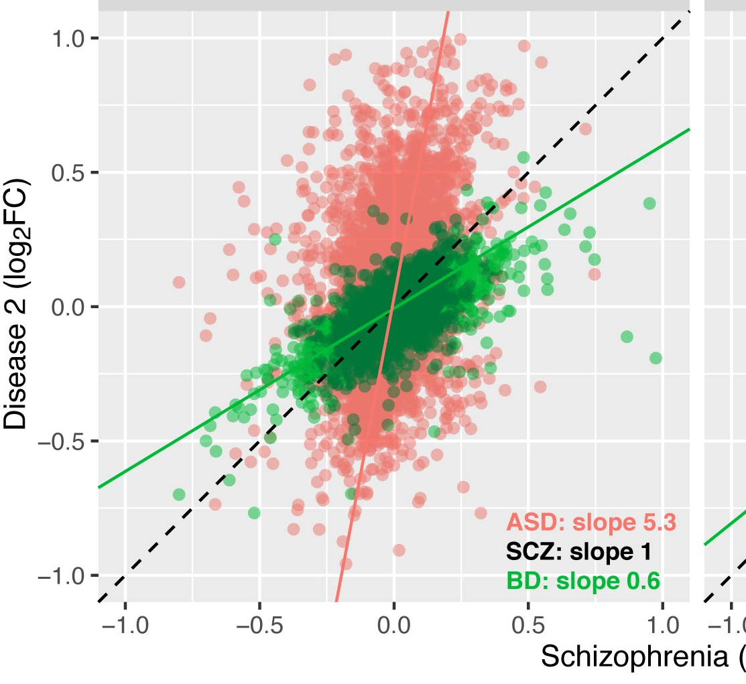
4. RNAseq gene-level differential expression
Meta-Analysis
BrainGVEX
SCZ vs CTL
SCZ vs CTL
log2FC / FDR
CommonMind
SCZ vs CTL
BrainGVEX
BD vs CTL
BD vs CTL
log2FC / FDR
CommonMind
BD vs CTL
UCLA-ASD
ASD vs CTL
ASD vs CTL
log2FC / FDR
Yale-ASD
ASD vs CTL

Slide 12
4. RNAseq gene-level differential expression
Major Covariates – Sequencing Statistics
Meta-Data: seqPC1 and seqPC2 are first two principle components
of scaled sequencing statistic matrix

Slide 13
5. RNAseq network analysis
consensus Network Analysis
Advantage: does not require batch
correction, more robust to batch effects
(regular) Network Analysis
Advantage: more interpretable
BrainGVEX
WGCNA
BrainGVEX
CommonMind
CommonMind
BrainSpan
BrainSpan
Batch Correction
WGCNA
Consensus
quantile
0.5
UCLA-ASD
UCLA-ASD
Yale-ASD
Yale-ASD
iPSC
iPSC

