Slide 1
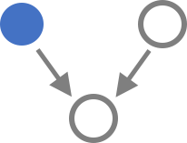
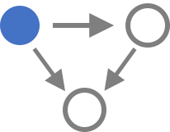
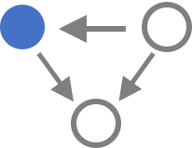
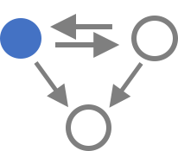
A
RBP
TF
B
C
Other TF | 212 | 38 | 14 | 2
Triplet | 10574 | 2135 | 1487 | 113
SUB1 in LUAD
MYC in BRCA

Slide 2
A
TF
RBP
B
C
Other TF | 212 | 38 | 14 | 2
Triplet | 10574 | 2135 | 1487 | 113
MYC in BRCA
SUB1 in LUAD

Slide 3
A
TF
RBP
B
C
Other TF | 212 | 2 | 14 | 38
Triplet | 10574 | 113 | 1487 | 2135
Logic Gate Usage of FFLs
MYC in BRCA
SUB1 in LUAD

Slide 4
Other TF | 212 | 2 | 14 | 38
Triplet | 10574 | 113 | 1487 | 2135
Logic Gate Usage of FFLs

Slide 5
Other TF | 212 | 38 | 14 | 2
Triplet | 10574 | 2135 | 1487 | 113

Slide 6
RBP
TF
Logic Gate Usage of FFLs
Other TF | 212 | 38 | 14 | 2
Triplet | 10574 | 2135 | 1487 | 113

Slide 7
+
+
-
-
+
+
-
-
+
-
-
+
+
+
-
-
-
+
+
-
+
+
-
-
+
+
-
-
+
+
-
-
+
+
-
-
-
-
+
+
+
-
-
+
+
-
-
+

Slide 8
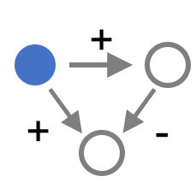
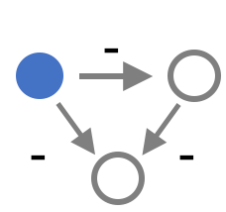
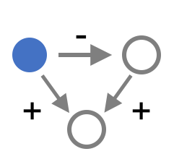
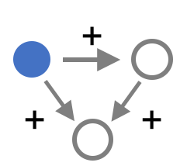

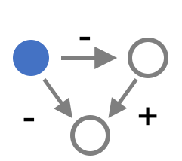

A
TF
RBP
B
C
MAX | 493
MXI1 | 208
NRF1 | 201
BHLHE40 | 195
ATF1 | 151
MAZ | 129
MNT | 122
ZNF143 | 120
... | ...
TF | Triplet
2 | 113
14 | 1487
38 | 2135
Logic Gate Usage of FFLs
MYC
SUB1

Slide 9
113
113
1487
2135
113
1487
MYC
NRF1
2135
MYC
T
NRF1
113
M
1487
C
2135
MYC
NRF1
T
T

Slide 10
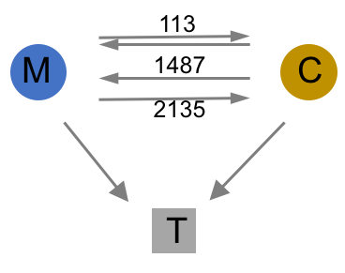
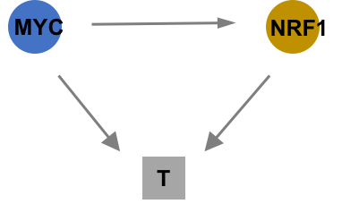
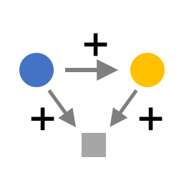
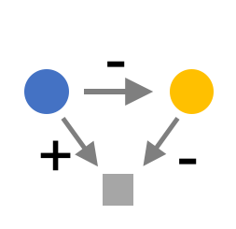
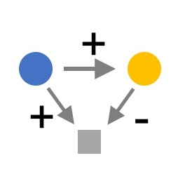

A
TF
RBP
B
C
Coherent FFLs
201
Incoherent FFLs
MYC
NRF1
MYC
SUB1

Slide 11
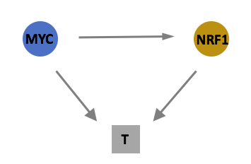
A
B
C
Coherent FFLs
201
Incoherent FFLs
MYC
Target
NRF1
MYC
SUB1

Slide 12
A
TF
RBP
B
C
Coherent FFLs
201
Incoherent FFLs
MYC
Target
NRF1
MYC
SUB1

Slide 13
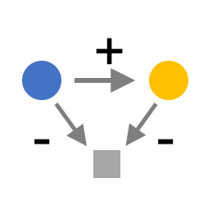
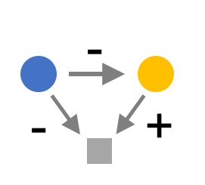
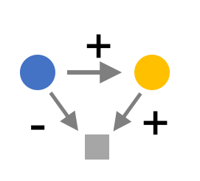
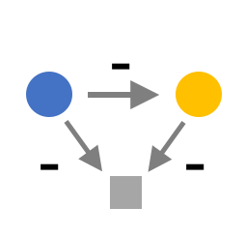
A
TF
RBP
B
C
20.6
9.1
16.6
15.9
201
coherent
62.2%
incoherent
37.9%
5.9
14.4
15.0
2.6
MYC
Target
Gate usage
NRF1
MYC
SUB1

Slide 14
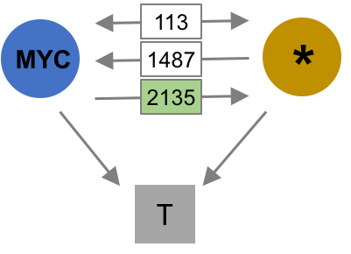
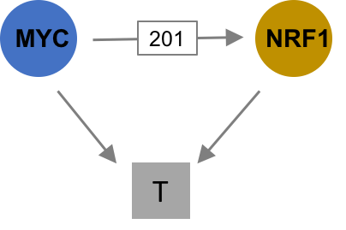
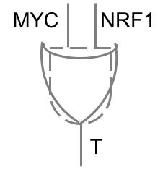
A
TF
RBP
B
C
21%
5.9%
9.1%
14%
OR | 89%
MYC only | 1.6%
NRF1 only | 0.9%
AND | 0.3%
… | …
17%
15%
16%
2.6%
MYC
SUB1

Slide 15
A
TF
RBP
B
C
B1
B3
B5
B7
C1
B4
B6
B8
21%
5.9%
B2
B9
C2
9.1%
14%
OR | 89%
MYC only | 1.6%
NRF1 only | 0.9%
AND | 0.3%
… | …
17%
15%
16%
2.6%
MYC
SUB1

Slide 16








A
TF
RBP
B
C(i)
113
C(ii)
C(iii)
D
MYC
1487
*
MYC
201
*
MYC
NRF1
2135
T
T
T
21%
5.9%
OR
89%
9.1%
14%
17%
15%
AND | MYC | NRF1
1.6% | 0.9% | 0.3%
16%
2.6%
63%
37%
coherent
incoherent
MYC
SUB1

Slide 17
A
TF
RBP
B
C(i)
113
C(ii)
C(iii)
D
MYC
1487
*
MYC
201
NRF1
MYC
NRF1
2135
T
T
T
21%
5.9%
OR
89%
9.1%
14%
17%
15%
AND | MYC | NRF1
1.6% | 0.9% | 0.3%
16%
2.6%
63%
37%
coherent
incoherent
MYC
SUB1

Slide 18
A
TF
RBP
B
C(i)
113
C(ii)
C(iii)
D
MYC
1487
*
MYC
201
NRF1
MYC
NRF1
2135
T
T
T
21%
5.9%
OR
89%
9.1%
14%
17%
15%
AND | MYC | NRF1
1.6% | 0.9% | 0.3%
16%
2.6%
63%
37%
coherent
incoherent
MYC
SUB1

Slide 19
A
TF
RBP
B
C(i)
113
C(ii)
C(iii)
D
MYC
1487
*
MYC
201
NRF1
MYC
NRF1
2135
T
T
T
21%
5.9%
OR
89%
9.1%
14%
17%
15%
AND | MYC | NRF1
1.6% | 0.9% | 0.3%
16%
2.6%
63%
37%
coherent
incoherent
MYC
SUB1

Slide 20
A
TF
RBP
B
C(i)
113
C(ii)
C(iii)
D
MYC
1487
*
MYC
201
NRF1
MYC
NRF1
2135
T
T
T
21%
5.9%
OR
89%
9.1%
14%
17%
15%
AND | MYC | NRF1
1.6% | 0.9% | 0.3%
16%
2.6%
63%
37%
coherent
incoherent
MYC
SUB1

Slide 21
MYC
113
*
1487
MYC
201
NRF1
2135
T
T

Slide 22
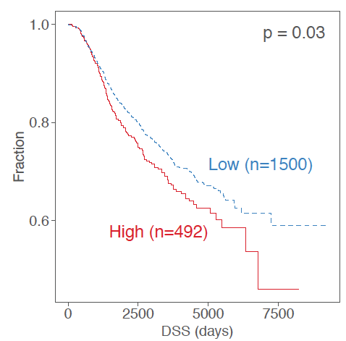
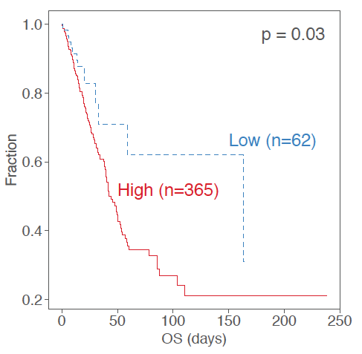


A
TF
RBP
B
C(i)
113
C(ii)
C(iii)
D
MYC
1487
*
MYC
201
NRF1
MYC
201
NRF1
2135
T
T
OR
89%
21%
5.9%
9.1%
14%
AND | MYC | NRF1
1.6% | 0.9% | 0.3%
Expression correlation
17%
15%
$$ρ$$
16%
2.6%
63%
37%
coherent
incoherent
T
MT
*T
MYC
SUB1

Slide 23
MYC
113
*
MYC
NRF1
MYC
NRF1
1487
201
2135
T
T
T

Slide 24
