Slide 1
Suggested slides for the Baylor talk
Prashant Emani

Slide 2
Expression of genes is quantified by transcription
Transcription
Proteins
Genes (DNA)
RNA transcripts
Protein coding mRNA
Translation
Non-coding regulatory RNAs
Regulation
Gene Expression measured by RNA-seq
In the building analogy, switching on lights is akin to active transcription of genes to produce RNA transcripts, while switching off the lights is related to gene silencing.
RNA-seq can quantify transcription, which is not merely a binary on/off process

Slide 3
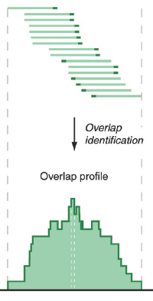
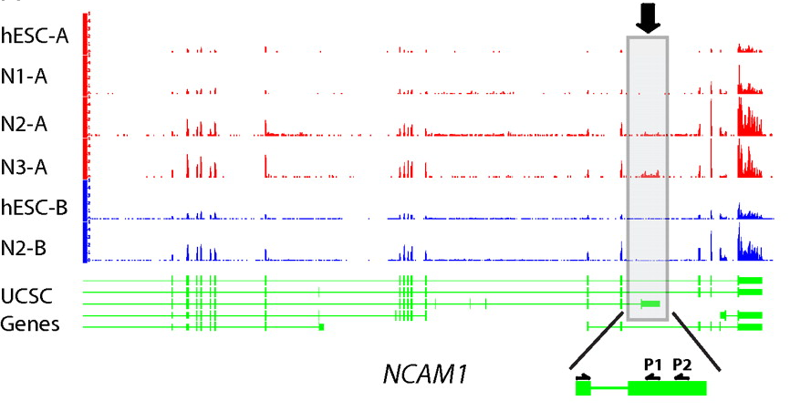
ATACAAGCAAGTATAAGTTCGTATGCCGTCTT
GGAGGCTGGAGTTGGGGACGTATGCGGCATAG
TACCGATCGAGTCGACTGTAAACGTAGGCATA
ATTCTGACTGGTGTCATGCTGATGTACTTAAA
Fastq sequence files
~5-10 GB
Index-building + Alignment to reference genome
BAM files
~1-2-fold reduction
Conversion to signal track by overlapping reads
Successive steps of Data Compression
Mapping to genes
BigWig files
~25-fold reduction
Gene/Transcript expression matrix
~500-fold reduction
Reads => Signal
Quantitative information from RNA-seq signal: average signals at exon level (RPKMs)
[PLOS CB 4:e1000158; PNAS 4:107: 5254 ; IJC 123:569 ]

