Slide 1
Using URL to access modERN data
3-30-2017
Jinrui Xu

Slide 2
Why URL
  quick and precise, but difficult to be created
To make it easier, we can use the DCC browser to generate a basic URL, then modify it slightly to access various data

Slide 3
E.g. we want the peak files of some TFs
  TFs of worm
  L1 Larva stage
  Genome version ce11
  ChIP-seq experiments
  in modERN project
  file format is *.bed

Slide 4
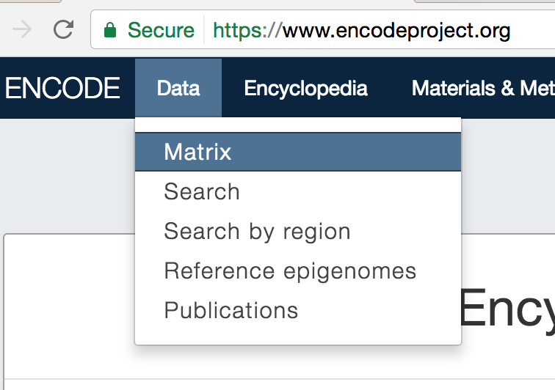
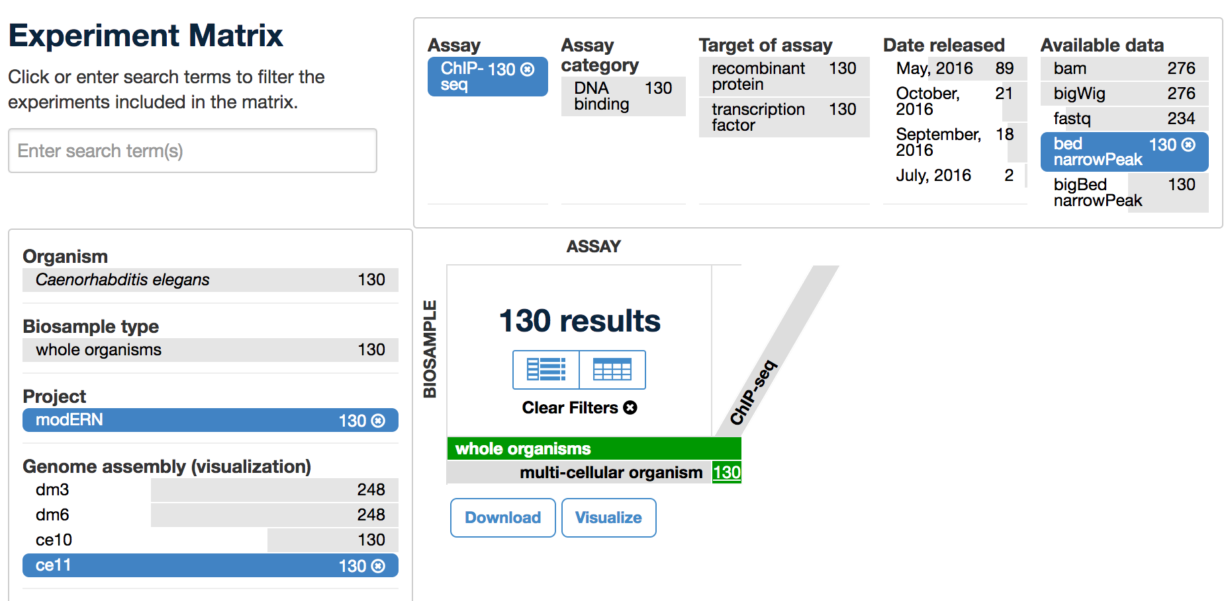
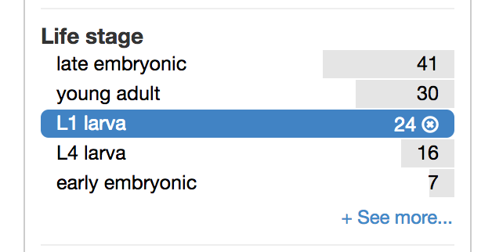
Use DCC browser to get the basic URL
WebPage1
WebPage2
WebPage3
Totally 24 TFs

Slide 5
The URL of WebPage3
  https://www.encodeproject.org/search/?type=Experiment&award.project=modERN&assay_title=ChIP-seq&files.file_type=bed+narrowPeak&assembly=ce11&biosample_term_name=multi-cellular+organism&assay_title=ChIP-seq&replicates.library.biosample.life_stage=L1+larva
With this URL, you can bulk download peak files and annotation of all the 24 TFs, then (program to) parse the annotation to focus on some interesting TFs

Slide 6
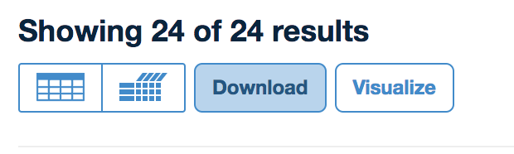
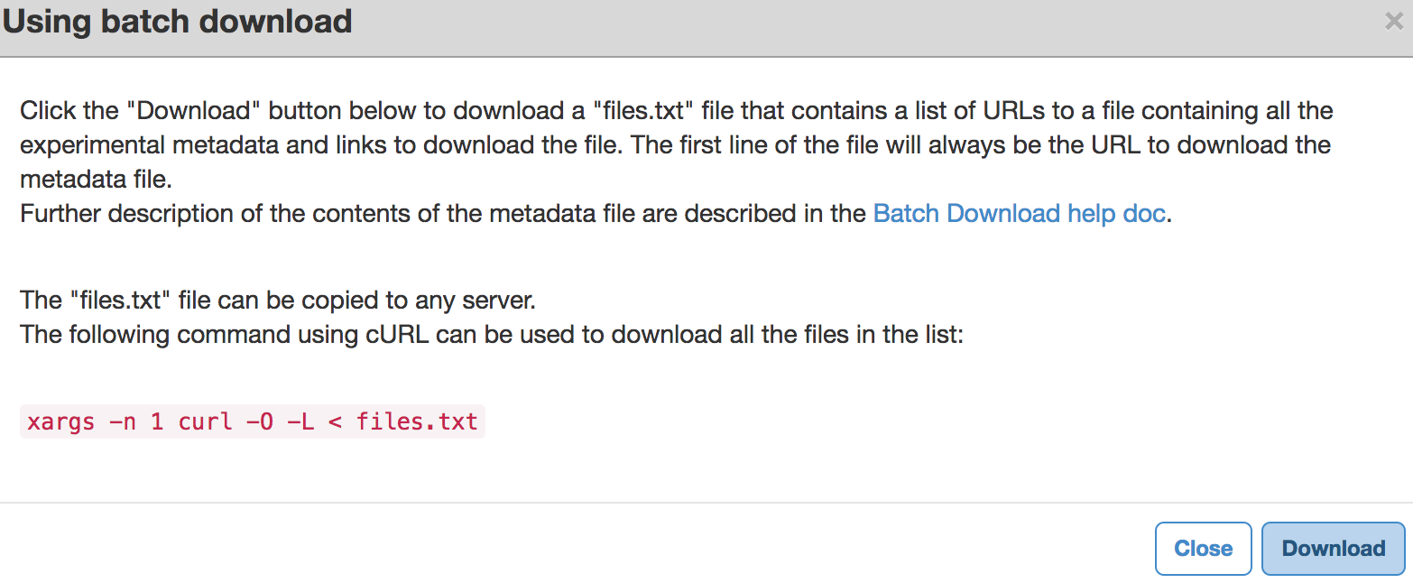
Downloading the bed files of all the 24 TFs
Step1: Click “Download” in the WebPapge3, a window will pop up
Step2: In the pop-up window, click “Download” to have a files.txt contains URLs
Step3: In a Linux terminal, run the command “xargs –n 1 curl -0 –L < files.txt”,
to download all bed files and an annotation file

Slide 7
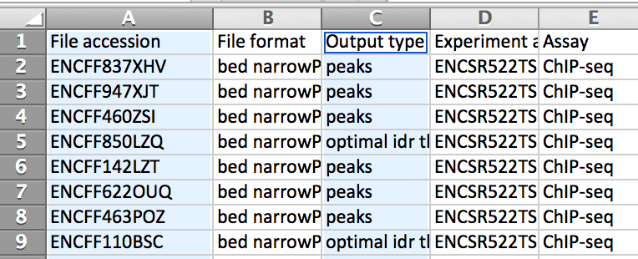
The annotation file can be read in excel

Slide 8
If we are interested in only one or several TFs from time to time
  Basic URL + modification. It can save you whole bunch of clickings
E.g. get the peak files of sox-4.
  In DCC, sox-4 is labeled as eGFP-sox-4
  Basic URL + &target.label=eGFP-sox-4=>
  https://www.encodeproject.org/search/?type=Experiment&award.project=modERN&assay_title=ChIP-seq&files.file_type=bed+narrowPeak&assembly=ce11&biosample_term_name=multi-cellular+organism&assay_title=ChIP-seq&replicates.library.biosample.life_stage=L1+larva&target.label=eGFP-sox-4
  Knowing only sox-4 or sox rather than the DCC label (eGFP-sox-4)
  Basic URL + &searchTerm=sox-4=>
  https://www.encodeproject.org/search/?type=Experiment&award.project=modERN&assay_title=ChIP-seq&files.file_type=bed+narrowPeak&assembly=ce11&biosample_term_name=multi-cellular+organism&assay_title=ChIP-seq&replicates.library.biosample.life_stage=L1+larva&searchTerm=sox-4

Slide 9
E.g. get the peak files of sox4, fkh-8 and ceh-85
  https://www.encodeproject.org/search/?type=Experiment&award.project=modERN&assay_title=ChIP-seq&files.file_type=bed+narrowPeak&assembly=ce11&biosample_term_name=multi-cellular+organism&assay_title=ChIP-seq&replicates.library.biosample.life_stage=L1+larva&searchTerm=sox-4+OR+fkh-8+OR+ceh-85

Slide 10
Get the peak files of the 23 TFs but not sox4
  https://www.encodeproject.org/search/?type=Experiment&award.project=modERN&assay_title=ChIP-seq&files.file_type=bed+narrowPeak&assembly=ce11&biosample_term_name=multi-cellular+organism&assay_title=ChIP-seq&replicates.library.biosample.life_stage=L1+larva&searchTerm=!sox-4

Slide 11
If you just want to review the 24 TFs: replace the “search” in the basic link by “experiments”
  https://www.encodeproject.org/experiments/?type=Experiment&award.project=modERN&assay_title=ChIP-seq&files.file_type=bed+narrowPeak&assembly=ce11&biosample_term_name=multi-cellular+organism&assay_title=ChIP-seq&replicates.library.biosample.life_stage=L1+larva
  You will see the 24 TF experiments containing bed files

Slide 12
Useful keys and their values

Slide 13
Acknowledgement
  Koon-Kiu Yan
  Donghoon Lee

Slide 14
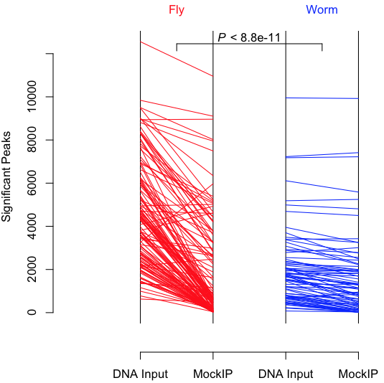
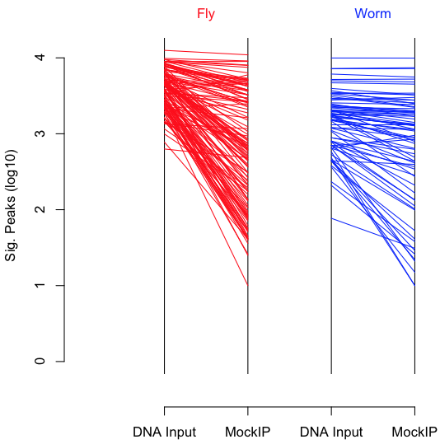
Number of significant peaks in fly and worm
A
B, log10 scale of A
p < 0.05 indicates % of peak lost due to mock IP in fly is significantly larger than in worm

