Slide 1
Spatial and temporal dynamics of C. elegans gene expression inferred from sci-RNA-seq data
Waterston and/or Trapnell lab meeting
2017-03-15

Slide 2
sci-RNA-seq: a combinatorial indexing protocol developed by Junyue Cao increases throughput and lowers costs

Slide 3
sci-RNA-seq of whole L2 C. elegans provides transcriptomic data for over 27 distinct cell types

Slide 4
sci-RNA-seq of whole L2 C. elegans provides transcriptomic data for over 27 distinct cell types

Slide 5
ChIP peaks enriched in tissue specific gene promoters

Slide 6
ChIP peaks enriched in cell type specific gene promoters

Slide 7
t-SNE of just body wall muscle cells

Slide 8
Gene expression gradients along the anterior-posterior axis in body wall muscle cells

Slide 9
Interim approach: draw a line between two clusters of fbl-1(+) cells (head and tail)

Slide 10
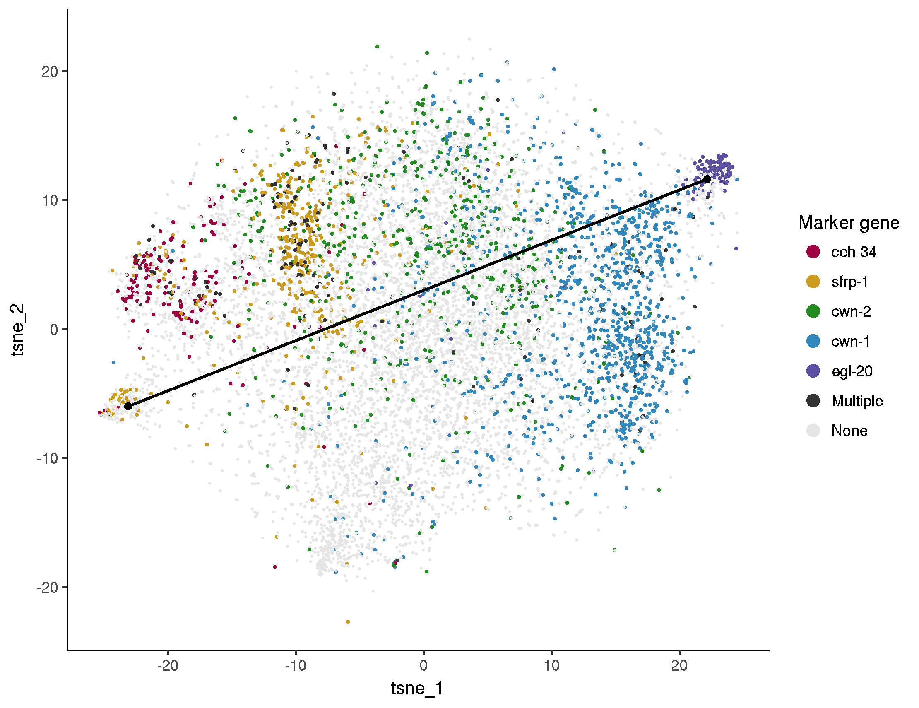
Interim approach: draw a line between two clusters of fbl-1(+) cells (head and tail)

Slide 11
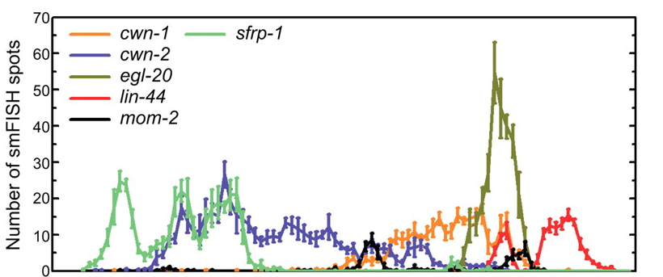
Inferred A-P expression patterns consistent with smFISH data
Harterink et al., Development, 2011

Slide 12
232 genes are DE on the anterior-posterior axis
Anterior
Posterior
Notes:
qval < 0.01 and >5% variance explained using binarized expression model

Slide 13
4 genes are DE in unc-129(+) dorsal vs. unc-130(+) ventral muscle cells
Notes:
Re-do with unc-6 as an additional ventral muscle marker

Slide 14
The great hypodermal subtype mystery

Slide 15
The great hypodermal subtype mystery
Pnhr-73::GFP
Pbah-1::GFP

Slide 16
The great hypodermal subtype mystery
MUP-4::GFP
Pgpx-5::GFP

Slide 17
Cell recovery rate in hyp7 syncytia is likely to be low

Slide 18
Marker gene expression patterns suggest that cells are coming from different developmental sub-stages within L2

Slide 19
Cells with low UMI counts often confound analysis
Shown: t-SNE of just cells in the bottom hypodermal cluster

Slide 20
Seam cell pseudotime is consistent with the literature on molting-related oscillatory gene expression

Slide 21
Lots of DE genes

