Slide 1
Analysis of de novo variants
Tychele N. Turner, Ph.D.
University of Washington
March 29, 2017

Slide 2

denovo-db
Landing place for human de novo variants from the literature
exome and genome data
version 1.3
47 studies
18 primary phenotypes
184,766 variants
10,643 orthogonal validations
Query
gene, chr. position, phenotype, function, CADD threshold, sample ID, study
@denovodb
http://denovo-db.gs.washington.edu/denovo-db/
http://denovo-db.gs.washington.edu
Turner et al. 2016, Nucleic Acids Research Database Issue Breakthrough Article

Slide 3
denovo-db usage

Slide 4
de novo variants in disease
Discovery of genes involved in neurodevelopmental disorders by assessing clustering of missense mutations

Slide 5
CLUstering by Mutation Position (CLUMP)
  Uses a Partitioning Around Medoids (PAM) algorithm
Linear representation of protein
Result 1
medoids=3
If there are 6 mutations CLUMP randomly picks a certain number of medoids
It than looks for the number of medoids that give the best local minimum but yet makes sure the clusters are not too close
amino acid change
location of medoid
Turner et al. 2015, Hum Mol Genet

Slide 6
CLUstering by Mutation Position (CLUMP)
  Uses a Partitioning Around Medoids (PAM) algorithm
Linear representation of protein
Result 2
medoids=2
If there are 6 mutations CLUMP randomly picks a certain number of medoids
It than looks for the number of medoids that give the best local minimum but yet makes sure the clusters are not too close
amino acid change
location of medoid

Slide 7
CLUstering by Mutation Position (CLUMP)
  Uses a Partitioning Around Medoids (PAM) algorithm
Linear representation of protein
Result 3
medoids=3
If there are 6 mutations CLUMP randomly picks a certain number of medoids
It than looks for the number of medoids that give the best local minimum but yet makes sure the clusters are not too close
amino acid change
location of medoid

Slide 8
CLUstering by Mutation Position (CLUMP)
  Uses a Partitioning Around Medoids (PAM) algorithm
Linear representation of protein
Result 4
medoids=2
If there are 6 mutations CLUMP randomly picks a certain number of medoids
It than looks for the number of medoids that give the best local minimum but yet makes sure the clusters are not too close
amino acid change
location of medoid

Slide 9
CLUstering by Mutation Position (CLUMP)
  Uses a Partitioning Around Medoids (PAM) algorithm
Linear representation of protein
Result 1
medoids=3
If there are 6 mutations CLUMP randomly picks a certain number of medoids
It than looks for the number of medoids that give the best local minimum but yet makes sure the clusters are not too close
amino acid change
location of medoid
Lower CLUMP scores indicate more clustering as mutations tend to be very close to the medoids

Slide 10
Missense clustering is greatest in autosomal dominant disorders
1.0
0.8
Data collected from HGMD
Clustering
AD > AR > control
AD vs. AR (P = 5.7 x 10⁻⁴)
AD vs. controls (P = 2.8 x 10⁻¹⁵)
AR vs. controls (P = 4.5 x 10⁻⁴)
0.6
cumulative fraction of proteins
0.4
0.2
0.0
0
2
4
6
8
CLUMP score
Turner et al. 2015, Hum Mol Genet

Slide 11
Applying CLUMP to missense variants in neurodevelopmental disorders (NDD)
GRIN2B
CLUMP score=0.968, p<1x10⁻³
Neurodevelopmental disorders
1 variant
2+ variants
amino acid position
1
10
20
30
40
CADD scale
Geisheker et al., unpublished

Slide 12
Applying CLUMP to missense variants in neurodevelopmental disorders (NDD)
KCNQ2
CLUMP score=0.349, p<1x10⁻³
Neurodevelopmental disorders
1 variant
2+ variants
amino acid position
1
10
20
30
40
CADD scale

Slide 13
Clustered mutations and 3D protein structure
PTPN11
CLUMP score=0.813, p=0.03
Neurodevelopmental disorders
1 variant
2+ variants
amino acid position
1
10
20
30
40
CADD scale

Slide 14
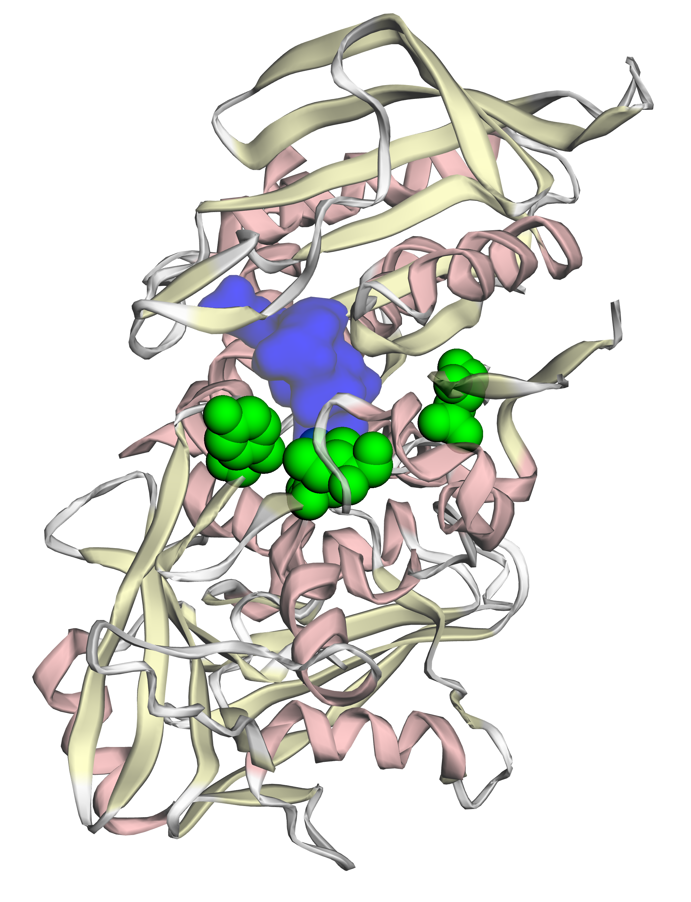
Clustered mutations and 3D protein structure
Missense
Variants
3D rendering using http://mupit.icm.jhu.edu/

Slide 15
Conclusions
denovo-db is a database for de novo variants from the literature
Clustering of missense variants are detectable in NDDs using CLUMP leading to identification of disease-related genes

Slide 16
Future Directions
Continued aggregation of de novo variants
Expanded data usage page
Updated features as more genome data is published
Increased integration with other control databases (ExAC, ESP, BRAVO)

Slide 17
Acknowledgments
University of Washington (denovo-db)
Evan Eichler
Deborah Nickerson
Qian Yi
Niklas Krumm
John Huddleston
Kendra Hoekzema
Holly Stessman
Anna-Lisa Doebley
Raphael Bernier
Johns Hopkins University School of Medicine (CLUMP)
Rachel Karchin
Aravinda Chakravarti
Funding from the Simons Foundation, National Institute of Mental Health, National Human Genome Research Institute, National Heart, Lung and Blood Institute, Howard
Hughes Medical Institute, and the Autism Science Foundation

