Slide 1

Challenges and Opportunities:
The Use of ClinVar and the Beacon Network for
Gene Discovery and Expanded Data Sharing
Heidi Rehm
On behalf of the Broad Center for Mendelian Genomics

Slide 2
Resources to aid in matching
Matchmaker Exchange
  Federated network of databases
  Primarily controlled access (exceptions MyGene2, part of DECIPHER)
  Must use the system through choosing to work with a single site’s portal of entry
  Primarily gene-level matching
ClinVar
  Variant-level resource (with supporting case-level data)
  Public access (tens of thousands of hits per day) and content downloadable to insert in genomic pipelines
Beacon
  Variant-level queries of genomic data
  Tiered access (public > registered > controlled)
  Federated network with centralized search interface and API access

Slide 3
Case Presentation
16 year old male with:
Congenital blindness (light perception only, pale optic nerves)
Microcephaly
Severe developmental delay (speech and motor delay)
Seizures (since 11 mo)
  Immunodeficiency (profound decrease in T-cells, low tetanus titers, abnl T cell proliferation PHA, lymphopenia, multiple viral infections)
Dysmorphic (smooth philtrum, prominent lips, tall narrow ears, mild pectus, thoracic kyphosis, thick coarse hair, wide spaced teeth)
Family history: Unaffected parents and sibs
Courtesy of David Sweetser, MD, Chief of Genetics, MGH
Notes:
Genetic Testing
9/17/99 karyotype normal 46,XY
9/9/2011 Chromosomal microarray (CGH+SNP) 599 kb duplication chr5q34, maternally inherited
Metabolic Testing - Copper, ceruloplasm,lactate, T+F carnitine, PAA, UOA, creatine, guanidinoacetate, sulfocysteine, 7-dehydrocholesterol, CHO-def transferrin
Osteoporosis - Hip Z-4.7 SD, L1-L4 -2.7 SD, nl AP, Phos, Ca, 25-OH Vit D, PTH
Cardiac ECHO - nl
EEG - frequent epileptiform activity over the left hemisphere, mostly occipital, less frequently temporal. there is also continuous slowing over the posterior left hemisphere.
Brain MRI - Normal orbits, optic nerve (13 mo) increased T2 signal in paratrigonal white matter greater than expected for age. Question periventricular leukomalacia (PVL). however, there is no irregularity to the surface of the ventricles to support the diagnosis of PVL.
Note: A distal duplication, 5q34--,ter, associated with short stature, mild mental retardation, delayed puberty, chronic eczema, hernias, dysmorphic facies including short receding forehead, high nasal bridge, thick alae nasales, prominent nasal tip, dental caries, digital anomalies and normal life expectancy.

Slide 4
Whole Exome Sequencing Results
DIAPH1, c.533+1G>A, heterozygous, de novo
DIAPH1, Exon 23-24 deletion, heterozygous, maternal
cis vs trans unknown
Courtesy of David Sweetser, MD, Chief of Genetics, MGH

Slide 5
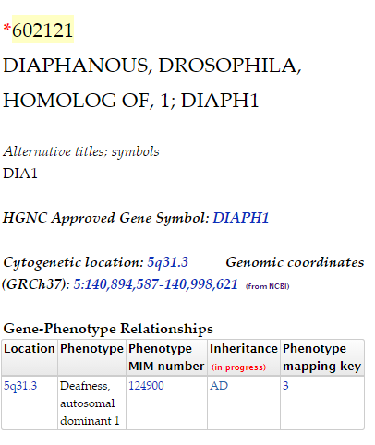
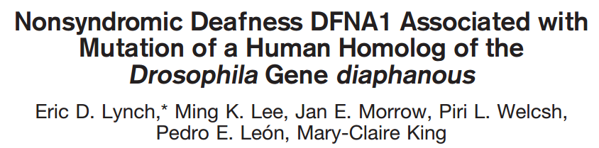
OMIM
Science. 1997. 278:1315-8
Only 1 mutation had ever been published: TTAA insertion at +1 splice site leading to a frameshift that truncates 52 c-term AA

Slide 6
Case was unsolved at this stage
Patient was documented to have normal hearing, conflicting with only known pathogenic mutation causing dominant hearing loss
Cis vs trans configuration of variants was unknown
Then ClinVar was searched……

Slide 7
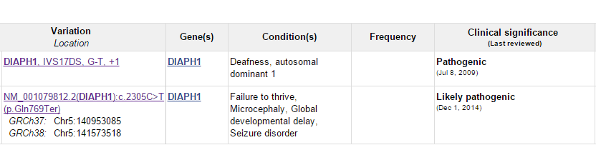
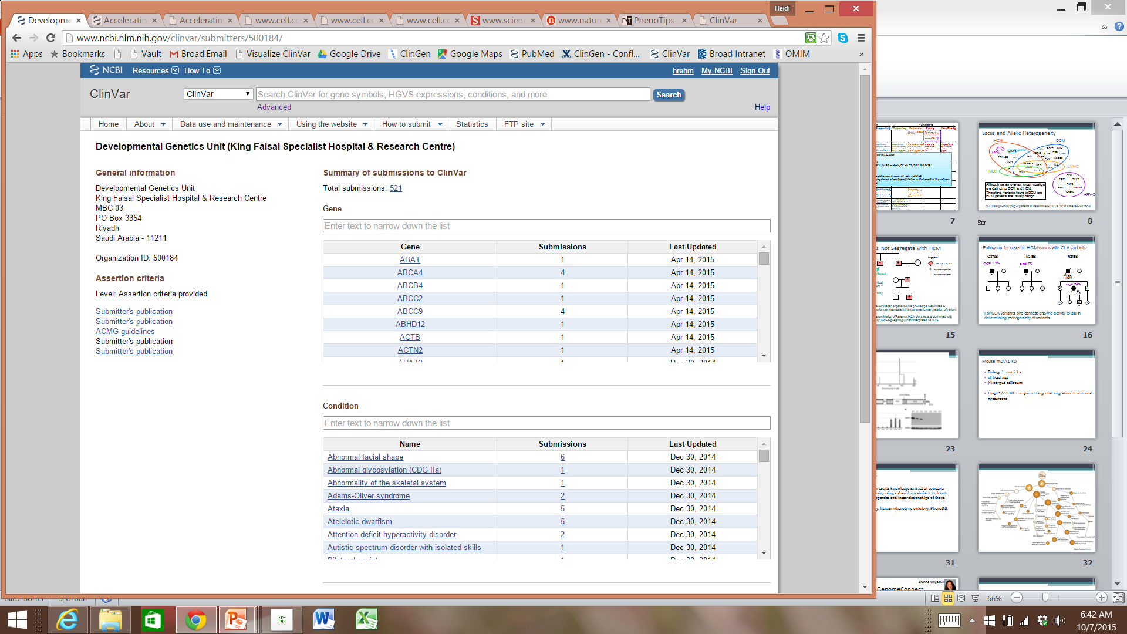
Pre-publication deposition to ClinVar
Contacted the ClinVar submitter, to get more details on the case

Slide 8
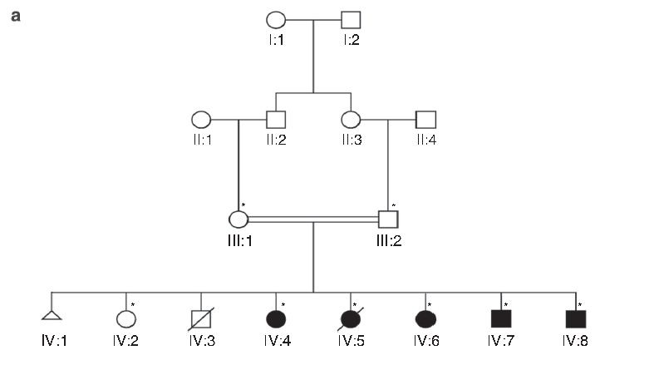
Homozygous DFNA1 p.Gln778*
Microcephaly
Severe visual impairment
Intellectual disability
Short stature
Seizures
Normal hearing
Notes:
Saudi Arabia, second child dies 3 mo CHD, IV.5 died chest infection

Slide 9
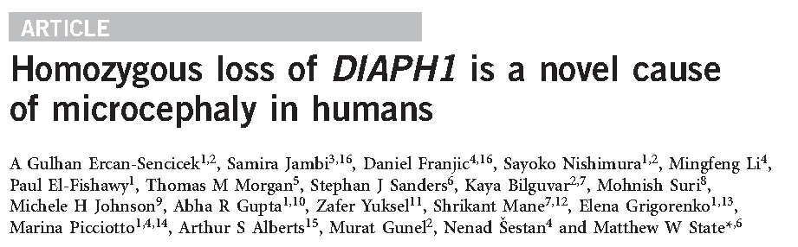
Publication showed homozygous null effect on protein
Null effect also predicted for the c.533+1G>A and Exon 23-24 deletion variants
Dominant hearing loss phenotype likely due to distinct gain-of-function mechanism
Case solved!

Slide 10
ClinVar Communication
I receive ~ 1 email per week from a clinician requesting the exchange of detailed phenotype to clarify VUSs found in patients
In some cases this has allowed variants to move form VUS to LP/P or LB/B

Slide 11
Roles for ClinVar
Primarily used as a resource to share interpreted variants (P, LP, VUS, LB, B) in known genes
Can also submit candidates for:
  phenotype expansions of known genes
  novel genes
    These may be entered as VUS or Likely Pathogenic with phenotypic features submitted as HPO terms and the uncertainty in gene-phenotype association explained in a text description
Labs are encouraged to submit alternate interpretations of variants incorrectly reported as pathogenic

Slide 12
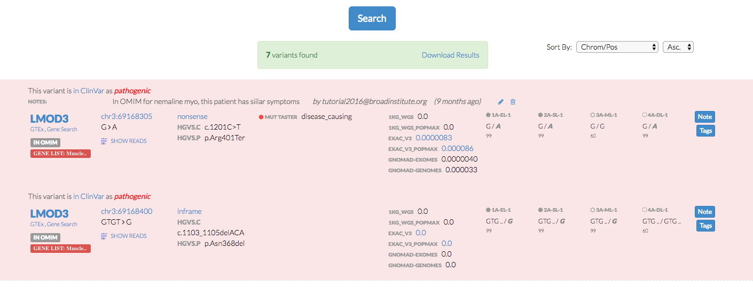
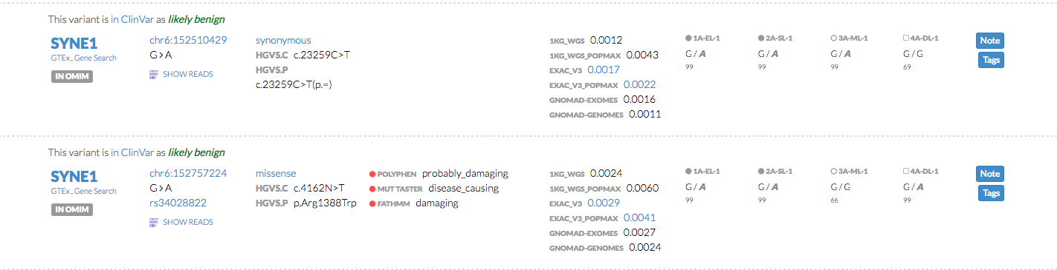
Links to ClinVar

Slide 13
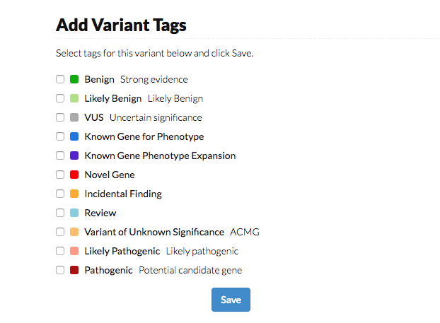

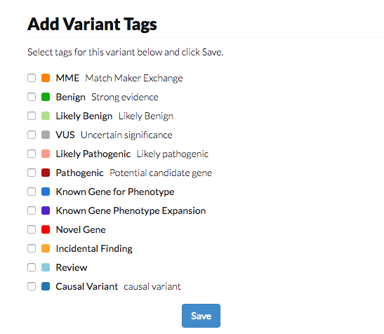

Slide 14

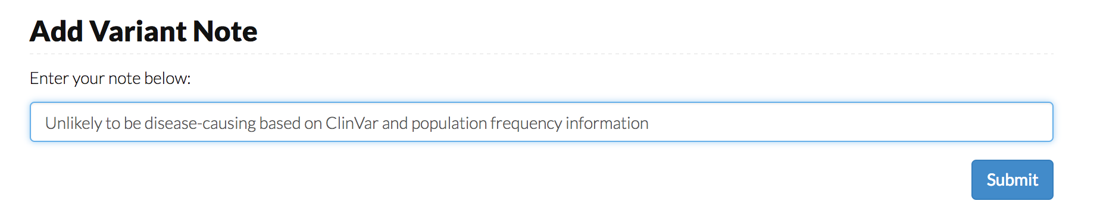
Identification of incorrect classifications in the public domain
pathogenic
1KG_WGS 0.0358
1KG_WGS_POPMAX 0.0833
EXAC_V3 0.0219
EXAC_V3_POPMAX 0.07336
GNOMAD-EXOMES
GNOMAD-GENOMES
DMD
chrX:31478314
T>A
c.8729A>T
p.Glu2910Val
rs41305353
Broad CMG will begin submitting these to ClinVar as well.
Unlikely to be pathogenic based on 0.8% population frequency in gnomAD and identification in healthy individuals.

Slide 15

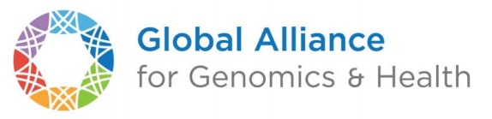


The Beacon Project
A beacon is a web-service that can be queried for the existence of a variant
A user can ask a beacon, do you have information about the allele “C at position 32,936,732 on chromosome 13?”
A Beacon responds yes or no, and may include metadata about the allele.
100K+
Individuals
200+
VCF Files
Database
Clinical Record or EMR
Datasets
e.g. gnomAD, BIPMed
e.g. ClinVar, BRCA Exchange
e.g. PhenomeCentral, FHIR
60+
Slides modified from Marc Fiume, Beacon Project Co-Lead
Beacons
25+
Organizations
Search interface available at beacon-network.org
Data available through an API
6
Continents

Slide 16



Tiered Access and Progressive Disclosure
Public: accessible to anonymous users of the internet
Registered: accessible to users with an account
Controlled: accessible to users who have been manually approved
1
Discovery
2
Registration
3
Sharing
query:
chrom : 13,
allele: C,
position : 32936732,
assembly : GRCh37
query:
token : 4389638616,
chrom : 13,
allele: C,
position : 32936732,
assembly : GRCh37
full name
email
I agree …
I agree …
response :
exists : true
metadata : frequency: 0.1
register : <url>
Register
response :
exists : true,
metadata :
frequency: 0.1
patients: [ phenotypes ]

Slide 17
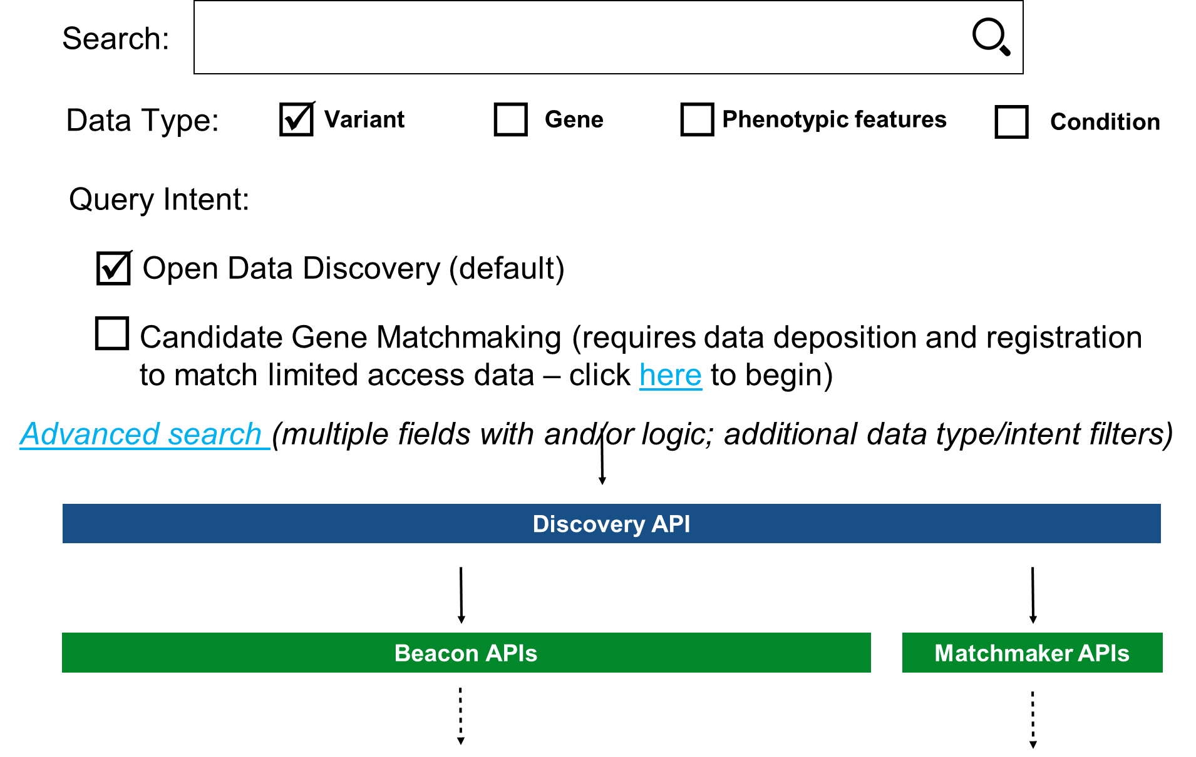

Beacon and Matchmaker
Combine into one interface??
Mock-up of search interface
Beacon
Matchmaker
Notes:
More different in their philosophies than in their underlying technologies

Slide 18
In summary……
CMGs are encouraged to submit variants to ClinVar
  Causal variants (required)
  Candidate variants in known or novel genes (VUS, LP as appropriate)
  Corrected interpretations for misinterpreted variants
CMGs should use the Beacon network to identify data on candidate variants and light Beacons on their data
We hope to continue to make ClinVar, Beacon and MME useful to both the clinical and research communities – feedback is welcome!

