Slide 1
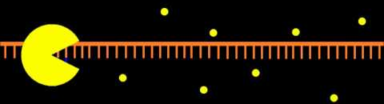
When are LOF mutations not LOF mutations?
Zeynep H. Coban-Akdemir, Ph.D.
GSP Meeting
March 29th 2017
Department of Molecular and Human Genetics
Baylor College of Medicine

Slide 2
Disclosures
No conflicts of interest

Slide 3
Nonsense-mediated decay (NMD)
Notes:
The NMD pathway is an mRNA surveillance system that protects eukaryotic cells by reducing the production of harmful truncated proteins translated from PTC-bearing transcripts1. In addition, NMD is involved in post-transcriptional regulation of global gene expression2. PTC-introducing variants cause human genetic diseases3, making NMD an important modulator of disease outcome. In particular, NMD can both protect against disease4 and aggravate disease phenotypes5. Therefore, a complete understanding of how the NMD machinery selects transcripts to degrade is crucial for predicting the phenotypic consequences of nonsense mutations in humans.

Slide 4
Nonsense-mediated decay (NMD)
Notes:
Drawn as linear but inreality is circular
Following transcription, polyadenylation and 5’capping
Non-stop and no-go

Slide 5
Nonsense-mediated decay (NMD)
Predicted mono-allelic expression
Notes:
Drawn as linear but inreality is circular
Following transcription, polyadenylation and 5’capping
Non-stop and no-go

Slide 6
Nonsense-mediated decay (NMD)
Predicted bi-allelic (mutant) expression
Predicted mono-allelic expression
Notes:
Drawn as linear but inreality is circular
Following transcription, polyadenylation and 5’capping
Non-stop and no-go

Slide 7
Nonsense-mediated decay (NMD)
NMD-competent
NMD-incompetent
Predicted mono-allelic expression
Notes:
Drawn as linear but inreality is circular
Following transcription, polyadenylation and 5’capping
Non-stop and no-go

Slide 8
Are we properly interpreting truncating variants?
High probability of being deleterious
53,689 ‘pathogenic’ variants in ClinVar
22,700 (42.3%) are truncating variants
RNA-decay can affect clinical outcomes
Notes:
Although I haven’t found anything in DVL2 yet
DVl3 has a very similar story to DVl1
6 total pathogenic variants which are tightly clustered within 100nt of each other
Contrary to DVl1 the variants are also located in the final exon and includes two splice acceptors mutations
But all are still -1 framesifting and escape from NMD

Slide 9
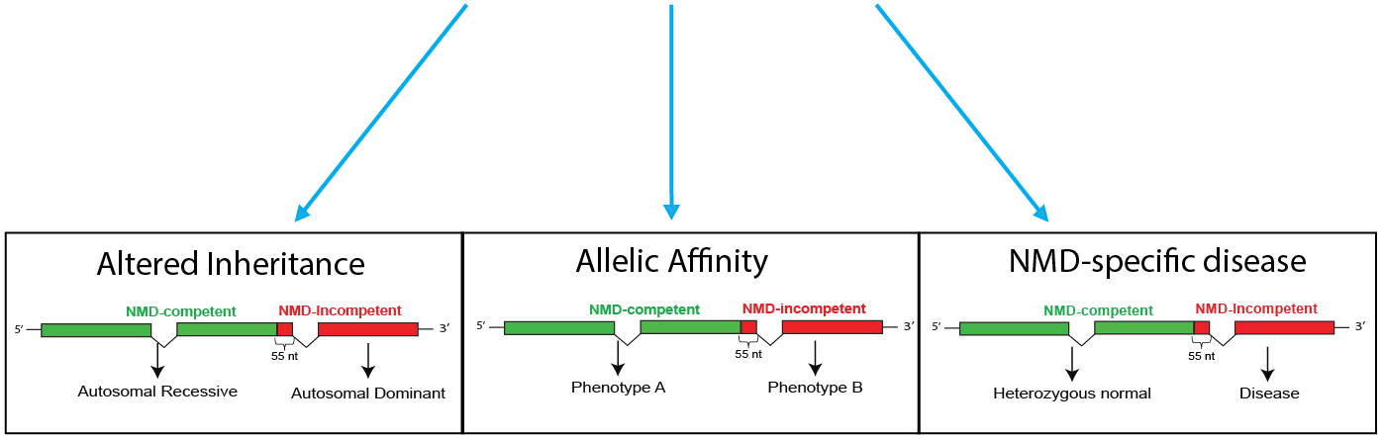
Various molecular consequences from truncating variants
 | 5’ PTV | 3’ PTV
VWF | Recessive Von Willebrand disease | Dominant Von Willebrand disease
HBB | Recessive Βeta-Thalassemia | Dominant Βeta-Thalassemia
PTV: Protein truncating variant
Notes:
Examples include HBB and B-thalassemia
VWF von willebrand disease

Slide 10
Various molecular consequences from truncating variants
-distinct traits from the variants in the same gene
 | 5’ PTV | 3’ PTV
VWF | Recessive Von Willebrand disease | Dominant Von Willebrand disease
HBB | Recessive Βeta-Thalassemia | Dominant Βeta-Thalassemia
 | 5’ PTV | 3’ PTV
ROR2 | Brachydactylytype B1 | Robinow syndrome
DMD | Duchenne muscular dystrophy | Becker muscular dystrophy
PTV: Protein truncating variant
Notes:
Examples include HBB and B-thalassemia
VWF von willebrand disease

Slide 11
Aim: To find novel disease genes that underlie Mendelian phenotypes through escape from NMD
Various molecular consequences from truncating variants
-distinct traits from same gene
 | 5’ PTV | 3’ PTV
VWF | Recessive Von Willebrand disease | Dominant Von Willebrand disease
HBB | Recessive Βeta-Thalassemia | Dominant Βeta-Thalassemia
 | 5’ PTV | 3’ PTV
ROR2 | Brachydactylytype B1 | Robinow syndrome
DMD | Duchenne muscular dystrophy | Becker muscular dystrophy
 | 5’ PTV | 3’ PTV
DVL1 | No associated phenotype | Robinow syndrome
PTV: Protein truncating variant
Notes:
Examples include HBB and B-thalassemia
VWF von willebrand disease

Slide 12
An example of NMD-specific disease gene: DVL1
DVL1-mediated Robinow syndrome
White, Janson, et al. The American Journal of Human Genetics 96.4 (2015): 612-622.
Notes:
~Although I initially screened all coding regions, it was quickly clear that all pathogenic variants were tightly clustered
~This depicts the location of all identified variants to date including several found by our collaborators
~they are all within 100nt of each other in the penultimate exon
14 individuals
10 distinct variants
All variants in the penultimate exon
In total, six distinct frameshift mutations were found in eight subjects, and all were heterozygous truncating variants within the penultimate
exon ofDVL1.
All variant alleles are predicted to result in a premature terminationcodon within the last exon, escape nonsense-mediated
decay (NMD), and most likely generate a C-terminally truncated protein with a distinct1 reading-frame terminus. Study of the transcripts
extracted from affected subjects’ leukocytes confirmed expression of both wild-type and variant alleles, supporting the hypothesis
that mutant mRNA escapes NMD.

Slide 13
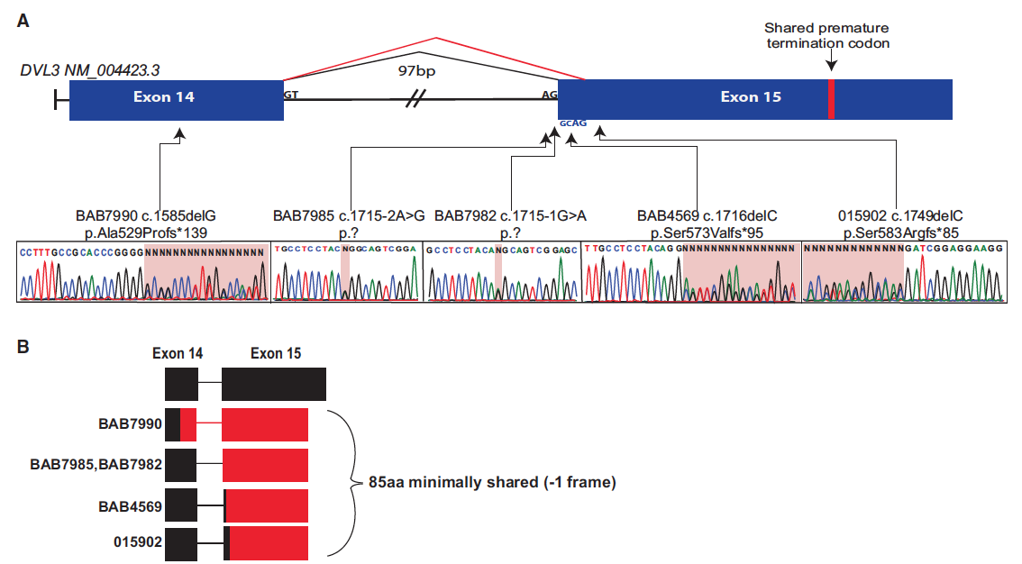
An example of NMD-specific disease gene: DVL3
DVL3-mediated Robinow syndrome
White, Janson, et al. The American Journal of Human Genetics 98.3 (2016): 553-561.
Notes:
Although I haven’t found anything in DVL2 yet
DVl3 has a very similar story to DVl1
Similar to the variants observed in DVL1-mediated
Robinow syndrome, all variants in DVL3 result in a 1 frameshift, indicating that these highly specific alterations might be a common
cause of dominant Robinow syndrome.
Remarkably, targeted sequencing identified five unrelated individuals harboring heterozygous, de novo frameshift
variants in DVL3,
6 total pathogenic variants which are tightly clustered within 100nt of each other
Contrary to DVl1 the variants are also located in the final exon and includes two splice acceptors mutations
But all are still -1 framesifting and escape from NMD

Slide 14
Step 1: Quality control of frameshift variants
CMG: Center for Mendelian Genomics
ARIC: Atherosclerosis Risk in Communities Study

Slide 15
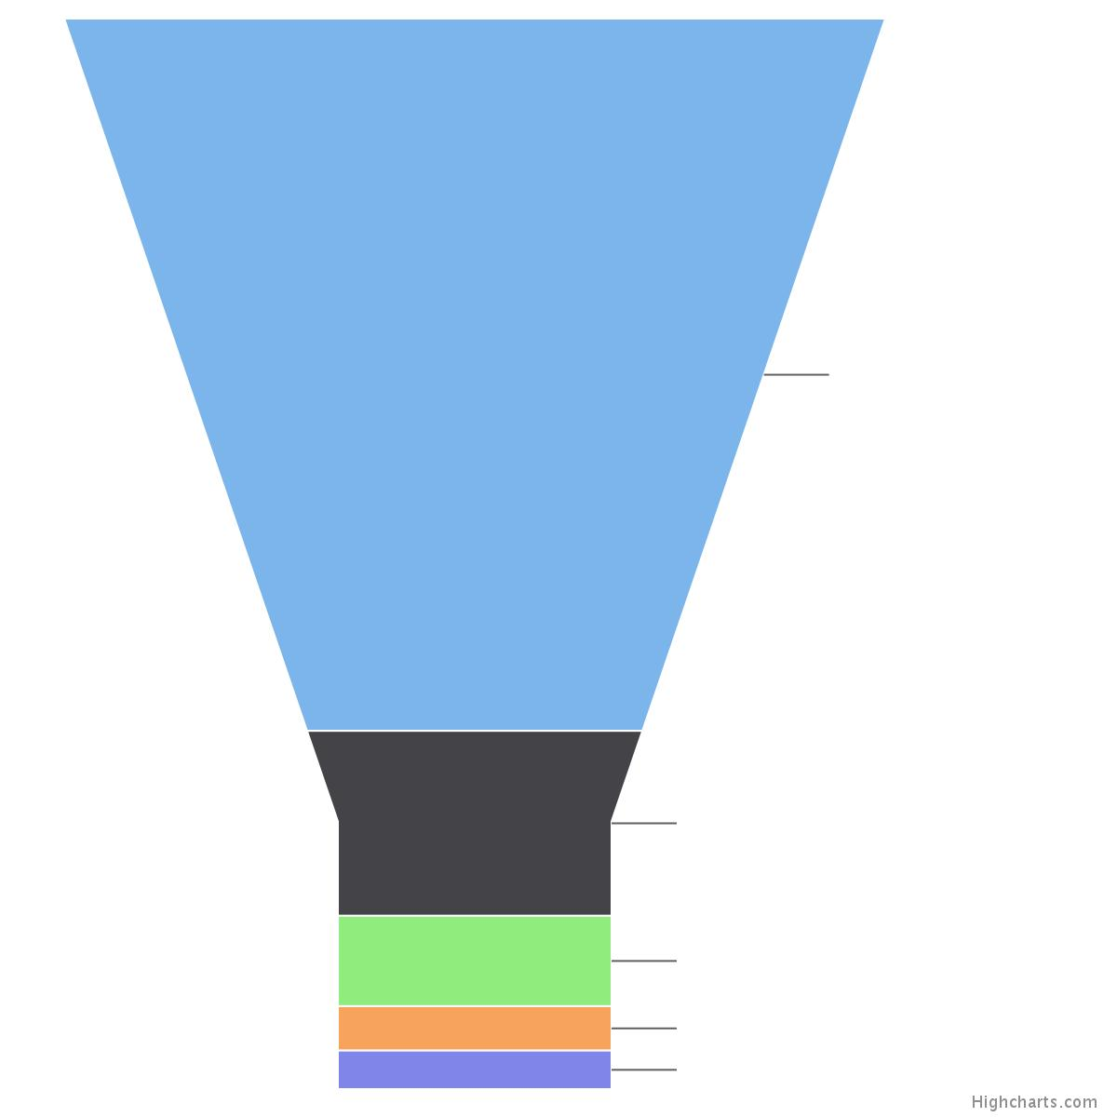
Overall analysis of Baylor-CMG cohort frameshift variants
Variant Filter Funnel
Baylor-CMG
ARIC
All variants
(INDELs)
3,554,390
12,364,600
1,492,197
5,801,374
Het high-quality indels
Het high-quality
frameshift variants
580,486
2,458,002
Filtered by frequency
(<= 1 percent)
52,832
160,308
Unique
19,567
27,955

Slide 16
Step 2: Prediction of NMD-incompetent variants
CMG: Center for Mendelian Genomics
ARIC: Atherosclerosis Risk in Communities Study

Slide 17
Algorithm workflow

Slide 18
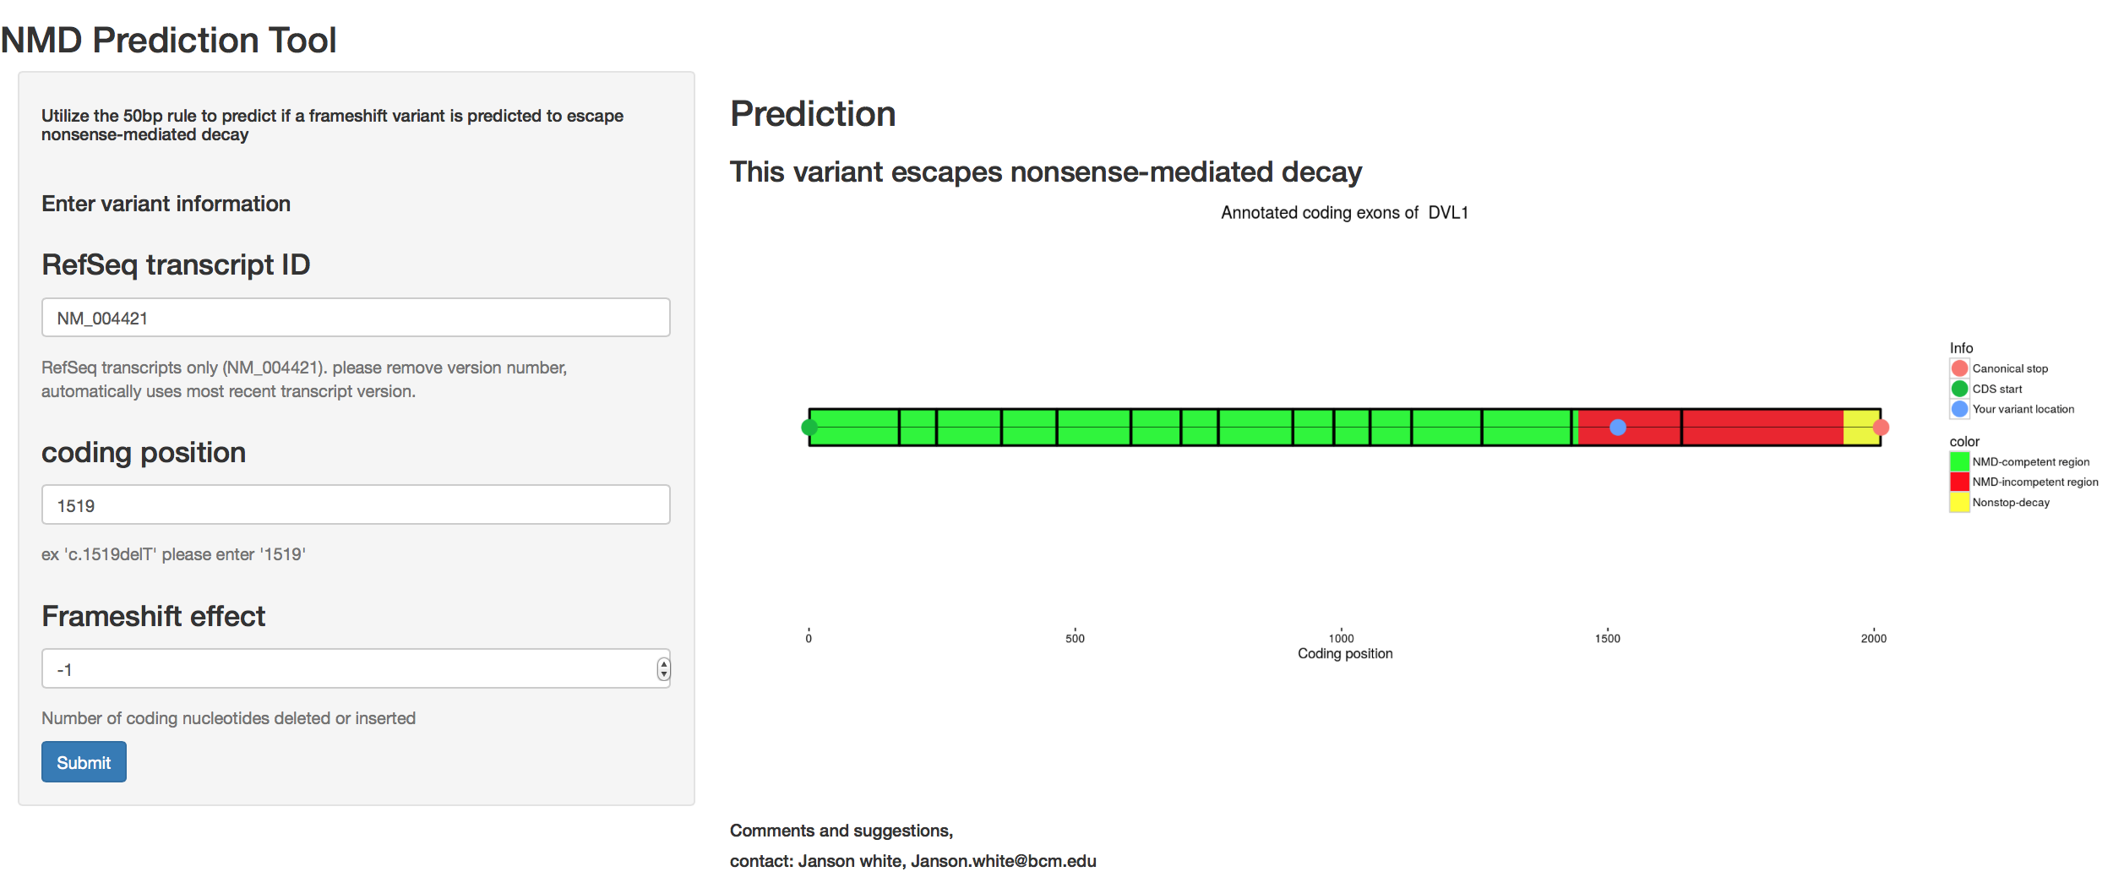
The prediction webtool
It can be difficult to manually predict mutant allele expression for frameshift variants!
https://nmdpredictions.shinyapps.io/shiny/
Notes:
Beta to the beta version
So with the algorithym we have an easy way making NMD predictions across massive number of varaints in seconds

Slide 19
Distribution of flagged PTC locations (boundaries) in all UCSC canonical transcripts
A region (NMD-competent region)
B region (NMD-incompetent region)
-1 frame
+1 frame

Slide 20
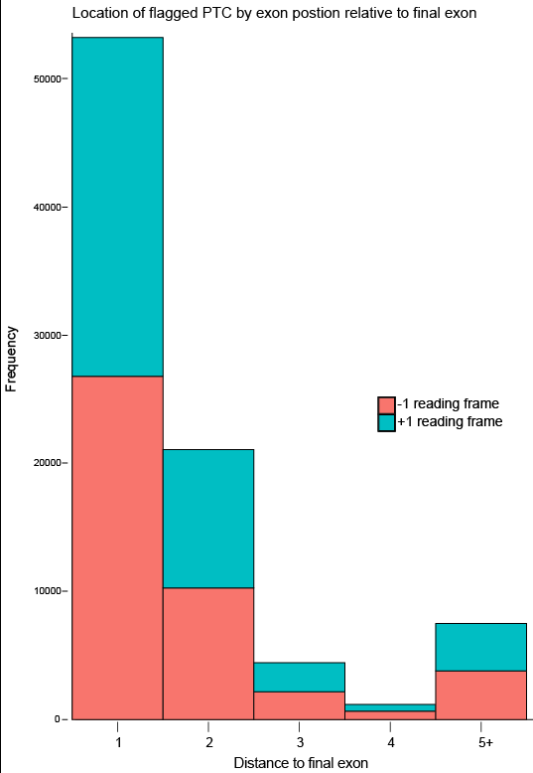
Distribution of flagged PTC locations (boundaries) in regards to distance to final exon
Location of NMD boundary by exon
A region (NMD-competent region)
B region (NMD-incompetent region)

Slide 21
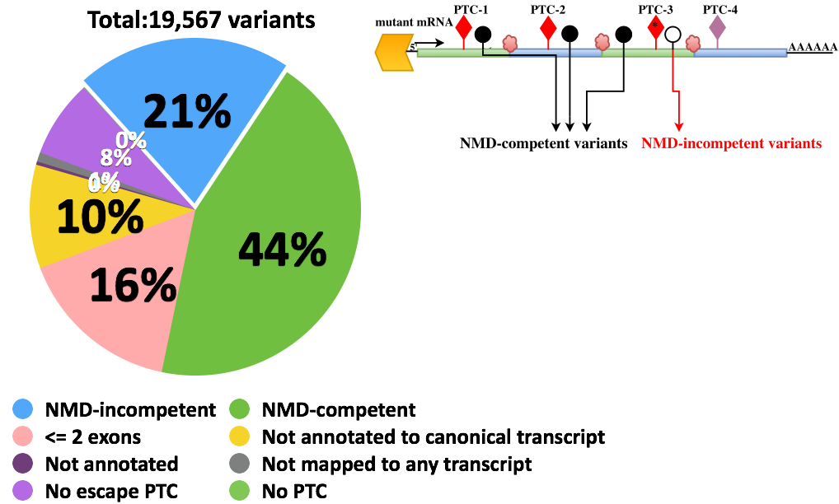
Classification of Baylor-CMG cohort frameshift variants
A region (NMD-competent region)
B region (NMD-incompetent region)

Slide 22
Step 3: Prediction of novel disease genes
CMG: Center for Mendelian Genomics
ARIC: Atherosclerosis Risk in Communities Study

Slide 23
NMD-incompetency enrichment score
A region (NMD-competent region)
B region (NMD-incompetent region)
ARIC database
length1
length2

Slide 24
Genes depleted for NMD-incompetent frameshift variants in ARIC database
A region (NMD-competent region)
B region (NMD-incompetent region)
DVL1
(-1 frame)
ARIC database
DVL1
(-1 frame)
Baylor-CMG database
611 genes in total depleted for NMD-incompetent frameshift variants in ARIC database
A subset of these genes have more than one frameshift variant predicted to escape from NMD in Baylor-CMG database in patients presented with similar clinical phenotypes.
Average pLI score=0.13

Slide 25
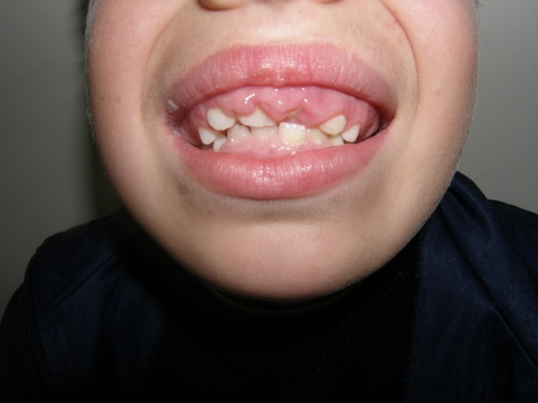
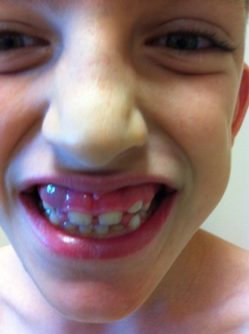
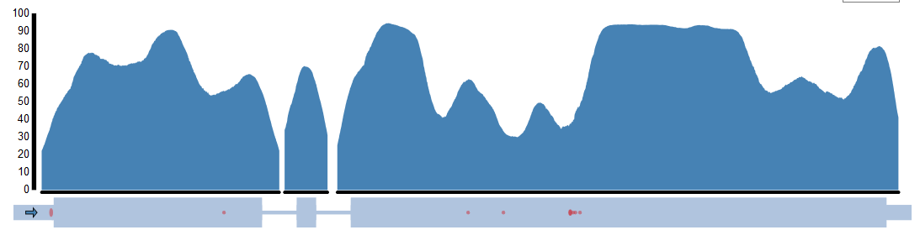
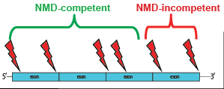
Candidate gene for NMD-specific disease - REST
BAB4235
BAB4122
Baylor-CMG
Patient ID | Variant | NMD-prediction | phenotype
BAB4122 | exon4:c.2865del- de novo | Escapes NMD | Hereditary Gingival Fibromatosis
BAB4235 | exon4:c.T1310A | Escapes NMD | Hereditary Gingival Fibromatosis
Yavuz Bayram and Janson White

Slide 26
Conclusions
NMD-incompetent frameshift variants → highly under-recognized in genomic analyses and likely result in a wide variety of human disease
Ranking of transcripts in terms of NMD-incompetency enrichment score metric → an effective and efficient tool in discovery of novel disease genes underlying Mendelian phenotypes due to production of truncated or C-terminally altered proteins
Reinterpretation of LOF intolerance score (pLI score) in ExAC database taking into account NMD-incompetent region definition

Slide 27




Co-authors:
Janson White
Shalini Jhangiani
Tomasz Gambin
Yavuz Bayram
Eric Boerwinkle
Richard A. Gibbs
Claudia M.B. Carvalho
James R. Lupski
This work was funded in part by the US National Human Genome Research Institute (NHGRI)/ National Heart Lung and Blood Institute (NHLBI) grant number U54HG006542 to the Baylor-Hopkins Center for Mendelian Genomics (BHCMG)

