Slide 1







Broad Center for Mendelian Genomics year 1 update

Slide 2
Year 1 overview
substantial focus on infrastructure, resource and methods development
ramping up sequence production, with samples committed to fill year 2 capacity
remain focused on high-coverage exomes as workhorse, but also 173 WGS in exome-negative

Slide 3




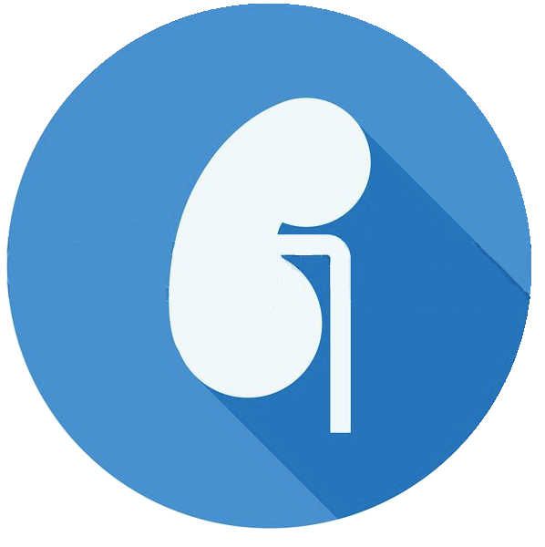

Disease areas of focus
Retinal
Cardiology
Neurodev
Muscle
Kidney
Orphan
202
136
566
138
103
372
Samples
Known Gene Cases
19.3%
Analysis Pending
16.3%
17.7%
14.1%
12.5%
Novel Candidate Genes
14
N/A
58
8
5
23

Slide 4
Major collaborations
Manton Center, Boston Children’s: orphan diseases
Joe Gleeson, UCSD: consanguineous neurodevelopmental
Eric Pierce, Mass Eye and Ear Institute: retinal diseases
Friedhelm Hildebrandt, Boston Children’s: renal disease
Newcastle University, UK: neuromuscular disorders
Tartu University, orphan diseases

Slide 5
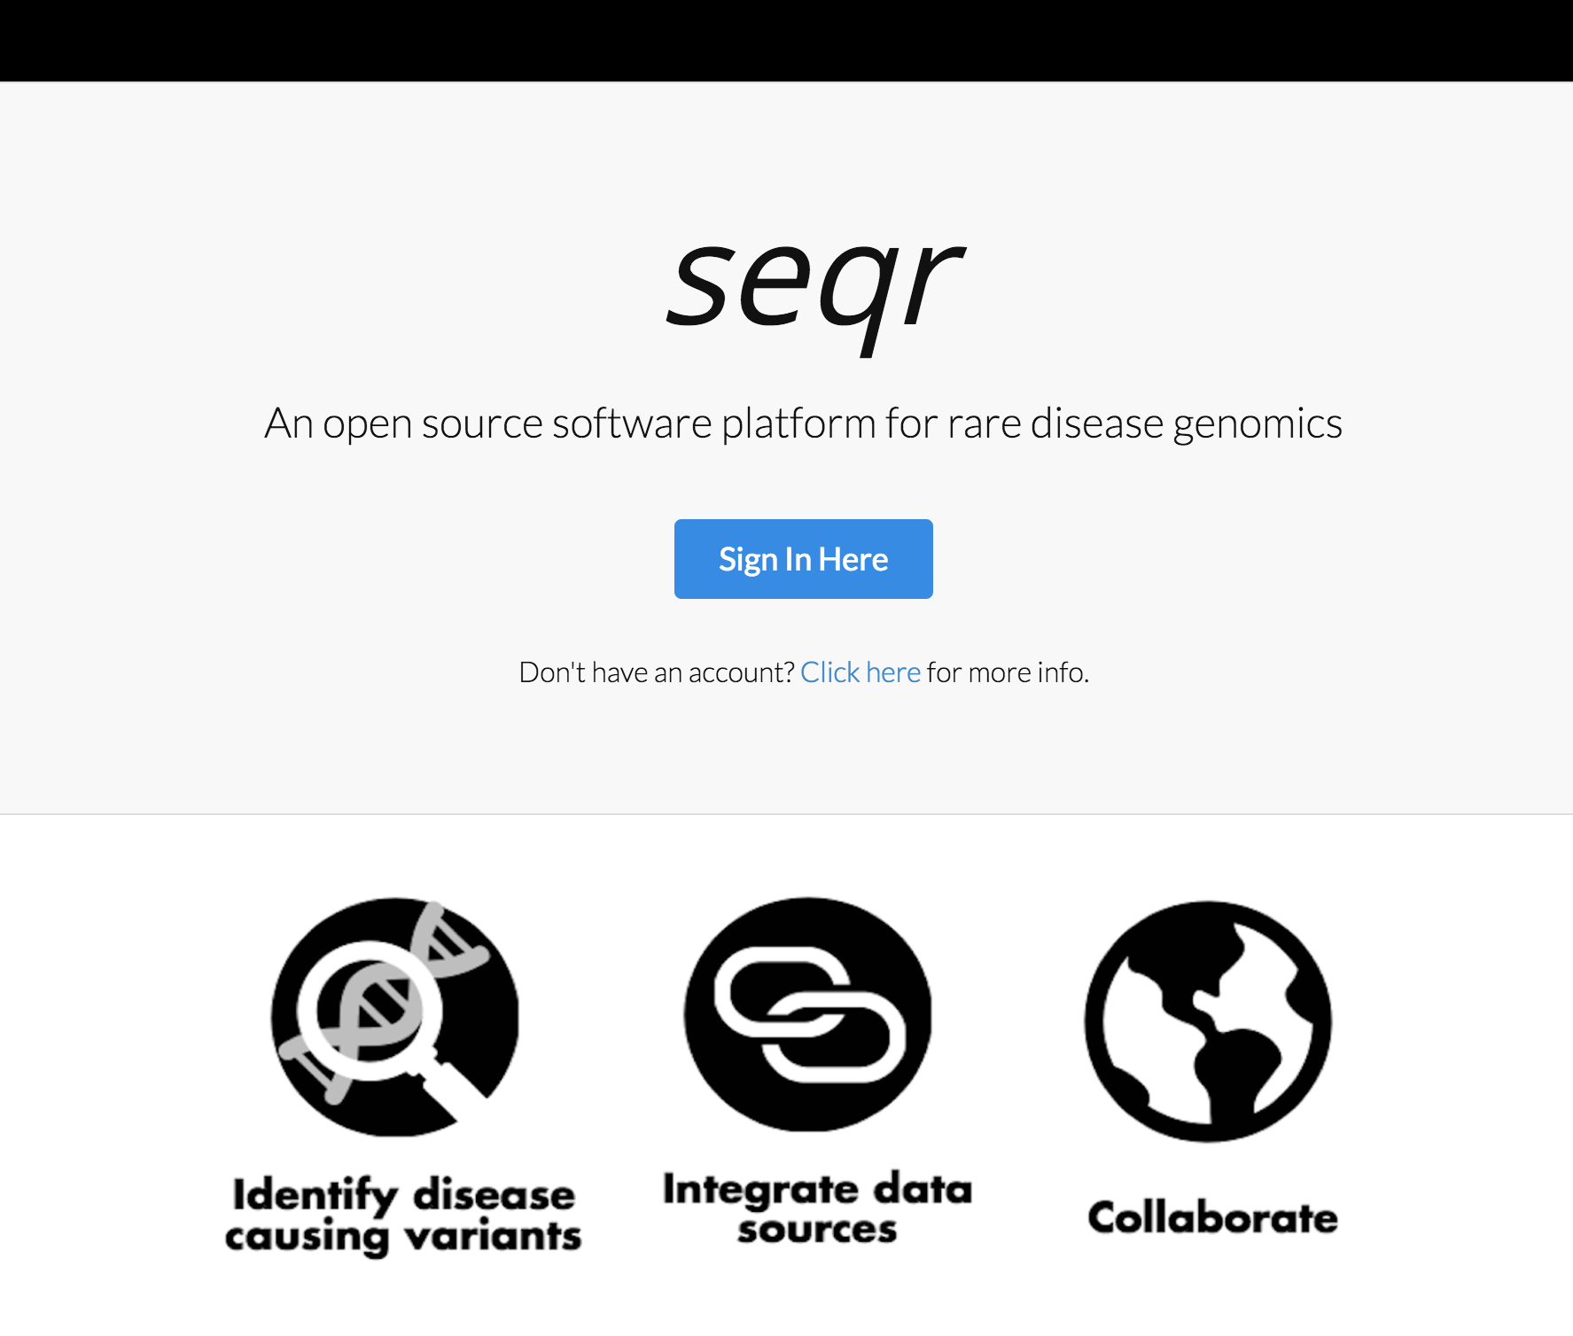
The seqr platform
Our platform for analysis and communication
  Case review
  Phenotype collection
  Variant filtration
  BAM file read visualization
  Gene/variant interpretation
  Communication of results
  Submission to Matchmaker Exchange
Ben Weisburd
Harindra Arachchi

Slide 6
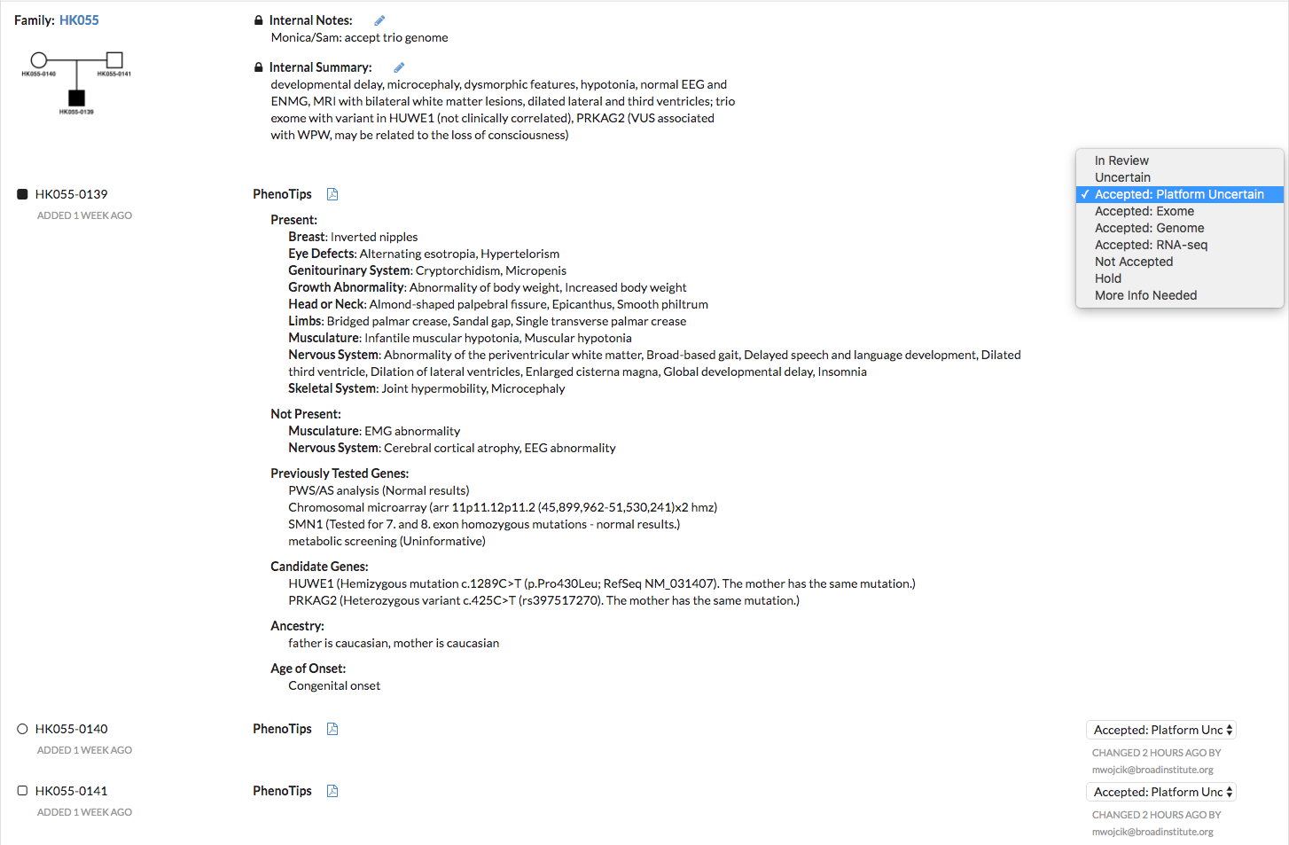
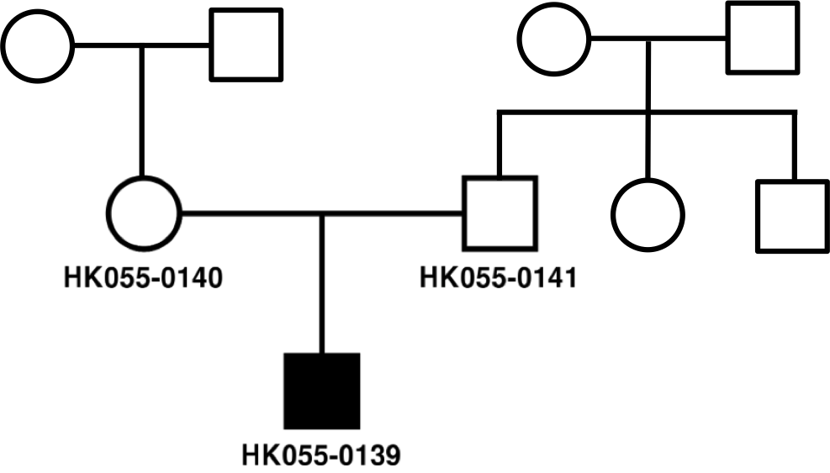
Case review in seqr
Case Review team communicates through internal notes and summary
Cohorts first prescreened with a simple 1 page questionnaire
Cohorts have added power for gene discovery, so we may take some cases with less prescreening for good cohorts
Pedigree
Case Review team selects updates status of review and the final decision on a case
HPO terms
Phenotype information is entered by collaborators into a custom Phenotips form launched through seqr including…
Prescreening
Collaborators can see decisions and also receive list of accepted samples
Decision is made on individual level so can select best family members for trio, quad, etc.

Slide 7
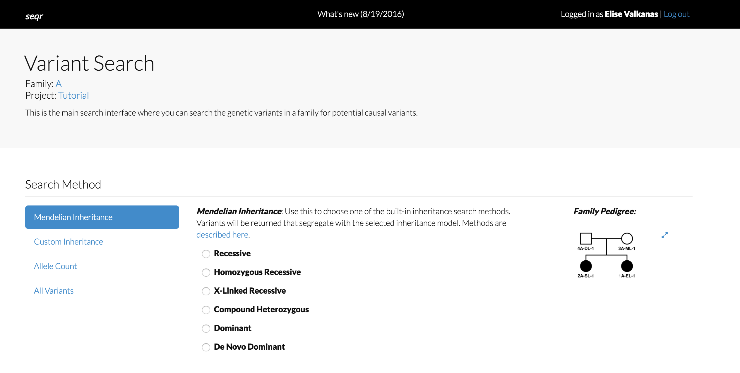
Variant searching in seqr
More filters
  Functional class
  Variant type
  Allele frequency- 1000 genomes, ExAC, gnomAD WES/WGS
  Genomic location- coordinates, gene list
  In silico predictors of deleteriousness
  Call quality

Slide 8
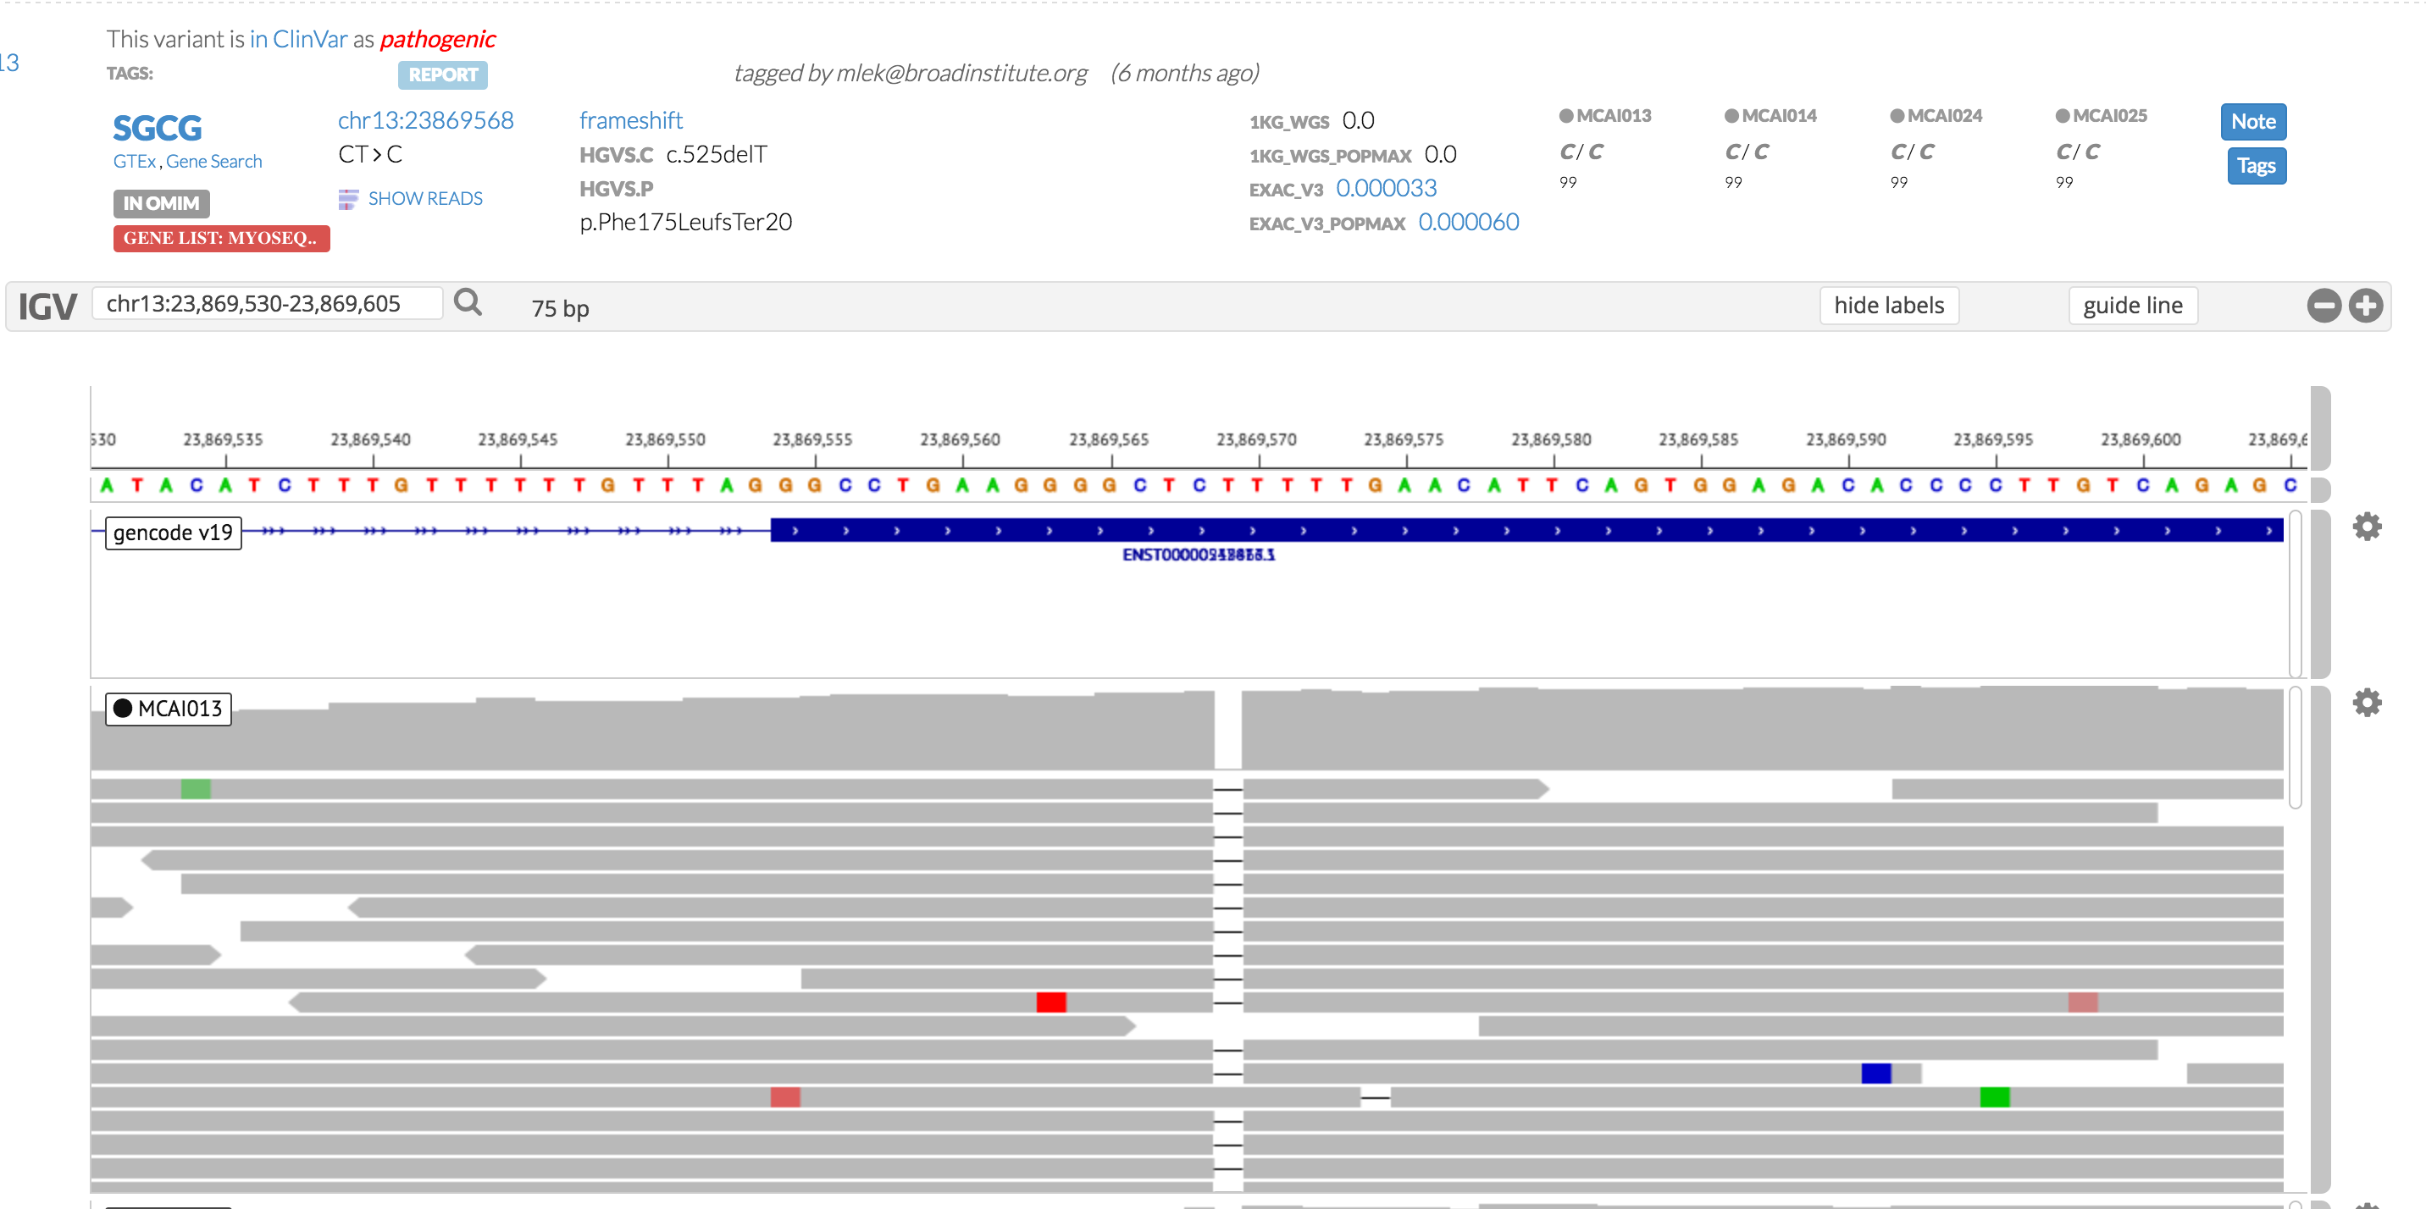



Read visualization
1A-EL-1

Slide 9
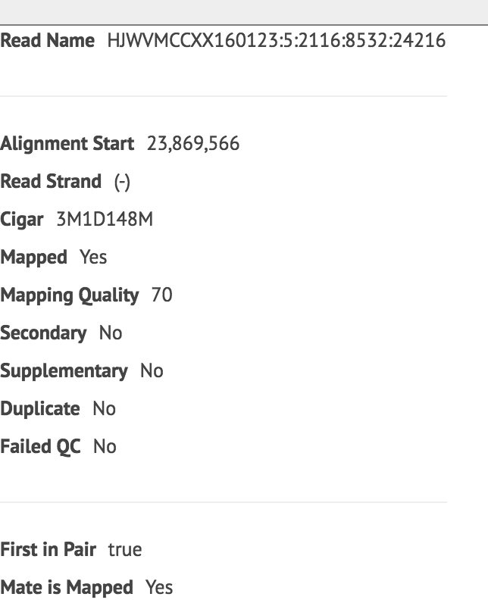
Read visualization
1A-EL-1

Slide 10
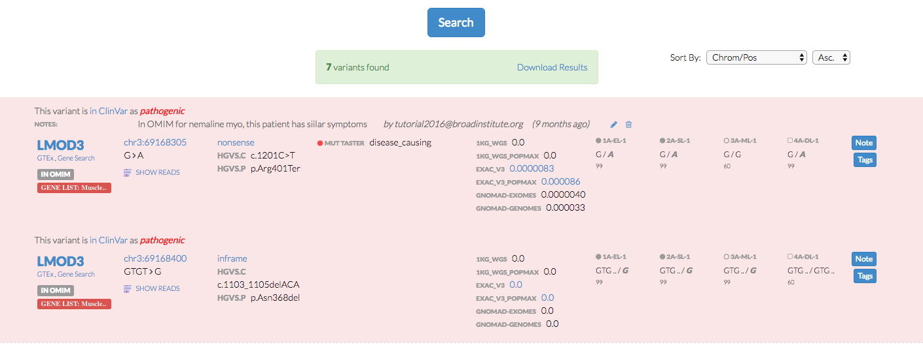
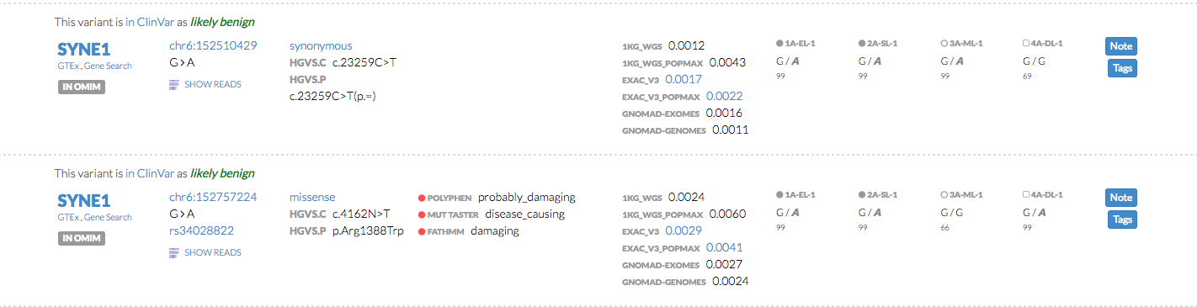

Slide 12
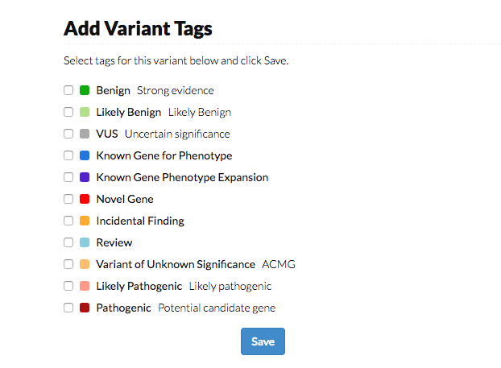
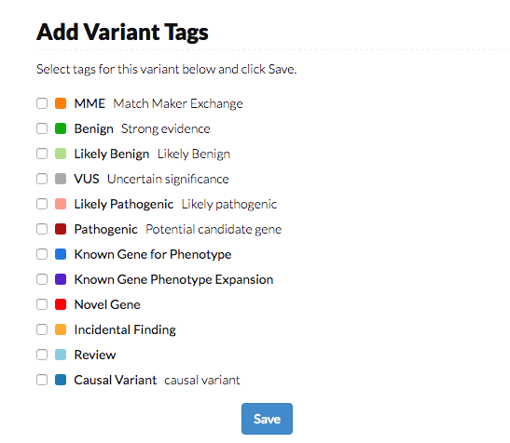

Slide 13


Slide 14


Slide 16


Slide 17
Coming soon to seqr
CNV integration for both exomes and genomes
Improved splice variant prediction
Non-coding annotations
Transcript-specific annotation
RNA-seq integration

Slide 18
Incorporating better reference data sets

Slide 19
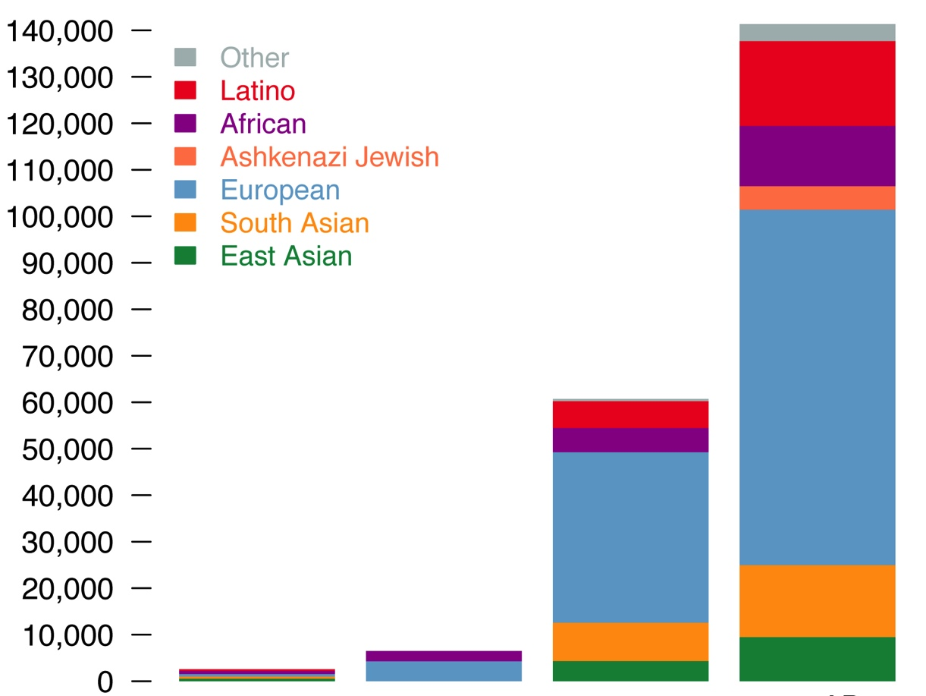
The Genome Aggregation Database (gnomAD)
123,136 exomes and 15,496 whole genomes
Exomes and genomes called separately but analyzed together
New populations (e.g. >5K Ashkenazi Jewish)
1000 Genomes
ESP
ExAC
gnomAD

Slide 20



The Genome Aggregation Database (gnomAD)
East Asian
South Asian
Latino
African
European
# variants remaining after 0.1% filter
ESP
ExAC
1000 Genomes
ESP
ExAC
gnomAD

Slide 21
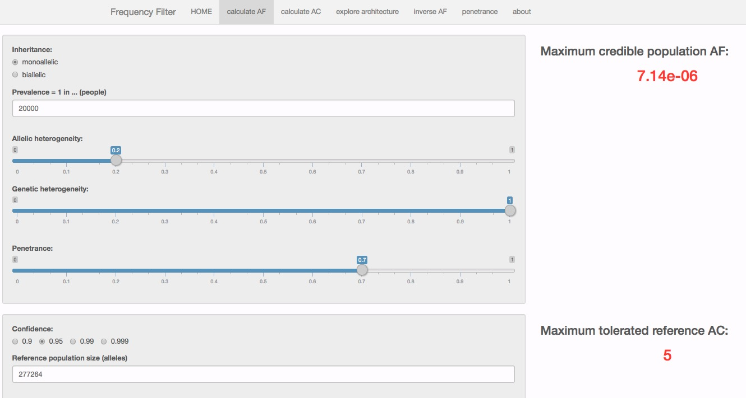
Statistical framework for variant filtering
Prevalence of a condition: 1 in 20,000
Most common pathogenic variant explains what % of cases?: 20%
# of genes that cause condition: 1
Penetrance: 70%
Control alleles sequenced (i.e. coverage in gnomAD): 277,264
https://jamesware.shinyapps.io/alleleFrequencyApp/
Whiffin*, Minikel* et al., bioRxiv 073114

Slide 22
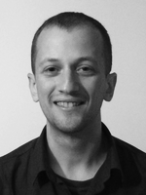

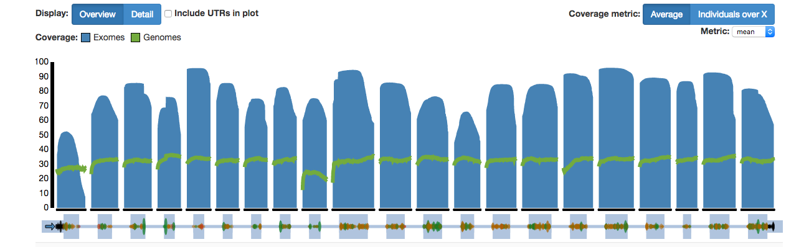
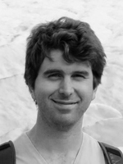
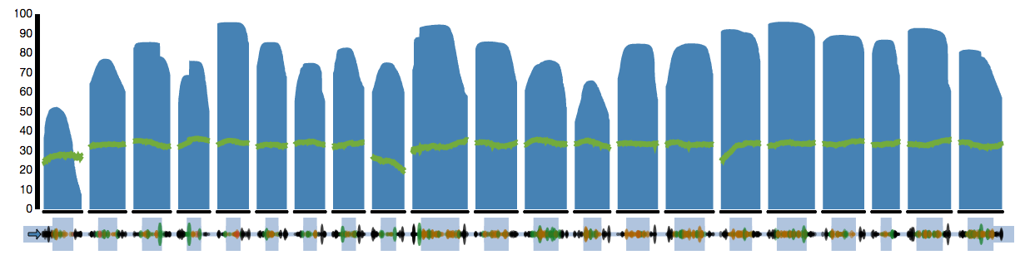
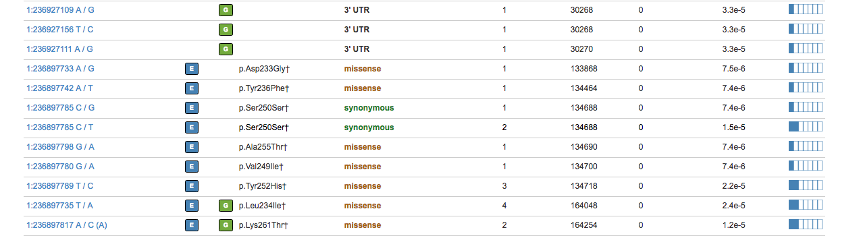
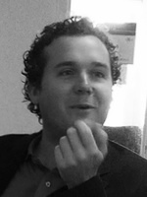
Accessing the data
Ben
Weisburd
Matthew
Solomonson
Konrad
Karczewski
gnomad.broadinstitute.org

Slide 23
Improving diagnosis with RNA-seq

Slide 24
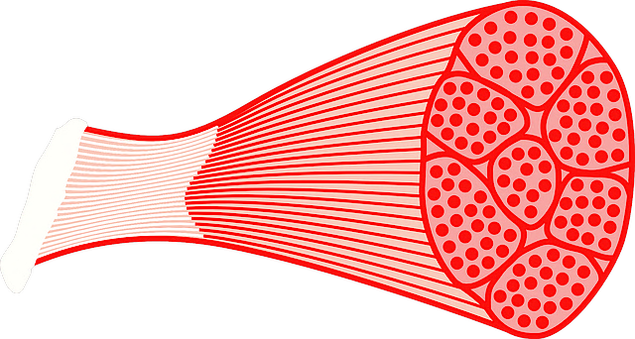

An analysis framework for patient transcriptome sequencing
Patient muscle
(n=63)
GTEx control muscle
(n=184)
RNA-sequencing
QC comparison of patient and GTEx RNA-seq
Variant Calling
RNA
WES
T
T
A
A

Slide 25
Four undiagnosed collagen-VI myopathy patients
Four patients with collagen VI myopathy with
extensive prior testing including:
Clinical sequencing of three COL6 genes
cDNA sequencing from fibroblasts of COL6 genes
Deletion/ duplication testing
Exome sequencing
Whole genome sequencing
Carsten Bonnemann
Francesco Muntoni
Notes:
She was wheelchai—bound by the age of 6

Slide 26
RNA-seq identifies an intronic splice-gain in COL6A1
376
Patient 1
423
104
153
Patient 2
389
376
91
86
159
Patient 3
174
31
38
Patient 4
178
162
27
31
Control
122
86
COL6A1

Slide 27
RNA-seq identifies an intronic splice-gain in COL6A1
Patient
AAG|GGCGC
AAG|GTCGC
Donor splice
site-creating variant

Slide 28
RNA-seq identifies an intronic splice-gain in COL6A1
Patient
AG|ACCGC
AG|ACCGC
AAG|GGCGC
AAG|GTCGC
Acceptor splice site
activated
Donor splice
site-creating variant

Slide 29
RNA-seq identifies an intronic splice-gain in COL6A1
Gly-X-Y
Gly-X-Y
In-frame inclusion of 24 amino acids into the transcript disrupts the glycine-glycine repeats, known dominant-negative effect
Intronic splice creating variant is de novo in all 4 patients
Now found recurrently in 27 other cases!

Slide 30
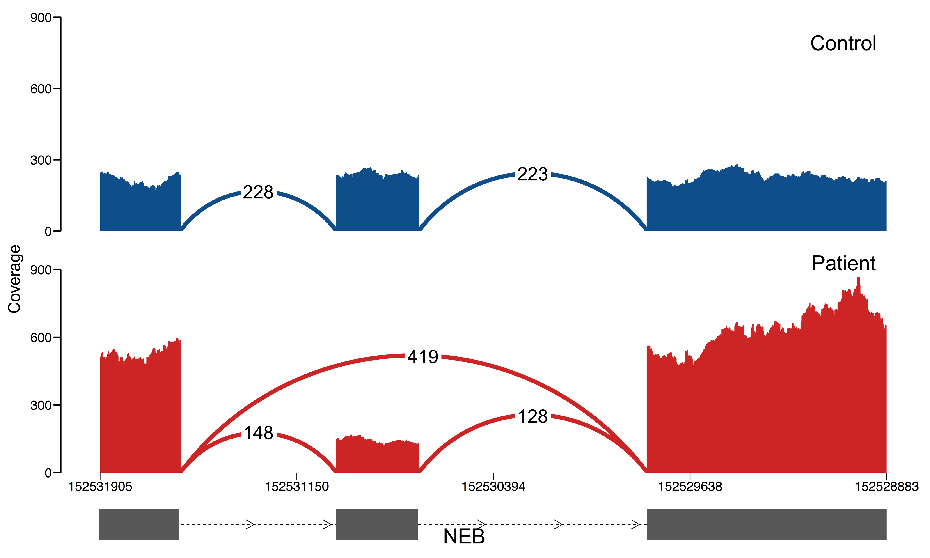
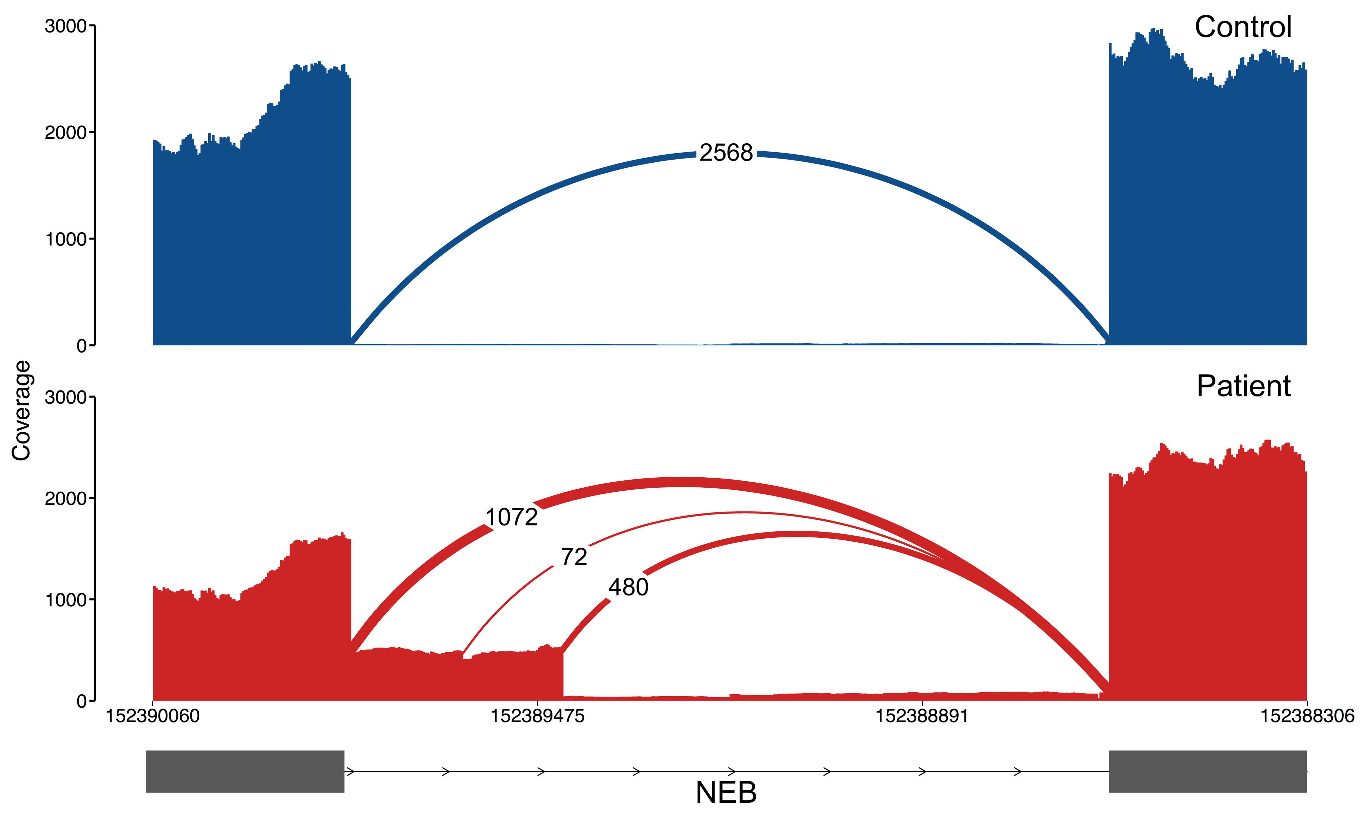
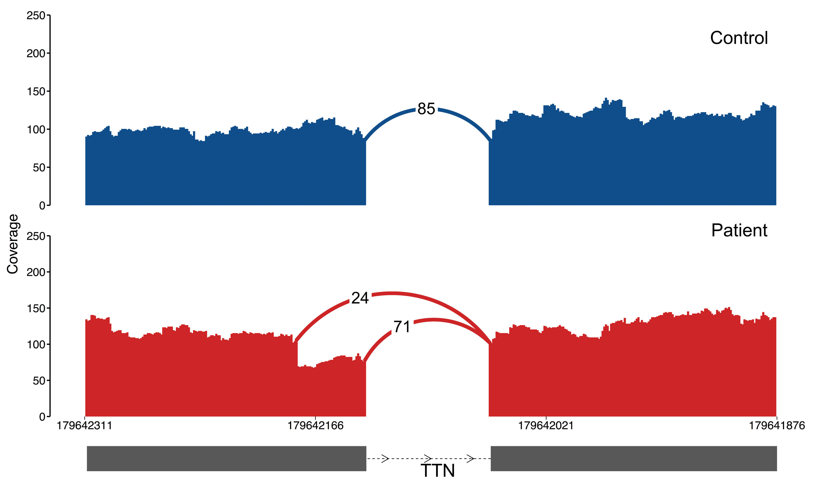
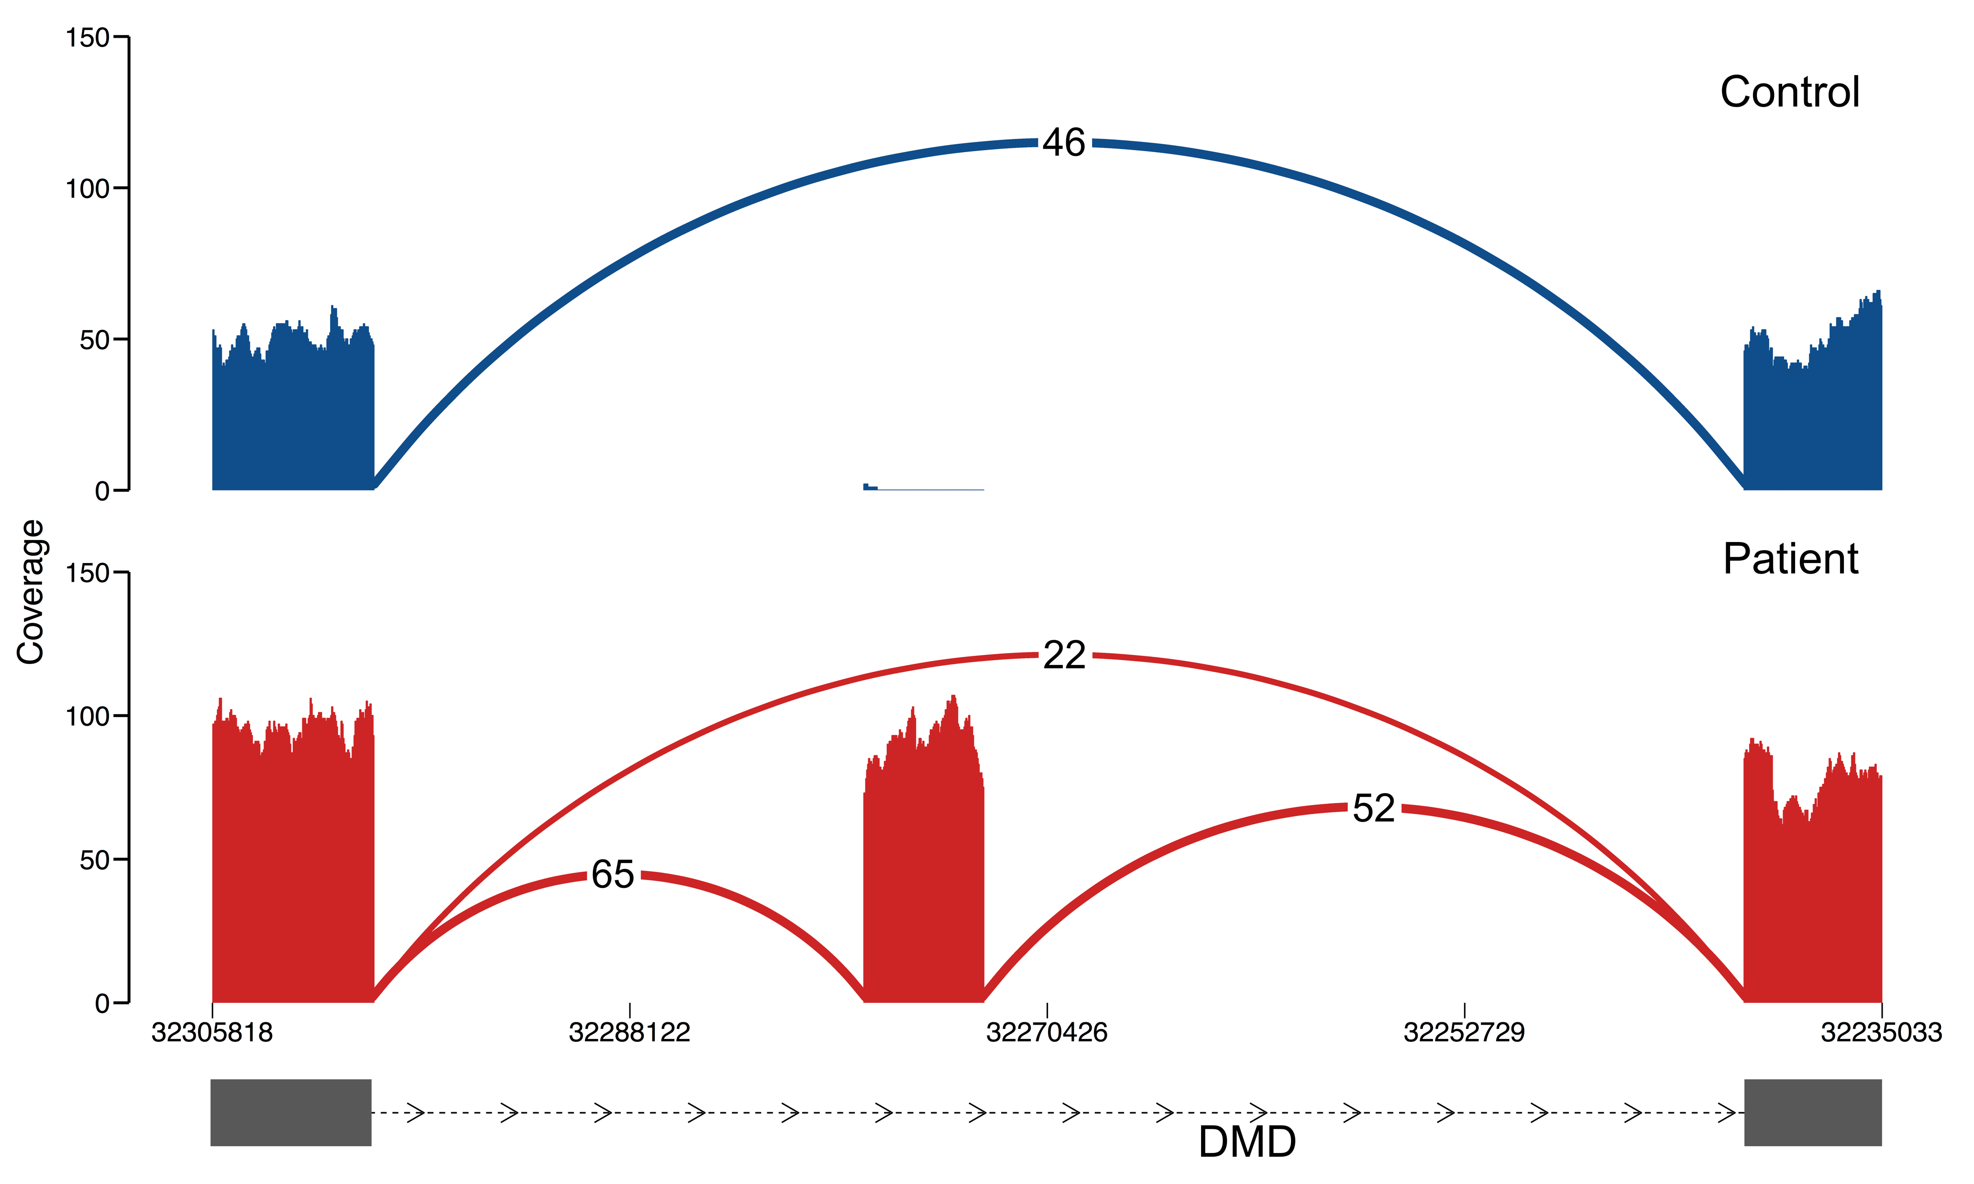
35% diagnosis rate in exome-unsolved cases
Exon skipping
Exon extension
Now at over 100 muscle disease cases with muscle RNA-seq
Expanding to kidney biopsies, fibroblasts in other disease areas
Exonic splice-gain
Intronic splice-gain

Slide 31
Case study: SMCHD1 and arhinia

Slide 32
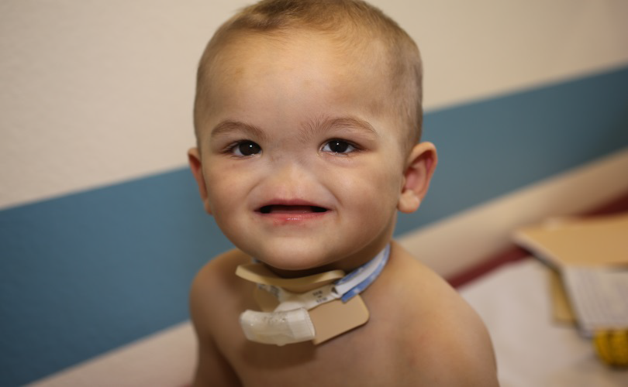
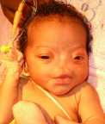
Congenital arhinia
Absent external nose and olfactory system
Rare congenital malformation (80 cases)
Full phenotypic spectrum not systematically described
    Other craniofacial defects: eyes, ears, palate, and maxilla
    Bosma triad (n= 17): Arhinia + ocular + reproductive defects
Unknown genetic cause despite genetic testing (Karyotype, Array-CGH, candidate gene seq)
Mike Talkowski
Notes:
Congenital arhinia is defined as the complete absence of the external nose and olfactory system. It is an extremely rare malformation with only 80 cases reported in the past century. Because of the rarity of this condition and because of the multiple specialists involved in the care of these patients, the full phenotypic spectrum of arhinia has not been systematically catalogued. A review of the 80 previous case reports suggests a high prevalence of associated craniofacial defects. 17 patients have been described with arhinia accompanied by ocular and reproductive defects, a triad delineated Dr. James Bosma in the 1980’s. This constellation of features suggests a NC or craniofacial placode defect, however, candidate gene approaches have been unsuccessful.
As an endocrinologist, I first encountered a patient with this syndrome when she presented for treatment of primary amenorrhea. By chance, her mother had kept a newspaper clipping from more than 20 years ago describing a man with the same syndrome. Through a bit of detective work, I was able to locate this man who was now in his 70’s and who was one of the two patients described in Bosma’s original report.

Slide 33
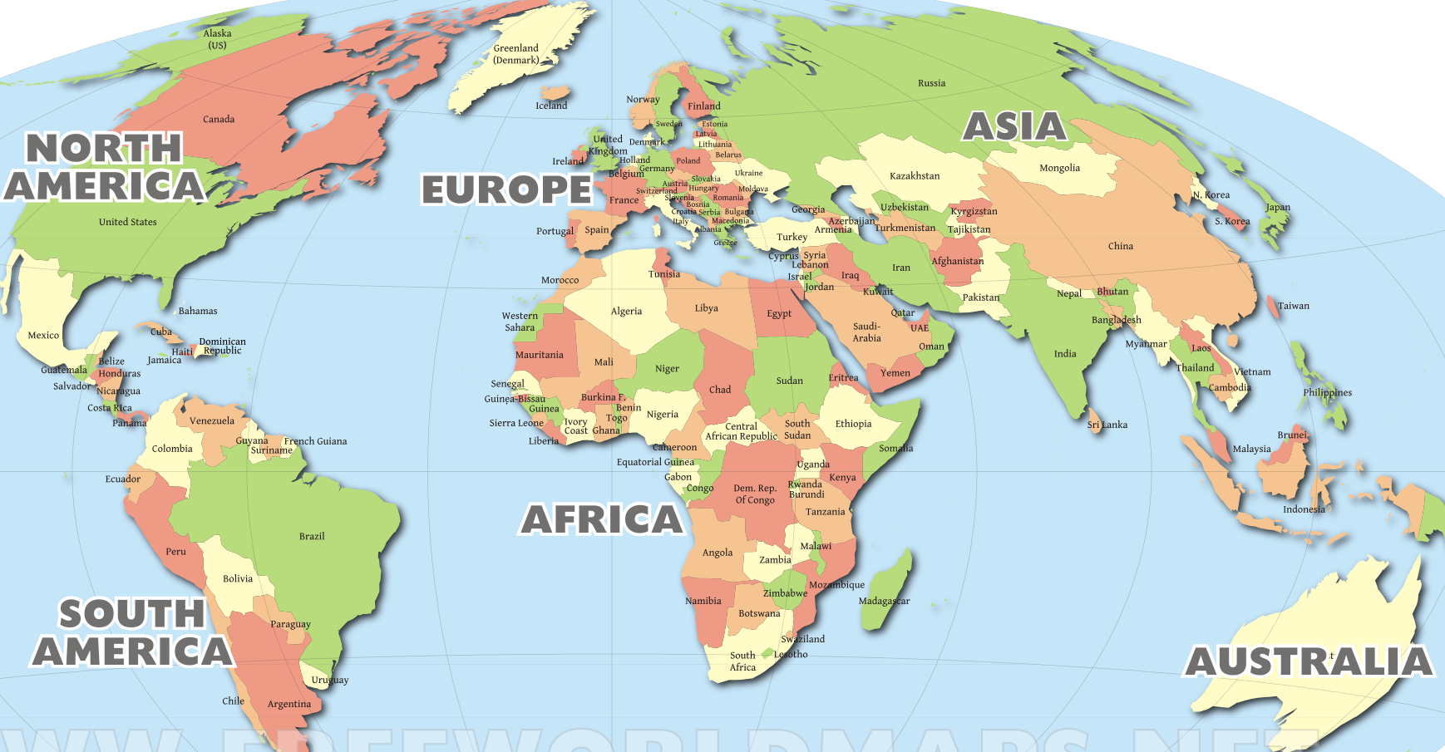
International consortium
Collected 40 cases of arhinia worldwide
Notes:
We established an international consortium to aggregate all available cases of arhinia, identify the genetic cause, and define the phenotypic spectrum.

Slide 34
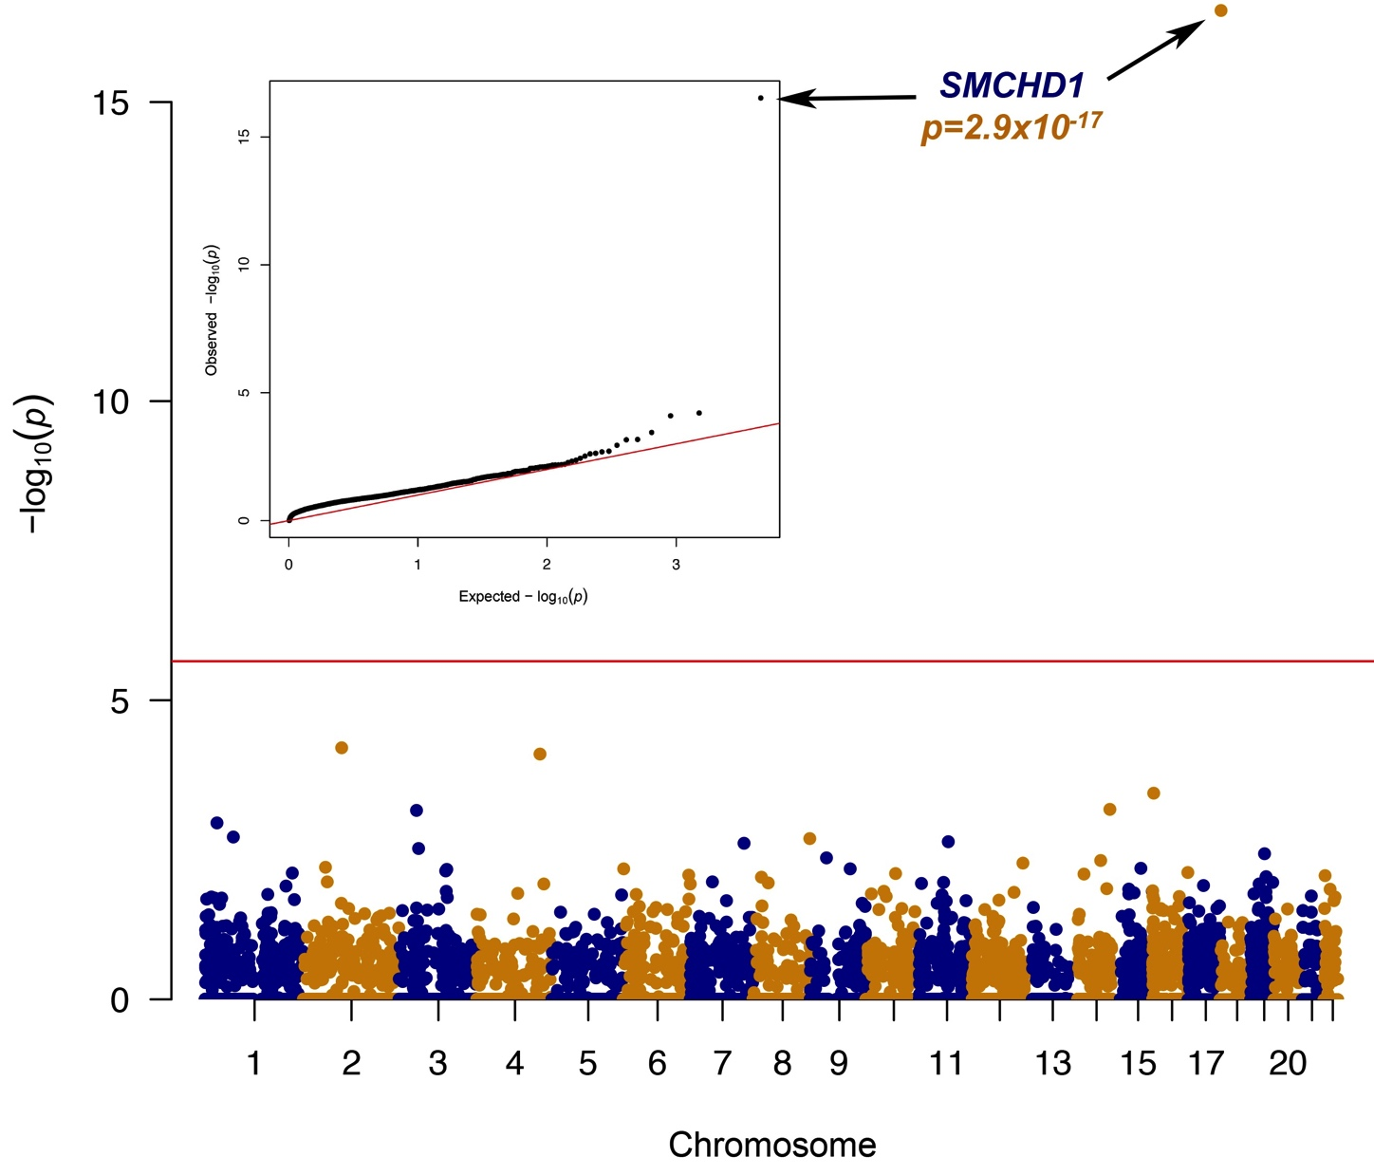
Accumulation of Rare Mutations in SMCHD1
Compared gene-based arhinia allele counts with Exome Aggregation Consortium (ExAC) controls (n=60,706)
  Gene Burden Filters
  EXAC adjusted freq of 0.1%
  Nonsynonymous and splice
  No sex chromosomes
  Mean Depth of 10 reads
  Mapping Quality >10
Notes:
We collect a cohort of 40.

Slide 35
Conservation of SMCHD1 ATPase Domain
Arhinia (n=31)
Rare Mutations in SMCHD1 (MAF<0.0001)
Missense
Nonsense/Frameshift
Inframe deletion/insertion
# Mutations
ATPase#
SMC
Hinge*
FSHD2 (n=89)
# Mutations
ATPase#
SMC
Hinge*
Exons 1-19
ExAC (n=656)
# Mutations
ATPase#
SMC
Hinge*
Notes:
Single mutation found in both FSHD2 and Arhinia. Kaitlin Samocha

Slide 36
Samples in the pipeline
Retinal
Cardiology
Neurodev
Muscle
Kidney
Orphan
202
136
566
138
103
372
Samples
Solved
19.3%
Analysis Pending
16.3%
17.7%
14.1%
12.5%
Novel Candidate Genes
14
N/A
58
8
5
23
Queue
500
300
300
300
400
600

Slide 37
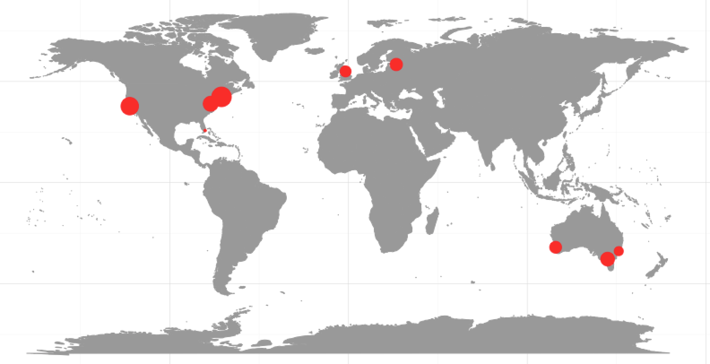
CMG acknowledgments
Co-Director Heidi Rehm
Analysis
Monkol Lek
Thomas Mullen
Elise Valkanas
Kristen Laricchia
Anne O'Donnell Luria
Beryl Cummings
Jamie Marshall
Monica Wojcik
Miriam Udler
Mike Wilson
Simon Sadedin
Software
Ben Weisburd
Harindra Arachchi
Laura Gauthier
Coordination
Hayley Brooks
Samantha Baxter
Jaime Chang
Namrata Gupta
Broad Genomics Platform
Stacey Gabriel
Steven Ferriera
Susanna Hamilton
Steering Committee
Joe Gleeson
Eric Pierce
Alan Beggs
Mark Daly
Christine Seidman
David Sweetser
Vamsi Mootha
Our local and international collaborators
Our patients and their families
Funding
UM1HG008900

Slide 38
gnomAD acknowledgments
Analysis
Konrad Karczewski
Laurent Francioli
Kristen Laricchia
Monkol Lek
Anne O'Donnell Luria
Kaitlin Samocha
Laura Gauthier
Mark Daly
Production
Eric Banks
Kathleen Tibbetts
Charlotte Tolonen
Dave Shiga
Jose Soto
Yossi Farjoun
Laura Gauthier
Sam Novod
Valentin Ruano-Rubio
Bradley Taylor
George Grant
Everyone in DSP
Intel GenomicsDB
Website
Ben Weisburd
Konrad Karczewski
Matt Solomonson
Daniel Birnbaum
Broad Genomics Platform
Stacey Gabriel
Steven Ferriera
Susanna Hamilton
Ethics
Jessica Alföldi
Namrata Gupta
Andrea Saltzman
Molly Schleicher
Stacey Donnelly
Hail
Cotton Seed
Jon Bloom
Alex Bloemendal
Tim Poterba
Jackie Goldstein
Dan King
Ben Neale
Funding
NIGMS R01 GM104371
NIDDK U54 DK105566
Broad Institute
The 107 PIs of the gnomAD Consortium
gnomad.broadinstitute.org/about
macarthurlab.org/jobs

Slide 39
Diagnosis rate with RNA-seq
Reporting a 35%
diagnosis rate
21%
66%
50%

Slide 40
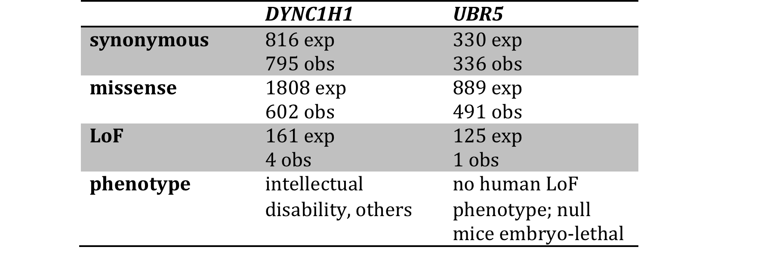
Detecting genes depleted for LoF
Loss-of-function
0.97
1.02
0.33
0.55
Observed
0.03
0.01
Expected
Kaitlin Samocha

Slide 41
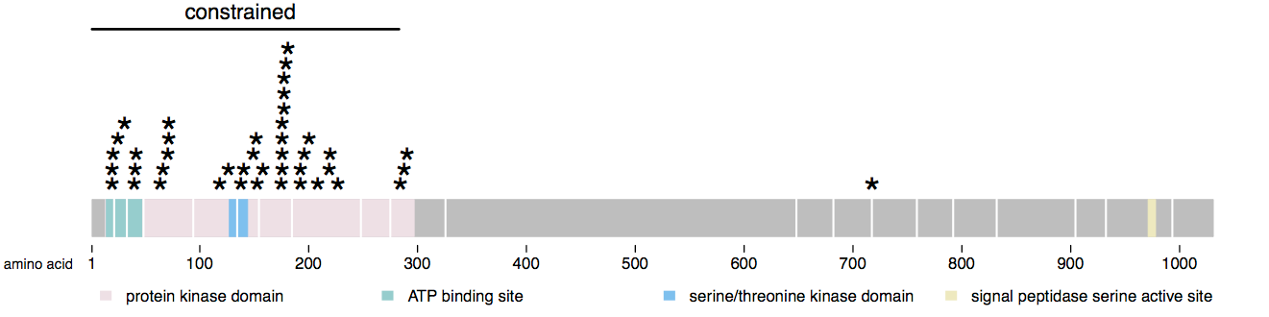
Detecting regions depleted for missense
depleted for variation in ExAC
enriched for mutations in patients
CDKL5 mutations cause severe infantile seizures
Constraint would allow us to correctly prioritize the N-terminal region, even with no prior causal mutations
Overall, 89% of ClinVar missense mutations in severe HI genes fall within the 14% most constrained sequence
Kaitlin Samocha

Slide 42
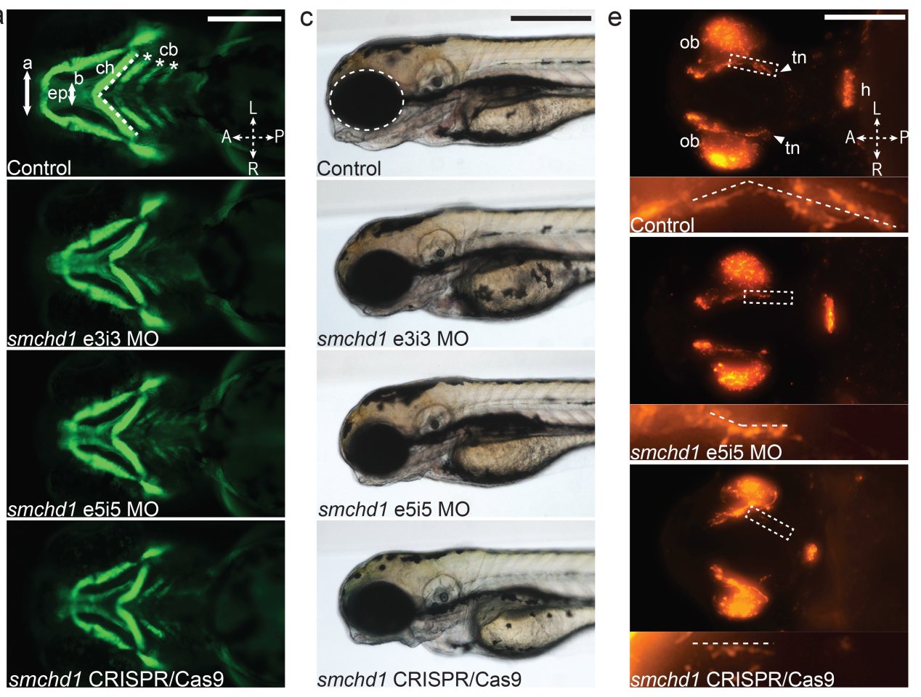
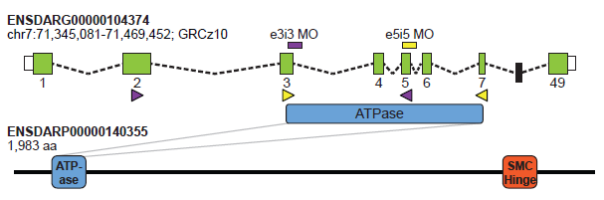

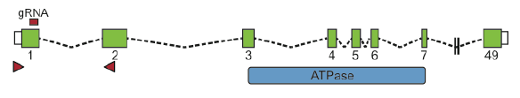
In vivo modeling of smchd1 suppression in zebrafish
Facial Cartilage Eye Size GnRH neurons
Zebrafish SMCHD1 ortholog
and experimental design
Notes:
To answer this question, we worked with Erica Davis at the Duke Center for Human Disease Modeling to model these mutations in zebrafish, examining 3 phenotypes relevant to the Bosma triad.
The zebrafish genome encodes one smchd1 orthologue with the conserved ATPase and SMC hinge domains and does not contain the D4Z4 locus, allowing us to study phenotypes relevant to arhinia that are independent of FSHD risk.
As there is no zebrafish structure homologous to the human nose, we examined facial cartilage using a transgenic line with a collagen-GFP reporter. Zebrafish eye development and GnRH neuronal ontogeny, however, are largely conserved between species.
We targeted the ATPase domain with 2 different Mos and phenotyped the embryos between 1.5 and 3 days post-fertilization. Here you can see that the morphant embryos have narrower ethmoid plates, a structure analogous to the human palate, and abnormal lower jaw structures, including a broader ceratohyal arch angle, and fewer paired ceratobrachial arches (normally 5). Eye size was also significantly reduced. Whole-mount immunostaining of GnRH neurons revealed that the hypothalamus and olfactory bulbs were intact, but the length of the terminal nerve, shown here, where GnRH type 3 neurons reside, was reduced by half.
Importantly, all of these phenotypes could be rescued by co-injection of WT human SMCHD1 mRNA.
Next, we used CRISPR/Cas9 to disrupt the coding sequence of SMCHD1 and confirmed all 3 findings in an F0 mutant model.

Slide 43
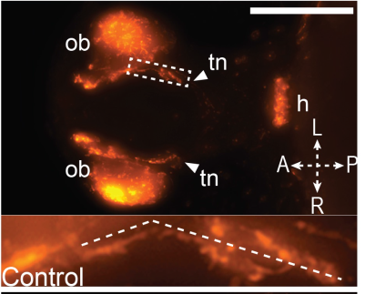
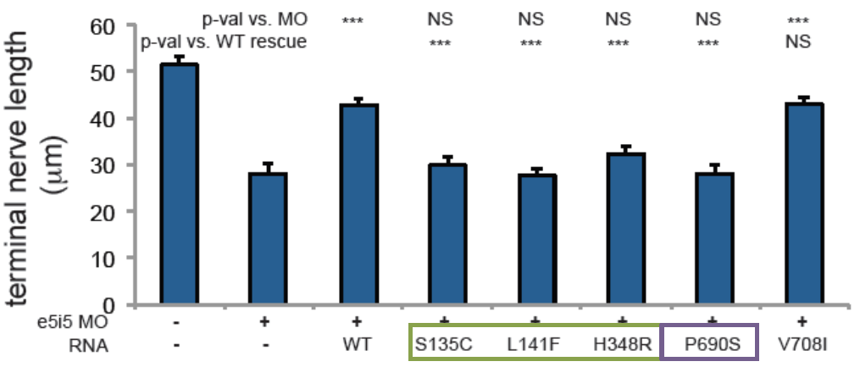
Allele-specific rescue
Terminal nerve length (µm)
MO
wt
arh arh arh FSHD
ExAC
Terminal nerve
length (µm)
MO and Human SMCHD1 mRNA
Notes:
Finally we explored the functional impact of 3 recurrent arhinia variants and 1 FSHD2 variant using our most robust phenotype, the GnRH-positive terminal nerve length.
Control embryos had a length of 50um which was reduced by half in the exon 5 morphants. The shorter nerve length could be rescued significantly with WT human mRNA and with a presumably benign, common variant from the ExaC control database, but not with mutant mRNA bearing 1 of 3 recurrent arhinia variants or an FSHD2 variant.
These results therefore support a loss of function mechanism IN THE ZEBRAFISH but do not differentiate the pathways leading to arhinia vs. FSHD2.

