Slide 1
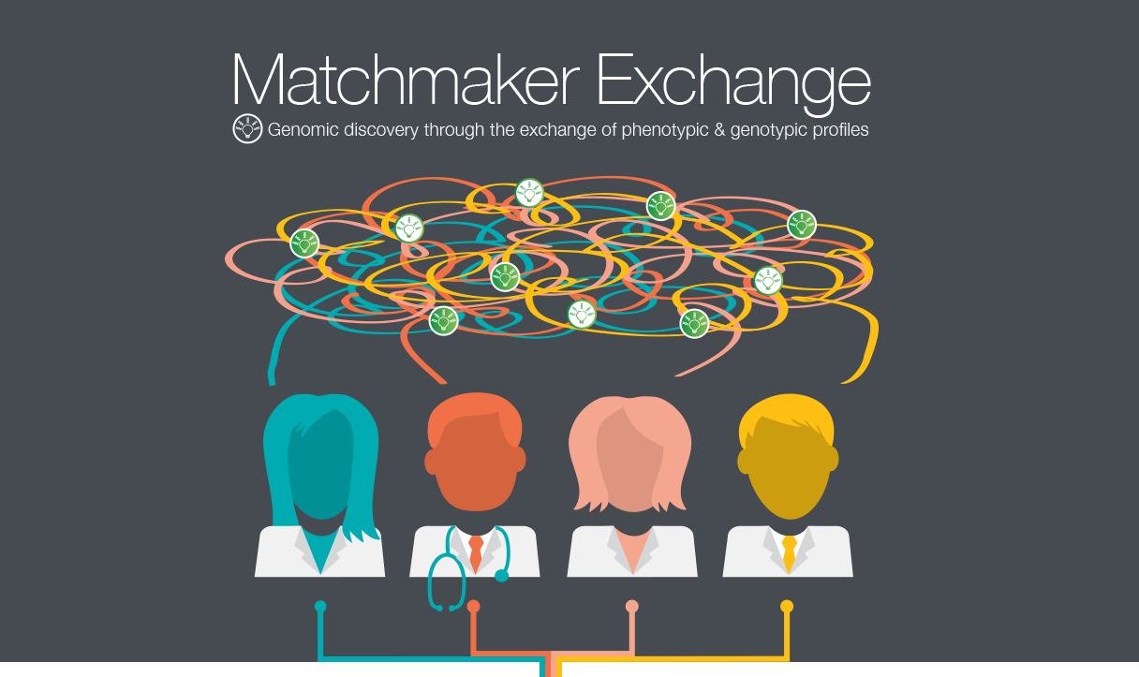

Slide 2
The Principles of Matchmaking
Courtesy of Joel Krier

Slide 3
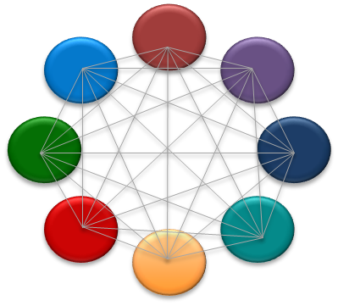
Federated Network
API Fields
ID (Mandatory) +/- Label
Submitter (Mandatory)
Phenotypic Features and/or
Gene Names (Mandatory)
Disorders (Optional) - OMIM or OrphaNet
Sex, Age of Onset, Inhertance (Optional)
Matching typically on gene with phenotype used for ranking
Supported today:
Match on Gene/Phenotype
1 strong candidate gene (e.g. de novo variant in GUS)
10 candidate genes each with rare variant
Match on phenotype Only
Match case to non-human models
Patient-initiated matching
Philippakis et al. The Matchmaker Exchange: A Platform for Rare Disease Gene Discovery. Hum Mutat. 2015;36(10):915-21.
Buske et al. The Matchmaker Exchange API: automating patient matching through the exchange of structured phenotypic and genotypic profiles. Hum Mutat. 2015;36(10):922-7

Slide 4
The Matchmaker Exchange: Connecting Matchmakers to Accelerate Gene Discovery
www.matchmakerexchange.org

