Slide 1
GeneMatcher and CMGs
Nara Sobreira, MD, PhD
Johns Hopkins University
McKusick-Nathans Institute of Genetic Medicine
Baylor-Hopkins Center for Mendelian Genomics
Notes:
Added “for WES” Could also work for WGS

Slide 2
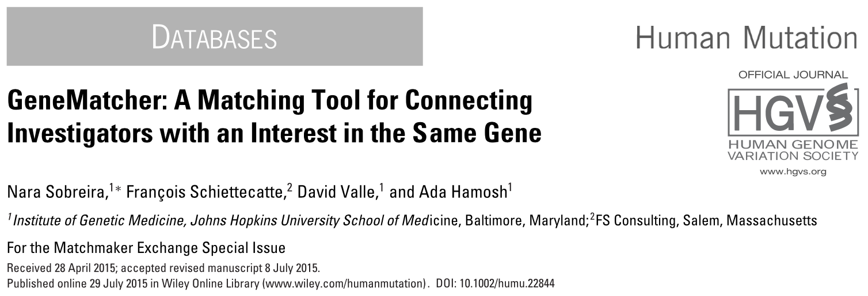
http://genematcher.org

Slide 3
GeneMatcher overview
Intended to find other patients / model organisms for novel candidate disease genes
Only deidentified data and genes, so no IRB required
Automated matching
Submitters choose to follow up at their discretion
Also matches on genomic location, phenotypic features, OMIM disease numbers

Slide 4
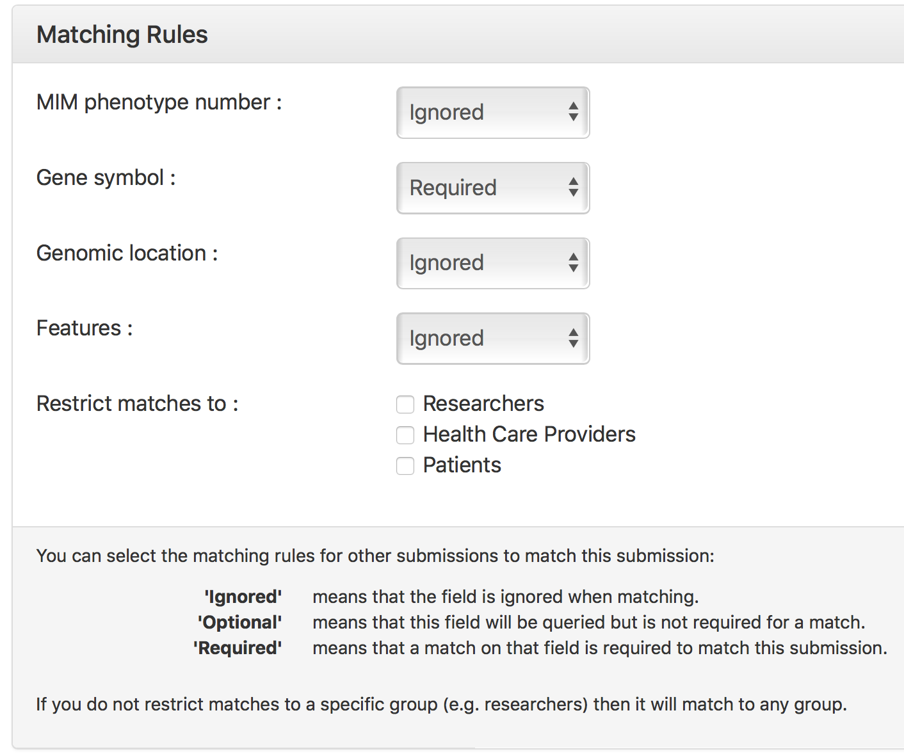
GeneMatcher matching options
Phenotypic
Features:

Slide 5
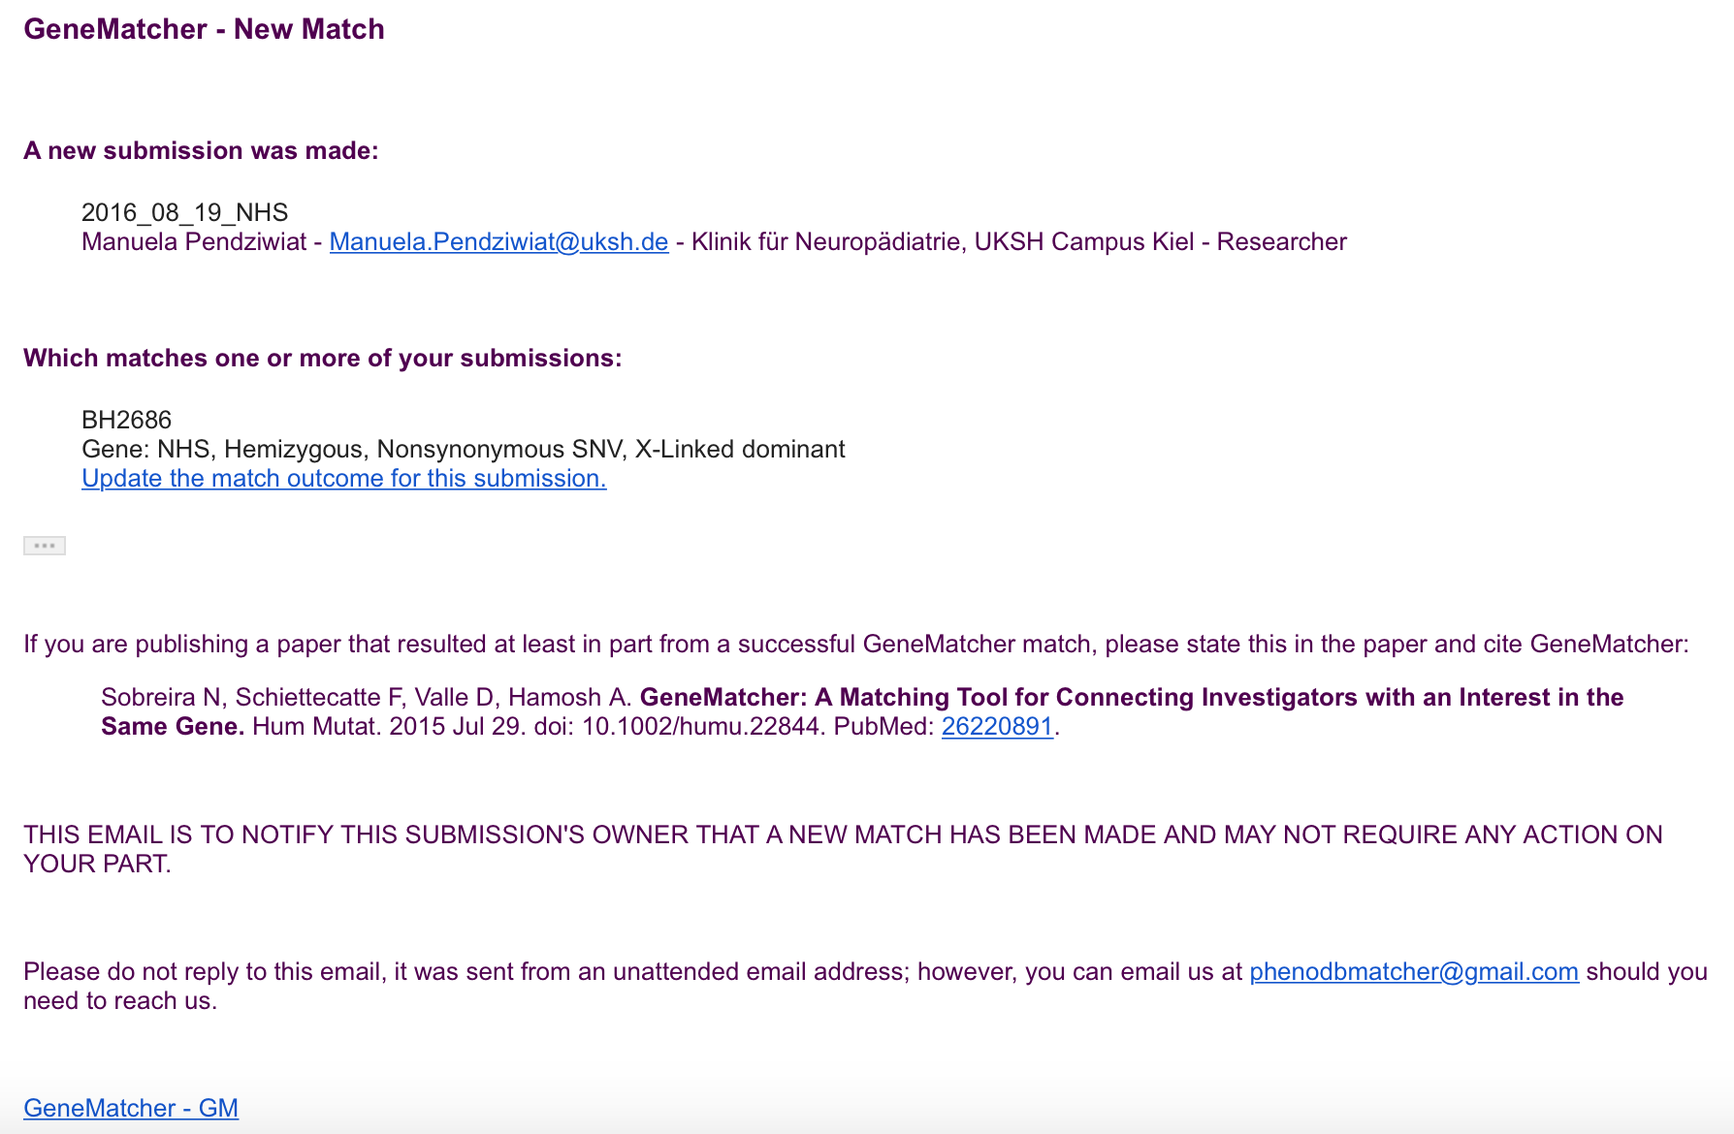
GeneMatcher email notification

Slide 6
BHCMG PhenoDB numbers
Holds data on 5,283 submissions
Including 68 cohorts ranging from 5-295
More than 6,225 samples have been sequenced
Phenotype data from more than 10,284 individuals
BHCMG has identified more than 256 novel disease genes
More than 478 known genes and 190 of them with phenotypic expansion
610 genes have been sent from BHCMG to GeneMatcher

Slide 7
From PhenoDB to GeneMatcher

Slide 8
From PhenoDB to GeneMatcher
General rules
less than 5 novel disease candidate genes per family
candidate genes are submitted as soon as the analysis is finished if the submitter agrees
7 months after the analysis was finished the novel candidate genes are submitted to GeneMatcher (< 5)
If > 5 novel candidate genes, we select the 5 best candidates using a number of different criteria
Not every gene in the gene discovery report table is in GeneMatcher
We submit genes to GeneMatcher that are not in the gene discovery report table

Slide 9
BHCMG GeneMatcher numbers
610 unique genes submitted
322 of them have matched
20 genes identified as novel disease genes. TELO2, SPATA5, HNRNPK, ATAD3A, EMC1, MIPEP, EBF3 are published and 13 others genes are under further investigation
Of the 106 matches:
Partial phenotype match - 16
Not a phenotype match - 67
Different inheritance mode - 36
False positive variant - 0
Variant didn't segregrate with phenotype - 1
Commonly mutated gene - 5
Same patient - 0

Slide 10
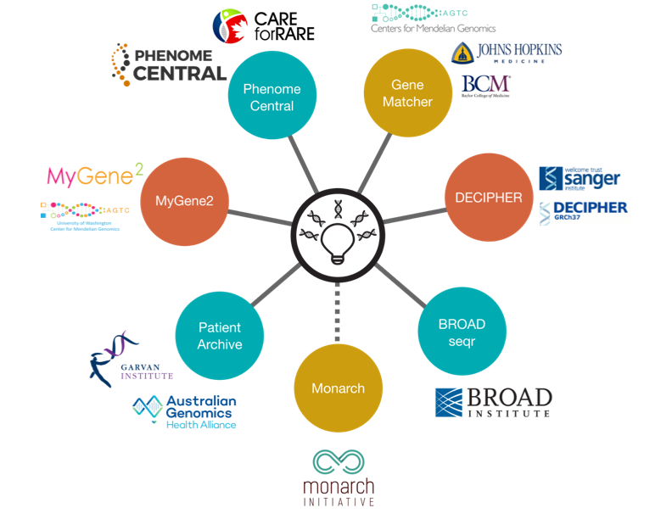
http://matchmakerexchange.org

Slide 11
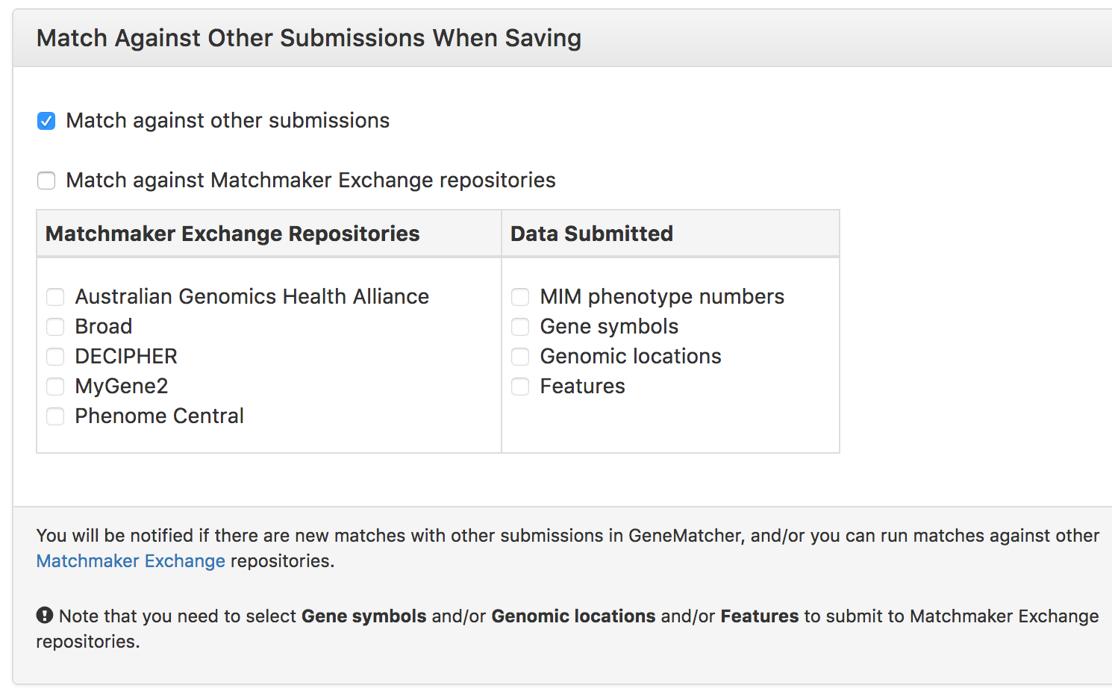
GeneMatcher options for MME

Slide 12
From GeneMatcher to other MME nodes
449 GeneMatcher users have had matches with one of the other MME repositories
44 matches - 449 GeneMatcher users have had matches

Slide 13
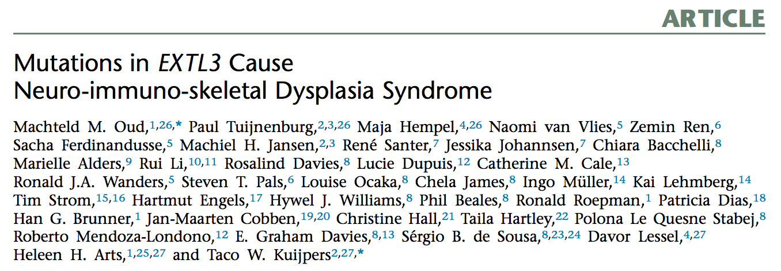
GeneMatcher - PhenomeCentral Match

Slide 14
Thanks for your attention!
Acknowledgements
Ada Hamosh, François Schiettecatte, Corinne Boehm, Julie Hoover-Fong, Reid Sutton, Jim Lupski, David Valle and others for PhenoDB
Ada Hamosh, François Schiettecatte and David Valle for GeneMatcher
The CMGs and especially the Baylor-Hopkins CMG team

