Slide 1
Matchmaker Exchange with matchbox at Broad Institute
Harindra Arachchi
Broad Center for Mendelian Genomics
Analytic and Translational Genetics Unit at the Massachusetts General Hospital

Slide 2
Overview
Analysis process
Analysis team organization
Post-match process
Contact information of submissions
Operational metrics
Discussion proposals

Slide 3
Analysis process
Matchmaker Exchange (MME)
patients
seqr
phenotypes
patients
matchbox
genotypes
comments
annotations
Insert phenotypes and genotypes into seqr
Analyze, annotate, comment, to collaboratively identify gene candidates
Add to MME as deemed appropriate by project team
Notes:
2) When does your center add genes to MME? Only at 7 months and then are added automatically? Or, do you systematically ask investigators if they would like to add genes to MME as soon as the gene is discovered even if before 7 months? Or do you only add to MME early upon request by investigators?

Slide 4
Project team organization
Centralized analyst meetings develop common methods, analyses, and disperse knowledge.
Community meetings generate new collaborations
Monthly MME-dedicated meetings to track results, post-match conversations
Project team
Collaborator team
Broad CMG analyst
Project team
Collaborator team
Broad CMG analyst

Slide 5
Project team organization
Team decides when/what gene candidates are added into MME. Typically, novel genes unless they contribute to a novel phenotype
Centralized analyst meetings develop common methods, analyses, and disperse knowledge.
Community meetings generate new collaborations
Monthly MME-dedicated meetings to track results, post-match conversations
Project team
Collaborator team
Broad CMG analyst
Project team
Collaborator team
Broad CMG analyst
*Discussions are in progress over automated addition at 7months.
Notes:
2) When does your center add genes to MME? Only at 7 months and then are added automatically? Or, do you systematically ask investigators if they would like to add genes to MME as soon as the gene is discovered even if before 7 months? Or do you only add to MME early upon request by investigators?
5) Do you inquire periodically with CMG investigators about whether they followed-up on matches?
“we are only putting candidates and not known genes (unless the known gene is a candidate for a novel phenotype). We may not having any that fit Tier 1 level in the sense that you almost need to have already matched to get to Tier 1 but from a definition standpoint, we would not exclude Tier 1 in case we/collaborator could garner more cases while putting together a manuscript on a Tier 1 gene - do the analysts agree that this is consistent with practice and future plans?”

Slide 6
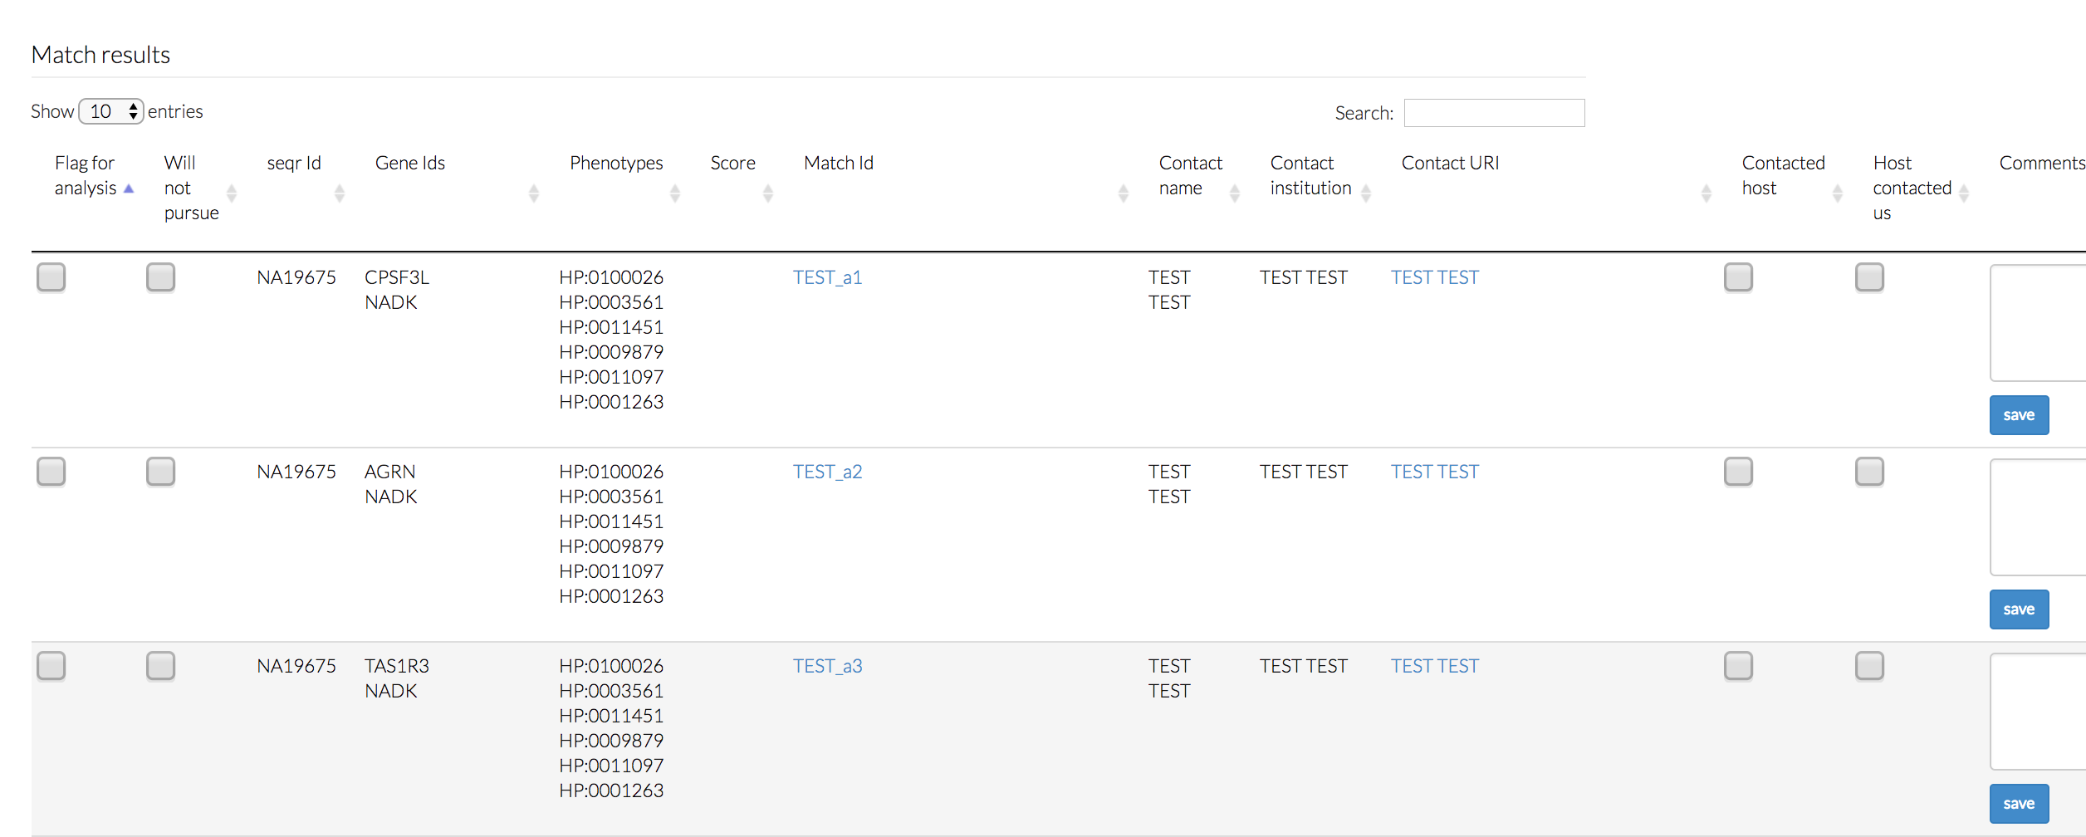
Post-match process
Matchmaker Exchange (MME)
Email list with a pool of analysts.
matchmaker@broad
Contact request
patients
seqr-matchbox live search
Project team
Collaborator team
Broad CMG analyst
Notes:
To help explain match process

Slide 7
Post-match process
Matchmaker Exchange (MME)
Email list with a pool of analysts.
matchmaker@broad
Contact request
patients
Data owner is ALWAYS kept in the loop and notified immediately.
No pre-screening
seqr-matchbox live search
Project team
Data owner can search at any point to get live instant results
Collaborator team
Broad CMG analyst
Notes:
3) When you receive a match notification, what is your protocol for handling the match? (distinguishing between match notifications and actual match inquiries) For example:
a) Do you forward match notification email to investigator within 1 week/1 month/??
immediately
b) Do you request information from the external investigator before informing your CMG investigators?
no, (sometimes we ask for the match ID on our side when they haven’t provided it)
c) Do you pre-screen, i.e., only forward matches to CMG investigators if you receive an actual manual inquiry (e.g. an email asking to share information) from the outside investigator?
no
d) Do you proactively reach out to external investigators based on a match notification or do you wait to be contacted manually by an external investigator?
both

Slide 8
Typical contact detail
Contact Institution:
Contact URL:
Broad Center for Mendelian Genomics
matchmaker@broad…org
Contact details
We name the data-owner with every submission
We forward every contact request to data-owner
This process is in place for tracking, QC, and helping the data-owner
Contact name:
Samanth Baxter (data owner: name-of-PI)
Notes:
4) When you submit to MME, whose contact information is shared? (Does the outside investigator receive the name and email of a generic contact/proxy coordinator at your CMG? Or do they receive the name and email of the original investigator?)
yes, but just the name of the original data owner.

Slide 9
Operational metrics
Live since November 2016
Has 36 patients as of 3/23/2017, with thousands in potential (in seqr).
53 unique genes
223 unique HPO terms
matchbox
13 post-match conversations
~7 post-match possible collaborations
2298 match requests
42 matches
Notes:
6) How many match notifications have you received for your CMG investigators?
2298
If you have this information/if applicable:
how many of these did you receive a manual inquiry about;
12
b) how many did your investigators follow up on;
~7
c) if you pre-screen incoming inquiries, how many/what proportion did you decide were worth involving your investigators about?
we don’t

Slide 10
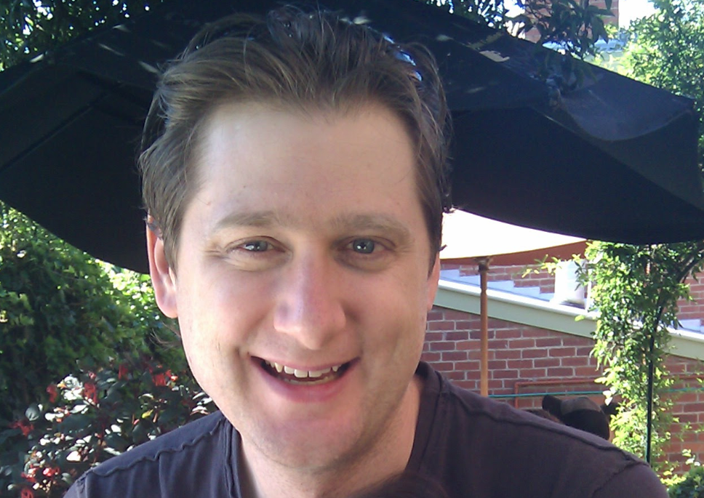
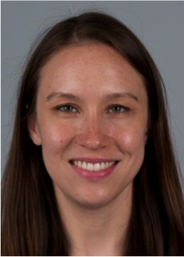
Post-match advanced discussions in progress
Most of our on-going discussions involve our Estonia cohort with analysis led by Monica Hsiung Wojcik M.D.
External MME node: GeneMatcher
Simon Sadedin
Monica Hsiung Wojcik M.D.

Slide 11
Discussion proposals
Genes in MME that have been deemed invalid.
Example: we matched and reached out on a gene that we later learned had been deemed no longer causal after investigation. This resulted in a loss of about 30mins on all parties involved. How can we minimize these?
How do we incentivize collaborators to submit patients to MME
Notes:
Other issues:

Slide 12
Thank you!
Daniel MacArthur
Heidi Rehm
Anthony Philippakis
Monica Hsiung Wojcik
Ben Weisburd
Elise Valkanas
Anne O’Donnell-Luria
Monkol Lek
MacArthur Lab
Orion Buske
Francois Schiettecatte
Nara Sobreira
Ada Hamosh
Jules Jacobsen
Melissa Haendel

