Slide 1
GeneMatcher - Users experience
Ada Hamosh MD
Johns Hopkins University
McKusick-Nathans Institute of Genetic Medicine
Baylor-Hopkins Center for Mendelian Genomics
Notes:
Added “for WES” Could also work for WGS

Slide 2
GeneMatcher genes and matches over time
As of 1 March 2017
6,189 genes by 2,935 submitters
16,612 matches
2,417 (39%) matched genes
Number
Date

Slide 3
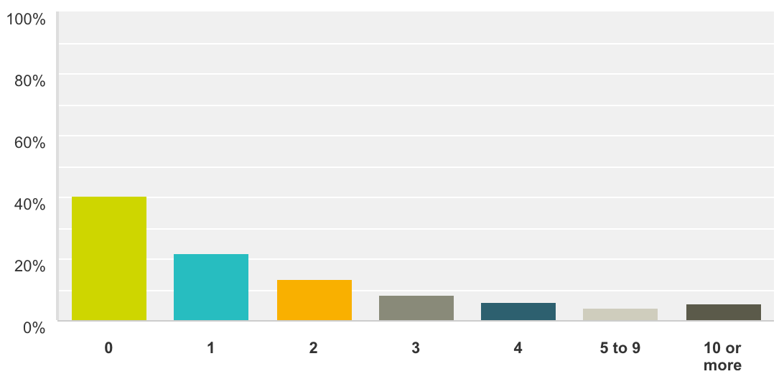
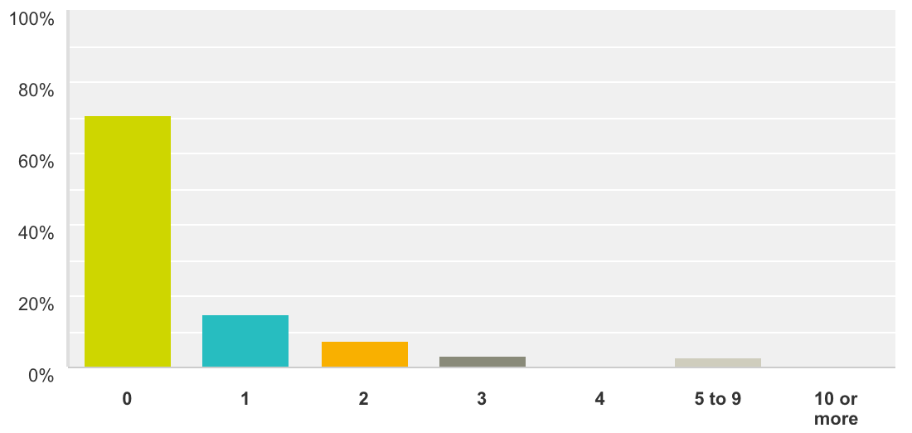
GeneMatcher Survey
146 users responded
87 users (59%) have identified a novel gene/phenotype association by using GeneMatcher (Figure 1)
43 users (29%) have published at least 1 paper that included data acquired from a match in GeneMatcher (Figure 2)
Figure 1 - How many novel gene/phenotype associations have you defined by using GeneMatcher?
Figure 2 - In how many publications have you used data acquired from a match in GeneMatcher?

Slide 4
GeneMatcher Survey – 116 respondents
28 (24 %) have not had an unsuccessful match
74 (63 %) had gene matches that were not a phenotype match
30 (26 %) had matches that had different modes of inheritance
9 (8 %) had matches on genes with false positive variants
14 (12 %) had matches on genes with variants that did not segregate as expected in the other family members
4 (34 %) had matches on a gene that turned out to be commonly mutated among controls
14 (12 %) had matches that involved the same patient

Slide 5
GeneMatcher Survey
41 of 127 (32 %) said that the unsuccessful gene match(es) helped to rule out a gene(s)
75 of 140 (53.57%) identified themselves as health care providers
107 of 140 (76.42%) users identified themselves as researchers.
Only one identified himself as a patient
48 of 75 health care providers (64%) identified the responsible gene for at least one family under their care by using GeneMatcher
7 of these families had been under diagnostic investigation for more than 9 years
Notes:
Patients now 26

Slide 6
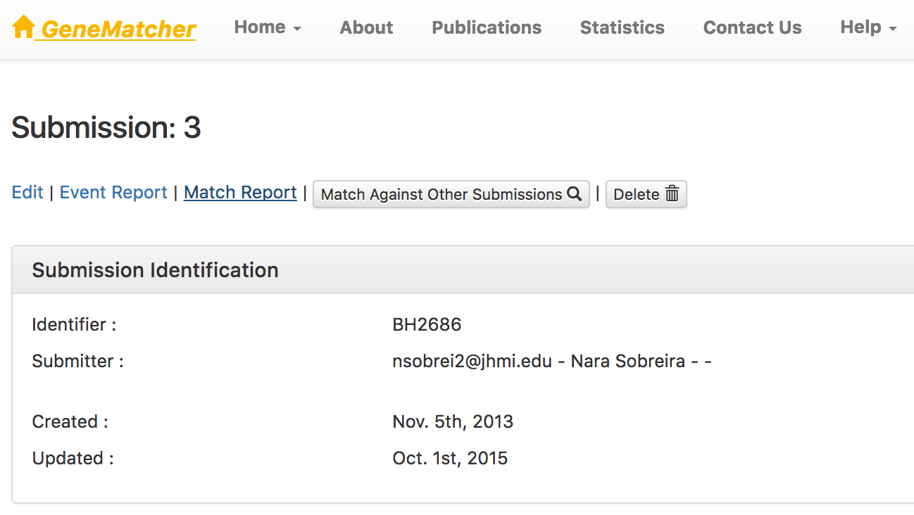
Match outcome tracking system

Slide 7
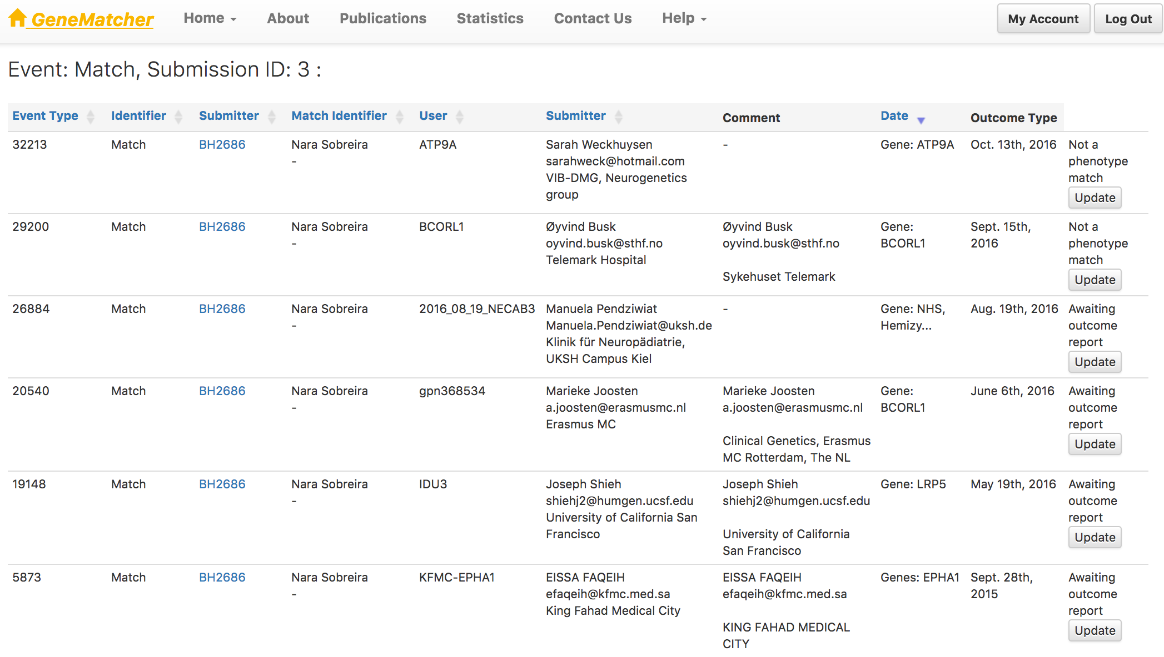
Match outcome tracking system

Slide 8
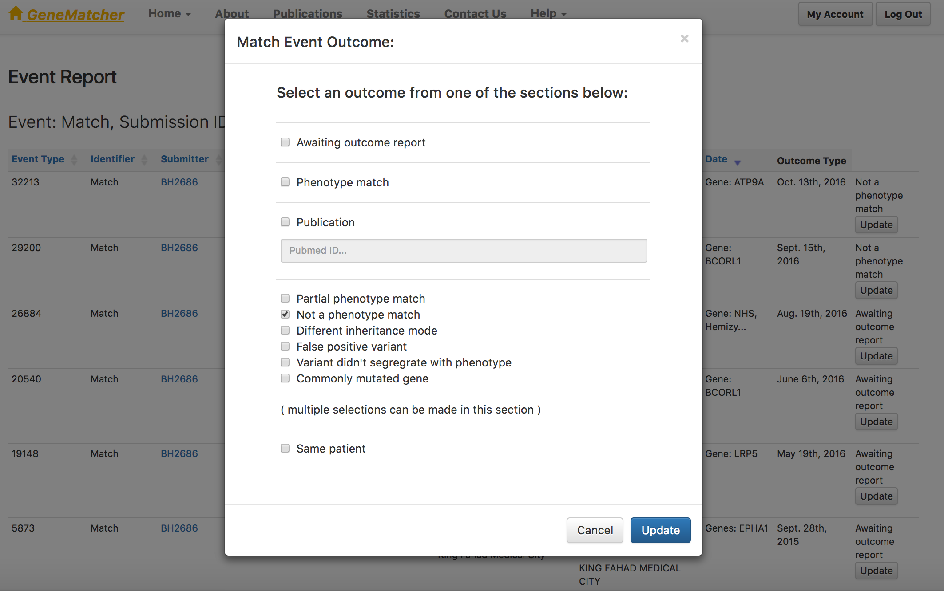
Match outcome tracking system

Slide 9
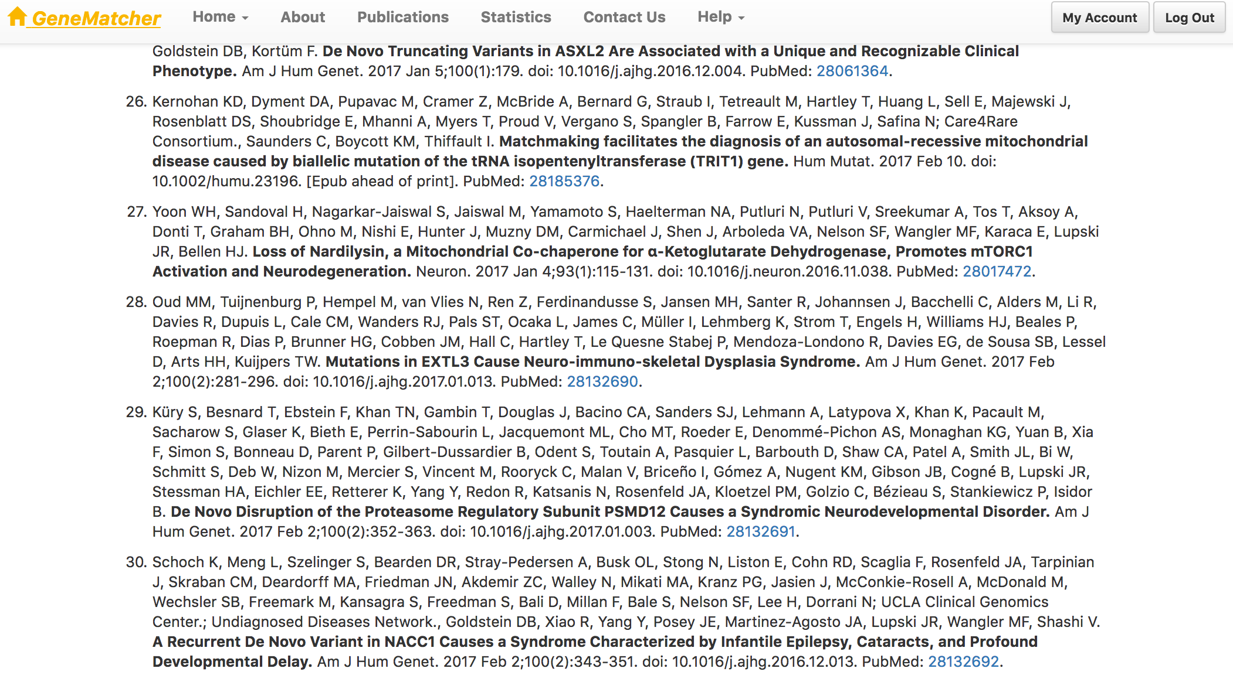
GeneMatcher Publications

Slide 10
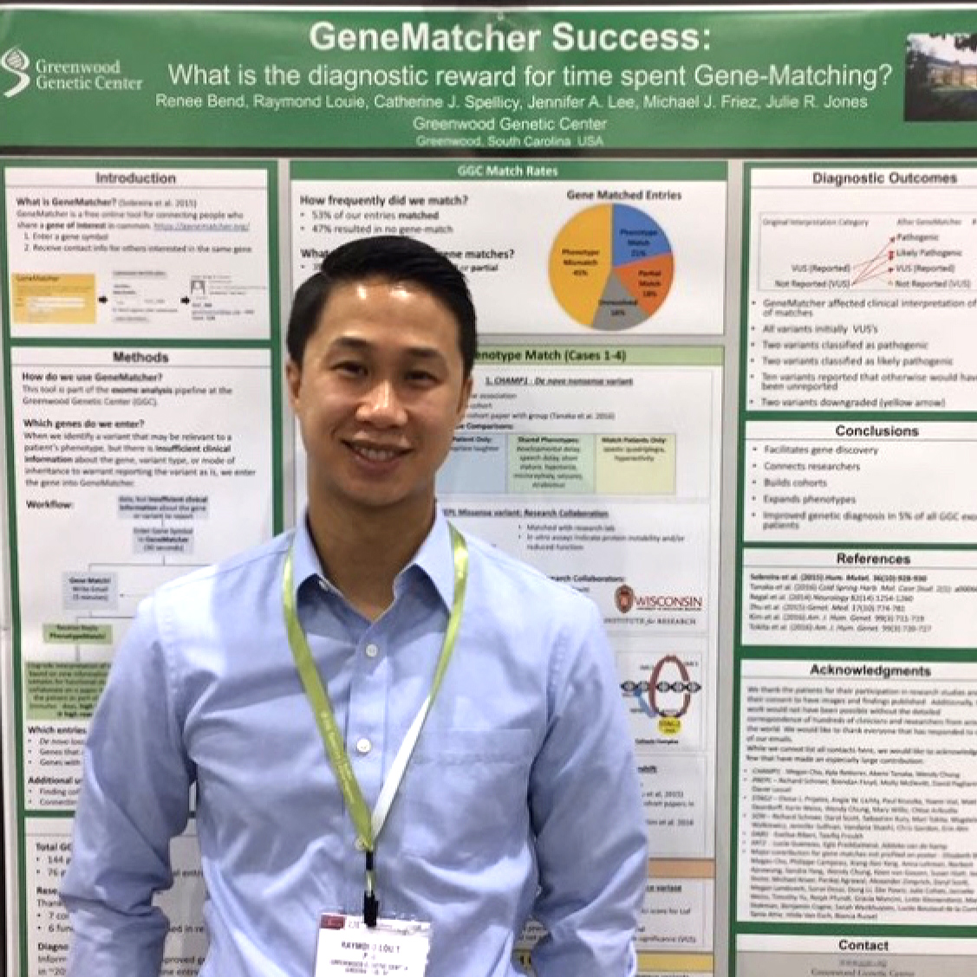
GeneMatcher - ACMG 2017
WDR26 Haploinsufficiency Causes a Recognizable Syndrome of Intellectual Disability, Seizures, Abnormal Gait, and Distinctive Facial Features - Presenting Author: Cara Skraban, MD, Children's Hospital of Philadelphia (Oral platform)
Reanalysis of Exomes and Genomes Leads to New Diagnoses - Presenting Author: Susan Hiatt, PhD, HudsonAlpha Institute for Biotechnology (Oral platform)
Diagnostic Utility of Collaborative Gene Matching Databases in Delineating a Novel Neurodevelopmental Syndrome Associated with a de novo NACC1 Mutation - Presenting Author: Szabolcs Szelinger, PhD, University of California, Los Angeles (Poster presentation)
GeneMatcher Success: What is the Diagnostic Reward for Time Spent Gene-Matching? - Presenting Author: Raymond Louie, PhD, Greenwood Genetic Center (Poster presentation)

Slide 11
Thanks for your attention!
Acknowledgements
Nara Sobreira, François Schiettecatte and David Valle
The CMGs and especially the Baylor-Hopkins CMG team

