Slide 1
Report of the Unsolved Cases Committee
Liz Blue
Division of Medical Genetics
University of Washington

Slide 2
Overall Goal
Identify strategies and processes to improve the CMGs ability to identify variants and genes responsible for presumed Mendelian phenotypes

Slide 3
Solve rate
Pros:
Short hand metric for measuring success
Cons:
A ratio determined by numerator and denominator
The numerator sums up the success with the cases under consideration
The denominator influenced by how broadly we cast our net; what are we willing to miss?

Slide 4
Unsolved cases: Some possibilities
Between Centers
Differences in WES sequencing strategy
Capture space
Depth
Differences in analytic pipelines
Methods to identify variants (ex., CNVs)
Variant annotation to predict consequences (ex., VEP)
Strategy to prioritize variants (ex., filters)

Slide 5
Unsolved cases: Some possibilities – cont.
General
Causative variants not in exome
Causative variants in exome but additional studies required to recognize consequence (ex., RNA-seq)
Disease genetic but not simple Mendelian
Oligogenic
Imprinting
High frequency modifier
Complex trait with familial clustering
Environmental phenocopies
Notes:
Expectation is that these would be difficult for any CMG to solve using current standard approaches.
Will require new approaches as we go forward

Slide 6
Unsolved cases: First exercise
Compare analytic pipeline outcomes by exchanging sequence data on unsolved cases
Share protocols to evaluate best practices
In the process, may discover new disease genes

Slide 7
Unsolved cases: First exercise
Each CMG submits at least one unsolved project to the group
Members of each CMG can then select from that list and reanalyze that data
Monthly calls to discuss data and results
Notes:
Contrast with the Analysis Group who is combining data sets on the same phenotypes across centers for new analyses

Slide 8
Exercise 1: 16 unsolved cases
Data sharing initially complicated but process nearing completion
Data included
Snapshot of the phenotype
Most likely mode of inheritance
Pedigree and phenotype information
BAM files
WES from most groups, additional WGS from the Broad
Results shared from the originating center
Additional analyses performed beyond standard protocol
Candidate gene list
Data analysis in progress
Notes:
16 projects include: 2 UW, 9BH, 2 Broad, 3 Yale
How was this complicated? Required DSA/DTAs took time for signatures, while we’ve encountered some challenges actually transferring files. UW completed download of Broad WGS data on 3/22/2017 and received final DTA to send data to BHCMG on 3/23/2017.
Not all groups have accessed all projects

Slide 9
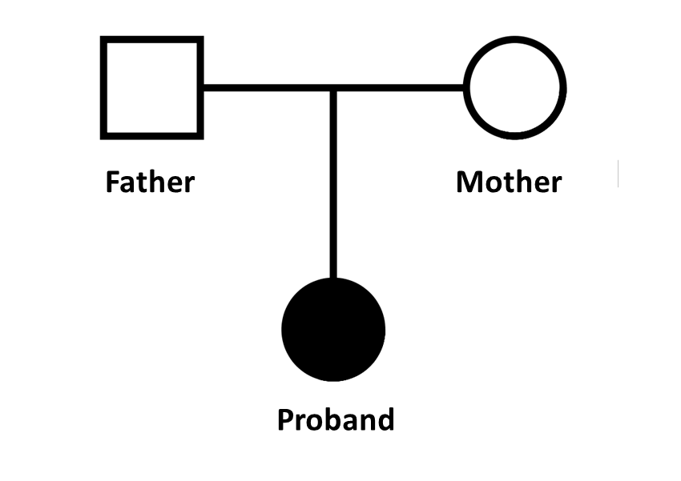
Examples from the Broad
Two trios with different phenotypes
Data sharing
WES BAMs for all subjects
WGS BAMs for all subjects
Phenotypic details
Preliminary results available
Broad
Baylor-Hopkins CMG (BH-CMG)
University of Washington CMG (UW-CMG)

Slide 10
Examples from the Broad
All groups generated multisample VCFs using GATK and best practices
Broad and UW-CMG (v3.4), BH-CMG (v3.3)
All groups searched exome-wide for hom recessive, cpd het, dominant inherited and de novo variants
BH-CMG specifically looked for X-linked
Broad and UW-CMG performed candidate gene screens
All groups filtered variants for their coding effect and frequency
Each group used different approaches to variant annotation
Consequence
Allele frequency

Slide 11
Example 1: AP Project from the Broad
Autosomal recessive limb-girdle muscular dystrophy
Scoliosis
Progressive weakness of proximal upper and lower extremities
Respiratory dysfunction leading to artificial respiration
Dystrophic muscle biopsy
Elevated CK count
NO conduction defects or cardiomyopathy
NO alpha dystroglycanopathy or myofibrillar myopathy
NO sarcoglycan, dysferlin, calpain, dystrophin, caveolin, or emerlin deficiencies
WES and WGS data shared for all members of the trio

Slide 12
Example 1: AP Project from the Broad
Broad Institute
UW-CMG
Candidate genes: none
De novo model: SNX14, TMEM209
Homozygous recessive: none
Compound heterozygote: MEGF8, PUM1, FMOD, SRRM2, FCGBP, LAMA5
Candidate genes: TTN*
De novo model: SNX14, TMEM209
Homozygous recessive: none
Compound heterozygote: MEGF8
Notes:
TTN: Paternal variants include 2 missense variants with maxAAF near 2% while the maternal missense variant has maxAAF = 0.0008. Missense variants in TTN are hard to interpret, and the paternal alleles are too common, making it unlikely that TTN explains the phenotype in this case.

Slide 13
Example 1: AP Project from the Broad
Broad Institute
BH-CMG
Candidate genes: none
De novo model: SNX14, TMEM209
Homozygous recessive: none
Compound heterozygote: MEGF8, PUM1, FMOD, SRRM2, FCGBP, LAMA5
Known candidate genes: NRXN1, SNX14, SIGMAR1
Novel candidate gene - De novo model: TMEM209
Novel candidate gene - Homozygous recessive and Compound heterozygote: none

Slide 14
Example 1: AP Project - results
Two genes nominated as candidates by all three CMGs
De novo frameshift variant in SNX14
Variants in SNX14 known to cause recessive spinocerebellar ataxia (SCA)
Zebrafish models of SNX14 can exhibit scoliosis
Patient with CNV over SNX14 noted as “definitely pathogenic” in DECIPHER exhibits muscular hypotonia
Initially excluded because of phenotypic misfit between SCA and LGMD, but the Broad is now exploring the variant because picked up by other CMGs
Compound heterozygote variants in TMEM209 (aka NET31)
Novel, not associated with phenotypes in OMIM, DECIPHER, or Monarch
Encodes a nuclear envelope protein like LMNA, another nuclear envelope protein gene responsible for Emery Dreifuss Muscular Dystrophy
Notes:
MEGF8 was nominated by Broad and UWCMG but not BHCMG. Why not mention this?
5 genes unique to Broad, 2 unique to BHCMG, 1 to UWCMG
(I kind of like the way you had it listed before better, first you do not make it clear that TMEM29 is a novel gene. Second I did not list only SNX14, I also listed NRXN1, SNX14, SIGMAR1 and actually I do not think that SNX14 is a good candidate at all, SIGMAR1 is a much better in terms of phenotype comparison. Third, I do not think we want to focus on the results that we found as the same but in the results that we found as different and your previous slides (7 and 8) show it and this one does not.

Slide 15
Example 1: DG Project - Broad
Isolated case with ligamentous laxity, hip dysplasia, motor delay, coloboma
Additional HPO terms
Joint hypermobility
Infantile hypotonia
Wide inter-nipple distance
Soft skin
Ptosis
NO ophthalmoplegia
NO contractures of lower limbs or hands
NO hyperkeratosis pilaris
NO elevated creatine kinase after exercise
Genes screened: COL6A1, COL6A2, COL6A3
WES and WGS data shared for all members of the trio
Notes:
European ancestry

Slide 16
Example 1: DG Project - Broad
Broad Institute
UW-CMG
Candidate genes: none
De novo model: ASCL1, VPS29
Homozygous recessive: none
Compound heterozygote: ABCA4, INTS9, AHDC1, NEB, TTN, GBE1, C5orf42, NOP9
Other*: PYCR1
Candidate genes: none
De novo model: ASCL1, VPS29
Homozygous recessive: none
Compound heterozygote: ABCA4, INTS9
Notes:
one het hit also in parent, collaborator was interested in finding a second allele.
De novo dominant variants in ARL13B and ZNF681 didn ’t validate in BAM
The two AHDC1 variants are synonymous, and the two NOP9 variants are inframe indels.

Slide 17
Example 1: DG Project - Broad
Broad Institute
BH-CMG
Candidate genes: none
De novo model: ASCL1, VPS29
Homozygous recessive: none
Compound heterozygote: ABCA4, INTS9, AHDC1, NEB, TTN, GBE1, C5orf42, NOP9
Other*: PYCR1
Known candidate genes: none
Novel candidate gene - De novo model: VPS29
Novel candidate gene - Homozygous recessive: none
Novel candidate gene - Compound heterozygote: INTS9

Slide 18
Example 1: DG Project - results
2 genes nominated as candidates by all three CMGs
Compound heterozygote variants in INTS9
Patients with CNVs intersecting INTS9 noted as “definitely pathogenic” in DECIPHER can exhibit coloboma, hypotonia, motor delay, and wide inter-nipple distance
De novo missense variant in VPS29
Variants in VPS29 have been associated with Parkinson’s disease
Notes:
ASCL1 (de novo) and ABCA4 (comphet) were nominated by Broad and UWCMG but not BHCMG.
7 genes unique to Broad, 0 unique to BHCMG, 0 to UWCMG

Slide 19
Next steps
Exercise 1: All centers complete their analyses
Compare results at the variant level by conference call
Share detailed protocols
Evaluate why some genes nominated by one CMG and not another
Exercise 1: Additional evaluation of top candidates
Consulting gene experts
Perform alternative experiments (ex. RNA-seq) for functional testing
Search for additional cases through GeneMatcher/Matchmaker Exchange
Exercise 2 (does not need to wait on Exercise 1)
Consider and test additional models
WGS of those that remain unsolved ?

Slide 20
Thanks to contributors
Baylor-Hopkins
Nara Sobreira
Zeynep Hande Coban Akdemir
Dimitrios Avramopoulos
Kim Doheny
Betty Fernandini
Dane Witmer
Elizabeth Wohler
David Valle
Broad Institute
Hayley Brooks
Monkol Lek
Daniel MacArthur
Heidi Rehm
Elise Valkanas
UW
Liz Blue
Mike Bamshad
Jessica Chong
Debbie Nickerson
Yale
Declan Clarke
Mark Gerstein
Arif Harmanci
Jim Knight
NIH NHGRI
Nicole Lockhart
Jon Lotempio
Lu Wang
GSPCC Coordinating Center
Steve Buyske Natalie Makow
Tara Matise Jin Xing

