Slide 1



Heterogeneity and Data Science:
Future Opportunities for the CMGs
Eric Boerwinkle
CMG/GSP Meeting
Bethesda, MD
March, 2017

Slide 2
Opportunities for the CMGs
Expand ethnic representation
Broader Class of Models of Disease and Inheritance
New data types (SVs and phased data; RG)
Virtuous cycle of Practice and Discovery
A Data Lake and New Models of Data Sharing

Slide 3
Opportunities for the CMGs
Heterogeneity
Expand ethnic representation
Broader Class of Models of Disease and Inheritance
New data types (SVs and phased data; RG)
Virtuous cycle of Practice and Discovery
A Data Lake and New Models of Data Sharing
Data
Accumulation
Data
Science

Slide 4
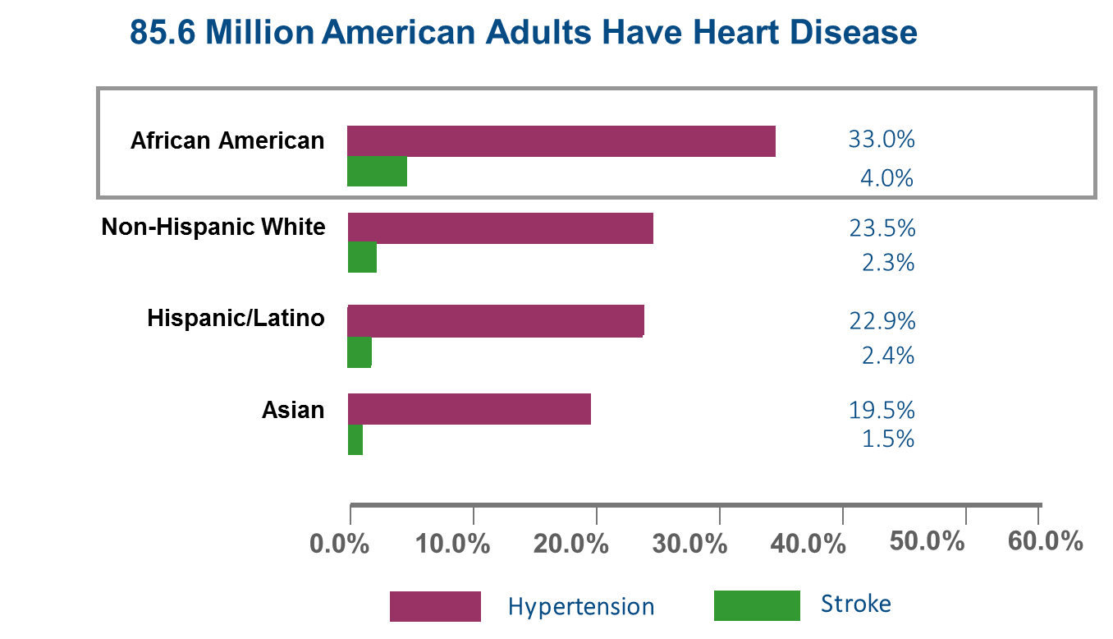
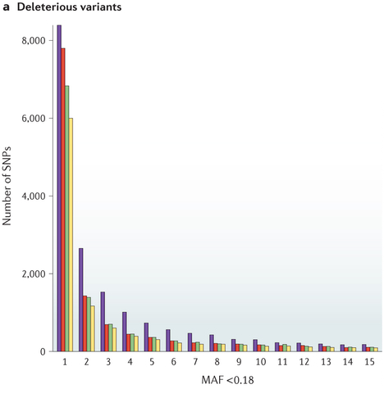
Why Multi-Ethnic Studies?
Differences in Environment
Differences in site frequency spectrum
G x E
Epidemiology of Disease
A full 1/3 of solved cases come
from genes discovered in
the past four years. Yang, JAMA

Slide 5
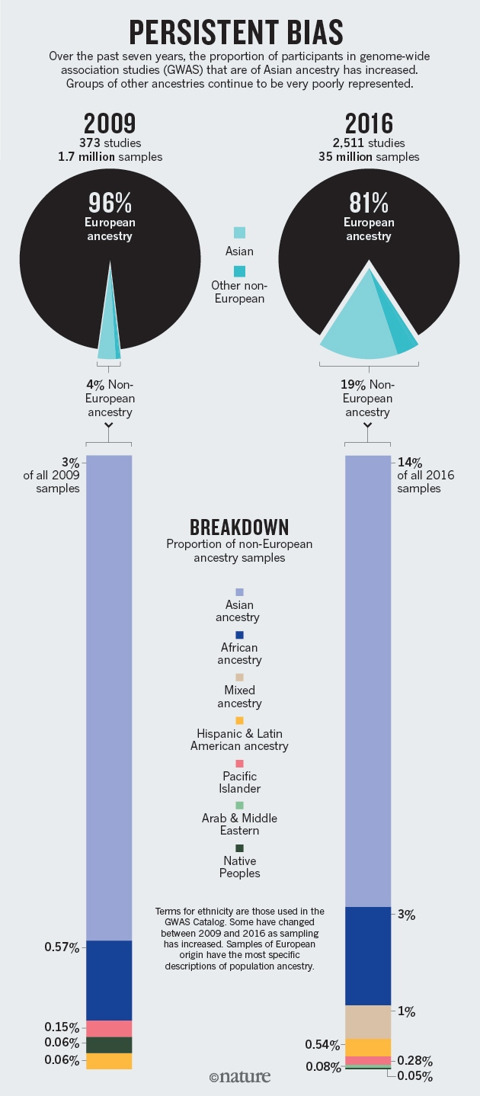
Persistent Bias
Popejoy and Fullerton: Nature, 2016

Slide 6
Opportunities for the CMGs
Expand ethnic representation
Broader Class of Models of Disease and Inheritance
New data types (SVs and phased data; RG)
Virtuous cycle of Practice and Discovery
A Data Lake and New Models of Data Sharing

Slide 7
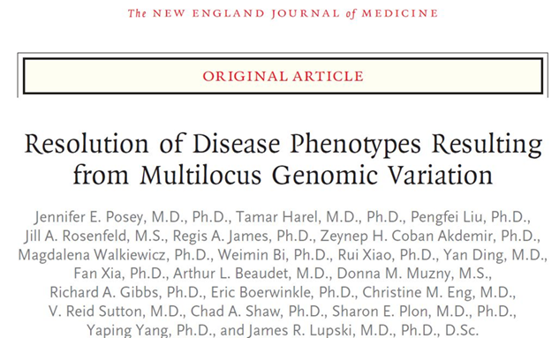
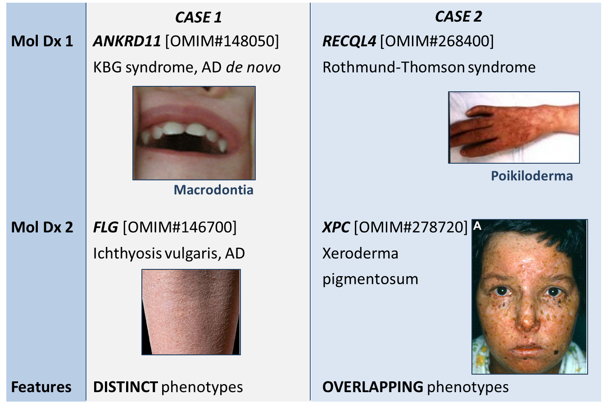
Challenging Simple Models of Inheritance
Molecular diagnosis:
Gene A
Gene B
Gene A
Gene B
Phenotype:
Concept:
Distinct phenotypes
Overlapping phenotypes
7374 sequential cases for proband-WES
Diagnosis in 28.2% (2076/7374)
Two or more diagnoses related to phenotype in 4.9% (101/2076) of diagnosed cases
Notes:
Many seminal discoveries have challenged and refined our understanding of inheritance.

Slide 8
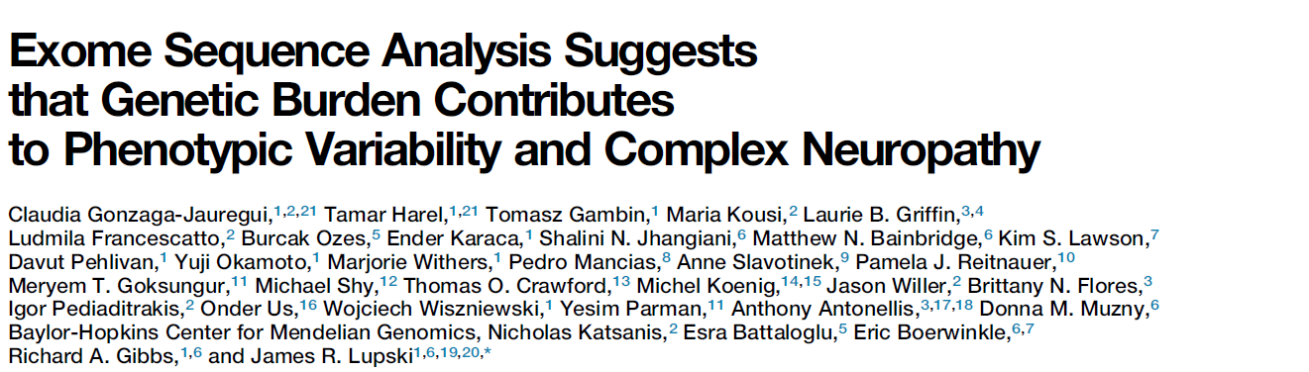
Oligogenic Involvement / Inheritance
Gonzaga-Jauregui, et al (2015)
Cell Reports 12: 1169-1183
Highlights:
•WES of a neuropathy cohort identifies causal variants in ∼45% of patients
•Three candidate peripheral neuropathy disease genes
(PMP2, DNAJB5, SPTLC3) proposed
•Evidence for genetic mutation burden found in two independent cohorts
•Variant combinatorial effects may contribute to
clinical variability and expressivity

Slide 9
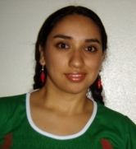

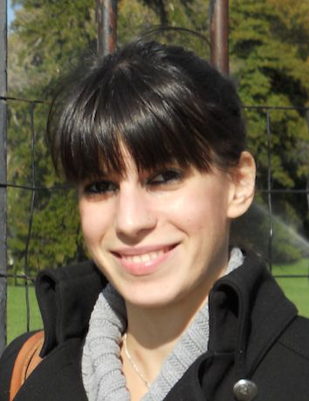
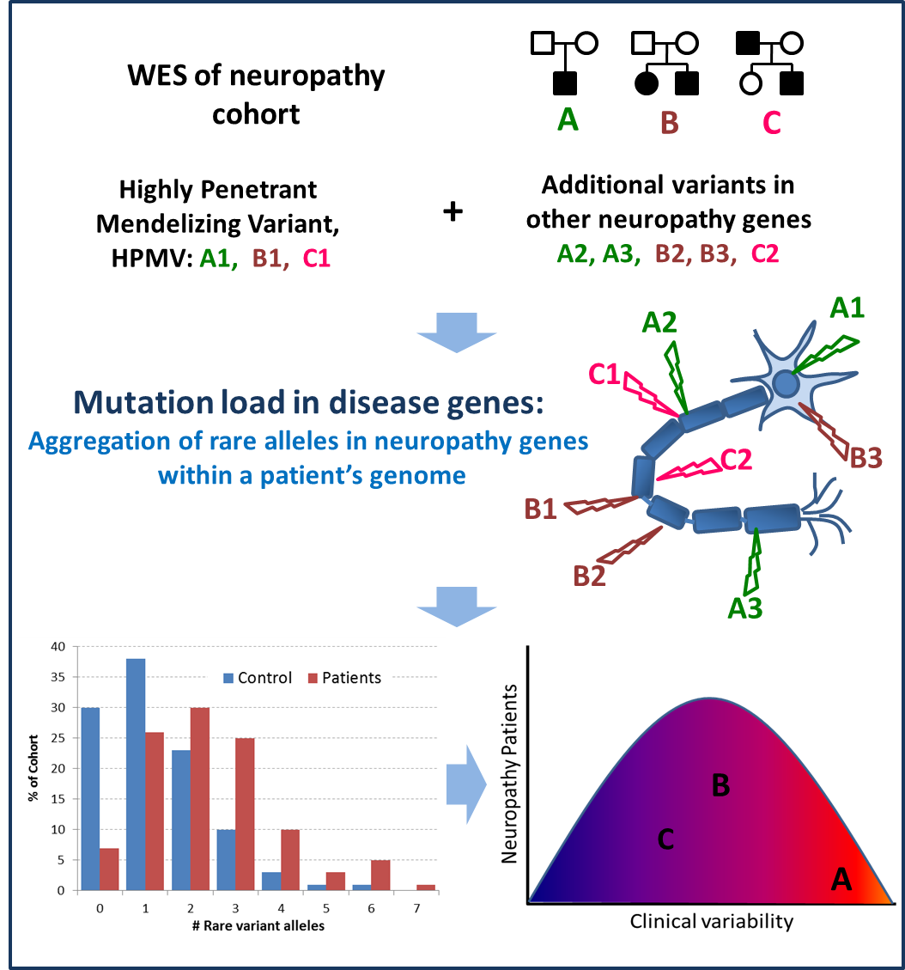



Mutation burden & Dz
Claudia
Gonzaga-
Jauregui
Tamar
Harel
37 unrelated families CMT-like
peripheral neuropathy
refractory to molecular Dx
WES, study rare vrnts in
neuropathy genes in
subjects vs cntrls
evidence for burden NA cohort
replicate in 2nd (Turkish) pt pop
Maria Kousi
Combinatorial effect of
rare variants contributes
to Dz burden & variable
expression of Dz
Gonzaga-Jauregui, Harel, et al.
(2015) Cell Reports 12:1169-1183
Gibbs, Battaloglu, Boerwinkle,
Katsanis & Lupski Labs
+
=
X
X
X
Sub-optimal dose
morpholino A1
Sub-optimal dose
morpholino A2
phenotype
Model genetic interactions in zebrafish

Slide 10
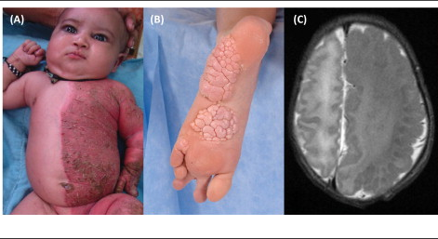
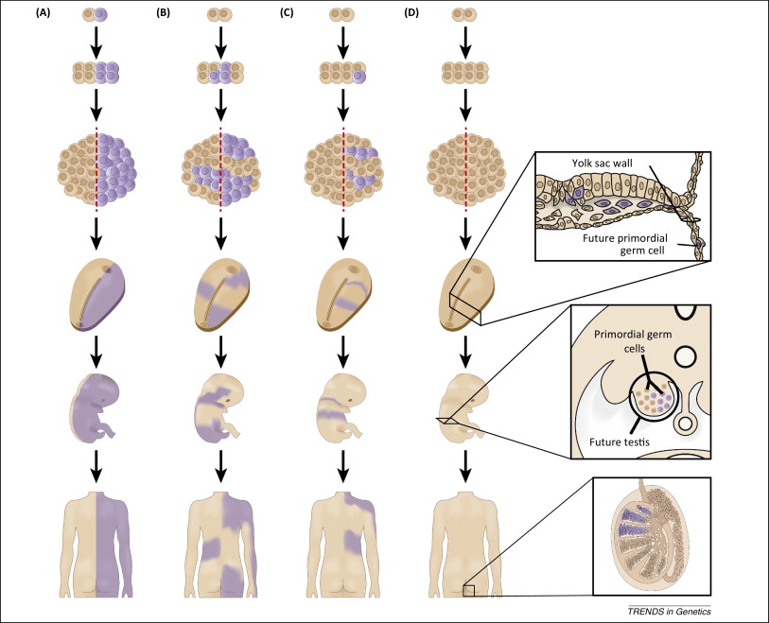
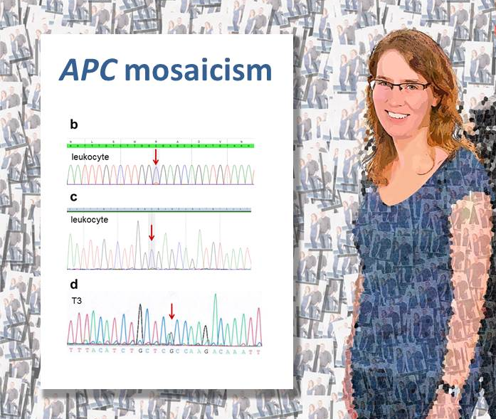
Mosaicism

Slide 11
Opportunities for the CMGs
Expand ethnic representation
Broader Class of Models of Disease and Inheritance
New data types (SVs and phased data; RG)
Virtuous cycle of Practice and Discovery
A Data Lake and New Models of Data Sharing

Slide 12
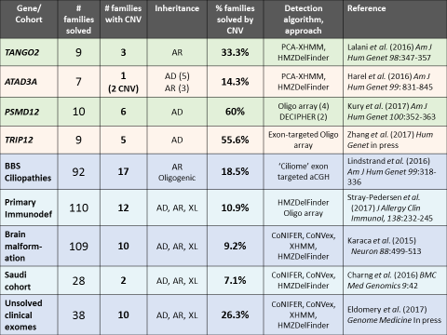
Notes:
ATAD3A: note 5 families with single DN allele, 1 family with single HOM allele (biallelic), and 1 family with compound CNVs – how best to quantify alleles?

Slide 13

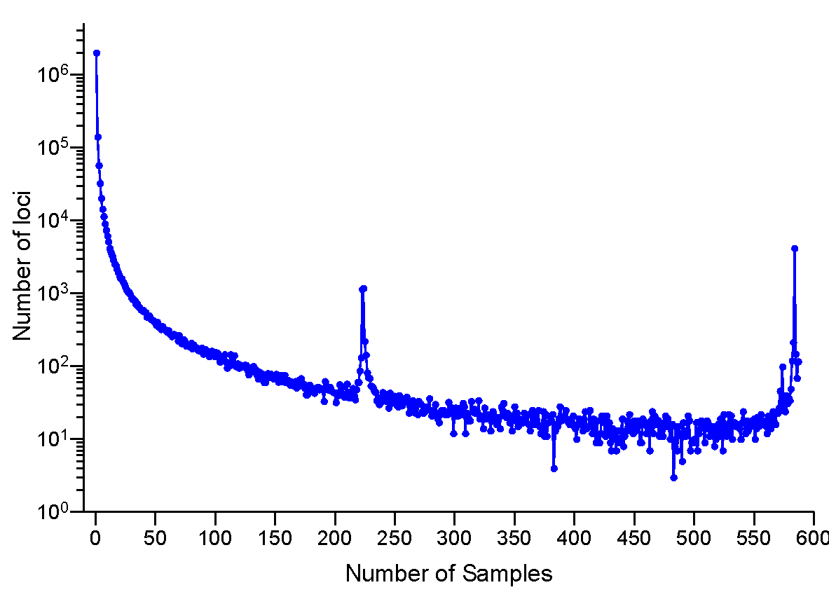
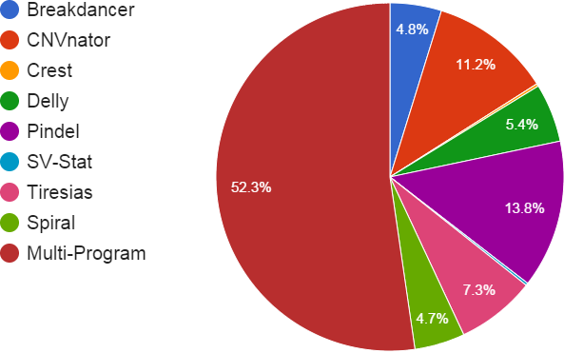
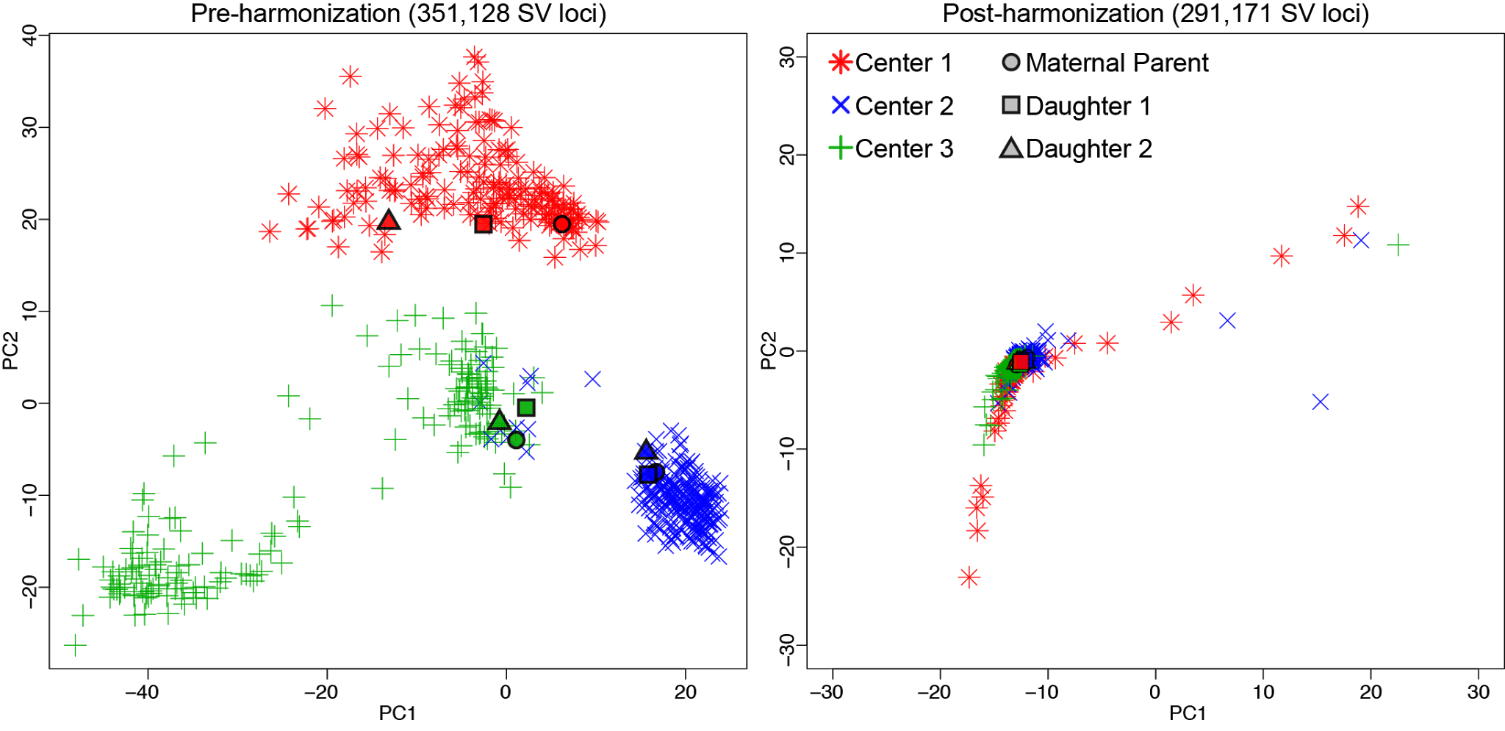
Structural Variant Heterogeneity
5,325 HS1011 SVs
584 ADSP Samples from 3 centers
  Three Replicates
12 SV methods into Parliament
~350K loci AC >1
2,004,259 singletons (83.8%)
2,554 SVs identified by a single method
Parliament on HS1011
  8 Short-Read SV methods
  3 Orthogonal Data Types
18K distinct deletion loci
5K loci have orthogonal support
Notes:
Applying Parliament to 584 ADSP samples, saw 83% of calls were one program in one sample
Noisy
Focused on ~350K loci that occurred in at least two samples
Strong clustering by center
Reveals new bifurcation in WashU
This is NOT the bimodal issue
Need to understand the batch effects
Combination of noise and preferential sensitivity
Slides 14-17 are one slide

Slide 14
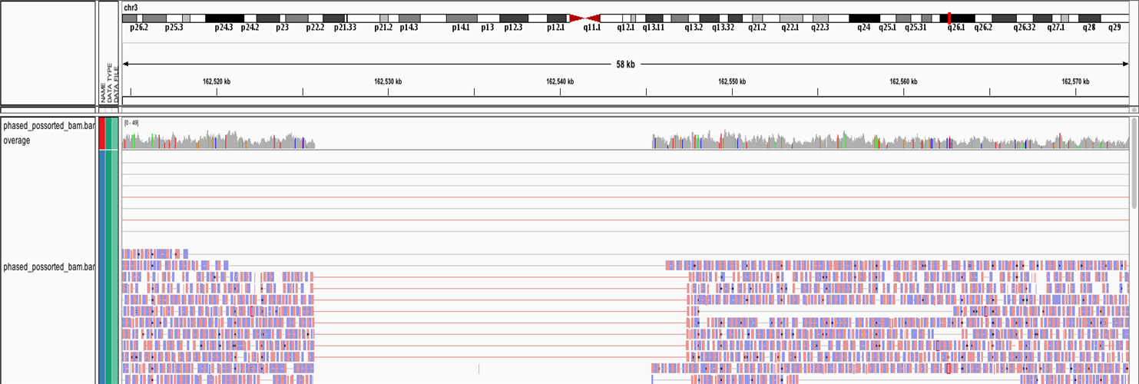
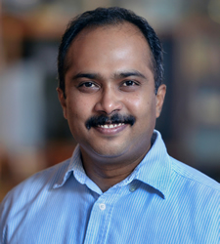
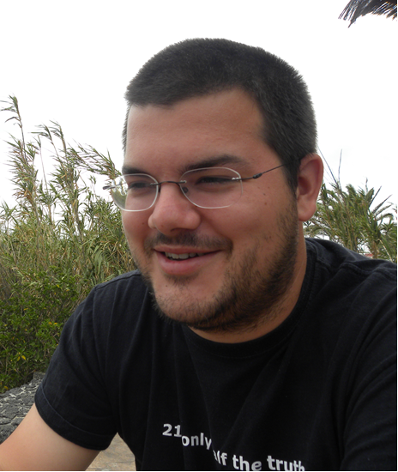
Not just Whole Genomes, but Improved Genomes
Local Diploid Assembly
Phase
Improvements in important but difficult regions
(e.g. FMR, DM1, HLA and cytochromes)
Detect insertions and duplications
as well as we detect deletions
Localize break points
Large Het Deletion and Small Hom Deletion
PacBio
Continues sequence
Average 10kbp
10-15% error rate
Still pretty expensive
10x Genomics
Linked read information
Average 100kbp
0.5% error rate
Cheaper

Slide 15
Opportunities for the CMGs
Expand ethnic representation
Broader Class of Models of Disease and Inheritance
New data types (SVs and phased data; RG)
Virtuous cycle of Practice and Discovery
A Data Lake and New Models of Data Sharing

Slide 16
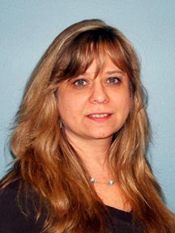
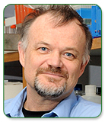

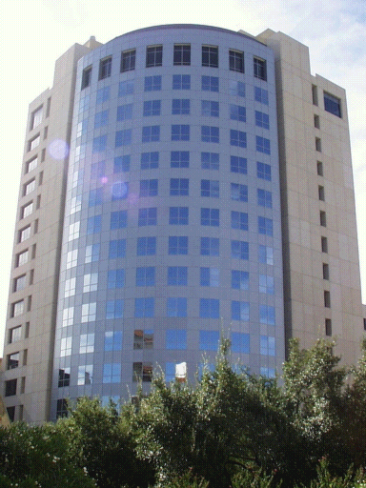
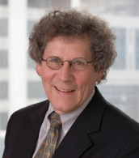
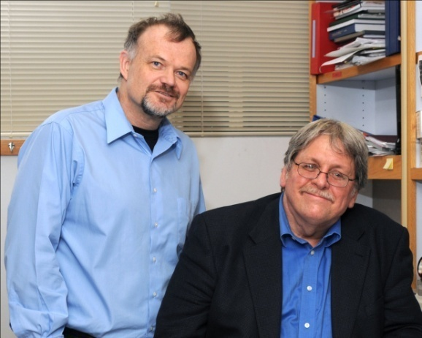
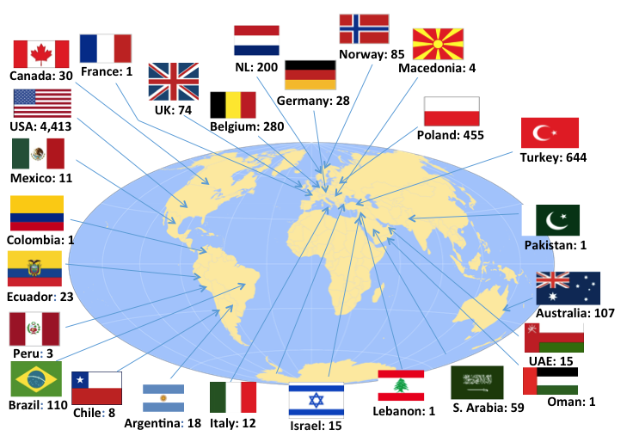


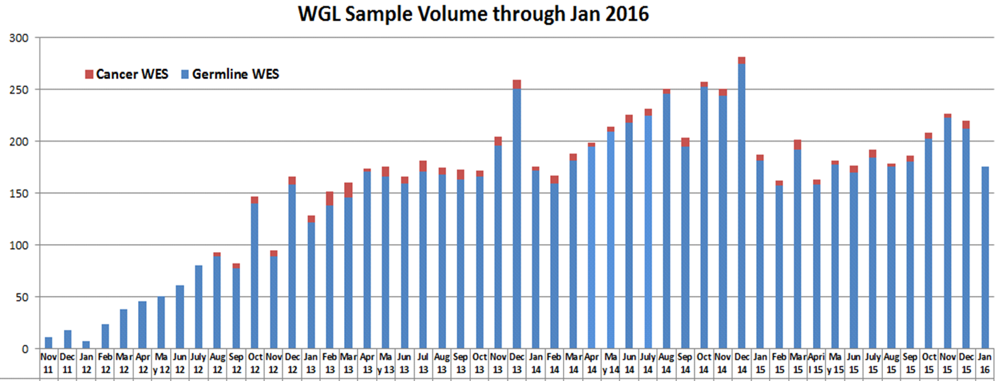

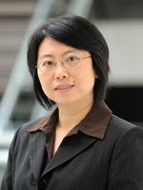
> 53,000 BCM EXOMES
BCM-JOHNS HOPKINS
CENTER FOR
MENDELIAN GENOMICS
(7,100)
RESEARCH
(34,000)
James Lupski
David Valle
DISCOVERY
~75%
‘Undiagnosed’
DIAGNOSIS
(12,000)
Christine Eng
Yaping Yang
Notes:
The NHGRI has charted out four major groups – genome sequencing and analysis centers, Mendelian disorders sequencing centers, clinical sequencing exploratory research and informatics tools. Baylor College of Medicine has been funded for the first three.
The most recent collaboration has been with the Baylor-Johns Hopkins Center for Mendelian Genomics. A paper came out in July of this year and outlined the program and it’s initiatives.
The four major goals are to one, collect samples from all Mendelian disorders whose genetic basis is not understood. The CMGs have gathered a collective list of all phenotypes we currently have in our pipelines. They will be sharing this list on their website to encourage collaboration.
Two, we want to improve the efficiency of sequencing and ongoing technology innovation.
Three, we will determine the genetic basis for as many Mendelian diseases as possible.
And four, we will disseminate methods and data to facilitate gene discovery by others. We plan to submit all sequencing data within 9 months from analysis completion to dbGap for all studies.
July 2012 – invited comment came out…
(1) to ascertain samples for all Mendelian disorders for which the genetic basis is not yet under- stood from clinicians and investigators around the world by developing a ‘‘public list’’ of samples and by coordinating sub- missions to the NIH program with those of other international programs; (2) to improve the efficiency of the sequencing pipeline and quality of exome and genome data through ongoing technology innovation; (3) to determine the genetic basis for as many Mendelian conditions as possible; and (4) to disseminate methods and data to facilitate gene discovery by investigators working independently across the globe. The CMGs will study disorders with age of onset across the entire lifespan including well- delineated, known Mendelian phenotypes as well as novel pheno- types thought to represent Mendelian traits on the basis of their segregation pattern in families.
The key drivers for the CMGs are to serve the scientific community and the individuals and families with rare diseases by improving knowledge about these rare conditions. By making specific diagnoses and exploring on a genome level the relationships between sequence variation and phenotype, collab- oratively we can achieve more comprehensive pre-symptomatic or carrier screening. Additionally, the knowledge obtained from these efforts could initiate the exploration of new and/or improved therapeutics for these conditions.
The CMG will provide the community with access to production infrastruc- ture, bioinformatics support, and analytical expertise. The chal- lenge to the human genetics community is to help initiate this new phase of medical genomics and take advantage of this new oppor- tunity by providing the resources for such studies that obviously cannot occur without finding and characterizing the patients and their families.

Slide 17
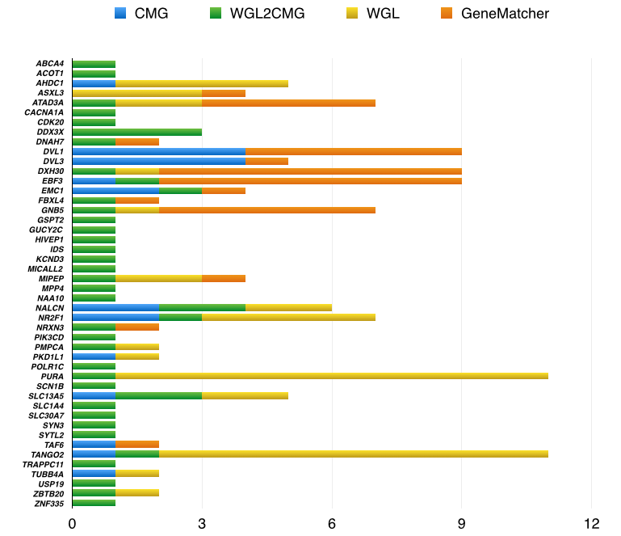
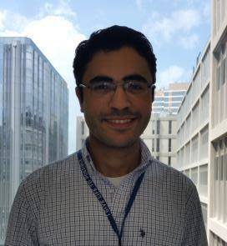
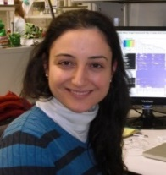




146 cases solved through collaborative work between
BHCMG + clinical exome lab at BCM + GeneMatcher
Mohammad
Eldomery
Zeynep
Coban
Akdemir
Tamar
Harel
WGL= clinical whole genome lab
WGL2CMG unsolved clinical exomes
15 ‘disease genes’ found:
AHDC1, ASXL3, ATAD3A, DVL1,
DVL3, EBF3, EMC1, GNB5, MIPEP,
NR2F1, PKD1L1, PSMD12, PURA,
TAF6, TANGO2
www.genematcher.org
Bainbridge, et al (2013) Genome Med 5.11
Bosch, et al (2014) AJHG 94.2: 303-309
Lalani, et al (2014) AJHG 95.5: 579-583
Xia, et al (2014) AJHG 94.5: 784-789
White, et al (2015) AJHG 96.4: 612-622
Yuan, et al (2015) JCI 125.2: 636-651
Harel, et al (2016) AJHG 98.3: 562-570
Lalani, et al (2016) AJHG 98:347-357
White, et al (2016) AJHG 98:553-561
Lodder, et al (2016) AJHG 99:704-710
Vetrini, et al (2016) AJHG 99:886-893
Harel, et al (2016) AJHG 99_831-845
Eldomery, et al (2016) Genome Medicine
8:106
Harms, et al (2017) AJHG 100:117-127
Kury, et al (2017) AJHG 100: 352-363
Number of solved cases
Eldomery, Coban-Akdemir, Harel, et al Genome Medicine 2017 online

Slide 18
The Opportunities
Expand ethnic representation
Broader Class of Models of Disease and Inheritance
New data types (SVs and phased data; RG)
Virtuous cycle of Practice and Discovery
A Data Lake and New Models of Data Sharing

Slide 19
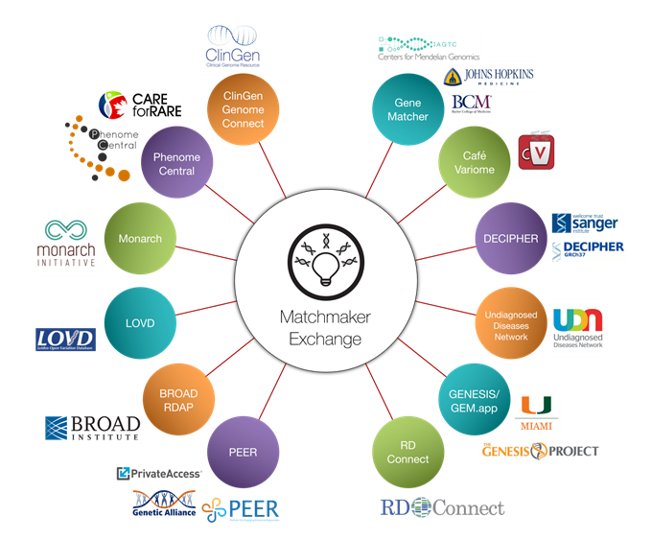
Current Model of Information Sharing

Slide 20



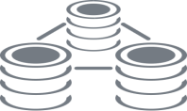
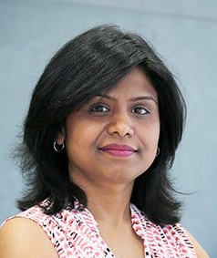

Data Lake: Architecture/Design/Governance
Source
Systems
EMR
Data Lake
Variant/Genotype Data
Sample Data
QC/Tracking Metrics
Phenotype/EMR
Annotation/Ontology
Project Level
Bio Marts
Project1
ETL
ETL
Sample LIMS
Proejct2
Heterogeneous Data Inputs that Change over Time
Variants
TOOL
TOOL
Researchers/Analysts
- Access Raw Data
- Queries/Reports
API Access
Analysis/Data Mining
Portal
Controlled Access
Reports/Queries
Visualizations
R-Integration
Notes:
Design – we are extracting data from the source systems i.e. lims for sample metadata, metrics, phenotype data – variant/genotype data from the vcf files (and maybe eventually emr data) and we are loading this in a semi structured format in the data lake. This data is available for query access for data scientists.
Additionally, we are curating this data and loading it on the what we call the bio marts and making this data available for external use as needed
Curation – based on consequence type, quality metrics etc.
This is our architecture – our choice of software was the cloudera distribution of hadoop – we decided to go with hadoop because of its ability to store and compute big data; to store structured and semi structured data, to scale horizontally as our data needs grow, and triplicate backup of data
Additionally – Will is exploring the option to have hadoop on dnanexus – this will be the data commons in DB format
Scaling and growth – 10 nodes, Storage – 300TB; 252GB memory in each node; data in triplicates – commodity hardware
Yes TOPMed is not part of this picture – right now – but even without moving topmed data into the hadoop environment, this can be useful for you – for reporting, tracking – just something to think about

Slide 21
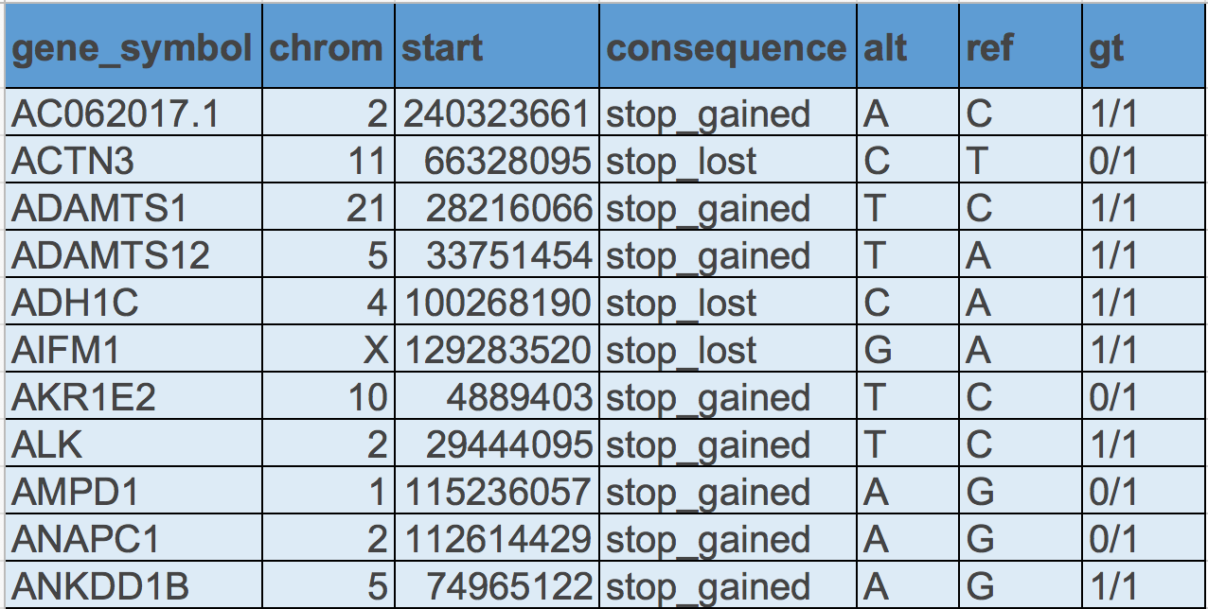
Query: Tabular display of high impact variant count in genes where the most severe consequence type is either a stop codon or missense for a selected sample. Search across ~2 billon records, results in 15 seconds.

Slide 22
Basic Components of an Analysis Commons
Genetic Data Sets
WGS, WES, -Omics
Phenotypes
Analytic Software & Pipelines
Statistical Analytic Commons
Authentication, HIPPA, CAP/CLIA, FISMA,
ISO 27001/2, GCP, GLP
Security
Analytic Users and Developers

Slide 23
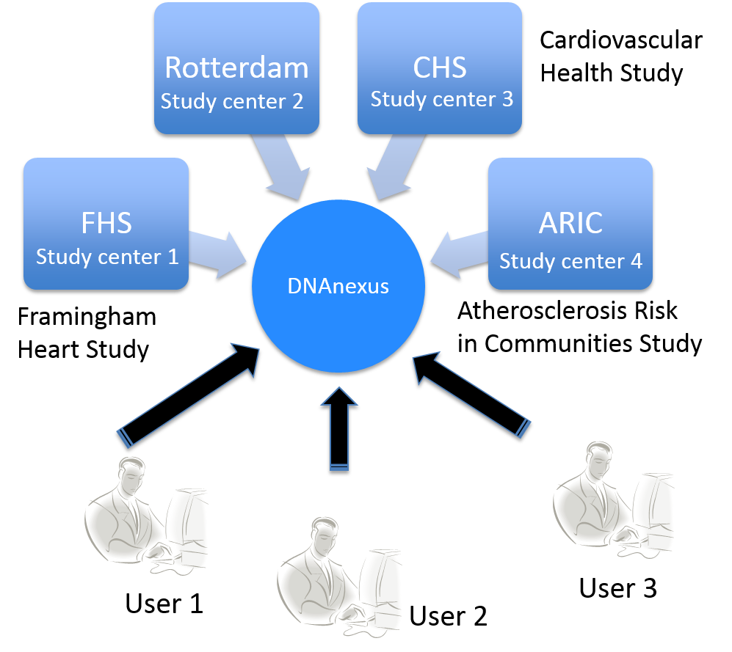
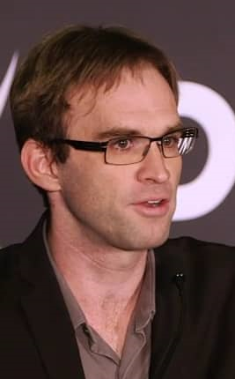



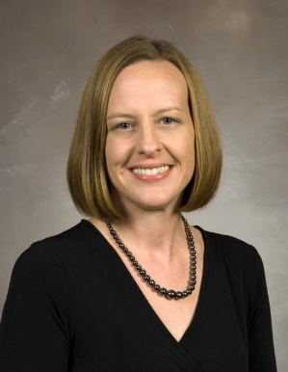

Community Engagement At-Scale
Big data (N=50,000)
Phenotype, WGS
Distributed investigators
Desire for version control
Flexibility
Data
Commons
Results produced by Analysis Commons

Slide 24




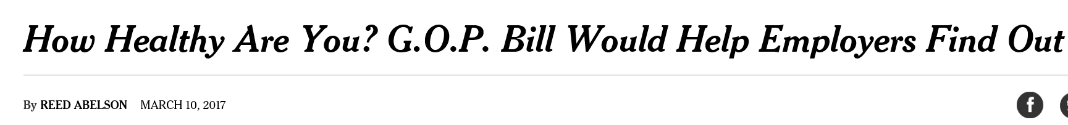

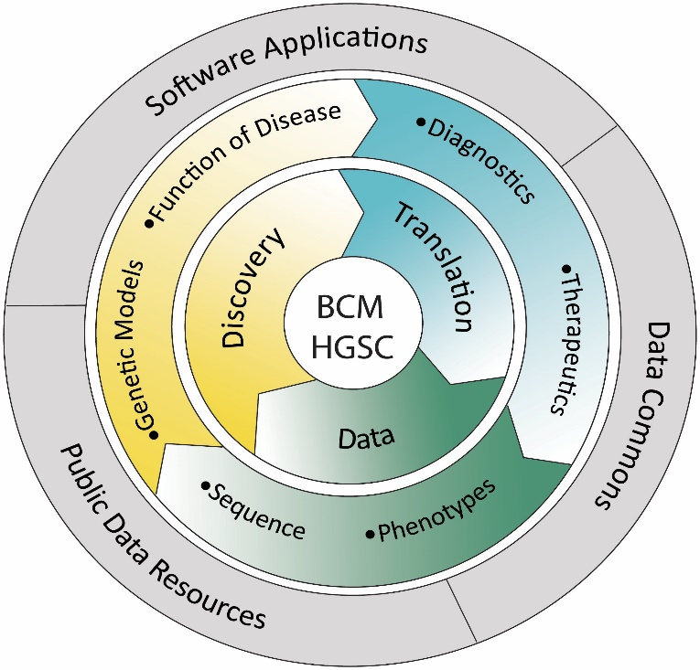
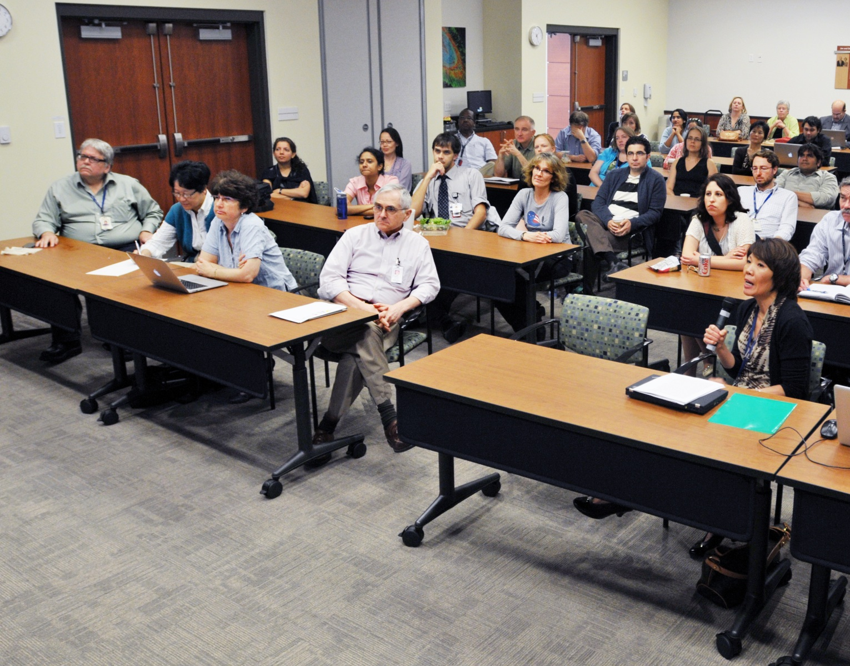
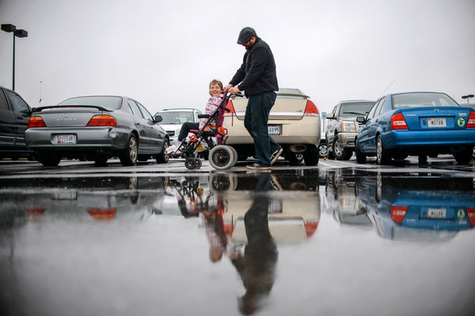
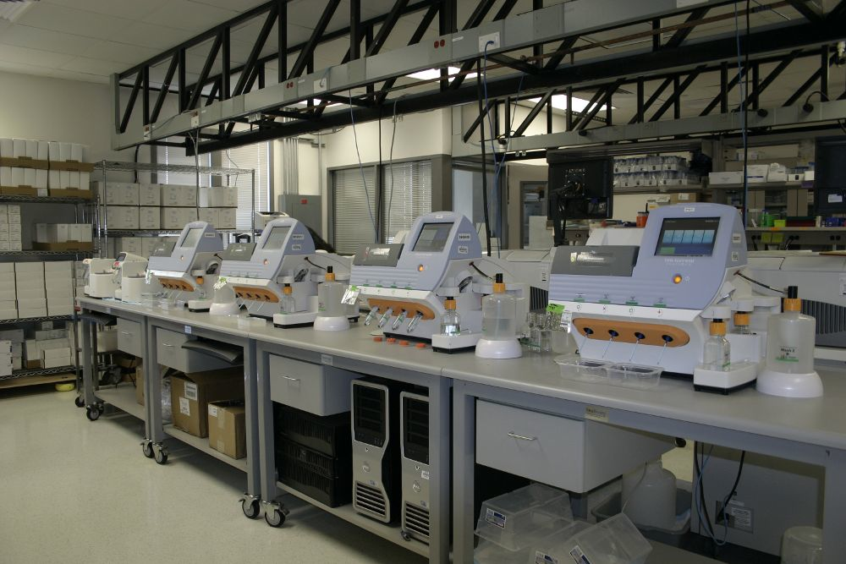
Clinical ⇔ Research Enterprises
DNA Test for Rare Disorders Becomes More Routine,
G. Kolata

