Slide 1
Yale ChIP-seq updates
Gerstein Lab
03/22/2017

Slide 2
Study Name | Samples | Status
Yale-ASD | 36 | Finished processing and compared with UMASS results
UCLA-ASD | 285 | Received the hard drive from Singapore, data uploaded to our new cluster, fastq files organized according to metadata, start processing next week
Yale-ipsc | 124 | Got corrected sample ID, will start processing
Reference tissue (Sestan lab at Yale) | 23 | Finished processing
Notes:
18
288
10 reference tissue

Slide 3
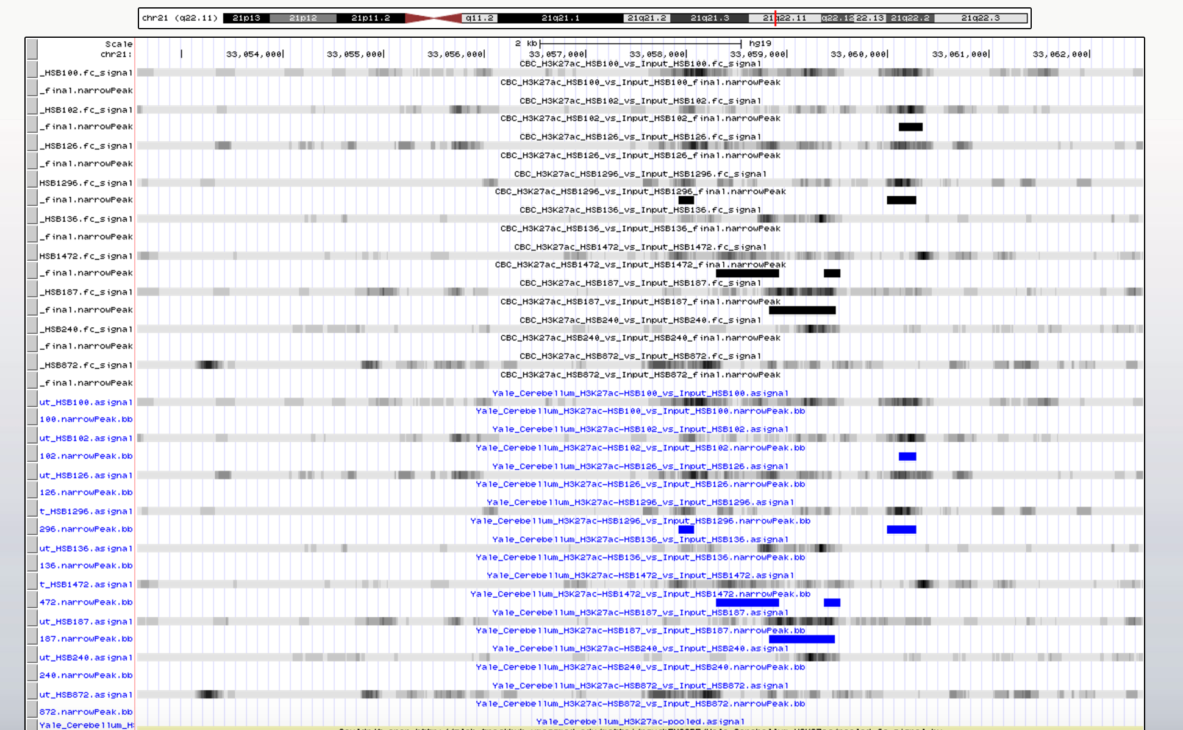
Yale site
Umass
site

