Slide 1
P2 Brain
03/27/2017

Slide 2
Differential gene expression: Disease cohort VS Controls
Disease cohort from CMC: BP, AFF, SCZ
18119 genes available for differential expression analysis
BP | AFF | SCZ | CMC_control | GTEx
47 | 8 | 275 | 291 | 222
Notes:
AFF: affective disorder

Slide 3
Results differ largely based depending on the control used…
 | CMC disease VS CMC control | CMC disease VS GTEx | CMC disease VS (CMC control + GTEx)
# of genes upregulated | 2778 | 8001 | 238
# of genes downregulated | 39 | 752 | 4064

Slide 4
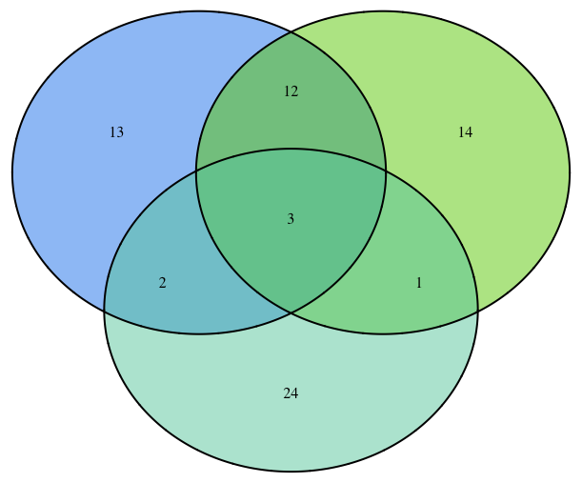
Intersection of top 30 upregulated genes
CMC disease VS CMC control
CMC disease VS GTEx
CDR1
RPS24
B2M
IDS
MAP2
RPL7
CMC disease VS (CMC control + GTEx)

Slide 5
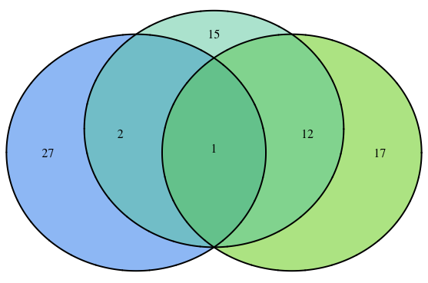
Intersection of top 30 down-regulated genes
CMC disease VS (CMC control + GTEx)
CMC disease VS CMC control
CMC disease VS GTEx
UBB
TMSB10
MT-ND3

Slide 6
GO terms | CMC disease VS CMC control | CMC disease VS GTEx | CMC disease VS (CMC control + GTEx)
Up-regulated gene | synaptic transmission, GABAergic; SRP-dependent cotranslational protein targeting to membrane; positive regulation of dendritic spine morphogenesis; viral transcription; nuclear-transcribed mRNA catabolic process, nonsense-mediated decay | positive regulation of protein localization to Cajal body; SRP-dependent cotranslational protein targeting to membrane; translational initiation; nuclear-transcribed mRNA catabolic process, nonsense-mediated decay; viral transcription | regulation of potassium ion transmembrane transporter activity; SRP-dependent cotranslational protein targeting to membrane; regulation of cation channel activity; Behavior; neuron development
Down-regulated gene | hydrogen ion transmembrane transport; mitochondrial electron transport, NADH to ubiquinone; mitochondrial respiratory chain complex I assembly | regulation of AMPA receptor activity; regulation of neuronal synaptic plasticity; associative learning; neurotransmitter transport; negative regulation of neuron death; regulation of neuron apoptotic process | positive regulation of protein localization to Cajal body; mitochondrial ATP synthesis coupled proton transport; mitochondrial electron transport, ubiquinol to cytochrome c; substantia nigra development

Slide 7
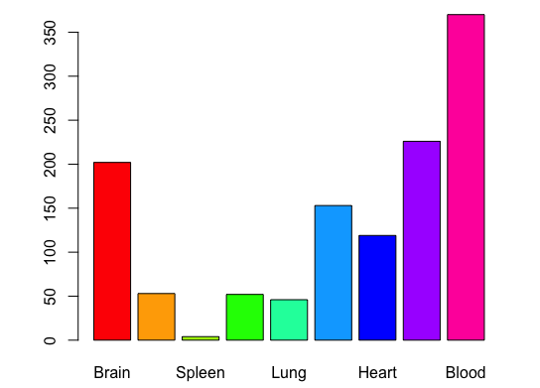
Summarize specifically expressed genes in different tissues in GTEx

