Slide 1
New Features in SCREEN
Zhiping Weng
UMass Med

Slide 2
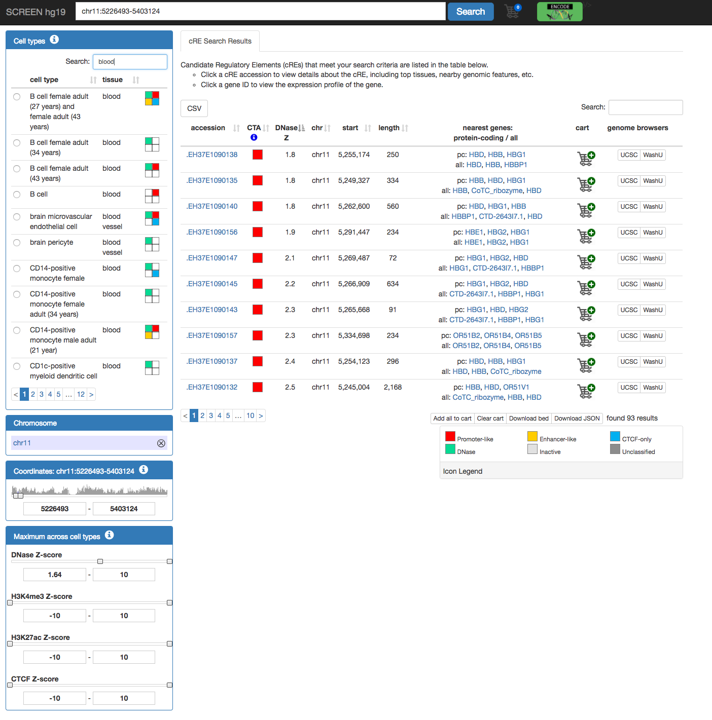
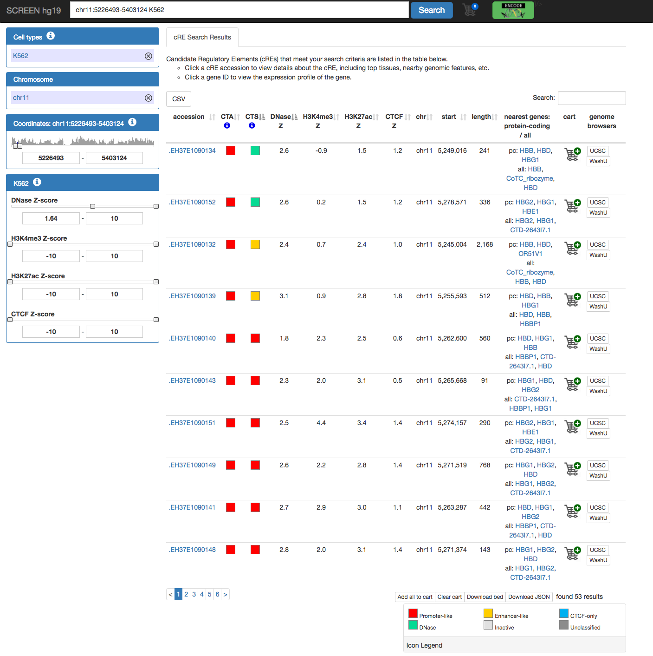
Color-coded icons of cell type and cRE

Slide 3
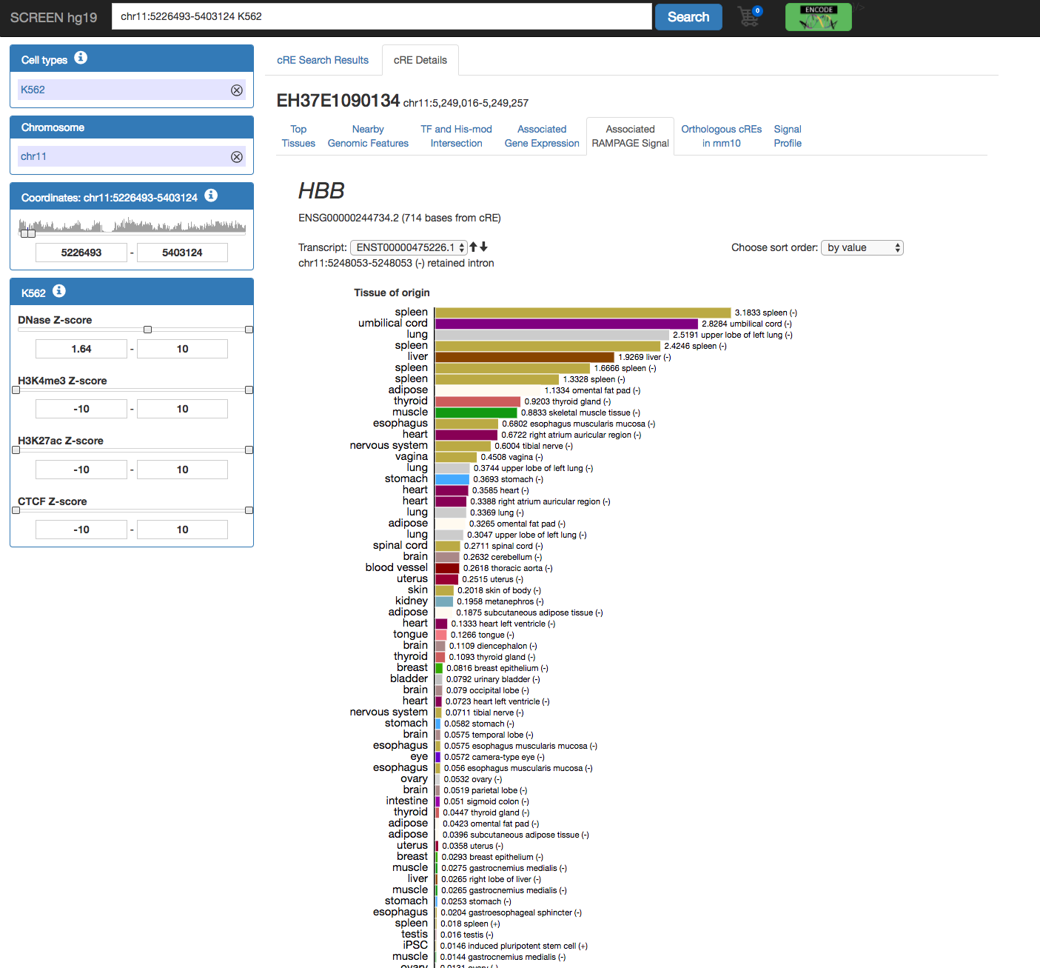
RAMPAGE visualization for TSS activities across cell types

Slide 4
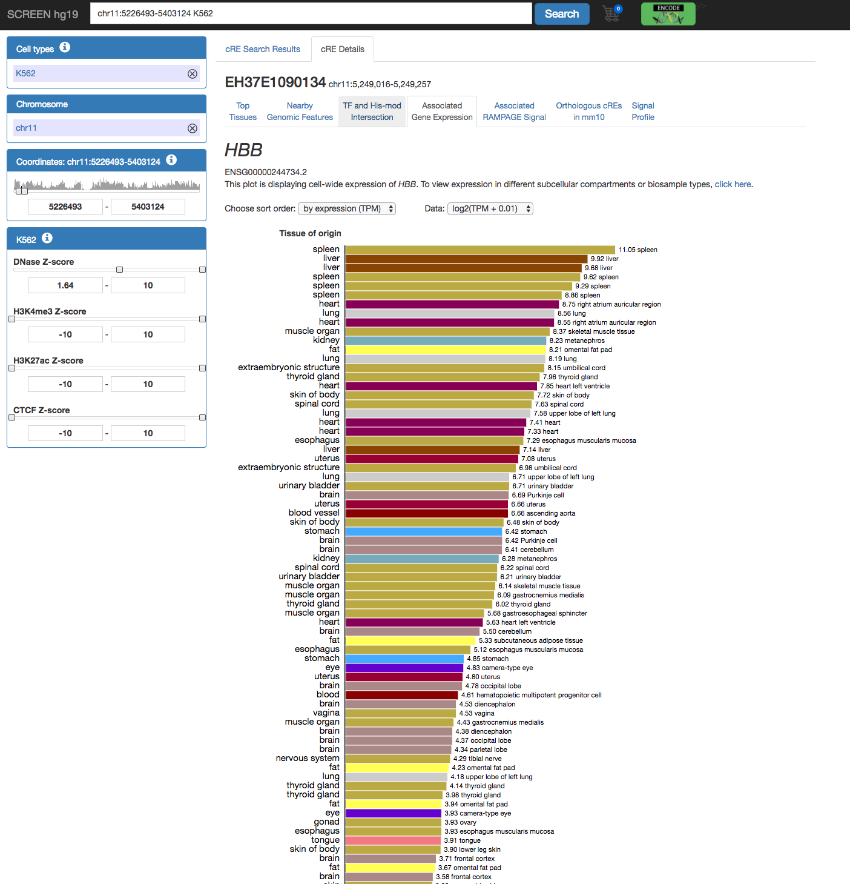
The corresponding RNA-seq data

