Slide 1
Classification of cREs
Jill Moore
Weng Lab
University of Massachusetts Medical School
March 25, 2017

Slide 2
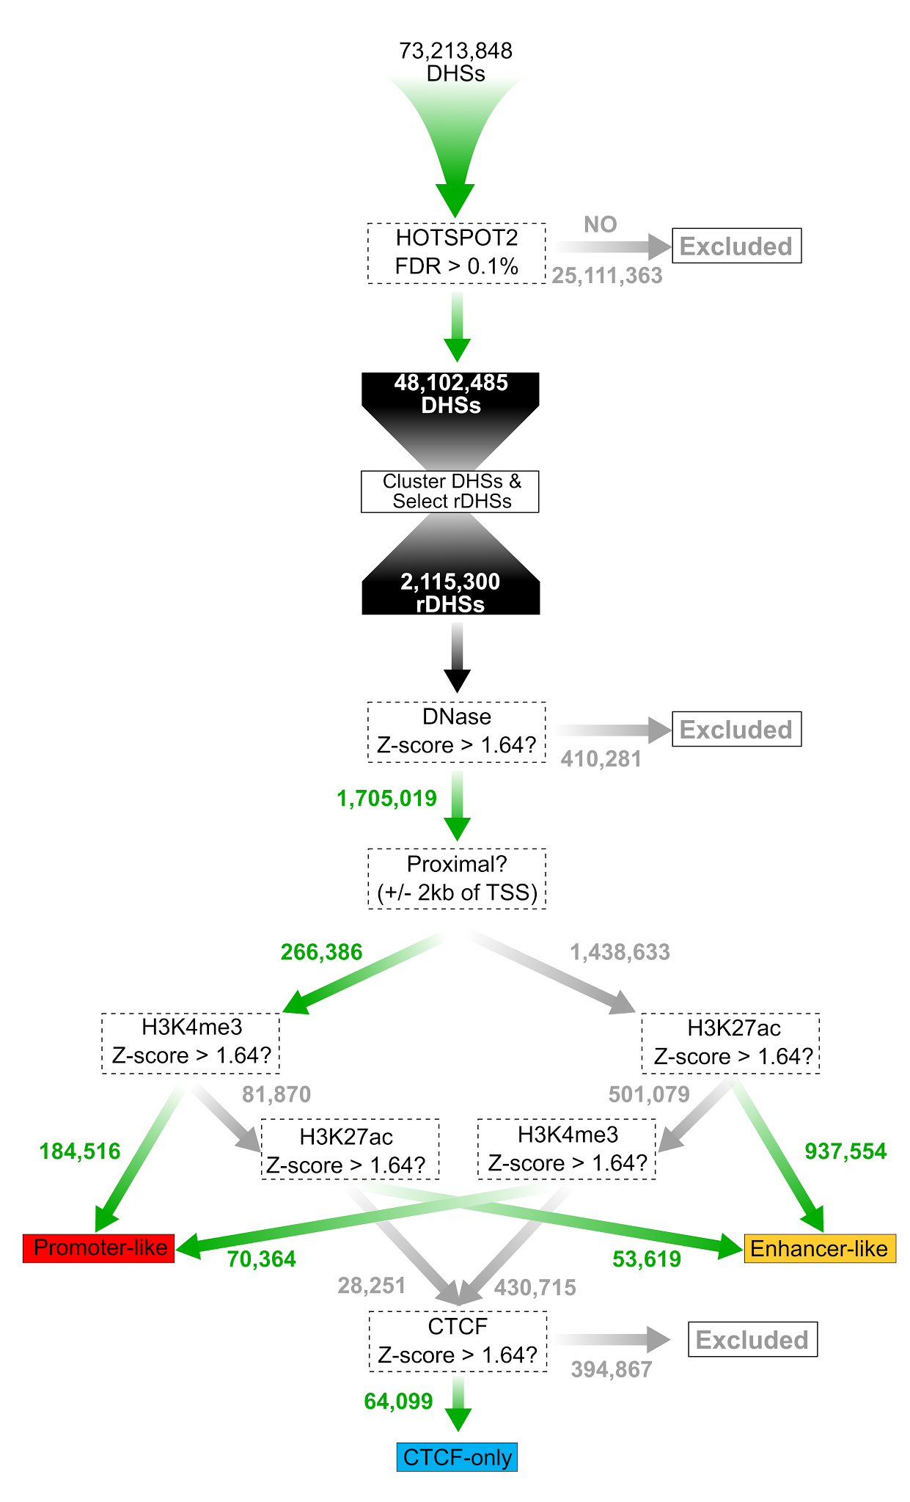
Current Registry Classification Methods
Pan-cell-type (PCT) classification:
Using the flow chart to the left we classify cREs into groups based on max Z-score of H3K4me3, H3K27ac and CTCF signal across all cell types and distance from TSS.
Definition of “pan-” as a prefix:
all-inclusive, especially in relation to the whole of a continent, racial group, religion, etc. e.g., "pan-African", “pan-cancer”
Single-cell-type (SCT) classification:
Using the same flowchart we also classify cREs using Z-scores in individual cell types (without taking into account information in other cell types). In cell types without all available data, we still make classifications but skip over the corresponding branches in the chart.

Slide 3
SCREEN Displays These Classification as Color Coded Icons &
Shows Cell Type Specific Z-scores
Example - cREs in gene body of HNF1A that are active in hepatocytes
PCT
PCT SCT

Slide 4
Users can also directly download this table to:
Perform their own classification with Excel by applying different Z-score thresholds and performing different schemes of grouping
Integrate with their own data

Slide 5
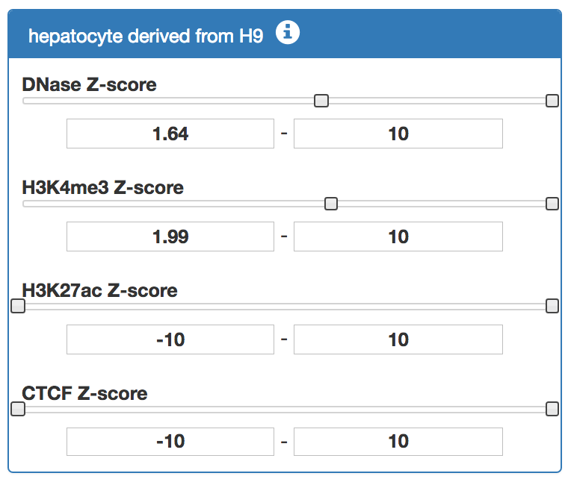
The use can also select their own thresholds using SCREEN and download the “cRE Search Results” table
For example, selecting all cREs in the gene body of HNF1A with H3K4me3 Z-score > 1.99 in hepatocytes. This immediately affects the cREs that are in the “cRE Search Results” table, but does not change the PCT and SCT assignments of these cREs (denoted by red, yellow, blue, green, and grey boxes).
PCT SCT

Slide 6
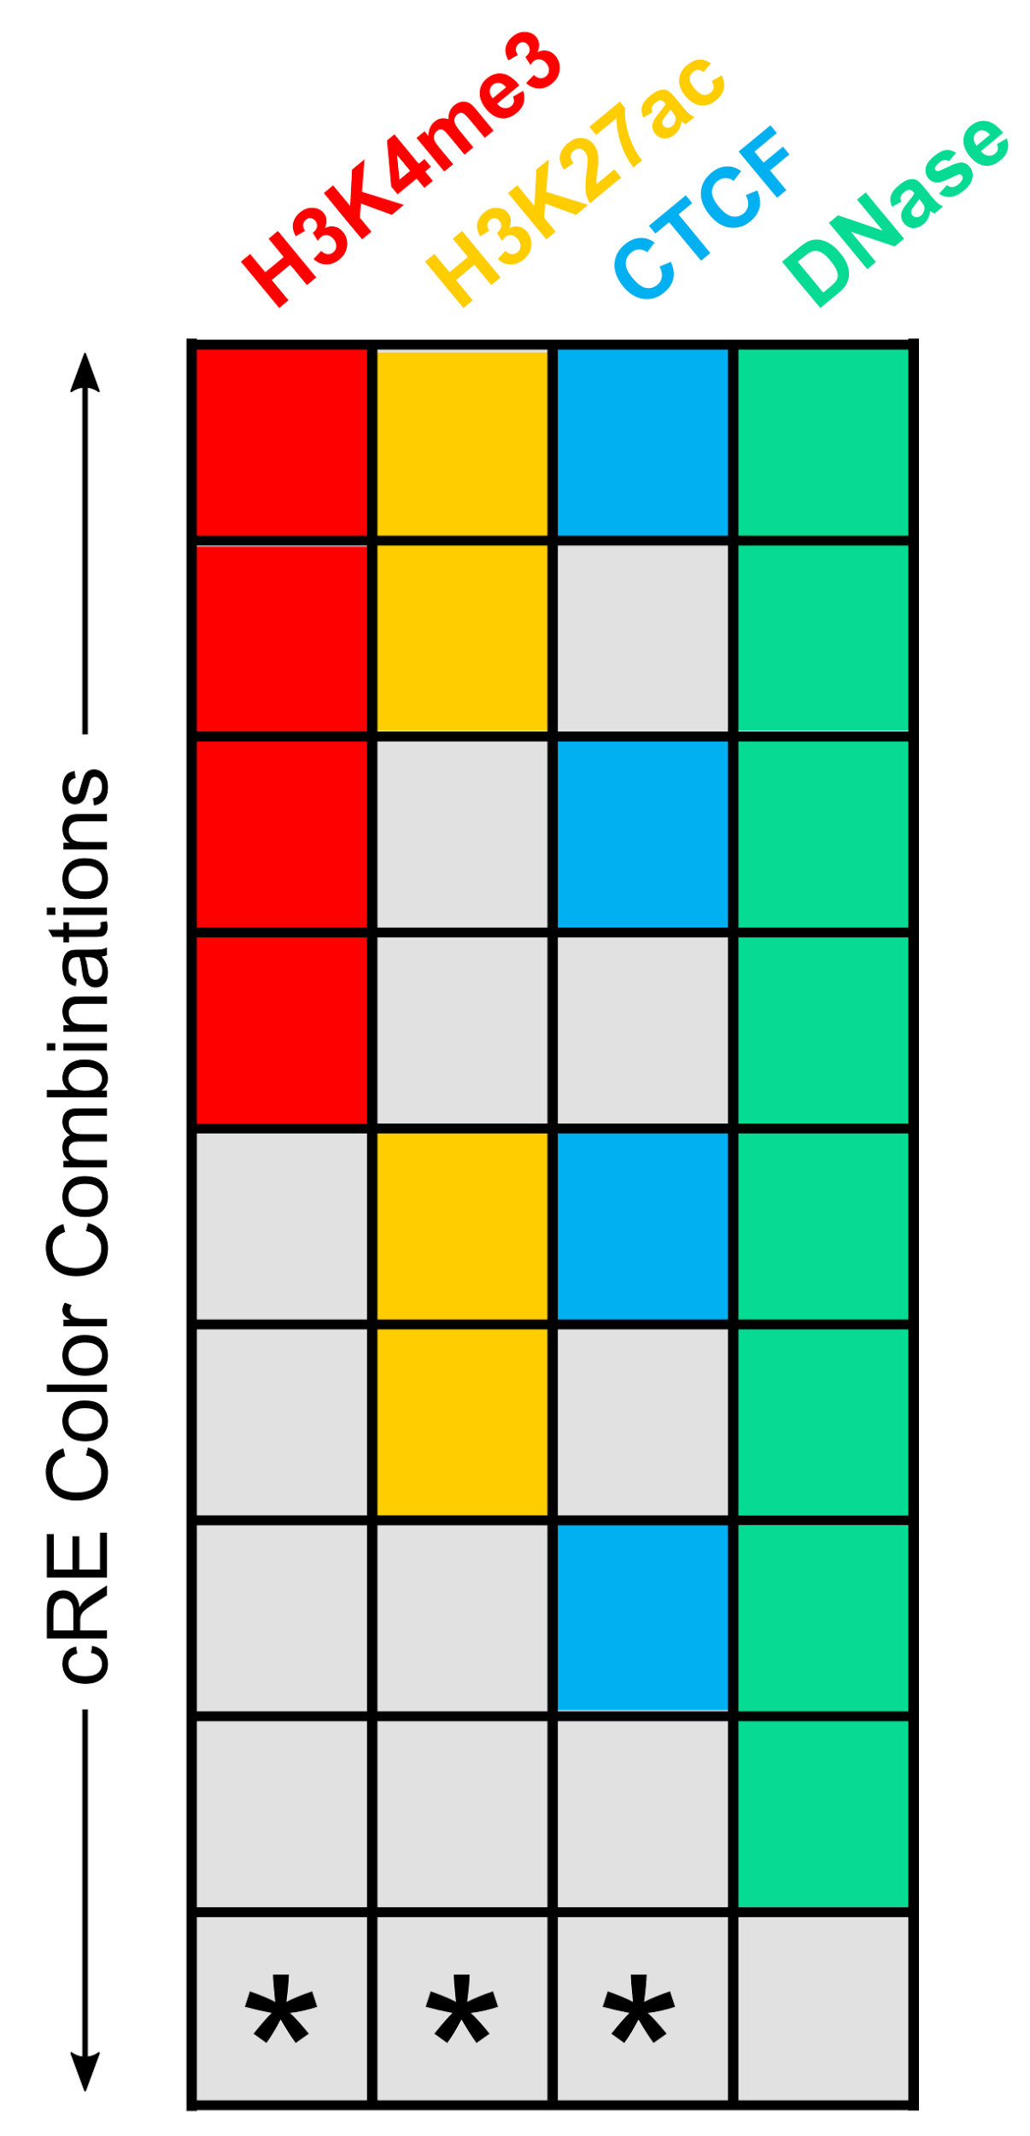
All Possible States of a cRE
In a particular cell type, we classify cREs with DNase Z-score < 1.64 as inactive
The remaining cREs fall into 8 groups based on if the Z-scores for H3K4me3, H3K27ac, or CTCF are > 1.64
For example, a cRE with the grey-yellow-grey-green combination of colors would have H3K27ac & DNase Z-scores ≥ 1.64 and H3K4me3 & CTCF Z-scores < 1.64

Slide 7
Rationale behind the current cRE classification in a particular cell type (single-cell-type classification)
Promoter-like
Enhancer-like
CTCF-only
DNase-only
Inactive

Slide 8
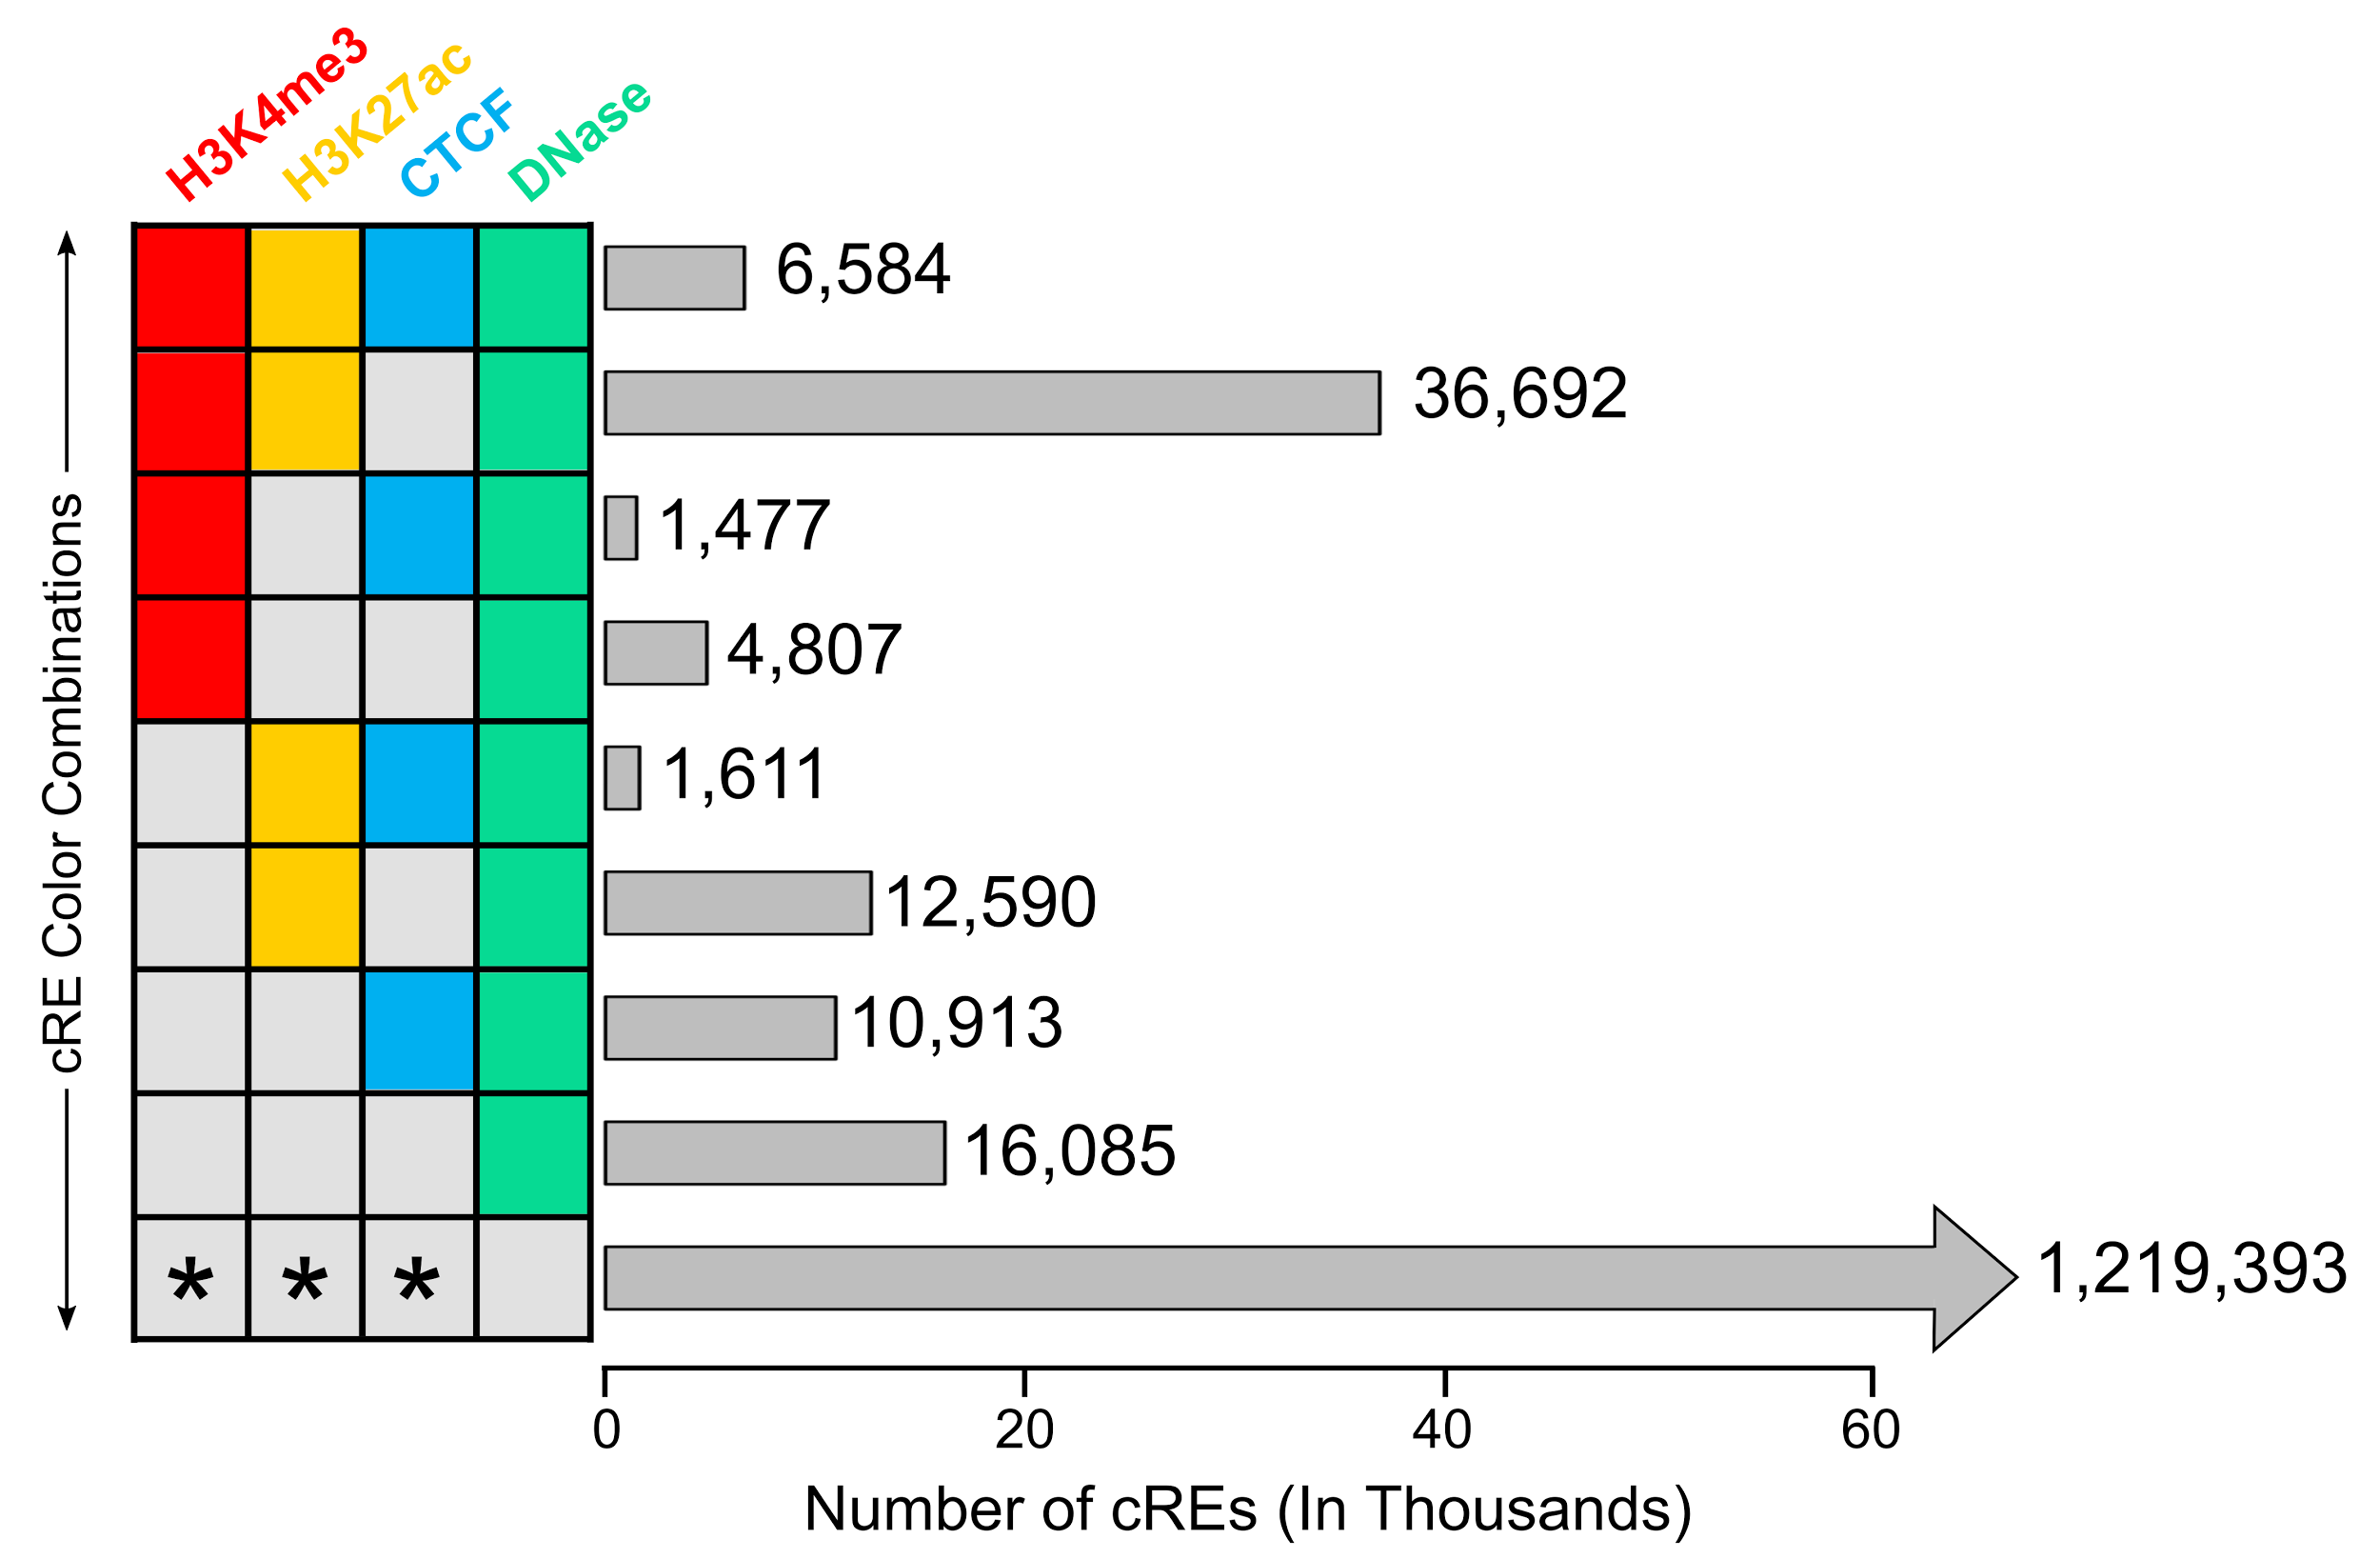
Number of cREs in GM12878

Slide 9
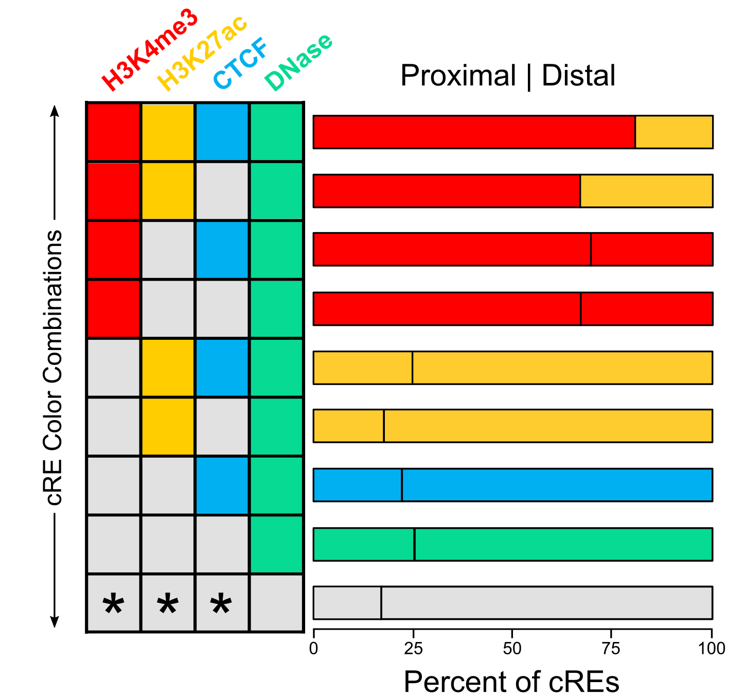
TSS Distal-Proximal Breakdown of GM12878 cREs
6,584
Proximal = within ± 2kb of Gencode annotated TSS
36,692
1,477
Promoter-like
4,807
Enhancer-like
1,611
CTCF-only
12,590
DNase-only
10.913
16,085
Inactive
1,219,393

Slide 10
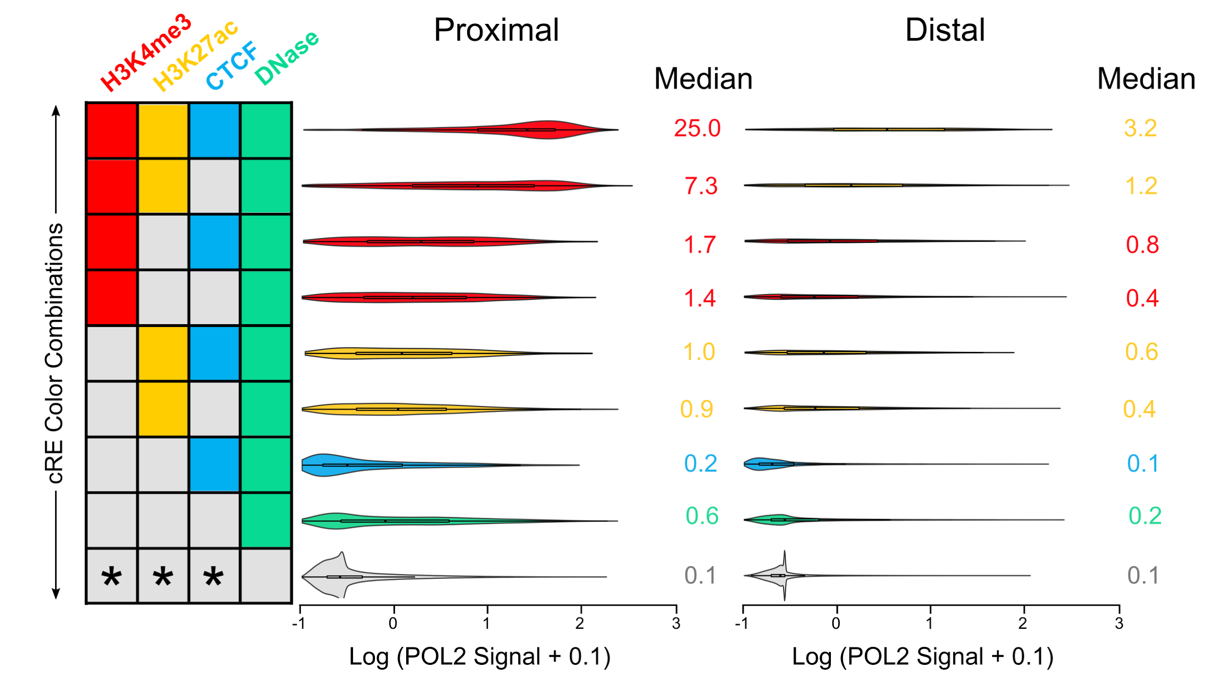
Average POL2 Signal Across cREs
5,293
1,291
24,445
12,247
1,027
450
3,223
1,584
397
1,214
2,191
10,399
2,375
8,538
4,046
12,039

Slide 11
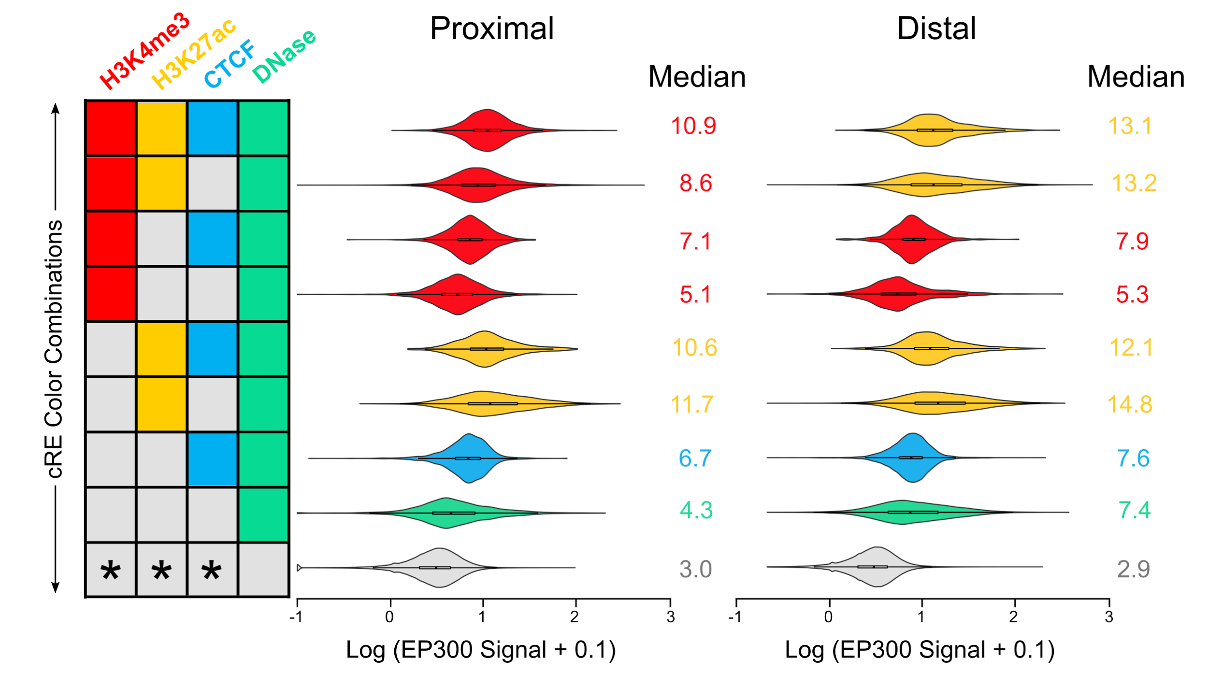
Average EP300 Signal Across cREs
5,293
1,291
24,445
12,247
1,027
450
3,223
1,584
397
1,214
2,191
10,399
2,375
8,538
4,046
12,039

Slide 12
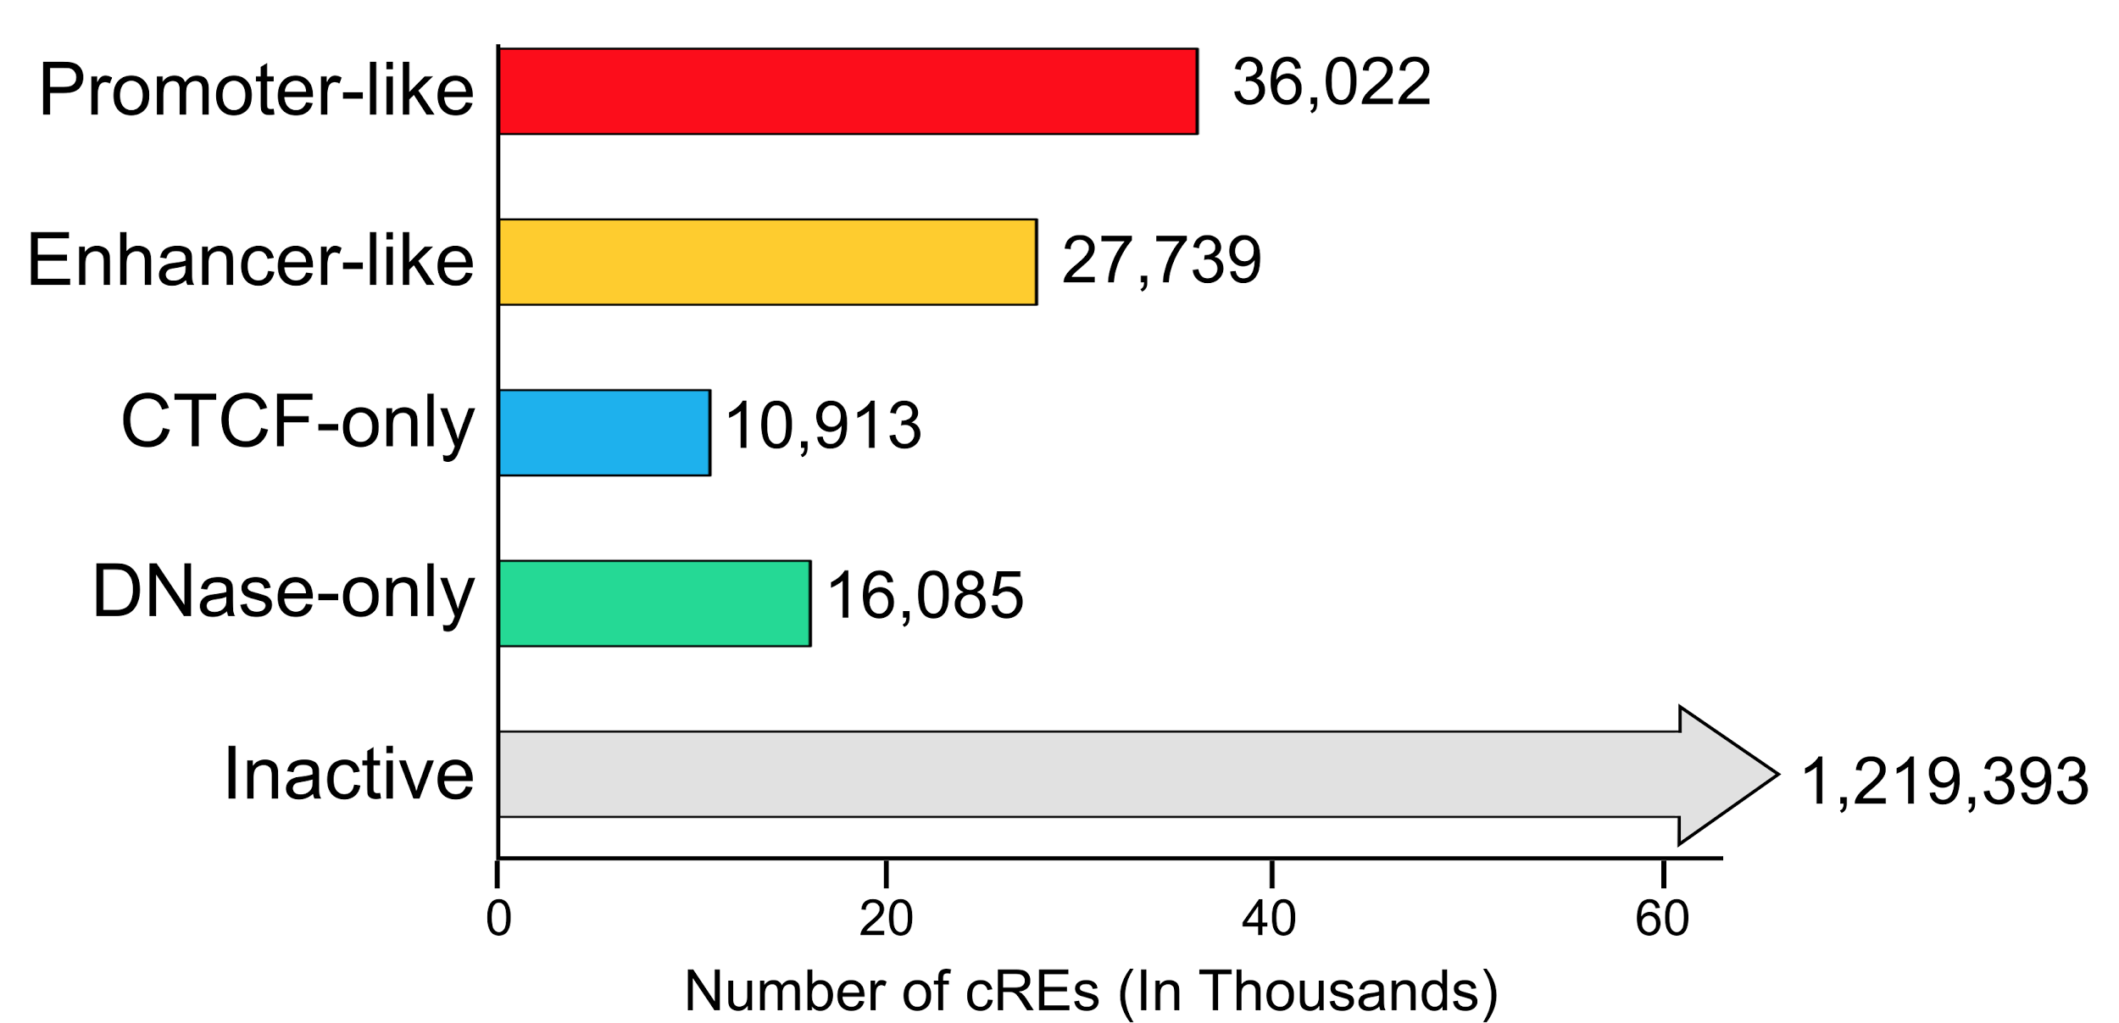
Number of cREs in GM12878

Slide 13
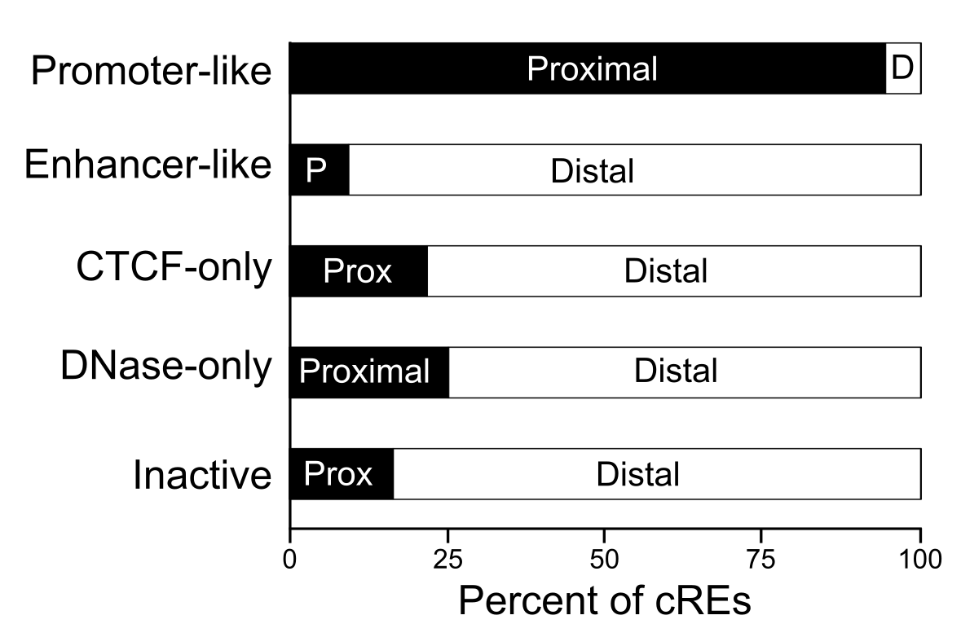
Distal-Proximal Breakdown of GM12878 cREs
*
*
* Distance from TSS is used in assigning these categories
Proximal = within ± 2kb of Gencode annotated TSS

Slide 14
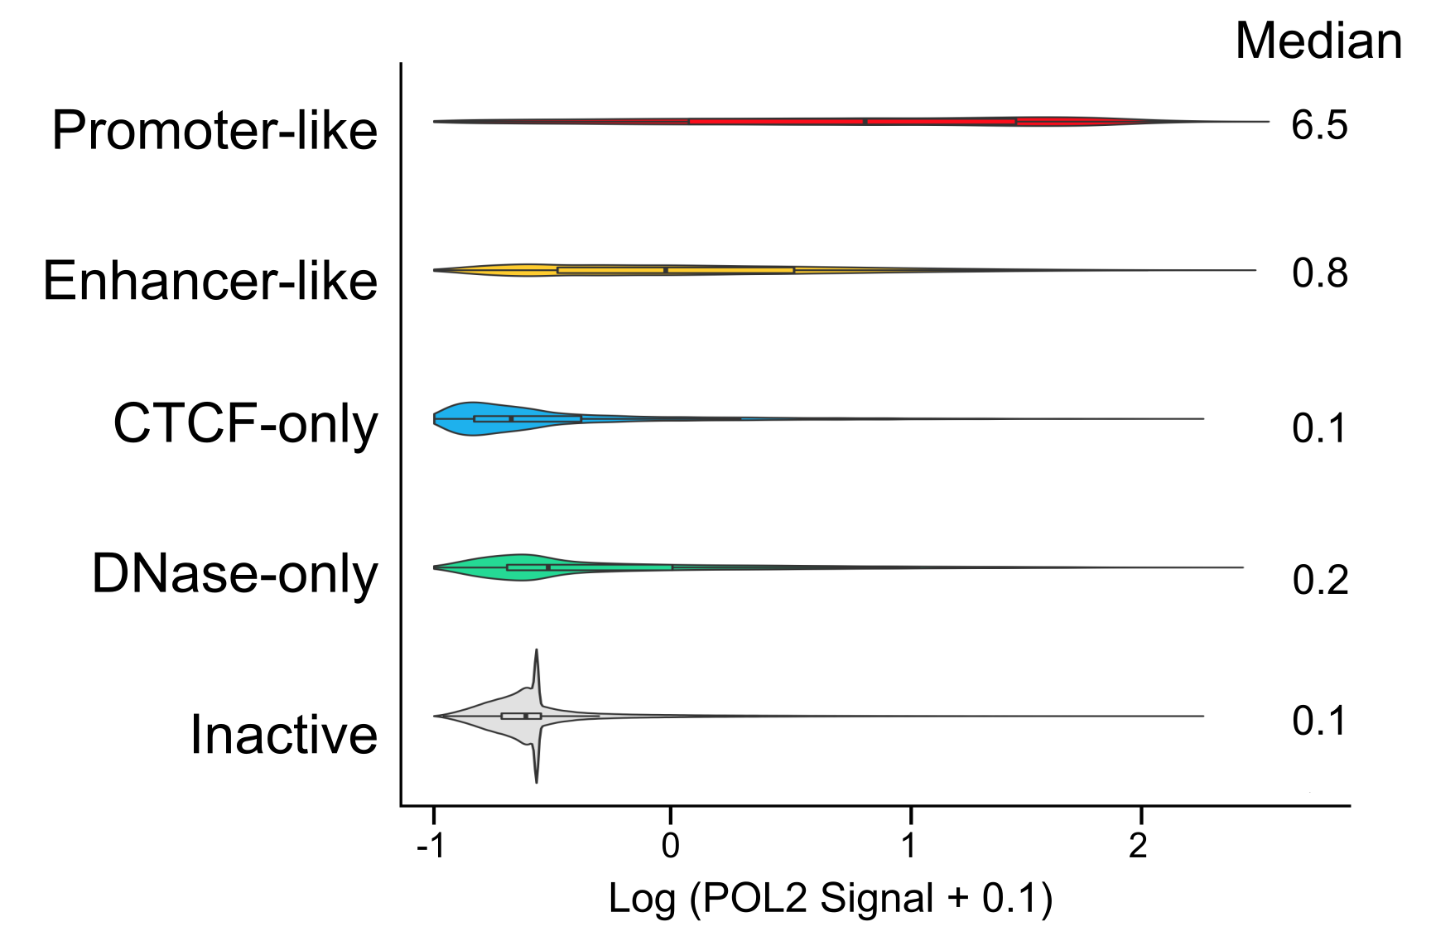
Average POL2 Signal Across cREs

Slide 15
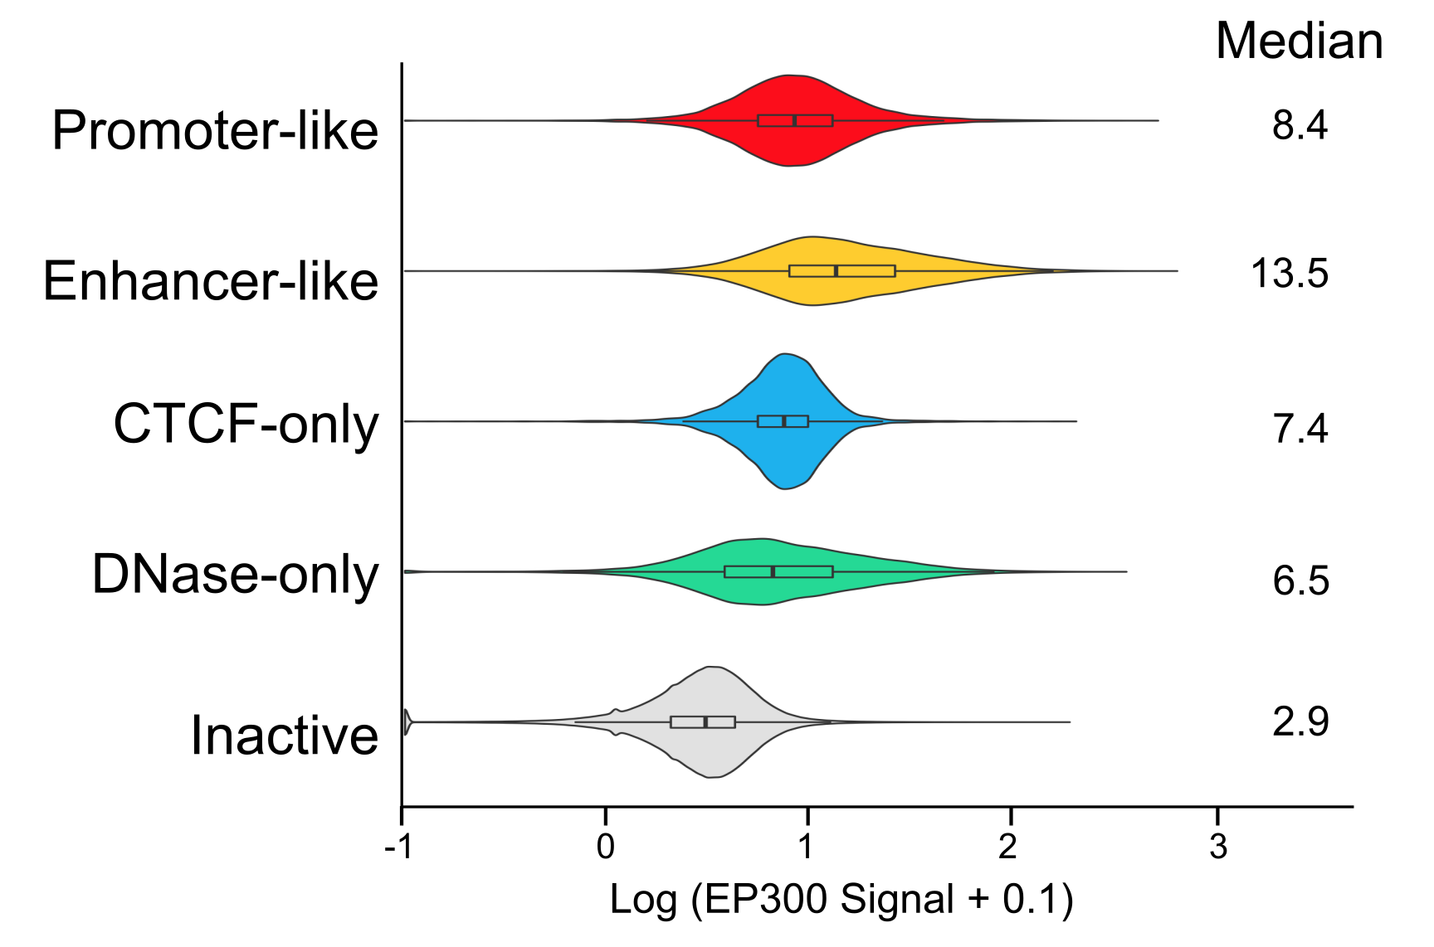
Average EP300 Signal Across cREs

Slide 16
Comparison of the current approach in SCREEN with Barbara and Ross’s proposal

Slide 17
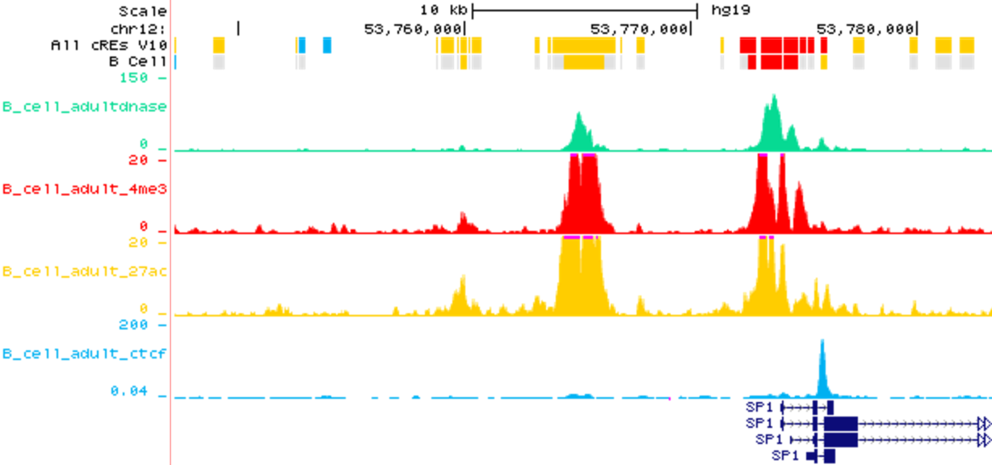
Overview of Current SCREEN UCSC Genome Browser Display
pan-cell-type cRE classification
cREs classification for B cells
Signals in B cells:
DNase
H3K4me3
H3K27ac
CTCF
Current SCREEN Display

Slide 18
Overview of Current SCREEN UCSC Genome Browser Display
Z-scores for this cRE in
B cells
PCT SCT
Current SCREEN Display

Slide 19
Barbara & Ross's Proposal
cREs are not classified into groups.
Instead, they propose to directly display the thresholded data using four color (Z-score ≥ 1.64) or grey (Z-score < 1.64) boxes, with each box corresponding to a data type.
There are 16 combinations when all four data types are available for a particular cell type (7 combinations for which DNase Z-score < 1.64 are omitted in the left figure)
Barbara & Ross's Proposed Display

Slide 20
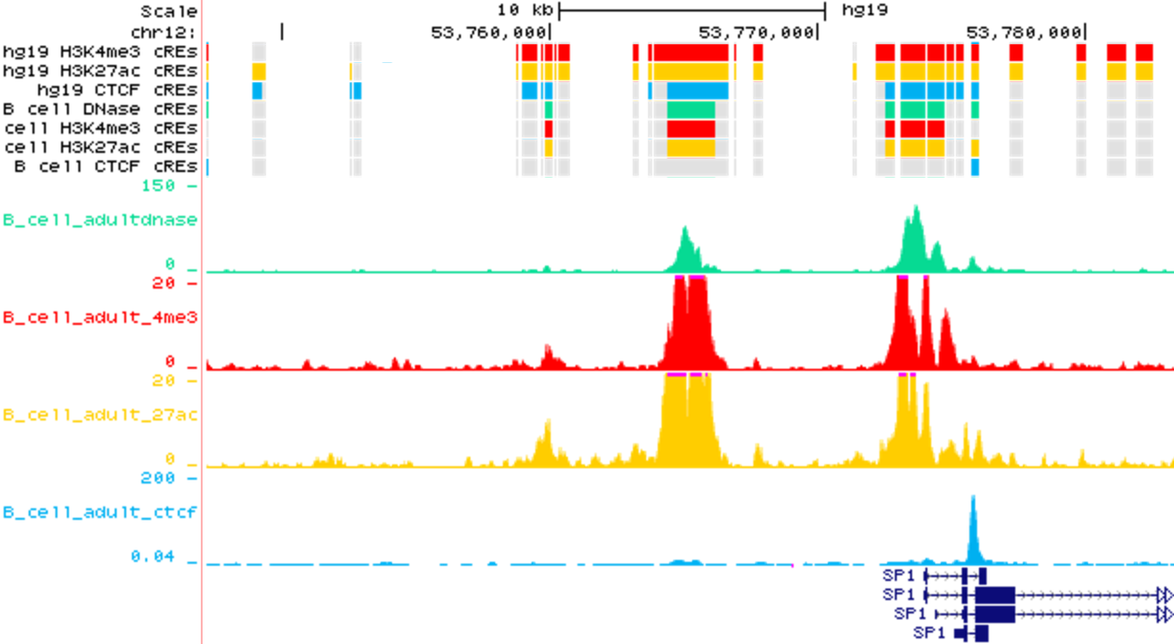
Overview of Barbara & Ross's Proposed Display
cRE tracks displaying
Color for maxZ > 1.64
B cell tracks displaying
cREs with
Z-scores > 1.64
B cell signal:
DNase
H3K4me3
H3K27ac
CTCF
Barbara & Ross's Proposed Display

Slide 21
Comparing tracks across three cell types that have all 4 datatypes
(DNase, H3K4me3, H3K27ac, and CTCF)
B Cell (Adult)
Bipolar Spindle Neuron (derived from IPSC)
Hepatocytes (derived from H9)

Slide 22
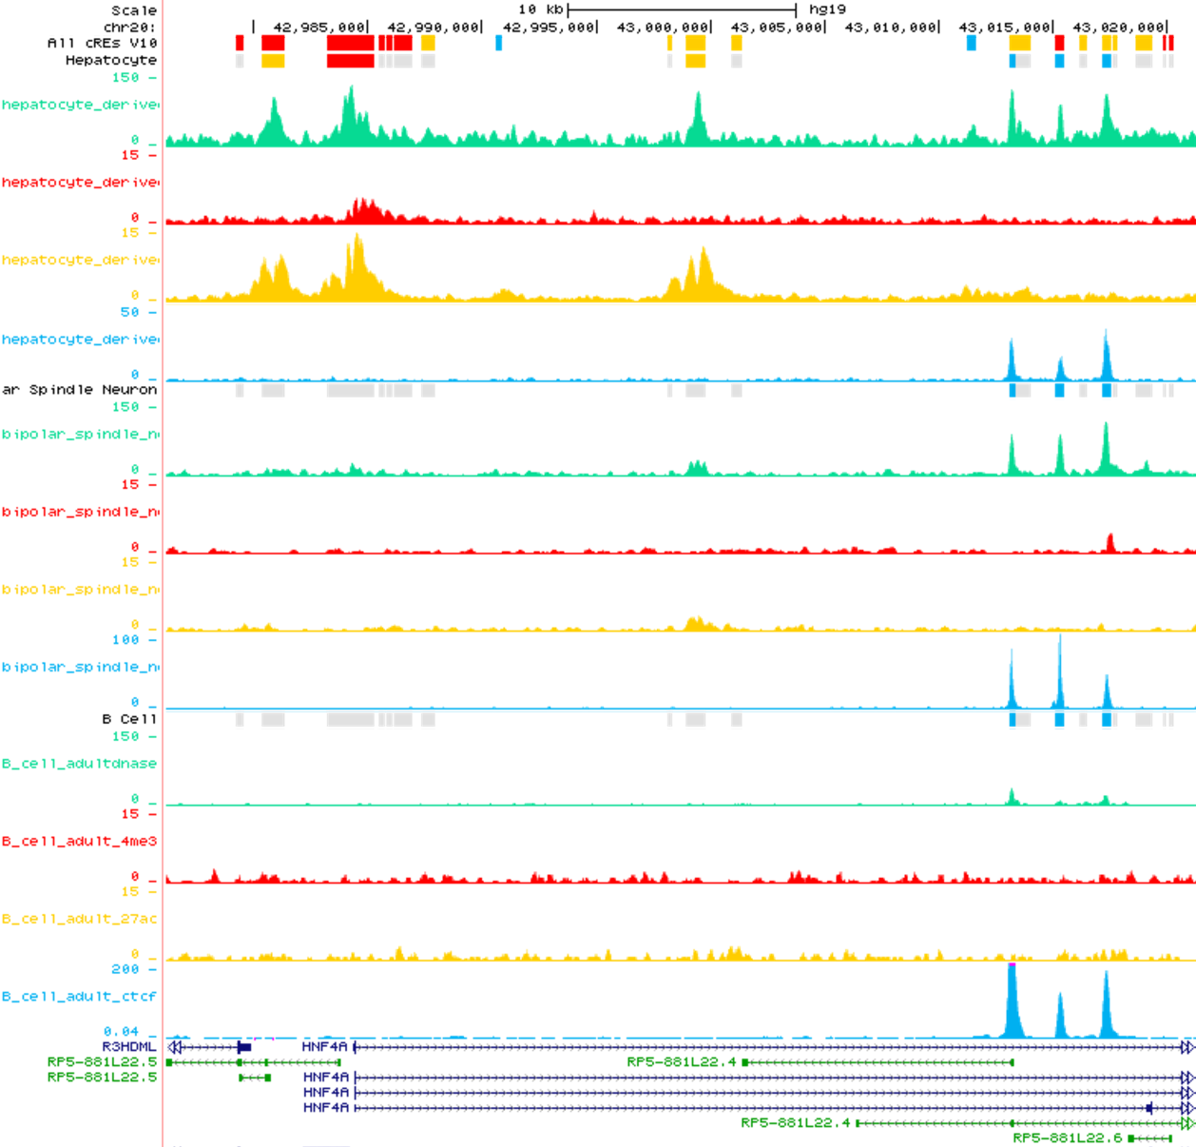
HNF4a - Hepatocyte
Nuclear Factor 4
Hepatocyte
Link to browser
chr20:42,977,999-43,021,004
Bipolar Spindle Neuron
B Cell
Current SCREEN Display

Slide 23
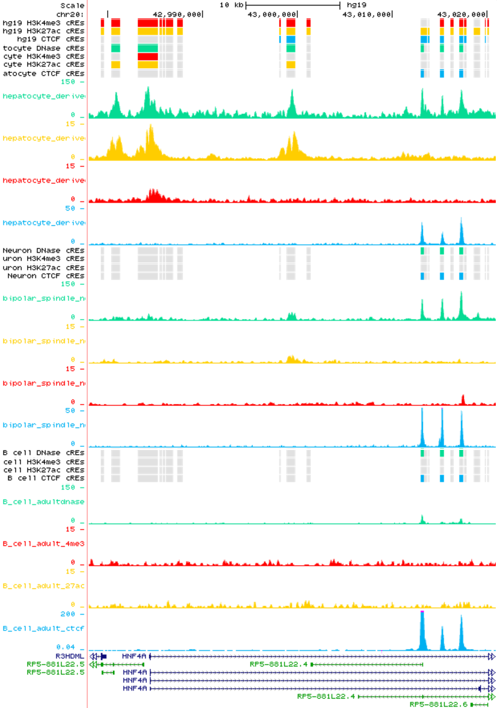
HNF4a - Hepatocyte
Nuclear Factor 4
Hepatocyte
Link to browser
chr20:42,977,999-43,021,004
Bipolar Spindle Neuron
B Cell
Barbara & Ross's Proposed Display

Slide 24
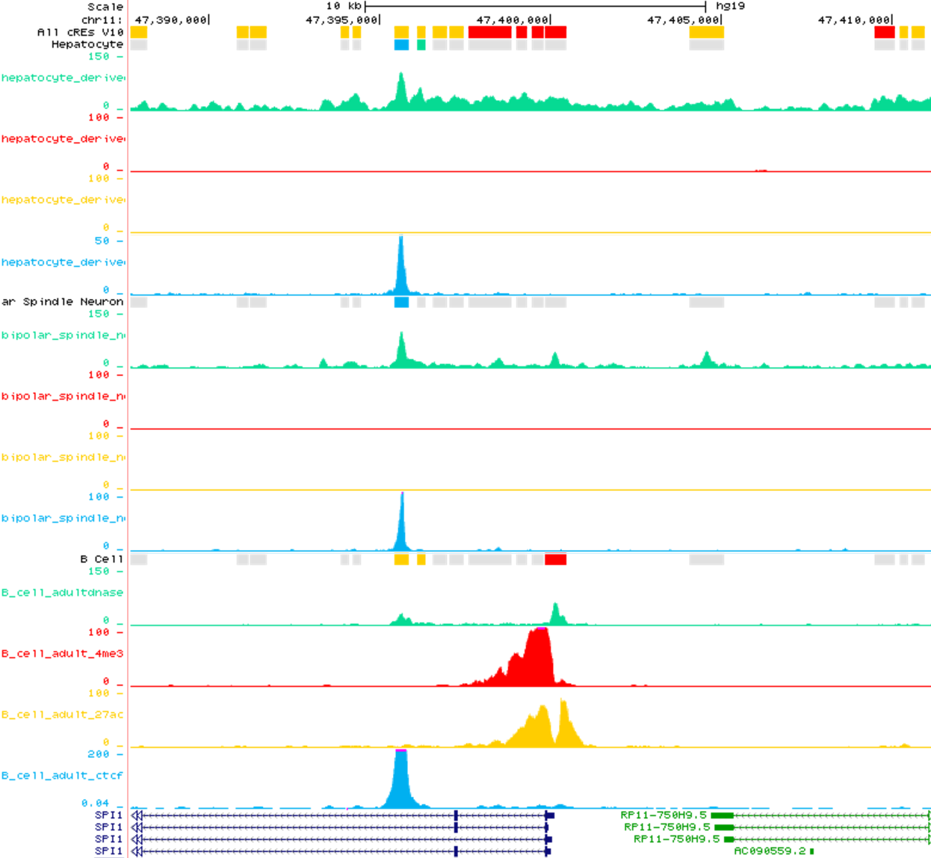
SPI1 - Hematopoietic Transcription Factor PU.1
Hepatocyte
Link to browser:
chr11:47,387,721-47,411,156
Bipolar Spindle Neuron
B Cell
Current SCREEN Display

Slide 25
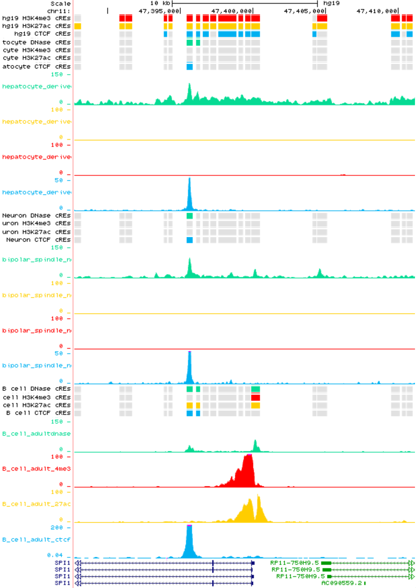
SPI1 - Hematopoietic Transcription Factor PU.1
Hepatocyte
Link to browser:
chr11:47,387,721-47,411,156
Bipolar Spindle Neuron
B Cell
Barbara & Ross's Proposed Display

Slide 26
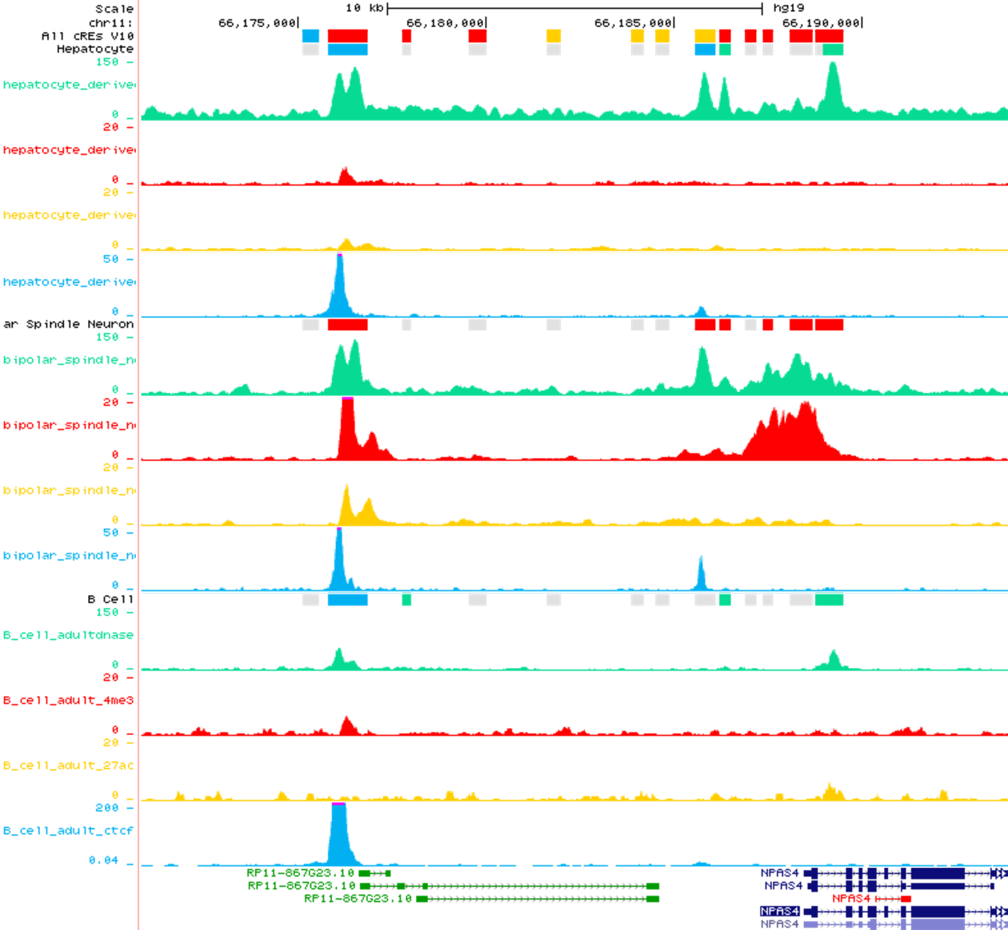
NPAS4 - Neuronal PAS Domain Protein 4
Hepatocyte
Link to browser:
chr11:66,170,828-66,193,905
Bipolar Spindle Neuron
B Cell
Current SCREEN Display

Slide 27
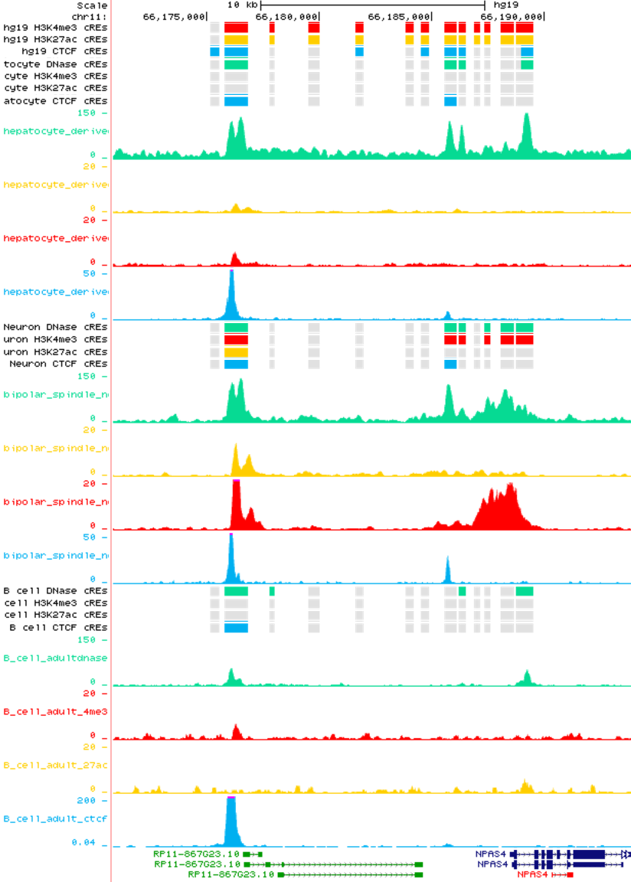
NPAS4 - Neuronal PAS Domain Protein 4
Hepatocyte
Link to browser:
chr11:66,170,828-66,193,905
Bipolar Spindle Neuron
B Cell
Barbara & Ross's Proposed Display

Slide 28
Original Slides From Barbara & Ross

Slide 29
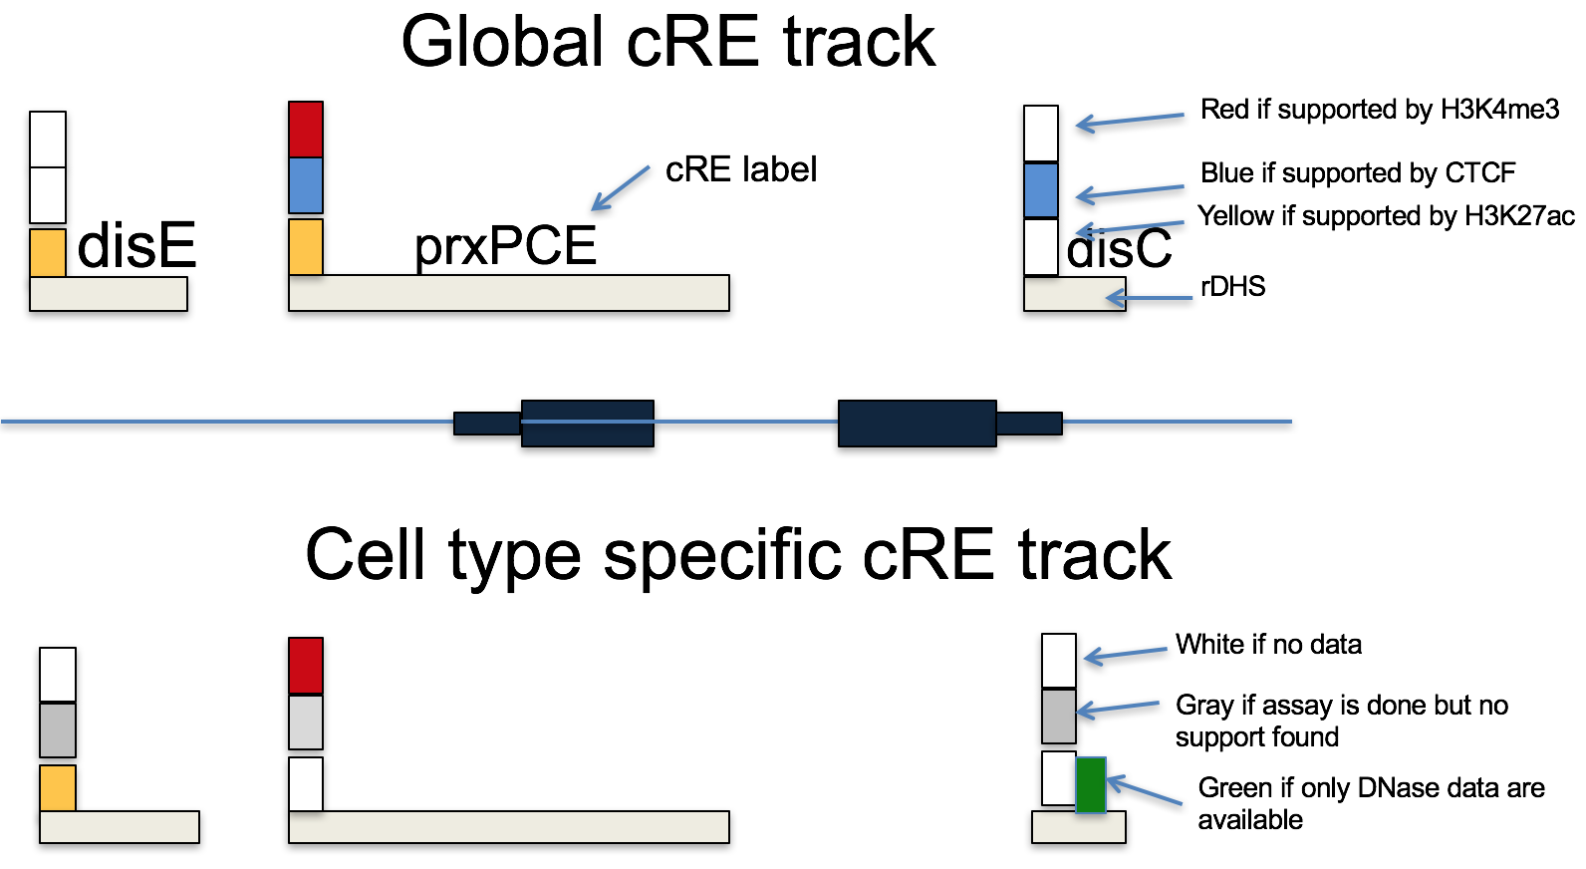
From conceptual mock-up4 multi-label_rh.ppt 3/17/17

Slide 30
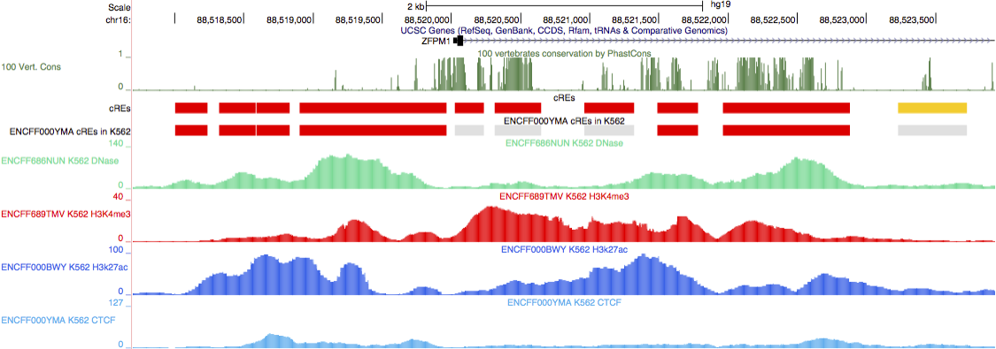
From Current3Label_cREs.pdf 3/17/17

Slide 31
From MultiLabel_cRE_BrowserDisplay_MockUp_v2.pdf 3/17/17

Slide 32
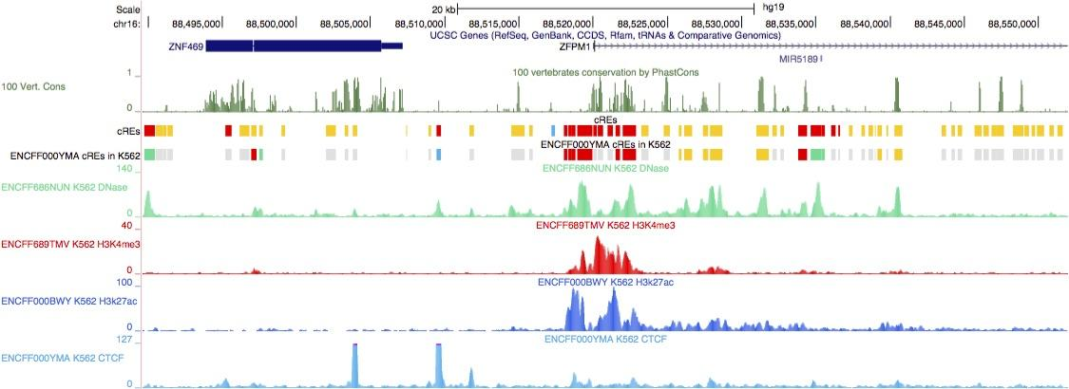
From Current3Label_cREs_ZoomOut.pdf 3/17/17

Slide 33
From mulitLabel_cREs_MockUp_ZoomOut.pdf 3/17/17

