Slide 1
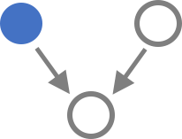
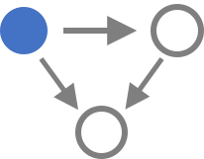
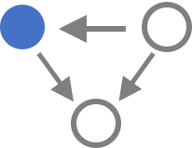
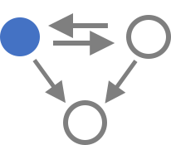
A
RBP
TF
B
C
Other TF | 212 | 38 | 14 | 2
Triplet | 10574 | 2135 | 1487 | 113
SUB1 in LUAD
MYC in BRCA

Slide 2
A
TF
RBP
B
C
Other TF | 212 | 38 | 14 | 2
Triplet | 10574 | 2135 | 1487 | 113
MYC in BRCA
SUB1 in LUAD

Slide 3
A
TF
RBP
B
C
Other TF | 212 | 2 | 14 | 38
Triplet | 10574 | 113 | 1487 | 2135
Logic Gate Usage of FFLs
MYC in BRCA
SUB1 in LUAD

Slide 4
Other TF | 212 | 2 | 14 | 38
Triplet | 10574 | 113 | 1487 | 2135
Logic Gate Usage of FFLs

Slide 5
Other TF | 212 | 38 | 14 | 2
Triplet | 10574 | 2135 | 1487 | 113

Slide 6
RBP
TF
Logic Gate Usage of FFLs
Other TF | 212 | 38 | 14 | 2
Triplet | 10574 | 2135 | 1487 | 113

Slide 7
+
+
-
-
+
+
-
-
+
-
-
+
+
+
-
-
-
+
+
-
+
+
-
-
+
+
-
-
+
+
-
-
+
+
-
-
-
-
+
+
+
-
+
-
+
-
-
+

Slide 8
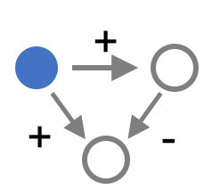
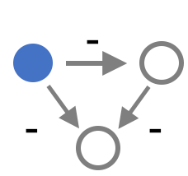
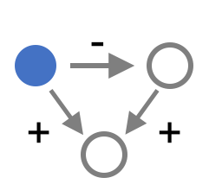
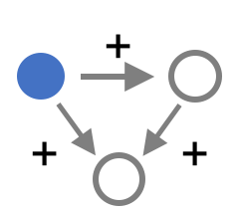

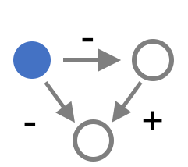

A
TF
RBP
B
C
MAX | 493
MXI1 | 208
NRF1 | 201
BHLHE40 | 195
ATF1 | 151
MAZ | 129
MNT | 122
ZNF143 | 120
... | ...
TF | Triplet
2 | 113
14 | 1487
38 | 2135
Logic Gate Usage of FFLs
MYC
SUB1

Slide 9
113
113
1487
2135
113
1487
2135
MYC
NRF1
113
M
1487
C
2135
MYC
NRF1
T
T

Slide 10
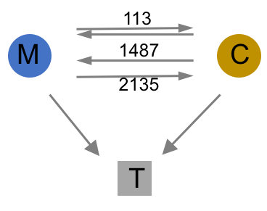
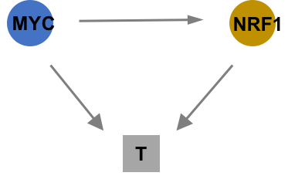
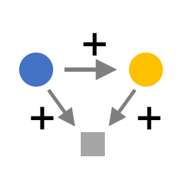

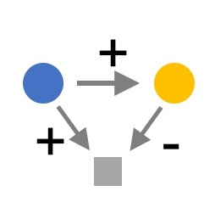

A
TF
RBP
B
C
Coherent FFLs
201
Incoherent FFLs
MYC
NRF1
MYC
SUB1

Slide 11
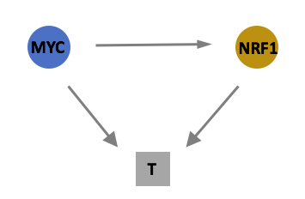
A
B
C
Coherent FFLs
201
Incoherent FFLs
MYC
Target
NRF1
MYC
SUB1

Slide 12
A
TF
RBP
B
C
Coherent FFLs
201
Incoherent FFLs
MYC
Target
NRF1
MYC
SUB1

Slide 13

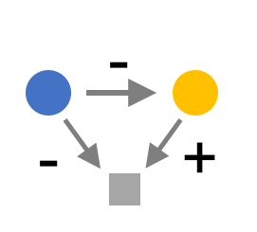
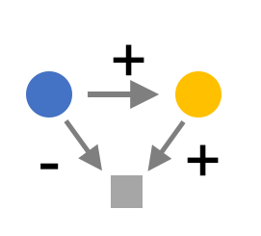

A
TF
RBP
B
C
201
20.6%
9.1%
16.6%
15.9%
coherent
62.2%
incoherent
37.9%
5.9%
14.4%
15.0%
2.6%
MYC
Logic gate
Target
NRF1
MYC
SUB1

Slide 14
A
TF
RBP
B
C
201
20.6%
9.1%
16.6%
15.9%
coherent
62.2%
incoherent
37.9%
5.9%
14.4%
15.0%
2.6%
MYC
Logic gate
Target
NRF1
MYC
SUB1

