Slide 1
LoF enrichment by functional category

Slide 2
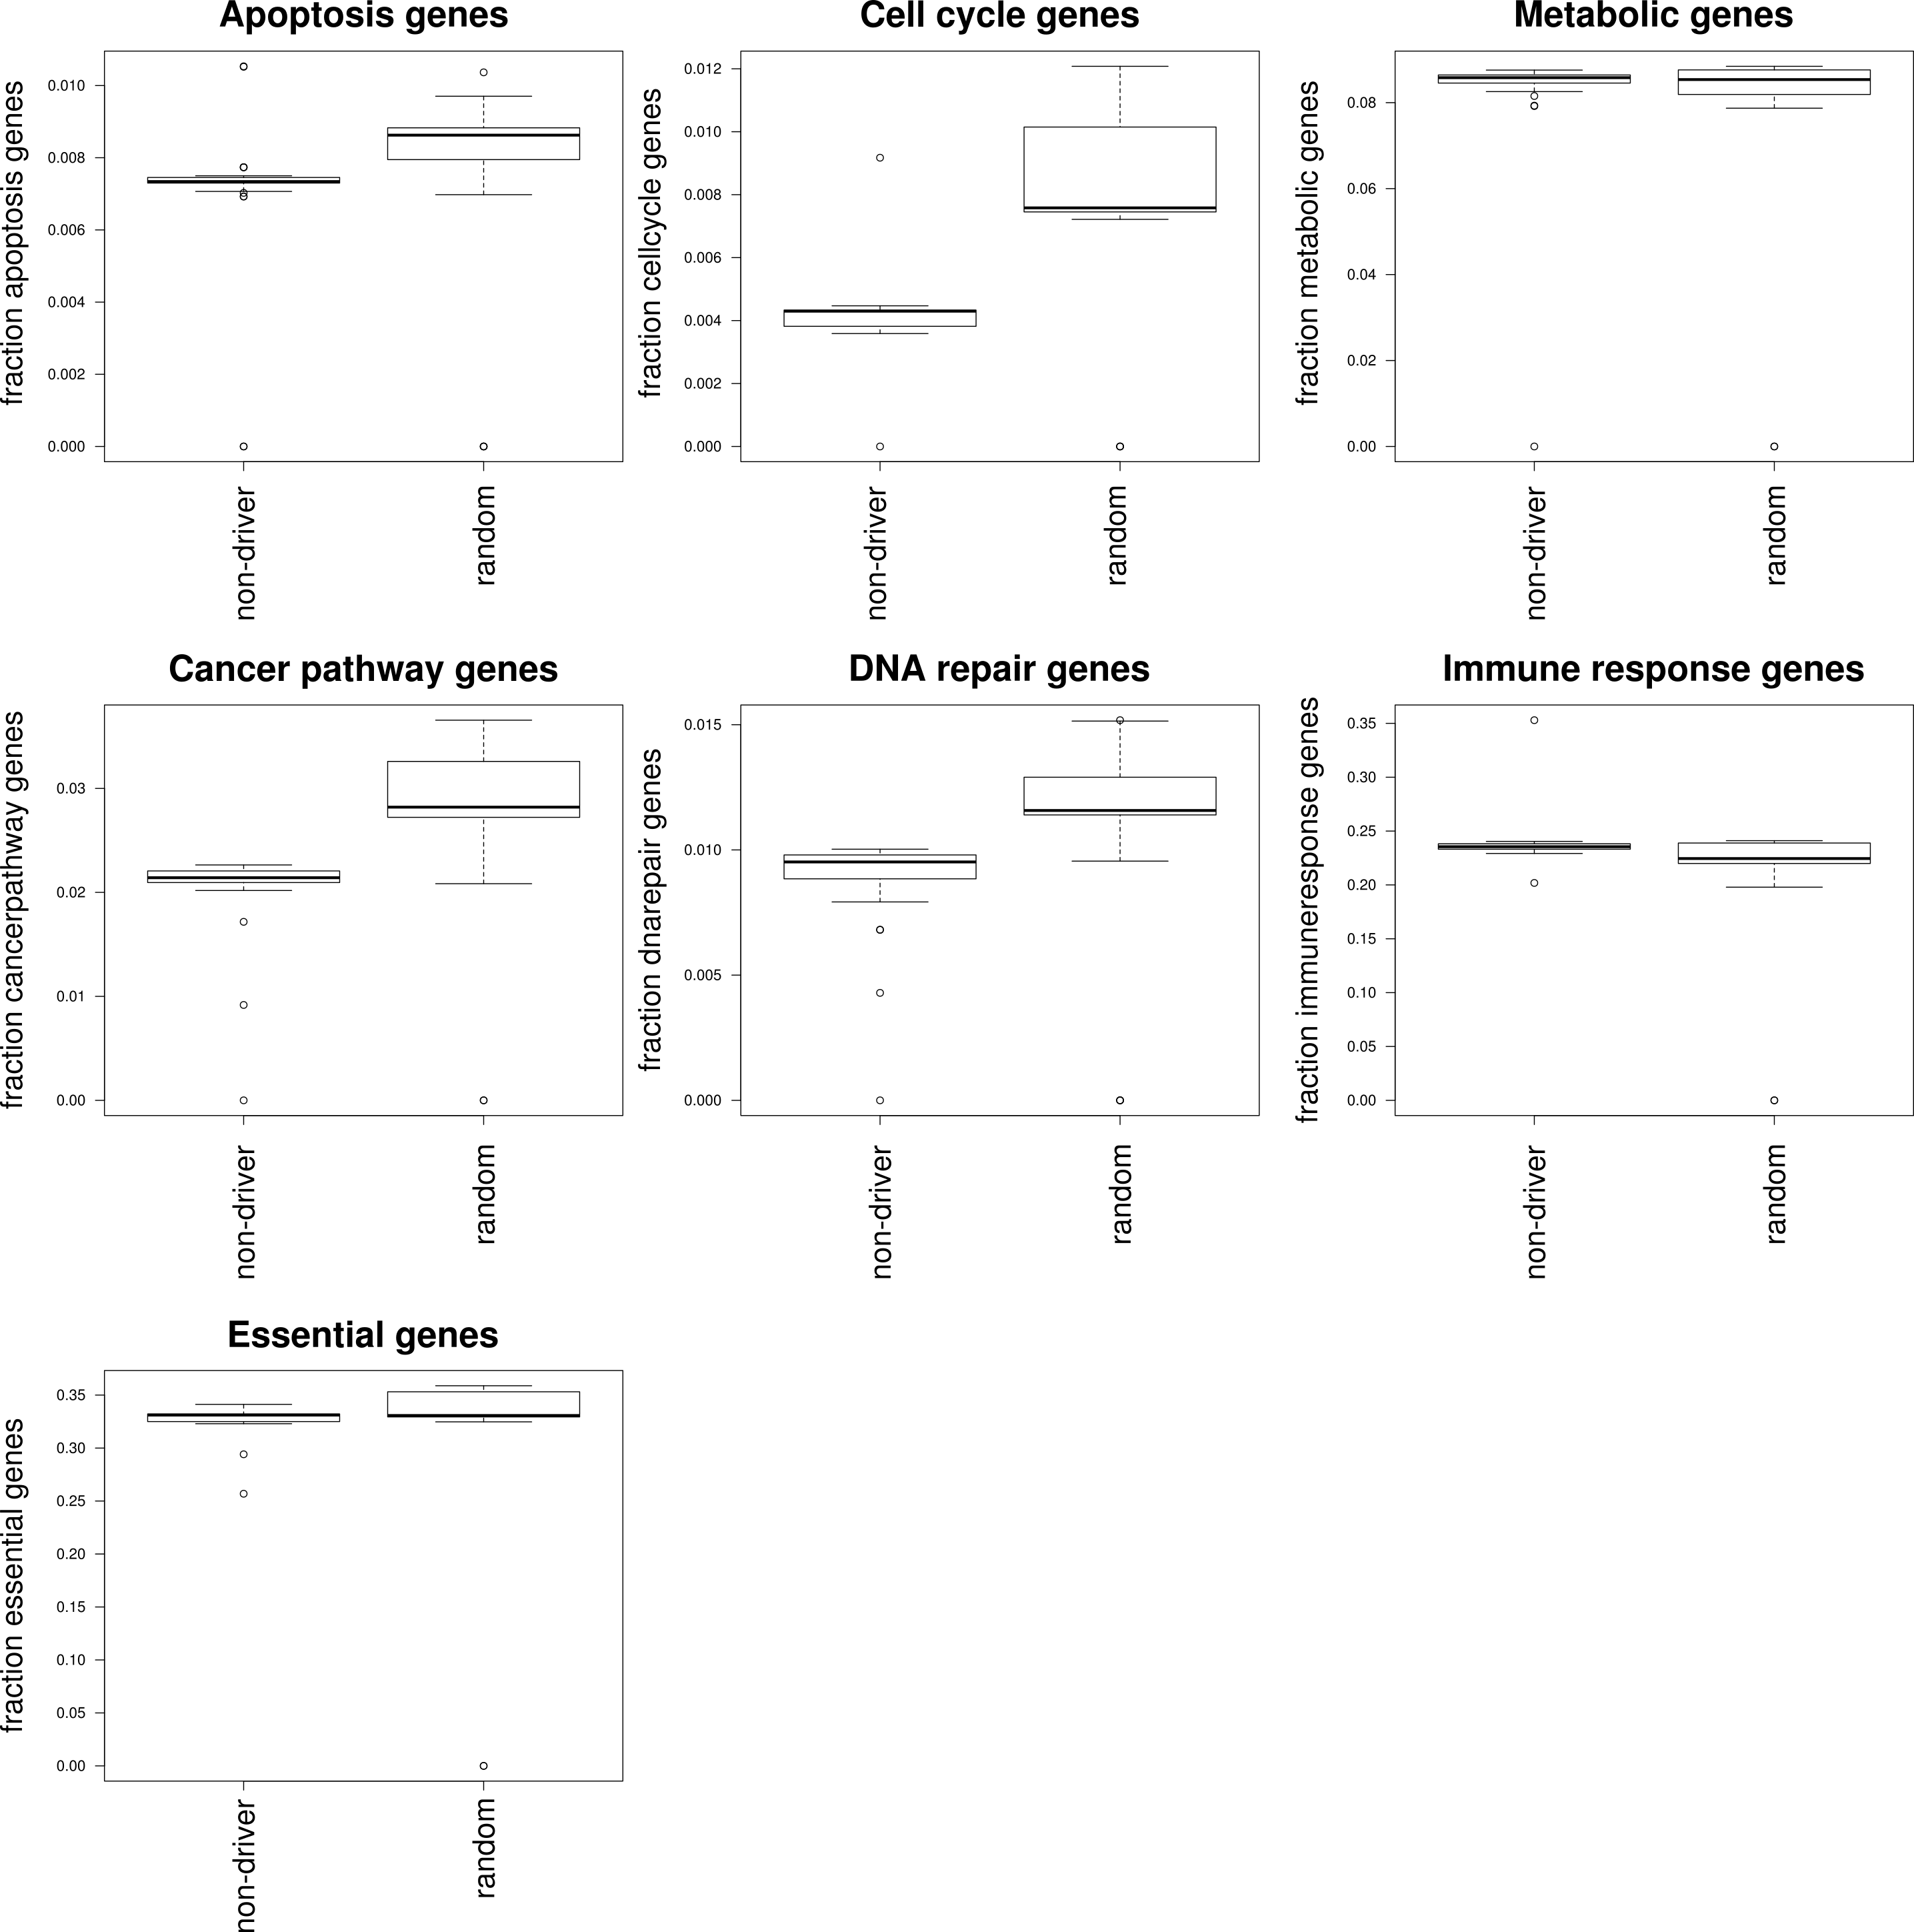

Slide 3
