Slide 3
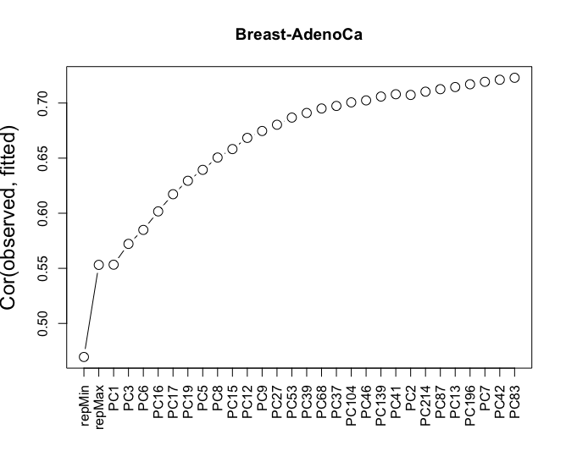
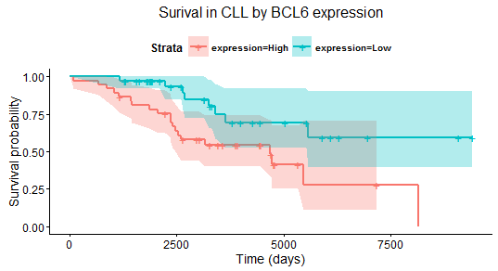
(A)
(B)
(C)
(D)
Notes:
1. Cut to 50s, replication timing from the main cell line, to show a few dot on the curve. How much improvement you have using matched, how much improvement you can used others

Slide 5
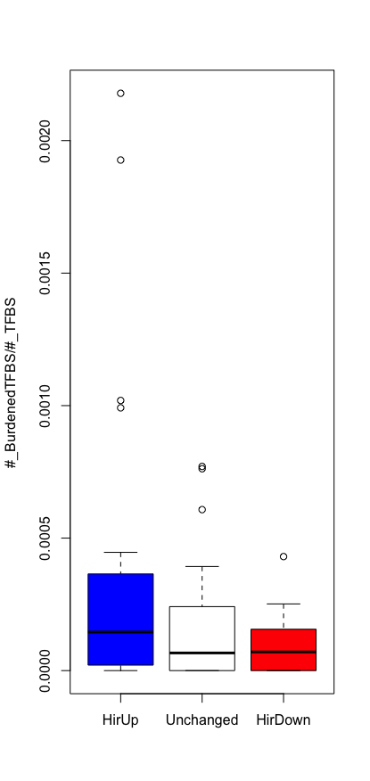
Active in K562
Active in G
Stay Less Active in Both
Stay More Active in Both
0.272
0.170
0.125

Slide 6
