Slide 1
psychENCODE ChIP-seq QC
Eugenio Mattei (Weng’s lab) – 2017/03/10
UMASS Medical School

Slide 2


EpiMap study
UMASS Yale
Yale-ASD study
36 samples
2 Brain regions : Cerebellum, DLPFC
1 Mark : H3K27ac
(will be used to compare the pipeline on two different clusters)
150 samples
2 Brain regions : ACC, DLPFC
2 Cell Types : NeuN+, NeuN-
2 Marks : H3K27ac, H3K4me3
CNON study
UCLA study
Not Frozen Yet
HDDs with fastqs

Slide 3
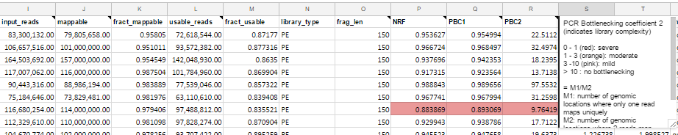
QC metrics
Library QC
Tools used: Samtools, Spp (https://github.com/kundajelab/phantompeakqualtools/blob/master/README.md)
PCR Bottlenecking Coefficient 1 (PBC1)
PCR Bottlenecking Coefficient 2 (PBC2)
Non-Redundant Fraction (NRF)
NSC Normalized strand cross-correlation
RSC Relative cross correlation coefficient
https://www.encodeproject.org/data-standards/terms/#library
Peak Calling Qc
Tools used :Custom scripts, HOMER
Signal around TSSs
Peak Size Distribution
Genomic Annotation
Genomic Distribution
Genome Browser
(All the plots in this power point)
https://docs.google.com/spreadsheets/d/11XlKIFkR9W-fKWwIj29W03pLYNBbX3c2FYtz-1UyCxg/edit?usp=sharing
https://github.com/weng-lab/psychip_snakemake (pipeline)

Slide 4
EpiMap study
150 samples
2 Brain regions : ACC, DLPFC
2 Cell Types : NeuN+, NeuN-
2 Marks : H3K27ac, H3K4me3

Slide 5
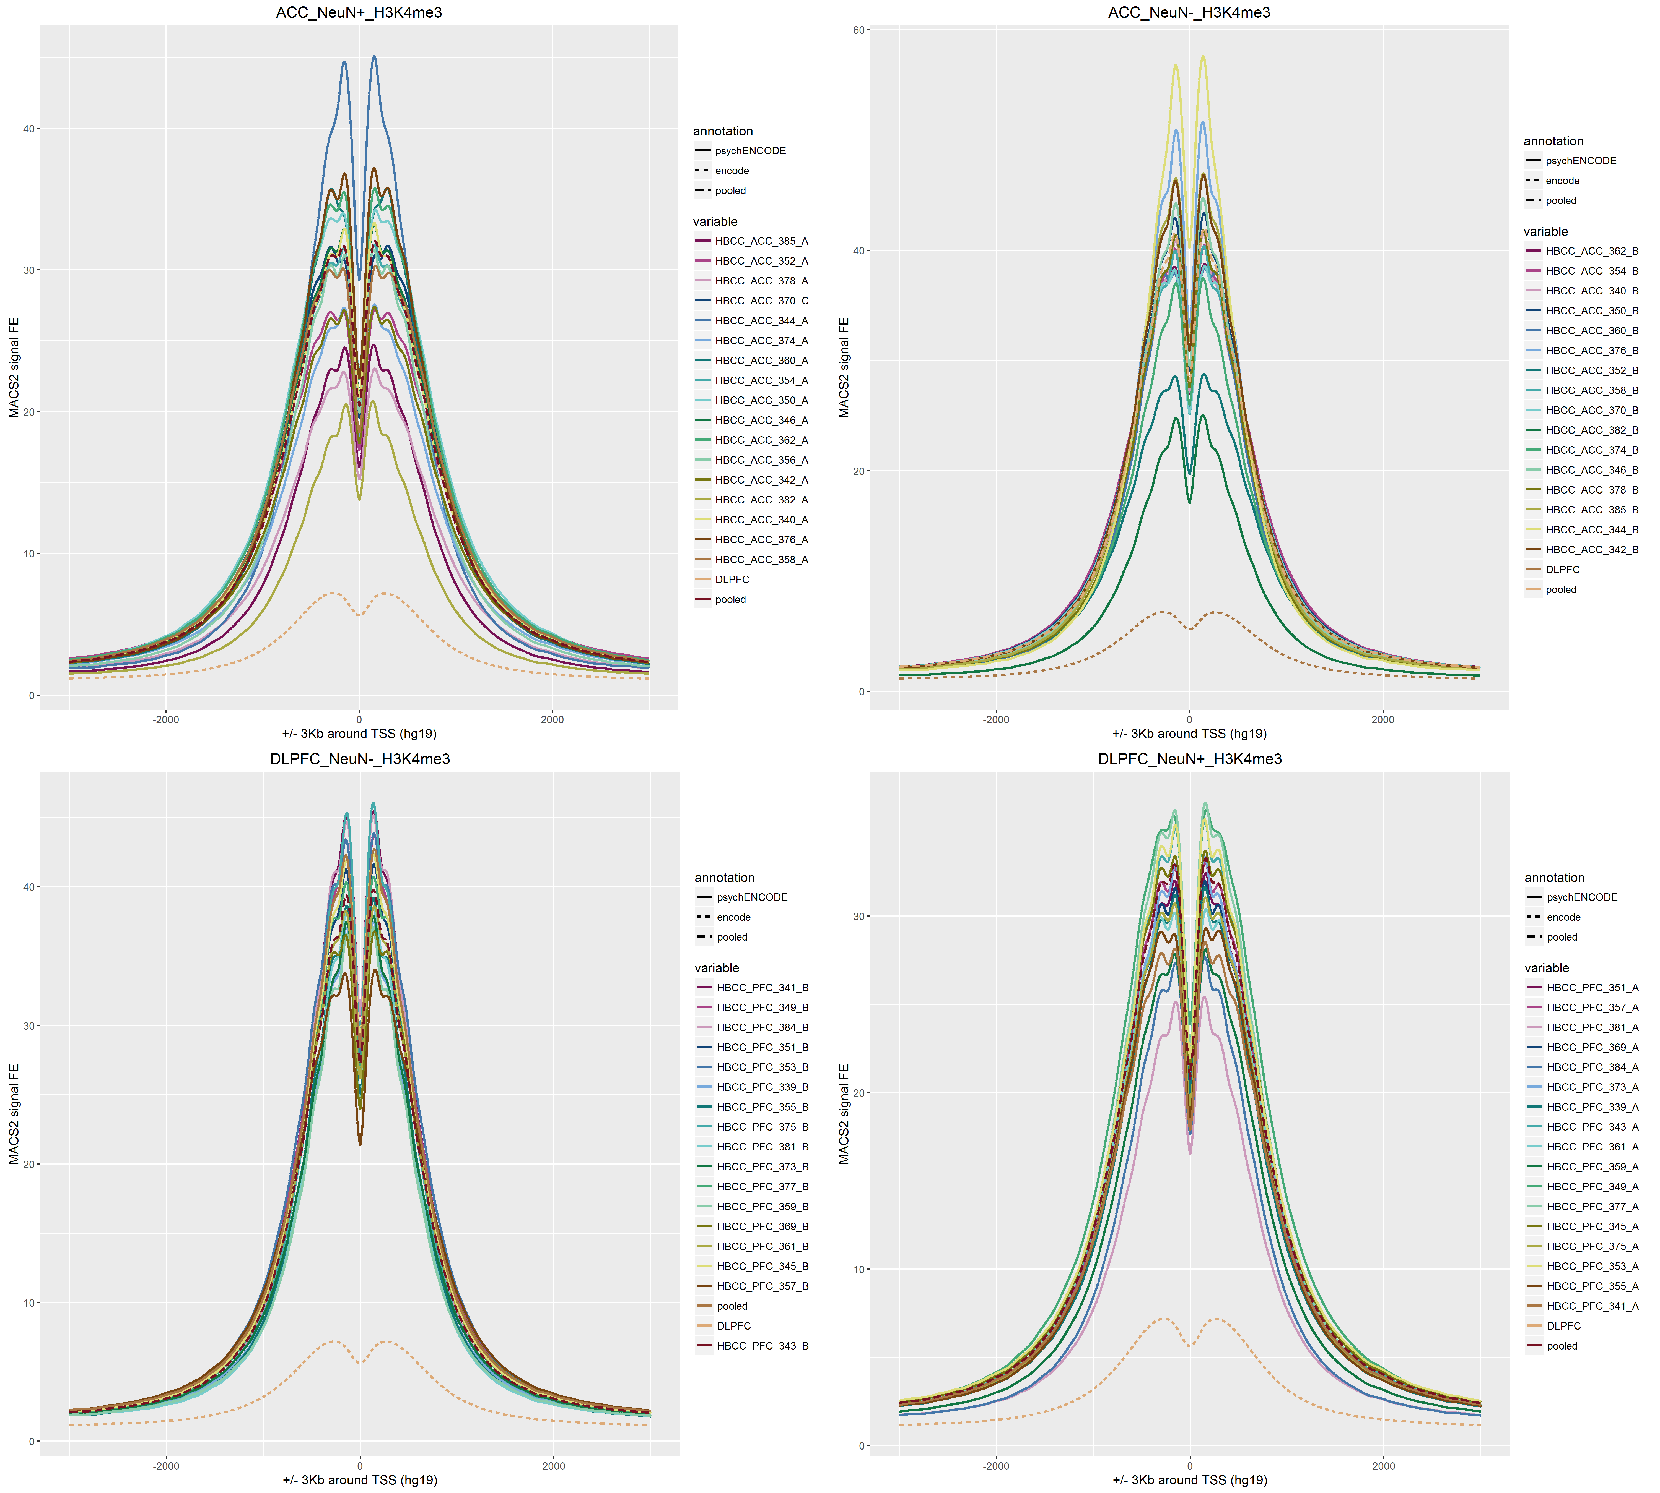
Signal Around TSS
For comparison purpose, two brain ChIP-seq libraries from ENCODE project are added to the plot (DLPFC)

Slide 6
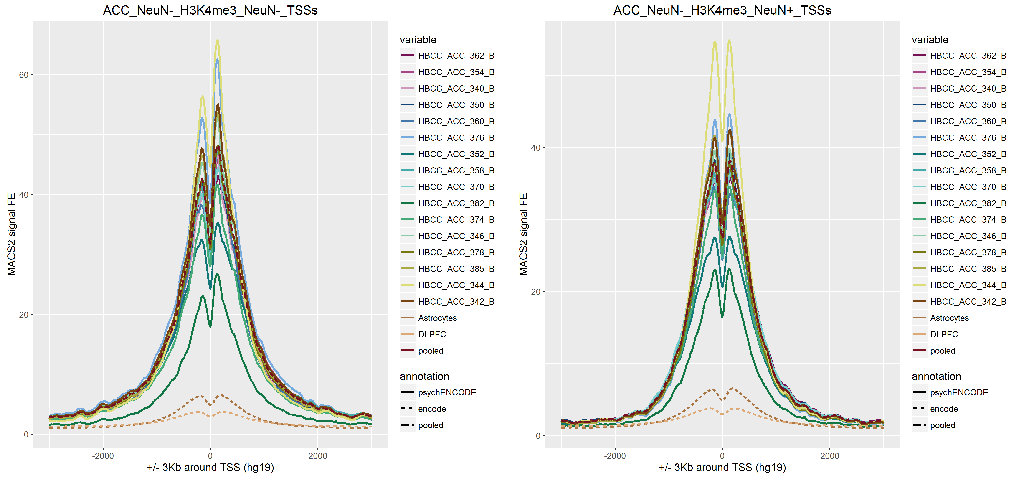
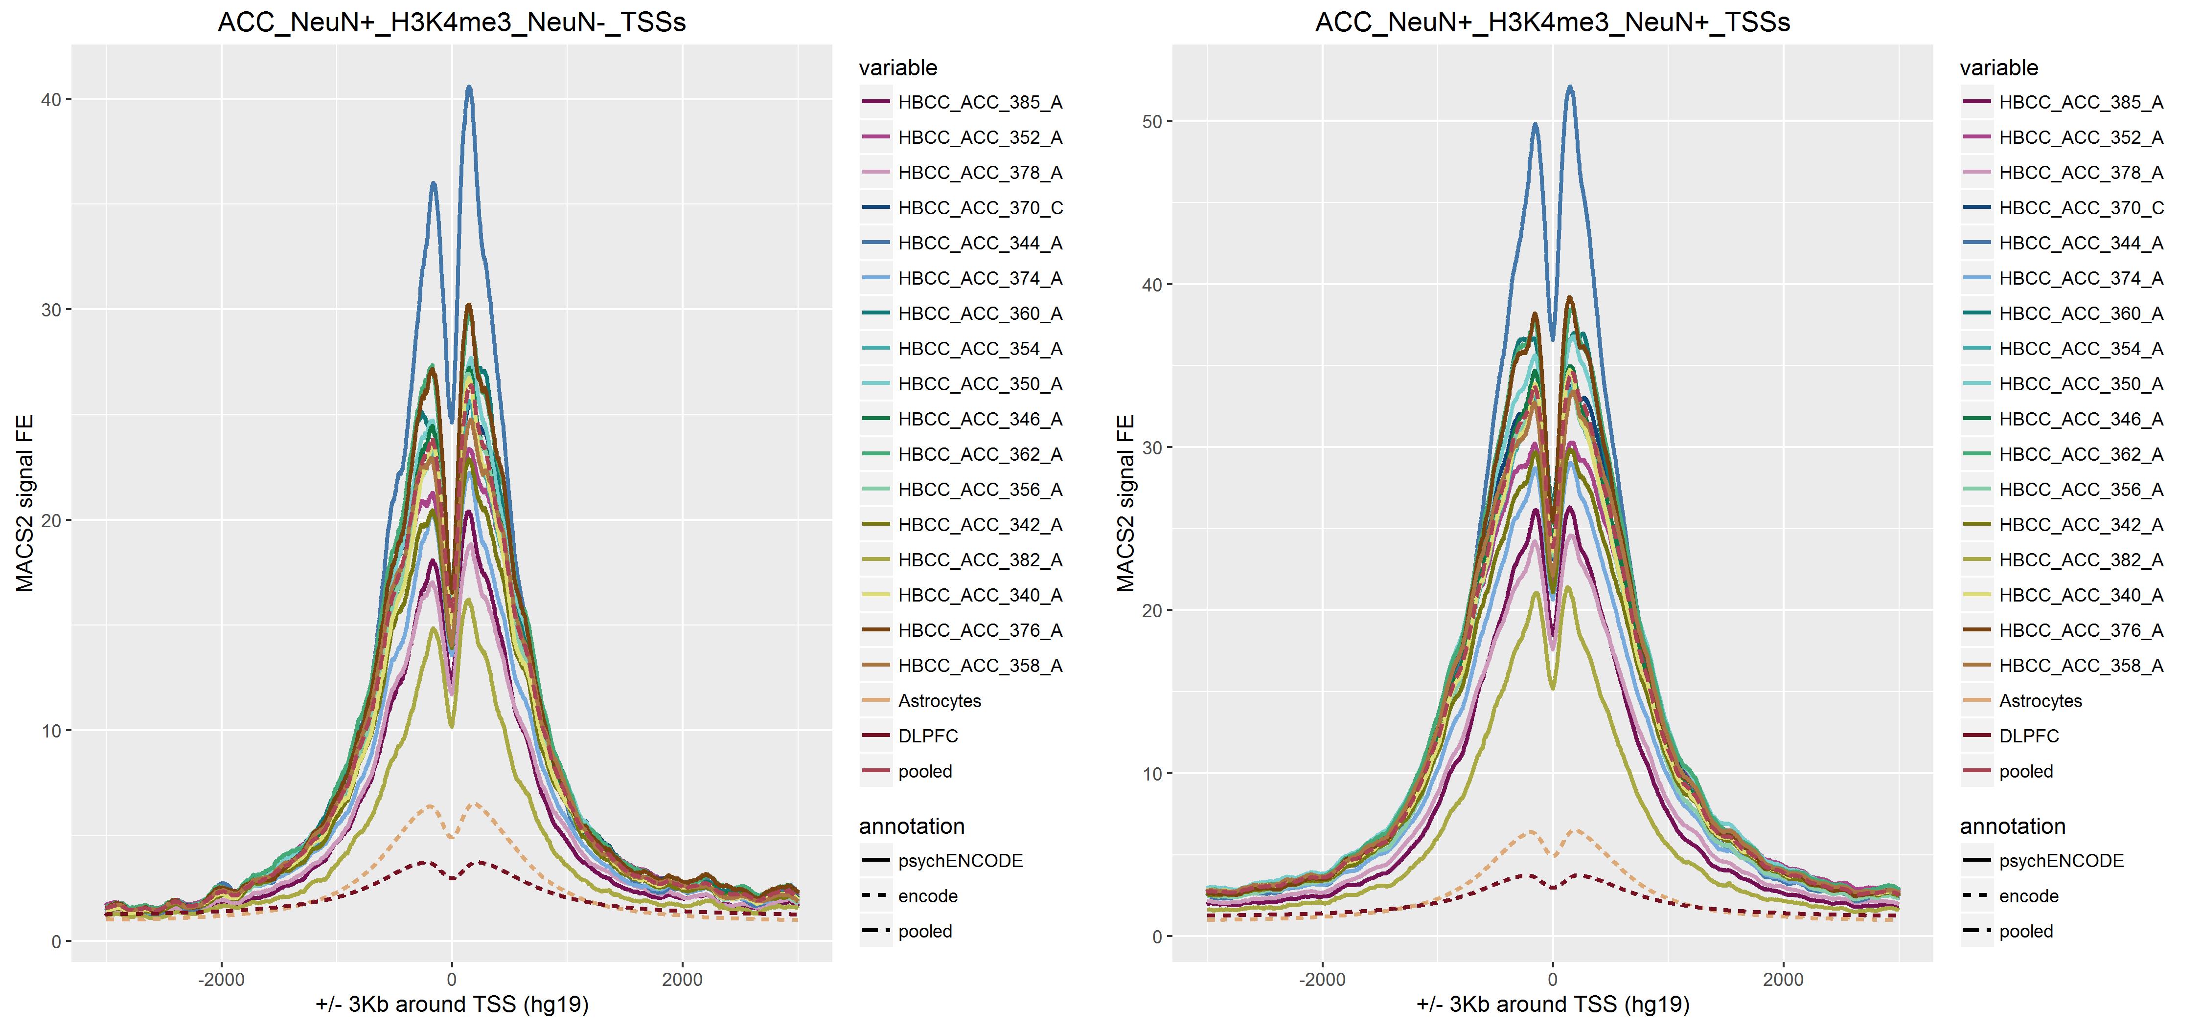
Signal Around TSS
NeuN-_Vs_NeuN+
For comparison purpose, two brain ChIP-seq libraries from ENCODE project are added to the plot (DLPFC, Astrocytes)

Slide 7
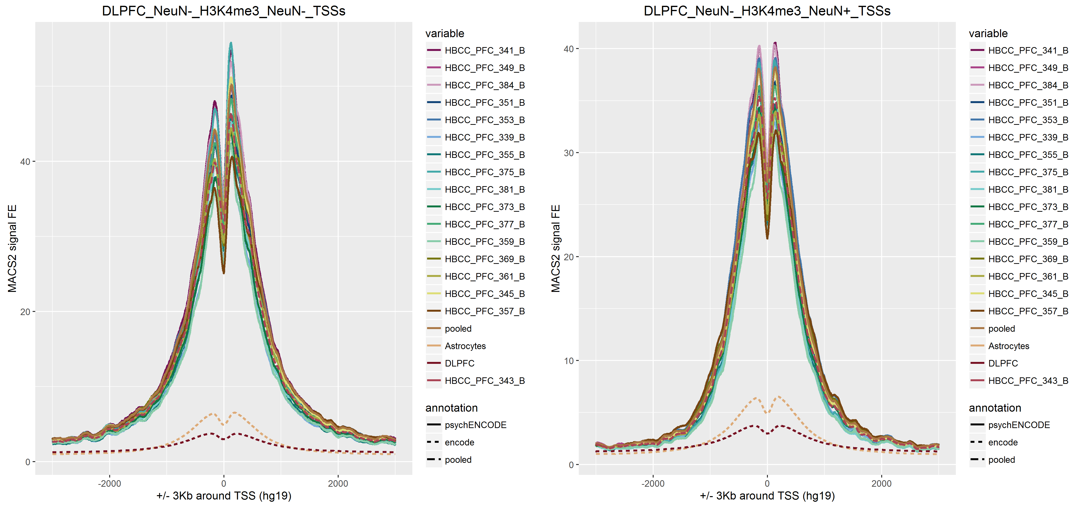
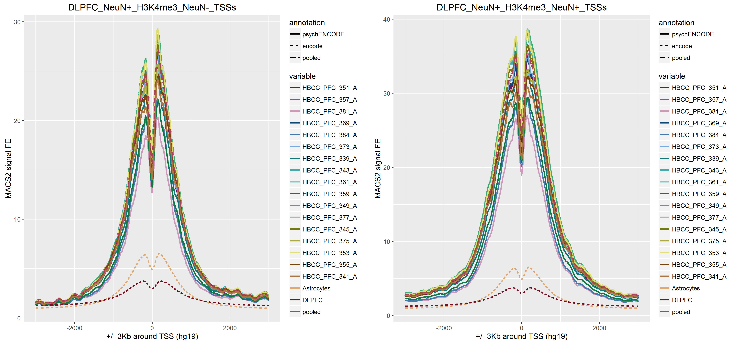
Signal Around TSS
NeuN-_Vs_NeuN+
For comparison purpose, two brain ChIP-seq libraries from ENCODE project are added to the plot (DLPFC, Astrocytes)

Slide 8
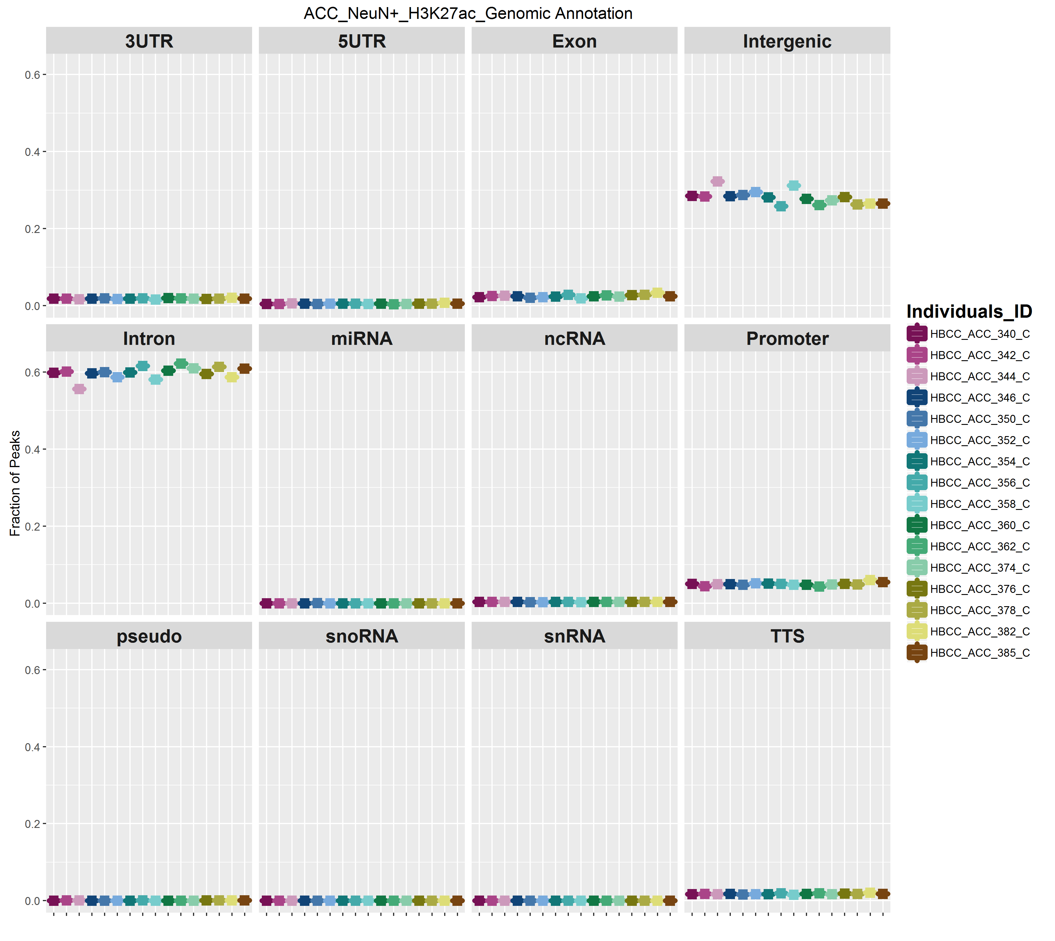
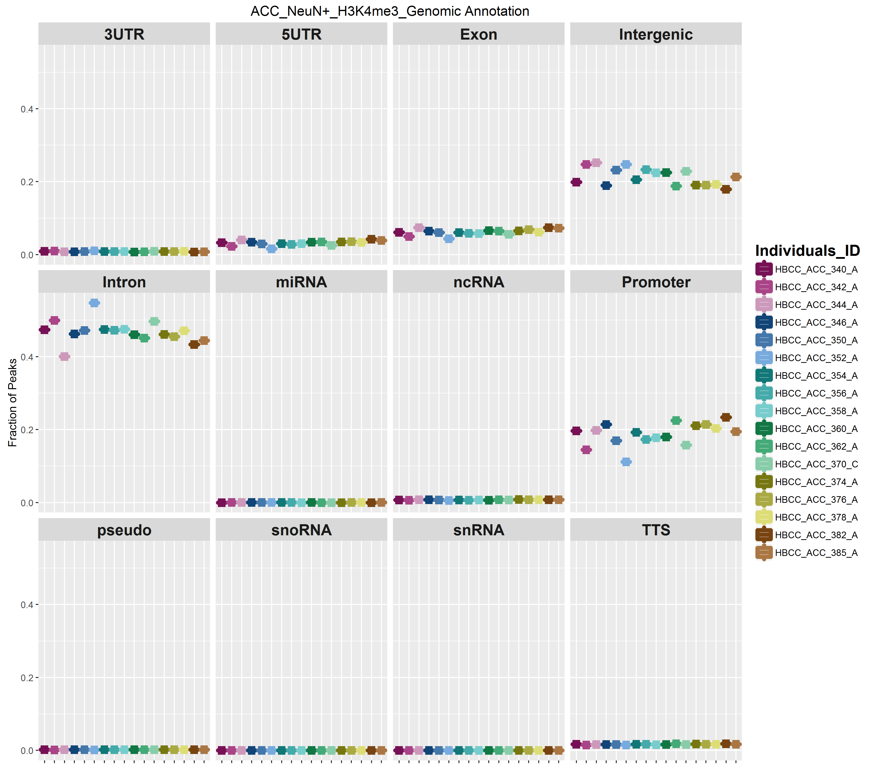
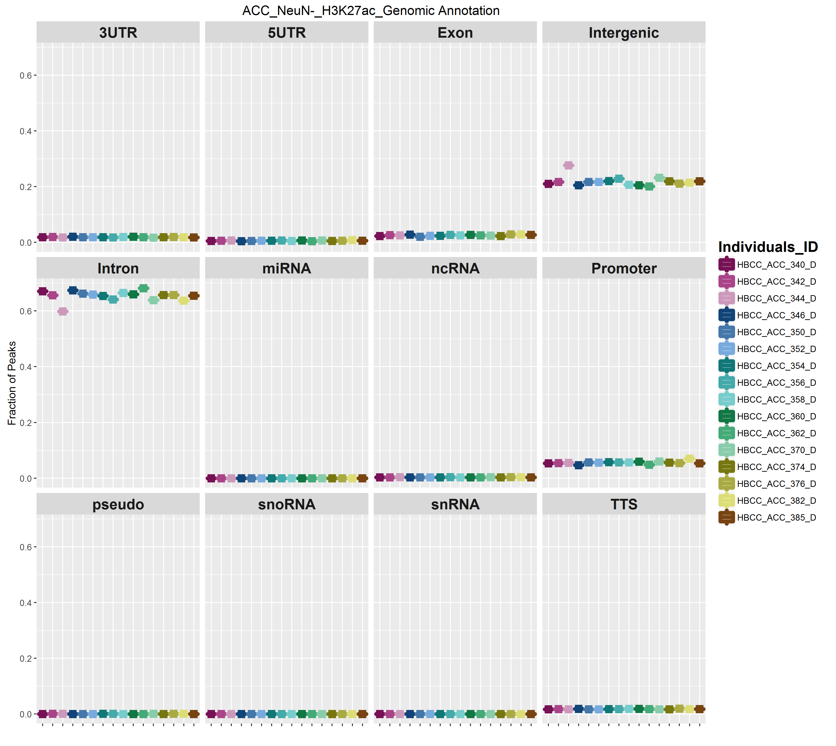
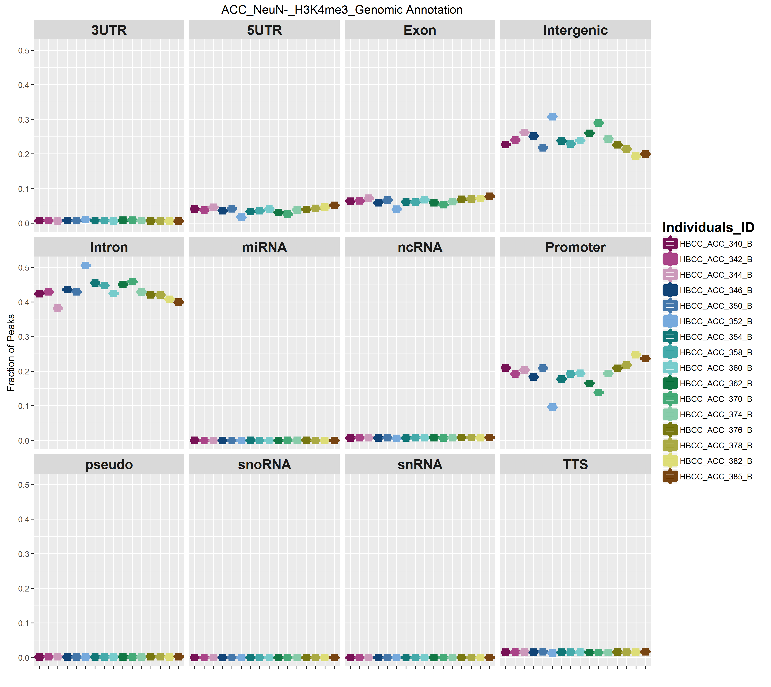

Slide 9
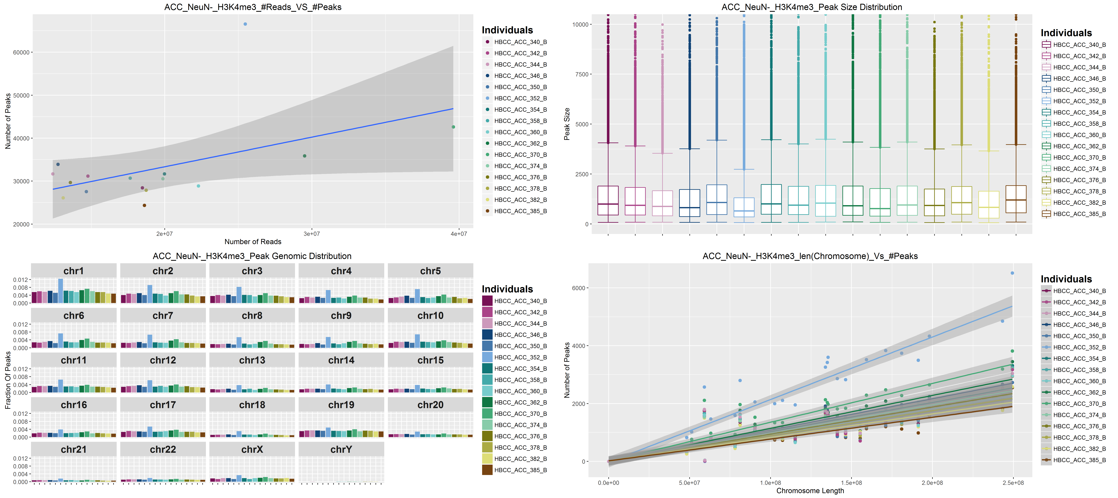

Slide 10
Candidate Regulatory Elements
(from SCREEN)
Yellow : Candidate Enhancer
Red : CandidatePromoter
ACC_NeuN-_H3K4me3
DLPFC_NeuN-_H3K4me3
ACC_NeuN+_H3K4me3
DLPFC_NeuN+_H3K4me3

Slide 11
Candidate Regulatory Elements
(from SCREEN)
Yellow : Candidate Enhancer
Red : CandidatePromoter
ACC_NeuN-_H3K27ac
DLPFC_NeuN-_H3K27ac
ACC_NeuN+_H3K27ac
DLPFC_NeuN+_H3K27ac

Slide 12
Yale-ASD study
36 samples
2 Brain regions : Cerebellum, DLPFC
1 Mark : H3K27ac

Slide 13
Cerebellum and DLPFC

Slide 14
Candidate Regulatory Elements
(from SCREEN)
Candidate Enahncer
Candidate Promoter
Lot of Background noise
Peaks missing

Slide 15
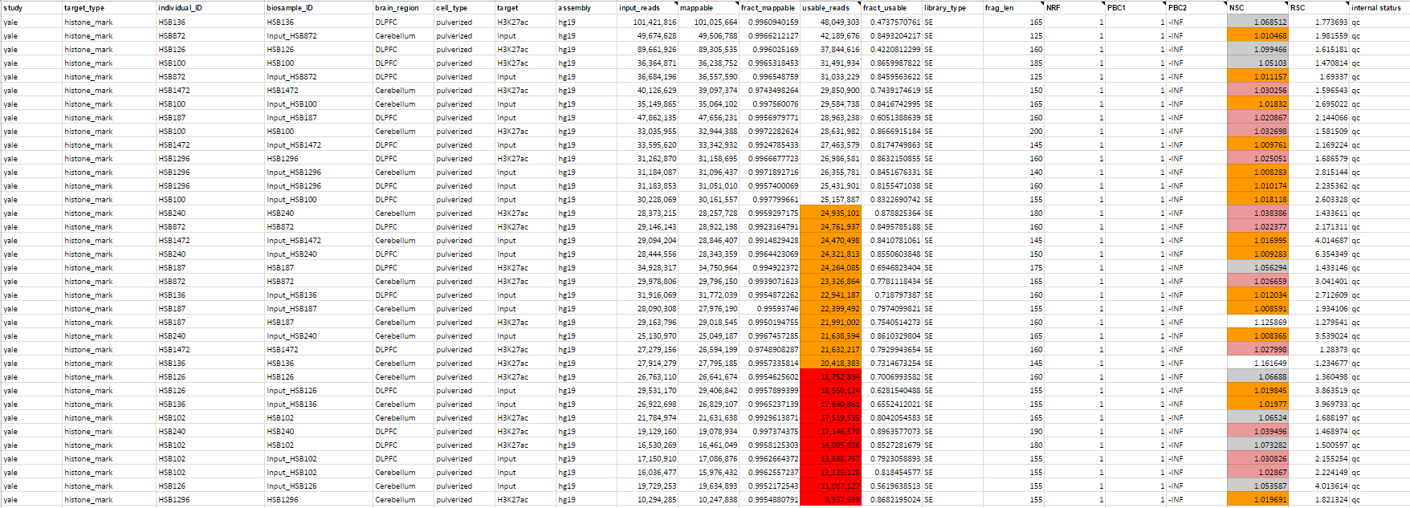
NSC < 1.05 is flagged as potential low signal-to-noise. Could be due to
- low enrichment
- few number of peaks due to biology of factor
- broad chromatin mark
Low number of usable reads

Slide 16
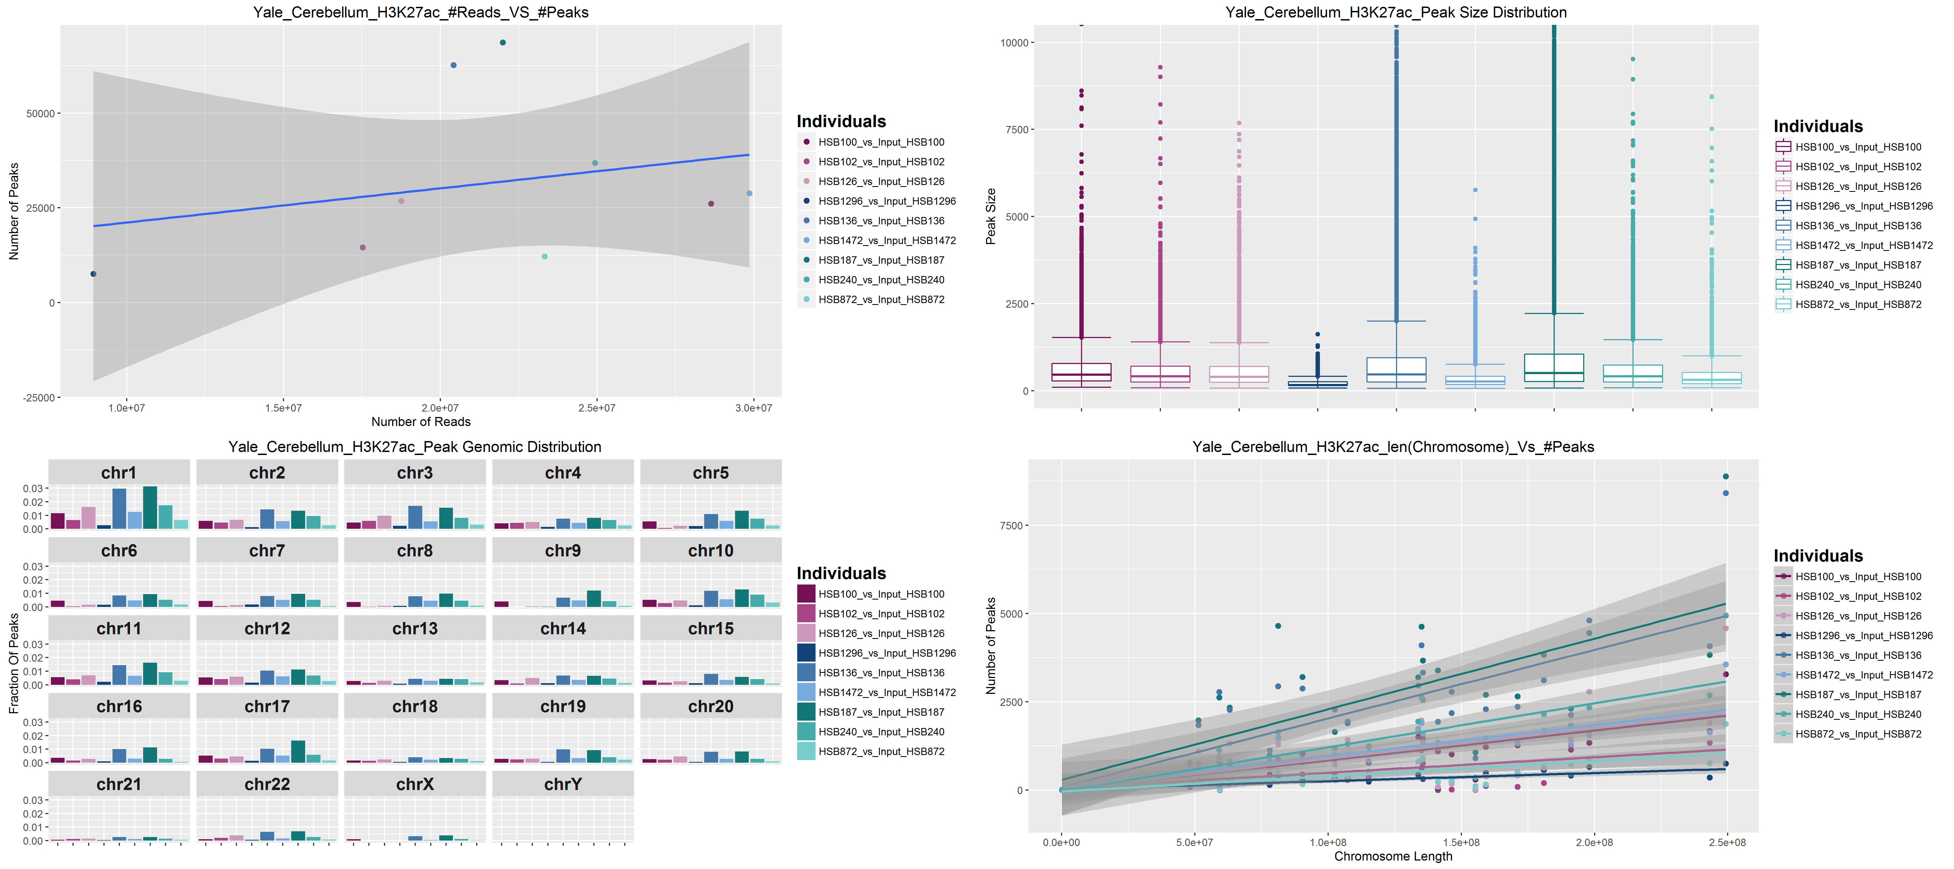

Slide 17
Conclusions and Future steps
Epimap data completed
Re running Yale data pooling the inputs together
Comparison of UMASS and Yale processing results
CNON should be available next week
http://zlab-trackhub.umassmed.edu/mattei/psychENCODE/hub_acc_minus_27.txt
http://zlab-trackhub.umassmed.edu/mattei/psychENCODE/hub_dlpfc_minus_27.txt
http://zlab-trackhub.umassmed.edu/mattei/psychENCODE/hub_acc_plus_27.txt
http://zlab-trackhub.umassmed.edu/mattei/psychENCODE/hub_dlpfc_plus_27.txt
http://zlab-trackhub.umassmed.edu/mattei/psychENCODE/hub_yale_dlpfc_27.txt
http://zlab-trackhub.umassmed.edu/mattei/psychENCODE/hub_yale_cerebellum_27.txt
http://zlab-trackhub.umassmed.edu/mattei/psychENCODE/hub_acc_minus_4me3.txt
http://zlab-trackhub.umassmed.edu/mattei/psychENCODE/hub_dlpfc_minus_4me3.txt
http://zlab-trackhub.umassmed.edu/mattei/psychENCODE/hub_acc_plus_4me3.txt
http://zlab-trackhub.umassmed.edu/mattei/psychENCODE/hub_dlpfc_plus_4me3.txt

Slide 18
Supplementary Figures
All the QC plots for the Libraries

Slide 19
EpiMap study
150 samples
2 Brain regions : ACC, DLPFC
2 Cell Types : NeuN+, NeuN-
2 Marks : H3K27ac, H3K4me3

Slide 20
H3K27ac

Slide 21
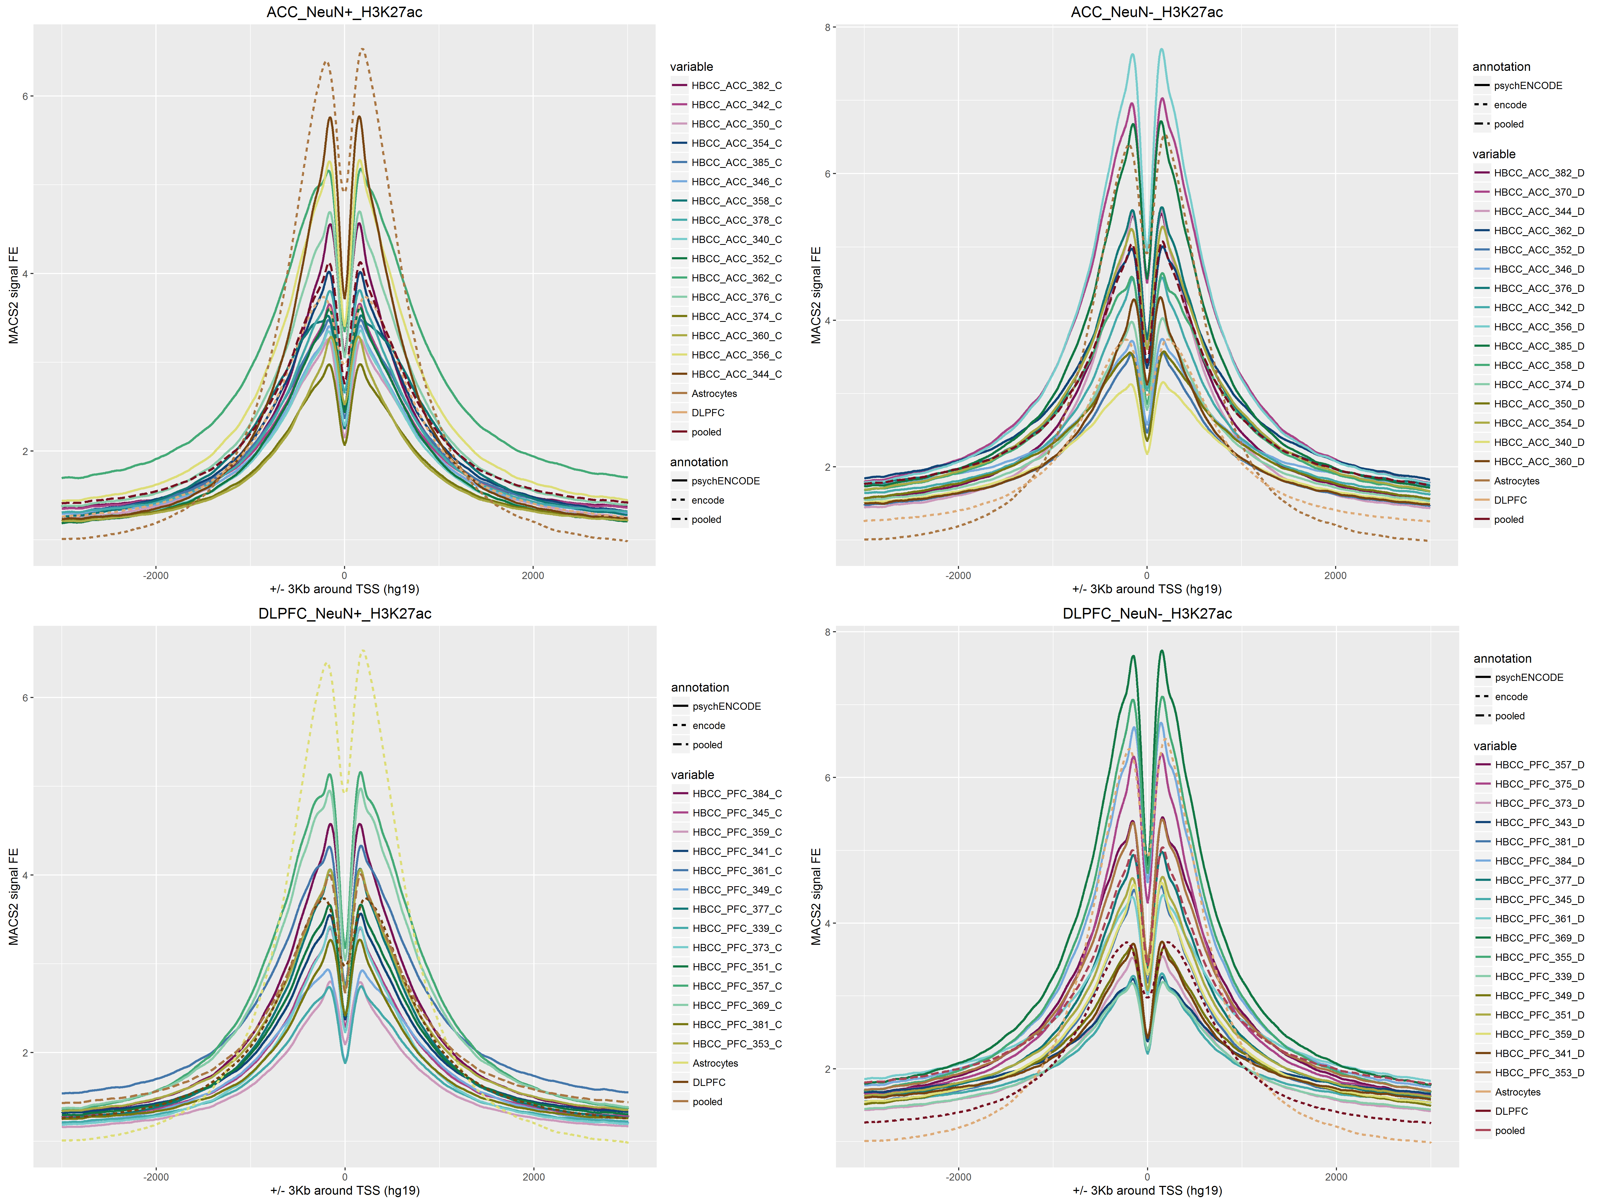
Signal Around TSS
For comparison purpose, two brain ChIP-seq libraries from ENCODE project are added to the plot (DLPFC, Astrocytes)

Slide 22
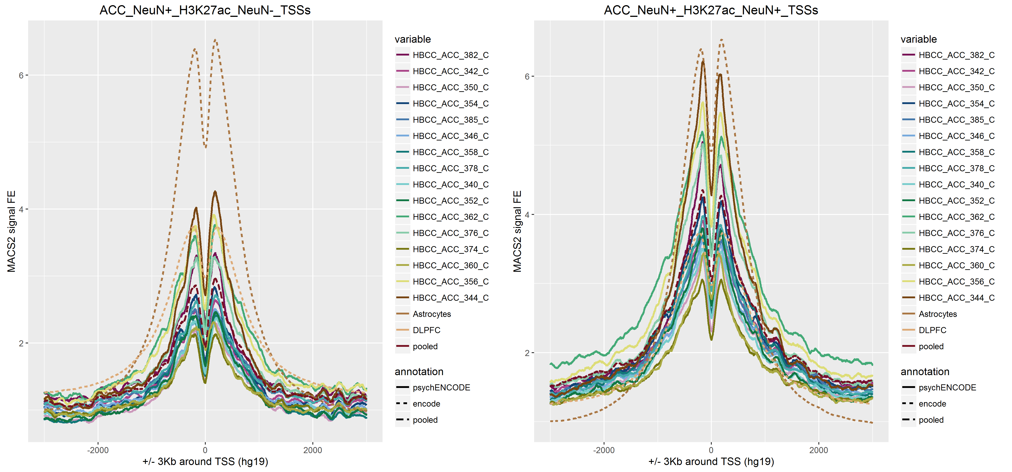
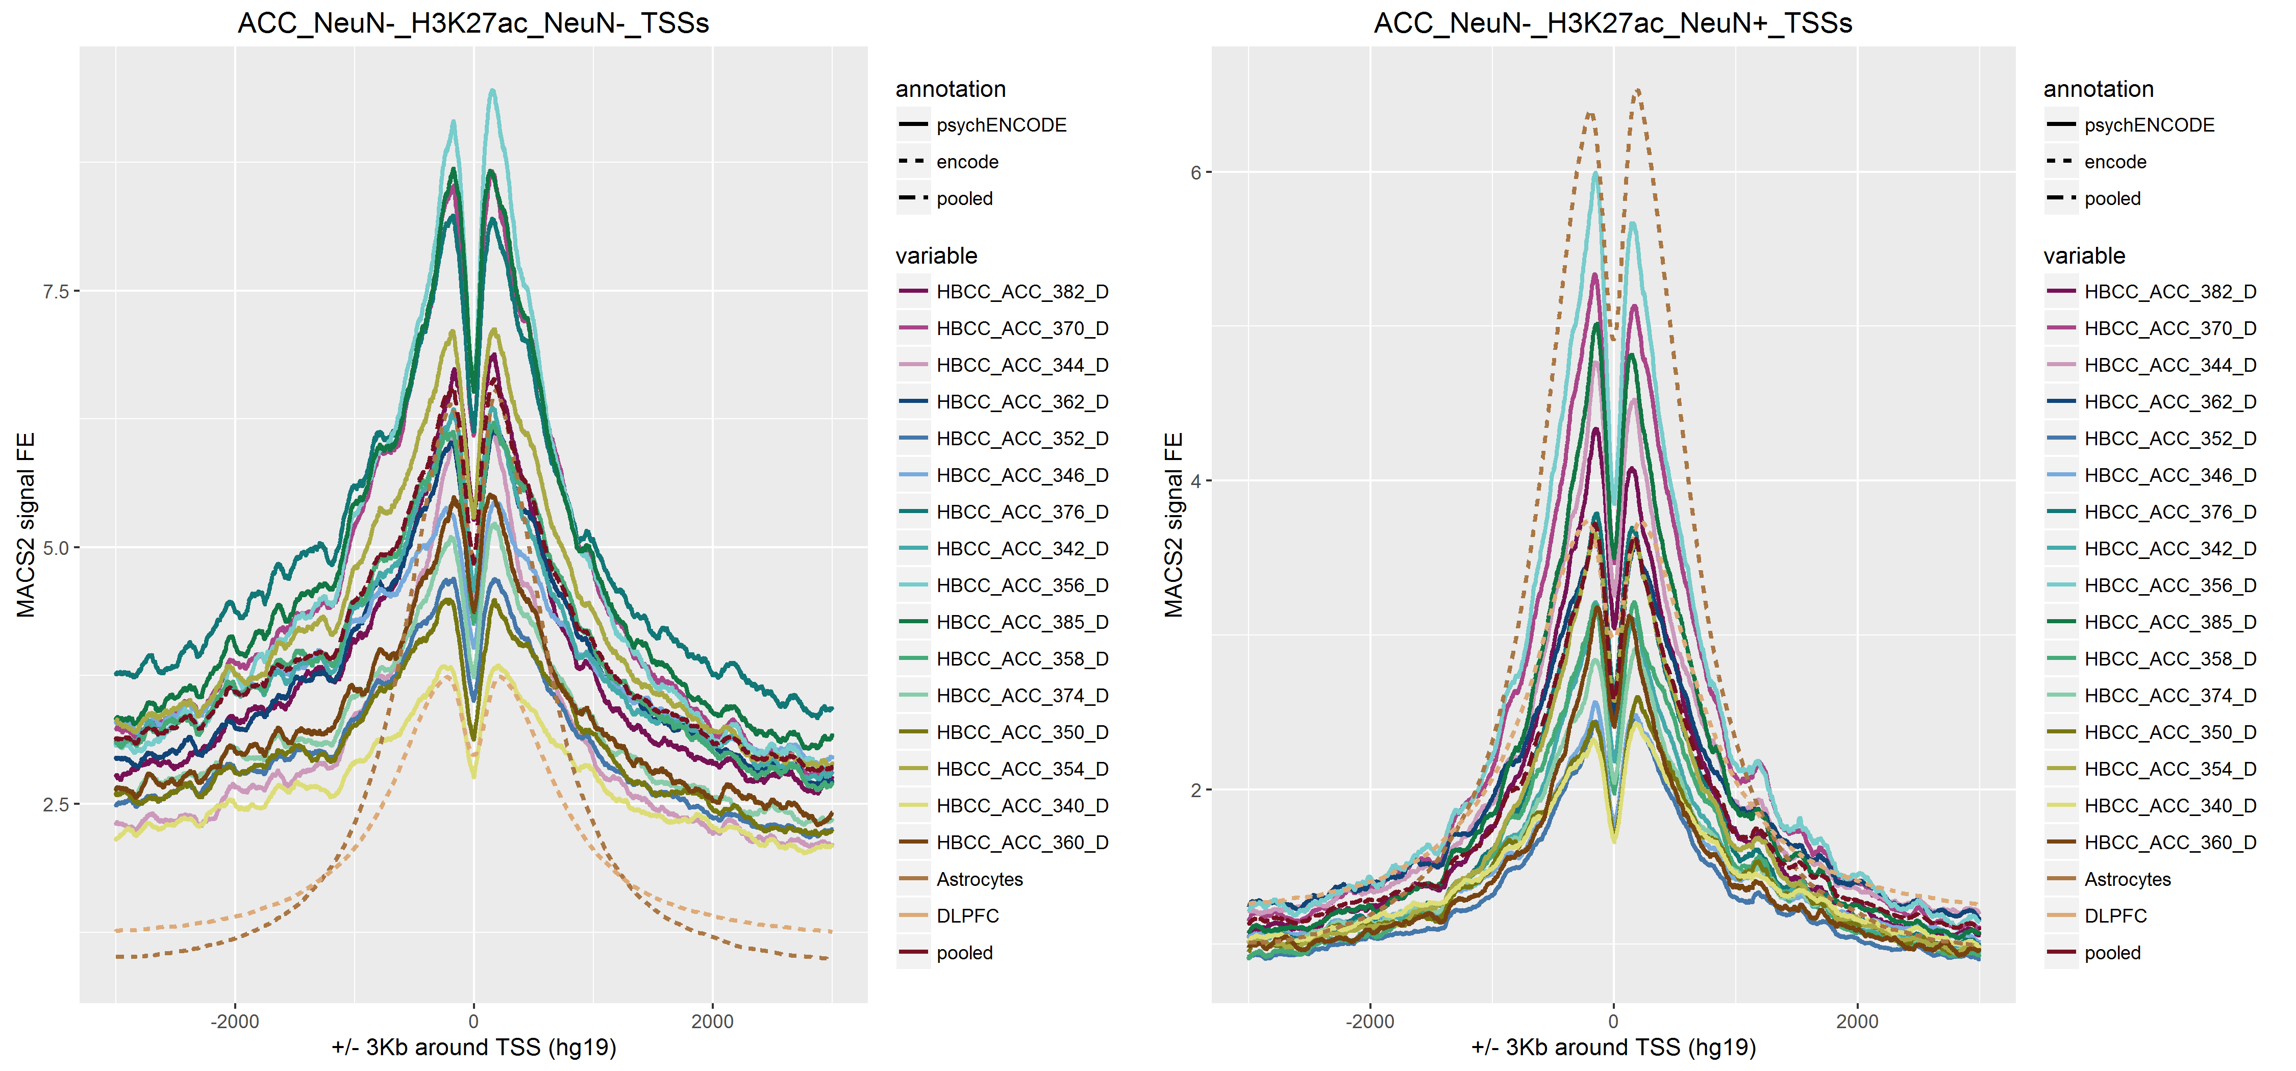
Signal Around TSS
NeuN-_Vs_NeuN+
For comparison purpose, two brain ChIP-seq libraries from ENCODE project are added to the plot (DLPFC, Astrocytes)

Slide 23
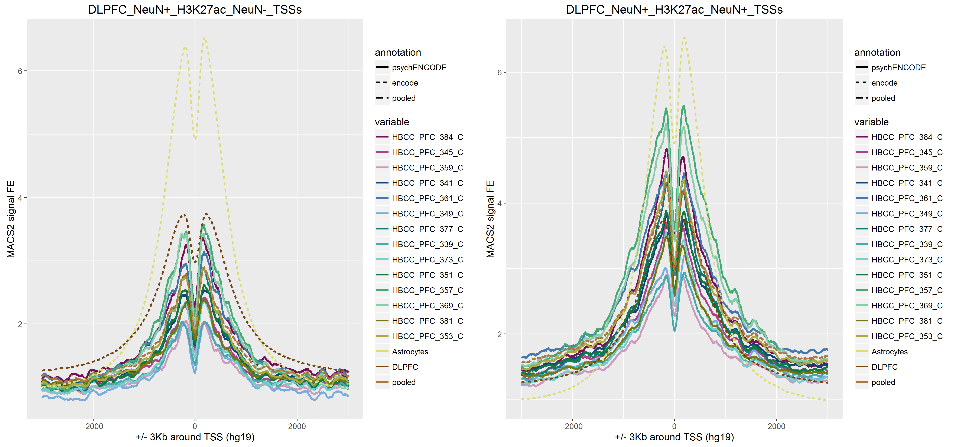
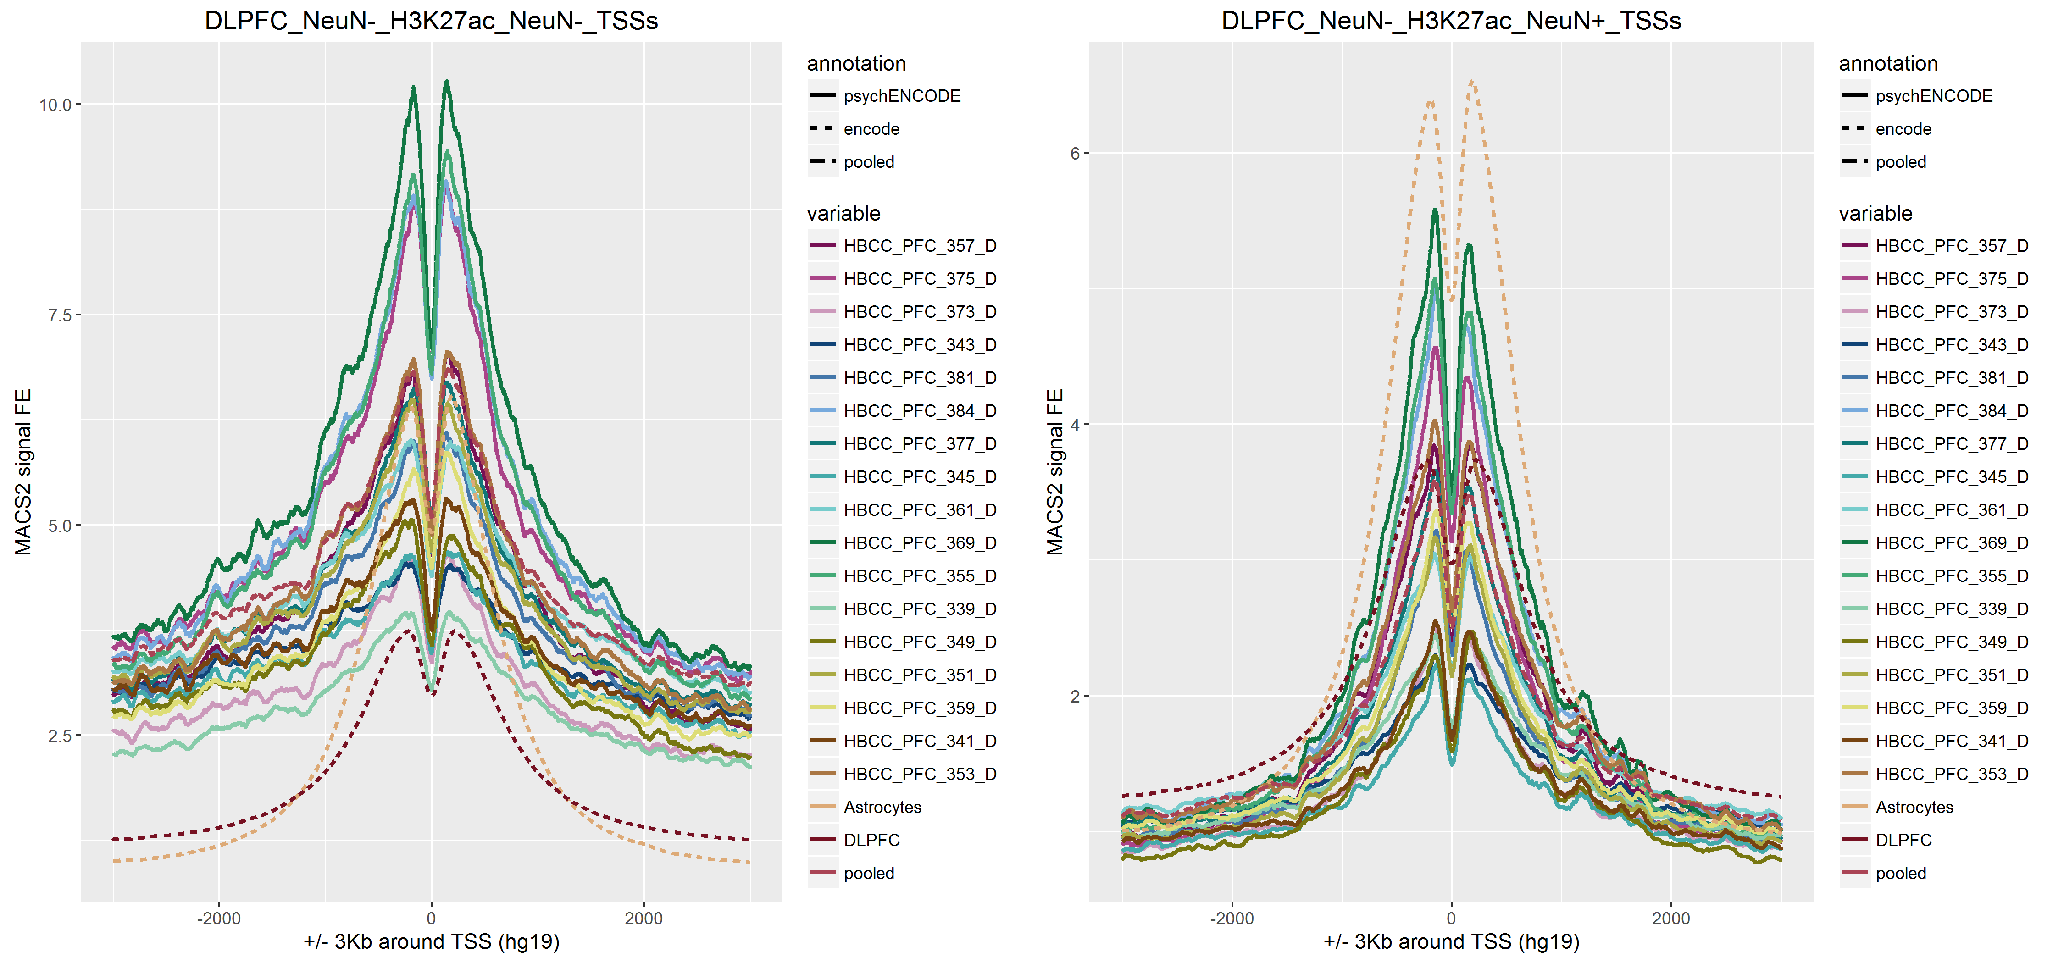
Signal Around TSS
NeuN-_Vs_NeuN+
For comparison purpose, two brain ChIP-seq libraries from ENCODE project are added to the plot (DLPFC, Astrocytes)

Slide 24
BigWigs Correlations

Slide 25
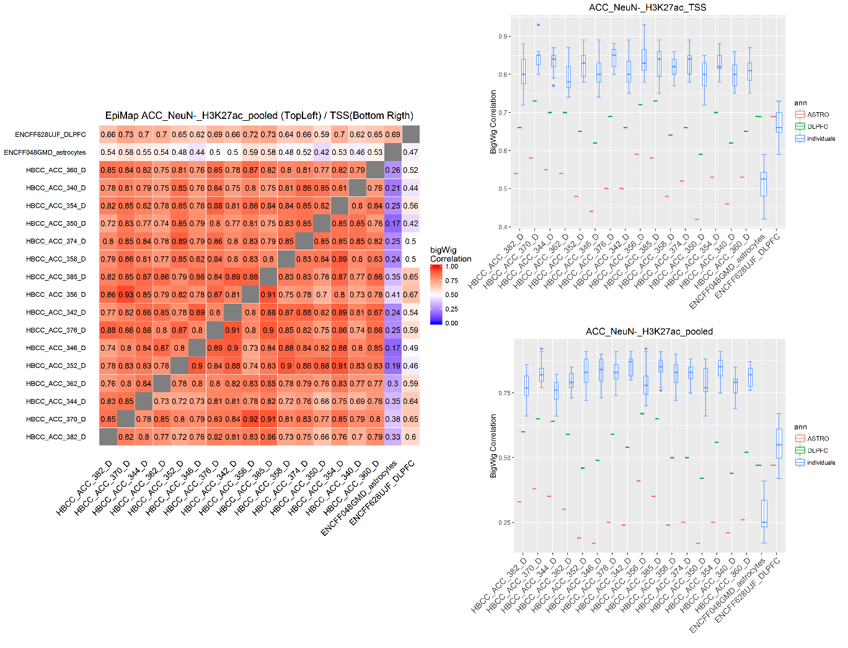
BigWig
Correlations
TSS as anchor regions
Pooled peaks as anchor regions

Slide 26
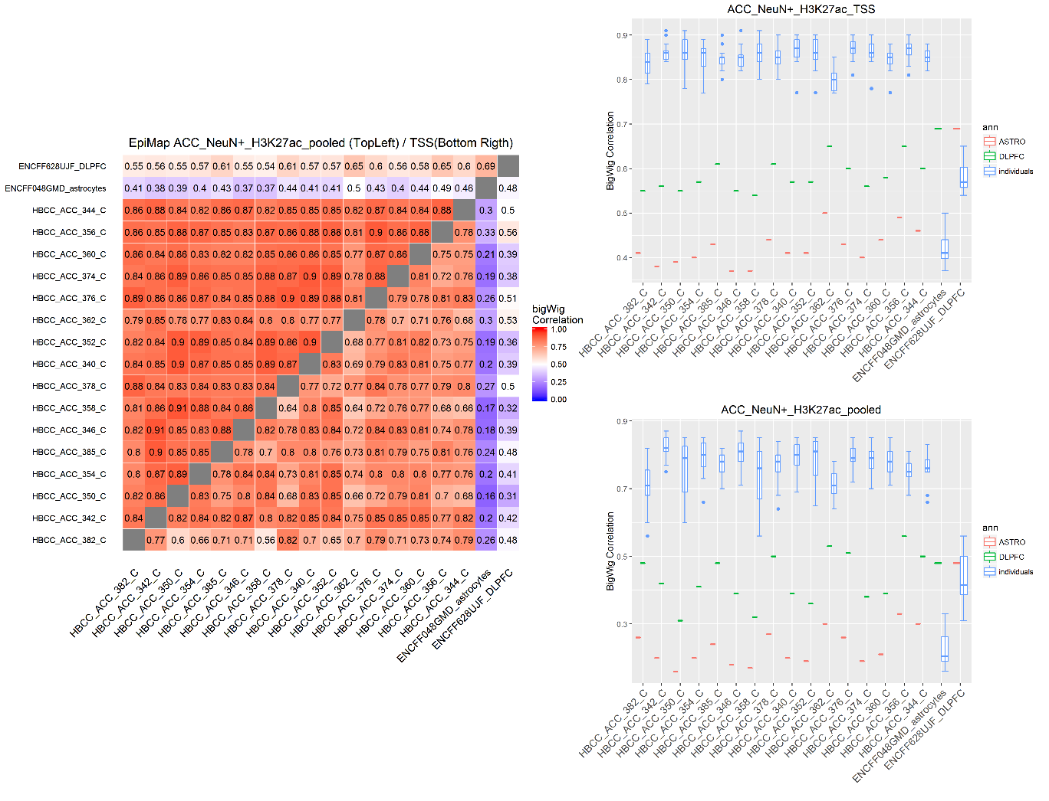
BigWig
Correlations
TSS as anchor regions
Pooled peaks as anchor regions

Slide 27
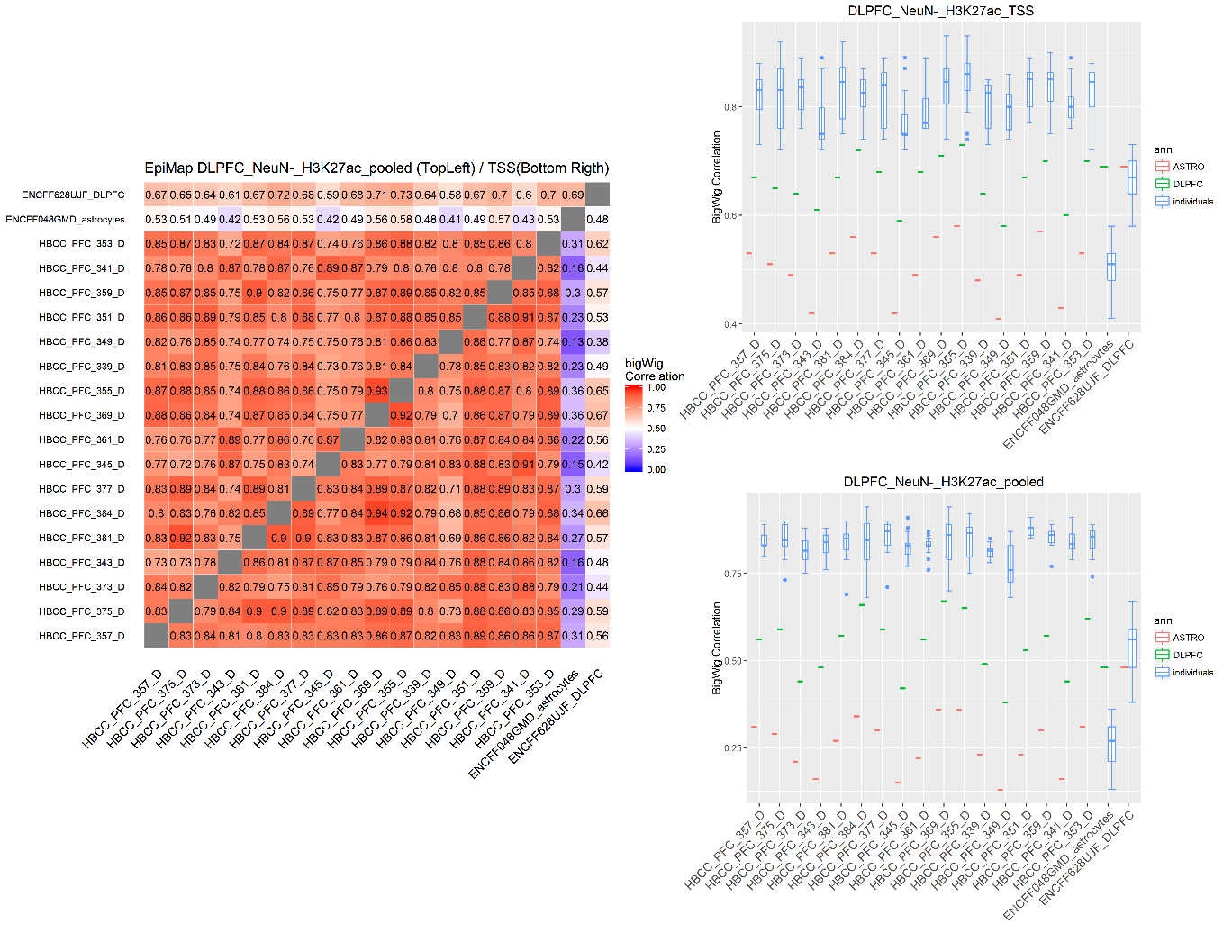
BigWig
Correlations
TSS as anchor regions
Pooled peaks as anchor regions

Slide 28
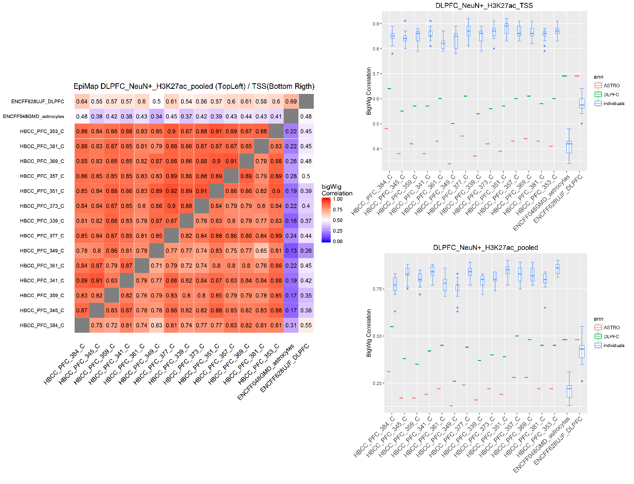
BigWig
Correlations
TSS as anchor regions
Pooled peaks as anchor regions

Slide 29
Peak intersections

Slide 30
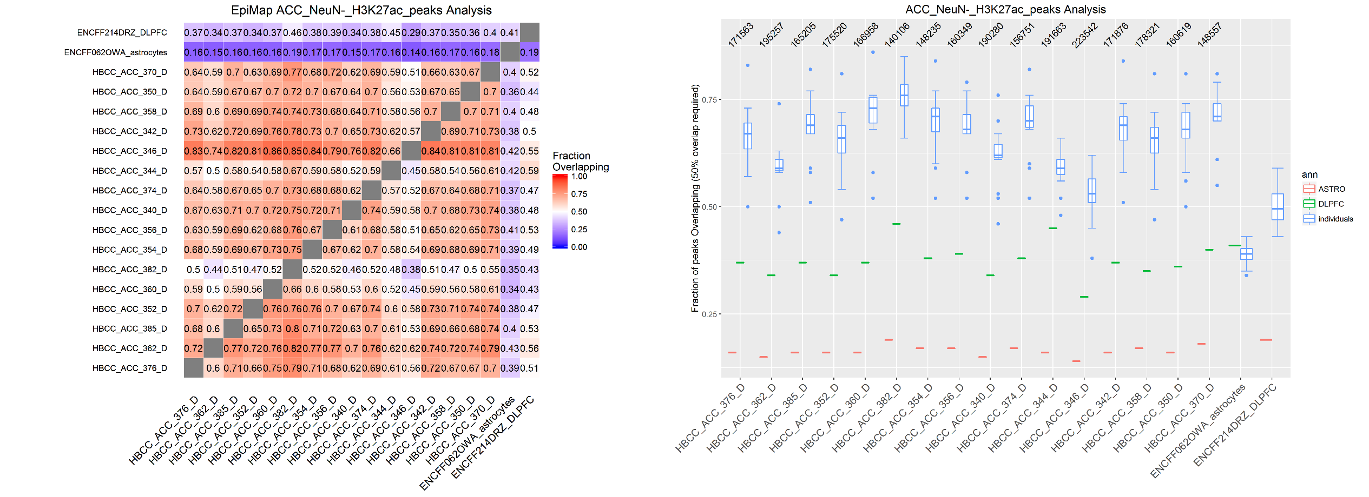
Peak Intersections
Peaks intersected using bedtools and requiring 50% of overlap

Slide 31
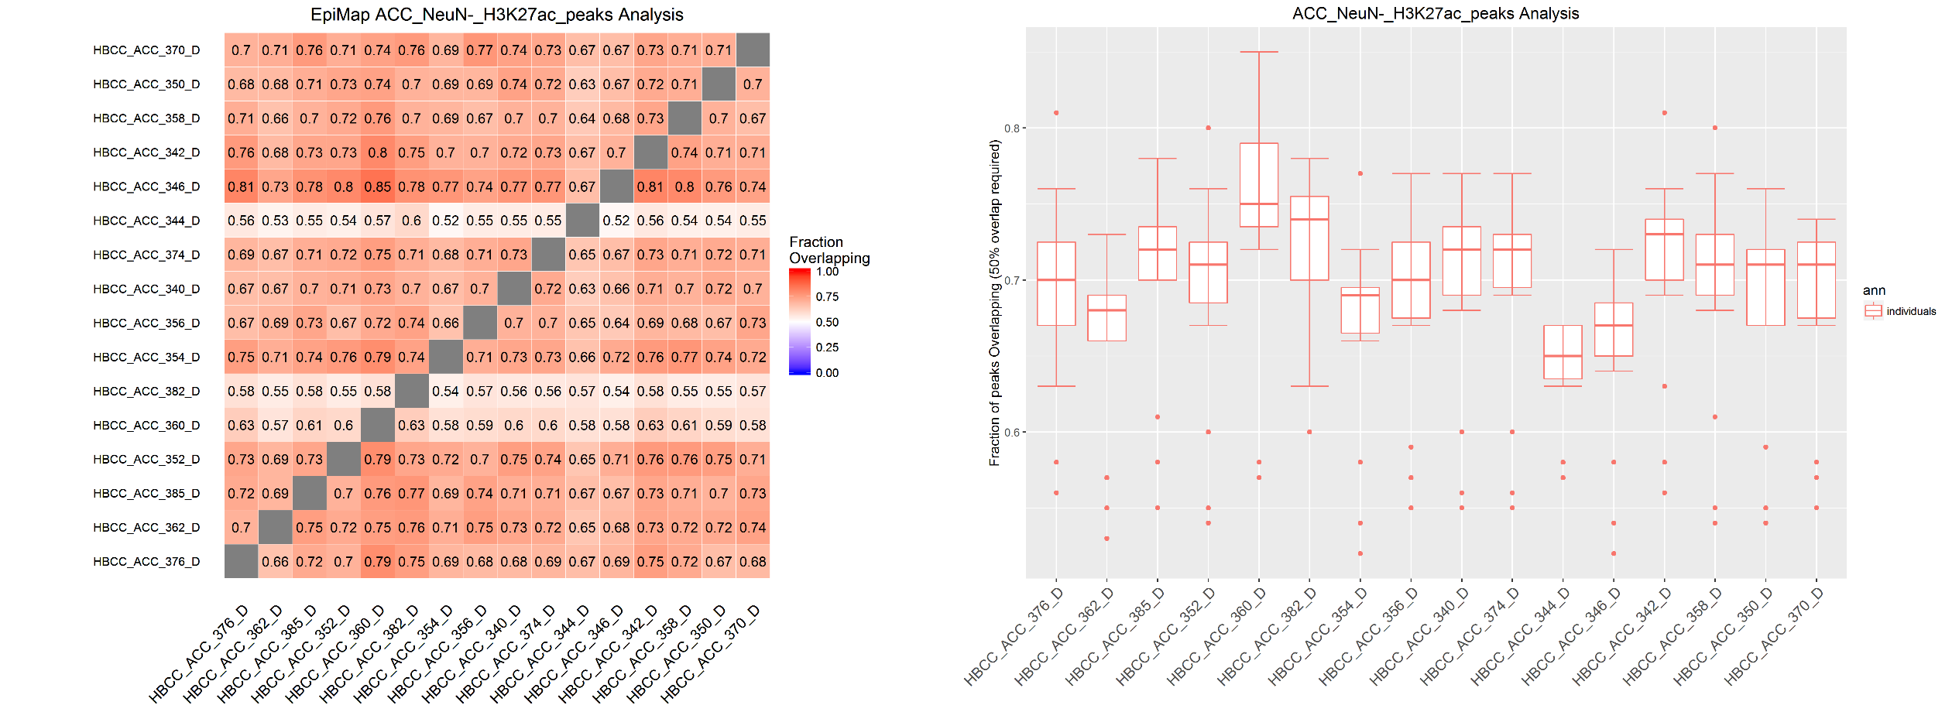
Peak Intersections
Peaks intersected using bedtools and requiring 50% of overlap. Peaks cut to have the same cardinality

Slide 32
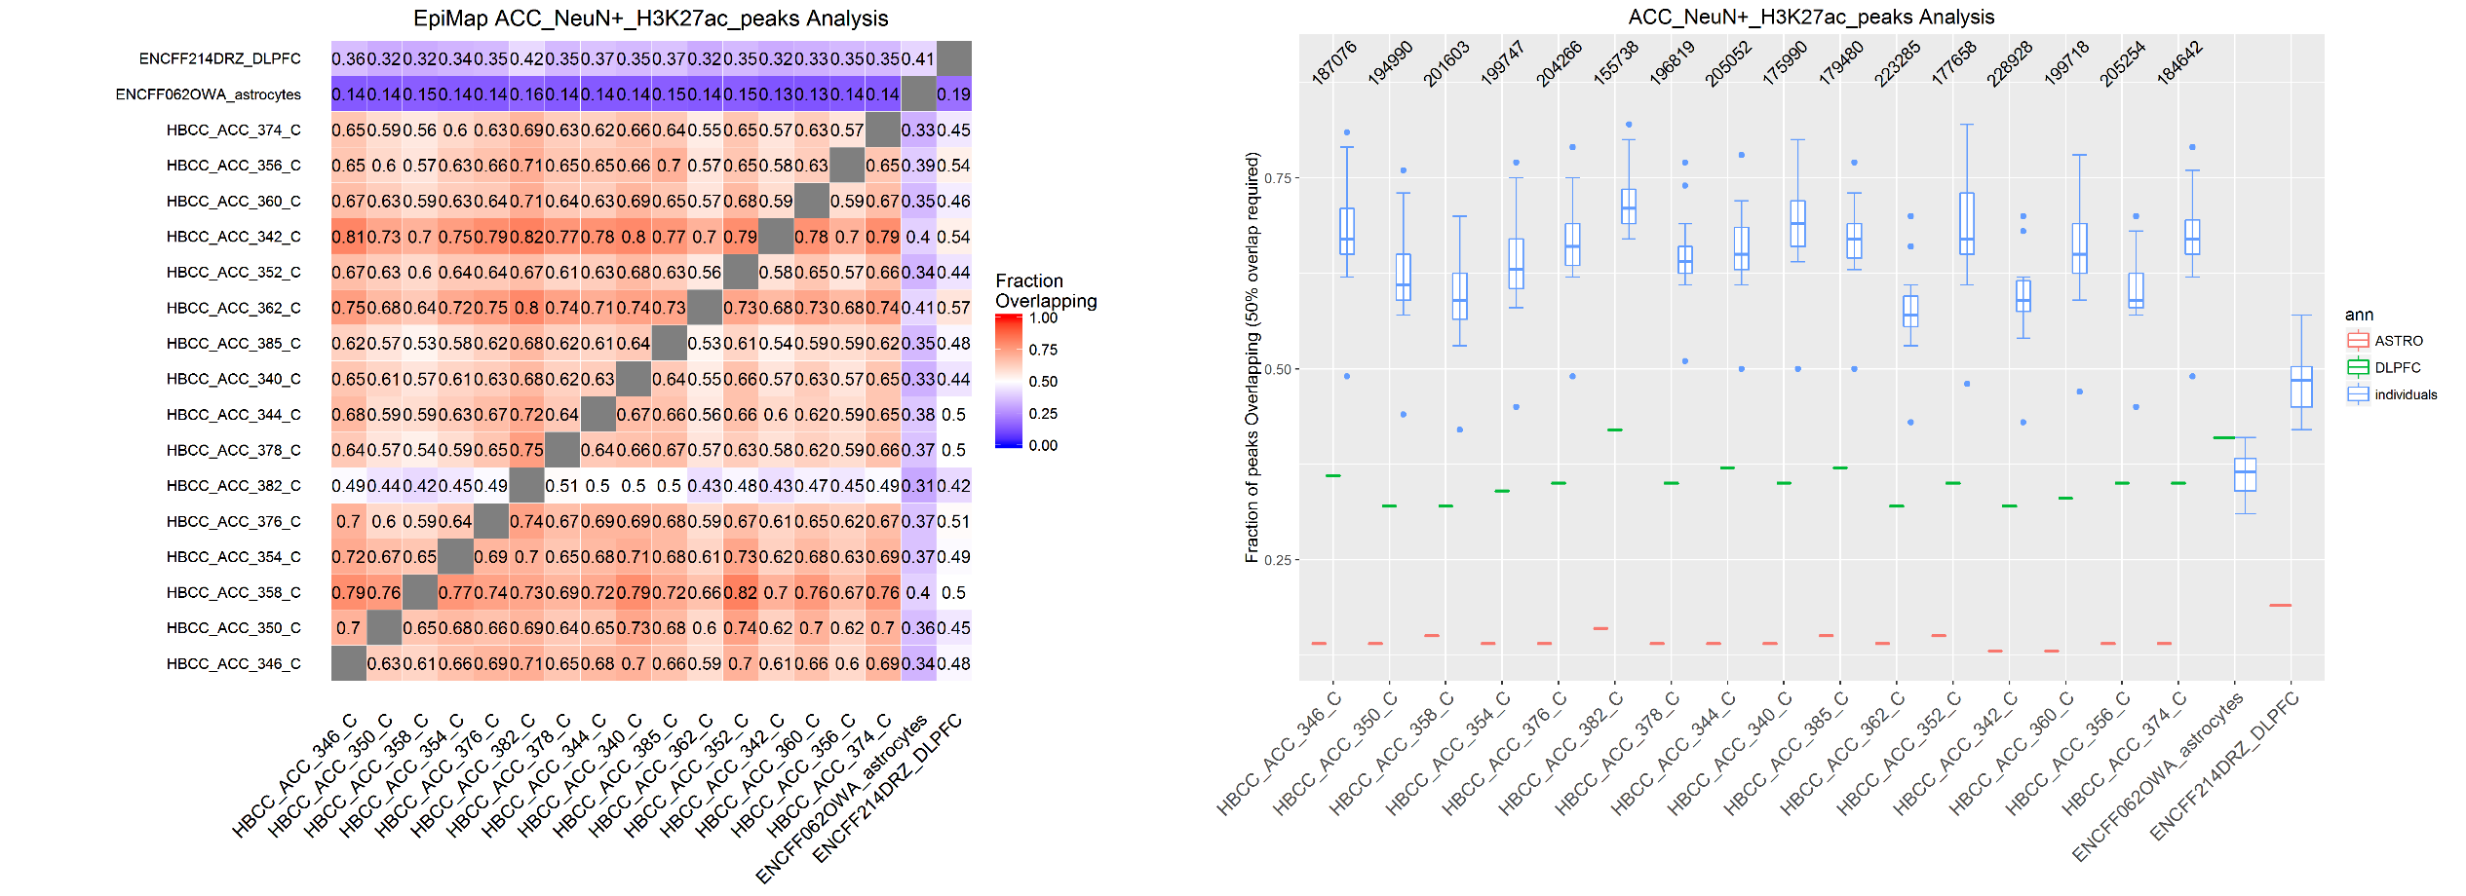
Peak Intersections
Peaks intersected using bedtools and requiring 50% of overlap

Slide 33
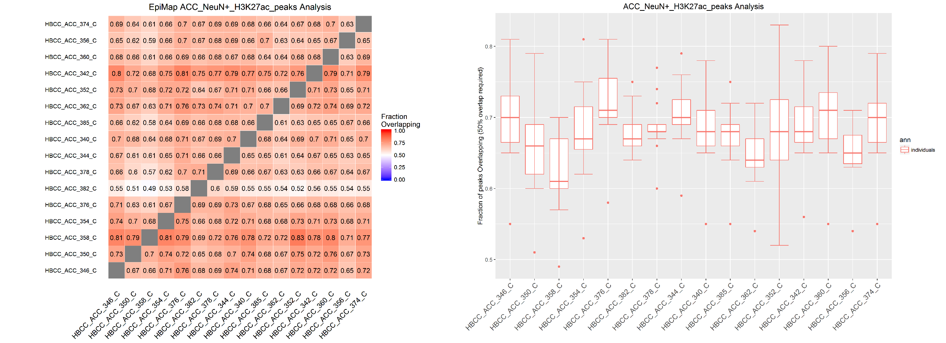
Peak Intersections
Peaks intersected using bedtools and requiring 50% of overlap. Peaks cut to have the same cardinality

Slide 34
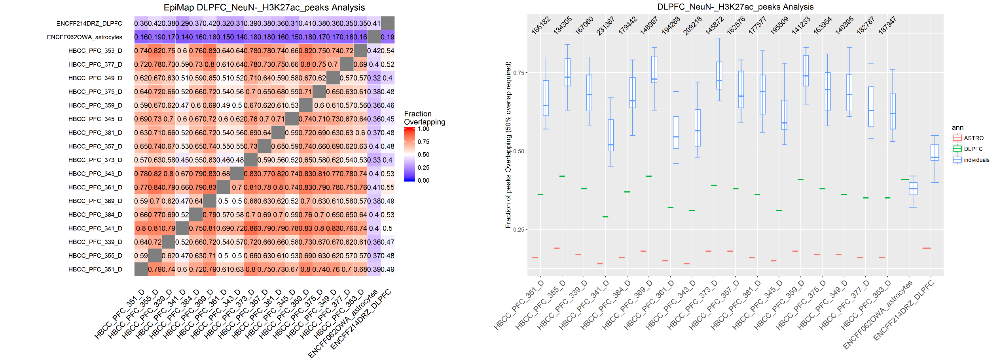
Peak Intersections
Peaks intersected using bedtools and requiring 50% of overlap

Slide 35
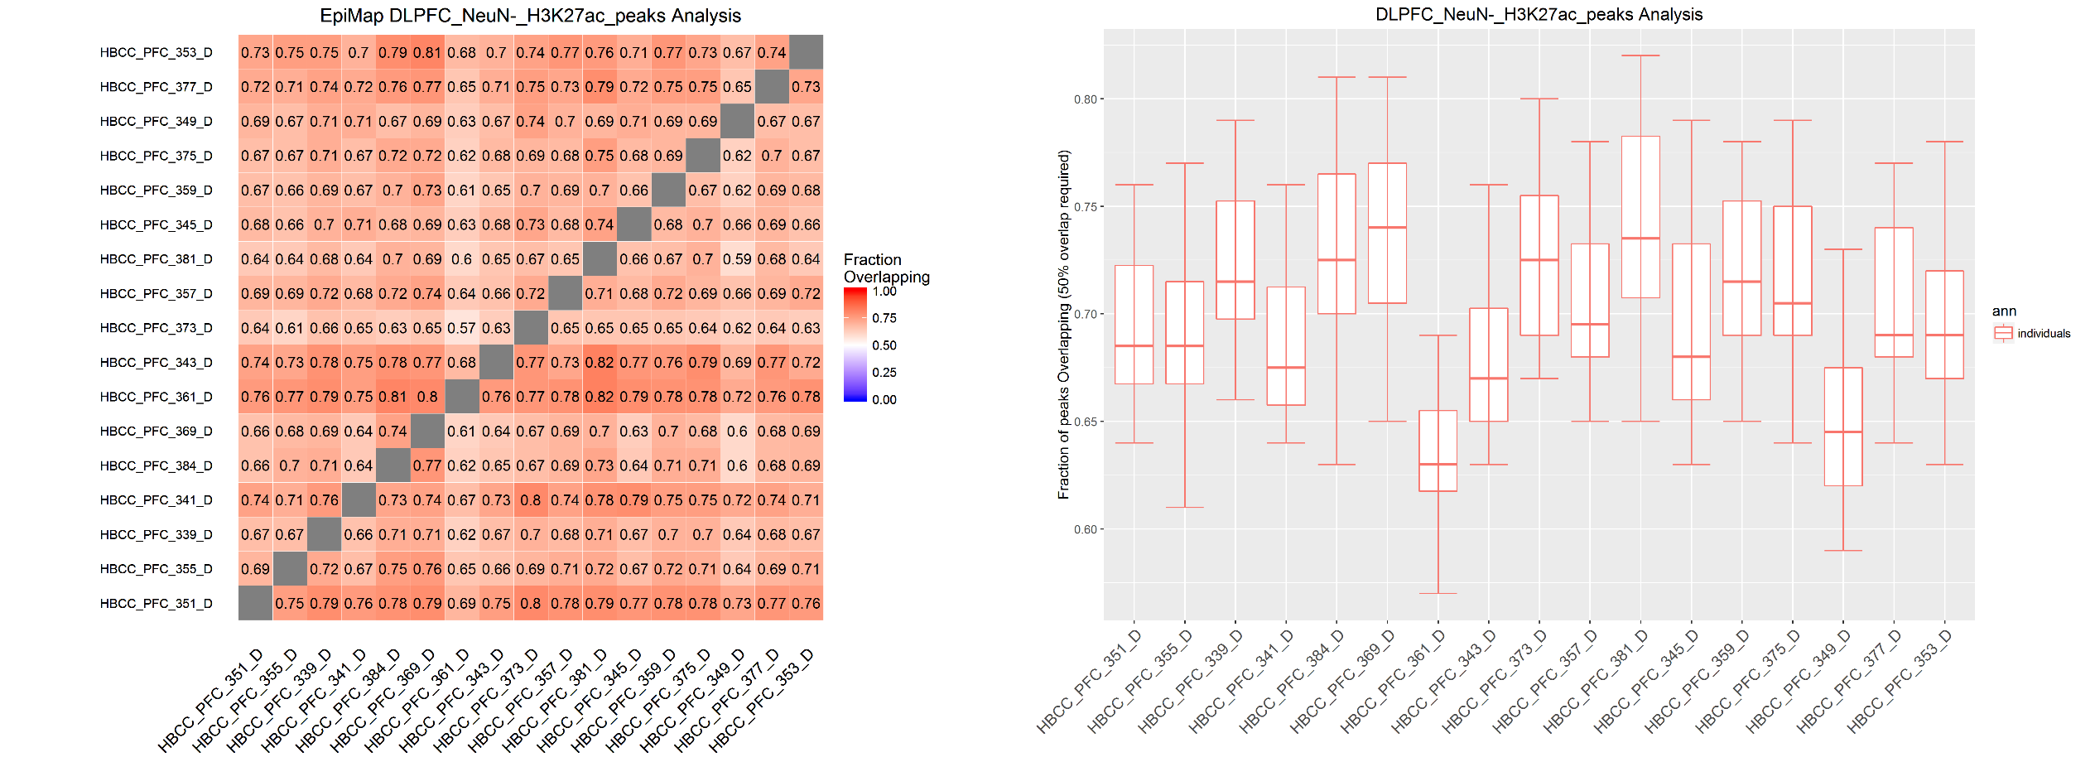
Peak Intersections
Peaks intersected using bedtools and requiring 50% of overlap. Peaks cut to have the same cardinality

Slide 36
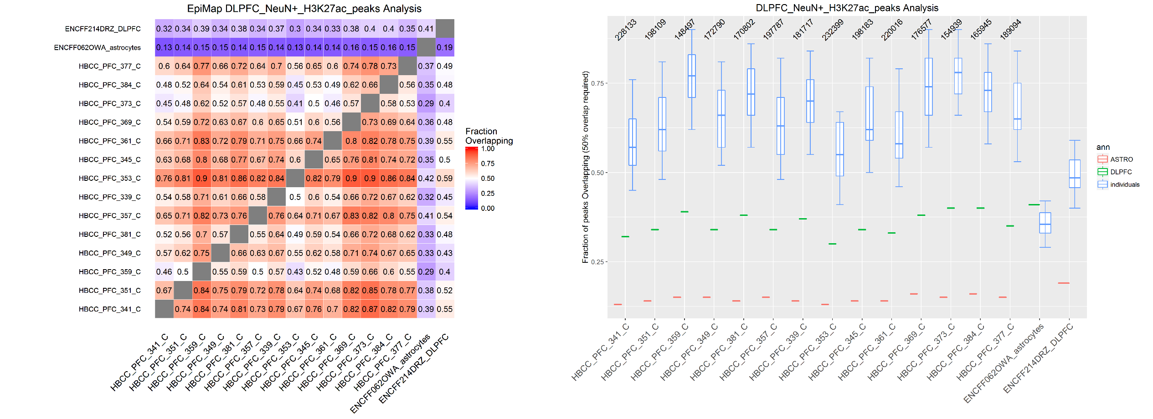
Peak Intersections
Peaks intersected using bedtools and requiring 50% of overlap

Slide 37
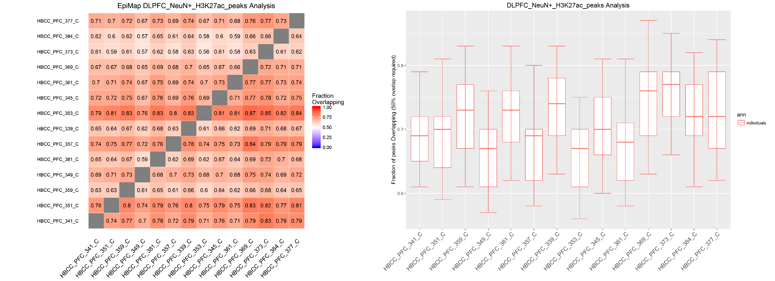
Peak Intersections
Peaks intersected using bedtools and requiring 50% of overlap. Peaks cut to have the same cardinality

Slide 38
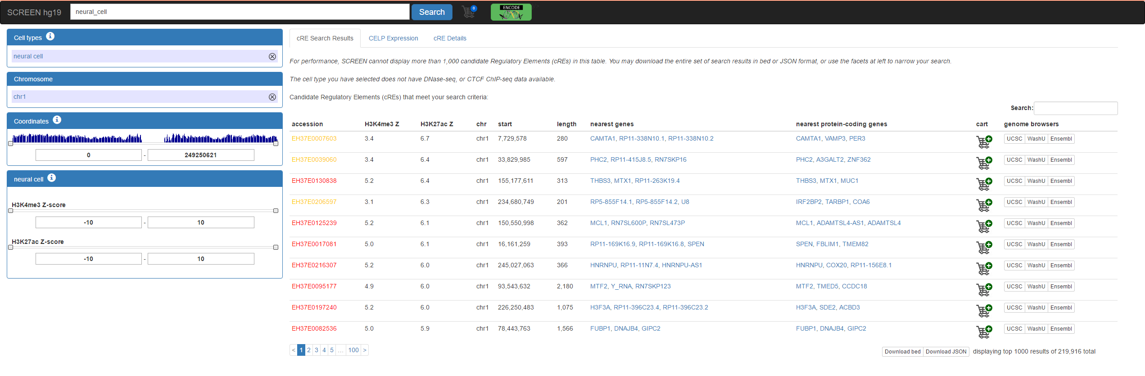
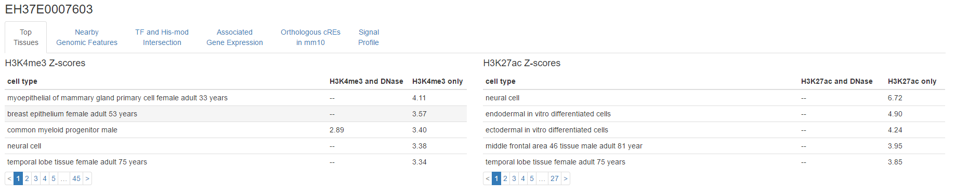
Qc using candidate Regulatory Elements (RE)
From SCREEN (http://screen.umassmed.edu) I selected a region of interest with high H3K27ac signal in brain samples (From ROADMAP).
Strong Enhancer candidate

Slide 39
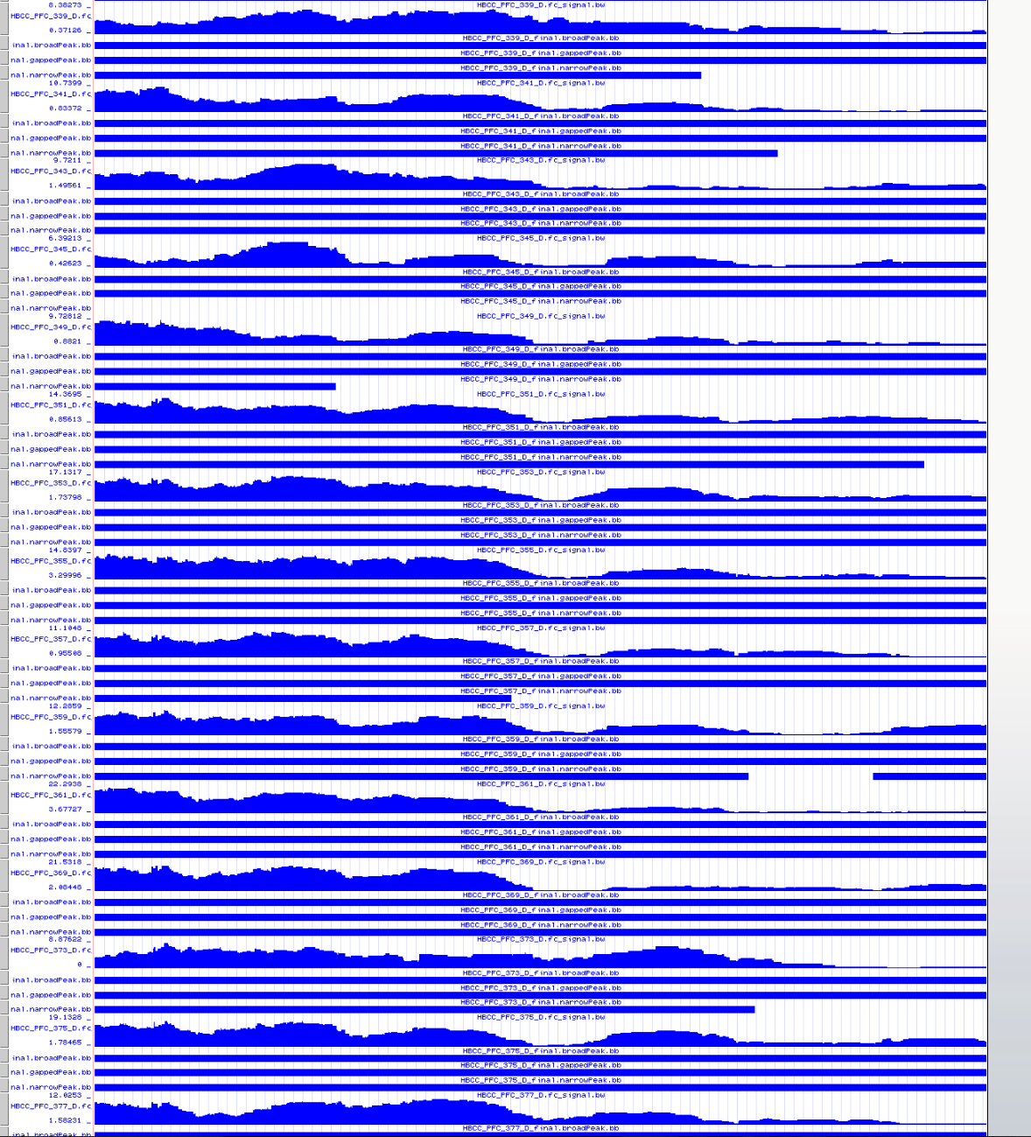
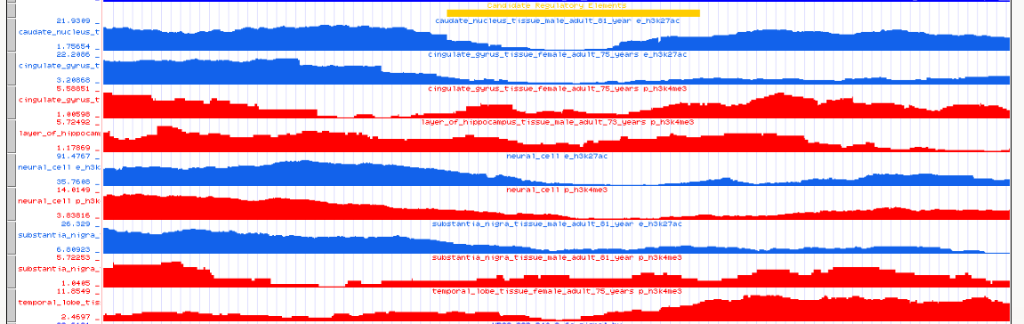
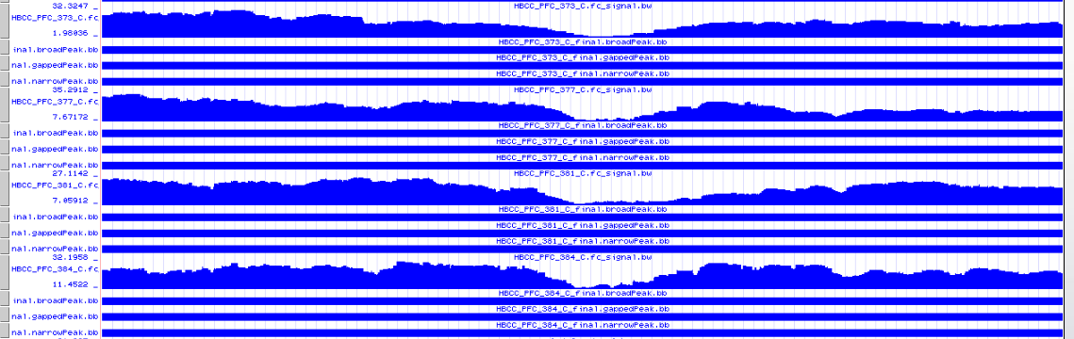
EH37E0007603

Slide 40
H3K4me3

Slide 41
Signal Around TSS
For comparison purpose, two brain ChIP-seq libraries from ENCODE project are added to the plot (DLPFC)

Slide 42
Signal Around TSS
NeuN-_Vs_NeuN+
For comparison purpose, two brain ChIP-seq libraries from ENCODE project are added to the plot (DLPFC, Astrocytes)

Slide 43
Signal Around TSS
NeuN-_Vs_NeuN+
For comparison purpose, two brain ChIP-seq libraries from ENCODE project are added to the plot (DLPFC, Astrocytes)

Slide 44
BigWigs Correlations

Slide 45
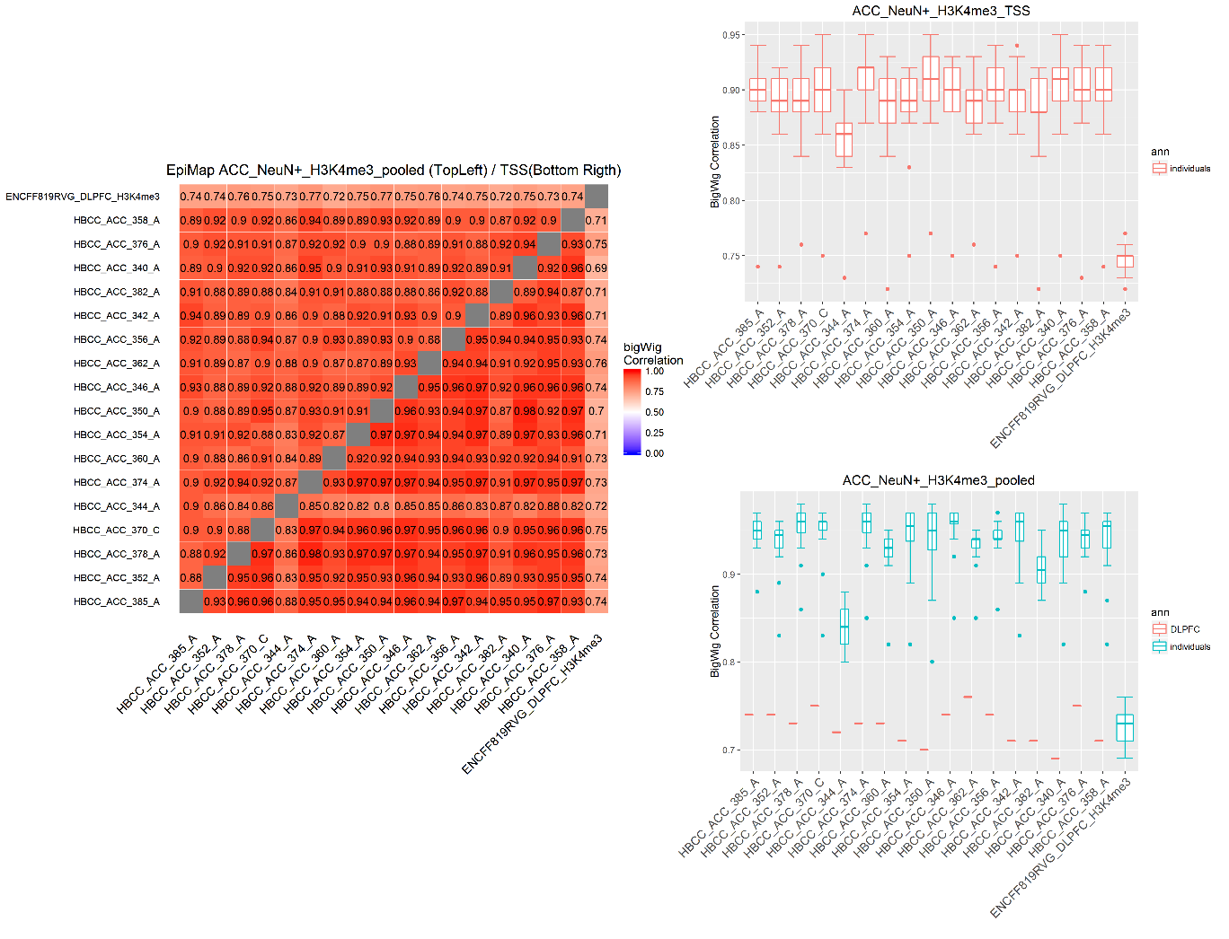
BigWig
Correlations
TSS as anchor regions
Pooled peaks as anchor regions

Slide 46
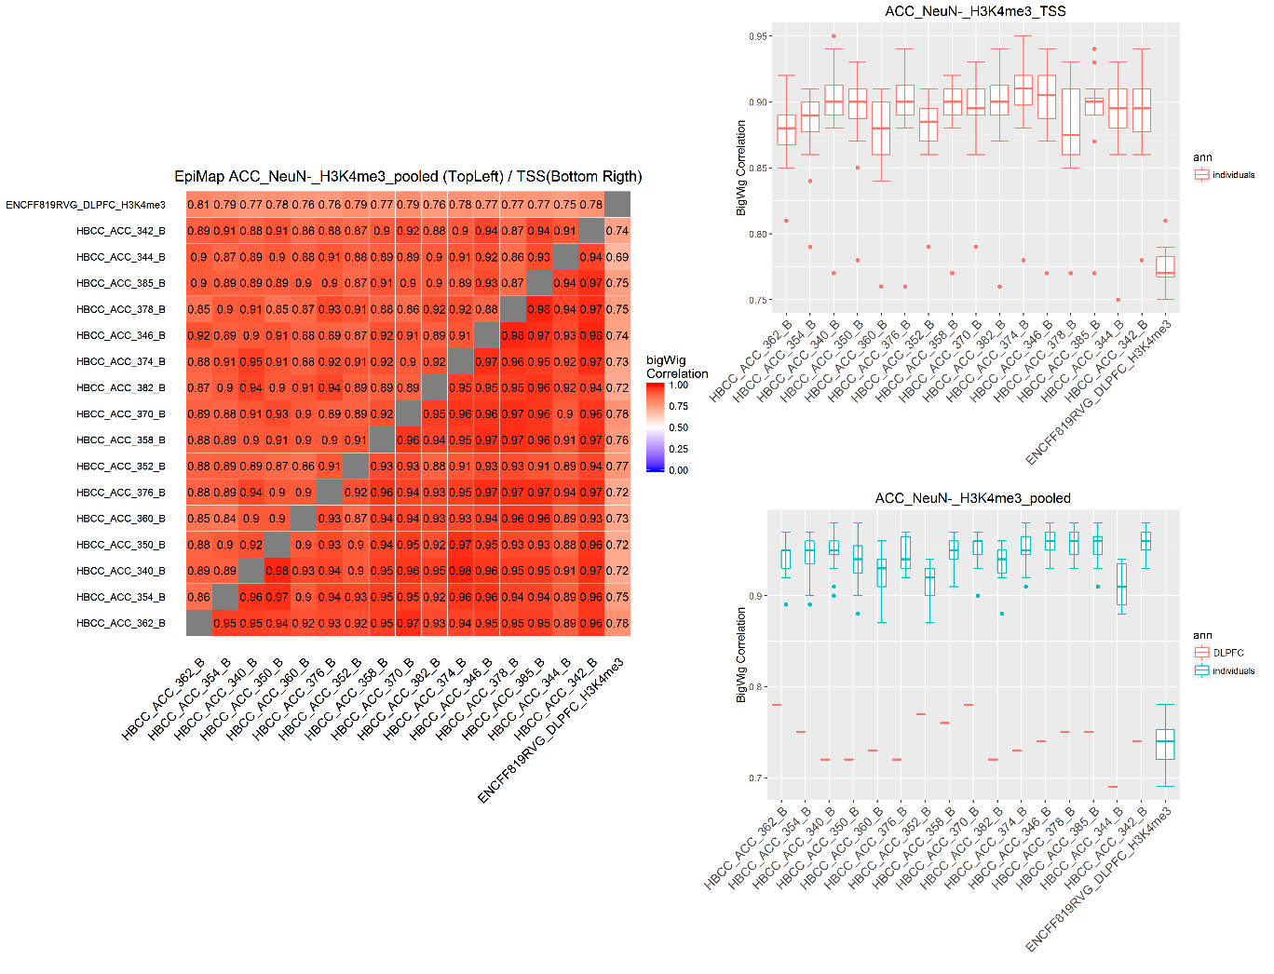
BigWig
Correlations
TSS as anchor regions
Pooled peaks as anchor regions

Slide 47
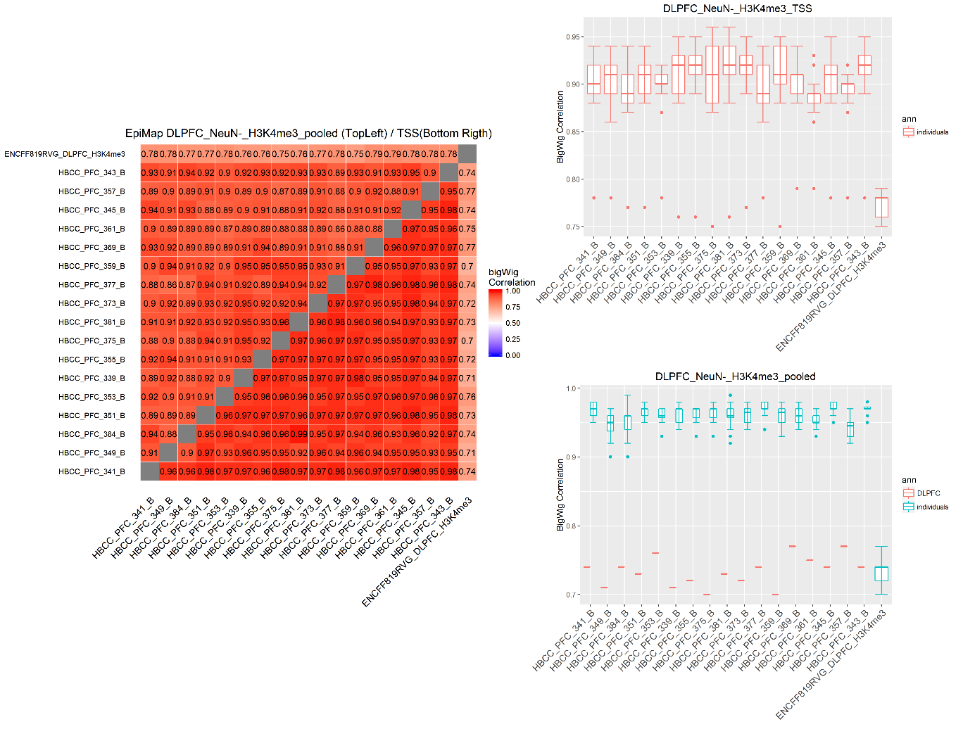
BigWig
Correlations
TSS as anchor regions
Pooled peaks as anchor regions

Slide 48
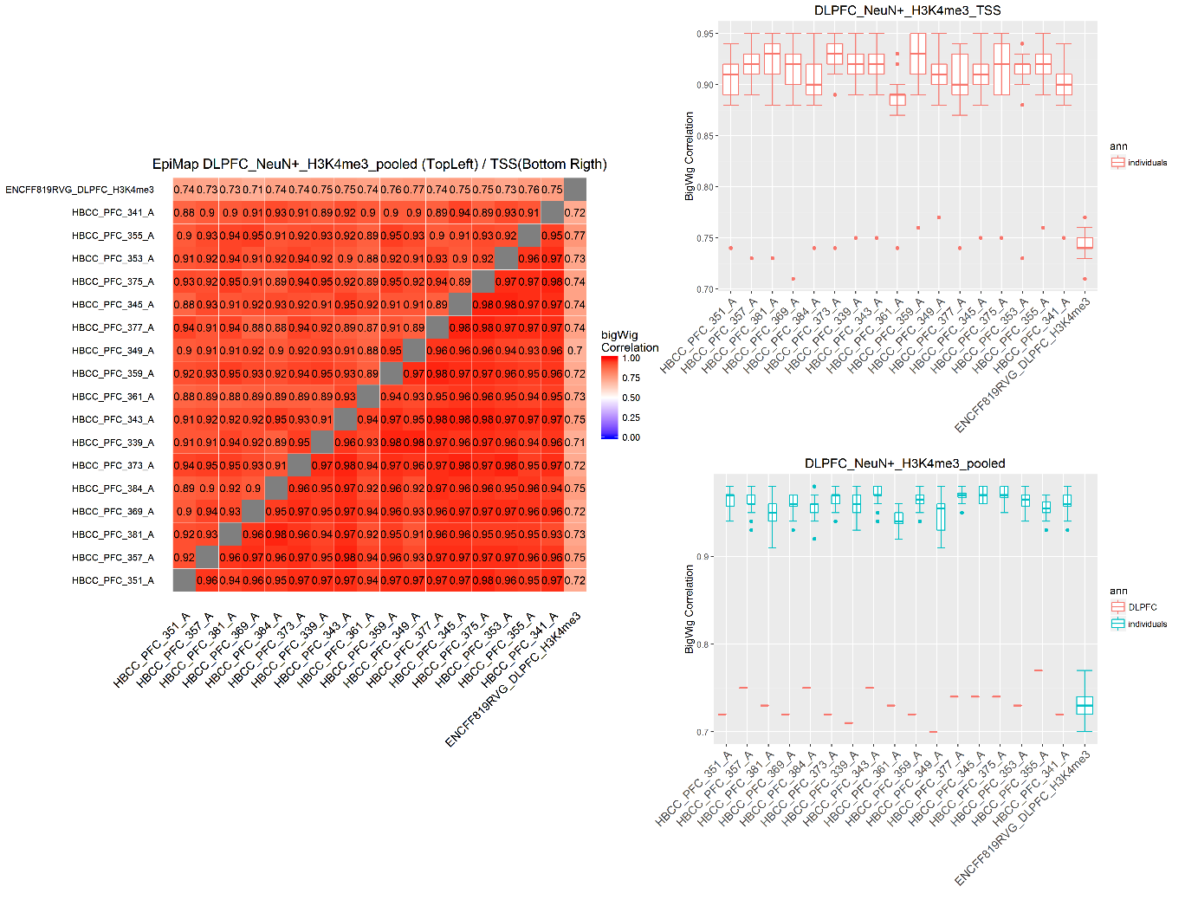
BigWig
Correlations
TSS as anchor regions
Pooled peaks as anchor regions

Slide 49
Peak intersections

Slide 50
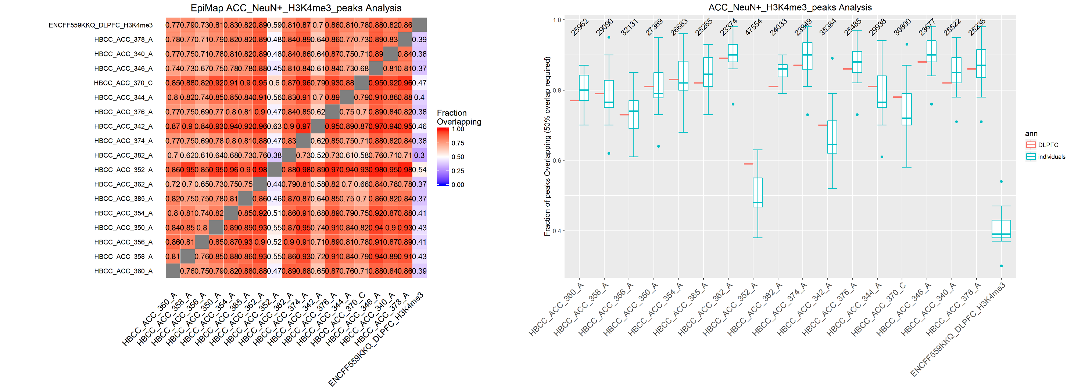
Peak Intersections
Peaks intersected using bedtools and requiring 50% of overlap

Slide 51
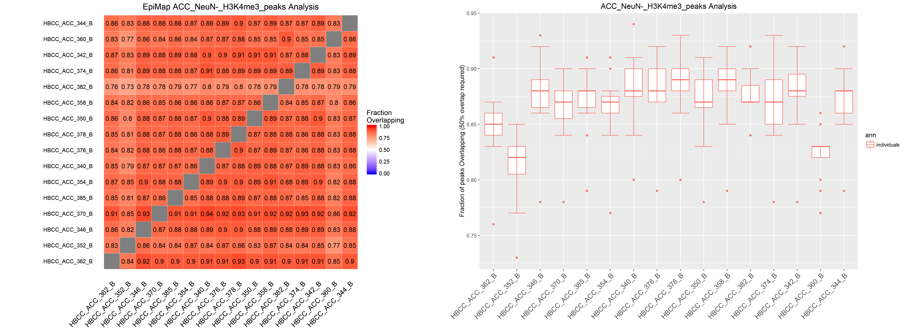
Peak Intersections
Peaks intersected using bedtools and requiring 50% of overlap. Peaks cut to have the same cardinality

Slide 52
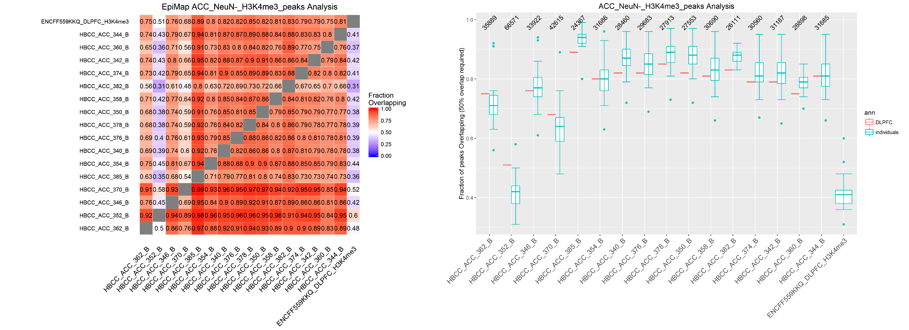
Peak Intersections
Peaks intersected using bedtools and requiring 50% of overlap

Slide 53
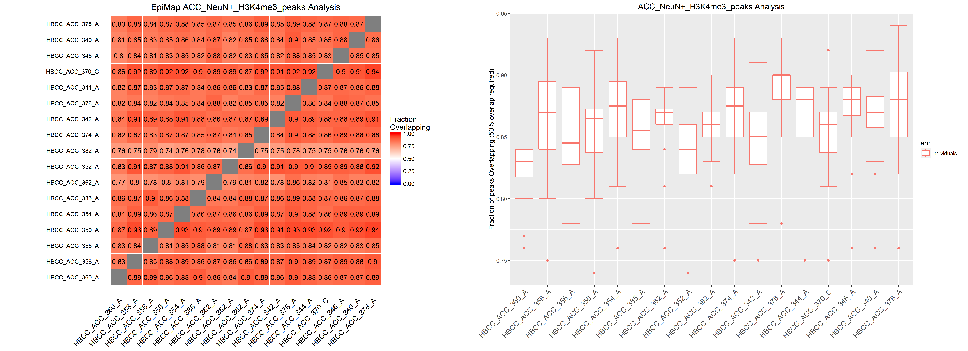
Peak Intersections
Peaks intersected using bedtools and requiring 50% of overlap. Peaks cut to have the same cardinality

Slide 54
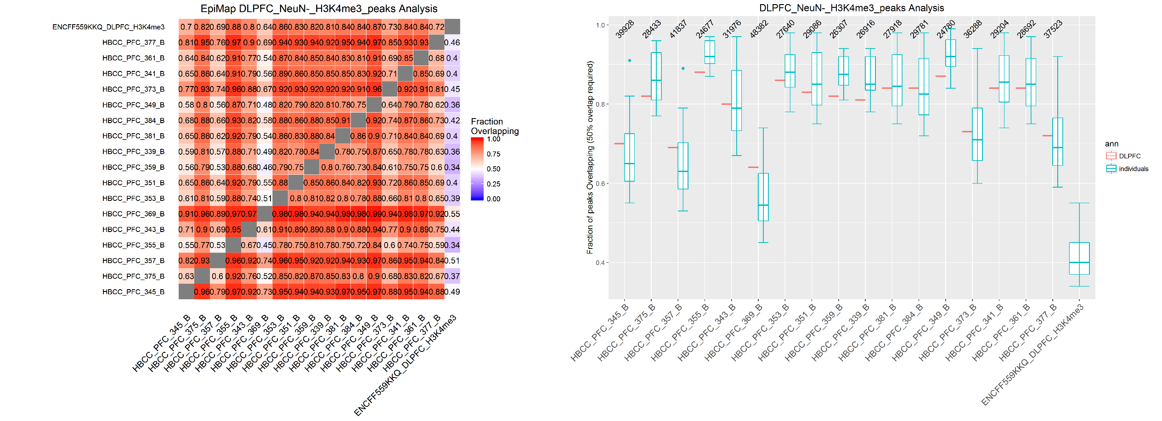
Peak Intersections
Peaks intersected using bedtools and requiring 50% of overlap

Slide 55
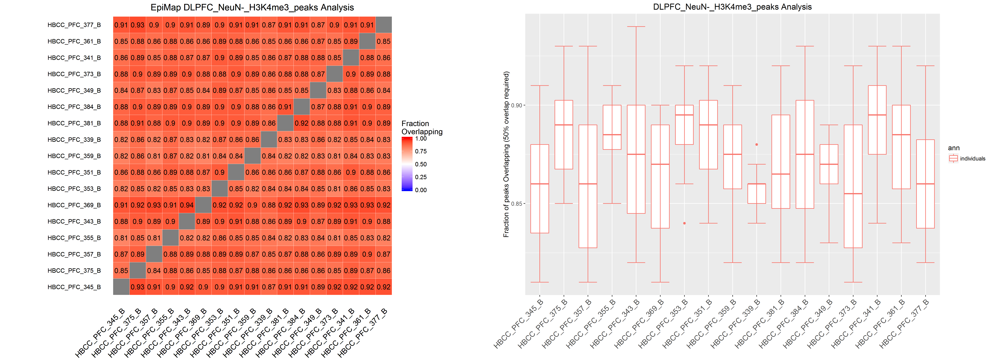
Peak Intersections
Peaks intersected using bedtools and requiring 50% of overlap. Peaks cut to have the same cardinality

Slide 56
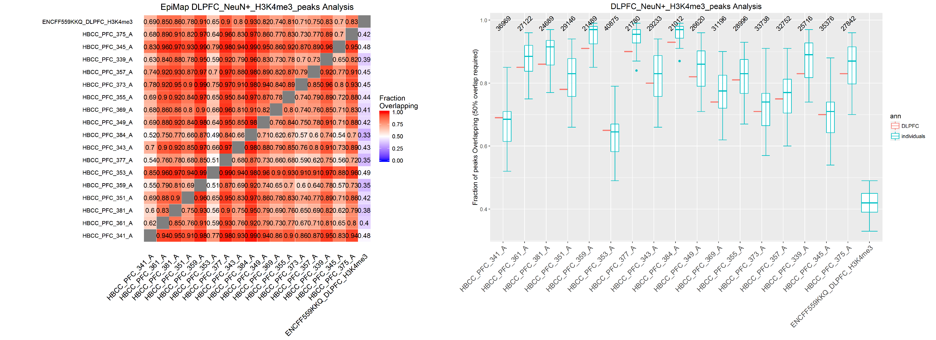
Peak Intersections
Peaks intersected using bedtools and requiring 50% of overlap

Slide 57
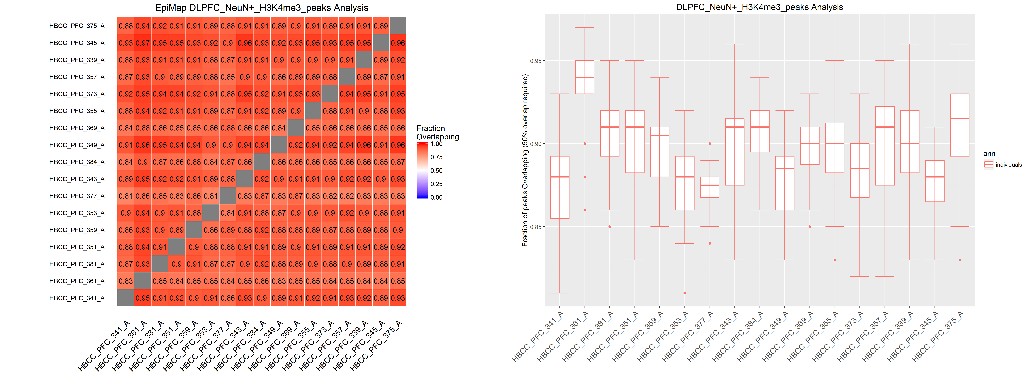
Peak Intersections
Peaks intersected using bedtools and requiring 50% of overlap. Peaks cut to have the same cardinality

Slide 58
SCREEN Regulatory Elements

Slide 59
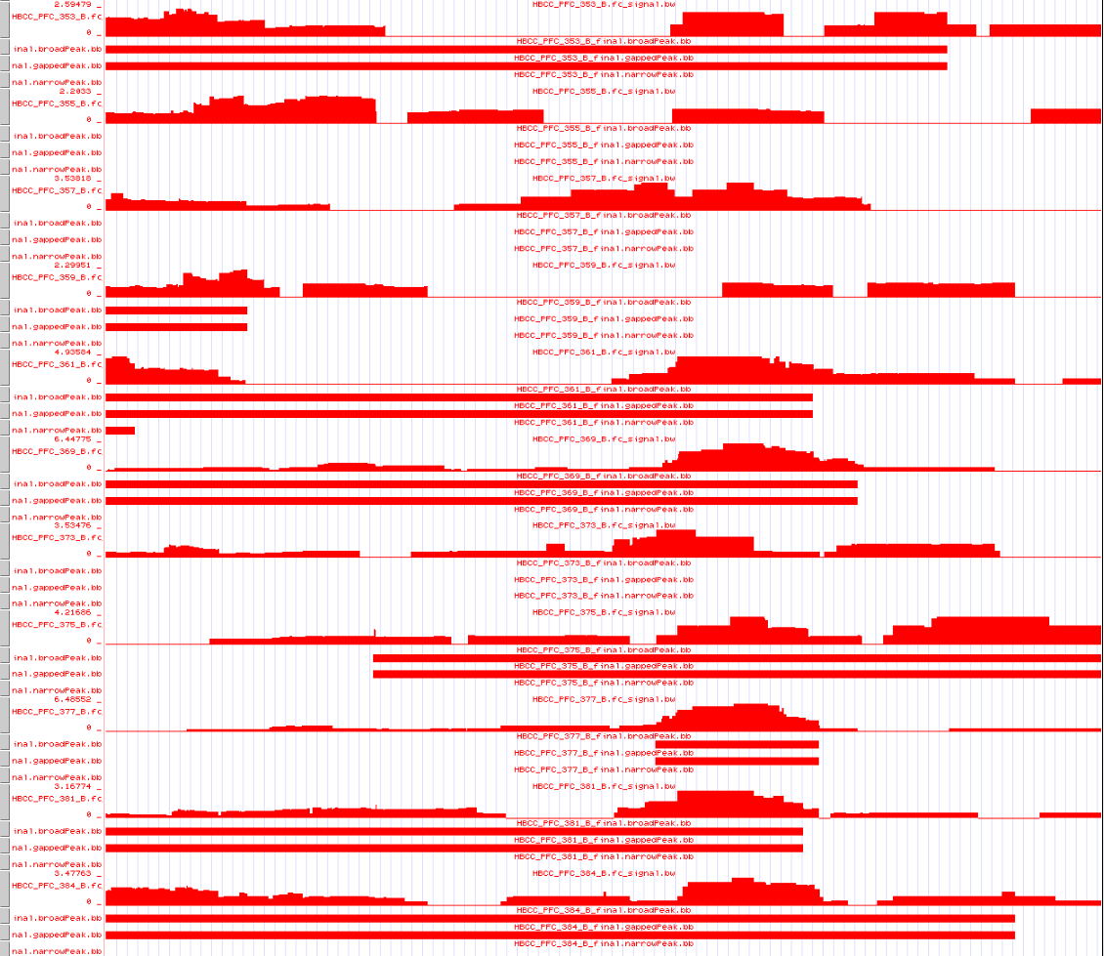
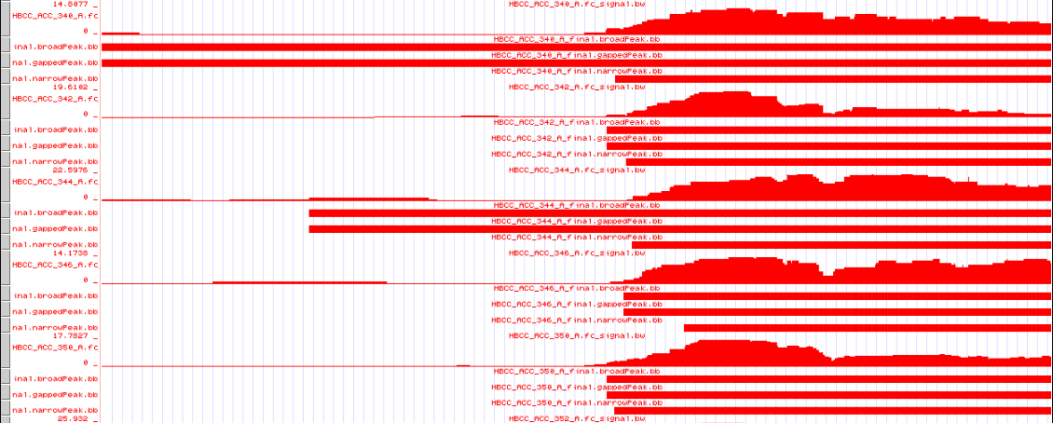
EH37E0007603

Slide 60
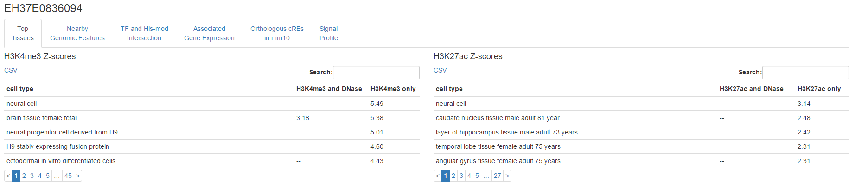

Slide 61




Slide 62



Slide 64





Slide 66


Slide 67


Slide 68


Slide 69


Slide 70


Slide 71


Slide 72


Slide 73
Next steps
Include results for the last H3K4me3 experiment
CNON is running
Get cell specific TSSs and redo correlations (published data?)
Programmatically check other regions in the genome browser
Jaccard index instead of fraction of overlapping

Slide 74
Yale-ASD study
36 samples
2 Brain regions : Cerebellum, DLPFC
1 Mark : H3K27ac

Slide 75
Cerebellum

Slide 76

Signal Around TSS
For comparison purpose, two brain ChIP-seq libraries from ENCODE project are added to the plot (DLPFC, Astrocytes)

Slide 77

BigWig
Correlations
TSS as anchor regions
Pooled peaks as anchor regions

Slide 78

Peak Intersections
Peaks intersected using bedtools and requiring 50% of overlap

Slide 79

Peak Intersections
Peaks intersected using bedtools and requiring 50% of overlap. Peaks cut to have the same cardinality

Slide 80
DLPFC

Slide 81

Signal Around TSS
For comparison purpose, two brain ChIP-seq libraries from ENCODE project are added to the plot (DLPFC, Astrocytes)

Slide 82

BigWig
Correlations
TSS as anchor regions
Pooled peaks as anchor regions

Slide 83

Peak Intersections
Peaks intersected using bedtools and requiring 50% of overlap

Slide 84

Peak Intersections
Peaks intersected using bedtools and requiring 50% of overlap. Peaks cut to have the same cardinality

Slide 85



Slide 87


