Slide 1
1) Process conglomerated RPKM data file to generate RPKM counts for each tissue on relevant samples
2) Filter on >=10 individuals with >0.1 RPKM and raw read counts greater than 6 -- ie, Genes must:
- have at least 10 samples with
- RPKM > 0.1 and
- raw read counts greater than 6"
→ GTEx is applying other (unlisted) criteria -- Had to do ultimately enforce that my data matched the GTEx data (in terms of samples & genes)
3) Quantile normalization
4) Inverse quantile normalization
5) Compare calculated expression values w/those reported by GTEx

Slide 2
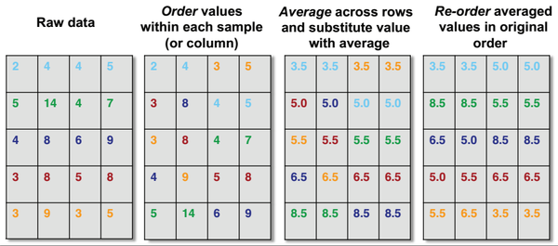
“Quantile normalization was performed within each tissue to bring the expression profile of each sample onto the same scale.”
→ This makes the distributions (for different samples) similar in terms of statistical properties
Genes (RPKM values)
Samples
Adapted from RA Irizarry, Dec 18 2014 (web post)

Slide 3
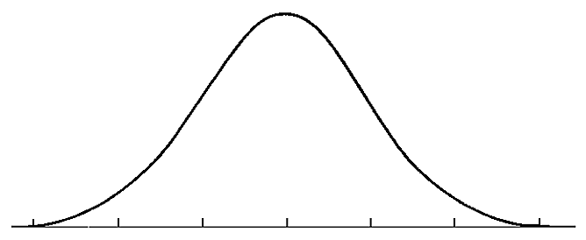
4) "To protect from outliers, inverse quantile normalization was performed for each gene, mapping each set of expression values to a standard normal."
1 2 3 4 5 6 7 8 9 10 11
Toy example for 1 gene with 11 samples (ie, expression values)
→ split integral of standard normal up into 12 equal-area slices
→ Then re-assign the original expression values (from previous step) to these 11 values from the standard normal distribution

Slide 4
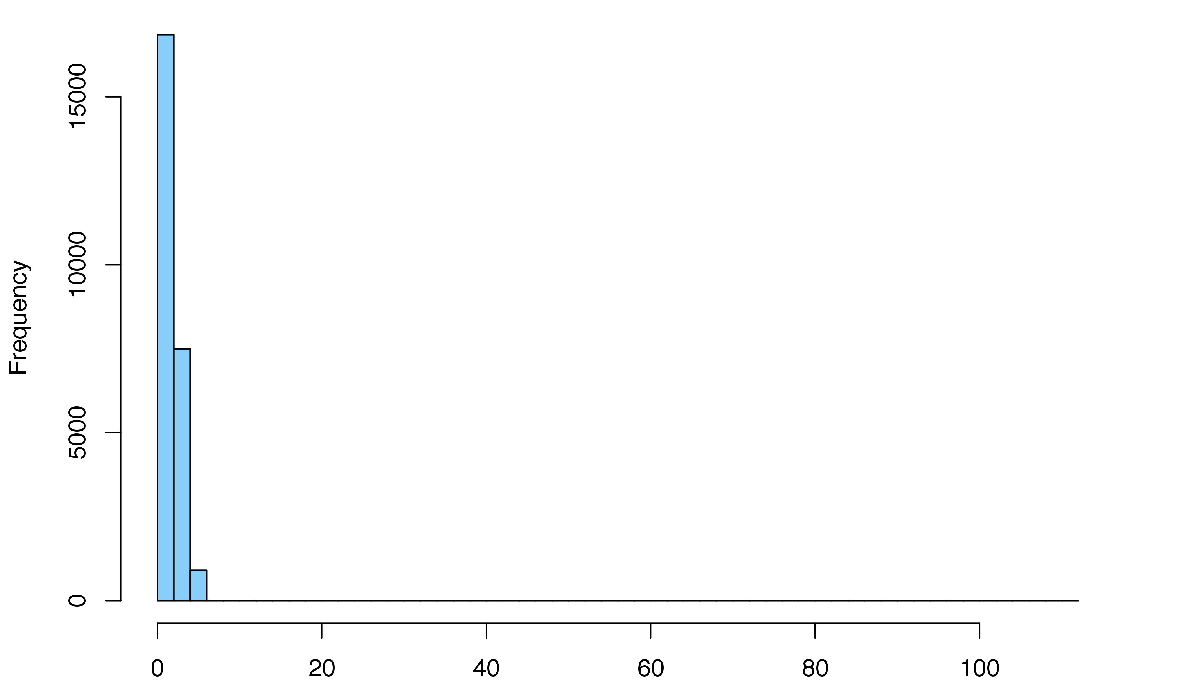
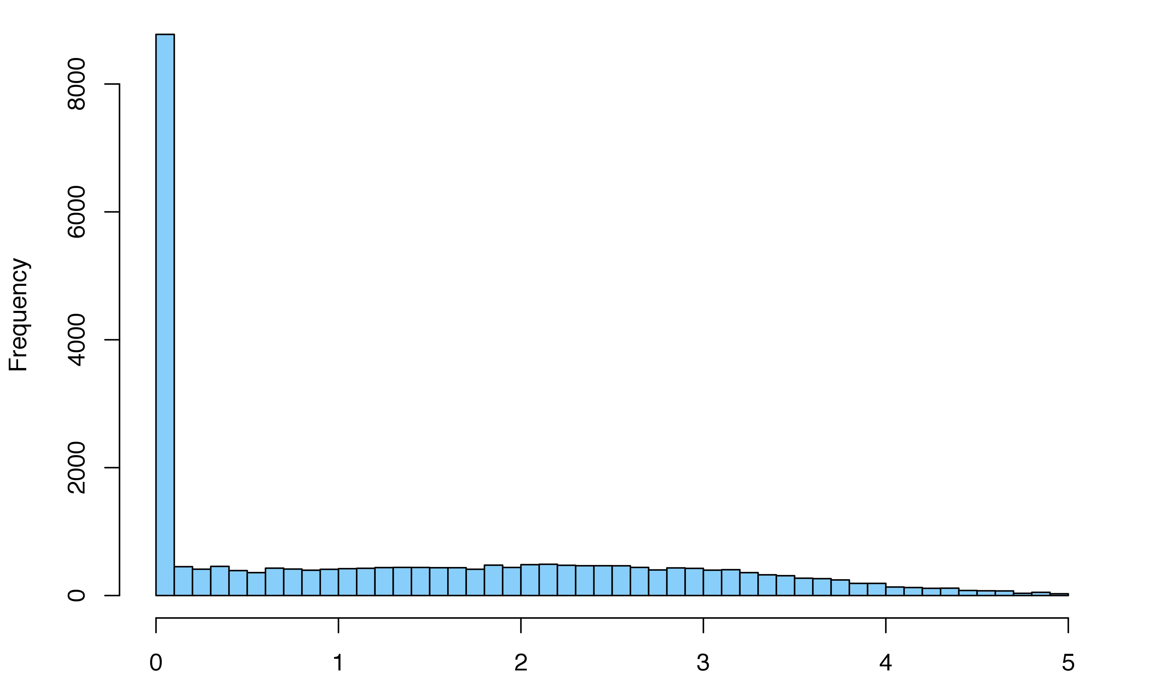
5) Compare calculated expression values w/those reported by GTEx
Error for a given gene ≡ ⟨ |fract_error| ⟩
where:
|fract_error| = abs { known– calculated / known }
and the mean ⟨ ⟩ is taken over all 96 samples

Slide 5
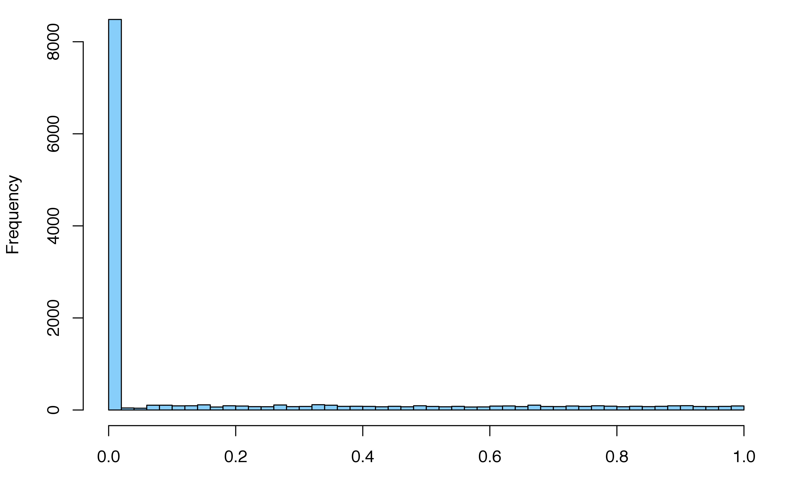
5) Compare calculated expression values w/those reported by GTEx
Error for a given gene ≡ ⟨ |fract_error| ⟩
where:
|fract_error| = abs { known– calculated / known }
and the mean ⟨ ⟩ is taken over all 96 samples

Slide 6
|fract_error|
= abs { known– calculated / known }
Max value in this heatmap: 180
Genes (200 shown)
Samples (all 96)

Slide 7
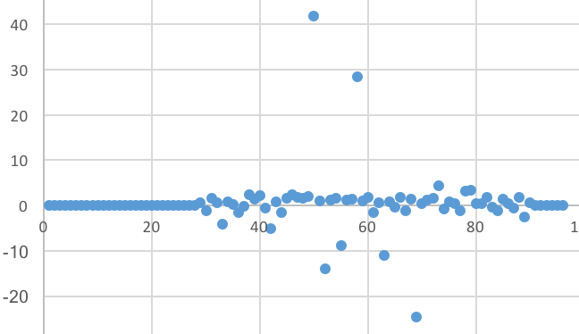
Sources of error:
1) samples with expression values close to 0
2) genes with extremely high expression values across all samples (not shown) -- ex: ribosomal proteins, etc
Known expr - calculated

