Slide 1
Paper E analysis update
02/19/2017
Gerstein Lab

Slide 2
Aim and deliverables for the functional impact paper
Decipher overall functional burdening in cancer genomes in the PCAWG project.
  Avg cancer has ~5 drivers & ~5000 mutations. What is the overall burdening of the many passengers in different cancers ?
  Look at Overall variation burden observed in various genomic elements (coding & noncoding) in different PCAWG cohorts.
      This work will provide comprehensive functional annotations across all of pcawg (FunSeq & aloft score)
  Coding and noncoding functional impact score distribution across pan-cancer cohorts.
      Enrichment/depletion of high impact passengers (other than drivers) in gene block/neighborhood
      Correlation of TF burdening with downstream gene expression changes
      Framework to evaluate structural variation impact score
  Decipher the the differential passenger burdening in various cohorts (how it relates to mechanism)
      Relate to different Signature, Ageing, sub-clonality & other clinical information

Slide 3
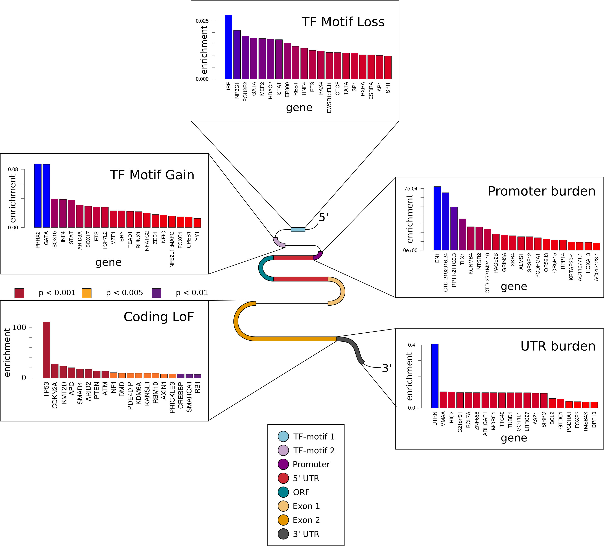

Slide 4
Annotation of large deletions (germline vs somatic)
Deletion enrichment score
CDS germline engulf
TFP germline engulf
CDS somatic engulf
CDS somatic partial
TFP somatic engulf
TFP somatic partial
CDS germline partial
TFP germline partial

Slide 5
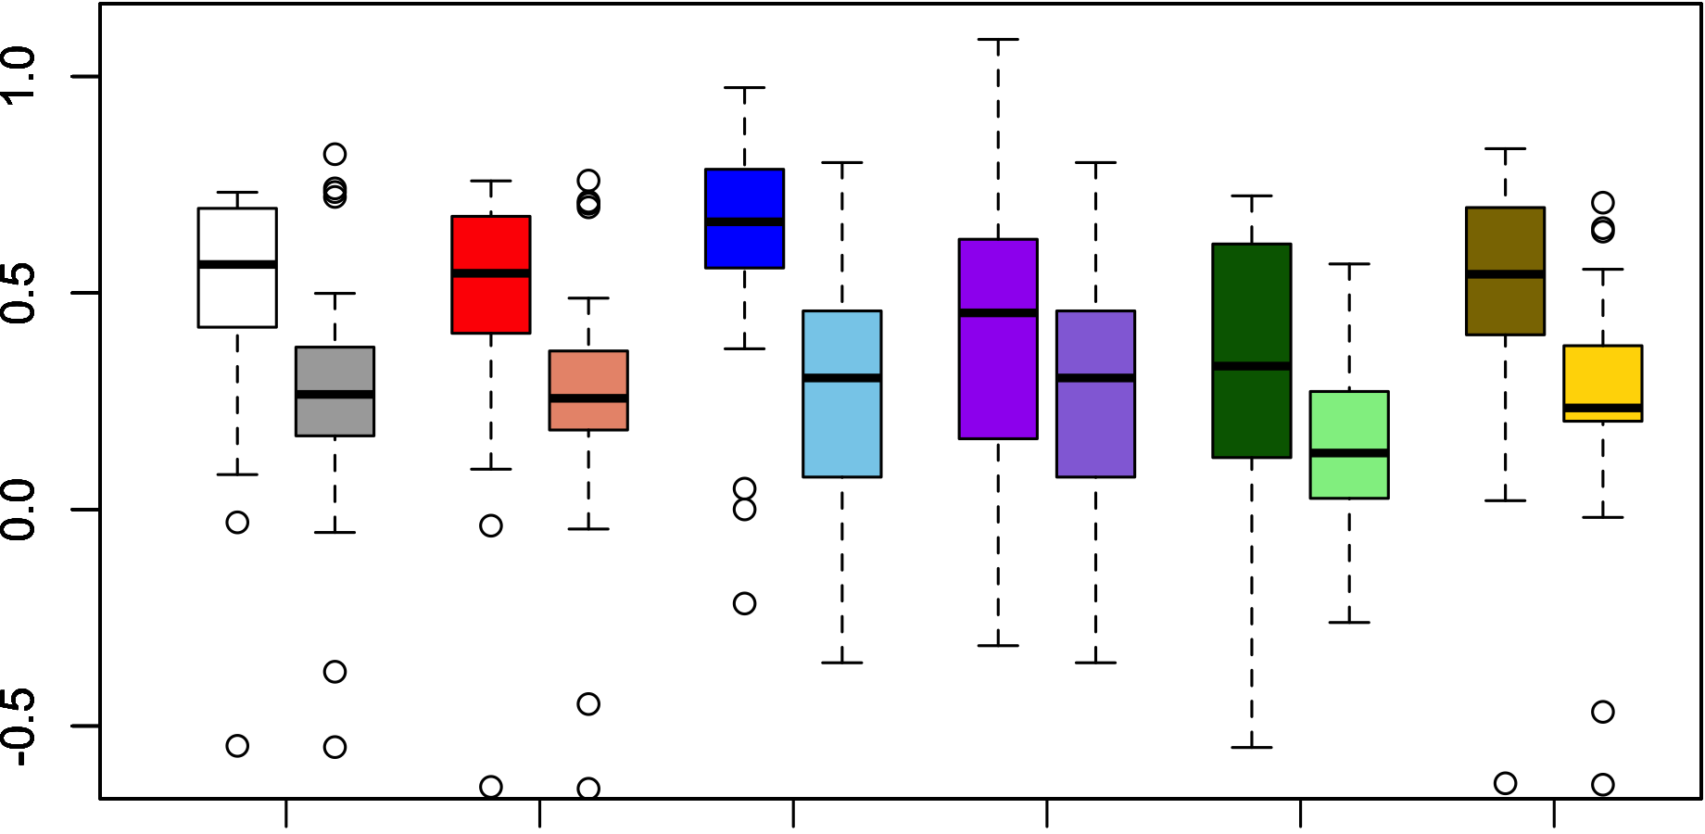
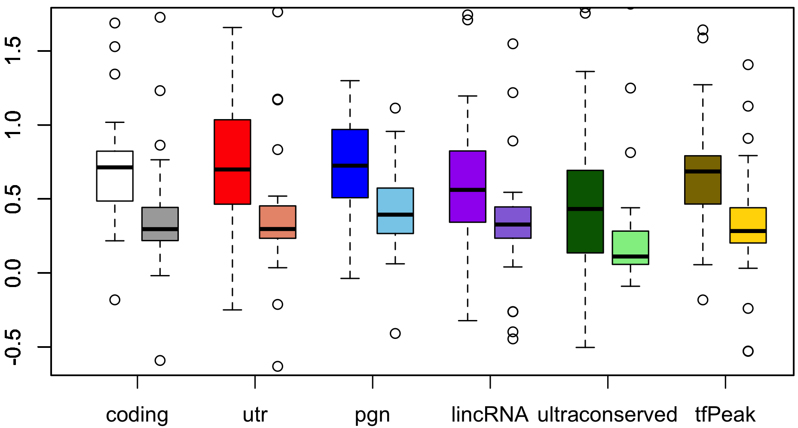
Enrichment score (del)
Enrichment score (dup)

Slide 6
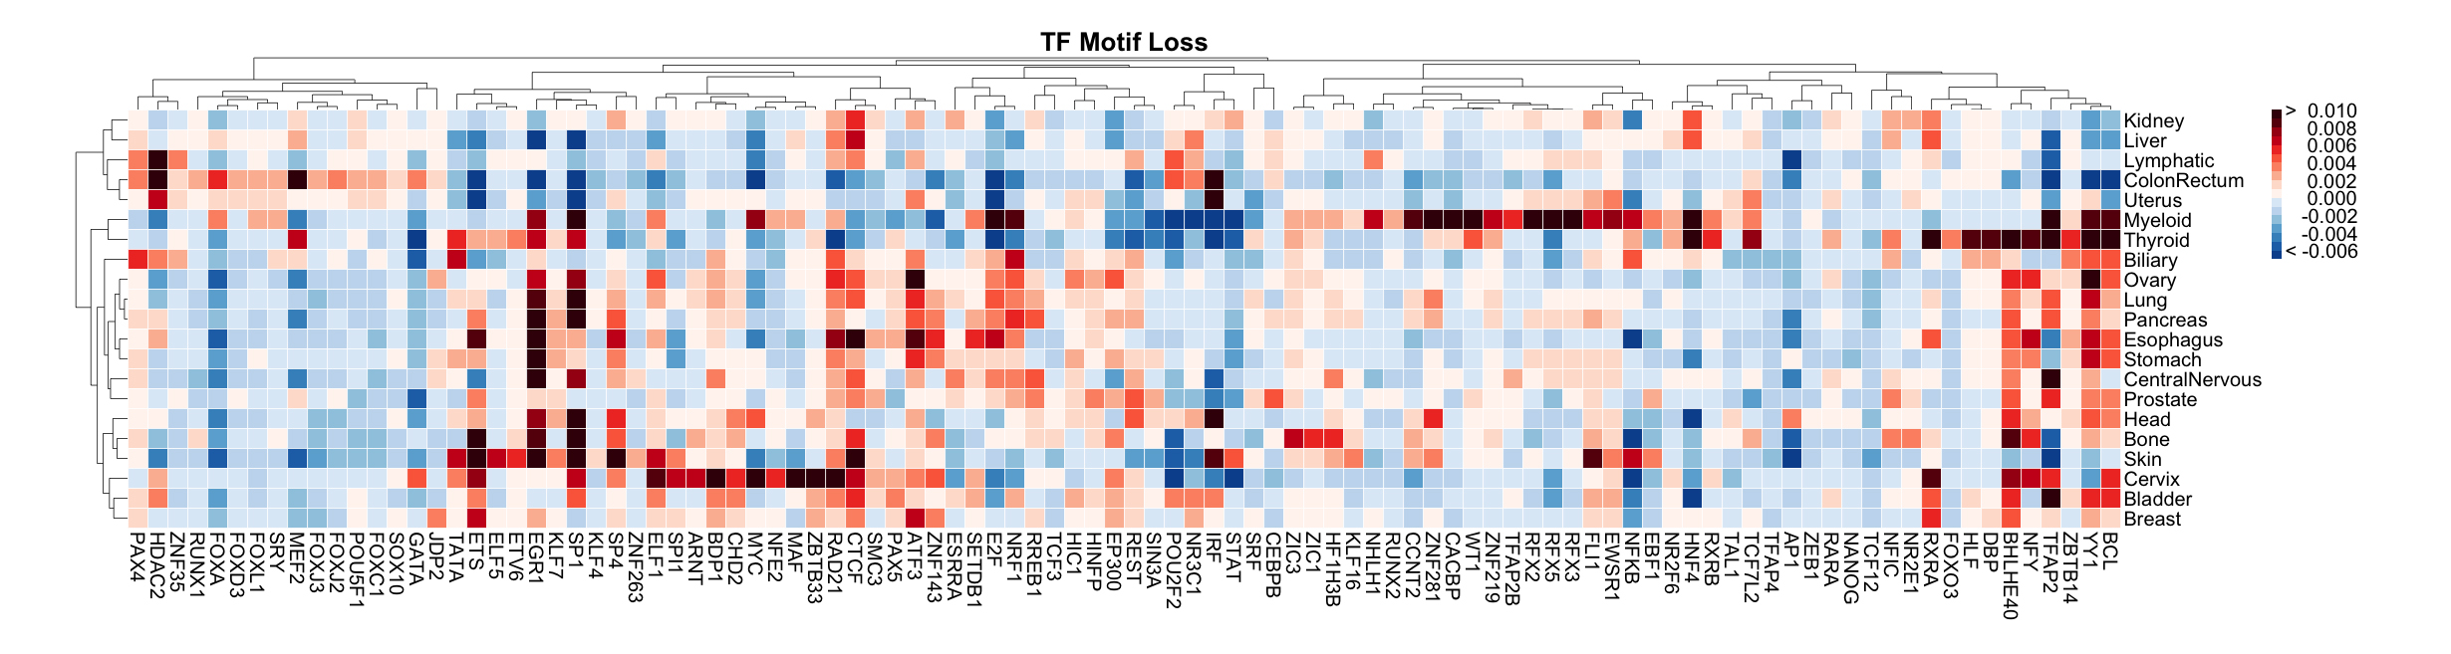
Motif Breaking events in different cancer subtypes
Alex & Ekta

Slide 8
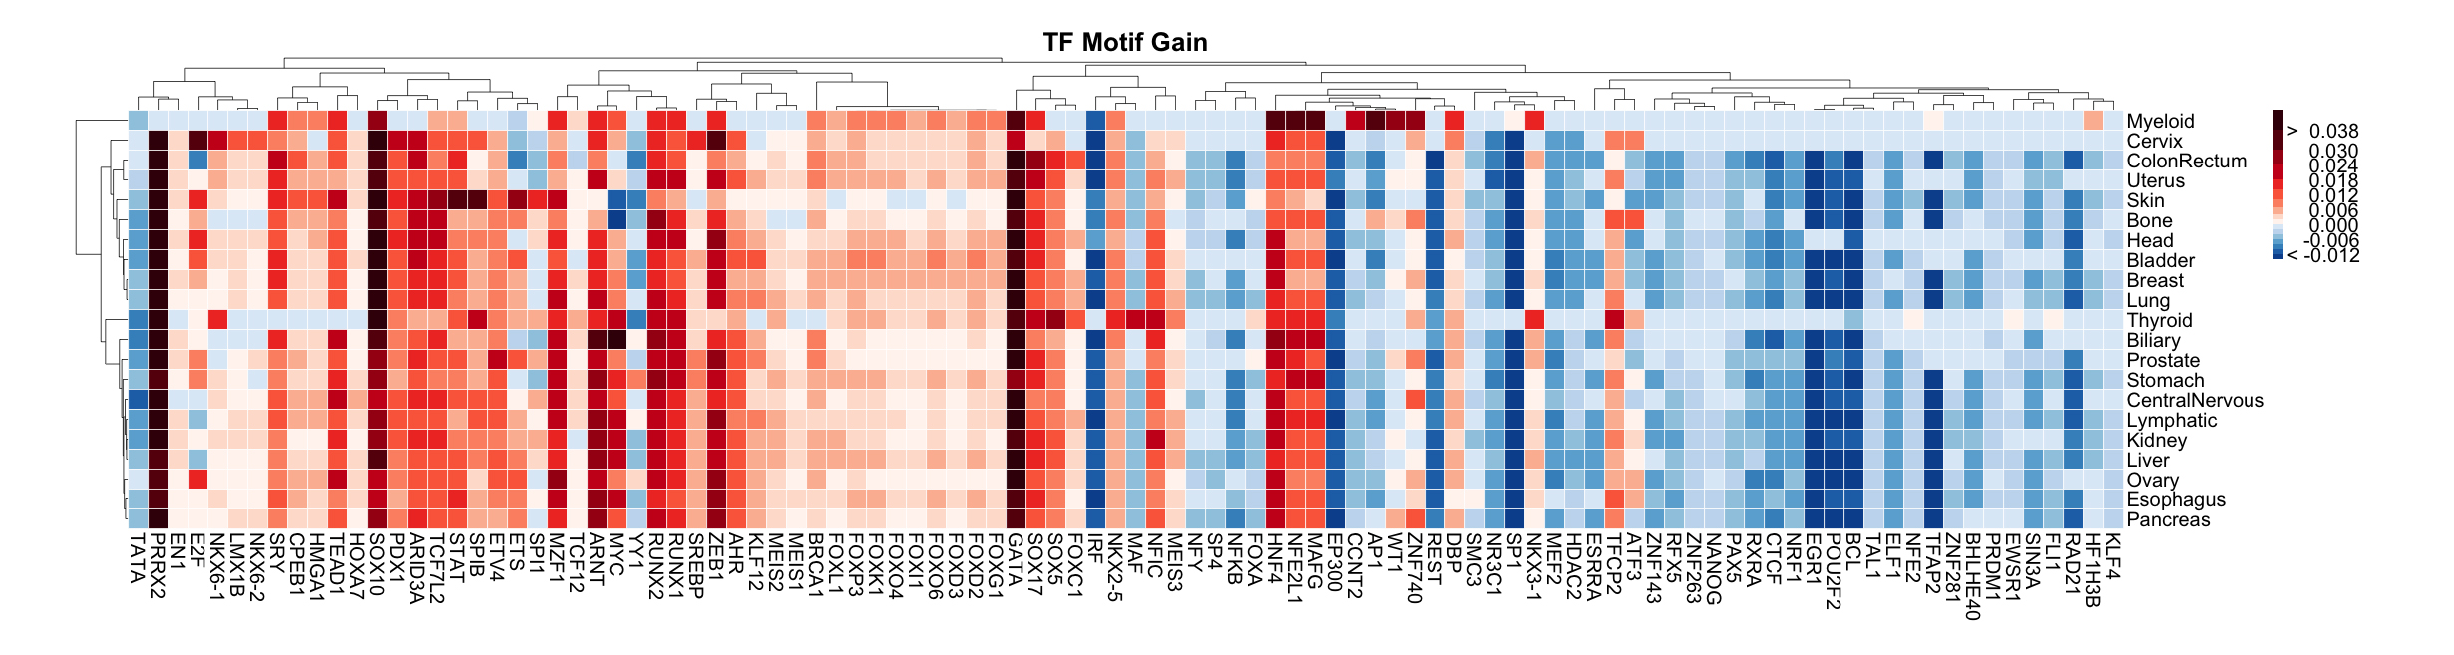
Motif Gain events in different cancer subtypes
Alex & Ekta

Slide 10
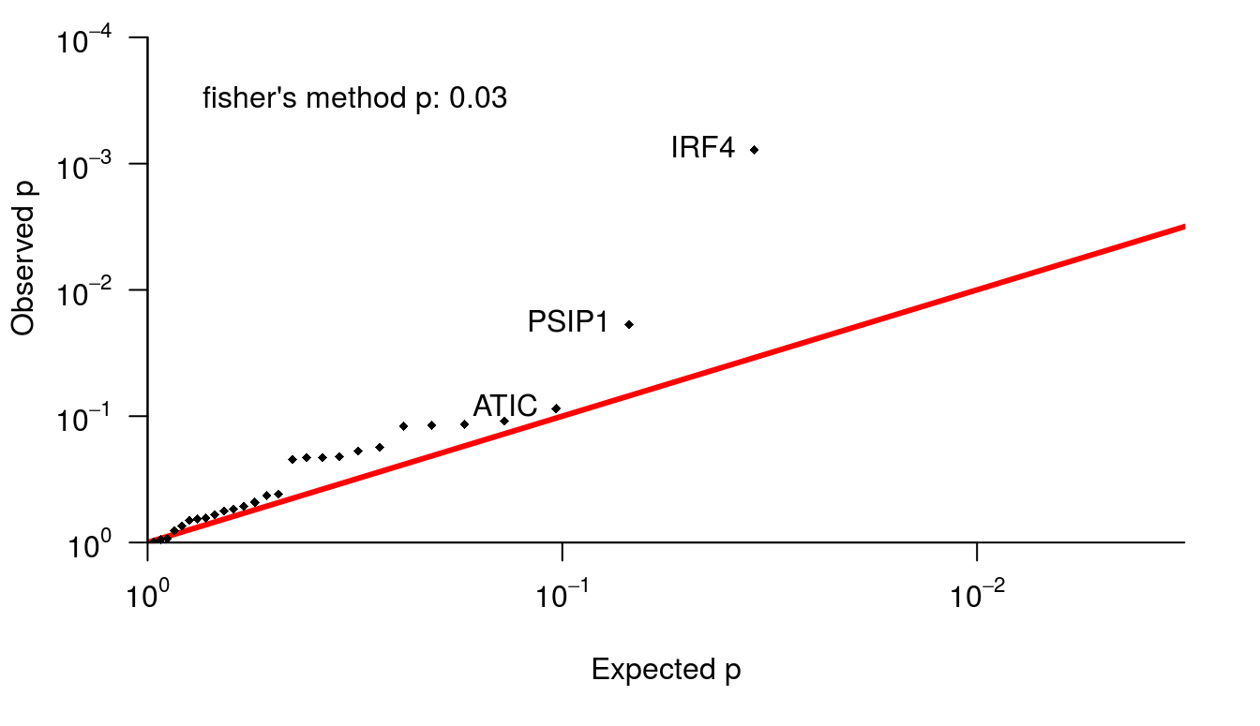
Target genes of TF undergoing alteration bias
Morten
Calvin & Carl

Slide 11
Mutation spectrum of TF breaking events

Slide 12
Noncoding impact score distribution
Original
Random sanger
Random Broad
Myeloid-AML
Prost-AdenoCA
P(Fscore)
FScore
FScore

Slide 13
Breakdown of SNVs based on impact score
Fraction of coding SNVs
Fraction of SNVs impacting TF motifs

Slide 14
Enrichment of medium impact passengers
coding
noncoding

Slide 15
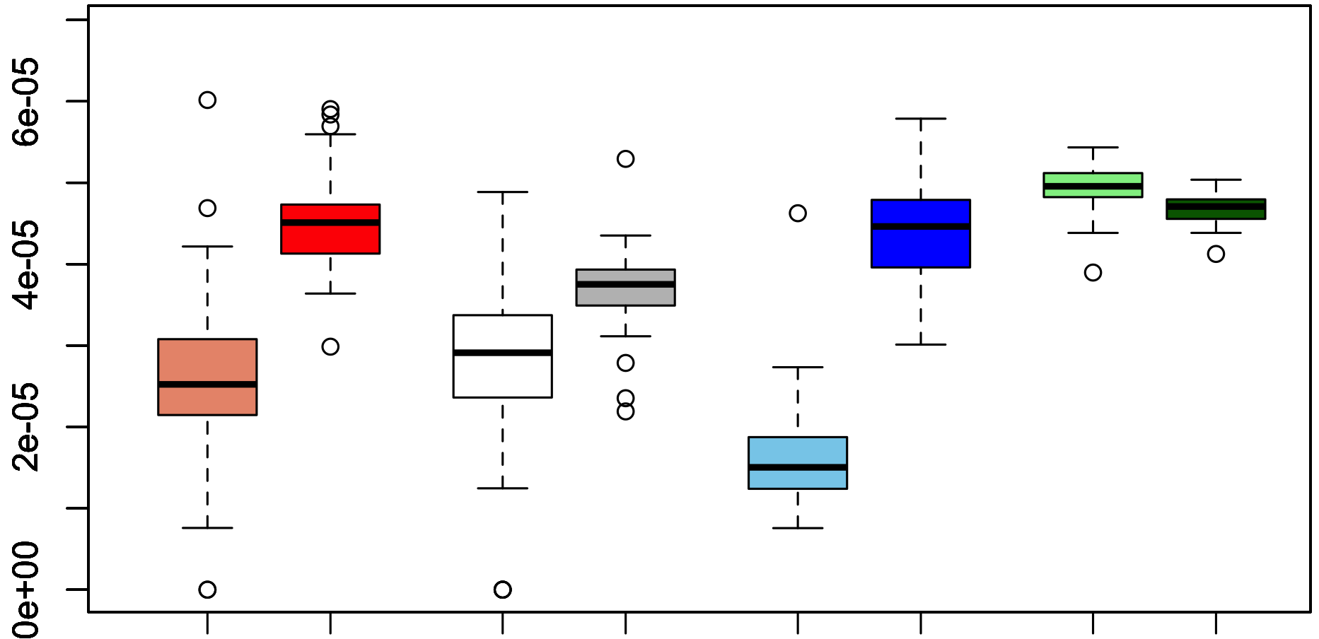
Gene categories influenced by medium impact passengers (nonsynonymous)
SNV fraction / gene (nonsynonymous)
Essential med impact
Immune med impact
Essential low impact
Metabolic low impact
Immune low impact
Metabolic med impact
Non-essential med impact
Non-essential low impact

Slide 16
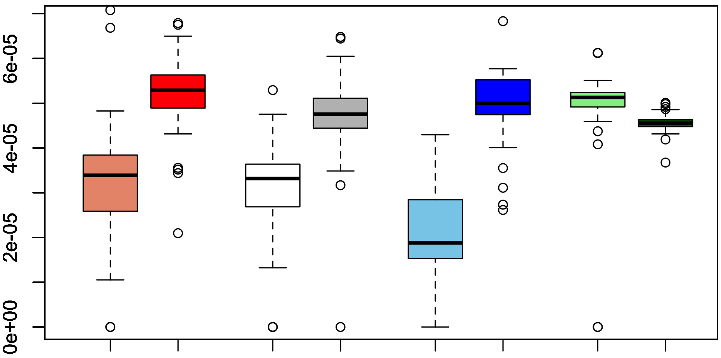
Gene categories influenced by medium impact passengers (promoters)
SNV fraction / gene
(promoter)
Essential med impact
Immune med impact
Essential low impact
Metabolic low impact
Immune low impact
Metabolic med impact
Non-essential low impact
Non-essential med impact

Slide 17
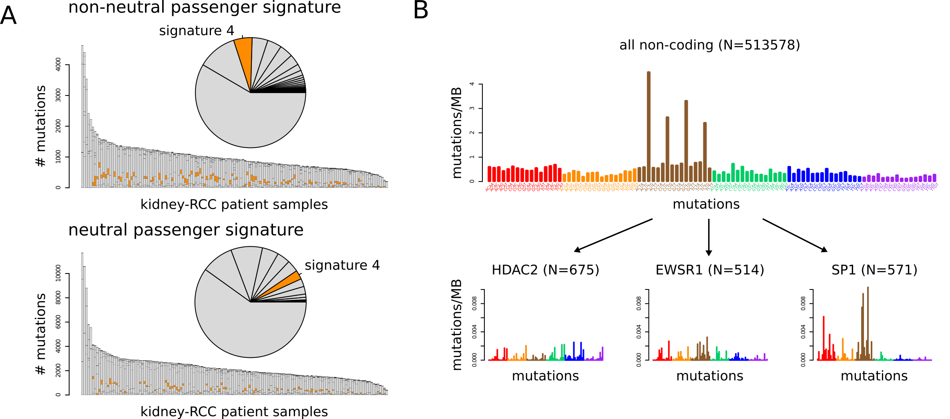
Signature composition of low and medium impact passengers
Medium impact passenger SNVs
Low impact passenger SNVs

Slide 18
Fraction of medium impact passengers among MSI & MSS samples

Slide 19
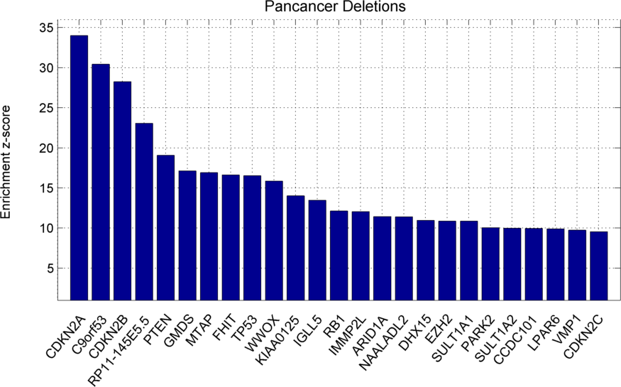
Large deletion impact score distribution across cancer types
SV impact score (deletions)

Slide 20
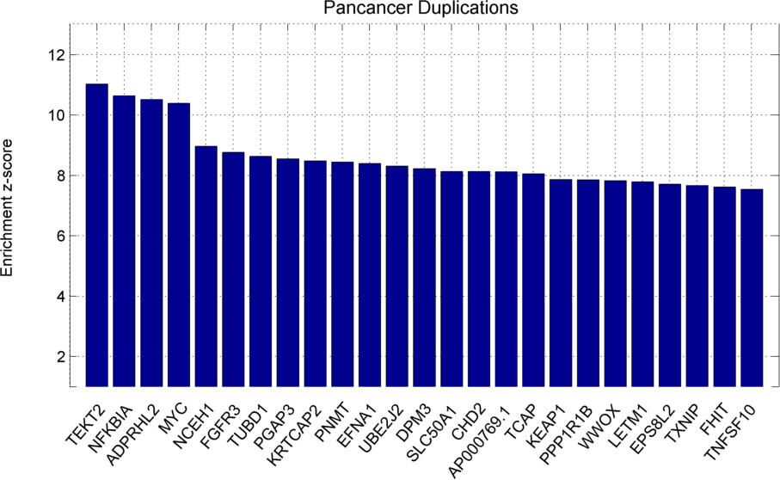
Large duplication impact score distribution across cancer types
SV impact score (duplications)

Slide 21
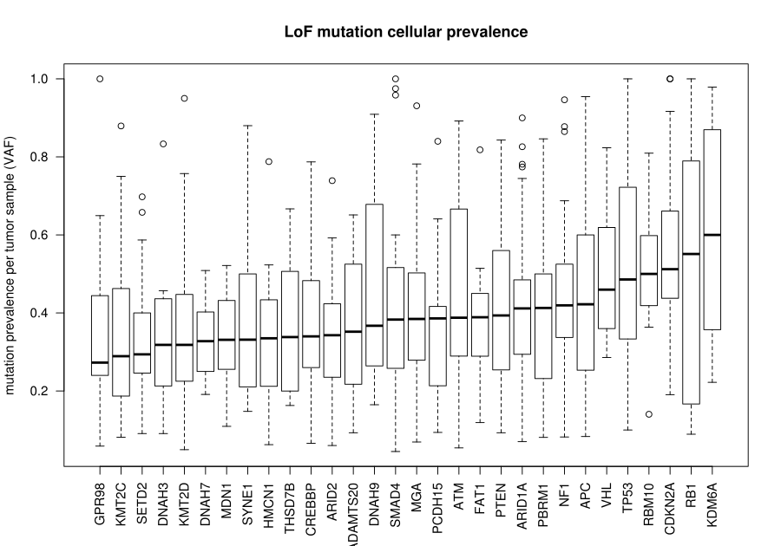

Slide 22
Subclonal ratio and impact score
Clonality ratio

Slide 23
Clonal mutation burden analysis
High Mutation rate & high heterogeneity score ( high clonal mutation burden)
Mutant-allele tumor heterogeneity score

Slide 24
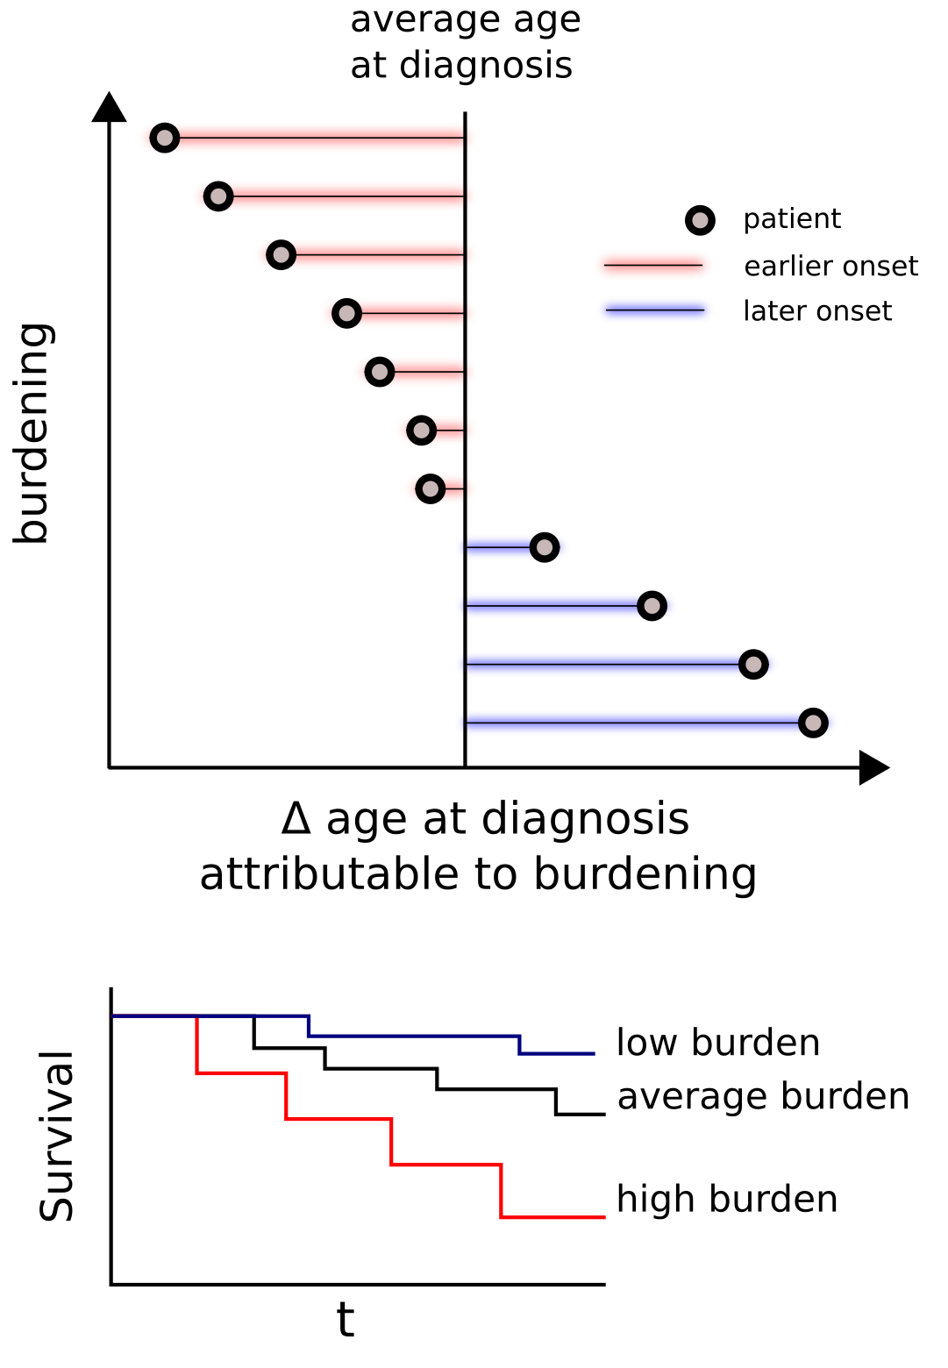
Age of cancer onset and mutation burden
Subtype | Coef | P.value
Biliary-AdenoCA | -3.397 | 0.068
Breast-AdenoCa | -2.911 | 0.020
CNS-GBM | 1.320 | 0.509
CNS-Medullo | -1.352 | 0.024
CNS-PiloAstro | -0.044 | 0.953
ColoRect-AdenoCA | -0.638 | 0.805
Eso-AdenoCa | 1.366 | 0.112
Head-SCC | -3.899 | 0.125
Kidney-ChRCC | -1.692 | 0.354
Kidney-RCC | -0.058 | 0.947
Liver-HCC | -0.146 | 0.822
Lung-AdenoCA | 1.892 | 0.263
Lung-SCC | 0.009 | 0.994
Lymph-BNHL | 0.458 | 0.807
Lymph-CLL | 1.165 | 0.244
Ovary-AdenoCA | 1.609 | 0.120
Panc-AdenoCA | -0.072 | 0.925
Panc-Endocrine | -4.260 | 0.002
Prost-AdenoCA | -0.089 | 0.877
Skin-Melanoma | -0.195 | 0.883
Stomach-AdenoCA | 0.123 | 0.958
Thy-AdenoCA | -5.580 | 0.072
Uterus-AdenoCA | 5.064 | 0.106
Linear regression predicting age in years of cancer diagnosis as a function of combined coding and noncoding germline burden. Patient race, and low-impact somatic load used as additional covariates.

Slide 25
Survivability and functional impact burden
Survival curves for Lymph-CLL and Kidney-RCC patients, stratified by Somatic Impact Burden relative to corresponding randomized sets, with 95% confidence intervals. Survival for patients in the top quartile by cancer subtype of Somatic Impact Burden is in pink, blue for the bottom quartile.

Slide 26
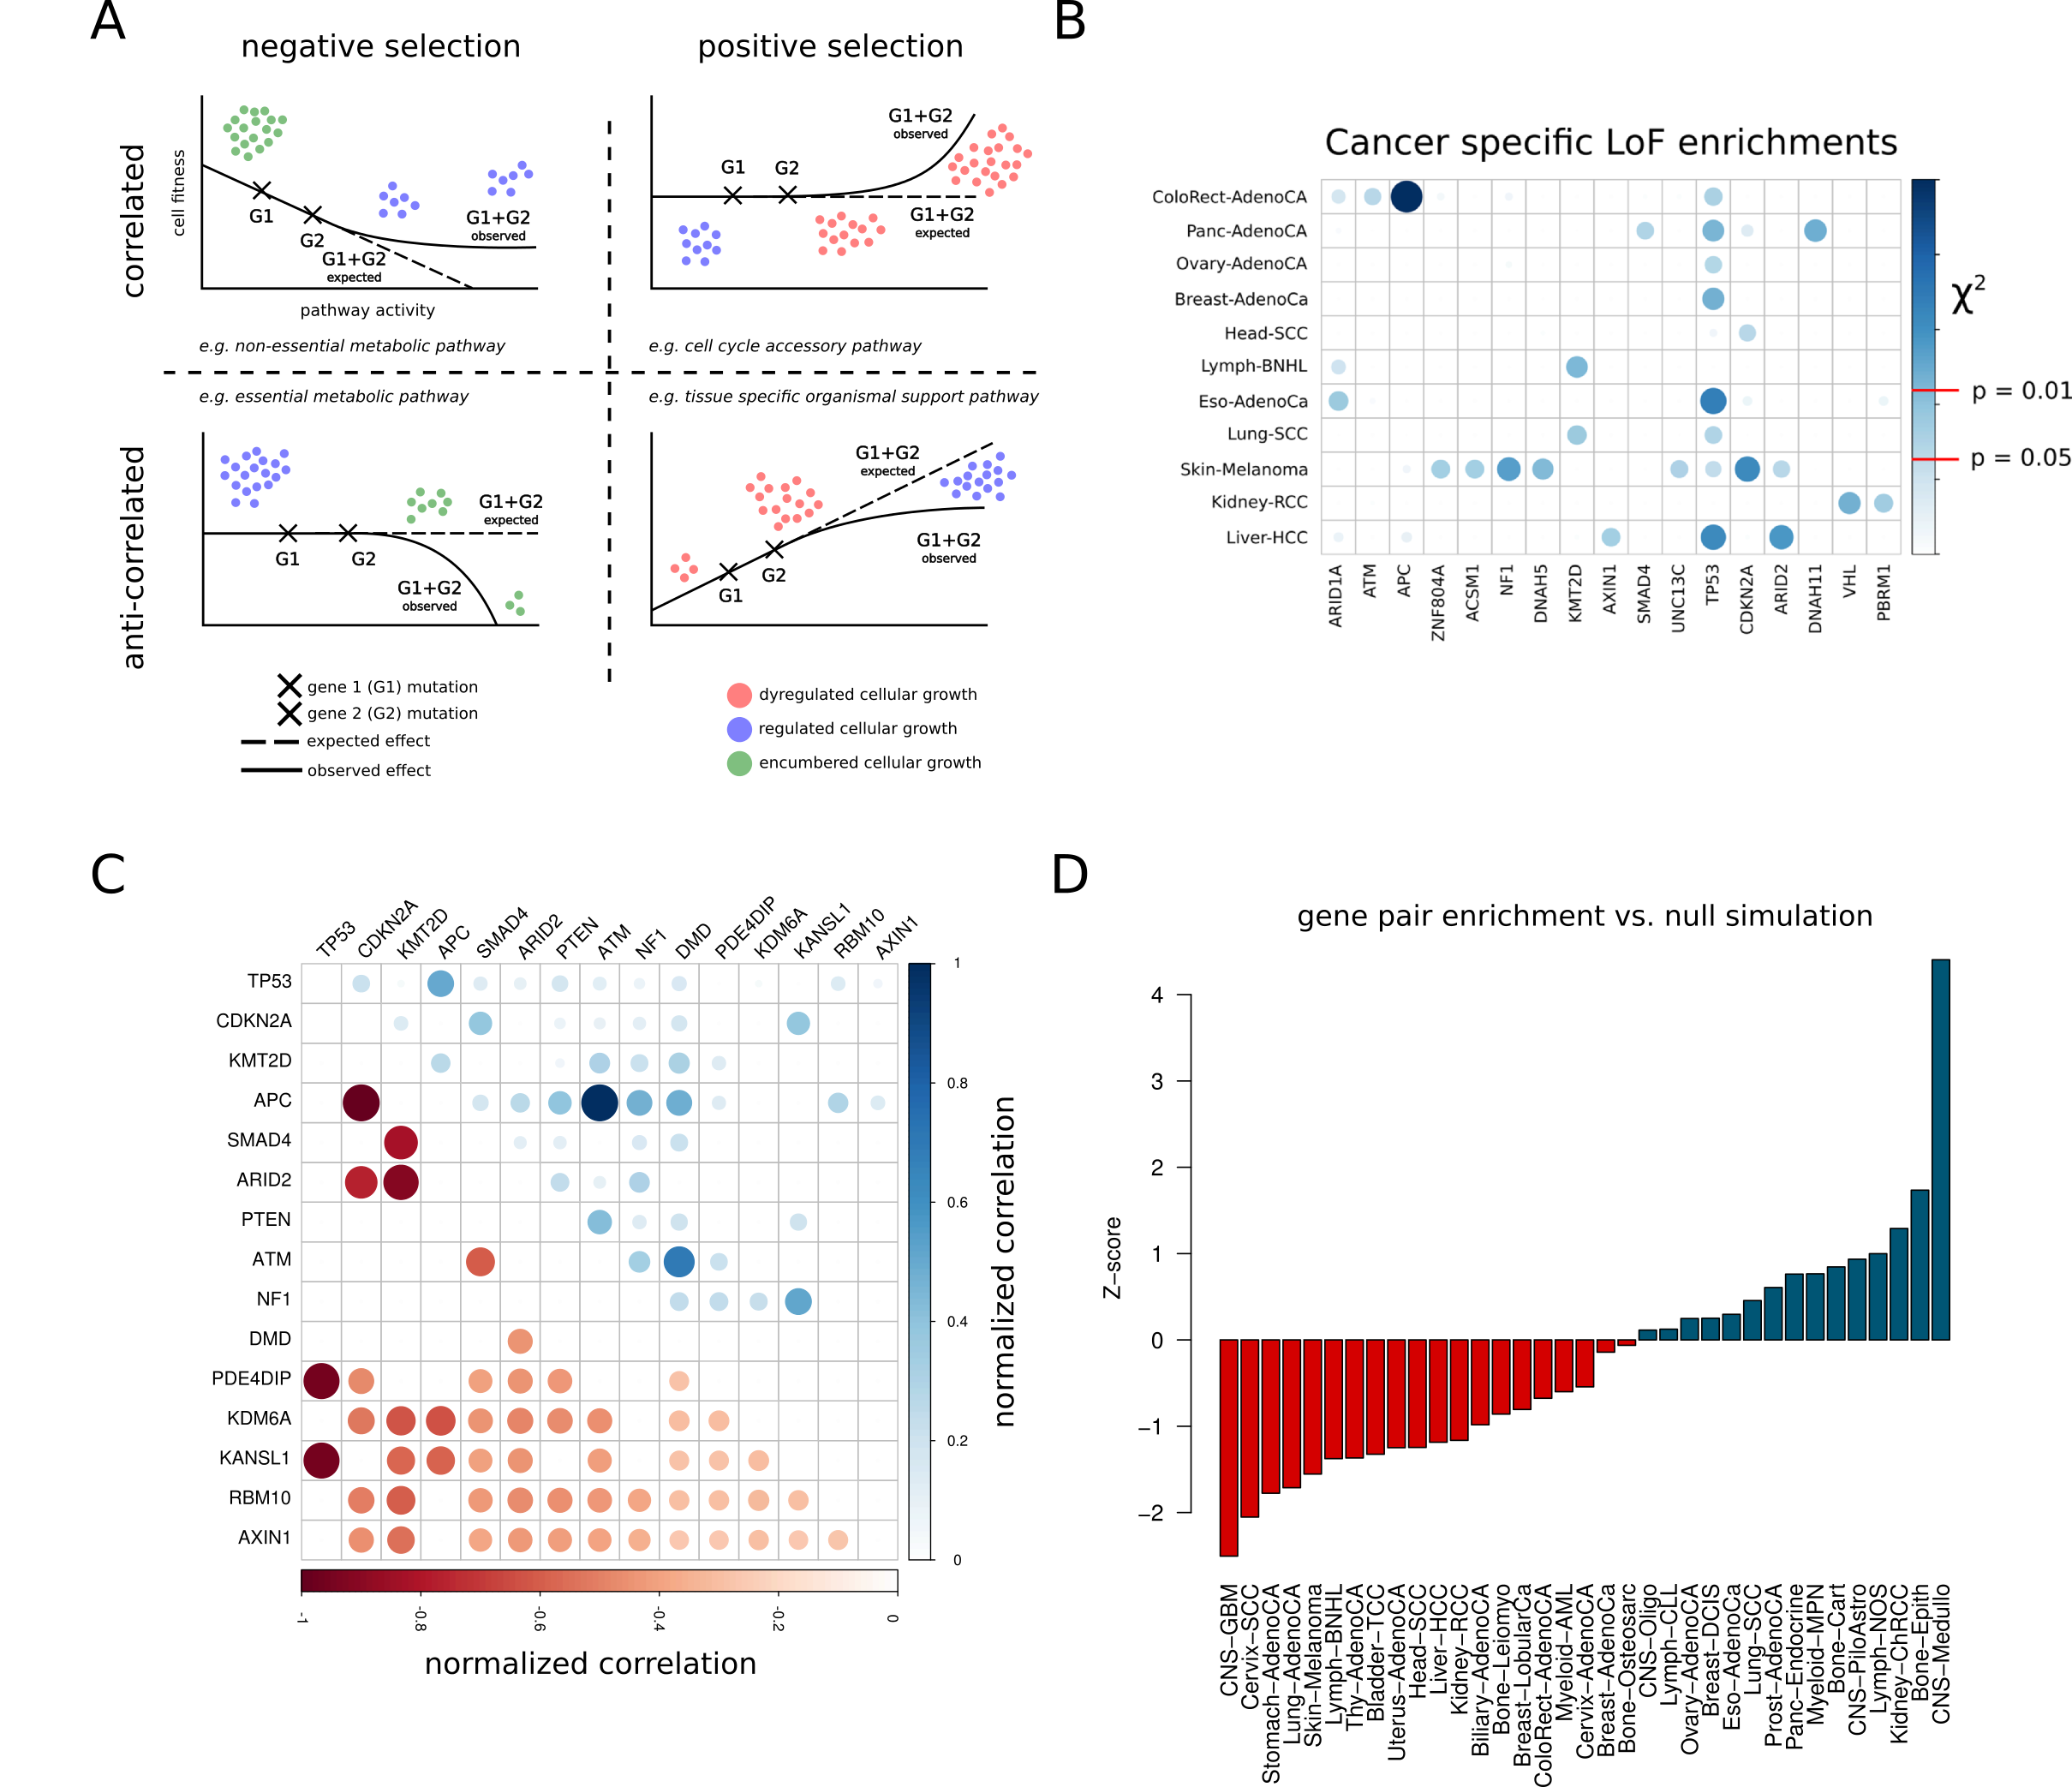
Correlation/anti-correlations among somatic SNVs

Slide 27
Correlation/anti-correlations among somatic SNVs

Slide 28
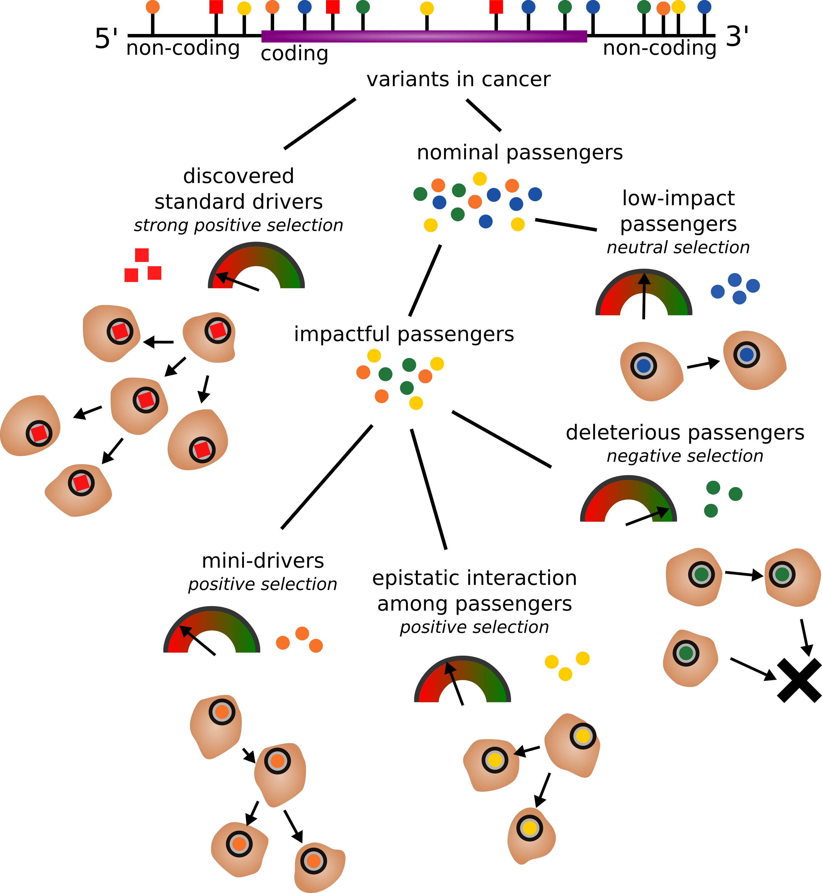

Slide 29
Ongoing work
Apply consensus mutation signature from PCAWG 7
Apply consensus subclonal assignments from PCAWG11
Downstream gene expression analysis for other TFs and their target genes
Closer inspection into suggestive evidence of weak positive/negative selection among passenger variants

