Slide 1
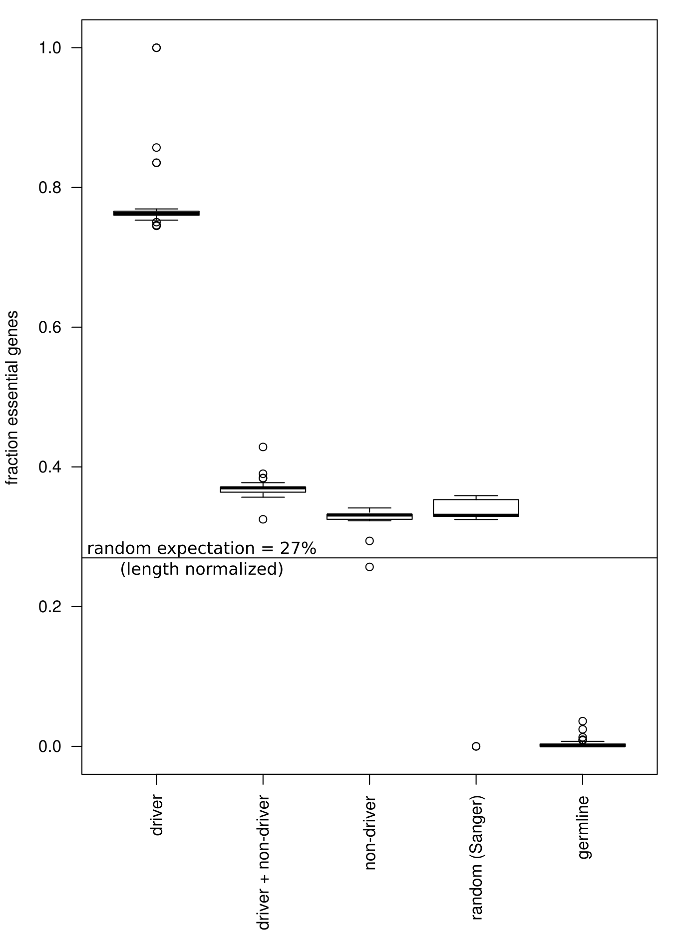

Slide 2
Random dataset LoF mutations (Sanger):
Shifted locally (N*10^2 BP?) means that a mutation in a gene, is likely reflected as a ‘random’ mutation in that same gene.
Shifted w/in trinucleotide context, means LoF mutation is likely reflected as a random LoF mutation (premature stop codon).
e.g. TAG --> TAG (perhaps in different reading frame).
Moreover, because driver mutations removed, random set may show increased LoF mutations in driver genes (e.g. synonymous/missense → LoF) compared with de-drivered somatic PCAWG…

Slide 3
