Slide 1
Pseudogenes

Slide 2
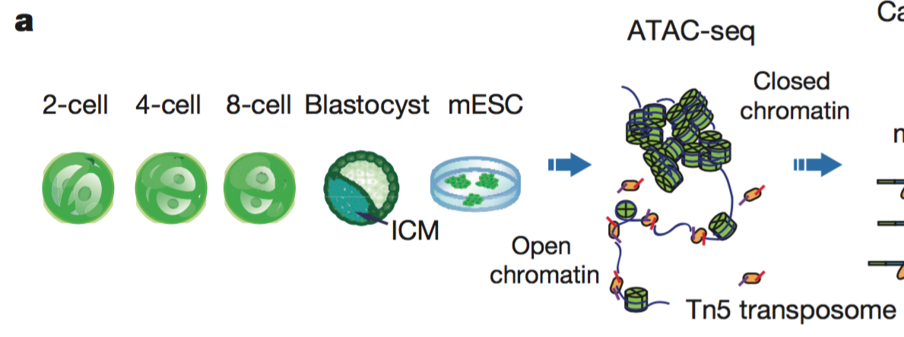
Gene expression and chromatin landscape of mouse embryos
RNA-seq and ATAC-seq experiments at different timepoints during embryogenesis.
Are parent genes differentially expressed relative to nonparents during the timepoints?
Does expression at different timepoints correlate with the number of pseudogenes?

Slide 3
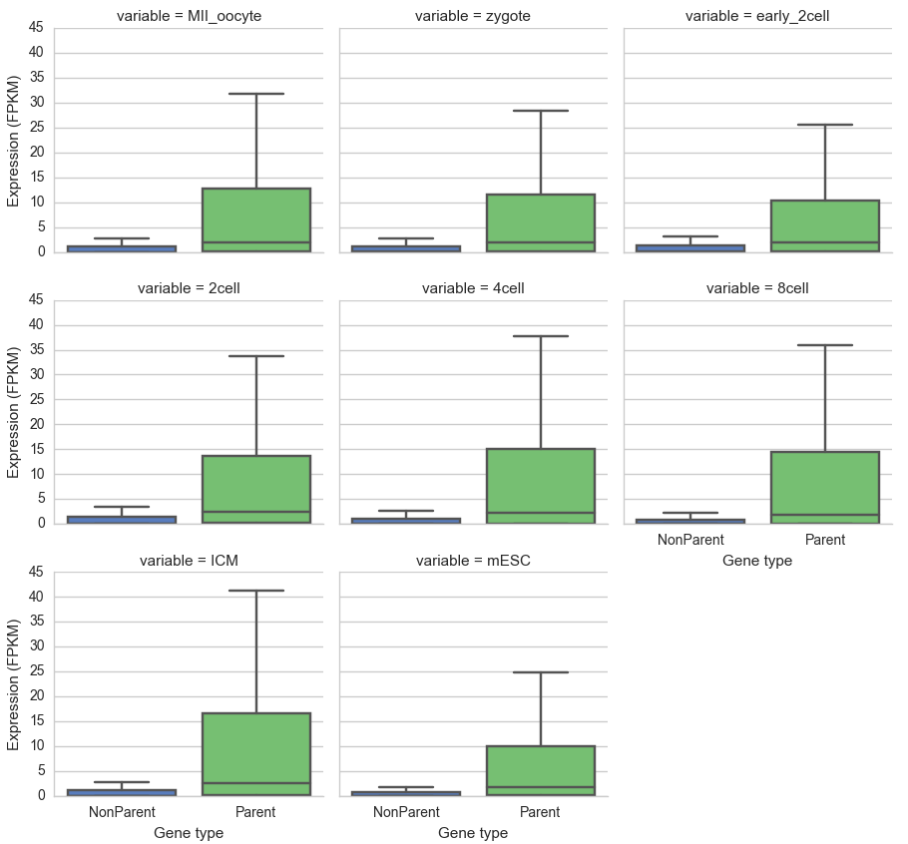
Expression of parent and nonparent genes
Expression at different timepoints during embryogenesis.
Average expression at all timepoints shows parent genes are more highly expressed.

Slide 4
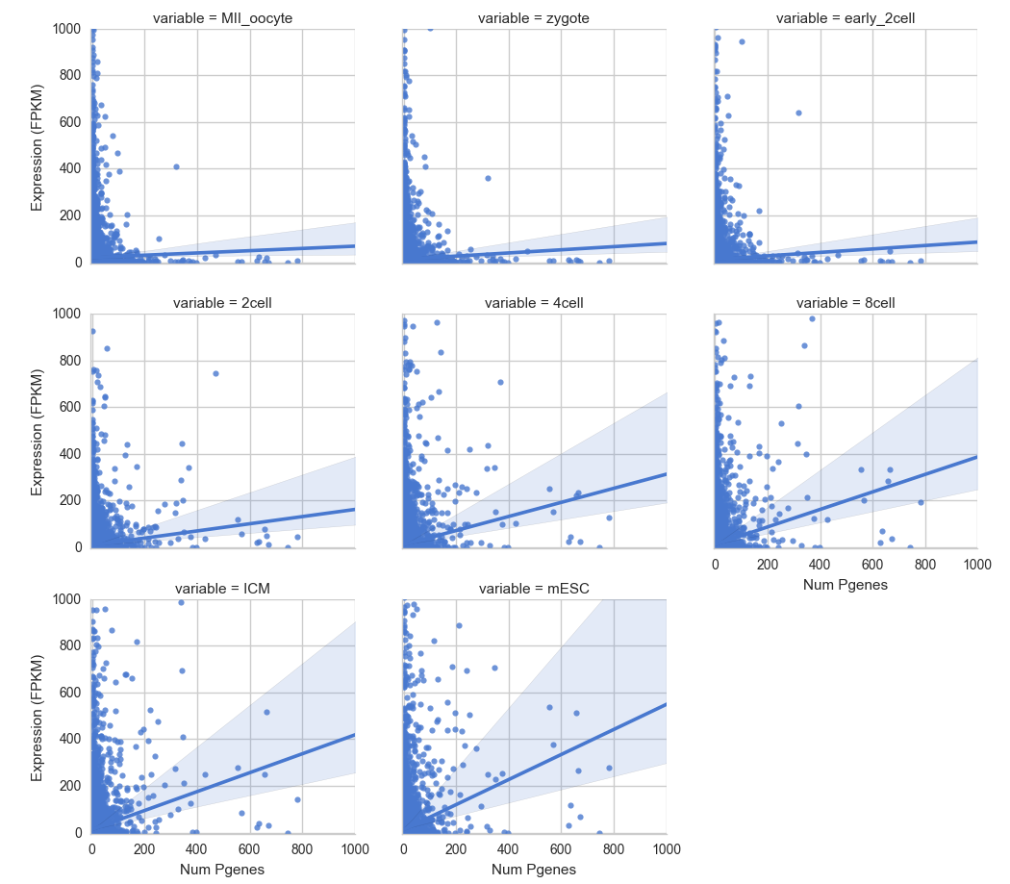
Expression vs. Pseudogenes
Expression at different timepoints during embryogenesis.
A stronger relationship between the a parent genes expression and its number of pseudogenes is observed for later timepoints.
Need to look at just processed pseudogenes.

Slide 5
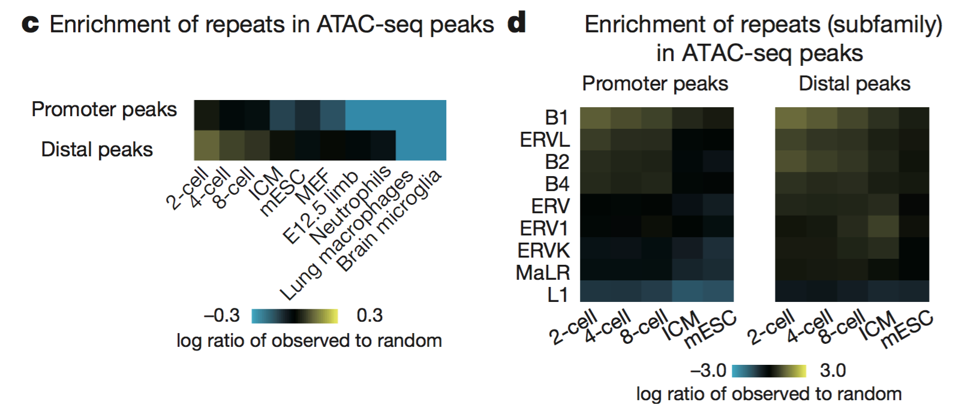
Gene expression and chromatin landscape of mouse embryos
ATAC- seq peaks showed preferential enrichment for repeats at the 2-cell stage with several subfamilies of short interspersed nuclear elements (SINEs) (B1, B2, and B4) and endogenous retroviral elements (ERVL) most enriched.
2-cell stage embryos contain the highest fraction of transcripts from repeats among all stages.
Data suggest that the accessible chromatin landscape in early embryos is extensively shaped by transposable elements.

Slide 6
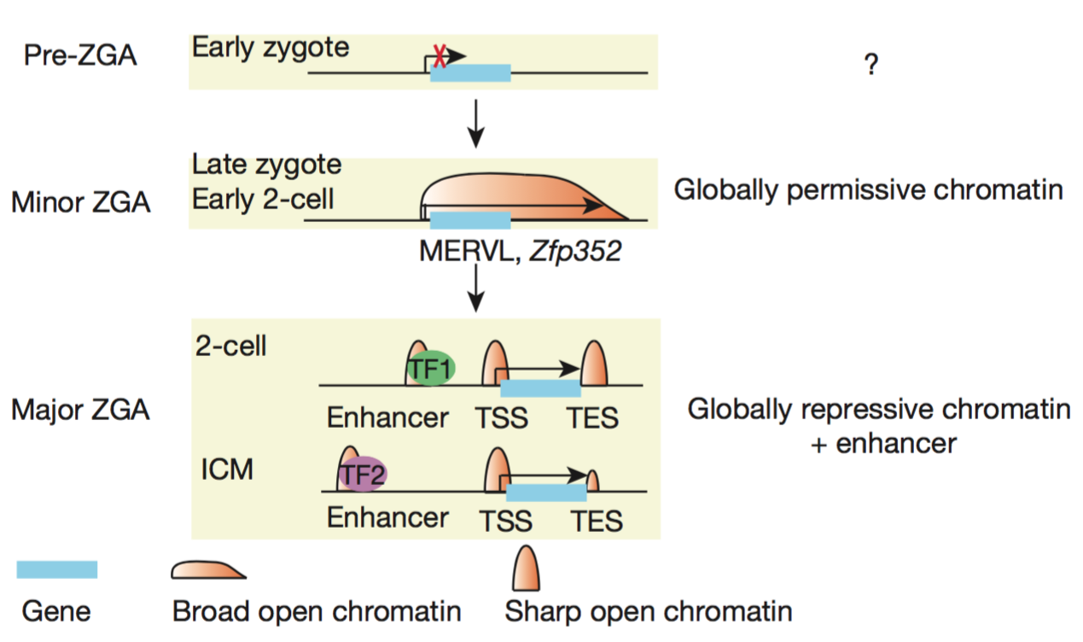
Gene expression and chromatin landscape of mouse embryos
RNA-seq and ATAC-seq experiments at different timepoints during embryogenesis.
Does the chromatin state at during embryogenesis drive pseudogene localization?
@ early 2 cell stage the open chromatin near MERVL is large in size (up to 117 kb; median length, 40 kb) and is specifically present at the 3′ down- stream of active MERVLs.
Examined early 2-cell embryos in which minor ZGA is most evident but preceding major ZGA

