Slide 1
Selection in PCAWG Passenger
Will Meyerson
Paper E

Slide 2
Table of Contents
Follow-up with weird result from last week about double LOFs
More with VAF-GERP

Slide 3
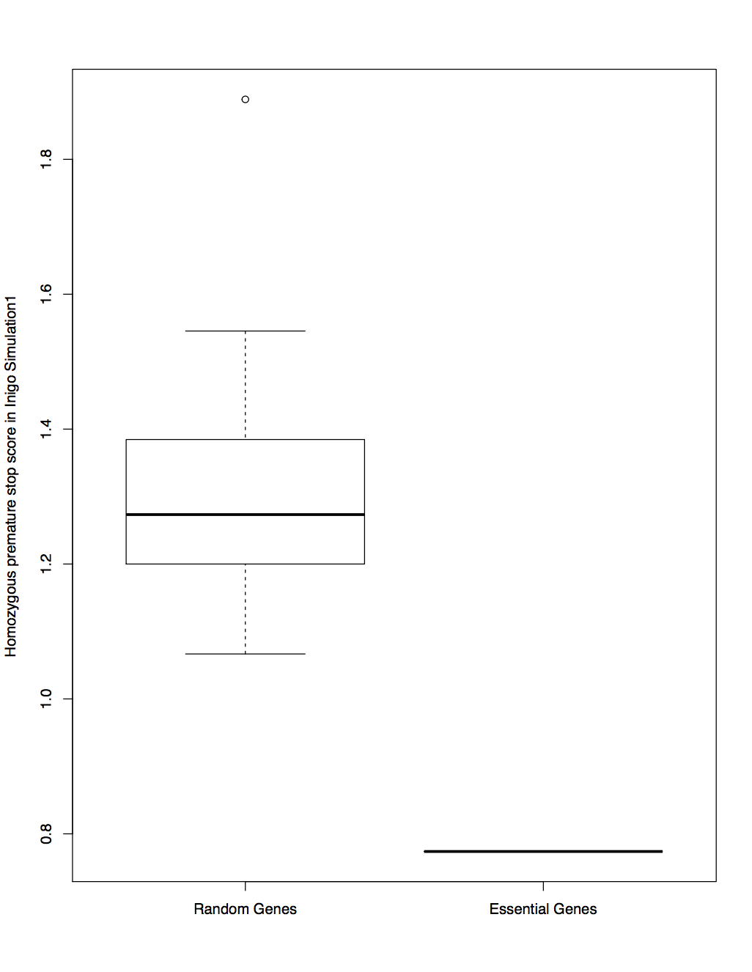
Remember that weirdness from last time

Slide 4
Here is the explanation
I think I discovered that essential genes are less vulnerable to mutation
This makes good evolutionary sense – we don’t want our essential genes messed with
Wonder what the mechanism is (shorter genes?, earlier replication timing? …)
Not necessarily a finding that belongs in Paper E - maybe I can do a personal side-project later

Slide 5
Sought deletions from SVs to give me more power
13,238 premature stop codons in PCAWG included samples
30,150 gene-patients affected by deletions

Slide 6
At first pass, there look like there are fewer double LOF events then expected
Table of observed duplicated LOF events
0 1 2 3 4 7 8 10
11649 136 14 2 1 1 1 1
Table of permuted duplicated LOF events
0 1 2 3 4 5 6 9 11 12 15 19 23 32 36 42
11593 158 22 7 7 5 1 3 1 2 1 1 1 1 1 1

Slide 7
Look at top under-double-loffed genes (p<= 1/10,000)
More in depth analysis suggests my null expectations aren’t realistic though
GENE | #dup | #lof | comment
CCSER1 | 0 | 156
DMD | 1 | 180
FHIT | 0 | 253 | nhibits MDM2-mediated proteasomal degradation of p53/TP53.
IMMP2L | 0 | 163
LRP1B | 0 | 216
LSAMP | 0 | 163 | neuronal ..., may have TSG activity
MACROD2 | 0 | 305
NAALADL2 | 0 | 141
WWOX | 1 | 256 | pcawg driver, TSG
PARK2 | 0 | 150 | ubiquitin ligase invovled in p53 pathway "may represent a tsg"
PDE4D | 1 | 150
# median rank is 15269, 16th percentile of essentiality, this is wrong# my expectations overestimate the number of expected duplications for# highly loffed genes# honorable mention: TP53, p.value 0.0028

Slide 8
High-impact variants in driver genes achieve higher VAF, suggesting positive selection.
High-impact variants in passenger genes achieve lower VAF, suggesting negative selection.
 | Signal for negatively correlated gene-wise VAF and GERP | Signal for positively correlated gene-wise VAF and GERP
PCAWG driver genes | 0.84 | 7.2e-10
PCAWG passenger genes | 2.34e-11 | 0.19

Slide 9
Here are the BH-significantly VAF-Gerp correlated genes:
Positive VAF-GERP
Negative VAF-GERP
ASAH2B
ASB11
AZI1
C17orf80
C3AR1
C3orf18
CAPZA2
CSMD3
EIF3J
EPOR
FAM209A
GAB1
GPM6A
HPCAL1
IGF2R
MMP14
NEIL3
NUP133
OAS3
POU5F1
PSTK
PTPRM
RBM14
RNLS
RPL36A
S100A7
SPATA32
SSBP2
STRBP
WHAMM
XKR9
ABCA4
ADAL
ANAPC4
CCDC37
CD9
CDKN1B
CSF2RB
CTNNB1
CTSV
DRG2
EGFL7
FRY
KRAS
MAT2B
MMP2
NDUFAF3
PEBP4
PYCR1
RCC2
SBK1
SHISA2
SRSF7
ZFYVE21
ZNF267
ZNF493
Encouraging that some oncogenes and cell cycle genes are included
Believable that ribosomal proteins need to be maintained

