Slide 1
Case studies in comparative cancer genomics

Slide 2
Cancer afflicts all multicellular organisms … to varying extents
Domazet-Lošo, T. et al. Naturally occurring tumours in the basal metazoan Hydra. Nat. Commun. 5:4222 doi: 10.1038/ncomms5222 (2014).
Doonan, J. and Sablowski, R. Walls around tumours – why plants do not develop cancer. Nat. Reviews Cancer. 10:794-802 doi:10.1038/nrc2942 (2010).
Image from http://hikersnotebook.net/Burls

Slide 3
Genomic analyses in other organisms offer extreme examples to reason from

Slide 4
Dogs
Elephants
Veterinary health expenditures

Slide 6
Cancer’s evolution is cut short
Typically, a cancer dies with its host
We might wonder: what would happen to a tumor if it had time to keep evolving?
This could exaggerate trends that would make their early signs on human-relevant time-scales more obvious in retrospect
With the advent of modern cell culture, we’ve been able to observe cancer progress for longer, but our observations here have two important limitations:
Cell culture does not recapitulate the immune, nutrient, spatial, and metastatic complexity of living hosts
Cell culture has existed thus far on a time-scale of decades, which is not dramatically longer than tumors in living hosts

Slide 7
Canine transmissible venereal tumor (CTVT) is the oldest tumor in the world
Canine transmissible venereal tumor (CTVT) is a tumor whose cells are passed from dog to dog during mating, allowing it to survive the death of its host
Normally, host immune systems prevent cancerous cells from one organism from growing in another, but CTVT has powerful immune-evasion mechanisms
CTVT has endured in this way for millennia and spread to every inhabited continent

Slide 8
Analyzed the genomes of CTVT specimens from two dogs, continents apart
Two primary analysis dogs: an Australian Aboriginal camp dog and and American cocker spaniel in Brazil
WGS @ 60 - 100X, 100 bp paired ends reads from tumor + normal (liver)

Slide 9
Results
CTVT harbors nearly 2 million SNVs (~95% shared between two dogs continents apart)
100-1000X as many SNVs in typical tumor, 10X as much as most-mutant PCAWG lung cancer, but actually less than the most mutant PCAWG colon cancer (2.4M)
> 2000 candidate SVs (~~90% shared), yet mostly diploid
No evidence for subclones
Any present variants under positive selection in CTVT have completed their selective sweep
“This suggests that CTVT is not undergoing positive selection at high frequency, possibly indicating that it is well adapted to its niche”
Largest mutational signature is UV signature (42%)
It is the cancer cells on the surface that are most easily transmitted between dogs
(Only) four identified driver mutations (SETD2, CDKN2A, MYC, ERG)
Surely there are more, but we presumably know little about dog cancer drivers
646 genes completely knocked out by homozygous deletion or LOF + deletion
Apparently these genes are truly non-essential for cellular survival
Founder dog lived 11,000 years ago
Last common ancestor of a CTVT sample from Brazil and a sample from Australia was about 460 years ago
Dates back to age of exploration
High rate of inbreeding among founder-dog’s ancestors
Tasmanian devils live on an island and are only other example of transmissible tumor. Low genetic diversity may make it easier for tumor transmission

Slide 10
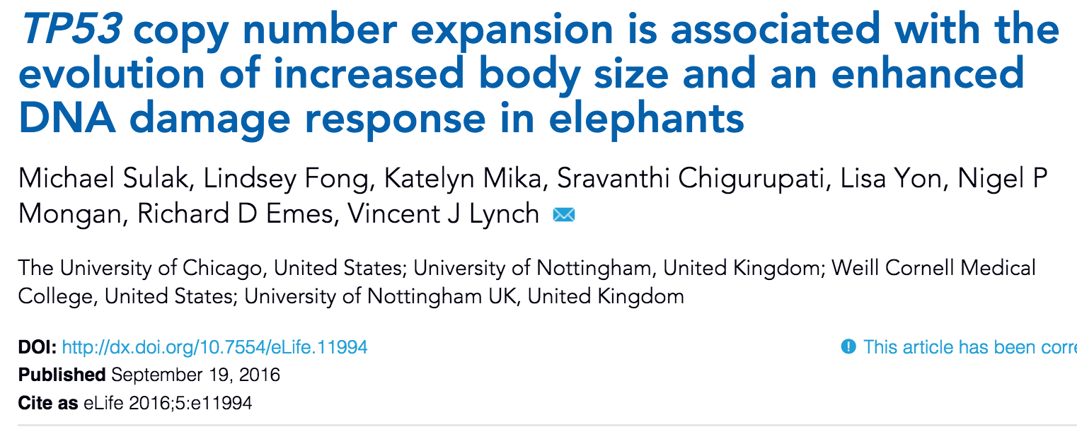

Slide 11
Some animals are really big

Slide 12
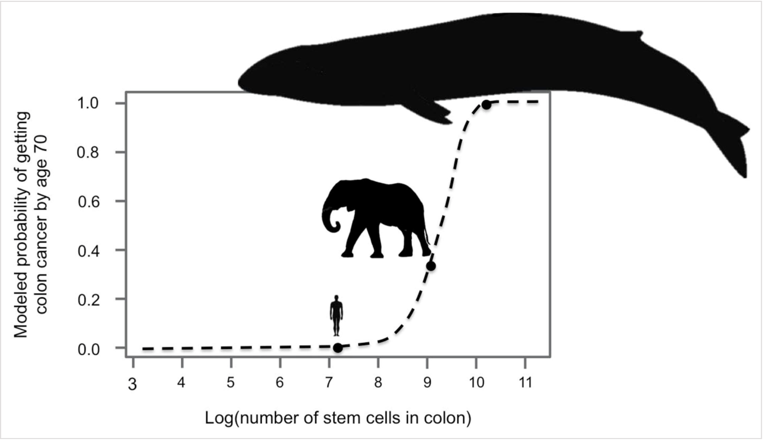
We would expect big animals to get cancer much earlier, but they don’t (Peto’s paradox)
Figure credit: Gaugrhan S. et al., Evolutionary biology: How elephants beat cancer. eLife 2016;5:e21864.

Slide 13
They followed up with hints that elephants have more copies of TP53 “The Guardian of the Genome”
Used BLAT on Human TP53 sequence against 61 mammal genomes and extinct American mastodon, woolly mammoth, and Columbian mammothgenome to find canonical TP53 in each species
From CDS of the canonical TP53 in each elephant, used BLAT on the rest of that elephant’s genome to find TP53 orthologues

Slide 14
Elephants have many more copies of “The Guardian of the Genome” (TP53) than do their relatives

Slide 15
Throughout history, elephant size has increased in tandem with TP53 copy number

Slide 16
At least some of these extra TP53 copies are transcribed in some profiled cell types
A lot less impressive when you see how few isoforms are actually transcribed
Maybe there are yet-unprofiled tissues that express other isoforms?

Slide 17
Elephant cells undergo apoptosis more easily than do the cells of related species

Slide 18
The TP53RTG repertoire expanded through repeated segmental duplications
TP53RTG copy number expansion is correlated with proboscidean body size
TP53RTG12 is transcribed from a transposable element derived promoter
Elephant cells likely express TP53RTG proteins and numerous isoforms of TP53
Elephant cells have an enhanced TP53-dependent DNA-damage response
TP53RTG genes are required for enhanced TP53 signaling and DNA-damage responses
TP53RTG12 enhances TP53 signaling and DNA-damage responses via a transdominant mechanism
What do extra TP53 genes cost?

Slide 19
I would have liked to see more controls
What if elephants just have more copy number of genes generally?

Slide 20
We used BLAT to search for TP53 genes in 61 Sarcopterygian genomes using the human TP53 protein sequences as an initial query. After identifying the canonical TP53 gene from each species, we used the nucleotide sequences corresponding to this TP53 CDS as the query sequence for additional BLAT searches within that species genome. To further confirm the orthology of each TP53 gene we used a reciprocal best BLAT approach, sequentially using the putative CDS of each TP53 gene as a query against the human genome; in each case the query gene was identified as TP53. Finally, we used the putative amino acid sequence of the TP53 protein as a query sequence in a BLAT search.
We used previously published whole genome shotgun sequencing data generated on a Roche 454 Genome Sequencer (GS FLX) to estimate the TP53 copy number in a 50,000–130,000 year old American mastodon (Mammut americanum){'Langmead'}

Slide 21
A major constraint on the evolution of large body sizes in animals is an increased risk of developing cancer. There is no correlation, however, between body size and cancer risk. This lack of correlation is often referred to as 'Peto's Paradox'. Here, we show that the elephant genome encodes 20 copies of the tumor suppressor gene TP53 and that the increase in TP53 copy number occurred coincident with the evolution of large body sizes, the evolution of extreme sensitivity to genotoxic stress, and a hyperactive TP53 signaling pathway in the elephant (Proboscidean) lineage. Furthermore, we show that several of the TP53 retrogenes (TP53RTGs) are transcribed and likely translated. While TP53RTGs do not appear to directly function as transcription factors, they do contribute to the enhanced sensitivity of elephant cells to DNA damage and the induction of apoptosis by regulating activity of the TP53 signaling pathway. These results suggest that an increase in the copy number of TP53 may have played a direct role in the evolution of very large body sizes and the resolution of Peto's paradox in Proboscideans.
African elephants – the largest living land mammal – had more retrogenes than any of the others with 19 in total. To investigate why African elephants have so many TP53 retrogenes, Sulak et al. also analyzed DNA from Asian elephants and several other closely related, but now extinct species, including the woolly mammoth. As expected, as species evolved larger body sizes they also evolved more TP53 retrogenes.

Slide 22
Among developed countries, the US is an outlier in terms of spending more on health care for smaller life expectancy gains

Slide 23
Why does US health care cost so much?
US malpractice law incentivizing defensive medicine?
De-coupling of cost Insurance?
Regulations?
…

