Slide 1
NCVARG Meeting
2/20/17
Kellie Cotter
Rubin Lab

Slide 2
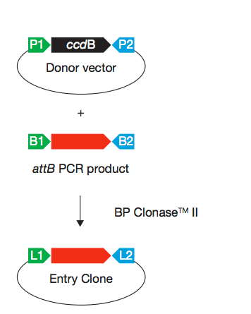
Gateway Cloning System
Generation of “entry clone” using PCR product and a “donor vector” with BP Clonase enzyme
Add attB sites onto region of interest via PCR primers
Donor vector = pDONR (purchased from Invitrogen)

Slide 3
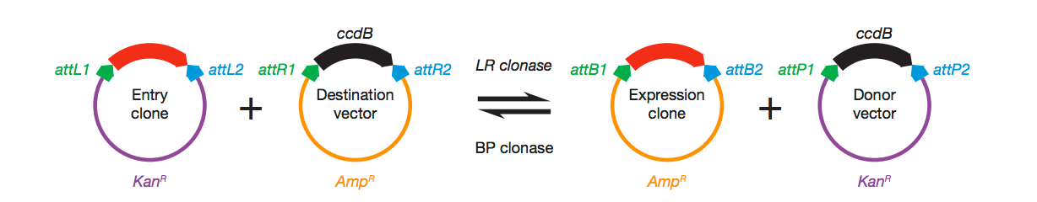
Gateway Cloning System
“Flip” PCR product of interest from entry clone into destination vector using LR clonase enzyme
Destination vector = pDEST-hSTARR-luc

Slide 4
WT Candidate High-Throughput Workflow
Design PCR primers to amplify the candidate region of interest include attB sites for cloining
Primers ordered in 96 well plates. PCR with SuperFi Polymerase.
Check successful amplification and product size on gel, and clean up PCR product with Ampure beads
Generate entry vectors with BP Clonase, then transform into bacteria (96-well format).
Plate bacteria and pick 4 colonies for each candidate.
Make 4 pools to be miniprepped separately, then sequence on MiSeq
Determine best clone for sequencing, flip into destination vector with LR clonase and miniprep.
Transfect into K562 cells and test luficerase activity

Slide 5
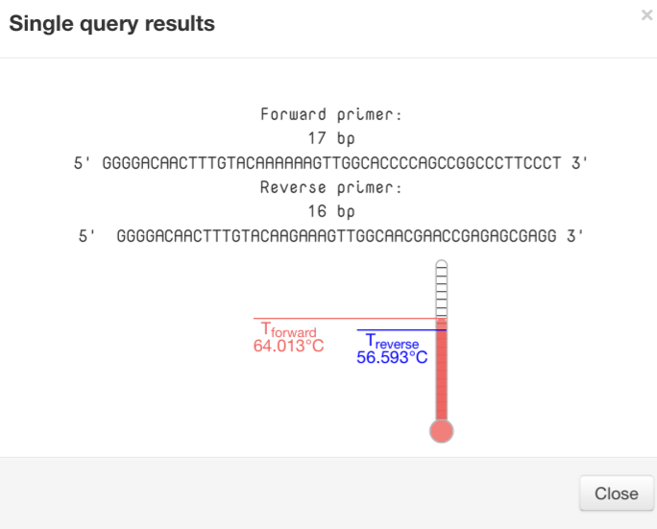
Step 1- Primer Design
Selected the first 20 variants to use to design primers.
6 could not find primers with PrimerDIY
2 had very discordant melting temperatures between F and R primers
Ordered 12 primer sets

Slide 6
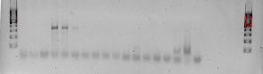
Step 2- PCR
Using Invitrogen SuperFi polymerase
High G/C content- some of the regions have <70% G/C
Use G/C enhancer in PCR reactions where % > 60
Two primer sets got no amplification even when using a gradient of annealing temperatures
10 moved on for cloning
15
10
400
300
200
100
56 °C
70 °C
56 °C
70 °C

Slide 7
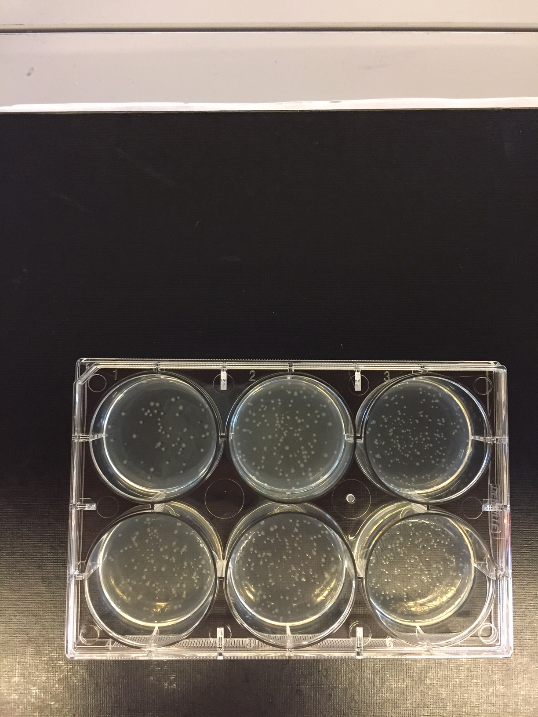
Step 3- Cloning into pDEST hSTARR luc
Clean up PCR products using Ampure beads
Generate entry vectors with BP clonase, transform and plate in 6-well plates
Pick colonies, miniprep and sequence
Generate destination vectors with LR clonase, transform and plate in 6-well plates
Pick colonies, miniprep and sequence

Slide 8
Step 4- Transfect into K562 cells
K562 seem to have lower transfection efficiencies
Need to use >200 ng per well (500 ng per transfection) to get good luciferase readings above background in 2 ul, 250 ng/ul, commonly get 50-100 ng/ul from miniprep

Slide 9
Step 4- Transfect into K562 cells

Slide 10
Moving Forward
PCR will be the rate limiting step, getting good primers and good amplification
Further, maximizing output from minipreps in order to get concentrated plasmid will require some optimization for 96-well plate format

