Slide 1
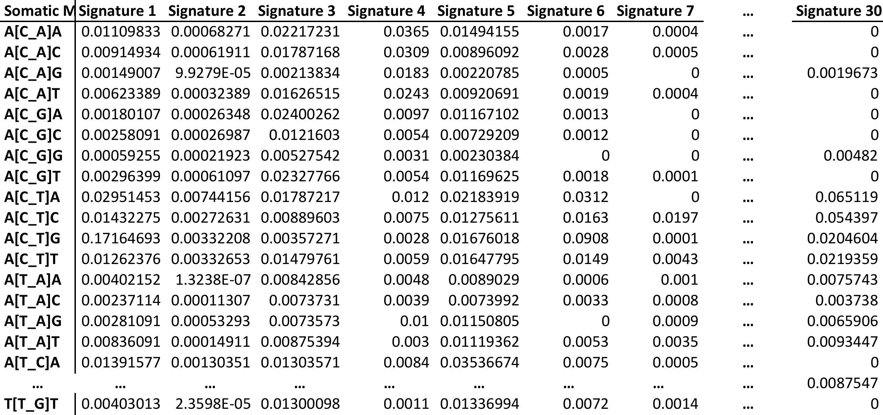
Signature probabilities

Slide 2
Let’s say clone X with 1000 mutations
Quadprog to deconvolute the mutations into signatures
Let’s say 0.2 Sig1, 0.5 Sig5, 0.3 Sig30
Mutation 1 25647 C T
  A[CT]A Sig1 = 0.029
  A[CT] A Sig5 = 0.021
  A[CT] A Sig30= 0.06
  => P(1_25647_C_T)= 0.2*0.029 + 0.5*0.021 + 0.3*0.06
Assign probability for all mutations
Test for enrichment in Prob vs LessProb

Slide 3
Prob vs LessProb
High impact mutations
Questions
Prob HIimp/ LessProb HIimpact
Do signatures drive High impact mutations
Do High impact mutations drive signatures
What are the differences between early and late subclones (with respect to 1 and 2)
Expectations
If > 1 , association between Signatures and High impact (direction unknown)

Slide 4
Prob vs LessProb
High impact mutations
Questions
Prob HIimp/ LessProb HIimpact
Do signatures drive High impact mutations
Do High impact mutations drive signatures
What are the differences between early and late subclones (with respect to 1 and 2)
Expectations
If > 1 , association between Signatures and High impact (direction unknown)

