Slide 1
In search of best control for ChIP-Seq
Jinrui
P2
02-15-2017

Slide 2
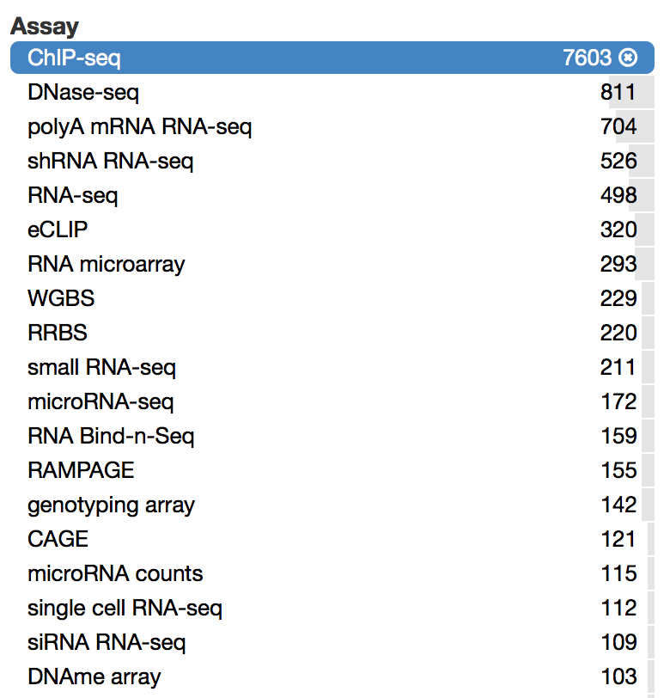
ChIP-Seq is to detect binding btw TF and DNA
ENCODE data distribution

Slide 3
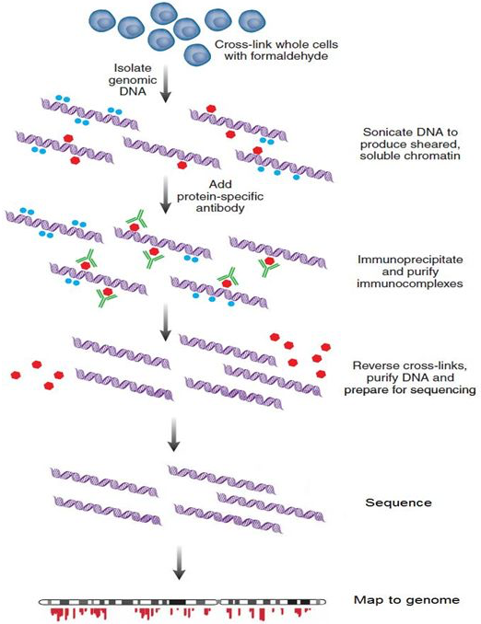
How to ChIP-Seq: the immunoprecipitation (IP) part
Treatment
Red: TF (with epitope)
Green: antibody specifically binds to the epitope of TF
Read profile A

Slide 4
How to ChIP-Seq: the three types of controls
(1) DNA input control
Red: TF (with epitope)
Green: antibody specifically binds to the epitope of TF
Read profile A’

Slide 5
How to ChIP-Seq: the three types of controls
(1) DNA input control
Red: TF (with epitope)
Green: antibody specifically binds to the epitope of TF
Read profile A’

Slide 6
How to ChIP-Seq: the three types of controls
(2) Mock IP control (B)
Red: TF (with epitope)
Green: antibody specifically binds to the epitope of TF
Read profile B

Slide 7
How to ChIP-Seq: the three types of controls
(2) Mock IP control (B)
Red: TF (with epitope)
Green: antibody specifically binds to the epitope of TF
Read profile B

Slide 8
In theory, the mock IP controls are better than DNA input
In practice, mock IP controls immunoprecipitate much less DNA, rendering statistics unreliable
More appropriate control, but less sufficient sampling

Slide 9
To mock IP or not, why is that still the question?
Gold standard: the better control should prioritize TF binding peaks with more TF binding motifs.
However,
Not many mock IP and DNA input controls are comparable and readily available
Lack of gold standard: many TFs has no binding motifs identified

Slide 10
Data set
61 TFs in fruit fly with DNA input, mock IP and binding motifs identified from bacteria one hybrid (B1H)
IP, represented by A; DNA input by A’
Mock IP by B; its DNA input by B’
Motif matrix
When treatment and control are from the same biological sample, B’ = A’

Slide 11
Peak calling using Poisson model (similar to MACS)
It ranks peaks by their p-values or read differences (intensity) between IP and control (DNA input, A’ or mock IP, B)
Compare top 500 peaks (will be determined by IDR cutoff)
Mock IP is worse than DNA input, especially when p-value used
When mock IP is used, intensity (no statistical model assumed) better than p-value
Peak calling using modified Poisson models lead to same conclusions

Slide 12
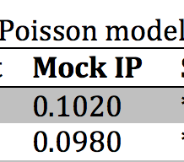
Peak calling using Fisher-exact test
A/A’ vs B/B’, combination of A’ and B
p-value performance improved, and better than intensity
B’ also matters or simply due to more accurate p-value calculations (especially, when sample size is small (will be distinguished))

Slide 13
Peak calling using SPP pipeline
Use the same algorithm to find candidate peaks as previous methods
Rank peaks without statistical models
Results differences are due to ranking strategies, e.g.

Slide 14
DNA input is better than mock IP when model-based methods are used
Mock IP is better w/o statistical models
The best of Mock IP (with SPP) is not significantly different from the best of DNA input (with Poisson model)
Note that when “mean of average motif per peak” used, SPP with mock IP is always ~1 fold better than DNA input, suggesting removing peaks with flat regions in control may boost SPP using mock IP.

Slide 15
Future work
Examine IgG controls in Human
Use motifs from other experiments
e.g. SELEX, systematic evolution of ligands by exponential enrichment
Use other (non)model-based pipelines
Combine mock IP controls and improve my model-based pipeline

Slide 16
Peak calling using Poisson-gamma model
Same conclusion as Poisson models
But may be modified to accommodate for insufficient samplings

