Slide 1
Patient-centric view of driver alterations and therapeutic opportunities in 2500 whole cancer genomes

Slide 2
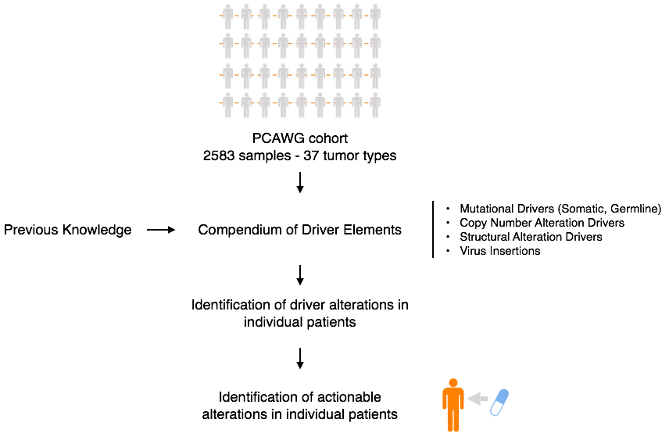

Slide 3
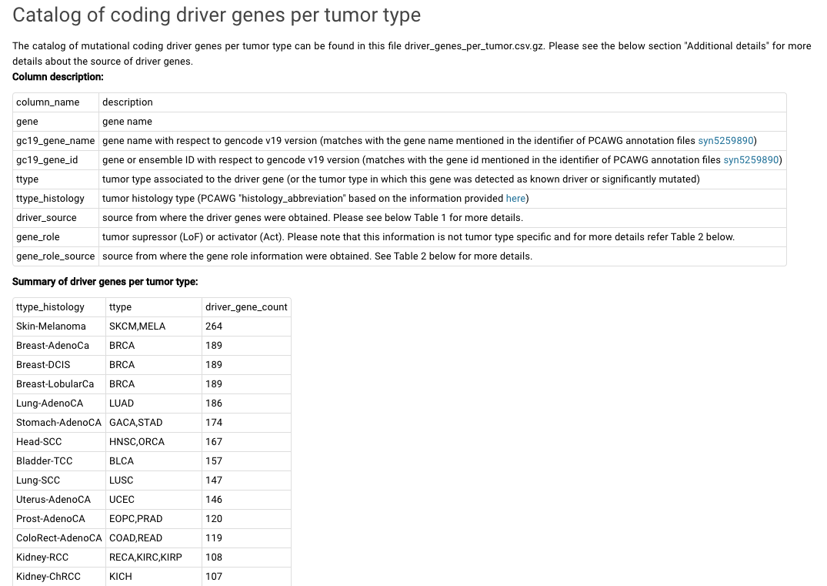
Compendium of driver elements per tumor type
https://www.synapse.org/#!Synapse:syn7304967

Slide 4
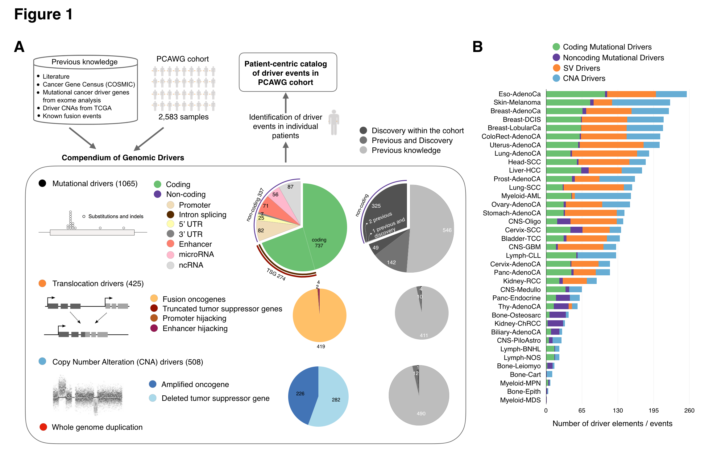

Slide 5
Identification of driver mutations in individual patients
Not all mutations in driver elements are driver mutations!
Examples:
TP53 is significantly mutated in Breast-AdenoCA (dNdScv p-value = 0)
Expected proportion of driver mutations = 0.99 (meaning almost no passengers)
MAP3K1 is significantly mutated in Breast-AdenoCA (dNdScv p-value = 0)
Expected proportion of driver mutations = 0.80 (meaning 0.20 are passengers)
FOXA1 is significantly mutated in Breast-AdenoCA (dNdScv p-value = 1.67e-05)
Expected proportion of driver mutations = 0.60 (meaning 0.40 are passengers)

Slide 6
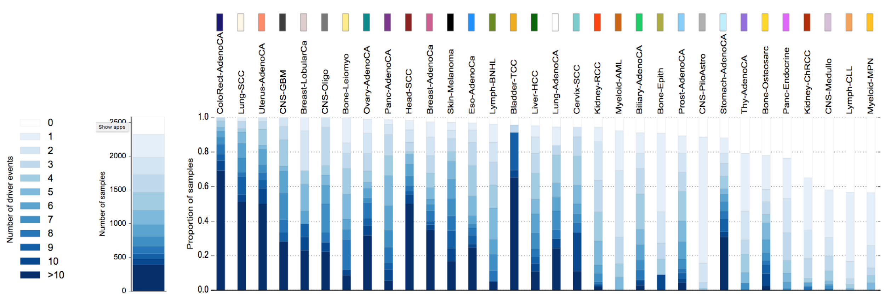
Patient-centric catalog of driver alterations

Slide 7
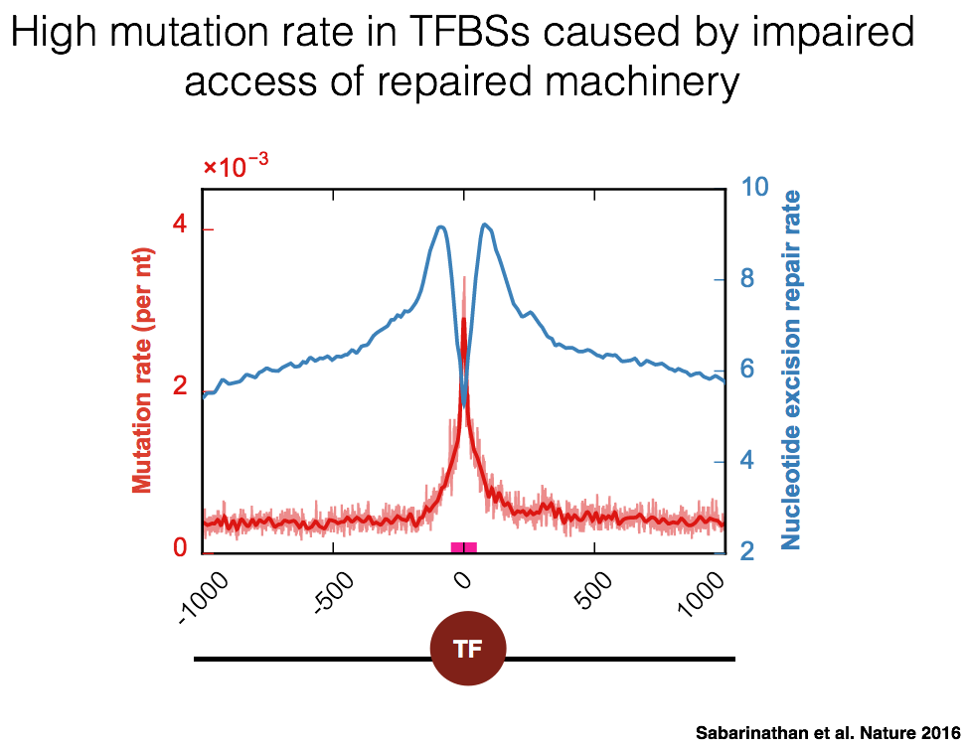
How to deal with promoters and 5’ UTR of melanoma?

Slide 8
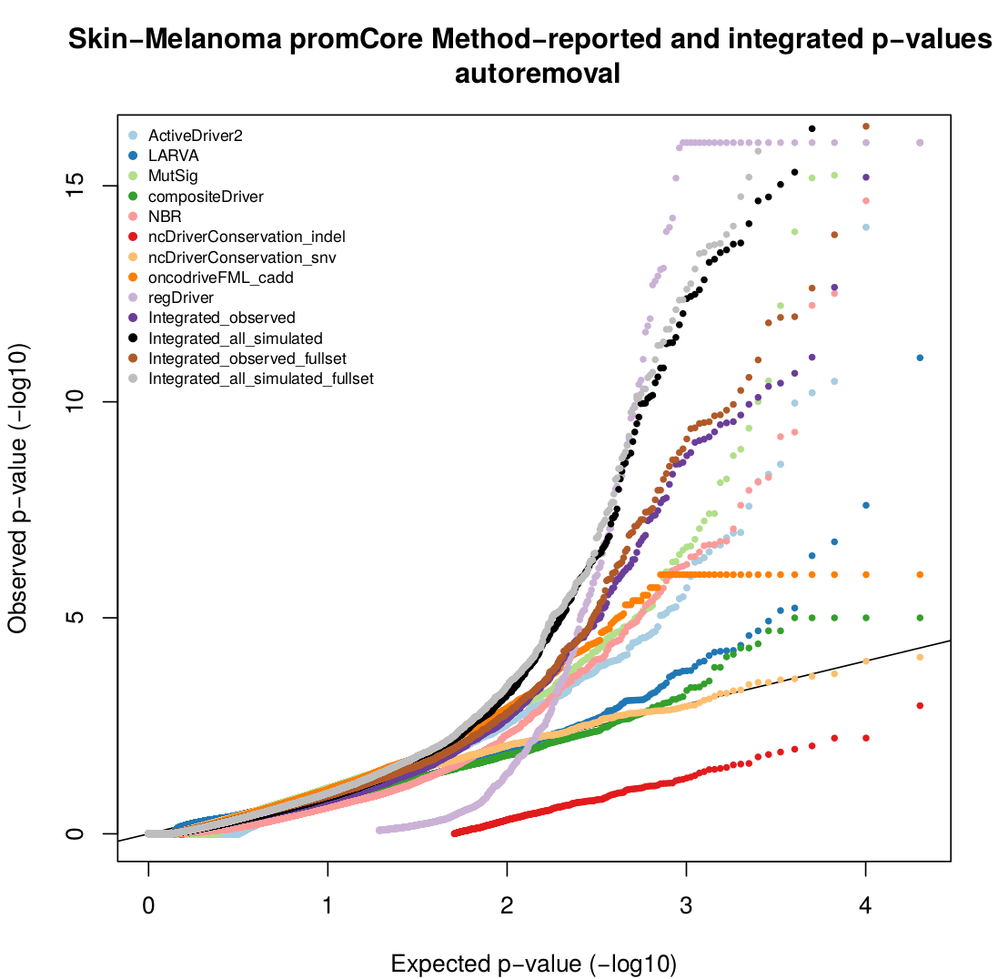
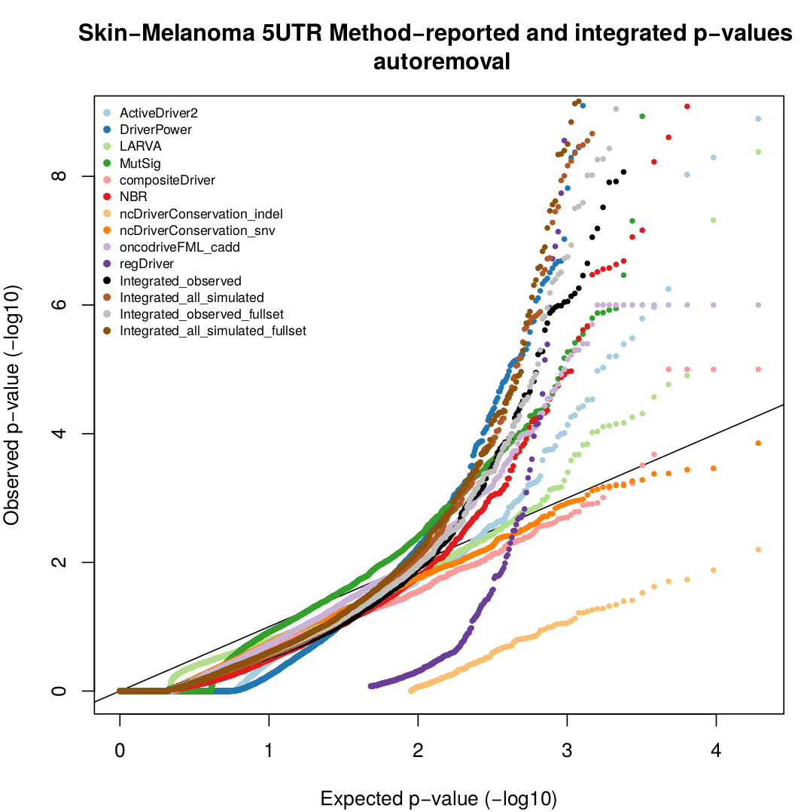
How to deal with promoters and 5’ UTR of melanoma?
QQ-plots from syn8035740
For patient-centric paper we propose to restrict to validated driver mutations, instead of the PCAWG discovery. Eg. TERT promoter (Huang et al., Science 2013), NFKBIE promoter (Shain et al., Nature Genetics 2015)

Slide 9
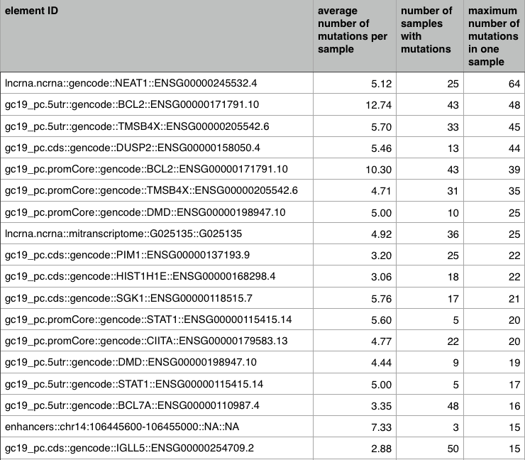
How to deal with somatic hypermutations in lymphomas?
Lymph-BNHL

Slide 10
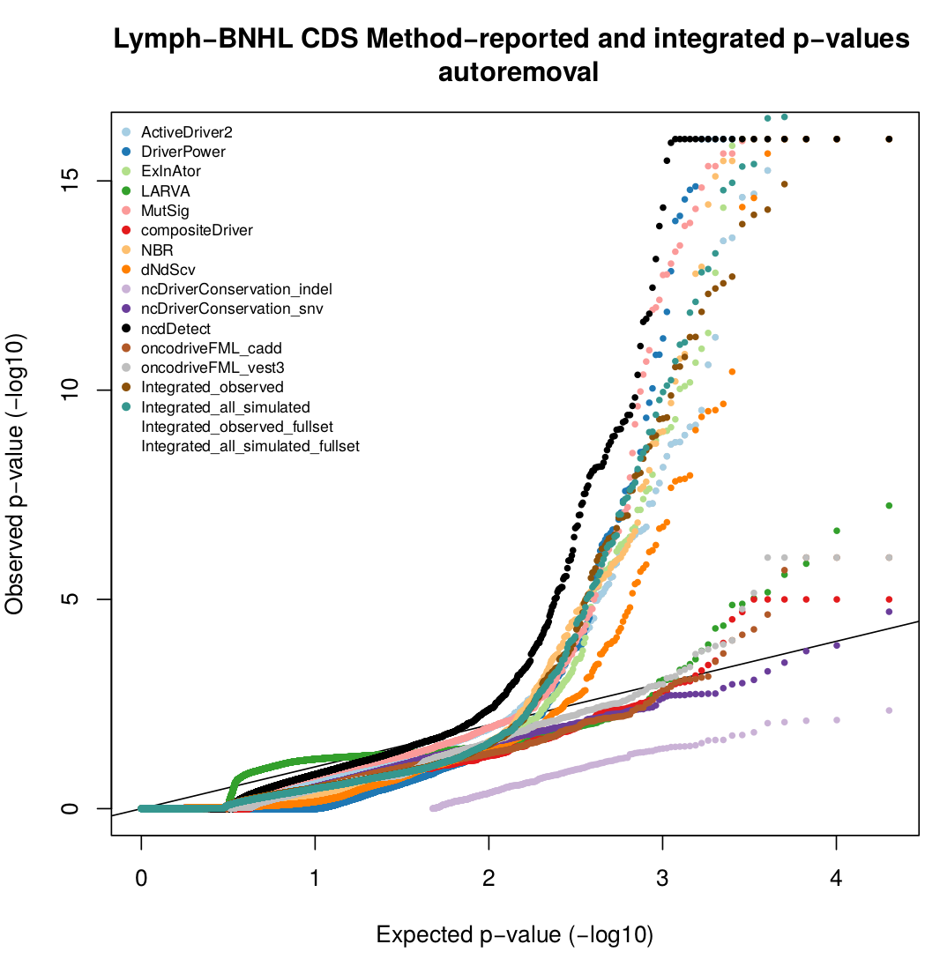
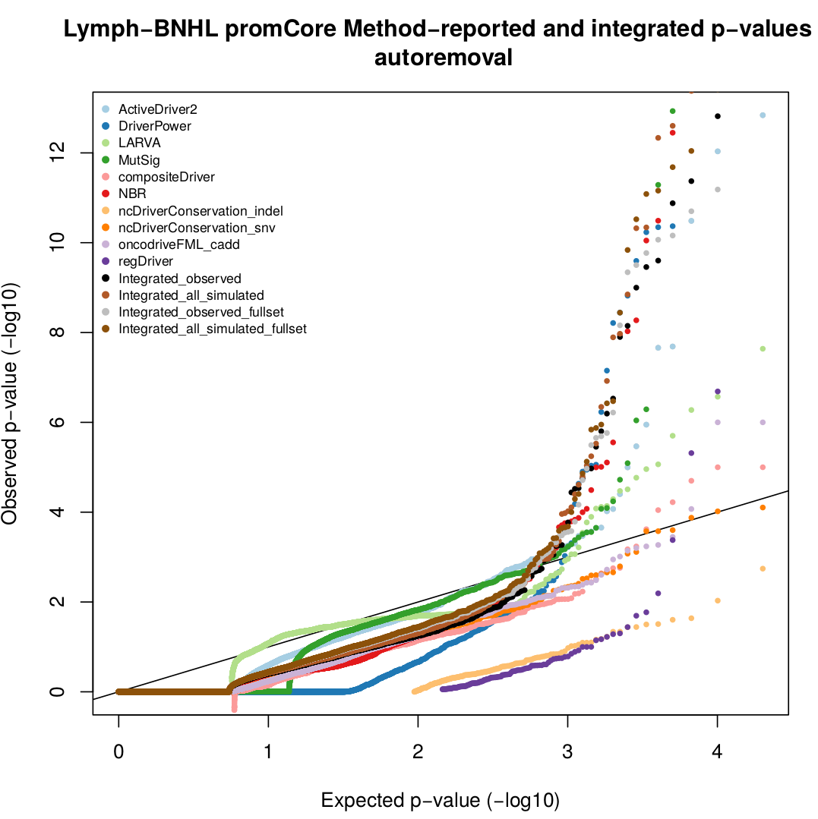
How to deal with somatic hypermutations in lymphomas?
QQ-plots from syn8035740

