Slide 1
A draft map of the human proteome
Min-Sik Kim et al.
Nature (2014)
Jay Stanley
02/10/17
CBB752b Discussion Section II

Slide 2
Characterizing life: from genome to proteome
Visualization of non-B DNA motifs. non-B DB.
Accessed 02/07/17 https://nonb-abcc.ncifcrf.gov/apps/site/help_visualize

Slide 3
Proteomics workflow
Min-Sik Kim et al. A draft map of the human proteome.
Nature (2014)

Slide 4
Proteomics workflow: SDS-PAGE
Sodium dodecyl sulfate (SDS)
Forces proteins into a rod like-shape via denaturation and coating with significant negative charge
Polyacrylamide gel electrophoresis (PAGE)
SDS coated protein extract is pipetted into a polyacrylamide gel
Applied voltage causes negatively charged proteins to migrate through the dense gel matrix
Smaller proteins migrate relatively faster in gel
Concentration of polyacrylamide gel changes the migration rate of proteins
György Hegyi et al. Introduction to Practical Biochemistry.
Eötvös Loránd University (2013)

Slide 5
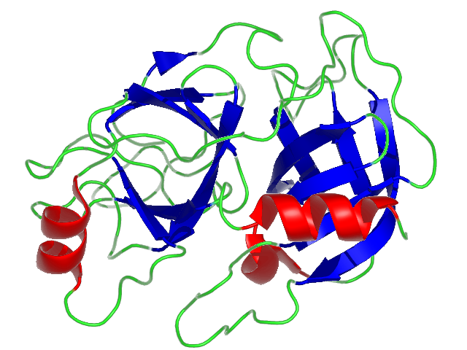
Proteomics workflow: Trypsin digestion
Trypsin
Serine protease
Formed in the small intestine by proteolytic activation of its proenzyme, trypsinogen
Cleaves proteins into smaller fragments at consensus sequence (lysine or arginine)
Crystal structure of bovine trypsin
Scissile bond
Leiros HK et al. Trypsin specificity as elucidated by LIE calculations, X-ray structures, and association constant measurements
Protein Sci. (2004)

Slide 6
Proteomics workflow: bRPLC
basic Reversed Phase Liquid Chromatography
Reversed Phase refers to non-polar stationary phase. Traditional chromatography uses polar stationary phase
Digested samples are dissolved in basic solvent A (10mM triethylammonium bicarbonate, pH8.5)
Hydrophobic residues bind preferentially (‘stick’) to non-polar stationary phase
A second solvent (mobile phase) is then titrated onto the column in increasing concentration (0-100%)
Increasing concentration corresponds to increasing non-polarity. As hydrophobicity increases in the mobile phase, more hydrophobic molecules are eluted
Advantages of RPLC:
Owing to their hydrophobic core, proteins are better retained on hydrophobic stationary phase
Less polar solvents can be used, which allows for finer control of eluent fractions and gradient separations
pH selectivity can control separations

Slide 7
Proteomics workflow: RPLC
RPLC was repeated using an analytical column
Solvent A was changed to 0.1% formic acid in water
Mobile phase changed to 7-30% solvent B (0.1% formic acid in 95% acetonitrile)
This step produces a chromatogram (below) for each eluent fraction
Facilitates absorbance based quantification of protein composition

Slide 8
Proteomics workflow: Tandem MS
MS/MS
Eluent from RPLC flows directly into mass spectrometer
Two rounds of ionization / fragmentation and mass analysis are performed

Slide 9
Tandem MS
Accumulates and routes ions;
Focuses ions; injects into mass analyzer
Captures, focuses, and transmit ions
Secondary mass filtration
low energy collision
Isolates ions by mass and removes neutral charges
Mass-analysis and ion fragmentation
Thermofisher

Slide 10
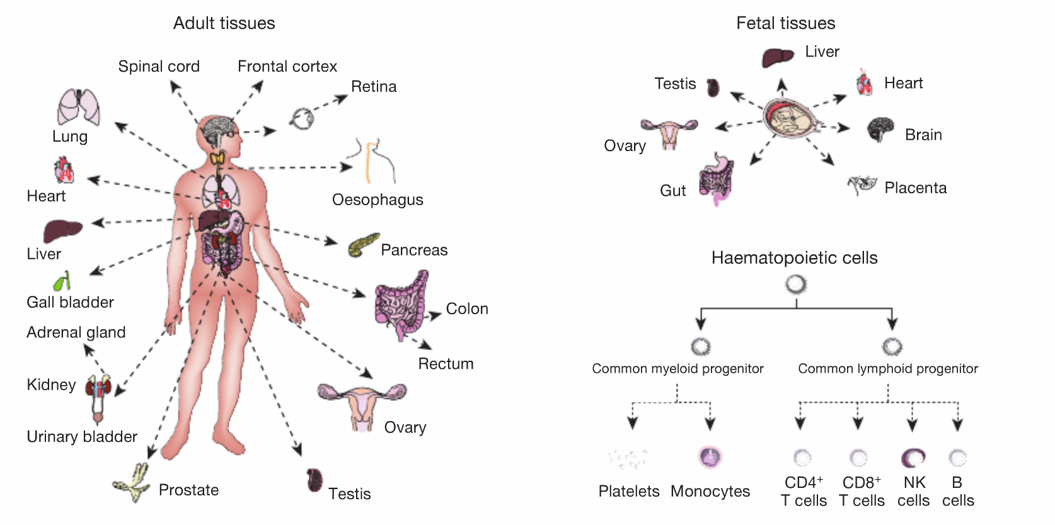
Tissue Sampling
Min-Sik Kim et al. A draft map of the human proteome.
Nature (2014)
Notes:
Fig 1a
30 histologically normal human cell and tissue types, including 17 adult tissues 7 fetal tissues, and 6 haematopoietic cell types
Pooled samples from three individuals per tissue type

Slide 11
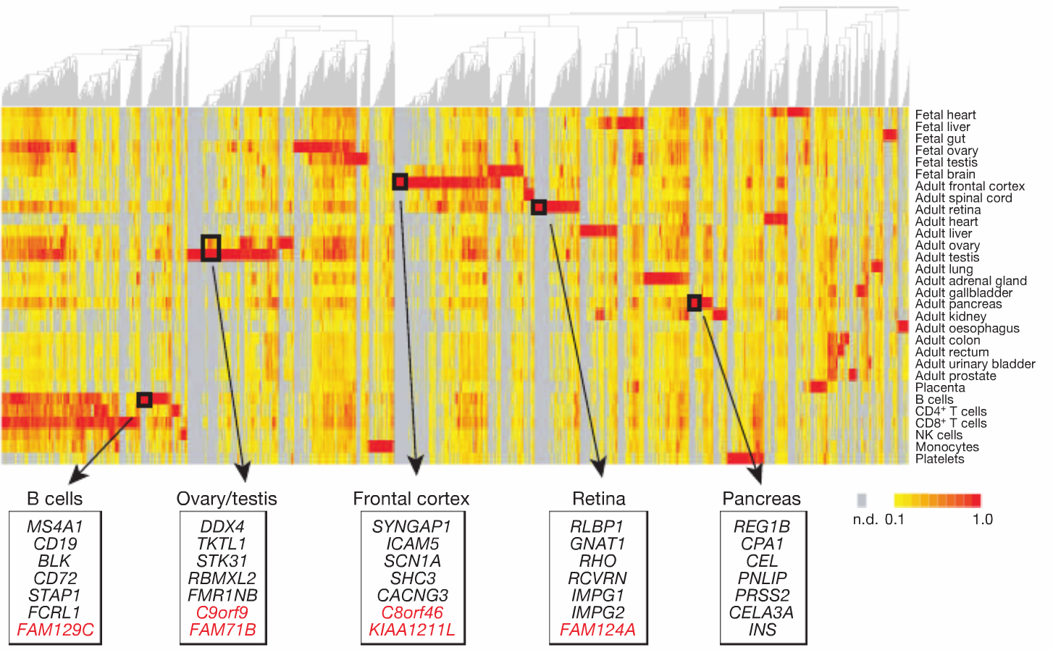
Tissue-specific proteome
Min-Sik Kim et al. A draft map of the human proteome.
Nature (2014)
Notes:
Fig 2a
Tissue-supervised hierarchical clustering reveals the landscape of gene expression across the analysed cells and tissues. Selected tissue-restricted genes are highlighted in boxes to show some well-studied genes (black) as well as hypothetical proteins of unknown function (red). The colour key indicates the normalized spectral counts per gene detected across the tissues. n.d., not determined.

Slide 12
Tissue-specific proteome
What’s going on here?
Min-Sik Kim et al. A draft map of the human proteome.
Nature (2014)
Notes:
Fig 2a
Tissue-supervised hierarchical clustering reveals the landscape of gene expression across the analysed cells and tissues. Selected tissue-restricted genes are highlighted in boxes to show some well-studied genes (black) as well as hypothetical proteins of unknown function (red). The colour key indicates the normalized spectral counts per gene detected across the tissues. n.d., not determined.

Slide 13
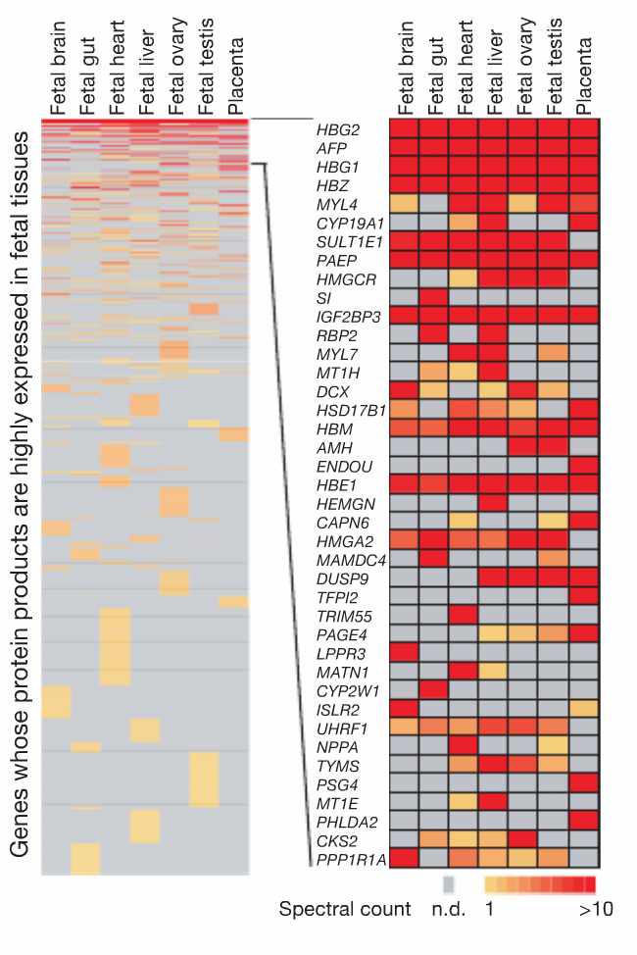
Fetal Tissue Proteome
Min-Sik Kim et al. A draft map of the human proteome.
Nature (2014)
Notes:
A heat map showing tissue expression of fetal tissue-restricted genes ordered by average expression across fetal tissues (left) and a zoom-in of the top 40 most abundant genes (right). The colour key indicates the spectral counts per gene.

Slide 14
Fetal Tissue Proteome
“Retinol Binding Protein 2” intracellular vitamin A metabolism
Scaffold protein for striated muscle sarcomeres
Min-Sik Kim et al. A draft map of the human proteome.
Nature (2014)
Notes:
A sarcomere (Greek sarx "flesh", meros "part") is the basic unit of striated muscle tissue. Skeletal muscles are composed of tubular muscle cells (myocytes called muscle fibers or myofibers) which are formed in a process known as myogenesis. Muscle fibers contain numerous tubular myofibrils. Myofibrils are composed of repeating sections of sarcomeres, which appear under the microscope as alternating dark and light bands. Sarcomeres are composed of long, fibrous proteins as filaments that slide past each other when a muscle contracts or relaxes.

Slide 15
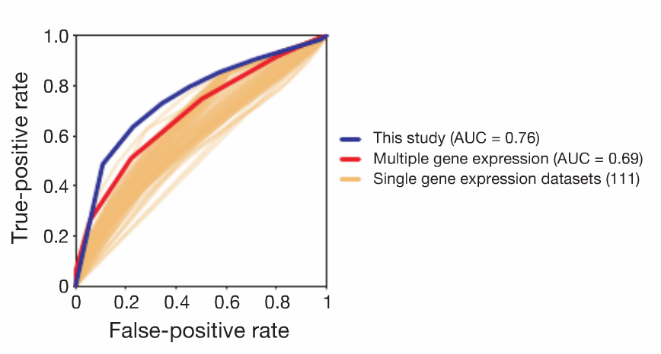
Predicting protein-protein interaction using proteome correlation
Min-Sik Kim et al. A draft map of the human proteome.
Nature (2014)
Notes:
“Sensitivity (true positive) as a function of fall-out (false positive)”
Built using probability density functions of true/false-positive rate and plotting their cumulative density
Upper –right is perfect classifier,
An ROC curve showing a comparison of the performance of the current data set (blue, area under the curve (AUC) 5 0.762) with 111 individual gene expression data sets (orange) and a composite of the 111 individual data sets (red, AUC 5 0.692).

Slide 16
Predicting protein-protein interaction using proteome correlation
Why is this result interesting enough to include?
Min-Sik Kim et al. A draft map of the human proteome.
Nature (2014)
Notes:
“Sensitivity (true positive) as a function of fall-out (false positive)”
Built using probability density functions of true/false-positive rate and plotting their cumulative density
Upper –right is perfect classifier,
An ROC curve showing a comparison of the performance of the current data set (blue, area under the curve (AUC) 5 0.762) with 111 individual gene expression data sets (orange) and a composite of the 111 individual data sets (red, AUC 5 0.692).

Slide 17
Predicting protein-protein interaction using proteome correlation
Why is this result interesting enough to include?
Very high degree of accurate prediction purely based on correlation
FTMS/MS proteomics data more accurate than transcriptomics
Min-Sik Kim et al. A draft map of the human proteome.
Nature (2014)
Notes:
“Sensitivity (true positive) as a function of fall-out (false positive)”
Built using probability density functions of true/false-positive rate and plotting their cumulative density
Upper –right is perfect classifier,
An ROC curve showing a comparison of the performance of the current data set (blue, area under the curve (AUC) 5 0.762) with 111 individual gene expression data sets (orange) and a composite of the 111 individual data sets (red, AUC 5 0.692).

Slide 18
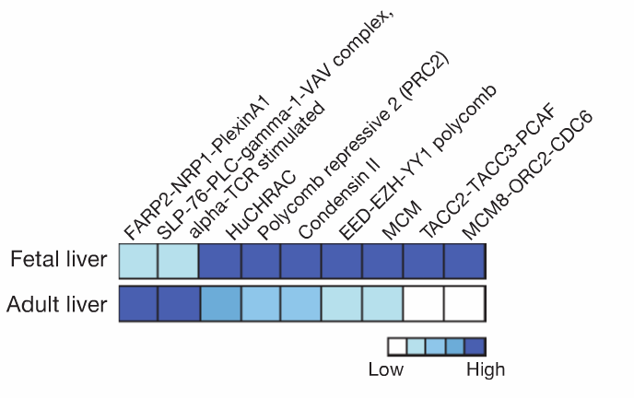
Development-dependent differential protein complex expression
Min-Sik Kim et al. A draft map of the human proteome.
Nature (2014)
Notes:
Developmental stage-specific differential expression of protein complexes in fetal and adult liver tissues. Heat map shows protein complexes with less than or equal to half of their subunits expressed in one of the tissue types. The darker the colour, the greater the number of expressed subunits.

Slide 19
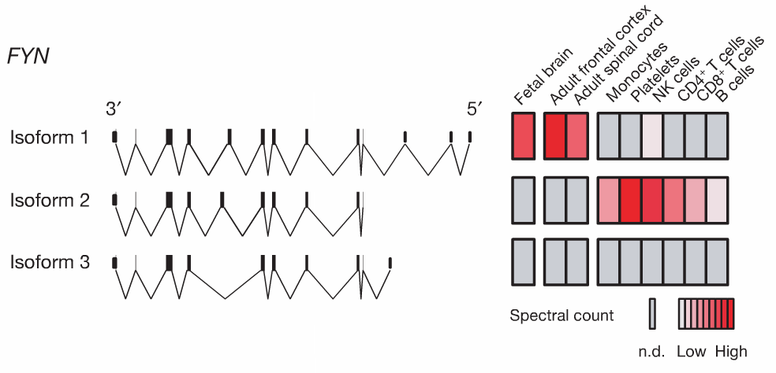
Tissue-dependent differential protein splicing
Min-Sik Kim et al. A draft map of the human proteome.
Nature (2014)
Notes:
Exon structure of three known isoforms of FYN (left) along with abundance of isoform-specific peptides detected in the indicated cells/tissues (right). The colour key indicates a relative expression based on the spectral counts of isoform-specific peptides detected.

Slide 20
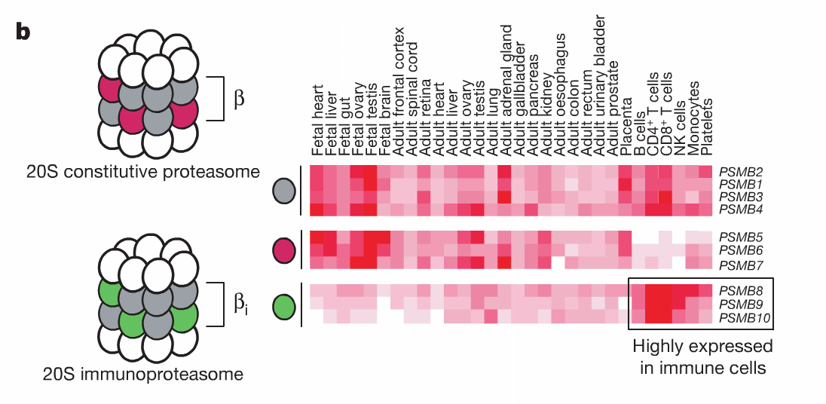
Cell-type dependent differential multimer organization
Min-Sik Kim et al. A draft map of the human proteome.
Nature (2014)
Notes:
20S constitutive proteasome and 20S immunoproteasome core complexes. Expression of their corresponding components are depicted by a heat map (red indicates higher expression) in the Human Proteome Map portal.

Slide 21
Differential protein expression, recap
What’s the difference?

Slide 22
Novel proteogenomic annotations
6-frame vs 3-frame distinction
Min-Sik Kim et al. A draft map of the human proteome.
Nature (2014)
Notes:
An overview of the multiple databases used in the proteogenomic analysis. A subset of peptides corresponding to genome search-specific peptides were synthesized and analysed by mass spectrometry.
. More importantly, we discovered 808 novel annotations of the human genome including translation of 140 pseudogenes, 44 novel ORFs, 106 novel coding regions/ exons within annotated gene structures and 110 gene/protein/exon exten- sion events in addition to 198 novel protein N termini and 201 novel signalpeptide cleavage sites

Slide 23
Pseudogenes
C. Chandrasekaran, E. Bertrán. Origins of new genes and pseudogenes
Nature Education (2008)
Notes:
Pseudogenes are segments of DNA that are related to real genes. Pseudogenes have lost at least some of the ability their real gene relative has in gene expression within the cell or their ability to code protein.^{[3]} Pseudogenes often result from the accumulation of multiple mutations within a gene whose product is not required for the survival of the organism. Although not fully functional, pseudogenes may be functional, similar to other kinds of noncoding DNA, which can perform regulatory functions. The "pseudo" in "pseudogene" implies a variation in sequence relative to the parent coding gene, but does not necessarily indicate pseudo-function. Despite being non-coding, many pseudogenes have important roles in normal physiology and abnormal pathology.^{[4]}
Although some pseudogenes do not have introns or promoters (such pseudogenes are copied from messenger RNA and incorporated into the chromosome, and are called "processed pseudogenes"),^{[5]} others have some gene-like features such as promoters, CpG islands, and splice sites. They are different from normal genes due to either a lack of protein-coding ability resulting from a variety of disabling mutations (e.g. premature stop codons or frameshifts), a lack of transcription, or their inability to encode RNA (such as with ribosomal RNA pseudogenes).

Slide 24
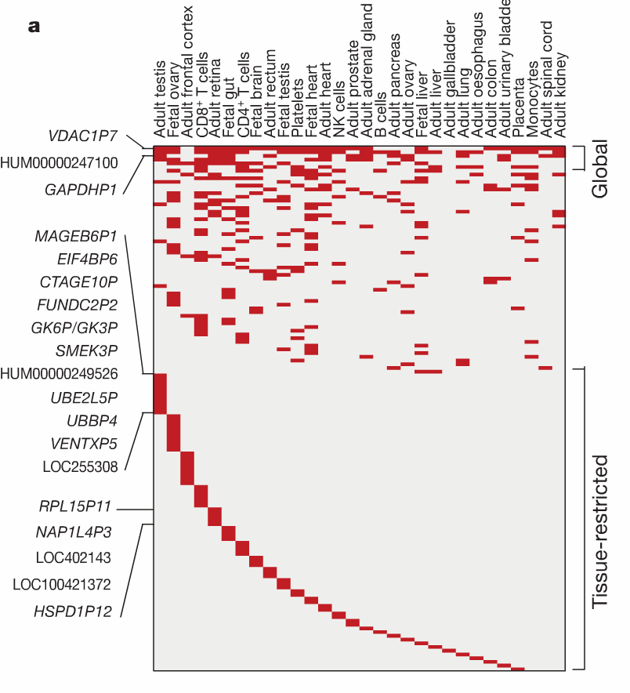
Translated pseudogenes
Min-Sik Kim et al. A draft map of the human proteome.
Nature (2014)
Notes:
A heat map shows the expression of pseudogenes (listed by name or accession code number) across the analysed cells/tissues. Some pseudogenes such as VDAC1P7 and GAPDHP1 were found to be globally expressed, whereas others were more restricted in their expression or were detected only in a single cell type/tissue as indicated.

Slide 25
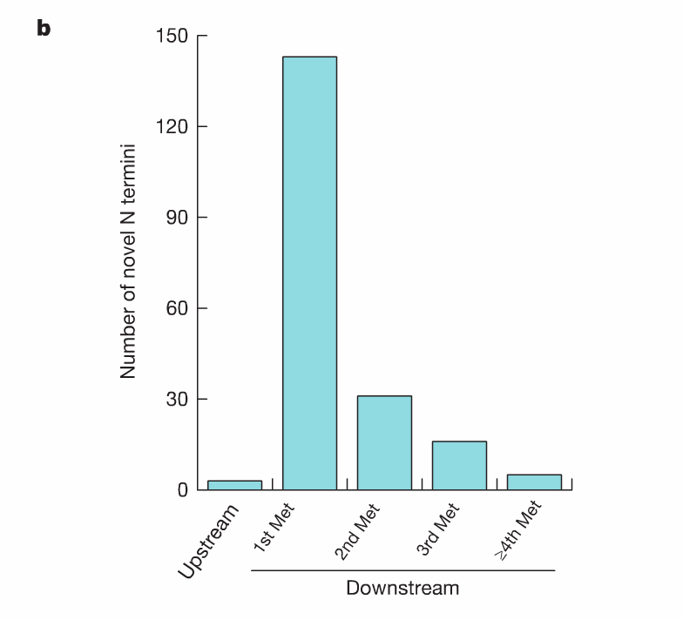
Non-canonical translation start – novel N termini
Min-Sik Kim et al. A draft map of the human proteome.
Nature (2014)
Notes:
The distribution of novel N termini detected with N-terminal acetylation is shown with respect to the location of the annotated translational start site. All sites in the 59 UTR are labelled upstream whereas those located downstream of the annotated AUG start sites are labelled as 1st Met, 2nd Met and so on
We confirmed 4,105 annotated N termini in RefSeq (from 4,132 protein- coding genes) to generate the largest catalogue of experimentally vali- dated translational start sites in humans (,20% of annotated genes). Annotation of start sites in proteins can be imprecise because initiation AUG codons are generally predicted by computation and are prone to errors. For instance, the optimal Kozak consensus sequence (CCACC [AUG]G), which is widely believed to surround the true initiation codon, occurs only in half of the human genes33. By searching unmatched MS/ MS spectra against customized databases, we identified 3 cases that map upstream and 195 cases that map downstream (within 100 amino acids) of the currently annotated translational initiation sites (Fig. 5b). The nucleotide sequences that surround the AUG codon of these novel trans- lational start sites show the same pattern as bona fide translational start sites (Extended Data Fig. 6), strongly indicating that we have identified true novel or alternative start sites. We also confirmed 201 annotated signal peptide cleavage sites and revised t

Slide 26
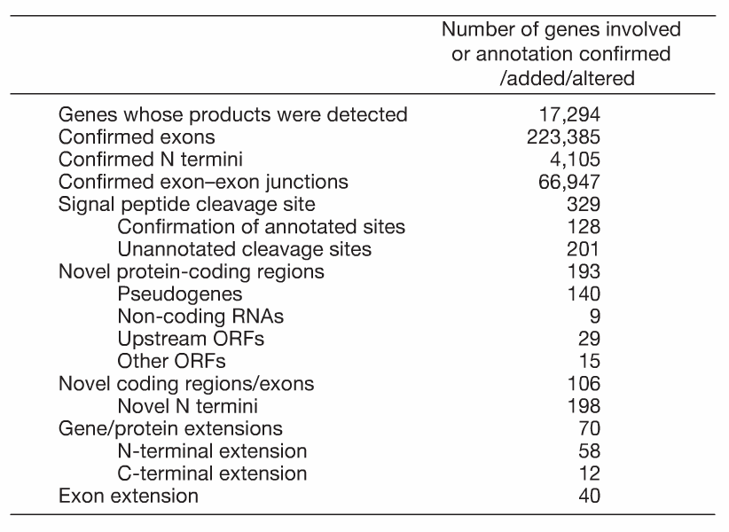
Summarizing the draft map
Min-Sik Kim et al. A draft map of the human proteome.
Nature (2014)

