Slide 1
Mass-spectrometry-based draft of the human proteome
Wilhelm et al.

Slide 2
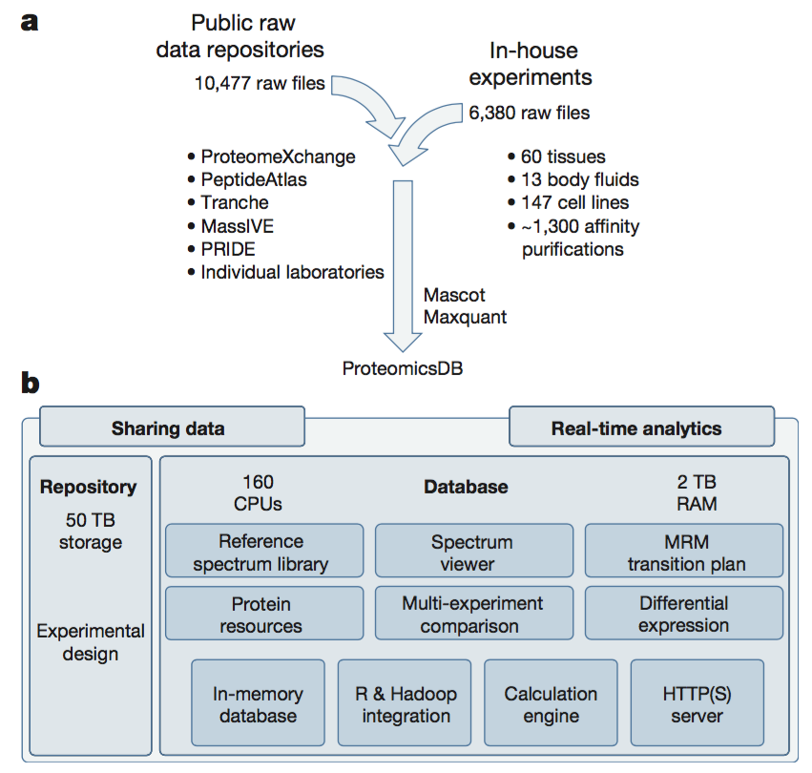

Slide 3
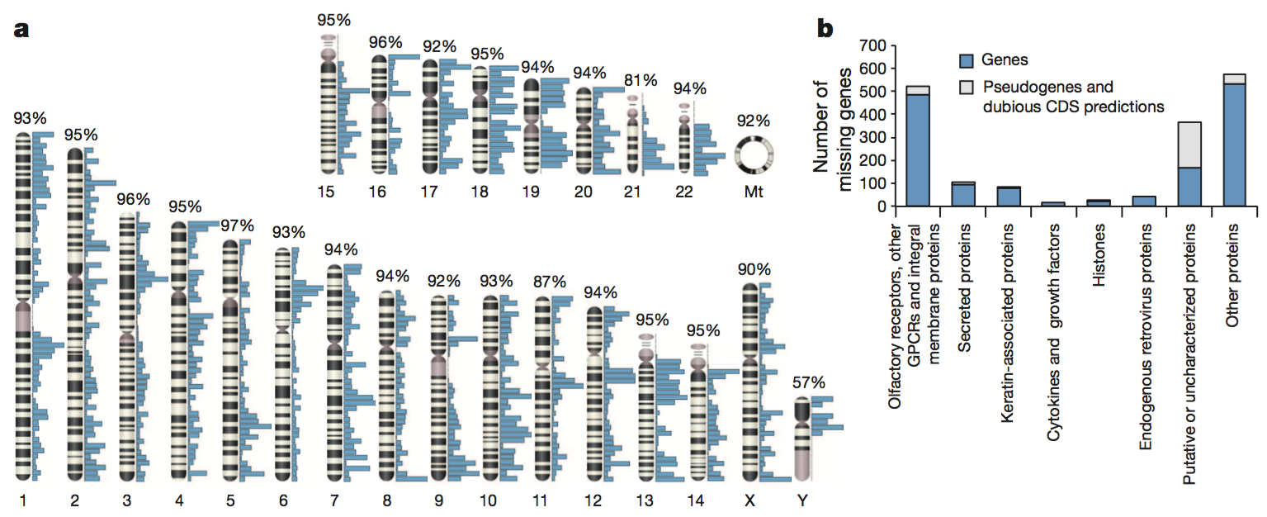

Slide 4
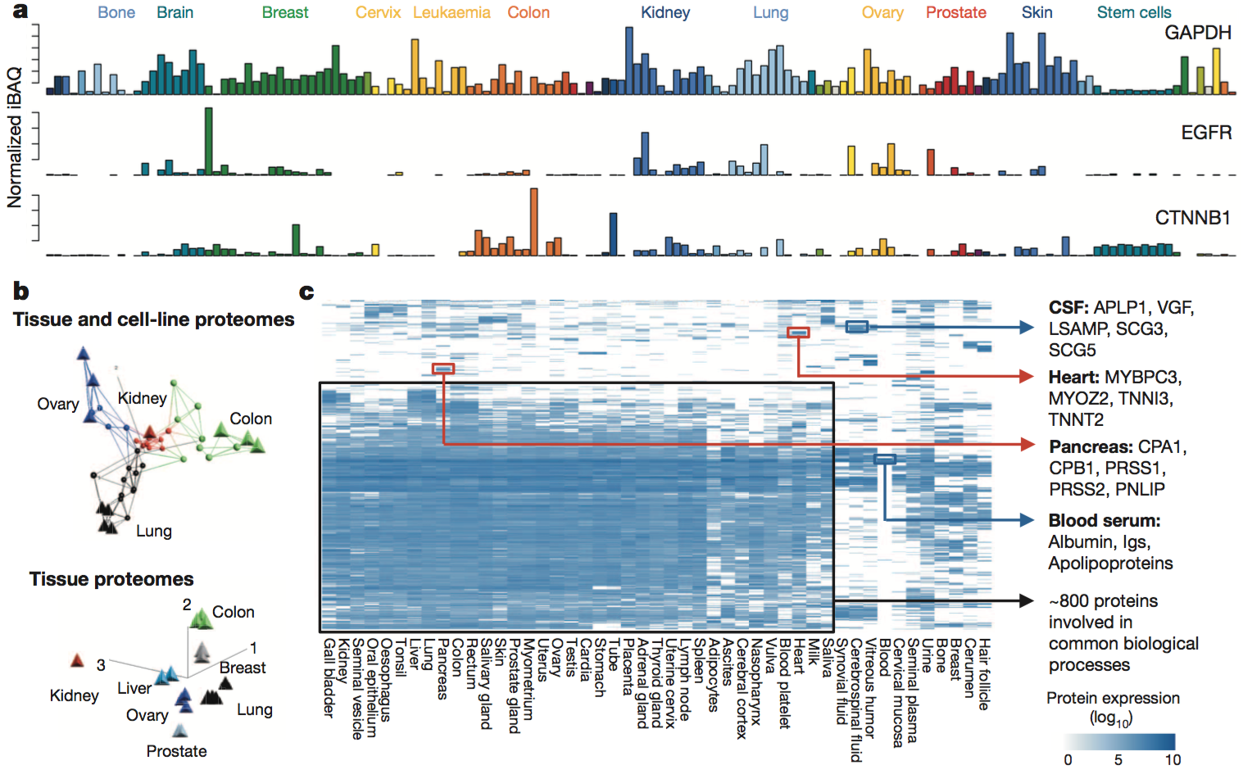

Slide 5
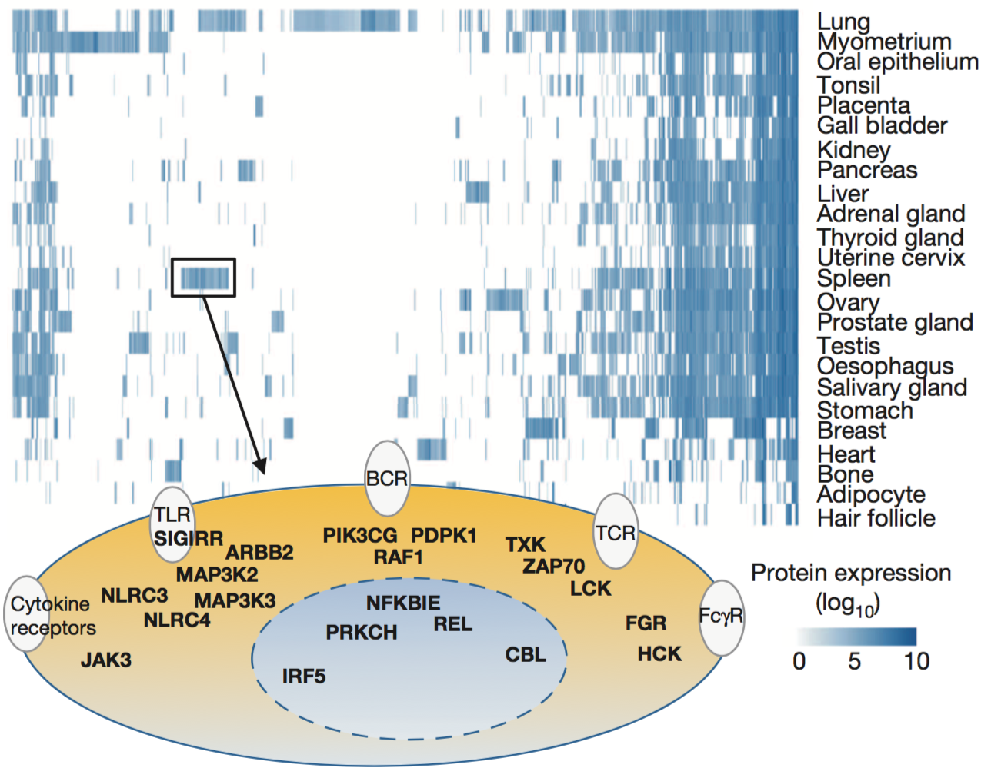

Slide 6
